Slide 1
Lecture 2: Meet the Linux Shell
Lecture Participation Poll #2
Log onto pollev.com/cse374
Or
Text CSE374 to 22333
CSE 374: Intermediate Programming Concepts and Tools

Slide 2
Administrivia
Exercise 0 will release today
Class webpage now live
Class discussion board available
Linux accounts will be available later this afternoon
  Username = uwnetid
  Password = tempPassword
Linux account issues? Fill out form: https://forms.gle/SDNkjSfmB7GLsFrT6
Fill out student survey: https://forms.gle/2nqB8HnAHhXeLWCD7

Slide 3
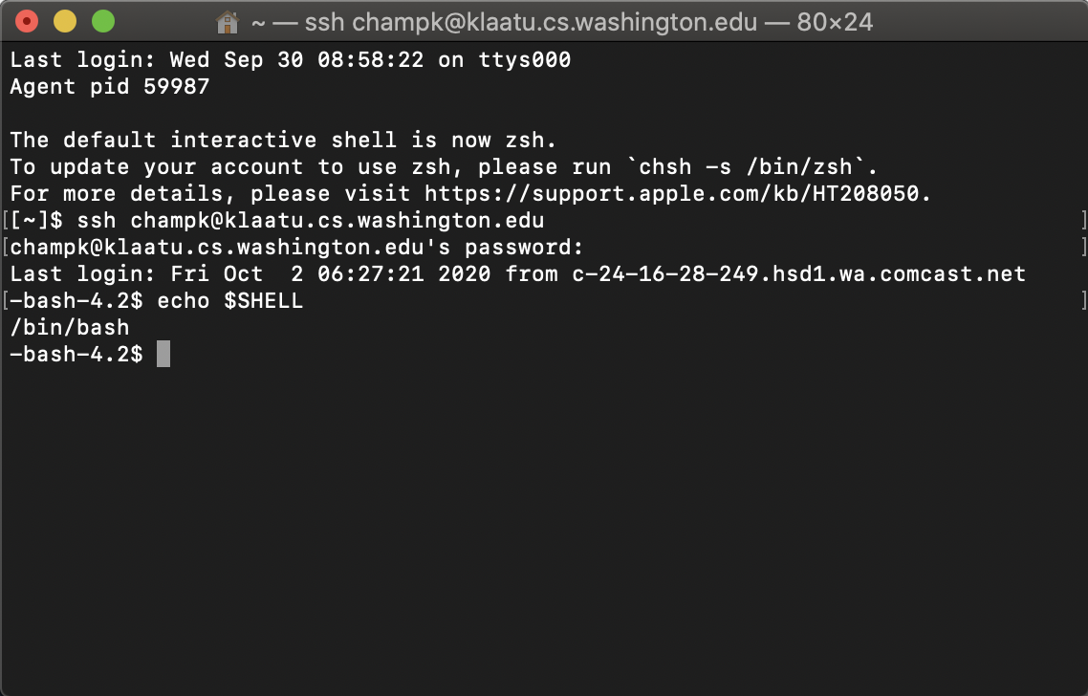
Meet the Linux Shell
Text based interface for Linux operating system
We will be using the “Bash” shell
  There are different versions, but for this course we will only be using bash
Use echo $SHELL to check which shell you are using
Bash in a unix shell and command language that is the default login shell for most Linux and MacOS
Interpreted, not compiled
  You’re on your own when things go wrong
Local MacOS terminal connecting to remote Linux machine

Slide 4
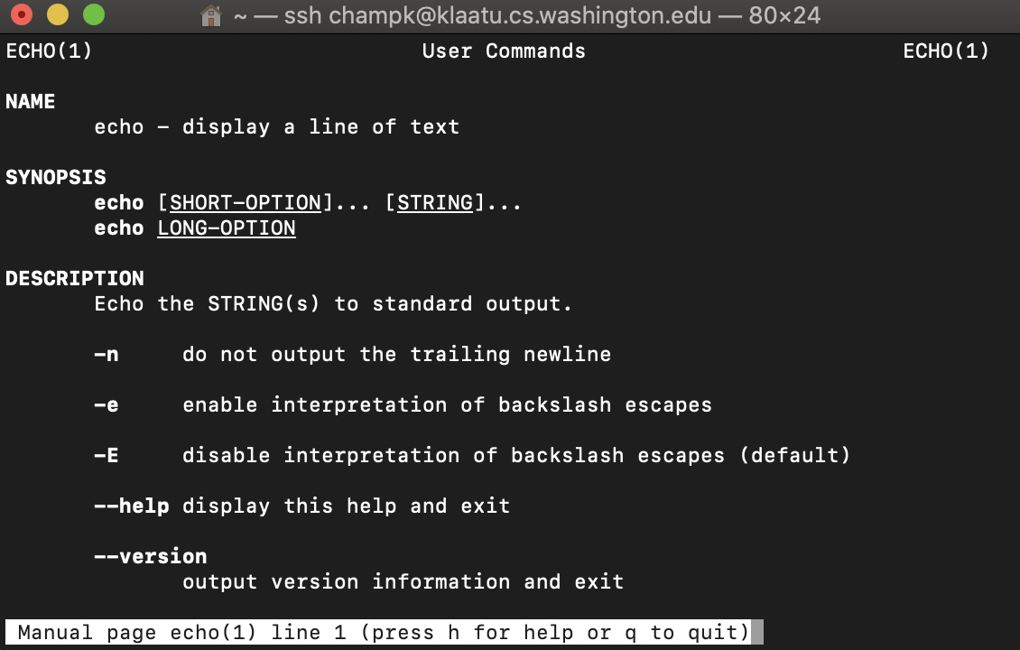
Commands in the Shell
The shell is a text-based interface that takes commands instead of clicks
Commands are pre-existing programs
  <command name> <options> <input || output>
To learn about an individual command use “man”
  <command name> man
  Short for “manual page”
  Can also use the --help option
echo man page

Slide 5
Shell Interaction Basics
Open the terminal application on your local computer
Connect to Klaatu Linux server with
ssh <username>@klaatu.cs.washington.edu
Enter in your password, you will not see characters as you type
Basic Interactions:
You can use copy and paste with with your usual short cuts
You can navigate through your executed commands by using the up and down arrows
  Convenient way to rerun commands or to fix small errors in previous command
The history command will print the commands you’ve used this session to the terminal

Slide 6
Linux Demo
Recorded Demo from 374 Sp 20 Instructor Megan Hazen

Slide 7
Running Programs
You can run a program by typing its path into the terminal
Some folders are globally visible, so you only need the program’s name
  /bin/ is globally visible because it is in the PATH shell variable
To run a program in the current directory you need to give the path
  ./local_program
  Running local_program by itself will not work because it’s not globally visible
All commands are bash files that are executed when you hit “enter” on a terminal line
  You can write and execute your own! More on that later

Slide 8
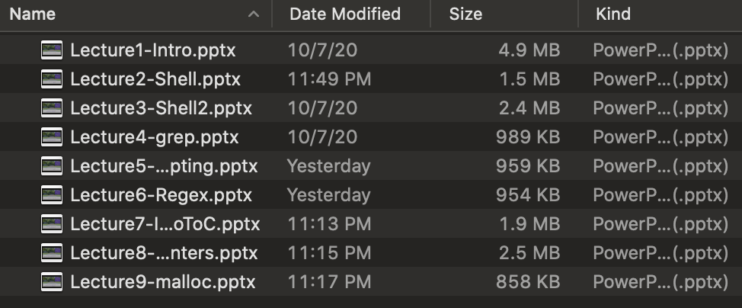
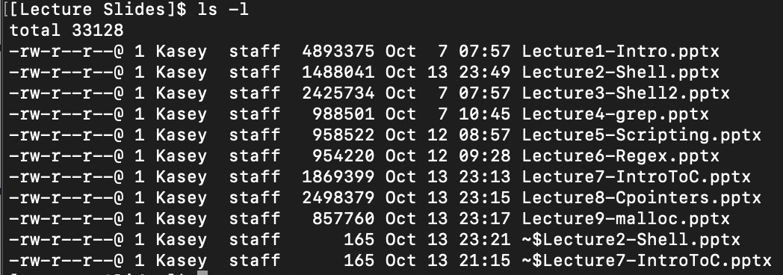
Files
A collection of data used for long term storage
  Stored on a hard drive
  Hard drive is the physical portion of a computer that stores large amounts of data sits outside the CPU
Files have…
  Name
    Unique string within the folder
  Type
    Indicated by the extension at the end of the name
  Content
    Data contained within the file
  Location
    Folder trail from drive to name
    “breadcrumb”
Finder GUI view of folder
ls –l view of folder

Slide 9
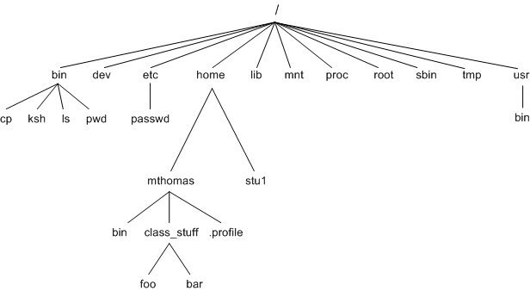
File System
Files contain other files, branching out from the root “/” forming a tree-like hierarchy
Files are located with a path of folders separated by “/” this is called the “file path”
Paths starting with “/” are called absolute paths
  Start searching from the root of the file system
  EX: /usr/documents/myFiles/myFile.txt
Paths that do NOT start with “/” are called relative paths
  Starts searching from current directory
  EX: myFiles/myFile.txt
pwd command will print the current directory
Tree diagram of file structure
https://homepages.uc.edu/~thomam/Intro_Unix_Text/File_System.html

Slide 10
Navigating the File System
cd – change directory
  cd <file path>
Terminal commands for paths
  ~ your home directory
    EX: cd ~ #change location to home directory
  . current directory
  .. parent directory
    EX: ls .. #print contents of parent directory
Beef up:
Change this slide to be about navigating the file system with bash
Recursive traversal vs non

Slide 11
Useful Commands
Command | Operation | Example
ls | See folder contents | ls -l
cd <folderName> | Move into given folder | cs Downloads
cp <source> <destination> | Make a copy of given file in given destination | cp file.txt myDir/
mv <oldName> <newname> | Rename or move given existing file to given name/destination | mv fil.txt file.txt
cat <fileName> | Print file contents to terminal window | cat file.txt
touch <filename> | Create empty file with given name | touch file.txt
echo <string> | Print given string to terminal window | echo “hello world”
pwd | Print working directory | pwd
mkdir <directoryName> | Create an empty directory at location specified | mkdir ~/newDir
exit | Exit the shell | exit

Slide 12
Other Useful Commands
Command | Operation | Example
pico <fileName> | Create or edit files | pico filename
echo <text> | Print text | echo hello world
pwd | Print working directory’s absolute path | pwd
touch <filename> | Create empty file | touch filename
mkdir | Create empty directory | mkdir
find –name <filename> | Search for file
exit | Exit the shell
Moving files between machines
Tar
Wget
Scp
Filezilla

Slide 13
Demo: File Manipulation

Slide 14
Questions?
Lecture Participation Poll #2
Log onto pollev.com/cse374
Or
Text CSE374 to 22333

