Slide 1
Lecture 1: Intro to Linux
Lecture Participation Poll #1
Vote for discussion board platform
Log onto pollev.com/cse374
Or
Text CSE374 to 22333
CSE 374: Intermediate Programming Concepts and Tools

Slide 2
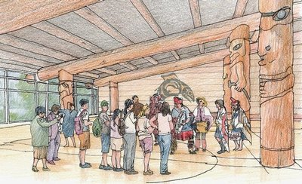
Welcome!
The world is BANANAS right now!
You are not expected to be at your best this quarter and that is OK
We are in this together
Humans first, students second
Patience, vulnerability, compassion
UW News: Campus ‘House of Knowledge’ longhouse a long-awaited dream
“We acknowledge that we are on the traditional land of the first people of Seattle, the Duwamish People past and present and honor with gratitude the land itself and the Duwamish Tribe.”

Slide 3
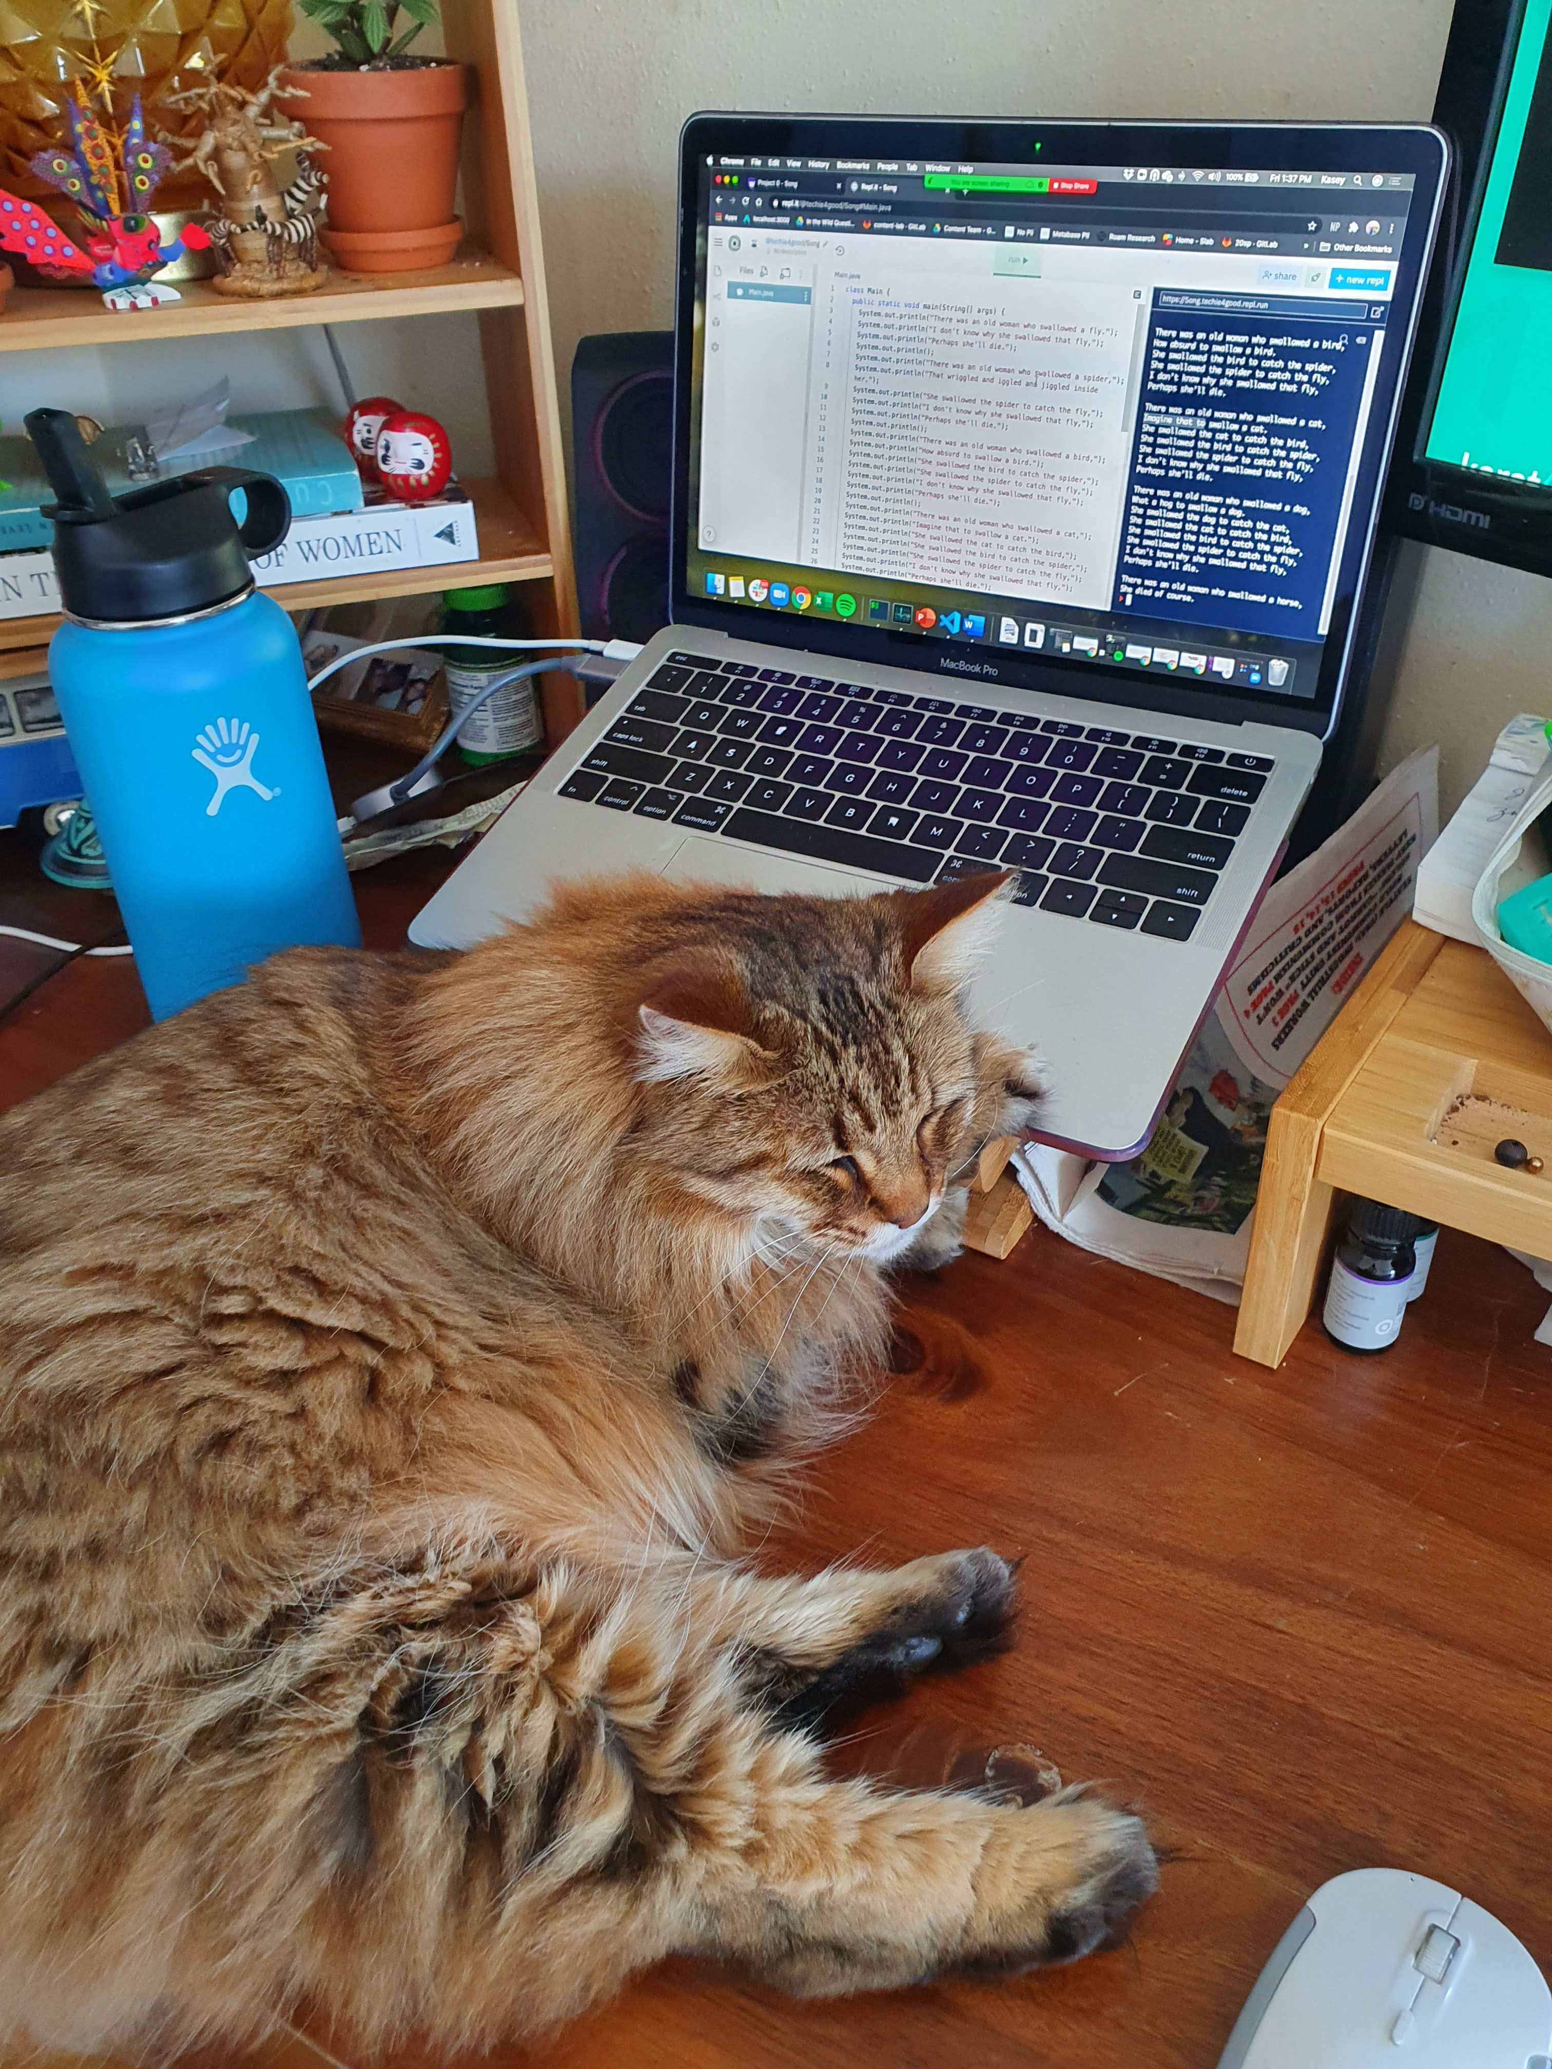
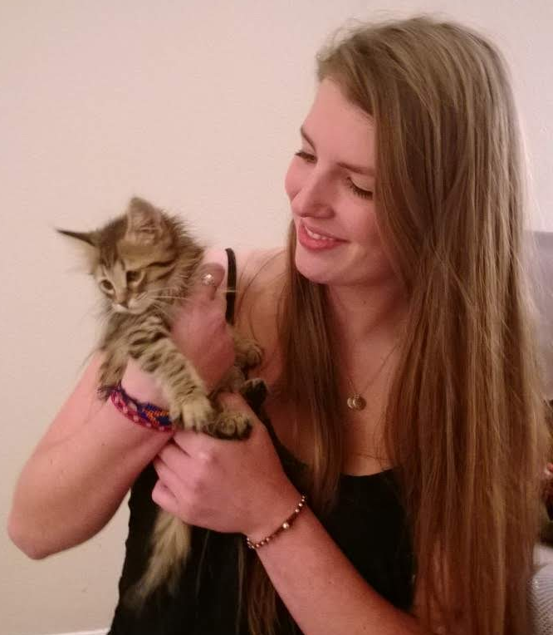
Hello!
I am Kasey Champion
Software Engineer @ Karat
High School Teacher @ Franklin High
champk@cs.washington.edu
@techie4good
Iron Fist No Mercy
“Mercy” for short

Slide 4
Meet your TAs
Kushal Jhunjhunwalla - kushaljh@cs.washington.edu
Kalyani Sunil Marathe - kmarathe@cs.washington.edu
Leah Perlmutter - lrperlmu@cs.washington.edu
Staff Mailing List - cse374-staff@cs.washington.edu

Slide 5
Course Overview
Course Goals
Gain a basic familiarity with the Linux
Skills to automate common computing tasks
Obtain beginning proficiency in C programming
Familiarity with C++ programming language
Learn the basics of programming tools
Practice core software-engineering practices
Understand the basics of shared-memory concurrency
Learn how to acquire additional information and skills independently
Course Topics
The Linux Operating System
Working with the Linux Shell
Scripting with Bash
C Programming Language
Computer Memory
Software Engineering Tools and Techniques
C++ Programming Language
Assembly Code
Concurrency

Slide 6
Course Components
Learning Components
Lectures
Recorded
Please participate ☺
Password after today! “374rocks”
Lecture Participation Polls
Graded on participation NOT correctness
Exercises
Accompany many lectures to give focused practice on individual topics
Homeworks
Larger assignments sprinkled throughout quarter
Review Assignments
3 this quarter
Optional group assignment
“Test like questions” without time limit and full access to notes
Office Hours
Please come hang out with us!
Course Tools
Class webpage
Central location for all information
Course canvas
Gradebook
Zoom
Lectures
Poll Everywhere
Lecture participation
Gradescope
Assignment submission
Discussion board
Get help
Anonymous Feedback Tool
Tell us how it’s going

Slide 7
Course Policies
Turn In Policy
Homework
Open once content is covered
“Due” on Fridays ~1.5 to 3 weeks later
5% ec bonus for making suggested due dates
11/6 Midpoint firm deadline
20% penalty / 24hrs late
Exercises
Open at end of lectures
Due 1 week later
10% penalty / 24hrs late
Review Assignments
Solo or groups of 2 to 4
Open on Friday, due 1 week later
20% penalty 24hrs late
50% penalty 48hrs late
No assignment accepted later than 48 hrs
Participation
Poll everywhere open at start of lecture
Due 32 hours later
No late polls will be accepted
Grade Breakdown
Homework
Exercises
Review Assignments
Participation
Academic Misconduct
Don’t share your code
Don’t look at others code
Don’t ”step by step”
DO talk to one another about concepts and approaches
DO look things up on the internet
Accommodations and Extenuating Circumstances
Make sure you get the support you are entitled to via DRS
If you’re having issues with DRS system reach out to Kasey
When in doubt, reach out!

Slide 8
Questions?

Slide 9
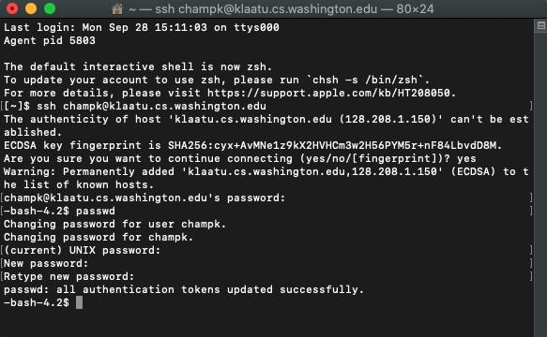
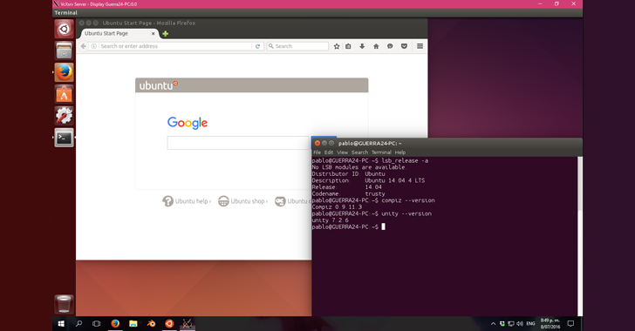
Meet Linux
What is Linux?
Linux is an operating system like Windows or MacOS
The operating system manages the relationship between computer hardware, software resources and user interaction points
Interact with the Linux machine via the shell
The shell is a text-based interface to the computer, for linux specifically “bash”
The shell is run by the terminal program
Linux also has a GUI interface, just like Windows and Mac have shell interfaces
Text interface is harder to use, but more efficient
Text interface allows for task automation
Linux was built in C using open source licensing and philosophies

Slide 10
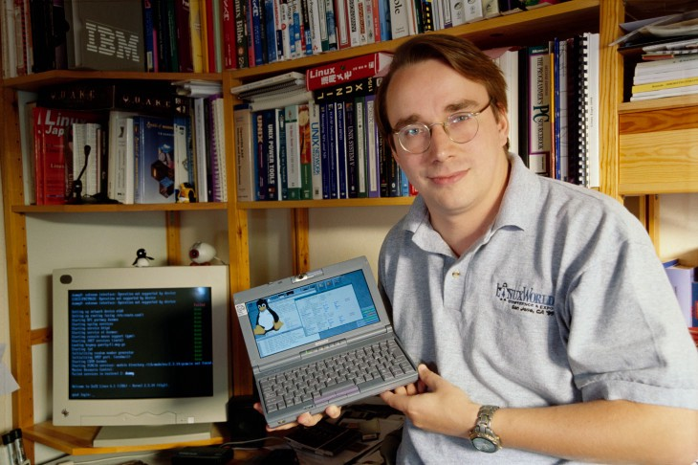
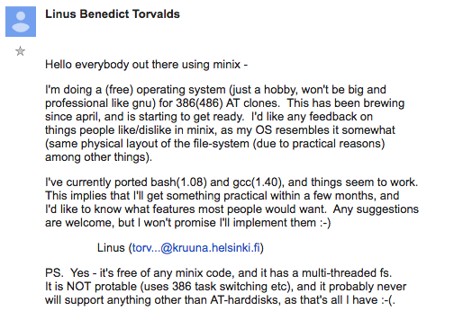
What Makes Linux “Linux”?
Linux is a family of open source Unix-like operating systems based on Linux kernel
Linux kernel was written by Linus Torvalds using the GNU Project open source system
GNU Project believed in freedom
freedom to run a program for any purpose
freedom to study the mechanics of the program and modify it
freedom to redistribute copies
freedom to improve and change modified versions for public use
GNU Project allowed Torvalds to make the Linux Kernel free and open for development by other engineers
MacOS is also based on unix kernel (Steve Jobs used Carnegie Mellon Mach kernel to take NeXT to market faster)
Android and Chrome OS based on Linux Kernel
https://www.pcmag.com/news/linuxs-linus-torvalds-sorry-for-being-a-jerk
Trivia
Linus Torvalds had wanted to call his invention Freax, a combination of "free", "freak", and "x" (as an allusion to Unix).
One of the volunteer administrators for the FTP server hated the name and instead named the project "Linux" on the server without consulting Torvalds. Torvalds disliked the name Linux as he found it too egotistical, but the name stuck.
https://en.wikipedia.org/wiki/History_of_Linux#Naming

Slide 11
Linux Demo
Recorded Demo from 374 Sp 20 Instructor Megan Hazen

Slide 12
Questions?

