Slide 1
Lecture 23: Intro to Memory and Caching
CSE 373: Data Structures and Algorithms

Slide 2
Administrivia
P5 Seam Carving due June 12
NO LATE DAYS
Grade scope submissions limited to 1x hour
Please please start early T_T
Exercise 5 More Graph Modeling due today
Exercise 6 goes out today, due
Post lecture questions coming, deadlines open until next week for extra credit
Midterm 2 Friday May 29th
1 week away!

Slide 3
Midterm 2
Topics
Midterm 2
Same format as Midterm 1
Canvas quiz
Out on Friday morning 8:30am PDT
Due Sunday morning 8:30am PDT
NO LATE ASSIGNMENTS ACCEPTED
~1 hour of work
Individual!
Heaps
Array Representations
removeMin(), buildHeap()
percolations
Graph implementations
Adjacency Matrix
Adjacency List
Graph Algorithms
BFS
DFS
Dijkstra’s
Prim’s
Kruskal’s
Topological sort
Disjoint Sets
Array representations
Union, findSet
Path compression optimization
union by size optimization
Sorting
Insertion
Selection
Heap
Merge
Quick
Best/worst case runtimes
Memory usage
stability

Slide 4
Outline (for drafting purposes but maybe ideas for outline worksheet)
- Demo with Memory (GB/MB used)
- some terms we will demystify today (on the worksheet)
- RAM (random access memory, main memory, etc.) https://en.wikipedia.org/wiki/Random-access_memory
- CPU (processor) – motivate with the math later, how prevalent math is
- cache
BIG IDEAS
- understand memory in general (like RAM, cache) as an array
- understand how memory is pulled into caches in groups
- understand how caching affects the code we write, data structures (worksheet problem: draw variables, objects, binary trees)
- LL / AL
- Heap as arrays vs Heaps as Nodes
Summary of how to use in your programming
BREAK
- other ideas: memory (RAM) as a cache for disk
Hierarchy of memory, why do we have different layers? physical desk example, just not physically possible to keep everything near CPU
Bytes/experiments / fields of objects/ primitive types/ object types, etc.

Slide 5
Big-takeaway question of the day
int sum = 0; Node current = front; while (current != null) { sum += current.data; current = current.next; } return sum;
int sum = 0; int i = 0; while (i < array.length) { sum += array[i]; i++; } return sum;
Assuming that the array is the same size as the linked list:
Which do you think is most efficient given what we know? (we have some tools to estimate runtime / what will take time, but we will learn more today)
Array code
Linked List code
Tied – both roughly equivalent
Notes:
This is the big takeaway for today. If you come out with any high-level knowledge it’s ideally why one of these is faster than the other.

Slide 6
Goal for today:
connect your already existing programming knowledge to a newer understanding of memory and how it works today.
- demo in IntelliJ and Activity Monitor (Task Manager on Windows)
Notes:
Memory may feel pretty abstract since we don’t talk about it that much as runtime, but we’re going to dive into it a little more today. To start giving you some context, when we talk about objects or big arrays or big data structures taking up memory, we’re actually talking about resources on your computer’s hardware being used up. If you open Task Manager on Windows or Activity Monitor on Mac, you’ll be able to see the memory usage of all the programs that are currently running (Google Chrome, Powerpoint, Zoom, etc.). Java programs are no different than these other programs – if you start running a Java program that consumes a lot of memory (creates lots of large data structures), you’ll see it appear on your list of programs and see that it can consume even multiple Gigabytes of data.

Slide 7
Roadmap
RAM
What is RAM?
How do our programs interact with RAM? (visually)
arrays
linked lists
caching
design decisions with caching in consideration
misc. vocabulary and setting up for next time
Notes:
We’re starting off today talking about RAM.

Slide 8
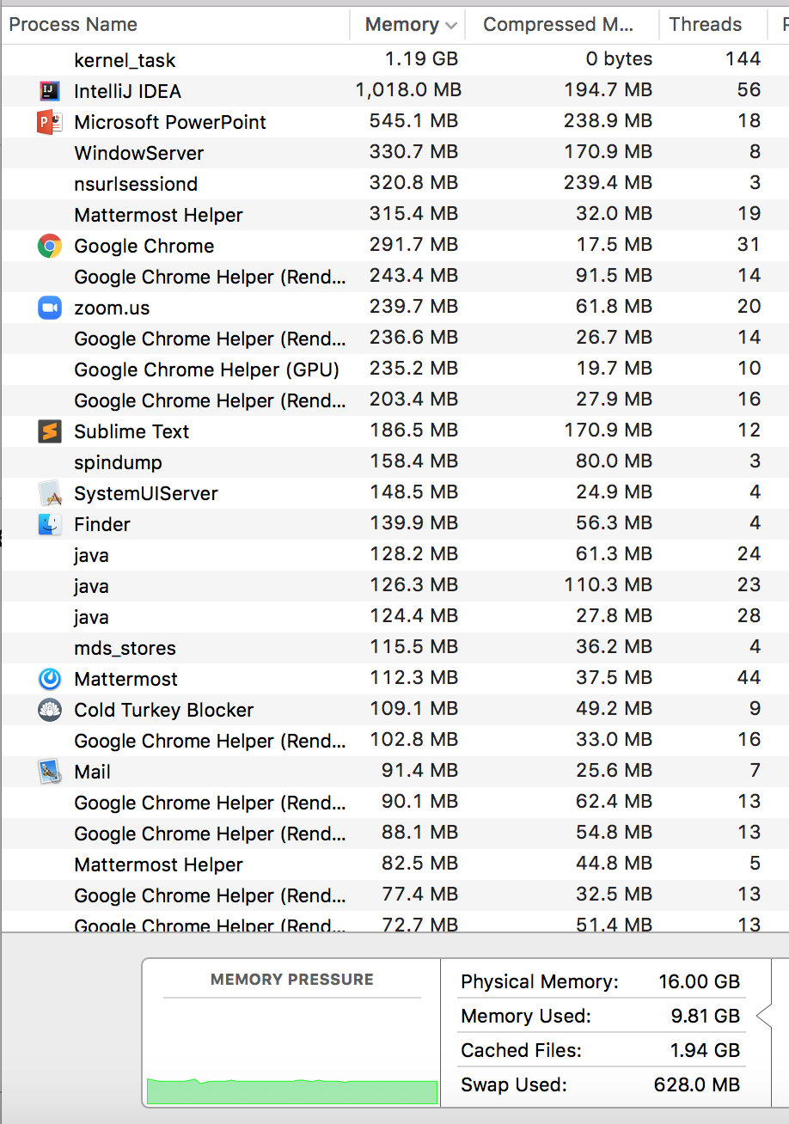
RAM (Random-Access Memory)
- RAM is where data gets stored for the programs you run. Think of it as the main memory storage location for your programs.
- RAM goes by a ton of different names: memory, main memory, RAM are all names for this same thing.
Notes:
RAM is a term frequently mentioned when purchasing computers and looking at the hardware details. For us programmers, RAM is the physical location where data gets stored for the programs we run. It’s the main location for data structures, variables, method calls, etc. that we create in our programs. When you look at this screenshot saying how much memory is being used, it’s talking about how much RAM. Somewhat frequently when things say ‘memory’ it really means RAM.

Slide 9
RAM can be represented as a huge array
This is a main takeaway
RAM:
addresses, storing stuff at specific locations
random access
Arrays
indices, storing stuff at specific locations
random access
=
If you’re interested in deeper than this : https://www.youtube.com/watch?v=fpnE6UAfbtU or take some EE classes?
Notes:
It turns out that for computer scientists / programming, we don’t have to know about the circuits and electricity that makes this green blob computer chip works. Luckily for us RAM can be thought of as a very big array -- this is how we should thing about RAM in our programs for us to be able to take advantage of it / understand how our programs interact with it.
RAM can be thought of as an array for 2 reasons in particular
you think of RAM having spaces for you to store stuff, just like you would in an array … and it also has indices (but for memory its called addresses) that describe where in RAM / the array a particular piece of data is located
Also just because of this Random access thing – you might have heard this before but people sometimes describe arrays as random access because you can access any random index in an array equally to other indices / easily. It’s the same for RAM (the computer chip one) – all addresses are easily accessed as all the others

Slide 10
Roadmap
RAM
What is RAM?
How do our programs interact with RAM? (visually)
arrays
linked lists
caching
design decisions with caching in consideration
misc. vocabulary and setting up for next time
Notes:
Now let’s talk about what these would look like visually.

Slide 11
A rough view of int and char data
int a = 5;
char letter = ‘z’
RAM
5
z
Notes:
A very high-level view (there are some more details to it if you want to Google / take more classes) of how variables and values are stored inside RAM visually. You can imagine that when we create variables like above, it’s just like putting things in array, except for this course we can think of your computer just choosing where things go (there’s a more well defined system for it that you can read up on – search memory layout)

Slide 12
A rough view of arrays and linked lists
int[] array = new int[3];
array[0] = 3;
array[1] = 7;
array[2] = 3;
Node front = new Node(3);
front.next = new Node(7);
front.next.next = new Node(3);
Notes:
How do data structures look like? Variables are simple but what about when we put things inside linked lists and arrays?

Slide 13
Activity (1 min in the chat)
Take 30 to think about what you remember about arrays and linked lists and how they relate to memory. Then in the 2nd half of 30 seconds, paste anything you recalled in the chat and we’ll go through some of them
If you have time, try to start thinking about what you recalled and how these data structures look in memory.
Arrays | Linked Lists

Slide 14
A rough view of arrays and linked lists
Arrays | Linked Lists
Contiguous in memory Simple | Each node is linked to the next, so not contiguous in memory Each node takes up more space than just the data itself – also stores pointers to the next (and prev if it’s doubly-linked) More flexible with memory / maybe can squeeze in nodes in places where we couldn’t have a full contiguous array of that size

Slide 15
A rough view of arrays and linked lists
int[] array = new int[3];
array[0] = 3;
array[1] = 7;
array[2] = 3;
3
7
3
Node front = new Node(3);
front.next = new Node(7);
front.next.next = new Node(3);
(drawing singly linked list instead of doubly because drawings are hard / the two are similar)
7
3
3
Notes:
You can see that the array elements are all ‘contiguous’ (right next each other sharing a border) whereas each node object that gets created goes somewhere in memory determined by your computer. It would only be by coincidence that they go next to each other.

Slide 16
A rough view of some other types (not the main focus but nice to know)
Binary trees?
- they look similar to linked lists: each tree node object is going to be created randomly somewhere in memory
Strings?
- Strings are really a bunch of characters in a particular order. Could probably use either, but many languages choose to implement a String as an array of characters (Java)
Objects?
-An object in memory stores its fields all right next to each other (contiguous in memory) so the shape of it is like an array. There a couple of extra things objects also store, like a reference to its method instructions.
Notes:
All text is explained above.

Slide 17
Roadmap
RAM
What is RAM?
How do our programs interact with RAM? (visually)
arrays
linked lists
caching
design decisions with caching in consideration
misc. vocabulary and setting up for next time

Slide 18
How memory is used and moves around
Notes:
Now that we understand the basics and can imagine memory just sitting there, we’re going to dive into how the computer uses RAM to actually run our programs.
But first… an analogy…. and we’re going to do this mad libs type thing.. can someone help me out and give me a number anywhere from 2 to 20?

Slide 19
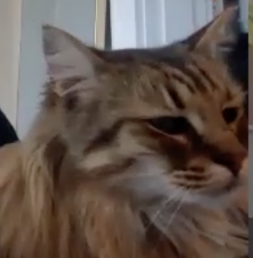
Notes:
Imagine you’re Mercy. Mercy has a problematic lifestyle where she eats a lot of tuna (maybe imagine 10 tuna fish) each day. This isn’t really a problem by itself, but it is when she has to travel to Safeway to get a tuna fish! How does Mercy go through this process?
Get hungry
Go to Safeway to get a tuna fish
Bring the tuna fish back home
Feel comfortable at home to eat the tuna fish
Get hungry again and repeat
Since Mercy is doing this multiple times every single day you can imagine that this gets very redundant. (The next few slides are all Mercy just repeating this). How can we improve this process and Mercy’s lifestyle? Skip to slide 35.

Slide 35
Solution to Mercy’s traveling problem
If we know Mercy is going to keep eating tuna . . . Why not buy a bunch during a single trip and save them all somewhere closer than the store?
Let’s get Mercy a refrigerator!

Slide 36
Notes:
If we bring a bunch of fish with Mercy back instead of just one… we can save the remaining Tuna fish for later! Even if we don’t eat them immediately they may be useful in the future. This is a key idea with caches.

Slide 39
Recap + connecting analogy back to computer

Slide 40
Before
CPU
CPU – kind of like the home / brain of your computer. Pretty much all computation is done here and data needs to move here to do anything significant with it (math, if checks, normal statement execution).
Data travels between RAM and the CPU, but it’s slow
RAM
Notes:
So in our analogy of Mercy and Safeway, there are a lot of parallels to how the computer actually works. RAM was like Safeway – that place that we have to travel to get some food (data) that we want. And it takes some medium amount of time to get there and back. Our house where we can eat food in computer-terms is the CPU (central processing unit) – which is like the brain of the computer. Pretty much all the computation needs to be done here (and we need the data located in the CPU before we can operate on it – like do math / if checks).

Slide 41
After
CPU
Cache!
Bring a bunch of food back when you go all the way to the store
Bring a bunch of data back when you go all the way to RAM
RAM
Notes:
So when we brought a bunch of food back with us for our refrigerator to store later… that act is just like how your computer automatically brings back a bunch of data when we go to RAM to store in our hardware cache.

Slide 42
Cache
Rough definition: a place to store some memory that’s smaller and closer to the CPU compared to RAM. Because caches are closer to the CPU (where your data generally needs to go to be computed / modified / acted on) getting data from cache to CPU is a lot quicker than from RAM to CPU. This means we love when the data we want to access is conveniently in the cache.
Generally we always store some data here in hopes that it will be used in the future and that we save ourselves the distance / time it takes to go to RAM.
Analogy from earlier: The refrigerator (a cache) in your house to store food closer to you than the store. Walking to your fridge is much quicker than walking to the store!

Slide 43
After
CPU
This is a big idea!
Cache!
Bring a bunch of food back when you go all the way to the store
Bring a bunch of data back when you go all the way to RAM
RAM

Slide 44
How is a bunch of memory taken from RAM?
This is a big idea (continued)!
Imagine you want to retrieve the 1 at index 4 in RAM
Your computer is smart enough to know to grab some of the surrounding data because computer designers think that it’s reasonably likely you’ll want to access that data too.
(You don’t have to do anything in your code for this to happen – it happens automatically every time you access data!)
To answer the title question, technically the term / units of transfer is in terms of ‘blocks’.

Slide 45
How is a bunch of memory taken from RAM? (continued)
CPU
original data (the 1) we wanted to look up gets passed back to the cpu
cache
all the data from the block gets brought to the cache

Slide 46
How does this pattern of memory grabbing affect our programs?
- This should have a major impact on programming with arrays. Say we access an index of an array that is stored in RAM. Because we grab a whole bunch of contiguous memory even when we just access one index in RAM, we’ll probably be grabbing other nearby parts of our array and storing that in our cache for quick access later.
Imagine that the below memory is just an entire array of length 13, with some data in it.
Just by accessing one element we bring the nearby elements back with us to the cache. In this case, it’s almost all of the array!

Slide 47
Activity (3 min in the pollev)
#1) Come up with a scenario (pseudocode or a situation) where you’d immediately benefit from caching (grabbing a bulk amount of data and bringing all of it to be cached) when using arrays.
#2) Come up with 1 scenario where you might not benefit from caching when using arrays.
possible answer: Looping through a loop starting at index 0, and just incrementing the index by 1 each time
possible answer: Jumping around in the array outside of the block of memory grabbed from the recent trip to RAM or only ever accessing the array in RAM once
How does caching / your answer to the 2nd question affect Linked Lists or node data structures in general?
possible answer: The data of a Linked list is inherently spread out in memory so grabbing nearby data probably won’t grab any other nodes in the linked list than the intended one – only by rare chance would we benefit and get another node close enough nearby.

Slide 48
Another demo, but timed
https://repl.it/repls/MistyroseLinedTransformation
(takes about 15 seconds to run)

Slide 49
Questions?

Slide 50
Roadmap
RAM
What is RAM?
How do our programs interact with RAM? (visually)
arrays
linked lists
caching
design decisions with caching in consideration
misc. vocabulary and setting up for next time

Slide 51
ArrayMap vs LinkedListMap (before (lecture 3) and now)
ArrayMap | LinkedMap
put O(n) get O(n) containsKey O(n) remove O(n) | put O(n) get O(n) containsKey O(n) remove O(n)
Both asymptotic runtimes are the same but we know all those methods have to loop through all the pairs.. which are either stored in a array or a linked list. So which is better? In terms of who benefits from caching, ArrayMap.
Notes:
Let’s compare some of the data structures from past lectures!
ArrayMap/LinkedMap have exactly the same asymptotic runtimes, but ArrayMap you’ll see caching benefits when it has to loop over all of the KV pairs.

Slide 52
Hashing: Separate chaining vs Open addressing / Probing in the context of caching
Java uses separate chaining for their hash tables…
… but Python uses a variant on probing (open addressing)!
Why? It turns out that if you use open addressing, you can gain more caching benefits than if you use separate chaining.
(Note: there are plenty of reasonable motives to still use chaining, don’t worry.)

Slide 53
Summary of caching benefits
- Helps arrays in many typical use cases (especially just looping through it normally) because we grab a bunch of the array data at once, and can look up that saved data quicker in the future.
- Doesn’t especially help linked list use cases, as grabbing nearby memory probably won’t include the next node or any of the other nodes.
Whenever you consider data structure implementations for your ADTs, arrays almost always have a plus because they have caching benefits. This is one of the most common points made online to support array implementations of ADTs.
this is a big takeaway!

Slide 54
Roadmap
RAM
What is RAM?
How do our programs interact with RAM? (visually)
arrays
linked lists
caching
design decisions with caching in consideration
misc. vocabulary and setting up for next time

Slide 55
Some new but related vocabulary
Spatial locality – the tendency for programs/processors to access data in nearby locations to previously accessed locations
Most of our programs do have spatial locality, just because they do things like looping through an array going index by index.
Programs that exhibit spatial locality will benefit from the caching that happens by your computer automatically (the programmer doesn’t have to do anything to make this happen).

Slide 56
Some new but related vocabulary
Temporal locality – tendency for program / processor to access one piece of data repeatedly
Just like they did with spatial locality, programs that exhibit temporal locality will benefit from the caching that happens by your computer automatically (the programmer doesn’t have to do anything to make this happen). Because you accessed data ‘recently’, it should be in the cache for you to access quickly the second time around.
Many programs exhibit temporal locality:
int result = someMethodCall(…);
for (int i = 0; i < 10; i++) {
System.out.println(result);
}
Here the variable ‘result’ is accessed repeatedly so after the first time it is loaded it’s put into the cache, and afterwards the lookups can just look in the cache

Slide 57
Activity: (3 min) why m2 would be faster than m1? What changes could you make to m1 to make it faster? Discuss!
public void m1(String[] strings) {
for (int i = 0; i < strings.length; i++) {
strings[i] = strings[i].trim();
}
for (int i = 0; i < strings.length; i++) {
strings[i] = strings[i].toLowerCase();
}
}
M2 exhibits good temporal locality, because we access strings[i] repeatedly so we know strings[i] is in the cache for when we call toLowerCase on the next line. M1 on the other hand … doesn’t have a guarantee strings[i] is still in the cache and easy to access.
public void m2(String[] strings) {
for (int i = 0; i < strings.length; i++) {
strings[i] = strings[i].trim();
strings[i] = strings[i].toLowerCase();
}
}
Remember that caches are small, and so not everything fits into the cache forever. When caches get full and want to store new data, they will evict old data. Often, it’s the least recently used data that gets pushed out – see LRU caching

Slide 58
Memory hierarchy, slowness + size increase,going towards RAM and DISK
There are actually multiple caches, and a whole hierarchy of places to store data on your computer. The more memory a layer can store, the slower it is to access.
In a sense, RAM is even a cache for Disk storage.

Slide 59
Main Idea Recap
Main ideas:
- RAM / memory is like an array and knowing how data looks inside RAM
- data needs to go to CPU to be processed
- caches help speed up CPU’s need for data from RAM by serving as a closer resource of data
- caching bonuses are usually just for arrays instead of linked lists/node data structures

Slide 60
References / other reading
CSE 351 Caching Slides
Wikipedia pages on CPU, RAM, and Locality
Another useful metaphor for locality and caching: https://medium.com/@adamzerner/spatial-and-temporal-locality-for-dummies-b080f2799dd
https://www.youtube.com/watch?v=fpnE6UAfbtU

