Slide 1
Lecture 20: Topological sort, reductions
Data Structures and Algorithms

Slide 2
Roadmap
- topological sort
- CSE373 20su creation, 2-Sat
- reductions, 2 color
- seam carving

Slide 3
Problem 1: Ordering Dependencies
Today’s (first) problem: Given a bunch of courses with prerequisites, find an order to take the courses in.
Math 126
CSE 374
CSE 143
CSE 142
CSE 373
CSE 417

Slide 4
Problem 1: Ordering Dependencies
Given a directed graph G, where we have an edge from u to v if u must happen before v.
We can only do things one at a time, can we find an order that respects dependencies?
Given: a directed graph G
Find: an ordering of the vertices so all edges go from left to right (all the dependency arrows are satisfied and the vertices can be processed left to right with no problems) .
Topological Sort (aka Topological Ordering)

Slide 5
Topological Ordering
Given: a directed graph G
Find: an ordering of the vertices so all edges go from left to right (all the dependency arrows are satisfied and the vertices can be processed left to right with no problems) .
Topological Sort (aka Topological Ordering)
A course prerequisite chart and a possible topological ordering.
Math 126
CSE 374
CSE 143
CSE 142
CSE 373
CSE 417
Math 126
CSE 142
CSE 143
CSE 373
CSE 374
CSE 417

Slide 6
Problem 1: Ordering Dependencies
Given a directed graph G, where we have an edge from u to v if u must happen before v.
We can only do things one at a time, can we find an order that respects dependencies?
Given: a directed graph G
Find: an ordering of the vertices so all edges go from left to right (all the dependency arrows are satisfied and the vertices can be processed left to right with no problems) .
Topological Sort (aka Topological Ordering)
Uses:
Graduating
Cooking
Organizing TODO-lists
Compiling multiple files

Slide 7
Can we always order a graph?
Can you topologically order this graph?
No
Where do I start?
A
B
C
A directed graph without any cycles.
Directed Acyclic Graph (DAG)
A graph has a topological ordering if and only if it is a DAG.
Notes:
3:00

Slide 8
Ordering a DAG
Does this graph have a topological ordering? If so find one.
0
0
0
1
1
A
C
D
B
E
2
1
1
0
0
A
C
B
D
E
If a vertex doesn’t have any edges going into it, we can add it to the ordering.
More generally, if the only incoming edges are from vertices already in the ordering, it’s safe to add.

Slide 9
How Do We Find a Topological Ordering?
TopologicalSort(Graph G, Vertex source)
count how many incoming edges each vertex has
Collection toProcess = new Collection()
foreach(Vertex v in G){
if(v.edgesRemaining == 0)
toProcess.insert(v)
}
topOrder = new List()
while(toProcess is not empty){
u = toProcess.remove()
topOrder.insert(u)
foreach(edge (u,v) leaving u){
v.edgesRemaining--
if(v.edgesRemaining == 0)
toProcess.insert(v)
}
}
[B/D]FS
Graph linear
+ V + E
Pick something with
$O(1)$ insert / removal
$$O(V + E)$$
$$+V$$
Runs as most once per edge
$$+E$$

Slide 10
Roadmap
- topological sort
- CSE373 20su creation, 2-Sat,
- reductions, 2 color
- seam carving

Slide 11
Example Problem: CSE 373 20su creation problem
Every quarter we send out an additional anonymous survey about reflecting on the course and improving the course for future quarters (rather than evaluating the instructors)
We list out each of the topics we’ve covered: Heap insertions, big-O problems, tree method, graph modeling… and ask you: what should we keep or throw away from the course?
To try to make y’all and future students happy and satisfied, we ask for your preferences. In this problem, we’re going to have each of you list two preferences of the form “I [do/don’t] want [] topic to be in CSE 373 20su version”
We’ll assume you’ll be happy if you get at least one of your two preferences.
Given: A list of 2 preferences per student.
Find: A set of topics so that every student gets at least one of their preferences (or accurately report no such topic set exists).
CSE373 20su Creation Problem

Slide 12
Example Problem: CSE 373 20su creation problem
Given: A list of 2 yes/no preferences per student.
Find: A set of topics so that every student gets at least one of their preferences (or accurately report no such topic set exists).
CSE373 20su Creation Problem
Some things to note:
example solution/thought: if there is no tree method, Student A is happy, but Student B would be happy just yet. To make Student B happy as well (make sure at least one preference is satisfied), we would make sure to include hash maps as a topic.
just with 2 student preferences, there’s already some constraints on our possible solutions! Because there’s disagreement on including the tree method in future versions, it means that whoever doesn’t get what they want for that question MUST have their other preference satisfied to complete this problem.
Student A:
- no tree method OR
- yes graph modeling
Student B:
- yes tree method OR
- yes hash maps

Slide 13
Example Problem: CSE 373 20su creation problem
Given: A list of 2 yes/no preferences per student.
Find: A set of topics so that every student gets at least one of their preferences (or accurately report no such topic set exists).
CSE373 20su Creation Problem
Some example solutions:
A)
no tree method
yes hash maps
no asymptotic analysis
B)
yes tree method
yes graph modeling
no heaps
Student A:
- no tree method OR
- yes graph modeling
Student B:
- yes tree method OR
- yes hash maps
Student C:
- no asymptotic analysis OR
- no heaps

Slide 14
Given: A list of 2 yes/no preferences per student.
Find: A set of topics so that every student gets at least one of their preferences (or accurately report no such topic set exists).
CSE373 20su Creation Problem
Student A:
- no tree method
- yes graph modeling
Student B:
- yes tree method
- yes hash maps
Student C:
- no asymptotic analysis
- no heaps
This problem (with a more general context 373 topics) is called the 2-satisfiability problem (2-SAT).
You can thing of these student preferences as parameters to our problem where each student’s preference is a boolean statement of a specific form. The student preferences above would be:
!treeMethod || graphModeling
treeMethod || hashMaps
!asymptoticAnalysis || !heaps
Given: A set of Boolean variables, and a list of requirements, each of the form:
variable1==[True/False] || variable2==[True/False]
Find: A setting of variables to “true” and “false” so that all of the requirements evaluate to “true”
2-Satisfiability (“2-SAT”)
Rephrased problem statement: go through these list of boolean conditions (preferences) where each is of the form (someVar || someOtherVar), and make sure they all preference entries evaluate to true for your proposed solution

Slide 15
20su Creation (2-SAT) algorithm
We have T kinds of topics and S students.
What if we try/loop through every possible combination of questions and then loop over the solution to make sure it works? If it does work then we can stop there, but in the worst case we’ll have to try every single combination.
generate all the possible solution lists of T/F for each topic
for each proposed solution of topics:
loop over the preferences input list and check that every entry has at least one of their preferences satisfied
How long does this take? O($2^{T}S)$
- there are 2^T possible proposed solutions, since there are T topics that could be included/not included.
- the input list is always of size S since there are S student preferences

Slide 16
O($2^{T}S)$ is pretty slow but at least it’s something. You never know when these types of things are going to come in handy.
If you want to see a more efficient way to solve this problem (S + T time) check out the end of this slide deck for an algorithm that will not be tested in this class. It uses a graph and topological sort (if you think about the last problem you could sort of see the fact that if some topic is chosen, it implies that something else has to be chose/not chosen, and we can represent those dependencies with a graph and topological sort to help us figure out what order to assign the problems in)

Slide 17
Roadmap
- topological sort
- CSE373 20su creation, 2-Sat
- reductions, 2-color
- seam carving

Slide 18
Reductions: Take 2
Using an algorithm for Problem B to solve Problem A.
Reduction (informally)
We reduced weighted shortest paths to unweighted shortest paths
Notes:
9:55

Slide 19
Weighted Graphs: A Reduction
Transform Input
u
2
u
1
2
s
t
s
t
1
v
v
Unweighted Shortest Paths
2
u
s
t
2
v
Transform Output
2
u
1
2
s
t
2
1
v
2

Slide 20
Reductions
It might not be too surprising that we can solve one shortest path problem with the algorithm for another shortest path problem.
The real power of reductions is that you can sometimes reduce a problem to another one that looks very very different.
We’re going to reduce a graph problem to 2-SAT.
Given an undirected, unweighted graph $G$, color each vertex “red” or “blue” such that the endpoints of every edge are different colors (or report no such coloring exists).
2-Coloring

Slide 21
2-Coloring
Can these graphs be 2-colored? If so find a 2-coloring. If not try to explain why one doesn’t exist.
B
C
B
C
E
E
A
A
D
D
Given an undirected, unweighted graph $G$, color each vertex “red” or “blue” such that the endpoints of every edge are different colors (or report no such coloring exists).
2-Coloring

Slide 22
2-Coloring
Can these graphs be 2-colored? If so find a 2-coloring. If not try to explain why one doesn’t exist.
B
C
B
C
E
E
A
A
D
D
Given an undirected, unweighted graph $G$, color each vertex “red” or “blue” such that the endpoints of every edge are different colors (or report no such coloring exists).
2-Coloring

Slide 23
2-Coloring
Why would we want to 2-color a graph?
We need to divide the vertices into two sets, and edges represent vertices that can’t be together.
You can modify [B/D]FS to come up with a 2-coloring (or determine none exists)
This is a good exercise!
But coming up with a whole new idea sounds like work.
And we already came up with that a 2-SAT algorithm.
Maybe we can be lazy and just use that!
Let’s reduce 2-Coloring to 2-SAT!
Use a 2-SAT algorithm
to solve 2-Coloring

Slide 24
A Reduction
We need to describe 2 steps
1. How to turn a graph for a 2-color problem into an input to 2-SAT
2. How to turn the ANSWER for that 2-SAT input into the answer for the original 2-coloring problem.
How can I describe a two coloring of my graph?
Have a variable for each vertex – is it red?
How do I make sure every edge has different colors? I need one red endpoint and one blue one, so this better be true to have an edge from v1 to v2:
(v1IsRed || v2isRed) && (!v1IsRed || !v2IsRed)

Slide 25
Transform Input
C
(AisRed||BisRed)&&(!AisRed||!BisRed)
(AisRed||DisRed)&&(!AisRed||!DisRed)
(BisRed||CisRed)&&(!BisRed||!CisRed)
(BisRed||EisRed)&&(!BisRed||!EisRed)
(DisRed||EisRed)&&(!DisRed||!EisRed)
B
E
A
D
2-SAT Algorithm
AisRed = True
BisRed = False
CisRed = True
DisRed = False
EisRed = True
Transform Output
B
C
E
A
D

Slide 26
Other examples of reductions
solving list.contains(item) can be reduced to solving list.indexOf(item) and then checking what the index was (if -1 false, true otherwise)
finding the minimum value in a list can be reduced to sorting your array/ turning it into a min-heap / and then just looking up the min value afterwards.
reductions are all about realizing that a specific problem you have is actually a specific version of a general problem you already know about / have solved. Turn your specific version (with whatever formatting / processing is required) into a form your general problem can solve!

Slide 27
More thoughts on reductions
we can’t teach you the solution to every single problem out there… it’s also unrealistic to come up with new ideas and solutions to each problem.. a lot of the time reusing existing tools / solutions is a common go to! In computer science / programming: try reducing your problem to an already solved one if you’re stuck. Ask yourself: how can I frame this in a different / simpler way /format that I’m more familiar with?
you already do this all the time in a less formal way with frameworks/libraries/looking up already implemented solutions — all we’re doing here is explicitly calling out this reduction process as a tool for designing algorithms.

Slide 28
Roadmap
- topological sort
- CSE373 20su creation
- reductions, 2-color
- seam carving

Slide 29
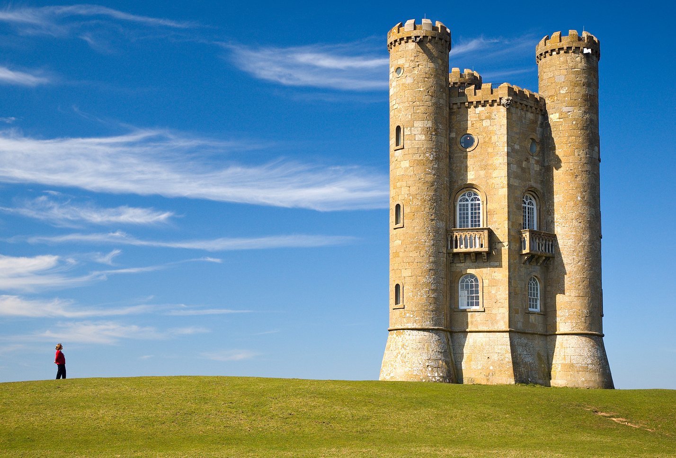
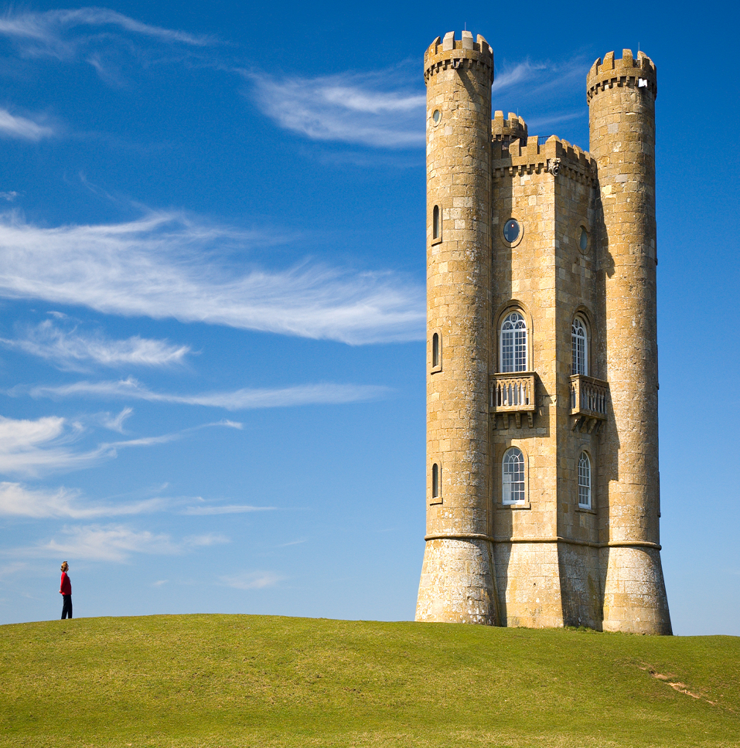
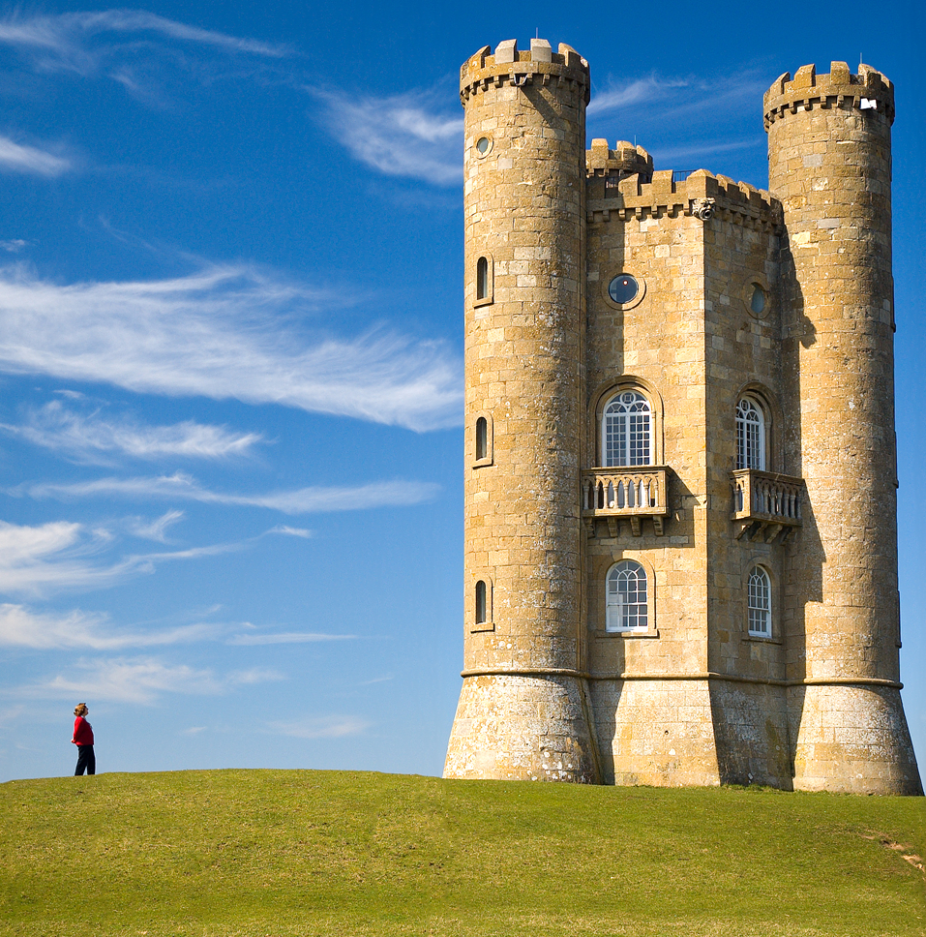
Content-Aware Image Resizing
Seam carving: A distortion-free technique for resizing an image by removing “unimportant seams”
Original Photo
Horizontally-Scaled (castle and person are distorted)
Seam-Carved (castle and person are undistorted; “unimportant” sky removed instead)
Seam carving for content-aware image resizing (Avidan, Shamir/ACM); Broadway Tower (Newton2, Yummifruitbat/Wikimedia)

Slide 30
Demo: https://www.youtube.com/watch?v=vIFCV2spKtg
Notes:
https://www.youtube.com/watch?v=vIFCV2spKtg: stop the video after they show the first vertical seam identified during the alphabet blocks – about 2.5m

Slide 31
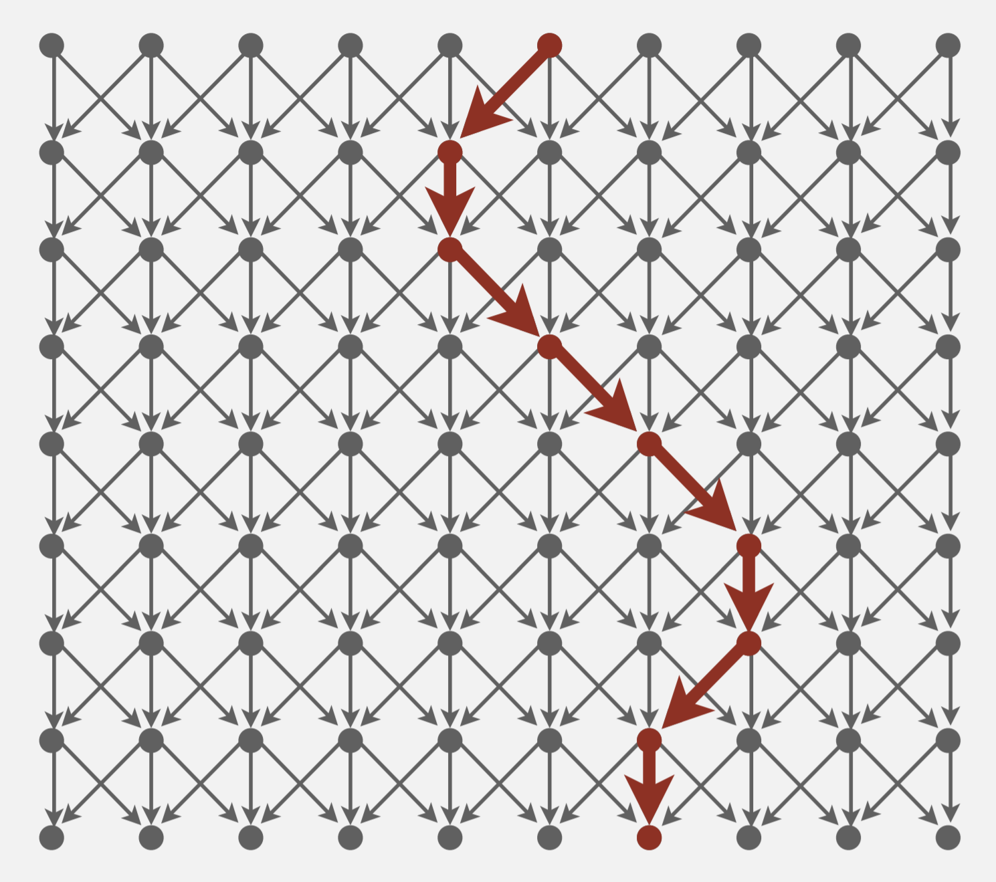
Seam Carving Reduces to Dijkstra’s algorithm
Transform the input so that it can be solved by the standard algorithm
Formulate the image as a graph
Vertices: pixel in the image
Edges: connects a pixel to its 3 downward neighbors
Edge Weights: the “energy” (visual difference) between adjacent pixels
Run the standard algorithm as-is on the transformed input
Run Dijkstra’s algorithm to find the shortest path (sum of weights) from top row to bottom row
Transform the output of the algorithm to solve the original problem
Interpret the path as a removable “seam” of unimportant pixels
Shortest Paths (Robert Sedgewick, Kevin Wayne/Princeton)

Slide 32
Formal Problem Statement
Using DijkstraShortestPathFinder, find the seam from any top vertex to any bottom vertex
Given a graph with positive edge weights and two distinguished subsets of vertices S and T, find a shortest path from any vertex in S to any vertex in T
S
T
Shortest Paths (Robert Sedgewick, Kevin Wayne/Princeton)

Slide 33
An Incomplete Reduction
DijkstraShortestPathFinder starts with a single vertex S and ends with a single vertex T
This problem specifies sets of vertices for the start and end
Your turn: brainstorm how to transform this graph into something Dijkstra’s knows how to operate on
S
T
Shortest Paths (Robert Sedgewick, Kevin Wayne/Princeton)

Slide 34
Content beyond this point is all optional
Notes:
12:30

Slide 35
Connected Components (undirected graphs)
A connected component (or just “component”) is a “piece” of an undirected graph.
Connected component [undirected graphs]
A set $S$ of vertices is a connected component (of an undirected graph) if:
It is connected, i.e. for all vertices $u,v$ in $S$: there is a walk from $u$ to $v$
It is maximal:
Either it’s the entire set of vertices, or
For every vertex u that’s not in S, $S∪\{u\}$ is not connected.

Slide 36
Find the connected components
B
B
E
E
C
C
A
A
D
D
F
{A,B,C,E}, {D,F} are the two components
{A,B,C,E}, {D} are the two components

Slide 37
Directed Graphs
In directed graphs we have two different notions of “connected”
One is “I can get there from here OR here from there” The other is “I can get there from here AND here from there”
Weakly Connected/Weakly Connected Components:
Pretend the graph is undirected (ignore the direction of the arrows)
Find the components of the undirected graph.
Strongly connected components
Want to get both directions

Slide 38
Strongly Connected Components
A subgraph C such that every pair of vertices in C is connected via some path in both directions, and there is no other vertex which is connected to every vertex of C in both directions.
Strongly Connected Component
A
D
E
B
C
Note: the direction of the edges matters!

Slide 39
Your turn: Find Strongly Connected Components
A
B
D
E
K
C
F
J
A subgraph C such that every pair of vertices in C is connected via some path in both directions, and there is no other vertex which is connected to every vertex of C in both directions.
Strongly Connected Component
{A}, {B}, {C,D,E,F}, {J,K}

Slide 40
Finding SCC Algorithm
Ok. How do we make a computer do this?
You could:
run a BFS from every vertex
For each vertex record what other vertices it can get to
A
B
D
E
K
C
F
J

Slide 41
Finding SCC Algorithm
Ok. How do we make a computer do this?
You could:
run a BFS from every vertex
For each vertex record what other vertices it can get to
But you can do better!
We’re recomputing a bunch of information, going from back to front skips recomputation.
Run a DFS first to do initial processing
While running DFS, run a second DFS to find the components based on the ordering you pull from the stack
Just two DFSs!
(see appendix for more details)
Know two things about the algorithm:
It is an application of depth first search
It runs in linear time

Slide 42
Why Find SCCs?
Graphs are useful because they encode relationships between arbitrary objects.
We’ve found the strongly connected components of G.
Let’s build a new graph out of them! Call it H
Have a vertex for each of the strongly connected components
Add an edge from component 1 to component 2 if there is an edge from a vertex inside 1 to one inside 2.
A
B
D
E
K
1
2
C
F
J
3
4

Slide 43
Why Find SCCs?
That’s awful meta. Why?
This new graph summarizes reachability information of the original graph.
I can get from A (of G) in 1 to F (of G) in 3 if and only if I can get from 1 to 3 in H.
A
B
D
E
K
1
2
C
F
J
3
4

Slide 44
Takeaways
Finding SCCs lets you collapse your graph to the meta-structure. If (and only if) your graph is a DAG, you can find a topological sort of your graph.
Both of these algorithms run in linear time.
Just about everything you could want to do with your graph will take at least as long.
You should think of these as “almost free” preprocessing of your graph.
Your other graph algorithms only need to work on
topologically sorted graphs and
strongly connected graphs.

Slide 45
A Longer Example
The best way to really see why this is useful is to do a bunch of examples.
Take CSE 417 for that. The second best way is to see one example right now...
This problem doesn’t look like it has anything to do with graphs
no maps
no roads
no social media friendships
Nonetheless, a graph representation is the best one.
I don’t expect you to remember the details of this algorithm.
I just want you to see
graphs can show up anywhere.
SCCs and Topological Sort are useful algorithms.
Notes:
24:00

Slide 46
Example Problem: Final Review
We have a long list of types of problems we might want to review for the final.
Heap insertion problem, big-O problems, finding closed forms of recurrences, graph modeling…
What should the TAs cover in the final review – what if we asked you?
To try to make you all happy, we might ask for your preferences. Each of you gives us two preferences of the form “I [do/don’t] want a [] problem on the review” *
We’ll assume you’ll be happy if you get at least one of your two preferences.
Given: A list of 2 preferences per student.
Find: A set of questions so every student gets at least one of their preferences (or accurately report no such question set exists).
Review Creation Problem
*This is NOT how the TAs are making the final review.

Slide 47
Review Creation: Take 1
We have Q kinds of questions and S students.
What if we try every possible combination of questions.
How long does this take? O($2^{Q}S)$
If we have a lot of questions, that’s really slow.
Instead we’re going to use a graph.
What should our vertices be?

Slide 48
Review Creation: Take 2
Pollev.com/cse373su19
What edges are added for the second set of preferences?
Each student introduces new relationships for data:
Let’s say your preferences are represented by this table:
Problem | YES | NO
Big-O | X
Recurrence |  | X
Graph
Heaps
Yes! Big-O
Yes! recurrence
Yes! Graph
Yes! Heaps
Problem | YES | NO
Big-O
Recurrence | X
Graph | X
Heaps
NO recurrence
NO Graph
NO Heaps
NO Big-O
If we don’t include a big-O proof, can you still be happy?
If we do include a recurrence can you still be happy?

Slide 49
Review Creation: Take 2
Each student introduces new relationships for data:
Let’s say your preferences are represented by this table:
Problem | YES | NO
Big-O | X
Recurrence |  | X
Graph
Heaps
Yes! Big-O
Yes! recurrence
Yes! Graph
Yes! Heaps
Problem | YES | NO
Big-O
Recurrence | X
Graph | X
Heaps
NO recurrence
NO Graph
NO Heaps
NO Big-O
If we don’t include a big-O proof, can you still be happy?
If we do include a recurrence can you still be happy?

Slide 50
Review Creation: Take 2
Hey we made a graph!
What do the edges mean?
Each edge goes from something making someone unhappy, to the only thing that could make them happy.
We need to avoid an edge that goes TRUE THING → FALSE THING
NO Big-O
NO recurrence
True
False

Slide 51
We need to avoid an edge that goes TRUE THING → FALSE THING
Let’s think about a single SCC of the graph.
Can we have a true and false statement in the same SCC?
What happens now that Yes B and NO B are in the same SCC?
NO C
NO E
NO B
Yes B
Yes A

Slide 52
Final Creation: SCCs
The vertices of a SCC must either be all true or all false.
Algorithm Step 1: Run SCC on the graph. Check that each question-type-pair are in different SCC.
Now what? Every SCC gets the same value.
Treat it as a single object!
We want to avoid edges from true things to false things.
“Trues” seem more useful for us at the end.
Is there some way to start from the end?
YES! Topological Sort

Slide 53
YesC
YesE
NO G
Yes D
NOB
NOA
NO F
Yes H
NO C
NO E
NO H
NO D
Yes F
Yes B
Yes A
Yes G

Slide 54
YesC
YesE
NO G
Yes D
NOB
NOA
NO F
Yes H
NO C
NO E
NO H
NO D
Yes F
Yes B
Yes A
Yes G

Slide 55
YesE
3
YesC
2
NO G
1
Yes D
NOB
NOA
NO F
Yes H
NO C
NO E
NO H
NO D
Yes F
Yes B
Yes A
6
Yes G
4
5

Slide 56
YesE
3
YesC
2
NO G
1
Yes D
NOB
NOA
NO F
False
False
Yes H
False
NO C
NO E
NO H
NO D
Yes F
Yes B
Yes A
6
True
Yes G
True
True
4
5

Slide 57
Making the Final
Algorithm: Make the requirements graph.
Find the SCCs.
If any SCC has including and not including a problem, we can’t make the final.
Run topological sort on the graph of SCC.
Starting from the end:
if everything in a component is unassigned, set them to true, and set their opposites to false.
This works!!
How fast is it?
O(Q + S). That’s a HUGE improvement.

Slide 58
Some More Context
The Final Making Problem was a type of “Satisfiability” problem.
We had a bunch of variables (include/exclude this question), and needed to satisfy everything in a list of requirements.
The algorithm we just made for Final Creation works for any 2-SAT problem.
Given: A set of Boolean variables, and a list of requirements, each of the form:
variable1==[True/False] || variable2==[True/False]
Find: A setting of variables to “true” and “false” so that all of the requirements evaluate to “true”
2-Satisfiability (“2-SAT”)

