Slide 1
Lecture 13: Intro to Graphs
CSE 373: Data Structures and Algorithms

Slide 2
Announcements
- p2 due tonight – office hours all today. Fill out the optional P2 feedback quiz (on Canvas) so we can improve this for future quarters!
- p3 released (pull from skeleton repo as usual) and website instructions are up, due next Wed 11:59pm
- exercise 3 out Friday, due next Friday

Slide 3
minHeap runtimes
A
Min Priority Queue ADT
removeMin():
remove root node
Find last node in tree and swap to top level
Percolate down to fix heap invariant
B
C
state
Set of comparable values
- Ordered based on “priority”
D
E
F
behavior
add():
Insert new node into next available spot
Percolate up to fix heap invariant
add(value) – add a new element to the collection
removeMin() – returns the element with the smallest priority, removes it from the collection
Finding the last node/next available spot is the hard part.
You can do it in $Θ(\log{n)}$time on complete trees, with some extra class variables…
But it’s NOT fun
And there’s a much better way!
peekMin() – find, but do not remove the element with the smallest priority

Slide 4
Implement Heaps with an array
We map our binary-tree representation of a heap into an array implementation where you fill in the array in level-order from left to right.
The array implementation of a heap is what people actually implement, but the tree drawing is how to think of it conceptually. Everything we’ve discussed about the tree representation still is true!
A
B
C
D
E
F
G
H
I
J
K
L
Fill array in level-order from left to right
0 | 1 | 2 | 3 | 4 | 5 | 6 | 7 | 8 | 9 | 10 | 11 | 12 | 13
A | B | C | D | E | F | G | H | I | J | K | L
Notes:
Gives us fast insertions and removals
Completeness forces height to be log(n)
Gives us contiguious memory

Slide 5
Implement Heaps with an array
How do we find the minimum node?
How do we find the last node?
How do we find the next open space?
How do we find a node’s left child?
How do we find a node’s right child?
How do we find a node’s parent?
$$peekMin()=arr[0]$$
A
$$lastNode()=arr[size −1]$$
B
C
$$openSpace()=arr[size]$$
D
E
F
G
$$leftChild\left(i\right)=2i+1$$
H
I
J
K
L
$$rightChild\left(i\right)=2i+2$$
Fill array in level-order from left to right
$$parent\left(i\right)=\frac{\left(i−1\right)}{2}$$
0 | 1 | 2 | 3 | 4 | 5 | 6 | 7 | 8 | 9 | 10 | 11 | 12 | 13
A | B | C | D | E | F | G | H | I | J | K | L
Notes:
Gives us fast insertions and removals
Completeness forces height to be log(n)
Gives us contiguious memory

Slide 6
Implement Heaps with an array
How do we find the minimum node?
How do we find the last node?
How do we find the next open space?
How do we find a node’s left child?
How do we find a node’s right child?
How do we find a node’s parent?
$$peekMin()=arr[1]$$
A
$$lastNode()=arr[size]$$
B
C
$$openSpace()=arr[size+1]$$
D
E
F
G
$$leftChild\left(i\right)=2i$$
H
I
J
K
L
$$rightChild\left(i\right)=2i$$
Fill array in level-order from left to right
$$parent\left(i\right)=\frac{i}{2}$$
0 | 1 | 2 | 3 | 4 | 5 | 6 | 7 | 8 | 9 | 10 | 11 | 12 | 13
/ | A | B | C | D | E | F | G | H | I | J | K | L
Notes:
Gives us fast insertions and removals
Completeness forces height to be log(n)
Gives us contiguious memory

Slide 7
Heap Implementation Runtimes
A
Implementation | add | removeMin | Peek
Array-based heap | worst: $Θ(\log{n)}$ in-practice: $Θ(1)$ | worst: $Θ(\log{n)}$ $$\text{in}\text{−}\text{practice}\text{:} Θ(\log{n)}$$ | $$Θ(1)$$
B
C
add()
worst – the item added is the new minimum and has to traverse all the way to the top of the tree
in-practice – most nodes are near the bottom of the tree, so in practice new values rarely travel further than a level or two
removeMin()
worst – the item pulled from the bottom of the tree is large and has to percolate all the way back down
in-practice – because we pull an item from the bottom level to replace the top node, that is probably where it belongs and has to percolate all the way back down
D
E
F
0 | 1 | 2 | 3 | 4 | 5 | 6 | 7
A | B | C | D | E | F
We’ve matched the asymptotic worst-case behavior of AVL trees, but we’re actually doing better!
- The constant factors for array accesses are better.
- The tree can be a constant factor shorter because of stricter height invariants.
- In-practice case for add is really good.
- A heap is MUCH simpler to implement.

Slide 8
Are heaps always better? AVL vs Heaps
- The really amazing things about heaps over AVL implementations are the constant factors (e.g. 1.2n instead of 2n) and the sweet sweet Theta(1) in-practice `add` time.
- The really amazing things about AVL implementations over heaps is that AVL trees are absolutely sorted, and they guarantee worst-case be able to find (contains/get) in Theta(log(n)) time.
If heaps have to implement methods like contains/get/ (more generally: finding a particular value inside the data structure) – it pretty much just has to loop through the array and incur a worst-case Theta(n) runtime.
Heaps are stuck at Theta(n) runtime and we can’t do anything more clever…. aha, just kidding.. unless…?

Slide 9
More Operations
Min Priority Queue ADT
We’ll use priority queues for lots of things later in the quarter.
Let’s add them to our ADT now.
Some of these will be asymptotically faster for a heap than an AVL tree!
BuildHeap(elements $e_{1},…,e_{n}$) Given $n$ elements, create a heap containing exactly those $n$ elements.
state
Set of comparable values
- Ordered based on “priority”
behavior
add(value) – add a new element to the collection
removeMin() – returns the element with the smallest priority, removes it from the collection
peekMin() – find, but do not remove the element with the smallest priority

Slide 10
Even More Operations
BuildHeap(elements $e_{1},…,e_{n}$) – Given $n$ elements, create a heap containing exactly those $n$ elements.
Try 1: Just call insert $n$ times.
Worst case running time?
$n$ calls, each worst case $Θ(\log{n})$. So it’s $Θ(n\log{n)}$right?
That proof isn’t valid. There’s no guarantee that we’re getting the worst case every time!
Proof is right if we just want an $O()$ bound
But it’s not clear if it’s tight.

Slide 11
BuildHeap Running Time
Let’s try again for a Theta bound.
The problem last time was making sure we always hit the worst case.
If we insert the elements in decreasing order we will!
Every node will have to percolate all the way up to the root.
So we really have $n$ $Θ(\log{n})$ operations. QED.
There’s still a bug with this proof!

Slide 12
BuildHeap Running Time (again)
Let’s try once more.
Saying the worst case was decreasing order was a good start.
What are the actual running times?
It’s $Θ(h)$, where $h$ is the current height.
The tree isn’t height $\log{n}$at the beginning.
But most nodes are inserted in the last two levels of the tree.
For most nodes, $h$ is $Θ\left(\log{n}\right)$.
The number of operations is at least
$\frac{n}{2}⋅Ω(\log{n)}=Ω\left(n\log{n}\right).$

Slide 13
Can We Do Better?
What’s causing the $n$ insert strategy to take so long?
Most nodes are near the bottom, and they might need to percolate all the way up.
What if instead we dumped everything in the array and then
tried to percolate things down to fix the invariant?
Seems like it might be faster
The bottom two levels of the tree have $Ω(n)$ nodes, the top two have $3$ nodes.
Maybe we can make “most nodes” go a constant distance.

Slide 14
Is It Really Faster?
Assume the tree is perfect
the proof for complete trees just gives a different constant factor.
percolateDown() doesn’t take $log n$ steps each time!
Half the nodes of the tree are leaves
Leaves run percolate down in constant time
1/4 of the nodes have at most 1 level to travel
1/8 the nodes have at most 2 levels to travel
etc…
work(n) ≈ $\frac{n}{2}⋅ 1 +\frac{n}{4}⋅ 2 +\frac{n}{8}⋅ 3 +⋯+1⋅(\log{n})$

Slide 15
Closed form Floyd’s buildHeap
$\text{n}\text{/2⋅ 1 +}\text{n}\text{/4⋅ 2 +}\text{n}\text{/8⋅ 3 +⋯+1⋅(}\text{log} \text{n}\text{)}$ factor out n
work(n) ≈$n\left(\frac{1}{2}+\frac{2}{4}+\frac{3}{8}+⋯+\frac{\log{n}}{n}\right)$
find a pattern -> powers of 2
work(n) ≈ $n\left(\frac{1}{2^{1}}+\frac{2}{2^{2}}+\frac{3}{2^{3}}+⋯+\frac{\log{n}}{2^{\log{n}}}\right)$
Summation!
$$work\left(n\right)≈n\sum_{i=1}^{?}{\frac{i}{2^{i}}}$$
? = upper limit should give last term
We don’t have a summation for this! Let’s make it look more like a summation we do know.
Infinite geometric series
$$if−1<x<1 then\sum_{i=0}^{∞}{x^{i}}=\frac{1}{1 −x}=x$$
$$work\left(n\right)≈n\sum_{i=1}^{logn}{\frac{i}{2^{i}}≤n\sum_{i=0}^{∞}{{\left(\frac{3}{4}\right)}^{i}=n ∗4}}$$
$$work\left(n\right)≤n\sum_{i=1}^{logn}{\frac{{\left(\frac{3}{2}\right)}^{i}}{2^{i}}}$$
Floyd’s buildHeap runs in O(n) time!
Notes:
Because $\frac{1}{2}$ the nodes are leaves, design algorithms that do less work closer to the bottom!
More careful analysis can reveal tighter bounds
Math strategy: rather than show a <= b directly, it can be simpler to show a <= t then t<= b (a la finding c and n₀)

Slide 16
Floyd’s buildHeap algorithm
Build a tree with the values:
12, 5, 11, 3, 10, 2, 9, 4, 8, 15, 7, 6
12
Add all values to back of array
percolateDown(parent) starting at last index
5
11
3
10
2
9
4
8
15
7
6
0 | 1 | 2 | 3 | 4 | 5 | 6 | 7 | 8 | 9 | 10 | 11 | 12 | 13
12
5
11
3
10
2
9
4
8
15
7
6

Slide 17
Floyd’s buildHeap algorithm
Build a tree with the values:
12, 5, 11, 3, 10, 2, 9, 4, 8, 15, 7, 6
12
Add all values to back of array
percolateDown(parent) starting at last index
percolateDown level 4
percolateDown level 3
5
11
7
9
3
10
2
4
8
15
7
6
10
0 | 1 | 2 | 3 | 4 | 5 | 6 | 7 | 8 | 9 | 10 | 11 | 12 | 13
12
5
11
3
10
2
9
4
8
15
7
6

Slide 18
Floyd’s buildHeap algorithm
Build a tree with the values:
12, 5, 11, 3, 10, 2, 9, 4, 8, 15, 7, 6
12
Add all values to back of array
percolateDown(parent) starting at last index
percolateDown level 4
percolateDown level 3
percolateDown level 2
3
5
11
2
7
6
9
5
10
2
3
11
keep percolating down
like normal here and swap 5 and 4
15
7
11
4
8
10
6
0 | 1 | 2 | 3 | 4 | 5 | 6 | 7 | 8 | 9 | 10 | 11 | 12 | 13
12
5
11
3
7
2
9
4
8
15
10
6

Slide 19
Floyd’s buildHeap algorithm
Build a tree with the values:
12, 5, 11, 3, 10, 2, 9, 4, 8, 15, 7, 6
2
12
Add all values to back of array
percolateDown(parent) starting at last index
percolateDown level 4
percolateDown level 3
percolateDown level 2
percolateDown level 1
3
5
11
2
12
7
9
4
10
2
3
6
5
8
15
7
6
10
11
0 | 1 | 2 | 3 | 4 | 5 | 6 | 7 | 8 | 9 | 10 | 11 | 12 | 13
12
3
2
4
7
6
9
5
8
15
10
11

Slide 20
Floyd’s buildHeap algorithm
Build a tree with the values:
12, 5, 11, 3, 10, 2, 9, 4, 8, 15, 7, 6
2
12
Add all values to back of array
percolateDown(parent) starting at last index
percolateDown level 4
percolateDown level 3
percolateDown level 2
percolateDown level 1
3
5
2
11
6
7
9
4
10
2
3
6
11
5
8
15
7
6
10
11
12
0 | 1 | 2 | 3 | 4 | 5 | 6 | 7 | 8 | 9 | 10 | 11 | 12 | 13
2
3
6
4
7
11
9
5
8
15
10
12

Slide 21
Relevant hint for project 3:
- When coming up with data structures, we can actually combine them with existing tools to improve our algorithms and runtimes. We can improve the worst-case runtime of get/contains to be a lot better than Theta(n) time depending on how we have our heap utilize an extra data-structure.
- For project 3, you should use an additional data structure to improve the runtime for changePriority(). It does not affect the correctness of your PQ at all (i.e. you can implement it correctly without the additional data structure). Please use a built-in Java collection instead of implementing your own (although you could in-theory).
For project 3, feel free to try the following development strategy for the changePriority method
implement changePriority without regards to efficiency (without the extra data structure) at first
then, analyze your code’s runtime and figure out which parts are inefficient
reflect on the data structures we’ve learned and see how any of them could be useful in improving the slow parts in your code

Slide 22
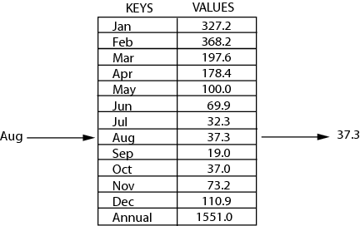
Review: Sets
map: Holds a set of distinct keys and a collection of values, where each key is associated with one value.
a.k.a. "dictionary"
set.contains("the")
true
Dictionary ADT
supported operations:
put(key, value): Adds a given item into collection with associated key,
if the map previously had a mapping for the given key, old value is replaced.
get(key): Retrieves the value mapped to the key
containsKey(key): returns true if key is already associated with value in map, false otherwise
remove(key): Removes the given key and its mapped value
state
Set of items & keys
Count of items
behavior
put(key, item) add item to collection indexed with key
get(key) return item associated with key
containsKey(key) return if key already in use
remove(key) remove item and associated key
size() return count of items

Slide 23
Questions

Slide 24
Introduction to Graphs

Slide 25
Inter-data Relationships
Arrays
Categorically associated
Sometimes ordered
Typically independent
Elements only store pure data, no connection info
Trees
Directional Relationships
Ordered for easy access
Limited connections
Elements store data and connection info
Graphs
Multiple relationship connections
Relationships dictate structure
Connection freedom!
Both elements and connections can store data
0 | 1 | 2
A | B | C
A
B
B
C
C
A

Slide 26
Graphs
Everything is graphs.
Most things we’ve studied this quarter can be represented by graphs.
BSTs are graphs
Linked lists? Graphs.
Heaps? Also can be represented as graphs.
Those trees we drew in the tree method? Graphs.
But it’s not just data structures that we’ve discussed…
Google Maps database? Graph.
Facebook? They have a “graph search” team. Because it’s a graph
Gitlab’s history of a repository? Graph.
Those pictures of prerequisites in your program? Graphs.
Family tree? That’s a graph

Slide 27
Graph: Formal Definition
G
A graph is defined by a pair of sets G = (V, E) where…
V is a set of vertices
A vertex or “node” is a data entity
E is a set of edges
An edge is a connection between two vertices
H
V = { A, B, C, D, E, F, G, H }
F
A
E = { (A, B), (A, C), (A, D), (A, H),
(C, B), (B, D), (D, E), (D, F),
(F, G), (G, H)}
D
C
B
E

Slide 28
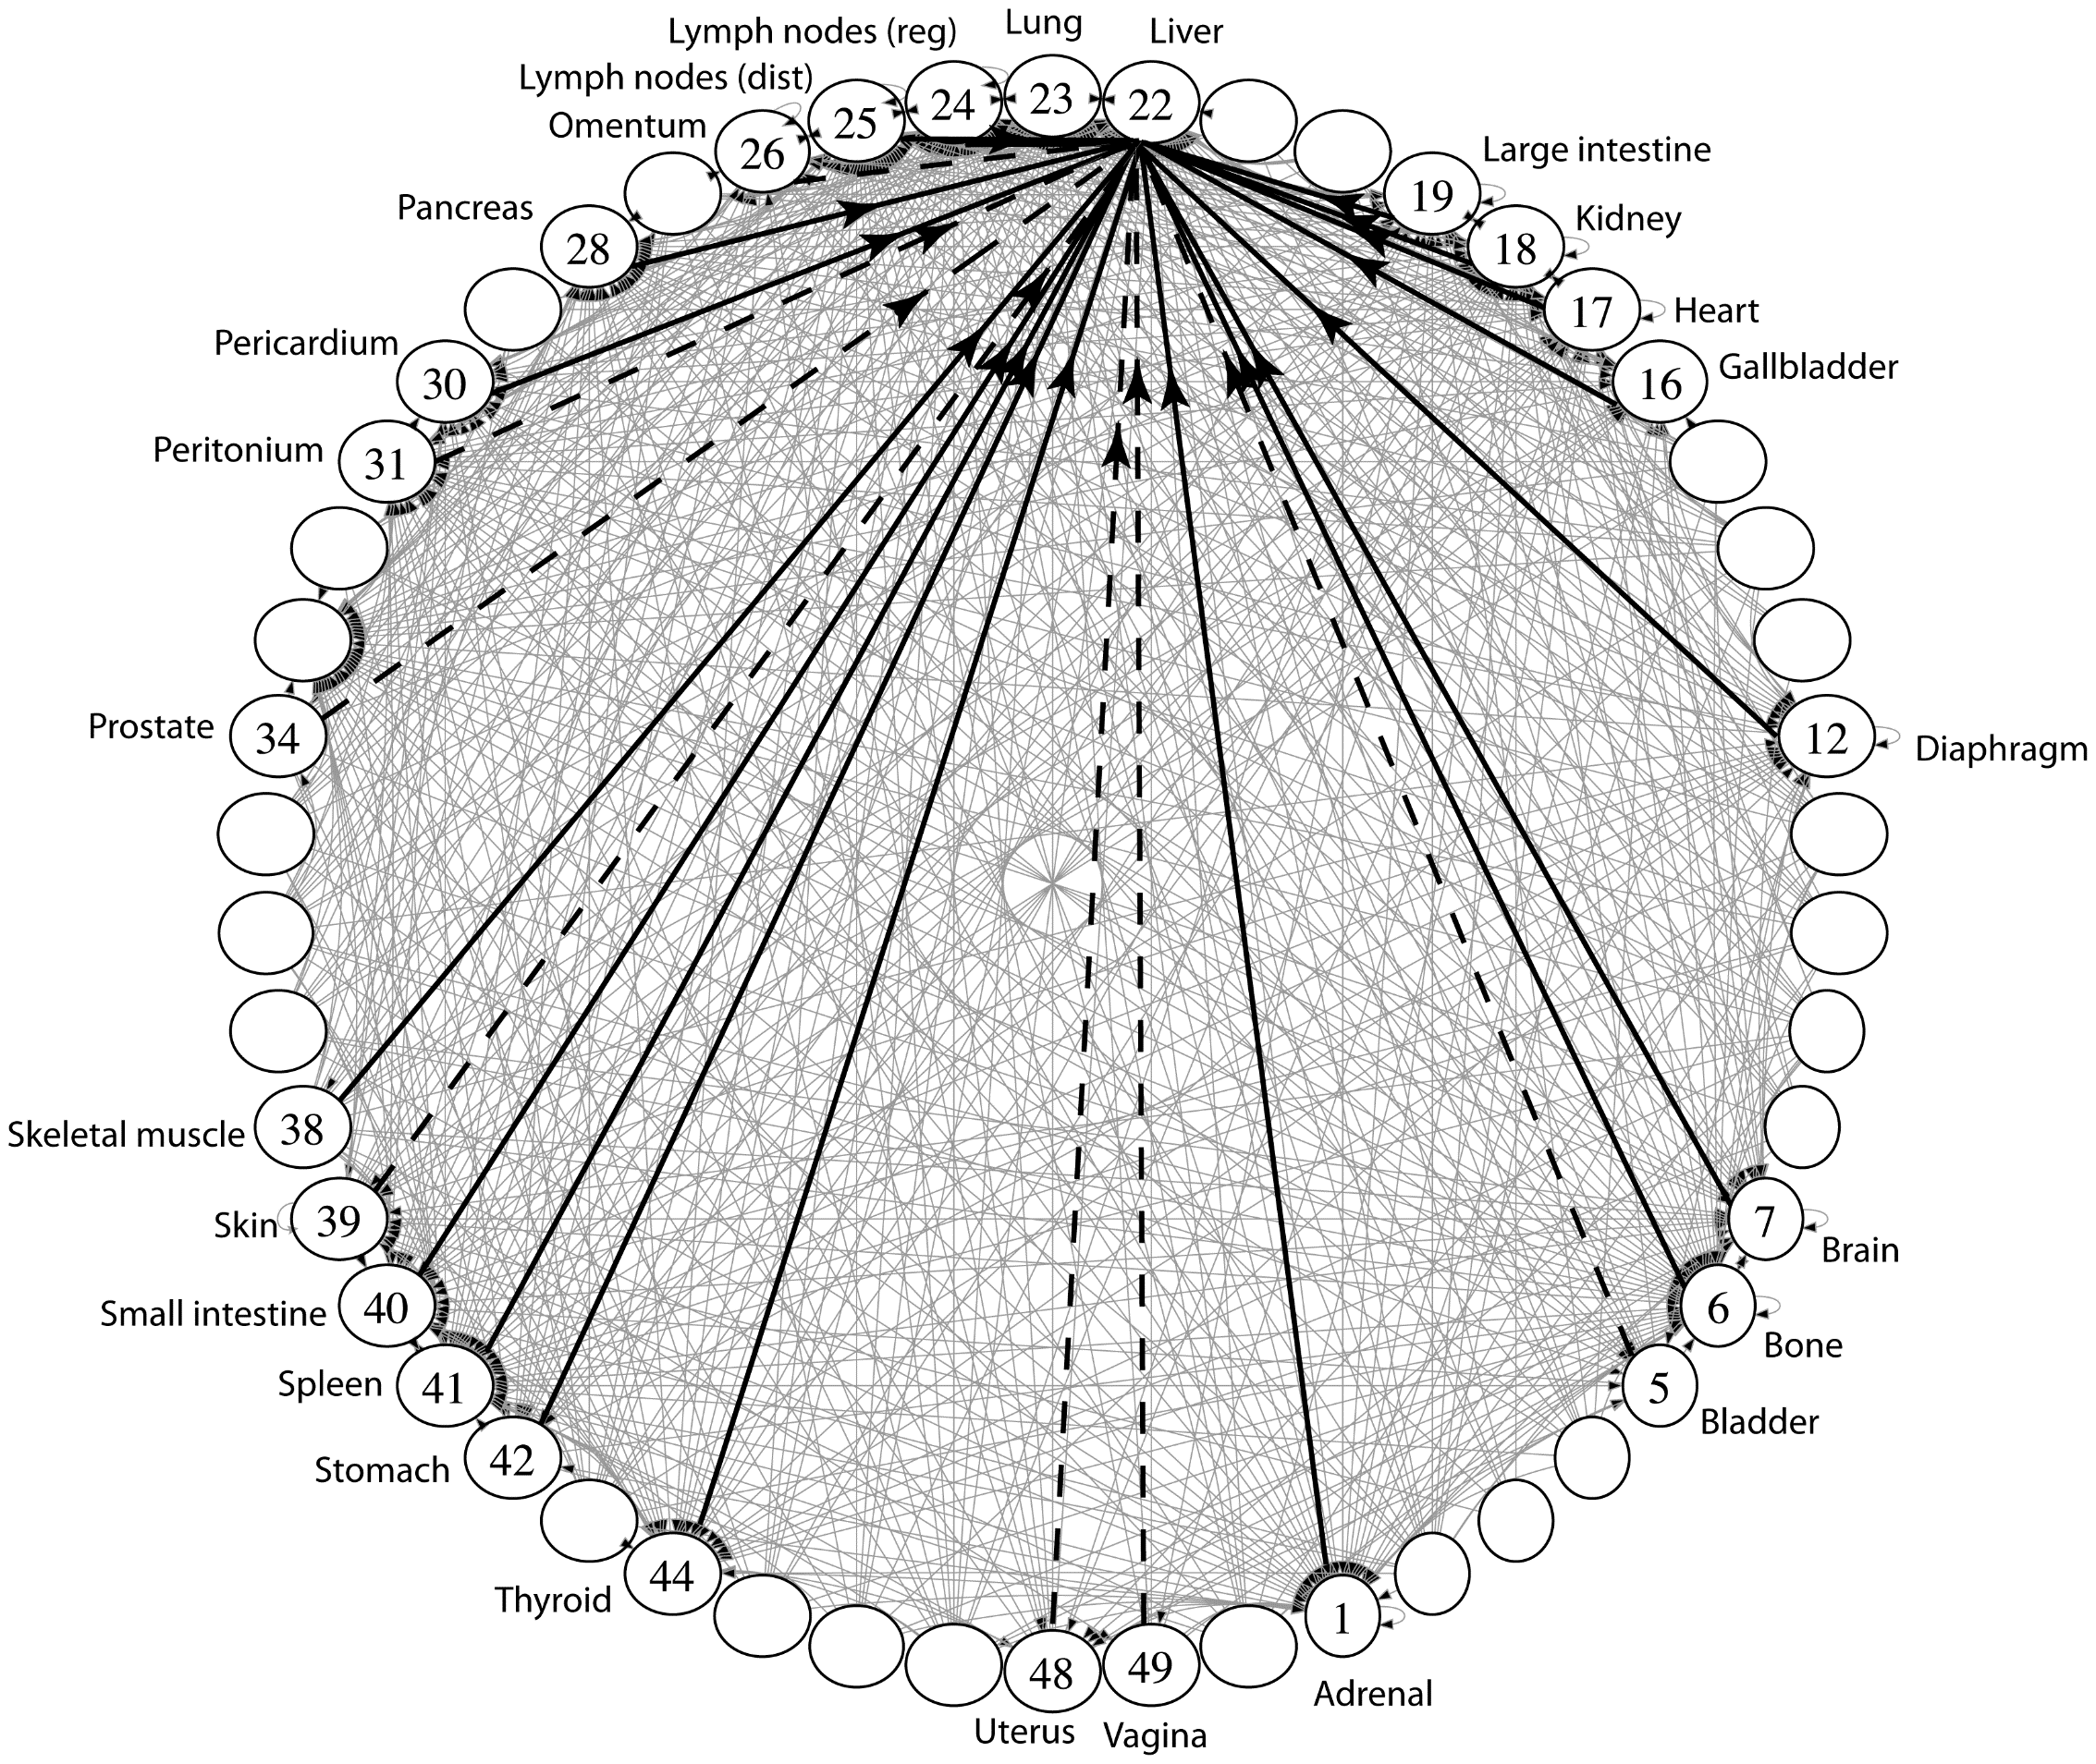
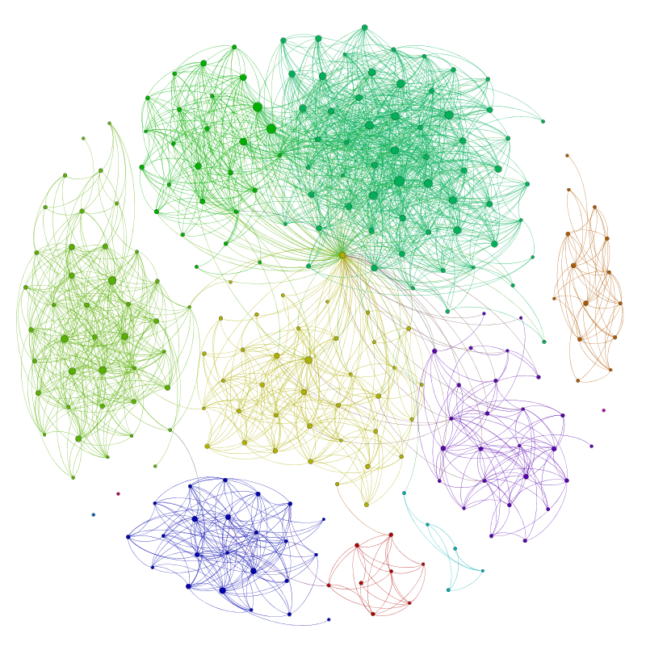
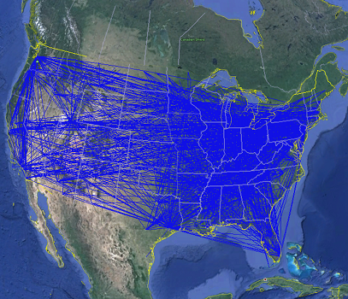
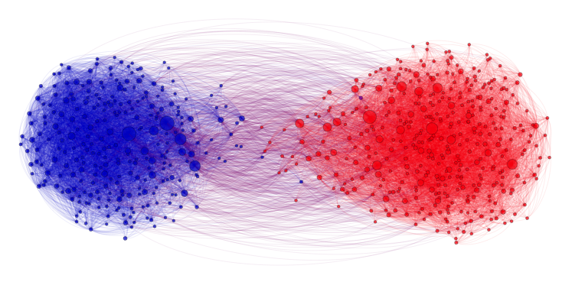
Applications
Physical Maps
Airline maps
Vertices are airports, edges are flight paths
Traffic
Vertices are addresses, edges are streets
Relationships
Social media graphs
Vertices are accounts, edges are follower relationships
Code bases
Vertices are classes, edges are usage
Influence
Biology
Vertices are cancer cell destinations, edges are migration paths
Related topics
Web Page Ranking
Vertices are web pages, edges are hyperlinks
Wikipedia
Vertices are articles, edges are links
SO MANY MORREEEE
www.allthingsgraphed.com

Slide 29
Graph Vocabulary
Undirected Graph:
Graph Direction
Undirected graph – edges have no direction and are two-way
Directed graphs – edges have direction and are thus one-way
Degree of a Vertex
Degree – the number of edges connected to that vertex
Karen : 1, Jim : 1, Pam : 1
In-degree – the number of directed edges that point to a vertex
Gunther : 0, Rachel : 2, Ross : 1
Out-degree – the number of directed edges that start at a vertex
Gunther : 1, Rachel : 1, Ross : 1
Karen
Jim
V = { Karen, Jim, Pam }
E = { (Jim, Pam), (Jim, Karen) } inferred (Karen, Jim) and (Pam, Jim)
Directed Graph:
Pam
V = { Gunther, Rachel, Ross }
E = { (Gunther, Rachel), (Rachel, Ross), (Ross, Rachel) }
Rachel
Gunther
Ross

Slide 30
Connected Graphs
Connected graph – a graph where every vertex is connected to every other vertex via some path. It is not required for every vertex to have an edge to every other vertex
There exists some way to get from each vertex to every other vertex
Connected Component – a subgraph in which any two vertices are connected via some path, but is connected to no additional vertices in the supergraph
There exists some way to get from each vertex within the connected component to every other vertex in the connected component
A vertex with no edges is itself a connected component
Robb
Sansa
Rickon
Dany
Viserys
Arya
Jon
Bran

Slide 31
Graph Vocabulary
Self loop – an edge that starts and ends at the same vertex
Parallel edges – two edges with the same start and end vertices
Simple graph – a graph with no self-loops and no parallel edges
Kanye
Andy
Michael
Ron
Ben
Chris
Leslie

Slide 32
Graph Terms
Walk – A sequence of adjacent vertices. Each connected to next by an edge.
Path – A walk that doesn’t repeat a vertex. A,B,C,D is a path. A,B,A is not.
(Directed) Walk–must follow the direction of the edges
Cycle – path with an extra edge from last vertex back to first.
Length – The number of edges in a walk/path/cycle. (A,B,C,D) has length 3.
A,B,C,D is a walk.
So is A,B,A
UW
Cap
Hill
West
lake
Univ
St
A,B,C,D,B is a directed walk.
A,B,A is not.
Sleep
Eat
Work
Cry
Notes:
Terminology here varies by source. This is what the textbook uses – some people use walk instead of path’ and reserve path for what we called a simple path.

Slide 33
Implementing a Graph
Implement with nodes…
Implementation gets super messy
What if you wanted a vertex without an edge?
How can we implement without requiring edges to access nodes?
Implement using some of our existing data structures!

Slide 34
Making Graphs
If your problem has data and relationships, you might want to represent it as a graph
How do you choose a representation?
Usually:
Think about what your “fundamental” objects are
Those become your vertices.
Then think about how they’re related
Those become your edges.

Slide 35
Some examples
Poll Everywhere!
Pollev.com/cse373activity
For each of the following think about what you should choose for vertices and edges.
The internet
Family tree
Input data for the “6 degrees of Kevin Bacon” game
Course Prerequisites

Slide 36
Some examples
For each of the following think about what you should choose for vertices and edges.
The internet
Vertices: webpages. Edges from a to b if a has a hyperlink to b.
Family tree
Vertices: people. Edges: from parent to child, maybe for marriages too?
Input data for the “6 Degrees of Kevin Bacon” game
Vertices: actors. Edges: if two people appeared in the same movie
Or: Vertices for actors and movies, edge from actors to movies they appeared in.
Course Prerequisites
Vertices: courses. Edge: from a to b if a is a prereq for b.

Slide 37
Adjacency Matrix
4
0
1
5
6
In an adjacency matrix a[u][v] is 1 if there is an edge (u,v), and 0 otherwise.
Worst-case Time Complexity (|V| = n, |E| = m):
Add Edge:
Remove Edge:
Check edge exists from (u,v):
Get outneighbors of u:
Get inneighbors of u:
Space Complexity:
2
3
 | 0 | 1 | 2 | 3 | 4 | 5 | 6
0 | 0 | 1 | 1 | 0 | 0 | 0 | 0
1 | 1 | 0 | 0 | 1 | 0 | 0 | 0
2 | 1 | 0 | 0 | 1 | 0 | 0 | 0
3 | 0 | 1 | 1 | 0 | 0 | 1 | 0
4 | 0 | 0 | 0 | 0 | 0 | 1 | 0
5 | 0 | 0 | 0 | 1 | 1 | 0 | 0
6 | 0 | 0 | 0 | 0 | 0 | 0 | 0
$$Θ(1)$$
$$Θ(1)$$
$$Θ(1)$$
$$Θ(n)$$
$$Θ(n)$$
$$Θ(n^{2})$$
Notes:
It is usual to write |V| = n and |E| = m, though sometimes we’ll abuse notation and just use V and E.

Slide 38
Adjacency List
B
A
Create a Dictionary of size V from type V to Collection of E
If (x,y) $∈$ E then add y to the set associated with the key x
C
D
An array where the $u^{th}$ element contains a list of neighbors of $u$.
Directed graphs: list of out-neighbors (a[u] has v for all (u,v) in E)
Time Complexity (|V| = n, |E| = m):
Add Edge:
Remove Edge (u,v):
Check edge exists from (u,v):
Get neighbors of u (out):
Get neighbors of u (in):
Space Complexity:
Linked Lists
$$Θ(1)$$
0
1
2
3
$$Θ( deg⁡(u) )$$
A
B
C
$$Θ( deg⁡(u) )$$
$Θ(\deg\left(u\right))$
B
$$Θ(n + m)$$
C
B
D
$$Θ(n + m)$$
D
A

Slide 39
Adjacency List
B
A
Create a Dictionary of size V from type V to Collection of E
If (x,y) $∈$ E then add y to the set associated with the key x
C
D
An array where the $u^{th}$ element contains a list of neighbors of $u$.
Directed graphs: list of out-neighbors (a[u] has v for all (u,v) in E)
Time Complexity (|V| = n, |E| = m):
Add Edge:
Remove Edge (u,v):
Check edge exists from (u,v):
Get neighbors of u (out):
Get neighbors of u (in):
Space Complexity:
Hash Tables
0 | 1 | 2 | 3 | 4
$$Θ(1)$$
0
1
2
3
$$Θ( 1 )$$
A
B
C
$$Θ( 1 )$$
$Θ(deg⁡(u))$
B
$$Θ(n )$$
0 | 1 | 2 | 3 | 4
C
B
D
$$Θ(n + m)$$
0 | 1 | 2 | 3 | 4
D
A

Slide 40
Tradeoffs
Adjacency Matrices take more space, and have slower $Θ()$ bounds, why would you use them?
For dense graphs (where $m$is close to$n^{2}$), the running times will be close
And the constant factors can be much better for matrices than for lists.
Sometimes the matrix itself is useful (“spectral graph theory”)
What’s the tradeoff between using linked lists and hash tables for the list of neighbors?
A hash table still might hit a worst-case
And the linked list might not
Graph algorithms often just need to iterate over all the neighbors, so you might get a better guarantee with the linked list.
For this class, unless we say otherwise, we’ll assume the hash tables operations on graphs are all $O\left(1\right).$
Because you can probably control the keys.
Unless we say otherwise, assume we’re using an adjacency list with hash tables for each list.

