Slide 1
Lecture 12: Intro to Heaps
CSE 373 Data Structures and Algorithms
CSE 373 20 SP – Chan & Champion

Slide 2
Announcements
Midterm Grades to Come
  no penalty for formatting
Project 2 due Wednesday April 29th
Project 3 goes out on Wednesday
Exercise 3 goes out on Friday
Grade Buckets
Percent Earned | Letter Grade | GPA
95 | A+ | 4.0
90 | A | 3.5
80 | B | 3.0
60 | C | 2.0
50 | D | 0.7

Slide 3
Priority Queues
PriorityQueue<FoodOrder> pq = new PriorityQueue<>();
some motivation for today’s lecture:
PQs are a staple of Java’s built-in data structures, commonly used for sorting needs
Using PQs and knowing their implementations are common technical interview subjects
You’re implementing one in the next project – so everything you get out of today should be useful for that!

Slide 4
Priority Queue / heaps roadmap
- PriorityQueue ADT
- PriorityQueue implementations with current toolkit
- Binary Heap idea + invariants
- Binary Heap methods
- Binary Heap implementation details

Slide 5
Imagine you’re managing a queue of food orders at a restaurant, which normally takes food orders first-come-first-served.
Suddenly, Ana Mari Cauce walks into the restaurant!
You realize that you should serve her as soon as possible (to gain political influence or so that she leaves the restaurant as soon as possible), and realize other celebrities (CSE 373 staff) could also arrive soon. Your new food management system should rank customers and let us know which food order we should work on next (the most prioritized thing).

Slide 6
Priority Queue ADT
Min Priority Queue ADT
Imagine you’re managing a queue of food orders at a restaurant, which normally takes food orders first-come-first-served. But suddenly, Ana Marie Cauce walks into the restaurant. You know that you should server her as soon as possible (to either suck up or kick her out of the restaurant), and realize other celebrities (CSE 373 staff) could also arrive soon. Your new food management system should rank customers and let us know which food order we should work on next (the most prioritized thing).
Other uses:
Well-designed printers
Huffman Coding (see in CSE 143 last hw)
Sorting algorithms
Graph algorithms
state
Set of comparable values
- Ordered based on “priority”
behavior
add(value) – add a new element to the collection
removeMin() – returns the element with the smallest priority, removes it from the collection
peekMin() – find, but do not remove the element with the smallest priority

Slide 7
Priority Queue ADT
If a Queue is “First-In-First-Out” (FIFO) Priority Queues are “Most-Important-Out-First”
Items in Priority Queue must be comparable –
The data structure will maintain some amount of internal sorting, in a sort of similar way to BSTs/AVLs
Min Priority Queue ADT
Max Priority Queue ADT
state
state
Set of comparable values
- Ordered based on “priority”
Set of comparable values
- Ordered based on “priority”
behavior
behavior
removeMin() – returns the element with the smallest priority, removes it from the collection
removeMax() – returns the element with the largest priority, removes it from the collection
peekMin() – find, but do not remove the element with the smallest priority
peekMax() – find, but do not remove the element with the largest priority
add(value) – add a new element to the collection
add(value) – add a new element to the collection

Slide 8
Implementing Priority Queues: Take I
2 Minutes
Maybe we already know how to implement a priority queue.
How long would removeMin and peek take with these data structures?
Implementation | add | removeMin | Peek
Unsorted Array
Linked List (sorted)
AVL Tree
For Array implementations, assume you do not need to resize.
Other than this assumption, do worst case analysis.

Slide 9
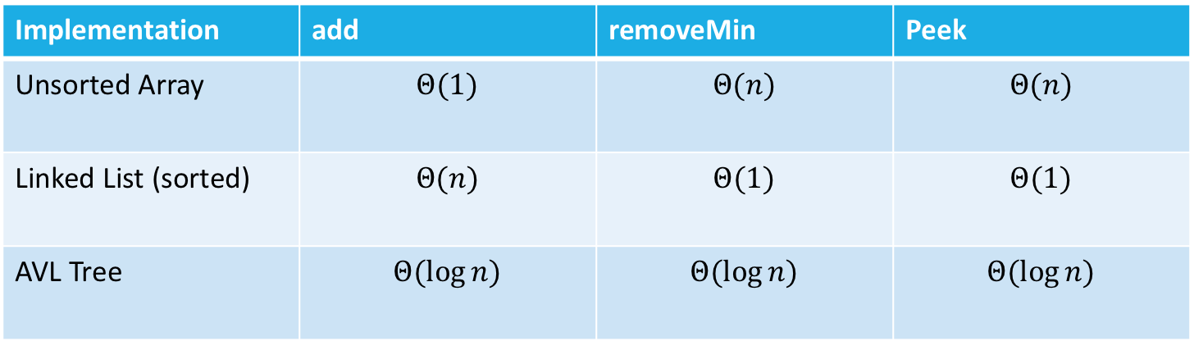
Implementing Priority Queues: Take I
Maybe we already know how to implement a priority queue.
How long would removeMin and peek take with these data structures?
Implementation | add | removeMin | Peek
Unsorted Array | $$Θ(1)$$ | $$Θ(n)$$ | $$Θ(n)$$
Linked List (sorted) | $$Θ(n)$$ | $$Θ(1)$$ | $$Θ(1)$$
AVL Tree | $$Θ(\log{n)}$$ | $$Θ(\log{n)}$$ | $$Θ(\log{n)}$$
For Array implementations, assume you do not need to resize.
Other than this assumption, do worst case analysis.

Slide 10
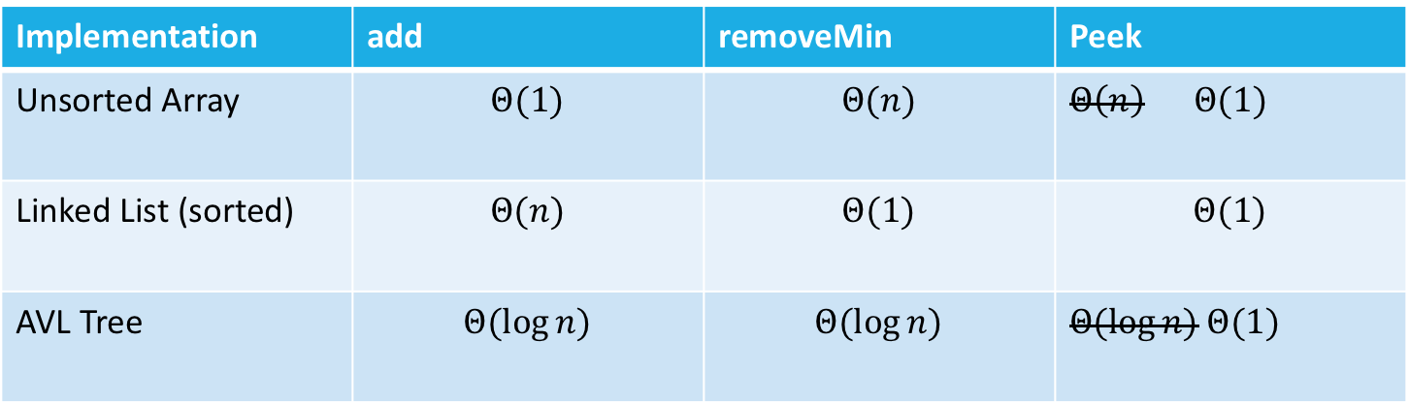
Implementing Priority Queues: Take I
Maybe we already know how to implement a priority queue.
How long would removeMin and peek take with these data structures?
Implementation | add | removeMin | Peek
Unsorted Array | $$Θ(1)$$ | $$Θ(n)$$ | $Θ\left(n\right) Θ(1)$
Linked List (sorted) | $$Θ(n)$$ | $$Θ(1)$$ | $$Θ(1)$$
AVL Tree | $$Θ(\log{n)}$$ | $$Θ(\log{n)}$$ | $Θ(\log{n)}$ $Θ(1)$
AVL Trees are our baseline – let’s look at what computer scientists came up with as an alternative, analyze that, and then come back to AVL Tree as an option later
Add a field to keep track of the min.
Update on every insert or remove.

Slide 11
Review: Binary Search Trees
A Binary Search Tree is a binary tree with the following invariant: for every node with value k in the BST:
  The left subtree only contains values <k
  The right subtree only contains values >k
9
5
17
1
8
31
class BSTNode<Value> {
Value v;
BSTNode left;
BSTNode right;
}
Reminder: the BST ordering applies recursively to the entire subtree
Notes:
A single sorted list can map to multiple BSTs, so it’s not an exact comparison.
When animation comes in, introduce “Smashed tree principle

Slide 12
Heaps
Idea:
In a BST, we organized the data to find anything quickly. (go left or right to find a value deeper in the tree)
Now we just want to find the smallest things fast, so let’s write a different invariant:
In particular, the smallest node is at the root!
  Super easy to peek now!
Do we need more invariants?
Heap invariant
Every node is less than or equal to both of its children.
4
4
5
6
5
6
8
373
7
7

Slide 13
Heaps
With the current definition we could still have degenerate trees. From our BST / AVL intuition, we know that degenerate trees take a long time to traverse from root → leaf, so we want to avoid these tree structures.
The BST invariant was a bit complicated to maintain.
  Because we had to make sure when we inserted we could maintain the exact BST structure where nodes to the left are less than, nodes to the right are greater than…
  The heap invariant is looser than the BST invariant.
  Which means we can make our structure invariant stricter.
A tree is complete if:
  Every row, except possibly the last, is completely full.
  The last row is filled from left to right (no “gap”)
4
4
2
Heap structure invariant:
A heap is always a complete tree.
6
4
6
5
5
8
9
5
8
9

Slide 14
Binary Heap invariants summary
This is a big idea! (heap invariants!)
One flavor of heap is a binary heap.
1. Binary Tree: every node has at most 2 children
2. Heap invariant: every node is smaller than (or equal to) its children
3. Heap structure invariant: Each level is “complete” meaning it has no “gaps”
- Heaps are filled up left to right
1
8
1
2
3
9
10
2
3
22
4
5
4
5
6
7
36
9
10
47
8

Slide 15
Self Check - Are these valid heaps?
2 Minutes
Binary Heap Invariants:
Binary Tree
Heap
Complete
INVALID
1
3
VALID
INVALID
4
4
7
7
5
2
5
6
9
8
6
3
7
8
9
11
10

Slide 16
Heap heights
A binary heap bounds our height at Theta(log(n)) because it’s complete – and it’s actually a little stricter and better than AVL.
2
This means the runtime to traverse from root to leaf or leaf to root will be log(n) time.
4
7
5
8
10
9
11
13

Slide 17
Questions?
Priority Queue ADT
Priority Queue possible implementations
Heap invariants
Heap height

Slide 18
Priority Queue / heaps roadmap
- PriorityQueue ADT
- PriorityQueue implementations with current toolkit
- Binary Heap idea + invariants
- Binary Heap methods
- Binary Heap implementation details

Slide 19

Implementing peekMin()
Runtime: $Θ$(1)
2
4
7
5
8
10
9
11
13

Slide 20
Implementing removeMin()
1.) Return min
2.) replace with bottom level right-most node
2
13
4
7
4
7
5
8
10
9
5
8
10
9
11
13
11
Structure invariant restored, heap invariant broken
Runtime:
Locating min = O(1)
Fixing heap = ?
  Removing overallRoot creates a gap
  Replacing with one of its children causes lots of gaps
  What node can we replace with overallRoot that wont cause any gaps?

Slide 21
Implementing removeMin() - percolateDown
3.) percolateDown()
What’s the worst-case running time?
Have to:
Find last element
Move it to top spot
Swap until invariant restored
(how many times do we have to swap?)
Recursively swap parent with smallest child
until parent is smaller than both children
(or we’re at a leaf).
13
4
This is a big idea! (height of all these tree DS correlates w worst case runtimes – we want to design our trees to have reasonably small height!)
4
7
5
13
5
10
9
13
11
8
this is why we want to keep the height of the tree small! The height of these tree structures (BST, AVL, heaps) directly correlates with the worst case runtimes
11
13
Structure invariant restored, heap invariant restored
Runtime:
Locating min = O(1)
Fixing heap = ?
  Removing overallRoot creates a gap
  Replacing with one of its children causes lots of gaps
  What node can we replace with overallRoot that wont cause any gaps?

Slide 22
Practice: removeMin()
3 Minutes
1.) Remove min node
2.) replace with bottom level right-most node
3.) percolateDown - Recursively swap parent with smallest child
until parent is smaller than both children
(or we’re at a leaf).
5
18
9
9
18
10
11
17
14
11
13
18
20
19
16
15
24
22
18

Slide 23
Why does percolateDown swap with the smallest child instead of just any child?
If we swap 13 and 7, the heap invariant isn’t restored!
7 is greater than 4 (it’s not the smallest child!) so it will violate the invariant.
13
4
7
5
8
10
9
11

Slide 24
Implementing add()
add() Algorithm:
  Insert a node on the bottom level that ensure no gaps
  Fix heap invariant by percolate UP
i.e. swap with parent,
until your parent is
smaller than you
(or you’re the root).
2
4
7
3
5
8
10
9
4
3
11
13
3
8
Worst case runtime is similar to removeMin and percolateDown – might have to do log(n) swaps, so the worst-case runtime is Theta(log(n))

Slide 25
Practice: Building a minHeap
3 Minutes
Construct a Min Binary Heap by adding the following values in this order:
5, 10, 15, 20, 7, 2
Add() Algorithm:
1.) Insert a node on the bottom level that ensures no gaps
2. )Fix heap invariant by percolate UP
i.e. swap with parent,
until your parent is
smaller than you
(or you’re the root).
Min Binary Heap Invariants
Binary Tree – each node has at most 2 children
Min Heap – each node’s children are larger than itself
Level Complete - new nodes are added from left to right completely filling each level before creating a new one
5
2
10
15
7
5
2
percolateUp!
20
7
2
10
15
percolateUp!
percolateUp!

Slide 26

minHeap runtimes
removeMin():
  remove root node
  Find last node in tree and swap to top level
  Percolate down to fix heap invariant
add():
  Insert new node into next available spot
  Percolate up to fix heap invariant
Finding the last node/next available spot is the hard part.
You can do it in $Θ(\log{n)}$time on complete trees, with some extra class variables…
But it’s NOT fun
And there’s a much better way!

Slide 27
Implement Heaps with an array
We map our binary-tree representation of a heap into an array implementation where you fill in the array in level-order from left to right.
The array implementation of a heap is what people actually implement, but the tree drawing is how to think of it conceptually. Everything we’ve discussed about the tree representation still is true!
A
B
C
D
E
F
G
H
I
J
K
L
Fill array in level-order from left to right
0 | 1 | 2 | 3 | 4 | 5 | 6 | 7 | 8 | 9 | 10 | 11 | 12 | 13
A | B | C | D | E | F | G | H | I | J | K | L
Notes:
Gives us fast insertions and removals
Completeness forces height to be log(n)
Gives us contiguious memory

Slide 28






Implement Heaps with an array
How do we find the minimum node?
How do we find the last node?
How do we find the next open space?
How do we find a node’s left child?
How do we find a node’s right child?
How do we find a node’s parent?
$$peekMin()=arr[0]$$
A
$$lastNode()=arr[size −1]$$
B
C
$$openSpace()=arr[size]$$
D
E
F
G
$$leftChild\left(i\right)=2i+1$$
H
I
J
K
L
$$rightChild\left(i\right)=2i+2$$
Fill array in level-order from left to right
$$parent\left(i\right)=\frac{\left(i−1\right)}{2}$$
0 | 1 | 2 | 3 | 4 | 5 | 6 | 7 | 8 | 9 | 10 | 11 | 12 | 13
A | B | C | D | E | F | G | H | I | J | K | L
Notes:
Gives us fast insertions and removals
Completeness forces height to be log(n)
Gives us contiguious memory

Slide 29






Implement Heaps with an array
How do we find the minimum node?
How do we find the last node?
How do we find the next open space?
How do we find a node’s left child?
How do we find a node’s right child?
How do we find a node’s parent?
$$peekMin()=arr[1]$$
A
$$lastNode()=arr[size]$$
B
C
$$openSpace()=arr[size+1]$$
D
E
F
G
$$leftChild\left(i\right)=2i$$
H
I
J
K
L
$$rightChild\left(i\right)=2i$$
Fill array in level-order from left to right
$$parent\left(i\right)=\frac{i}{2}$$
0 | 1 | 2 | 3 | 4 | 5 | 6 | 7 | 8 | 9 | 10 | 11 | 12 | 13
/ | A | B | C | D | E | F | G | H | I | J | K | L
Notes:
Gives us fast insertions and removals
Completeness forces height to be log(n)
Gives us contiguious memory

Slide 30
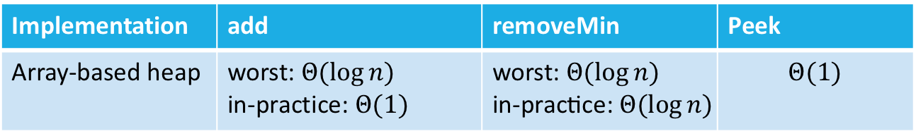
Heap Implementation Runtimes
A
Implementation | add | removeMin | Peek
Array-based heap | worst: $Θ(\log{n)}$ in-practice: $Θ(1)$ | worst: $Θ(\log{n)}$ $$\text{in}\text{−}\text{practice}\text{:} Θ(\log{n)}$$ | $$Θ(1)$$
B
C
We’ve matched the asymptotic worst-case behavior of AVL trees.
But we’re actually doing better!
- The constant factors for array accesses are better.
- The tree can be a constant factor shorter because of stricter height invariants.
- In-practice case for add is really good.
- A heap is MUCH simpler to implement.
D
E
F
0 | 1 | 2 | 3 | 4 | 5 | 6 | 7
A | B | C | D | E | F

Slide 31
Are heaps always better? AVL vs Heaps
- The really amazing things about heaps over AVL implementations are the constant factors (e.g. 1.2n instead of 2n) and the sweet sweet Theta(1) in-practice `add` time.
- The really amazing things about AVL implementations over heaps is that AVL trees are absolutely sorted, and they guarantee worst-case be able to find (contains/get) in Theta(log(n)) time.
If heaps have to implement methods like contains/get/ (more generally: finding a particular value inside the data structure) – it pretty much just has to loop through the array and incur a worst case Theta(n) runtime.
Heaps are stuck at Theta(n) runtime and we can’t do anything more clever…. aha, just kidding.. unless…?

Slide 32
Relevant hint for project 3:
- When coming up with data structures, we can actually combine them with existing tools to improve our algorithms and runtimes. We can improve the worst-case runtime of get/contains to be a lot better than Theta(n) time depending on how we have our heap utilize an extra data-structure.
- For project 3, you should use an additional data structure to improve the runtime for changePriority(). It does not affect the correctness of your PQ at all (i.e. you can implement it correctly without the additional data structure). Please use a built-in Java collection instead of implementing your own (although you could in-theory).
For project 3, feel free to try the following development strategy for the changePriority method
  implement changePriority without regards to efficiency (without the extra data structure) at first
  then, analyze your code’s runtime and figure out which parts are inefficient
  reflect on the data structures we’ve learned and see how any of them could be useful in improving the slow parts in your code

Slide 33
More Priority Queue Operations

Slide 34
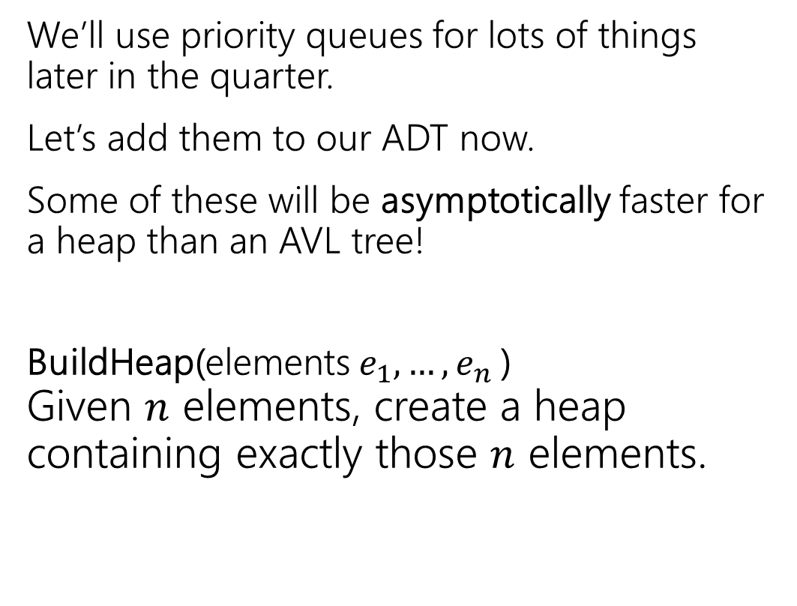
More Operations
Min Priority Queue ADT
We’ll use priority queues for lots of things later in the quarter.
Let’s add them to our ADT now.
Some of these will be asymptotically faster for a heap than an AVL tree!
BuildHeap(elements $e_{1},…,e_{n}$)
Given $n$ elements, create a heap containing exactly those $n$ elements.
state
Set of comparable values
- Ordered based on “priority”
behavior
add(value) – add a new element to the collection
removeMin() – returns the element with the smallest priority, removes it from the collection
peekMin() – find, but do not remove the element with the smallest priority

Slide 35
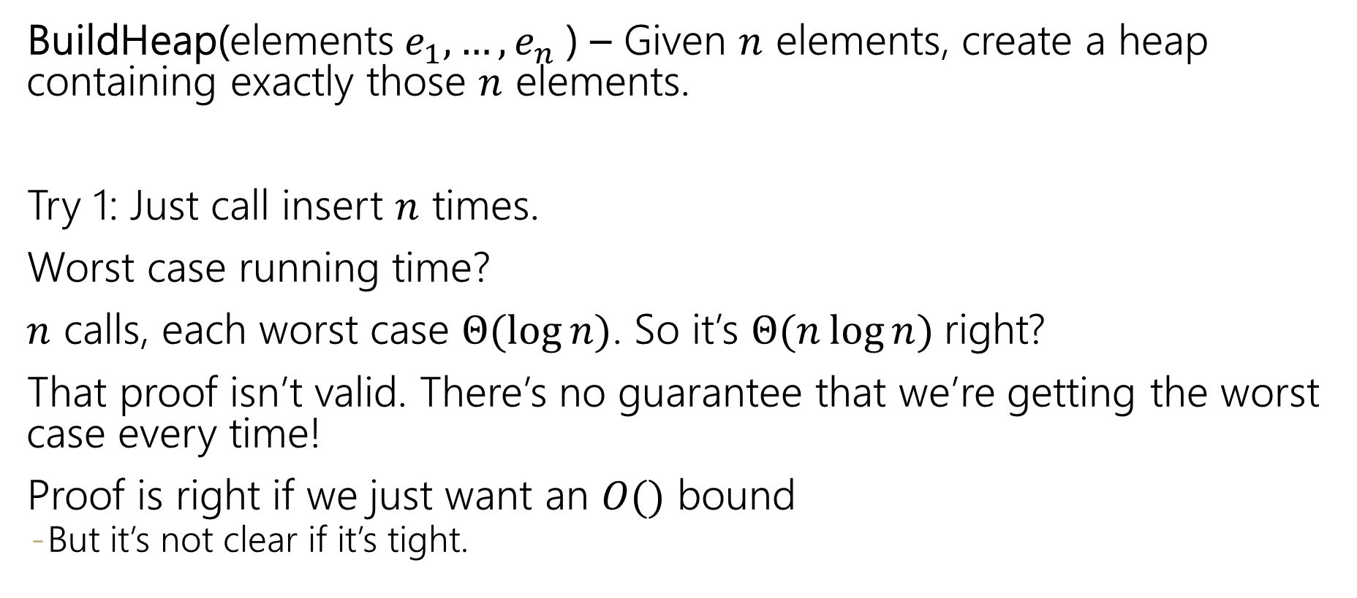
Even More Operations
BuildHeap(elements $e_{1},…,e_{n}$) – Given $n$ elements, create a heap containing exactly those $n$ elements.
Try 1: Just call insert $n$ times.
Worst case running time?
$n$ calls, each worst case $Θ(\log{n})$. So it’s $Θ(n\log{n)}$right?
That proof isn’t valid. There’s no guarantee that we’re getting the worst case every time!
Proof is right if we just want an $O()$ bound
  But it’s not clear if it’s tight.

Slide 36
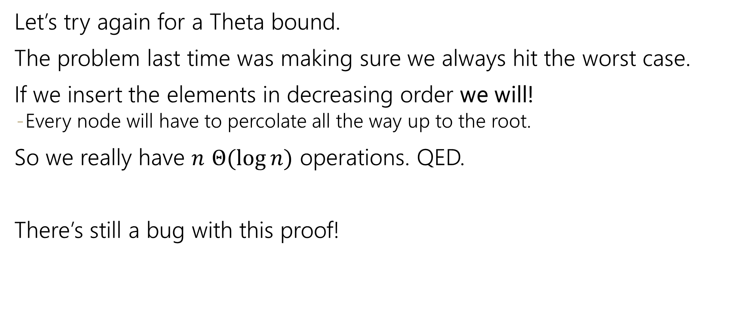
BuildHeap Running Time
Let’s try again for a Theta bound.
The problem last time was making sure we always hit the worst case.
If we insert the elements in decreasing order we will!
  Every node will have to percolate all the way up to the root.
So we really have $n$ $Θ(\log{n})$ operations. QED.
There’s still a bug with this proof!

Slide 37
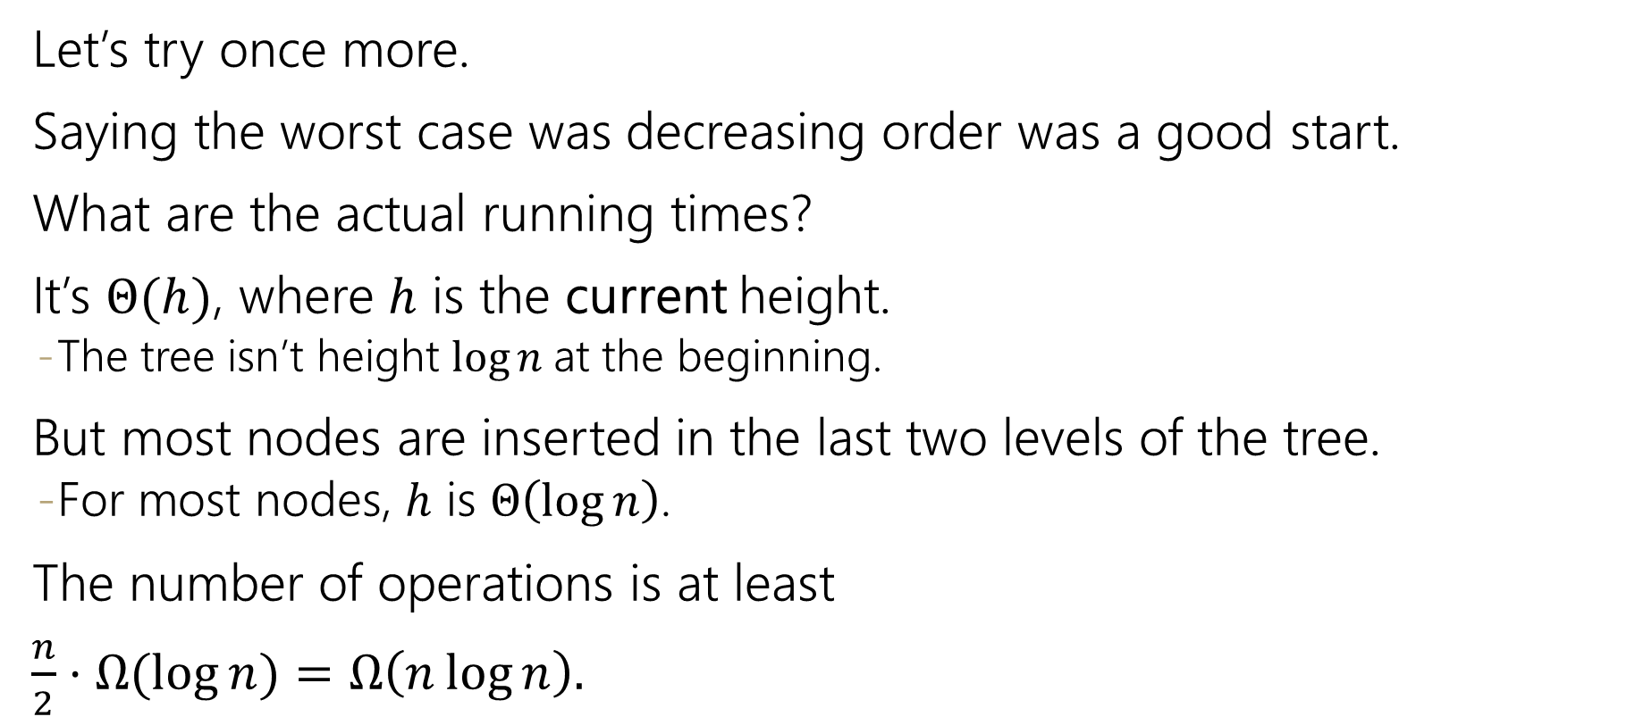
BuildHeap Running Time (again)
Let’s try once more.
Saying the worst case was decreasing order was a good start.
What are the actual running times?
It’s $Θ(h)$, where $h$ is the current height.
  The tree isn’t height $\log{n}$at the beginning.
But most nodes are inserted in the last two levels of the tree.
  For most nodes, $h$ is $Θ\left(\log{n}\right)$.
The number of operations is at least
$\frac{n}{2}⋅Ω(\log{n)}=Ω\left(n\log{n}\right).$

Slide 38
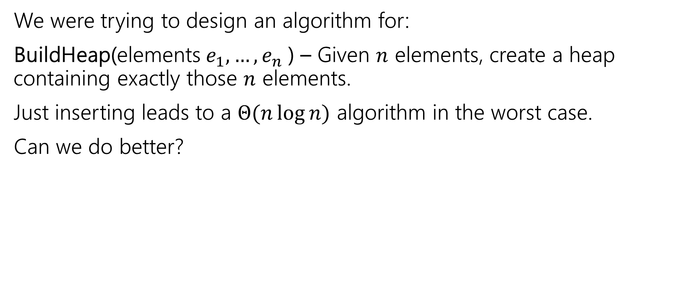
Where Were We?
We were trying to design an algorithm for:
BuildHeap(elements $e_{1},…,e_{n}$) – Given $n$ elements, create a heap containing exactly those $n$ elements.
Just inserting leads to a $Θ(n\log{n)}$ algorithm in the worst case.
Can we do better?

Slide 39
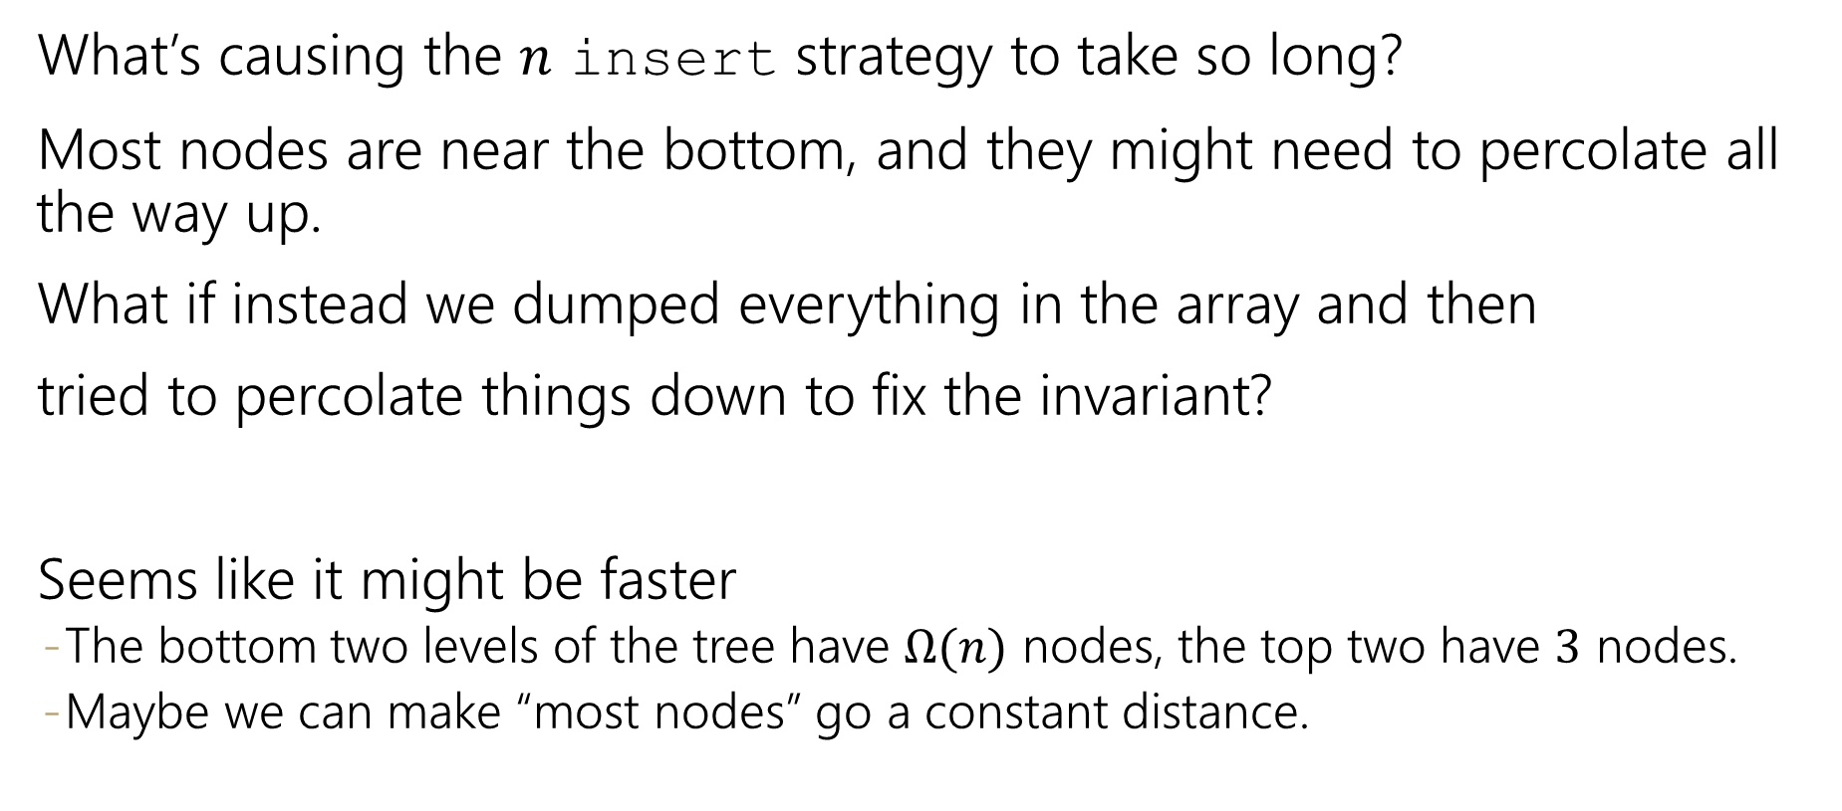
Can We Do Better?
What’s causing the $n$ insert strategy to take so long?
Most nodes are near the bottom, and they might need to percolate all the way up.
What if instead we dumped everything in the array and then
tried to percolate things down to fix the invariant?
Seems like it might be faster
  The bottom two levels of the tree have $Ω(n)$ nodes, the top two have $3$ nodes.
  Maybe we can make “most nodes” go a constant distance.

Slide 40
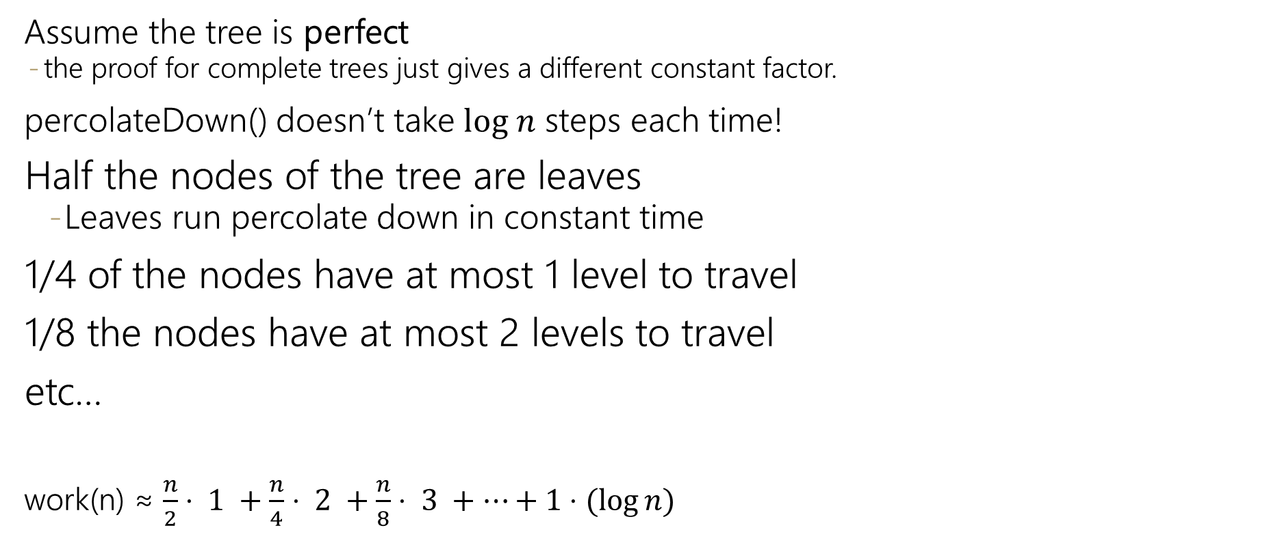
Is It Really Faster?
Assume the tree is perfect
  the proof for complete trees just gives a different constant factor.
percolateDown() doesn’t take $log n$ steps each time!
Half the nodes of the tree are leaves
    Leaves run percolate down in constant time
1/4 of the nodes have at most 1 level to travel
1/8 the nodes have at most 2 levels to travel
etc…
work(n) ≈ $\frac{n}{2}⋅ 1 +\frac{n}{4}⋅ 2 +\frac{n}{8}⋅ 3 +⋯+1⋅(\log{n})$

Slide 41


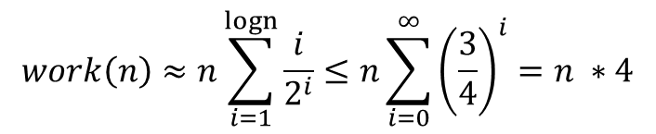
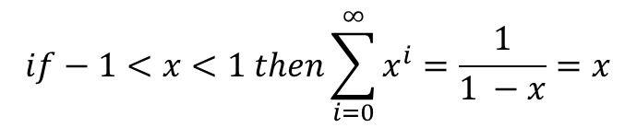


Closed form Floyd’s buildHeap
$\text{n}\text{/2⋅ 1 +}\text{n}\text{/4⋅ 2 +}\text{n}\text{/8⋅ 3 +⋯+1⋅(}\text{log} \text{n}\text{)}$
factor out n
work(n) ≈$n\left(\frac{1}{2}+\frac{2}{4}+\frac{3}{8}+⋯+\frac{\log{n}}{n}\right)$
find a pattern -> powers of 2
work(n) ≈ $n\left(\frac{1}{2^{1}}+\frac{2}{2^{2}}+\frac{3}{2^{3}}+⋯+\frac{\log{n}}{2^{\log{n}}}\right)$
Summation!
$$work\left(n\right)≈n\sum_{i=1}^{?}{\frac{i}{2^{i}}}$$
? = upper limit should give last term
We don’t have a summation for this! Let’s make it look more like a summation we do know.
Infinite geometric series
$$if−1<x<1 then\sum_{i=0}^{∞}{x^{i}}=\frac{1}{1 −x}=x$$
$$work\left(n\right)≈n\sum_{i=1}^{logn}{\frac{i}{2^{i}}≤n\sum_{i=0}^{∞}{{\left(\frac{3}{4}\right)}^{i}=n ∗4}}$$
$$work\left(n\right)≤n\sum_{i=1}^{logn}{\frac{{\left(\frac{3}{2}\right)}^{i}}{2^{i}}}$$
Floyd’s buildHeap runs in O(n) time!
Notes:
Because $\frac{1}{2}$ the nodes are leaves, design algorithms that do less work closer to the bottom!
More careful analysis can reveal tighter bounds
Math strategy: rather than show a <= b directly, it can be simpler to show a <= t then t<= b (a la finding c and n₀)

Slide 42
Floyd’s BuildHeap
Ok, it’s really faster.
But can we make it work?
It’s not clear what order to call the percolateDown’s in.
Should we start at the top or bottom? Will one percolateDown on each element be enough?

Slide 43
Floyd’s buildHeap algorithm
Build a tree with the values:
12, 5, 11, 3, 10, 2, 9, 4, 8, 15, 7, 6
12
Add all values to back of array
percolateDown(parent) starting at last index
5
11
3
10
2
9
4
8
15
7
6
0 | 1 | 2 | 3 | 4 | 5 | 6 | 7 | 8 | 9 | 10 | 11 | 12 | 13
12
5
11
3
10
2
9
4
8
15
7
6

Slide 44
Floyd’s buildHeap algorithm
Build a tree with the values:
12, 5, 11, 3, 10, 2, 9, 4, 8, 15, 7, 6
12
Add all values to back of array
percolateDown(parent) starting at last index
  percolateDown level 4
  percolateDown level 3
5
11
7
9
3
10
2
4
8
15
7
6
10
0 | 1 | 2 | 3 | 4 | 5 | 6 | 7 | 8 | 9 | 10 | 11 | 12 | 13
12
5
11
3
10
2
9
4
8
15
7
6

Slide 45
Floyd’s buildHeap algorithm
Build a tree with the values:
12, 5, 11, 3, 10, 2, 9, 4, 8, 15, 7, 6
12
Add all values to back of array
percolateDown(parent) starting at last index
  percolateDown level 4
  percolateDown level 3
  percolateDown level 2
3
5
11
2
7
6
9
5
10
2
3
11
keep percolating down
like normal here and swap 5 and 4
15
7
11
4
8
10
6
0 | 1 | 2 | 3 | 4 | 5 | 6 | 7 | 8 | 9 | 10 | 11 | 12 | 13
12
5
11
3
7
2
9
4
8
15
10
6

Slide 46
Floyd’s buildHeap algorithm
Build a tree with the values:
12, 5, 11, 3, 10, 2, 9, 4, 8, 15, 7, 6
2
12
Add all values to back of array
percolateDown(parent) starting at last index
  percolateDown level 4
  percolateDown level 3
  percolateDown level 2
  percolateDown level 1
3
5
11
2
12
7
9
4
10
2
3
6
5
8
15
7
6
10
11
0 | 1 | 2 | 3 | 4 | 5 | 6 | 7 | 8 | 9 | 10 | 11 | 12 | 13
12
3
2
4
7
6
9
5
8
15
10
11

Slide 47
Floyd’s buildHeap algorithm
Build a tree with the values:
12, 5, 11, 3, 10, 2, 9, 4, 8, 15, 7, 6
2
12
Add all values to back of array
percolateDown(parent) starting at last index
  percolateDown level 4
  percolateDown level 3
  percolateDown level 2
  percolateDown level 1
3
5
2
11
6
7
9
4
10
2
3
6
11
5
8
15
7
6
10
11
12
0 | 1 | 2 | 3 | 4 | 5 | 6 | 7 | 8 | 9 | 10 | 11 | 12 | 13
2
3
6
4
7
11
9
5
8
15
10
12

Slide 48
Even More Operations
These operations will be useful in a few weeks…
IncreaseKey(element,priority) Given an element of the heap and a new, larger priority, update that object’s priority.
DecreaseKey(element,priority) Given an element of the heap and a new, smaller priority, update that object’s priority.
Delete(element) Given an element of the heap, remove that element.
Should just be going to the right spot and percolating…
Going to the right spot is the tricky part.
In the programming projects, you’ll use a dictionary to find an element quickly.

