Slide 1
Lecture 11: Self Balancing Trees
CSE 373: Data Structures and Algorithms

Slide 2
Administrivia
Midterm Assessment
  Goes live Friday 8:30am PDT on Canvas
  Due Sunday 8:30am PDT (NO LATE ASSIGNMENTS ACCEPTED)
  Logistics
    Individual assignment
    Open notes
    Piazza going “private” for 48 hours
    TAs won’t be able to answer questions about exam, section problems or exercises for 48 hours
    Kasey & Zach will be available to answer questions – zoom call during PDT business hours Friday & Saturday
Project 2 due Wednesday April 29th
Exercise 2 due Friday April 24th
Seriously

Slide 3
Questions

Slide 4
AVL Trees
AVL Trees must satisfy the following properties:
  binary trees: all nodes must have between 0 and 2 children
  binary search tree: for all nodes, all keys in the left subtree must be smaller and all keys in the right subtree must be larger than the root node
  balanced: for all nodes, there can be no more than a difference of 1 in the height of the left subtree from the right. Math.abs(height(left subtree) – height(right subtree)) ≤ 1
  AVL stands for Adelson-Velsky and Landis (the inventors of the data structure)

Slide 5
Measuring Balance
Measuring balance:
For each node, compare the heights of its two sub trees
Balanced when the difference in height between sub trees is no greater than 1
8
10
8
7
7
9
15
Balanced
7
Balanced
Balanced
12
18
Unbalanced

Slide 6
Is this a valid AVL tree?
7
Is it…
Binary
BST
Balanced?
yes
yes
4
10
yes
3
5
9
12
2
6
8
11
13
14

Slide 7
Is this a valid AVL tree?
2 Minutes
6
Is it…
Binary
BST
Balanced?
yes
yes
2
8
no
Height = 0
Height = 2
1
4
7
12
3
5
10
13
9
11

Slide 8
Insertion
What happens if when we do an insertion, we break the AVL condition?
1
2
2
1
3
3
The AVL rebalances itself!
AVL are a type of “Self Balancing Tree”

Slide 9
Left Rotation
Rest of the tree
Rest of the tree
BALANCED
Right subtree is 1 longer
UNBALANCED
Right subtree is 2 longer
y
x
x
y
z
A
A
B
z
B
C
D
C
D

Slide 10
4
2
7
1
3
6
9
5
8
10
11

Slide 11
4
2
7
1
3
6
9
5
8
10
11

Slide 12
Right rotation
3
2
2
1
3
1
Just like a left rotation, just reflected.

Slide 13
It Gets More Complicated
There’s a “kink” in the tree where the insertion happened.
1
1
2
3
2
1
3
2
3
Now do a left rotation.
Can’t do a left rotation
Do a “right” rotation around 3 first.

Slide 14
Right Left Rotation
Rest of the tree
Rest of the tree
BALANCED
Right subtree is 1 longer
UNBALANCED
Right subtree is 2 longer
y
x
Left subtree is
1 longer
x
z
z
A
A
B
y
D
C
D
B
C

Slide 15
AVL Example: 8,9,10,12,11
8
9
10
Notes:
This is the line case.

Slide 16
AVL Example: 8,9,10,12,11
8
9
10
Notes:
Do a left rotation to correct

Slide 17
AVL Example: 8,9,10,12,11
9
8
10
12
11
Notes:
This is the kink case

Slide 18
AVL Example: 8,9,10,12,11
9
8
10
12
11
Notes:
Do a right rotation to get into a line case

Slide 19
AVL Example: 8,9,10,12,11
9
8
10
11
12
Notes:
Now do a left rotation to re-balance the line!

Slide 20
Two AVL Cases
Line Case
Solve with 1 rotation
Kink Case
Solve with 2 rotations
3
1
1
3
2
2
3
1
1
3
2
2
Rotate Right
Parent’s left becomes child’s right
Child’s right becomes its parent
Rotate Left
Parent’s right becomes child’s left
Child’s left becomes its parent
Right Kink Resolution
Rotate subtree left
Rotate root tree right
Left Kink Resolution
Rotate subtree right
Rotate root tree left

Slide 21
How Long Does Rebalancing Take?
Assume we store in each node the height of its subtree.
How do we find an unbalanced node?
  Just go back up the tree from where we inserted.
How many rotations might we have to do?
  Just a single or double rotation on the lowest unbalanced node.
  A rotation will cause the subtree rooted where the rotation happens to have the same height it had before insertion
  log(n) time to traverse to a leaf of the tree
  log(n) time to find the imbalanced node
  constant time to do the rotation(s)
  Theta(log(n)) time for put (the worst case for all interesting + common AVL methods (get/containsKey/put is logarithmic time)

Slide 22
Deletion
There is a similar set of rotations that will always let you rebalance an AVL tree after a deletion.
The textbook (or Wikipedia) can tell you more.
We won’t test you on deletions but here’s a high-level summary about them:
  Deletion is similar to insertion.
  It takes $Θ(\log{n)}$time on a dictionary with $n$ elements.
  We won’t ask you to perform a deletion.

Slide 23
Lots of cool Self-Balancing BSTs out there!
Popular self-balancing BSTs include:
AVL tree
Splay tree
2-3 tree
AA tree
Red-black tree
Scapegoat tree
Treap
(Not covered in this class, but several are in the textbook and all of them are online!)
(From https://en.wikipedia.org/wiki/Self-balancing_binary_search_tree#Implementations)

Slide 24
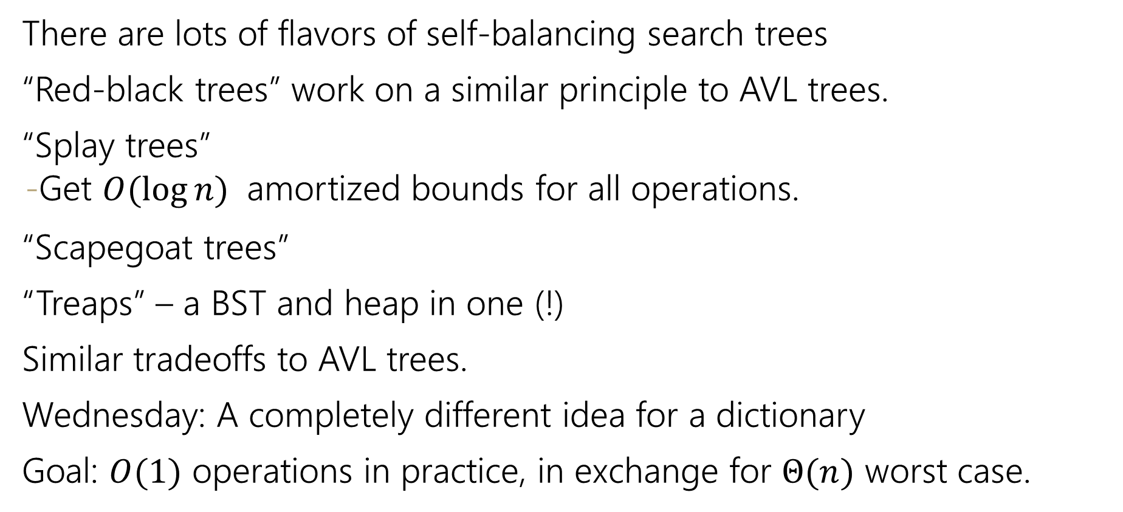
Aside: Other Self-Balancing Trees
There are lots of flavors of self-balancing search trees
“Red-black trees” work on a similar principle to AVL trees.
“Splay trees”
  Get $O(\log{n)}$ amortized bounds for all operations.
“Scapegoat trees”
“Treaps” – a BST and heap in one (!)
Similar tradeoffs to AVL trees.
Wednesday: A completely different idea for a dictionary
Goal: $O(1)$ operations in practice, in exchange for $Θ(n)$ worst case.

Slide 25
Questions

Slide 26
Your toolbox so far…
ADT
  List – flexibility, easy movement of elements within structure
  Stack – optimized for first in last out ordering
  Queue – optimized for first in first out ordering
  Dictionary (Map) – stores two pieces of data at each entry
Data Structure Implementation
  Array – easy look up, hard to rearrange
  Linked Nodes – hard to look up, easy to rearrange
  Hash Table – constant time look up, no ordering of data
  BST – efficient look up, possibility of bad worst case
  AVL Tree – efficient look up, protects against bad worst case, hard to implement
<- It’s all about data baby!
SUPER common in comp sci
- Databases
- Network router tables
- Compilers and Interpreters

Slide 27
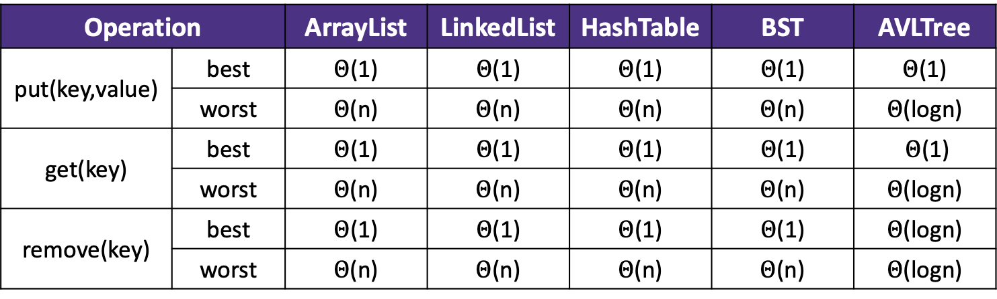
Review: Dictionaries
Dictionary ADT
Why are we so obsessed with Dictionaries?
state
When dealing with data:
  Adding data to your collection
  Getting data out of your collection
  Rearranging data in your collection
Set of items & keys
Count of items
behavior
put(key, item) add item to collection indexed with key
get(key) return item associated with key
containsKey(key) return if key already in use
remove(key) remove item and associated key
size() return count of items
Operation |  | ArrayList | LinkedList | HashTable | BST | AVLTree
put(key,value) | best | $Θ$(1) | $Θ$(1) | $Θ$(1) | $Θ$(1) | $Θ$(1)
 | worst | $Θ$(n) | $Θ$(n) | $Θ$(n) | $Θ$(n) | $Θ$(logn)
get(key) | best | $Θ$(1) | $Θ$(1) | $Θ$(1) | $Θ$(1) | $Θ$(1)
 | worst | $Θ$(n) | $Θ$(n) | $Θ$(n) | $Θ$(n) | $Θ$(logn)
remove(key) | best | $Θ$(1) | $Θ$(1) | $Θ$(1) | $Θ$(1) | $Θ$(logn)
 | worst | $Θ$(n) | $Θ$(n) | $Θ$(n) | $Θ$(n) | $Θ$(logn)

Slide 28
Design Decisions
Before coding can begin engineers must carefully consider the design of their code will organize and manage data
Things to consider:
What functionality is needed?
  What operations need to be supported?
  Which operations should be prioritized?
What type of data will you have?
  What are the relationships within the data?
  How much data will you have?
  Will your data set grow?
  Will your data set shrink?
How do you think things will play out?
  How likely are best cases?
  How likely are worst cases?

Slide 29
Example: Class Gradebook
pollev.com/cse373activity
What operations do you think the
grade book needs to support?
Please upvote which ones should be prioritized
You have been asked to create a new system for organizing students in a course and their accompanying grades
What functionality is needed?
  What operations need to be supported?
What type of data will you have?
  What are the relationships within the data?
  How much data will you have?
  Will your data set grow?
  Will your data set shrink?
How do you think things will play out?
  How likely are best cases?
  How likely are worst cases?
Add students to course
Organize students by name, keep grades in time order…
Add grade to student’s record
Update grade already in student’s record
A couple hundred students, < 20 grades per student
Remove student from course
A lot at the beginning,
Not much after that
Check if student is in course
Find specific grade for student
  Which operations should be prioritized?
Lots of add and drops?
Lots of grade updates?
Students with similar identifiers?

Slide 30
Example: Class Gradebook
pollev.com/cse373activity
Which data structure is the best fit to store the dictionary of students and their grades? Please upvote which you think is optimal
What data should we use to identify students? (keys)
  Student IDs – unique to each student, no confusion (or collisions)
  Names – easy to use, support easy to produce sorted by name
How should we store each student’s grades? (values)
  Array List – easy to access, keeps order of assignments
  Hash Table – super efficient access, no order maintained
Which data structure is the best fit to store students and their grades?
  Hash Table – student IDs as keys will make access very efficient
  AVL Tree - student names as keys will maintain alphabetical order

Slide 31
Practice: Music Storage
pollev.com/cse373activity
What operations do you think the
music system needs to support?
Please upvote which ones should be prioritized
You have been asked to create a new system for organizing songs in a music service. For each song you need to store the artist and how many plays that song has.
What functionality is needed?
  What operations need to be supported?
  Which operations should be prioritized?
What type of data will you have?
  What are the relationships within the data?
  How much data will you have?
  Will your data set grow?
  Will your data set shrink?
How do you think things will play out?
  How likely are best cases?
  How likely are worst cases?
Update number of plays for a song
Add a new song to an artist’s collection
Add a new artist and their songs to the service
Find an artist’s most popular song
Find service’s most popular artist
more…
Artists need to be associated with their songs,
songs need t be associated with their play counts
Play counts will get updated a lot
New songs will get added regularly
Some artists and songs will need to be accessed a lot more than others
Artist and song names can be very similar

Slide 32
Practice: Music Storage
pollev.com/cse373activity
Which data structure is the best fit to store the artists with their associated songs & play counts? Please upvote which you think is optimal
How should we store songs and their play counts?
Hash Table – song titles as keys, play count as values, quick access for updates
Array List – song titles as keys, play counts as values, maintain order of addition to system
How should we store artists with their associated songs?
Hash Table – artist as key,
Hash Table of their (songs, play counts) as values
AVL Tree of their songs as values
AVL Tree – artists as key, hash tables of songs and counts as values

