Slide 1
Lecture 10: BSTs and AVL Trees
CSE 373: Data Structures and Algorithms

Slide 2
Administrivia
Due Dates
  Exercise 2 – Due Friday 4/24
  Project 2 – Due Wednesday 4/29
    Plenty of time to find a partner still! Piazza, slack, section
      You’ll DEFINITELY want a partner by the final assignment
Midterm 1
  Lots of announcements- check course web page
    Full 48 hour turn around time
    Class is no longer curved (more details coming soon, see Friday’s lecture for current details)
  Practice quiz live on canvas
Asks
  Please fill out online logistics survey, extra credit!

Slide 3
Roadmap
Binary Trees
Binary Search Trees, invariants
  runtimes
AVL Trees, invariants

Slide 4
Dictionaries (aka Maps)
Every Programmer’s Best Friend
You’ll probably use one in almost every programming project.
  Because it’s hard to make a big project without needing one sooner or later.
// two types of Map implementations supposedly covered in CSE 143
Map<String, Integer> map1 = new HashMap<>();
Map<String, String> map2 = new TreeMap<>();
In-practice TreeMap is generally considered slower than HashMap, but it actually avoids the linear time worst-case HashMap runs into. It also fits this specific use case when you want to have your keys be continually sorted, and would generally be faster/easier in such a situation.
Reminder: There are always multiple tools for a given situation and designing algorithms and code is all about making design decisions and evaluating the tradeoffs!

Slide 5
Binary Trees
A tree is a collection of nodes
  Each node has at most 1 parent and anywhere from 0 to 2 children
  pretty similar to node based structures we’ve seen before (linked-lists)
  public class Node<K> {
  K data;
  Node<K> left;
  Node<K> right;
  }
Root node: the single node with no parent, “top” of the tree. Often called the ‘overallRoot’
Leaf node: a node with no children
Subtree: a node and all it descendants
Height: the number of edges contained in the longest path from root node to some leaf node
1
2
5
3
6
7
4
8

Slide 6
Tree Height
2 Minutes
What is the height (the number of edges contained in the longest path from root node to some leaf node ) of the following binary trees?
overallRoot
overallRoot
overallRoot
1
7
null
2
5
7
Height = 2
Height = 0
Height = -1 or NA

Slide 7
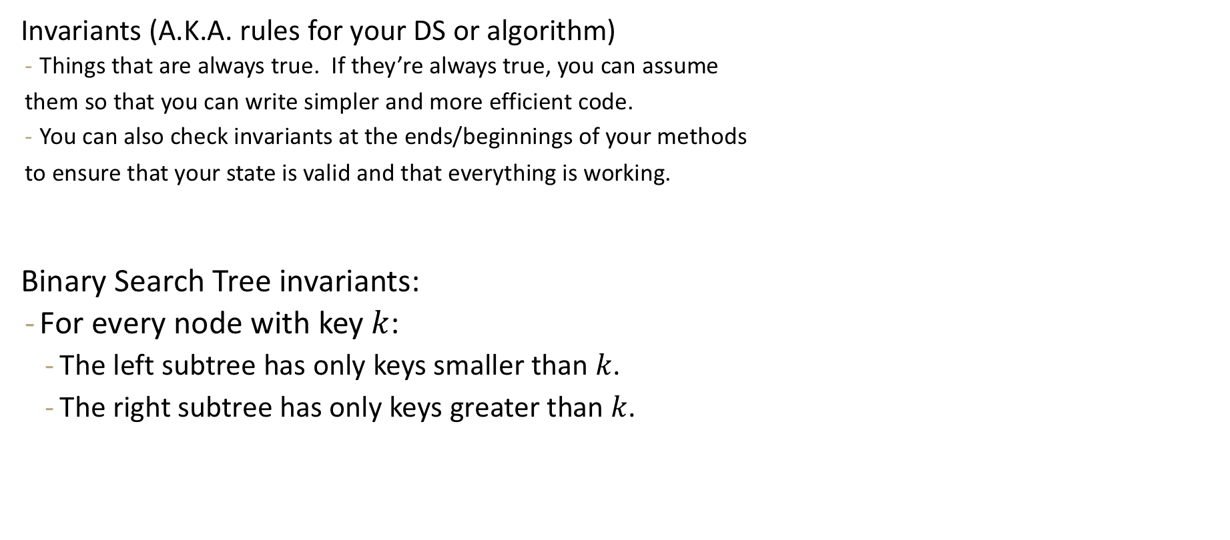
Binary Search Tree (BST)
10
Invariants (A.K.A. rules for your DS or algorithm)
  Things that are always true. If they’re always true, you can assume
  them so that you can write simpler and more efficient code.
  You can also check invariants at the ends/beginnings of your methods
  to ensure that your state is valid and that everything is working.
Binary Search Tree invariants:
  For every node with key $k$:
    The left subtree has only keys smaller than $k$.
    The right subtree has only keys greater than $k$.
8
32
2
9
11
50
5
38

Slide 8
a note about keys/maps
In reality, just like with HashMap all the elements need to store both the key and the value as a pair. So the node class would just have an extra field to store both the key and the value instead of just one piece of data.
  public class Node<K, V> {
  K key;
  V value;
  Node<K, V> left;
  Node<K, V> right;
  }
For simplicity we’re just going to show the keys, since that’s what will determine the sorted-ness and how the elements will interact with each other. This is just like in hash map where the keys determine where the elements go (we hash the keys and not the values).

Slide 9
Binary Trees vs Binary Search Trees: containsKey(2)
32
10
11
9
8
32
50
38
8
2
2
9
11
50
5
10
5
38

Slide 10
Binary Trees vs Binary Search Trees: containsKey(2)
public boolean containsKeyBT(node, key) {
if (node == null) {
return false;
} else if (node.key == key) {
return true;
} else {
return containsKeyBT(node.left) ||
containsKeyBT(node.right);
}
}
public boolean containsKeyBST(node, key) {
if (node == null) {
return false;
} else if (node.key == key) {
return true;
} else {
if (key <= node.key) {
return containsKeyBST(node.left);
} else {
return containsKeyBST(node.right);
}
}
}
8
4
12
2
6
10
14
1
3
5
7
9
11
13
15

Slide 11
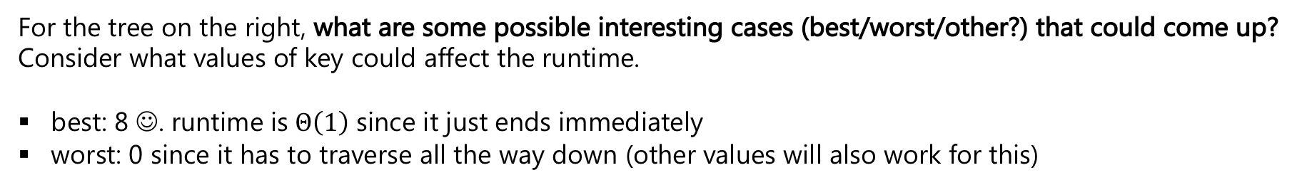

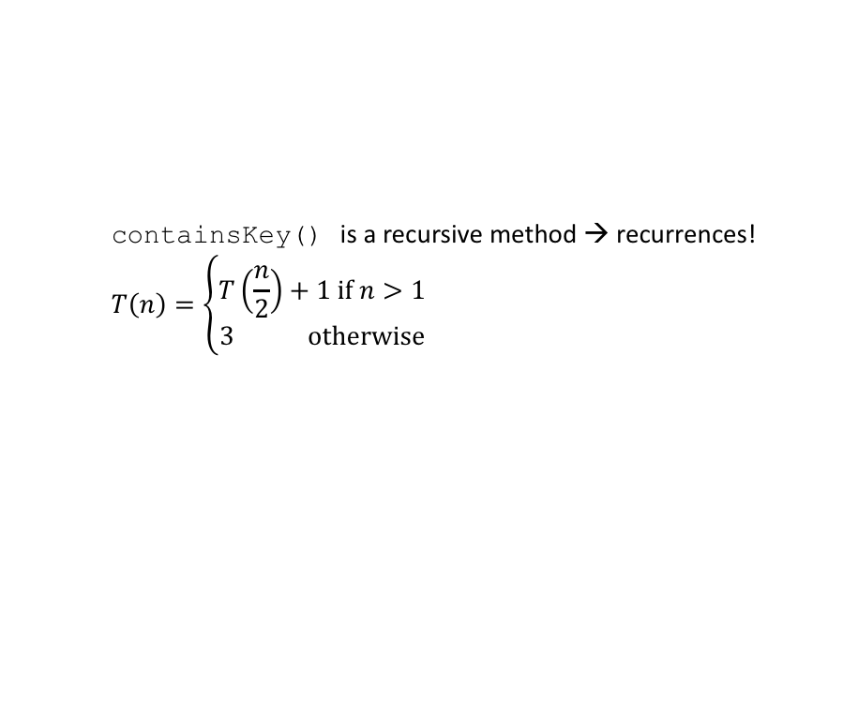
BST containsKey runtime
8
public boolean containsKeyBST(node, key) {
if (node == null) {
return false;
} else if (node.key == key) {
return true;
} else {
if (key <= node.key) {
return containsKeyBST(node.left);
} else {
return containsKeyBST(node.right);
}
}
}
4
12
2
6
10
14
1
3
5
7
9
11
13
15
For the tree on the right, what are some possible interesting cases (best/worst/other?) that could come up? Consider what values of key could affect the runtime.
best: 8 ☺. runtime is$Θ\left(1\right)$ since it just ends immediately
worst: 0 since it has to traverse all the way down (other values will also work for this)
containsKey() is a recursive method → recurrences!
$$T\left(n\right)=\left\{\begin{aligned}T\left(\frac{n}{2}\right)+1 if n>1 \\ 3 otherwise\end{aligned}\right.$$
$$T\left(n\right)=Θ(\log{n)}$$
Notes:
Can see constant work / no loops or anything in the recursive case – the only runtime constraint is really how many times does this actually recurse? For writing the recurrence, how much does the input get smaller on each recursive call?

Slide 12
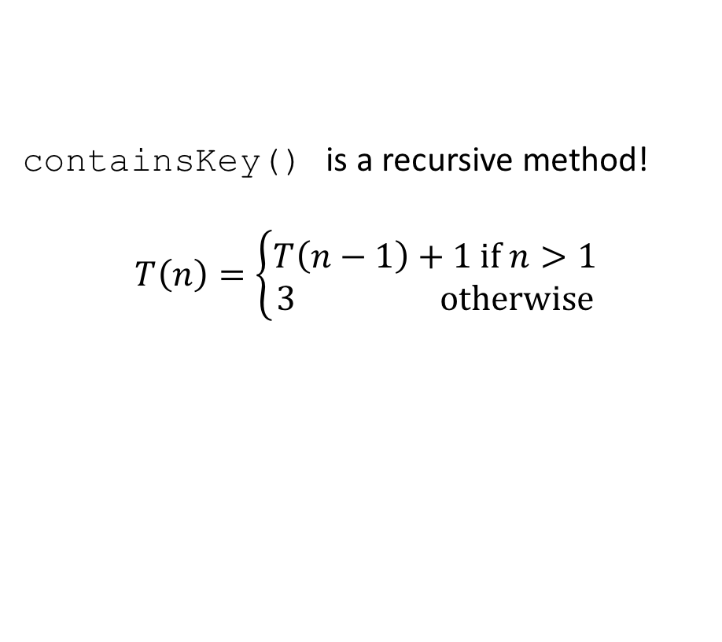


Is it possible to do worse than $Θ(\log{n)}$? 😈
We only considered changing the key parameter for that one particular BST in our last thought exercise, but what about if we consider the different possible arrangements of the BST as well?
Let’s try to come up with a valid BST with the numbers 1 through 15 (same as previous tree) and key combination that result in a worse runtime for containsKey.
containsKey() is a recursive method!
$$T\left(n\right)=\left\{\begin{aligned}T\left(n−1\right)+1 if n>1 \\ 3 otherwise\end{aligned}\right.$$
1
containsKey(16)
2
3
$$T\left(n\right)=Θ(n)$$
4
…
15

Slide 13
BST different states
Two different extreme states our BST could be in (there’s in-between, but it’s easiest to focus on the extremes as a starting point). Try containsKey(15) to see what the difference is.
Perfectly balanced – for every node, its descendants are split evenly between left and right subtrees.
Degenerate – for every node, all of its descendants are in the right subtree.
1
8
2
4
12
3
2
6
10
14
4
1
3
5
7
…
9
11
13
15
15

Slide 14
Questions break -- Anything y’all want to review / restate?
To gauge how long we should spend on questions,
plz do thumbs up / down for how you’re feeling
about the content we’ve covered so far
(clapping hands for neutral)
So far:
Binary Trees, definitions
Binary Search Tree, invariants
Best/Worst case runtimes for BTs and BSTs
  where the key is located
  how the tree is structured

Slide 15
How are we going to make this simpler / more efficient? Let’s enforce some invariants!
Observation: What was important was actually the height of the tree.
  Height: number of edges on the longest path from the root to a leaf.
That’s the number of recursive calls we’re going to make
  And each recursive call does a constant number of operations.
The BST invariant makes it easy to know where to find a key
But it doesn’t force the tree to be short.
Let’s add an invariant that forces the height to be short!

Slide 16
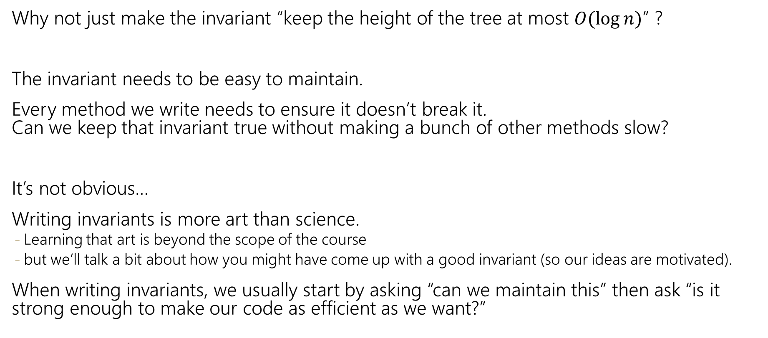
Invariants
Why not just make the invariant “keep the height of the tree at most $O(\log{n})$” ?
The invariant needs to be easy to maintain.
Every method we write needs to ensure it doesn’t break it.
Can we keep that invariant true without making a bunch of other methods slow?
It’s not obvious…
Writing invariants is more art than science.
  Learning that art is beyond the scope of the course
  but we’ll talk a bit about how you might have come up with a good invariant (so our ideas are motivated).
When writing invariants, we usually start by asking “can we maintain this” then ask “is it strong enough to make our code as efficient as we want?”

Slide 17

Avoiding $Θ\left(n\right)$ behavior
Here are some invariants you might try.
Can you maintain them? If not what can go wrong?
Do you think they are strong enough to make containsKey efficient?
Try to come up with BSTs that show these rules aren’t useful / too strict.
Root Balanced: The root must have the same number of nodes in its left and right subtrees
Recursively Balanced: Every node must have the same number of nodes in its left and right subtrees.
Root Height Balanced: The left and right subtrees of the root must have the same height.

Slide 18
Take 1 minute to consider this question and then we’ll move to breakouts to discuss! (See chat for tips on moving discussion along + general reminders. Note that you’ll be prepping now so you have stuff to say / questions to ask each other. We’re still experimenting w/ breakouts / trying more strategies with them to make them successful, thanks for your patience.)
Here are some invariants you might try.
Can you maintain them? If not what can go wrong?
Do you think they are strong enough to make containsKey efficient?
Try to come up with BSTs that show these rules aren’t useful / too strict.
Root Balanced: The root must have the same number of nodes in its left and right subtrees
Recursively Balanced: Every node must have the same number of nodes in its left and right subtrees.
Root Height Balanced: The left and right subtrees of the root must have the same height.

Slide 19
too weak
Root Balanced: The root must have the same number of nodes in its left and right subtrees

Slide 20
too strong
Recursively Balanced: Every node must have the same number of nodes in its left and right subtrees.

Slide 21
too weak
Root Height Balanced: The left and right subtrees of the root must have the same height.

Slide 22
Invariant Lessons
Need requirements everywhere, not just at root
Forcing things to be exactly equal is too difficult to maintain.

Slide 23
Roadmap
Binary Trees
Binary Search Trees, invariants
  runtimes
AVL Trees, invariants

Slide 24
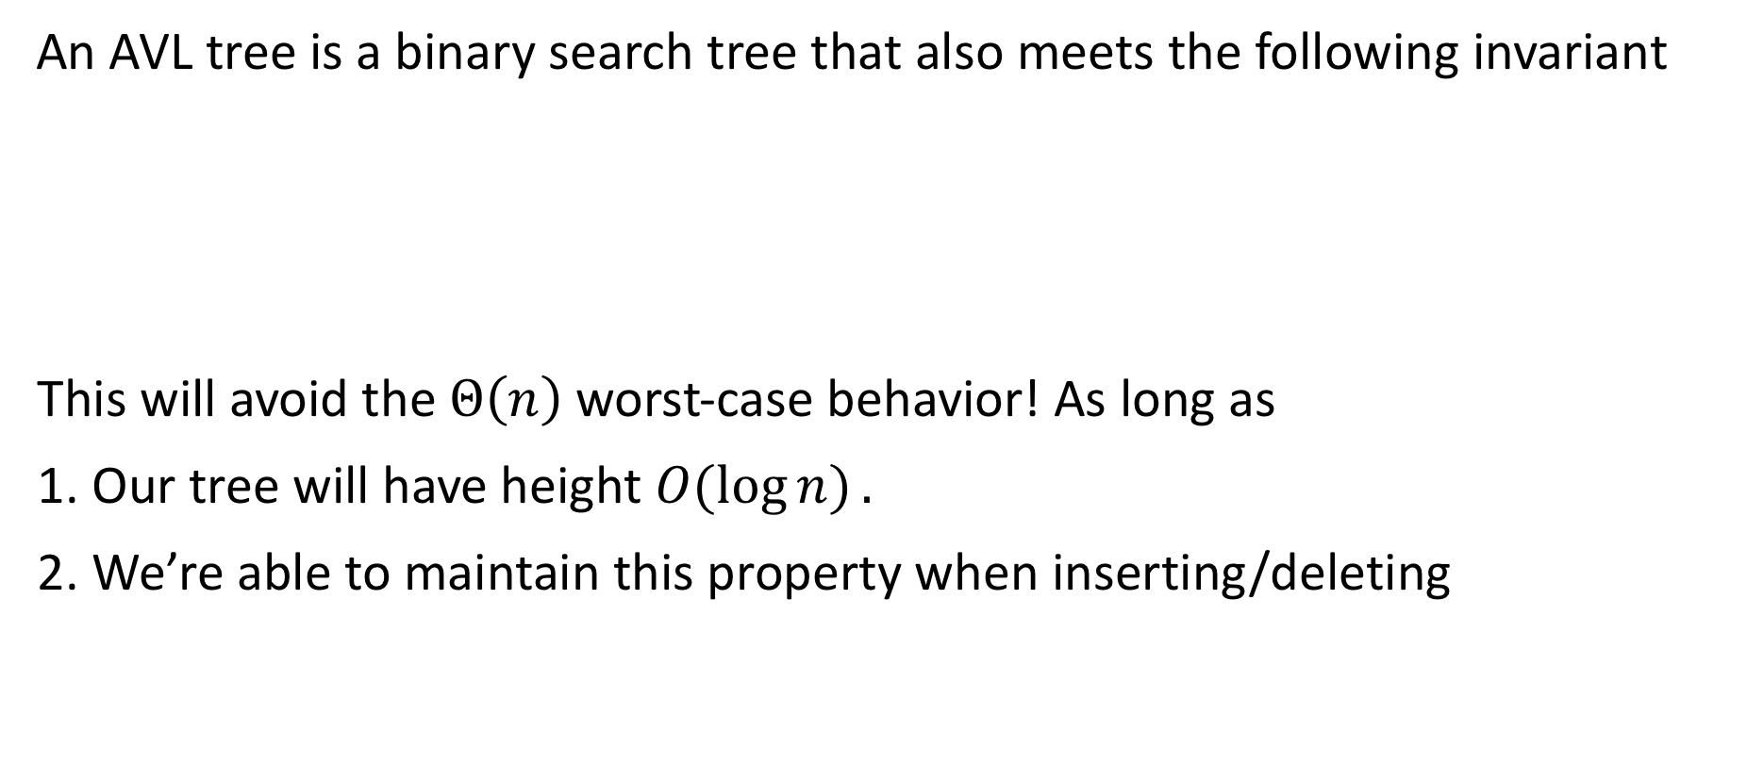
Avoiding the Degenerate Tree
An AVL tree is a binary search tree that also meets the following invariant
This will avoid the $Θ\left(n\right)$ worst-case behavior! As long as
1. Our tree will have height $O(\log{n)}.$
2. We’re able to maintain this property when inserting/deleting
AVL invariant: For every node, the height of its left subtree and right subtree differ by at most 1.

Slide 25
Practice w AVL invariants
AVL invariant: For every node, the height of its left subtree and right subtree differ by at most 1.
4
Is this a valid AVL tree?
3
7
5
9
2
6
8
10

Slide 26
Are These AVL Trees?
6
4
3
7
3
7
2
9
2
9
4
6
5
8
10
8
10
5

Slide 27
Insertion
What happens if when we do an insertion, we break the AVL condition?
1
2
2
1
3
3

Slide 28
Left Rotation
Rest of the tree
Rest of the tree
BALANCED
Right subtree is 1 longer
UNBALANCED
Right subtree is 2 longer
y
x
x
y
z
A
A
B
z
B
C
D
C
D

Slide 29
4
2
7
1
3
6
9
5
8
10
11

Slide 30
4
2
7
1
3
6
9
5
8
10
11

Slide 31
4
2
7
1
3
6
9
5
8
10
11

Slide 32

Meme break (it’s from some marvel movie that I haven’t watched -- you’re not alone if you don’t get this reference)

Slide 33
Right rotation
3
2
2
1
3
1
Just like a left roation, just reflected.

Slide 34
It Gets More Complicated
There’s a “kink” in the tree where the insertion happened.
1
1
2
3
2
1
3
2
3
Now do a left rotation.
Can’t do a left rotation
Do a “right” rotation around 3 first.

Slide 35
Right Left Rotation
Rest of the tree
Rest of the tree
BALANCED
Right subtree is 1 longer
UNBALANCED
Right subtree is 2 longer
y
x
Left subtree is
1 longer
x
z
z
A
A
B
y
D
C
D
B
C

Slide 36
AVL Example: 8,9,10,12,11
8
9
10
Notes:
This is the line case.

Slide 37
AVL Example: 8,9,10,12,11
8
9
10
Notes:
Do a left rotation to correct

Slide 38
AVL Example: 8,9,10,12,11
9
8
10
12
11
Notes:
This is the kink case

Slide 39
AVL Example: 8,9,10,12,11
9
8
10
12
11
Notes:
Do a right rotation to get into a line case

Slide 40
AVL Example: 8,9,10,12,11
9
8
10
11
12
Notes:
Now do a left rotation to re-balance the line!

Slide 41
How Long Does Rebalancing Take?
Assume we store in each node the height of its subtree.
How do we find an unbalanced node?
How many rotations might we have to do?

Slide 42
How Long Does Rebalancing Take?
Assume we store in each node the height of its subtree.
How do we find an unbalanced node?
  Just go back up the tree from where we inserted.
How many rotations might we have to do?
  Just a single or double rotation on the lowest unbalanced node.
  A rotation will cause the subtree rooted where the rotation happens to have the same height it had before insertion
  log(n) time to traverse to a leaf of the tree
  log(n) time to find the imbalanced node
  constant time to do the rotation(s)
  Theta(log(n)) time for put (the worst case for all interesting + common AVL methods (get/containsKey/put is logarithmic time)

Slide 43
4
2
7
1
3
6
9
5
8
10
11

Slide 44
4
2
7
1
3
6
9
5
8
10
11

Slide 45
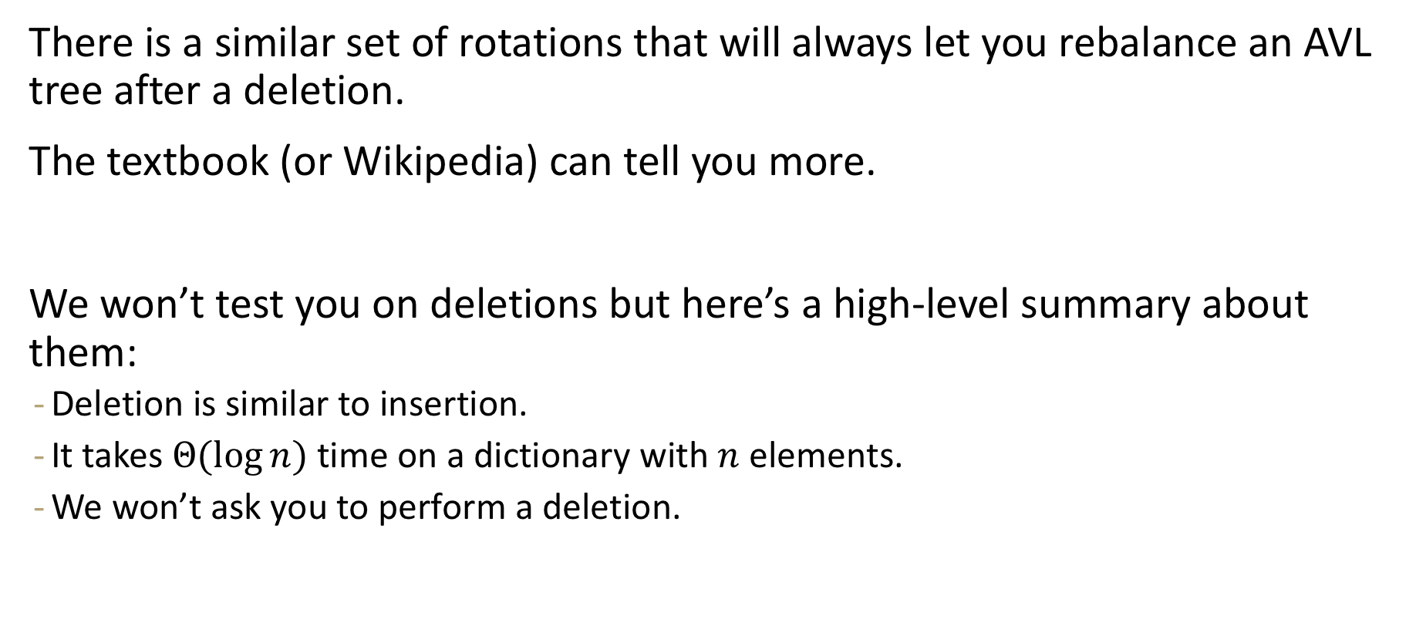
Deletion
There is a similar set of rotations that will always let you rebalance an AVL tree after a deletion.
The textbook (or Wikipedia) can tell you more.
We won’t test you on deletions but here’s a high-level summary about them:
  Deletion is similar to insertion.
  It takes $Θ(\log{n)}$time on a dictionary with $n$ elements.
  We won’t ask you to perform a deletion.

