Slide 1
Lecture 9: Administrivia and Hash maps with Open Addressing
CSE 373: Data Structures and Algorithms

Slide 2
Administrivia (there’s a lot today but not a full lecture’s worth of content today)
grade changes
midterm format
resources reminder/updates
please fill out online logistics survey - we heard you!

Slide 3
Grades
- People are stressed about their grades, about learning, cheating, curved classes, etc. so we’re going to make some changes to our grading policy, as we know this is a hard time for people:
- We’re going to look at past grade data and figure out some groupings so that we can give you some grade guarantees (AKA 90% is at least guaranteed some GPA)
- AKA this class will not be curved since if everyone does well percentage-wise everyone can all do well GPA wise
- if not enough people are doing as well percentage-wise as we expected when we set the grade guarantees, don’t worry -- we’ll adjust to make sure people get at least as good grades as normal quarters
- we’ll talk more about the guarantees next week (we haven’t decided them yet)

Slide 4
Exams (more like a weekend assessment now)
Extend turn around from 24 to 48 hours
  Out on Friday morning 8:30am pdt, due sunday morning 8:30am pdt
  NO LATE ASSESSMENTS ACCEPTED
  Previously: 2 hour time window from when you start to when it must be turned in
  You just have the full 48 hours
reminder:
- multiple versions of assessment (we’re going to make a bunch)
- should be done individually (you can do well solo, we believe in you)
- if other people do cheat (plz no), shouldn’t affect you bc of grade guarantees
- still done through canvas

Slide 5
What if something goes wrong and I can’t submit or…?
- during Saturday we’ll have a zoom call you can reach us at that we’ll try to just be in there chilling. Link TBD
- if you have bad internet connection and are worried about if something goes wrong, fill out this form and we can try to figure out another alternative method of communication.
  - https://forms.gle/tj626pRZVKWQ9fkx6

Slide 6
weekend assessment topics list
Things that could be on the exam
Code modeling (think lecture, exercise, section problems)
  Code → big theta runtime
  Case analysis
  Recursive code (code → recurrence, master theorem)
Asymptotic analysis (think lecture, section, exercise problems)
  Function -> big o/big theta/big omega
  Bounds for a given graph
Tree method (think section problems)
  Just till summation, we won’t ask you to simplify past that
AVL/BST invariants
  is this a BST/AVL?
Hashing
  Separate chaining mechanisms
  Open addressing mechanisms
Things not on the exams:
Simplifying summations
AVL tree rotations
Writing code
Programming projects knowledge (but prepare for this on the final)
Free response paragraph/sentence questions (we won’t ask you to explain best/worst case in English)

Slide 7
Practice run through / resources
- most of the resources for the exam we’ve already released
- find section/lecture problems that are relevant to the topics list and do those
- check out the not-graded canvas quiz we’re going to publish later today that’ll show you a rough idea of the format / how all the math stuff will work

Slide 8
Resources updates/reminders
  optional pre-lecture readings (sorry they might not line up perfectly, from different quarters)
    going to post these tonight / over the weekend for next week
  draft slides which may have significant changes by actual lecture time, but will cover same topics
    going to post these tonight / over the weekend for next week (same as above)
  review videos
    see on calendar!
  night time section (6:30PM Thursdays) / evening office hours Monday/Tuesday (9pm PDT)
  Piazza/slack/discord – class size is an asset – we can help each other learn more effectively because we can share questions, knowledge, and tips :P

Slide 9
Other things that are useful to know
no more warm ups so we have more time for lecture - instead we will make sure the post lecture review questions are there for you
  (we know we’re behind on the solutions for Monday/posting Wednesday – Kasey and Zach have been managing this but busy with other logistical stuff and it’s fallen off – going to re-delegate to amazing TAs to help out so they should be up more consistently in the future.We’ll post all of the remaining post-lecture questions for MWF this week later today. Thank you so much for your patience.)
we will do a better job of pointing out important part of slides, but they will always have more content than we can speak to so they can be a "living textbook"
We’ll respond to more ideas/suggestions/thoughts in more time (keep an eye on Piazza), but are also waiting for more responses to come in. Thanks to everyone so far, we’re reading all of them and are seriously considering all the feedback and ideas. We appreciate your effort to make this a better experience for all of us.

Slide 10
What about non integer keys?
Hash function definition
A hash function is any function that can be used to map data of arbitrary size to fixed-size values.
Let’s use define another hash function to change stuff like Strings into ints!
Best practices for designing hash functions:
Avoid collisions
  The more collisions, the further we move away from O(1+$λ$)
  Produce a wide range of indices, and distribute evenly over them
Low computational costs
  Hash function is called every time we want to interact with the data

Slide 11
(Before we % by length, we have to convert the data into an int)
Implementation 1: Simple aspect of values
public int hashCode(String input) {
return input.length();
}
Implementation 2: More aspects of value
public int hashCode(String input) {
int output = 0;
for(char c : input) {
out += (int)c;
}
return output;
}
Implementation 3: Multiple aspects of value + math!
public int hashCode(String input) {
int output = 1;
for (char c : input) {
int nextPrime = getNextPrime();
out *= Math.pow(nextPrime, (int)c);
}
return Math.pow(nextPrime, input.length());
}
Pro: super fast
Con: lots of collisions!
Pro: still really fast
Con: some collisions
Pro: few collisions
Con: slow, gigantic integers

Slide 12
Good Hashing
The hash function of a HashDictionary gets called a LOT:
  When first inserting something into the map
  When checking if a key is already in the map
  When resizing and redistributing all values into new structure
This is why it is so important to have a “good” hash function. A good hash function is:
  Deterministic – same input should generate the same output
  Efficiency - it should take a reasonable amount o time
  Uniformity – inputs should be spread “evenly” over output range
public int hashFn(String s) {
return random.nextInt()
}
public int hashFn(String s) {
if (s.length() % 2 == 0) {
if (s.length(). % 2 == 0) {
return 17;
} else {
return 43;
}
}
}
public int hashFn(String s) {
int retVal = 0;
for (int I = 0; I < s.length(); i++) {
for (int j = 0; j < s.length(); j++) {
retVal += helperFun(s, I, j);
}
}
return retVal;
}
NOT deterministic
NOT nicely spread out
NOT efficient

Slide 13
Java’s hashCode (relevant for project)
Luckily, most of these design decisions have been made for us by smart people. All objects in java come with a `hashCode()` method that does some magic (see previous slide for the not-magic version) to turn any object type (like String, ArrayList, Point, Scanner) into an integer. These hashCodes are designed to distribute pretty evenly / not have lots of collisions, so we use them as the starting point for determining the bucket index.
high level steps to figure out which bucket a key goes into
  call the key.hashCode() to get an int representation of the object
  % by the array table length to convert it to a valid index for your hash map

Slide 14

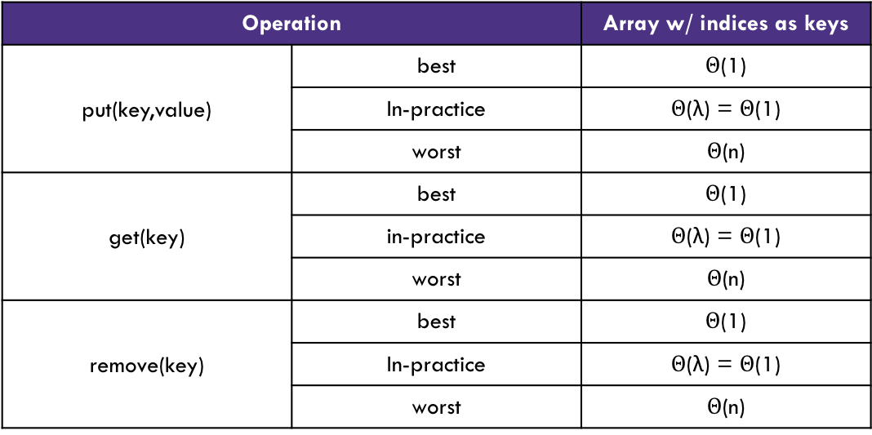
Review: Handling Collisions
Solution 1: Chaining
Each space holds a “bucket” that can store multiple values. Bucket is often implemented with a LinkedList
Operation |  | Array w/ indices as keys
put(key,value) | best | $Θ$(1)
 | In-practice | $Θ$(λ) = $Θ$(1)
 | worst | $Θ$(n)
get(key) | best | $Θ$(1)
 | in-practice | $Θ$(λ) = $Θ$(1)
 | worst | $Θ$(n)
remove(key) | best | $Θ$(1)
 | In-practice | $Θ$(λ) = $Θ$(1)
 | worst | $Θ$(n)
Average Case:
Depends on average number of elements per chain
Load Factor λ
If n is the total number of key-value pairs
Let c be the capacity of array
Load Factor λ = $\frac{n}{c}$

Slide 15
Handling Collisions
Solution 2: Open Addressing
Resolves collisions by choosing a different location to store a value if natural choice is already full.
Type 1: Linear Probing
If there is a collision, keep checking the next element until we find an open spot.
int findFinalLocation(Key s)
int naturalHash = this.getHash(s);
  int index = natrualHash % TableSize;
  while (index in use) {
  i++;
index = (naturalHash + i) % TableSize;
}
return index;

Slide 16
Linear Probing
Insert the following values into the Hash Table using a hashFunction of % table size and linear probing to resolve collisions
1, 5, 11, 7, 12, 17, 6, 25
0 | 1 | 2 | 3 | 4 | 5 | 6 | 7 | 8 | 9
6
17
1
12
25
7
11
5

Slide 17
Linear Probing
3 Minutes
Insert the following values into the Hash Table using a hashFunction of % table size and linear probing to resolve collisions
38, 19, 8, 109, 10
0 | 1 | 2 | 3 | 4 | 5 | 6 | 7 | 8 | 9
8
10
38
8
19
109
Problem:
  Linear probing causes clustering
  Clustering causes more looping when probing
Primary Clustering
When probing causes long chains of occupied slots within a hash table

Slide 18
Runtime
When is runtime good?
When we hit an empty slot
  (or an empty slot is a very short distance away)
When is runtime bad?
When we hit a “cluster”
Maximum Load Factor?
λ at most 1.0
When do we resize the array?
λ ≈ ½ is a good rule of thumb

Slide 19
Can we do better?
Clusters are caused by picking new space near natural index
Solution 2: Open Addressing
Type 2: Quadratic Probing
Instead of checking $i$ past the original location, check $i^{2}$ from the original location.
int findFinalLocation(Key s)
int naturalHash = this.getHash(s);
  int index = natrualHash % TableSize;
  while (index in use) {
  i++;
index = (naturalHash + i*i) % TableSize;
}
return index;

Slide 20
Quadratic Probing
Insert the following values into the Hash Table using a hashFunction of % table size and quadratic probing to resolve collisions
89, 18, 49, 58, 79, 27
0 | 1 | 2 | 3 | 4 | 5 | 6 | 7 | 8 | 9
58
79
27
18
49
89
(49 % 10 + 0 * 0) % 10 = 9
(49 % 10 + 1 * 1) % 10 = 0
(58 % 10 + 0 * 0) % 10 = 8
(58 % 10 + 1 * 1) % 10 = 9
(58 % 10 + 2 * 2) % 10 = 2
Now try to insert 9.
Uh-oh
Problems:
If λ≥ ½ we might never find an empty spot
  Infinite loop!
Can still get clusters
(79 % 10 + 0 * 0) % 10 = 9
(79 % 10 + 1 * 1) % 10 = 0
(79 % 10 + 2 * 2) % 10 = 3

Slide 21
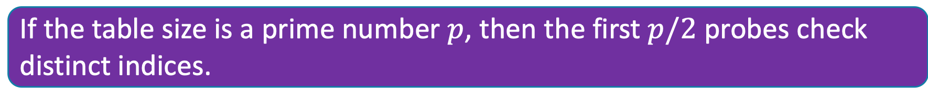
Quadratic Probing
There were empty spots. What gives?
Quadratic probing is not guaranteed to check every possible spot in the hash table.
The following is true:
Notice we have to assume $p$ is prime to get that guarantee.
If the table size is a prime number $p$, then the first $p/2$ probes check distinct indices.

Slide 22
Secondary Clustering
3 Minutes
Insert the following values into the Hash Table using a hashFunction of % table size and quadratic probing to resolve collisions
19, 39, 29, 9
0 | 1 | 2 | 3 | 4 | 5 | 6 | 7 | 8 | 9
39
29
9
19
Secondary Clustering
When using quadratic probing sometimes need to probe the same sequence of table cells, not necessarily next to one another

Slide 23
Probing
  h(k) = the natural hash
  h’(k, i) = resulting hash after probing
  i = iteration of the probe
  T = table size
Linear Probing:
h’(k, i) = (h(k) + i) % T
Quadratic Probing
h’(k, i) = (h(k) + i²) % T

Slide 24
Questions
Topics Covered:
Writing good hash functions
Open addressing to resolve collisions:
  Linear probing
  Quadratic probing

Slide 25
Double Hashing
Probing causes us to check the same indices over and over- can we check different ones instead?
Use a second hash function!
h’(k, i) = (h(k) + i * g(k)) % T
int findFinalLocation(Key s)
int naturalHash = this.getHash(s);
  int index = natrualHash % TableSize;
  while (index in use) {
  i++;
index = (naturalHash + i*jumpHash(s)) % TableSize;
}
return index;
<- Most effective if g(k) returns value relatively prime to table size

Slide 26
Second Hash Function
Effective if g(k) returns a value that is relatively prime to table size
  If T is a power of 2, make g(k) return an odd integer
  If T is a prime, make g(k) return anything except a multiple of the TableSize

Slide 27
Resizing: Open Addressing
How do we resize? Same as separate chaining
  Remake the table
  Evaluate the hash function over again.
  Re-insert.
When to resize?
  Depending on our load factor $λ$ AND our probing strategy.
  Hard Maximums:
    If $λ=1,$ put with a new key fails for linear probing.
    If $λ>1/2$ put with a new key might fail for quadratic probing, even with a prime tableSize
      And it might fail earlier with a non-prime size.
    If $λ=1$ put with a new key fails for double hashing
      And it might fail earlier if the second hash isn’t relatively prime with the tableSize

Slide 28

Running Times
What are the running times for:
insert
Best: $Θ(1)$
Worst: $Θ(n)$ (we have to make sure the key isn’t already in the bucket.)
find
Best: $Θ(1)$
Worst: $Θ O(n)$
delete
Best: $Θ(1)$
  Worst: $Θ(n)$

Slide 29

In-Practice
For open addressing:
We’ll assume you’ve set $λ$ appropriately, and that all the operations are $Θ\left(1\right).$
The actual dependence on $λ$ is complicated – see the textbook (or ask on piazza)
And the explanations are well-beyond the scope of this course.

Slide 30
Summary
1. Pick a hash function to:
  Avoid collisions
  Uniformly distribute data
  Reduce hash computational costs
2. Pick a collision strategy
  Chaining
    LinkedList
    AVL Tree
  Probing
    Linear
    Quadratic
    Double Hashing
No clustering
Potentially more “compact” (λ can be higher)
Managing clustering can be tricky
Less compact (keep λ < ½)
Array lookups tend to be a constant factor faster than traversing pointers

Slide 31
Summary
Separate Chaining
  Easy to implement
  Running times $O(1+λ)$ in practice
Open Addressing
  Uses less memory (usually).
  Various schemes:
  Linear Probing – easiest, but lots of clusters
  Quadratic Probing – middle ground, but need to be more careful about $λ$.
  Double Hashing – need a whole new hash function, but low chance of clustering.
Which you use depends on your application and what you’re worried about.

Slide 32
Extra optimizations
Idea 1: Take in better keys
  Really up to your client, but if you can control them, do!
Idea 2: Optimize the bucket
  Use an AVL tree instead of a Linked List
  Java starts off as a linked list then converts to AVL tree when buckets get large
Idea 3: Modify the array’s internal capacity
  When load factor gets too high, resize array
    Increase array size to next prime number that’s roughly double the array size
    Let the client fine-tune the $λ$ that causes you to resize

Slide 33
Other Hashing Applications
We use it for hash tables but there are lots of uses! Hashing is a really good way of taking arbitrary data and creating a succinct and unique summary of data.
Caching
  you’ve downloaded a large video file, You want to know if a new version is available, Rather than re-downloading the entire file, compare your file’s hash value with the server's hash value.
Fingerprinting
git hashes (“identification”)
  That crazy number that is attached to each of your commits
  SHA-1 hash incorporates the contents of your change, the name of the files and the lines of the files you changes
Ad Tracking
  track who has seen an ad if they saw it on a different device (if they saw it on their phone don’t want to show it on their laptop)
  https://panopticlick.eff.org will show you what is being hashed about you
YouTube Content ID
  Do two files contain the same thing? Copyright infringement
  Change the files a bit!
File Verification / Error Checking:
  compare the hash of a file instead of the file itself
  Find similar substrings in a large collection of strings – detecting plagiarism
Cryptography
Hashing also ”hides” the data by translating it, this can be used for security
  For password verification: Storing passwords in plaintext is insecure. So your passwords are stored as a hash
  Digital signatures

