Slide 1
Lecture 5: Case Analysis
CSE 373 – Data Structures and Algorithms

Slide 2
Warm Up!
$f(n)$ $∈$ $O(g\left(n\right))$ if there exist positive constants $c, n_{0}$ such that for all $n≥n_{0}$,
$$f\left(n\right)≤c⋅g\left(n\right)$$
Which of the following is in O(n²)? Ω(n²)? Θ(n²)?
Take 2 Minutes
Big-O
www.pollev.com/cse373activity for participating in our active learning questions.
https://www.pollev.com/cse373studentqs to ask your own questions
a.
$$f\left(n\right)=42$$
f(n) ∈ O(n²)
b.
$$f\left(n\right)=5n+100$$
$f(n)$ $∈ Ω(g\left(n\right))$ if there exist positive constants $c, n_{0}$ such that for all $n≥n_{0}$,
$$f\left(n\right)≥c⋅g\left(n\right)$$
Big-Omega
f(n) ∈ O(n²)
c.
$$f\left(n\right)=nlog2(3n)$$
f(n) ∈ O(n²)
d.
$$f\left(n\right)=4n^{2}−2n+10$$
$f(n)$ $∈$ $Θ(g\left(n\right))$ if
$f\left(n\right)$ is $O(g\left(n\right))$ and $f\left(n\right)$ is $Ω(g\left(n\right))$.
f(n) ∈ O(n²)
f(n) ∈ Ω(n²)
f(n) ∈ Θ(n²)
Big-Theta
e.
$$f\left(n\right)=2^{n}$$
f(n) ∈ Ω(n²)

Slide 3
Simplified, tight big-O
In this course, we’ll essentially use:
Polynomials ($n^{c}$ where $c$ is a constant: e.g. $n, n^{3}, \sqrt{n}, 1$)
Logarithms $\log{n}$
Exponents ($c^{n}$ where $c$ is a constant: e.g. $2^{n}, 3^{n}$)
Combinations of these (e.g. $\log\left(\log\left(n\right)\right)$, $n\log{n}, {\left(log\left(n\right)\right)}^{2}$)
For this course:
A “tight big-O” is the slowest growing function among those listed.
A “tight big-$Ω$” is the fastest growing function among those listed.
(A $Θ$ is always tight, because it’s an “equal to” statement)
A “simplified” big-O (or Omega or Theta)
Does not have any dominated terms.
Does not have any constant factors – just the combinations of those functions.

Slide 4
Administrivia
Project 0 due 11:59pm PST tonight
- Project 1 out by midnight tonight, due Wednesday April 15th
New post-lecture extra credit
Available on website before 6pm PST day of lecture
Closes 48 hours later
collaboration policy (please don’t share code with not-your-partner – but you can talk about it at a high level)
come to OH! We’re lonely and Piazza is getting filled with debugging questions that are easier to talk about in real-time.

Slide 5
Project notes
How to effectively work on partner projects:
Pair program! See the document on the webpage.
Two brains is better than one when debugging
We expect you to understand the full projects, not just half of the projects.
Meet in real-time with your partner (screen-share over a zoom call!).
Please don’t:
Come to office hours and say “my partner wrote this code, I don’t understand it. Please help me debug it.”
Just split the project in-half and each do half (or alternate projects)
Be mean to your partner. Working with someone else will probably take some patience but the result is usually awesome if we’re all respectful.

Slide 6
Questions

Slide 7
Case Analysis

Slide 8
Where we left off last time:
a piece of code
code modeling
a function modeling the runtime of a piece of code
big O runtime
big Omega runtime
big Theta runtime
asymptotic analysis
An example of the process
method1()
code modeling
f(n) =
5n +3
tight upper bound: O(n$)$
tight lower bound: $Ω$(n)
$Θ$(n)
Notes:
For a lot of code, your function is more normal / simple and so then there isn’t that much use for O / Omega Theta

Slide 9
What’s the code model for the runtime of `print` in terms of n? (Assume System.out.println takes constant runtime)
public void print(int n){
for(int i=0; i < n; i++){
System.out.println(i);
}
}

Slide 10
What’s the code model for the runtime of `print` in terms of n? (Assume System.out.println takes constant runtime)
Maybe something like f(n) = 3n + 2
(note: this is made up, since the details of the constants don’t matter)
public void print(int n){
for(int i=0; i < n; i++){
System.out.println(i);
}
}

Slide 11
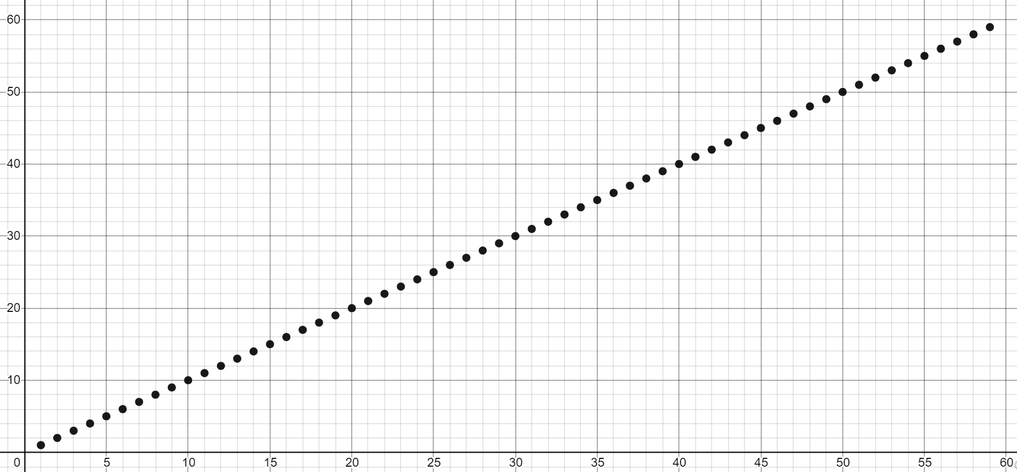
What’s the code model for the runtime of `print` in terms of n? (Assume System.out.println takes constant runtime)
Maybe something like f(n) = 3n + 2
(note: this is made up, since the details of the constants don’t matter)
public void print(int n){
for(int i=0; i < n; i++){
System.out.println(i);
}
}

Slide 12
Cases
We defined $f(n)$ to be (our model for) the number of operations the code does on an input of size $n$.
For the code we’ve seen so far, how the variable n (the size of the input) affects the code has been the only thing determining what the code model looks like. We’re now going to take a step and start looking at some code that has more factors than just n.

Slide 13
Linear Search
/* given an array and int toFind, return index where toFind is located, or -1 if not in array.*/
int linearSearch(int[] arr, int toFind){
for(int i=0; i < arr.length; i++){
if(arr[i] == toFind) {
return i;
}
}
return -1;
}
How should we model this code’s runtime as a mathematical function?

Slide 14
linearSearch Models: formulas
int linearSearch(int[] arr, int toFind){
for(int i=0; i < arr.length; i++){
if(arr[i] == toFind) {
return i;
}
}
return -1;
}
How should we model this code’s runtime as a mathematical function?
Unlike before, the number of steps for this piece of code does not depend solely on the input size, n (length of the array). In this case, there’s another factor which is: where does `toFind` appear in the input array (if at all)?

Slide 15
linearSearch Models: formulas
int linearSearch(int[] arr, int toFind){
for(int i=0; i < arr.length; i++){
if(arr[i] == toFind) {
return i;
}
}
return -1;
}
How should we model this code’s runtime as a mathematical function?
Unlike before, the number of steps for this piece of code does not depend solely on the input size, n (length of the array). In this case, there’s another factor which is: where does `toFind` appear in the input array (if at all)?
If toFind is in arr[0], we’ll only need one iteration. One specific example input: arr = [1, 2, 4, 9, 16, 25, 36, 49, 64] and toFind = 1
$f1\left(n\right)=$4
(note: the constants here were made-up since they don’t affect anything for this analysis)

Slide 16
linearSearch Models: formulas
int linearSearch(int[] arr, int toFind){
for(int i=0; i < arr.length; i++){
if(arr[i] == toFind) {
return i;
}
}
return -1;
}
How should we model this code’s runtime as a mathematical function?
Unlike before, the number of steps for this piece of code does not depend solely on the input size, n (length of the array). In this case, there’s another factor which is: where does `toFind` appear in the input array (if at all)?
If toFind is in arr[0], we’ll only need one iteration. One specific example input: arr = [1, 2, 4, 9, 16, 25, 36, 49, 64] and toFind = 1
$f1\left(n\right)=$4
If toFind is not in arr, we’ll need $n$ iterations. One specific example input : arr = [1, 2, 4, 9, 16, 25, 36, 49, 64] and toFind = -5
$$f2\left(n\right)=9n+1$$
(note: the constants here were made-up since they don’t affect anything for this analysis)

Slide 17
linearSearch Models: formulas
int linearSearch(int[] arr, int toFind){
for(int i=0; i < arr.length; i++){
if(arr[i] == toFind) {
return i;
}
}
return -1;
}
How should we model this code’s runtime as a mathematical function?
Unlike before, the number of steps for this piece of code does not depend solely on the input size, n (length of the array). In this case, there’s another factor which is: where does `toFind` appear in the input array (if at all)?
If toFind is in arr[0], we’ll only need one iteration. One specific example input: arr = [1, 2, 4, 9, 16, 25, 36, 49, 64] and toFind = 1
$f1\left(n\right)=$4
If toFind is not in arr, we’ll need $n$ iterations. One specific example input : arr = [1, 2, 4, 9, 16, 25, 36, 49, 64] and toFind = -5
$$f2\left(n\right)=9n+1$$
And what about in-between if toFind is somewhere inbetween? What if it’s at index 5? What if it’s index n – 5?
Every one of these situations deserves its own runtime function.
(note: the constants here were made-up since they don’t affect anything for this analysis)

Slide 18
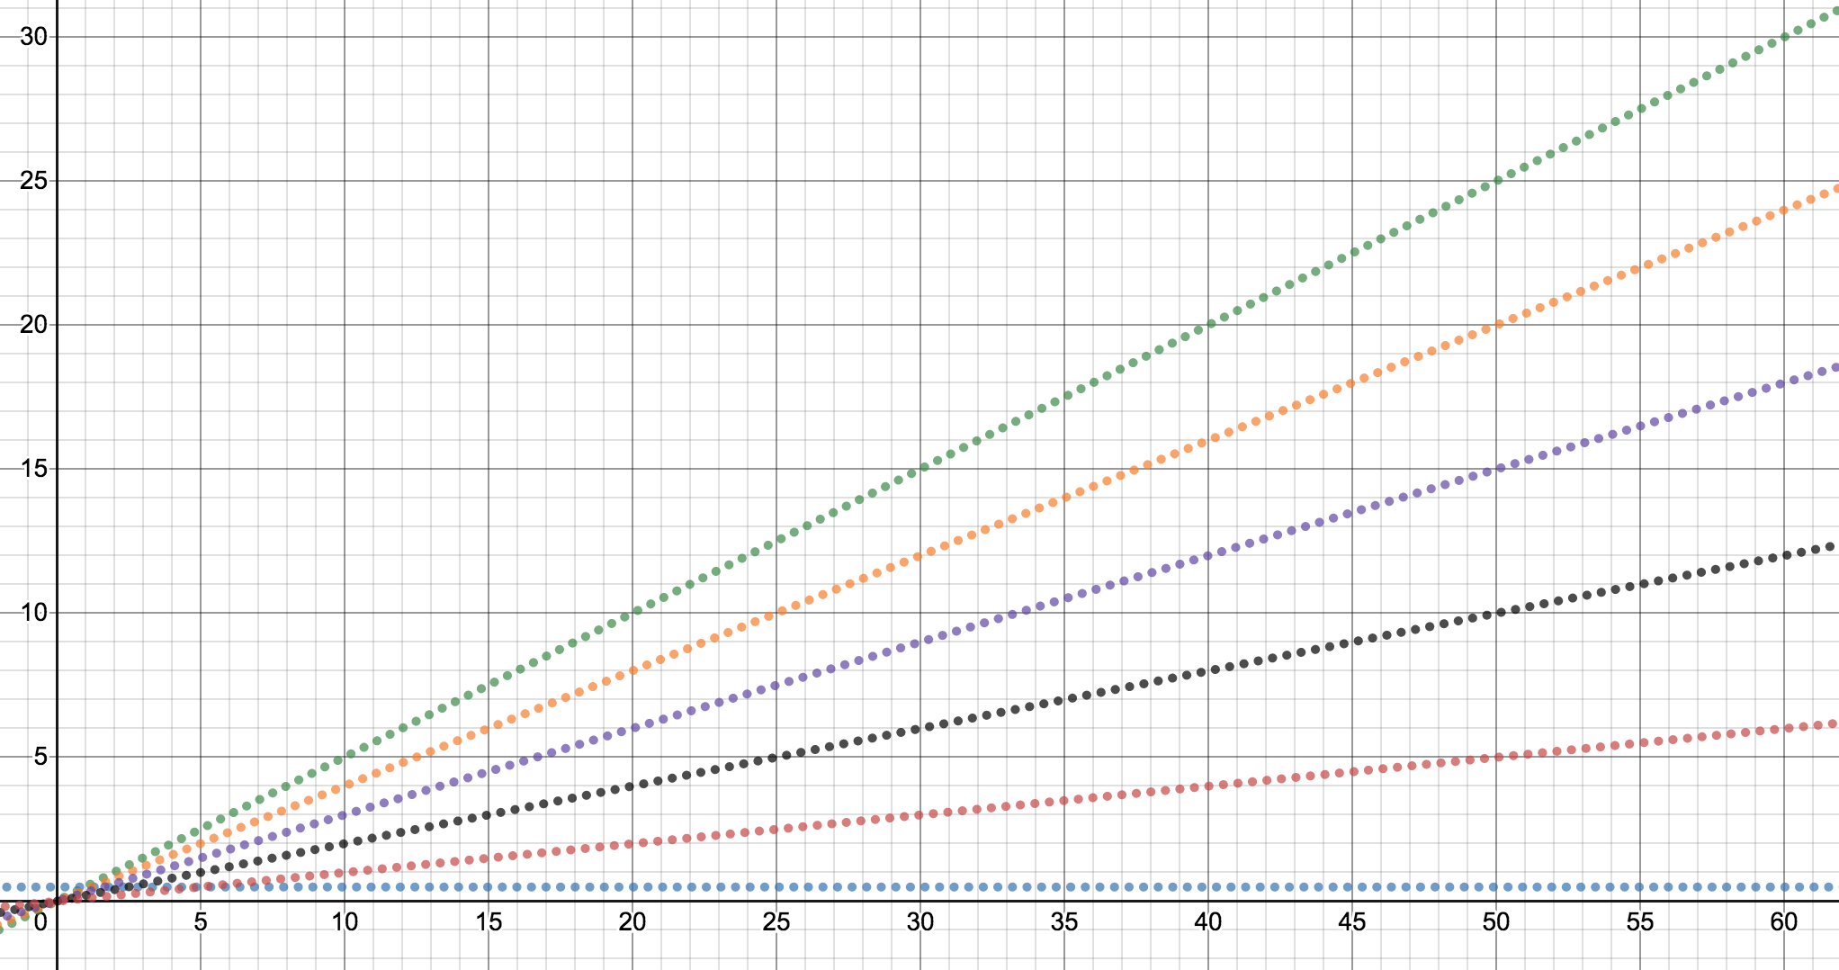
linearSearch Models: visually
int linearSearch(int[] arr, int toFind){
for(int i=0; i < arr.length; i++){
if(arr[i] == toFind) {
return i;
}
return -1;
}
9n + 1
7n + 4
6n + 3
4n + 2
2n + 1
4

Slide 19
public void print(int n){
for(int i=0; i < n; i++){
System.out.println(i);
}
}
public int linearSearch(int[] arr, int toFind){
for(int i=0; i < arr.length; i++){
if(arr[i] == toFind)
return i;
}
return -1;
9n + 1
2n + 1
7n + 4
6n + 3
4n + 2
2n + 1
These points are big ideas!
4
Code we’ve looked at before:
the `print` method only had one model/runtime function. The runtime function will ALWAYS be 2n + 1.
Code we’re looking at now: the `linearSearch` method has multiple possible models/runtime functions. Which runtime function is applicable depends on deciding which case we want to talk about.

Slide 20
Usually we care about the longest our code could run on an input of size $n$.
This is worst-case analysis
But sometimes we care about the fastest our code could finish on an input of size $n$.
This is best-case analysis
9n + 1
7n + 4
6n + 3
4n + 2
2n + 1
4
For linearSearch,
- the model for the worst case is $f\left(n\right)=9n+1$
- the model for the best case is $f\left(n\right)=4.$
Note: the best case and worst case situations for this method actually have different complexity class runtimes!
Notes:
Wow longest our code could run? Fastest our code could run? this sounds really similar to talking about O and Omega – and it is similar language – the main difference is that case analysis is when we’re converting code to a mathematical function. And asymptotic analysis is when we’re converting a function into O and Omega and Theta. Generally there’s not that much flexibility in the asymptotic analysis side and there’s a lot more interesting things to talk about in the case analysis side.

Slide 21
Case (rough definition): a description of the state of parameters and relevant state for a method/algorithm that is specific enough that a code model (runtime function) can be determined whose only parameters are the input size(s).
example cases from before:
toFind is in arr[0](best case)→ 4
toFind is not in arr(worst case)→9n + 1
So every different possible runtime function (see graph) that comes from some particular state of the parameters/data structure is a different case!
Usually we’ll only ask explicitly about best/worst in this course, but there are plenty of other useful cases to discuss, however (next slide).
Notes:
Wow longest our code could run? Fastest our code could run? this sounds really similar to talking about O and Omega – and it is similar language – the main difference is that case analysis is when we’re converting code to a mathematical function. And asymptotic analysis is when we’re converting a function into O and Omega and Theta. Generally there’s not that much flexibility in the asymptotic analysis side and there’s a lot more interesting things to talk about in the case analysis side.

Slide 22
Other useful types of cases (beyond best/worst)
“Assume X won’t happen case”
Assume our array won’t need to resize is the most common.
“Average case”
Assume your input is random
Need to specify what the possible inputs are and how likely they are.
$f(n)$ is now the average number of steps on a random input of size $n$.
“In-practice case”
This isn’t a real term. (We just made it up)
Make some reasonable assumptions about how the real-world is probably going to work
We’ll tell you the assumptions, and won’t ask you to come up with these assumptions on your own.
Then do worst-case analysis under those assumptions.

Slide 23
Where we left off last time:
a piece of code
code modeling
a function modeling the runtime of a piece of code
big O runtime
big Omega runtime
big Theta runtime
asymptotic analysis
An example of the process
method1()
code modeling
f(n) =
5n +3
tight upper bound: O(n$)$
tight lower bound: $Ω$(n)
$Θ$(n)
Notes:
This was where we left off on Monday – circle the asymptotic analysis part. Given a mathematical function, lets do asymptotic analysis on it and figure out how its upper/lower bounded.
But today we expanded on this code modeling part: given a piece of code, figure out what the important different possible code models are.

Slide 24
Where we left off last time:
a piece of code
code modeling
a function modeling the runtime of a piece of code
big O runtime
big Omega runtime
big Theta runtime
case analysis
asymptotic analysis
f(n) =
3
tight upper bound: O(1$)$
method1()
best case analysis
tight lower bound: $Ω$(1)
$Θ$(1)
worst case analysis
f(n) =
5n² +3n
tight upper bound: O(n²$)$
tight lower bound: $Ω$(n²)
$Θ$(n²)
some other case analysis
tight upper bound: O(n$)$
f(n) =
20n +3
tight lower bound: $Ω$(n)
$Θ$(n)
Notes:
For a lot of code, your function is more normal / simple and so then there isn’t that much use for O / Omega Theta

Slide 25
Questions?

Slide 26
Common Questions
How can you tell if there’s a different best/worst case code model for a given piece of code?
How does this relate to big O / big Omega / big Theta?
Can you choose n = 0 to be the best case? Can we choose n = infinity to be our worst case?

Slide 27
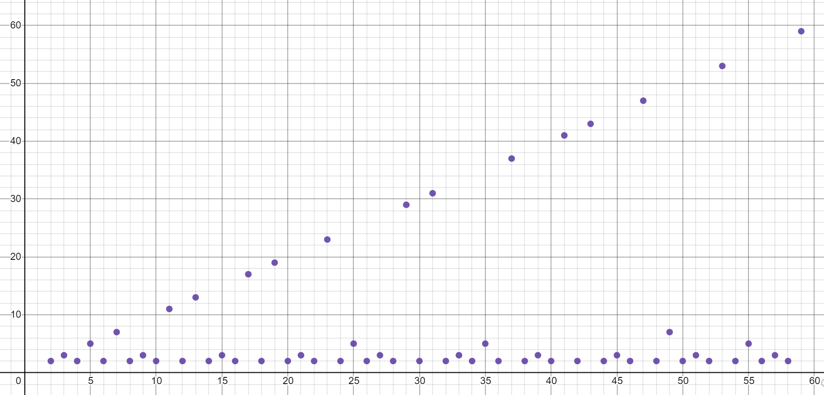
How can you tell if there’s a different best/worst case code model for a given piece of code?
boolean isPrime(int n){
int toTest = 2;
while(toTest < n){
if(n % toTest == 0) {
return true;
} else {
toTest++;
}
}
return false;
}
Are there other possible code models for this piece of code?
In other words: if n is given, are there still other factors that determine the runtime?

Slide 28
How can you tell if there’s a different best/worst case code model for a given piece of code?
Sometimes, there aren’t significantly different cases for a piece of code and there’s only one possible runtime function.
boolean isPrime(int n){
int toTest = 2;
while(toTest < n){
if(n % toTest == 0) {
return true;
} else {
toTest++;
}
}
return false;
}
No! This is actually pretty similar to the print method we saw earlier – the only variable / possible thing that can affect the runtime is the input parameter number, n.
Are there other possible code models for this piece of code?
In other words: if n is given, are there still other factors that determine the runtime?

Slide 29
Common Questions
How can you tell if there’s a different best/worst case code model for a given piece of code?
How does case analysis relate to asymptotic analysis (big O / big Omega / big Theta)?
Can you choose n = 0 to be the best case? Can we choose n = infinity to be our worst case?

Slide 30
Where we left off last time:
a piece of code
code modeling
a function modeling the runtime of a piece of code
big O runtime
big Omega runtime
big Theta runtime
case analysis
asymptotic analysis
f(n) =
3
tight upper bound: O(1$)$
method1()
best case analysis
tight lower bound: $Ω$(1)
$Θ$(1)
worst case analysis
f(n) =
5n² +3n
tight upper bound: O(n²$)$
tight lower bound: $Ω$(n²)
$Θ$(n²)
some other case analysis
tight upper bound: O(n$)$
f(n) =
20n +3
tight lower bound: $Ω$(n)
$Θ$(n)
Notes:
For a lot of code, your function is more normal / simple and so then there isn’t that much use for O / Omega Theta

Slide 31
Common Questions
How can you tell if there’s a different best/worst case code model for a given piece of code?
How does case analysis relate to asymptotic analysis (big O / big Omega / big Theta)?
Can you choose n = 0 to be the best case? Can we choose n = infinity to be our worst case?

Slide 32
Common Questions
How can you tell if there’s a different best/worst case code model for a given piece of code?
How does case analysis relate to asymptotic analysis (big O / big Omega / big Theta)?
Can you choose n = 0 to be the best case? Can we choose n = infinity to be our worst case?
Because this is all in the lens of code → mathematical function, this mathematical function has to be defined for all values of n. If you just scope it to the n = 0, what does your function look like? Basically you can’t decide on a specific input size since that’s supposed to be the x-axis for our graph. Doing so would be like honing in on one specific x/y point instead of defining a full function that can plug in any n.

Slide 33
How to do case analysis
1. Determine if there are actually significantly different cases.
Are there any other variables/parameters that could affect the runtime other than the input size? If the input/ data structure size is the only factor, then there aren’t any other significant cases (think isPrime and print).
2. Look at the code, and try to figure out more specifically how things could change depending on the input (except for the input size).
How can you exit loops early (for determining the best case)?
Conversely, How can you make sure loops run for as long as possible (for determining the worst case)?
Can you return (exit the method) early? (for determining the best case)
Are some if/else branches much slower than others?
3.. Figure out what inputs can cause you to hit the (best/worst) parts of the code. (e.g. what does the input array look like? What parameter values/ combinations of values trigger the expensive logic?)

Slide 34
Some previous data structure runtimes / code snippets + something new
ArrayList
- size
- insert(key, value) // ignore resizing
LinkedDictionary
- get
Bubble Sort code
We’re going to try breakouts again for these! See this google doc for the problems and instructions for breakouts!
solutions (link)

Slide 35
Breakout Instructions
1. Instructor will trigger breakout rooms
2. Accept the invite that pops up
3. Work with your partners to answer the question on slide 16
4. TAs will be coming in and out. Fill out this form to request a TA’s assistance: https://forms.gle/b9NiC1s11FKBcpm89
5. Instructor will end the breakouts in 5 minutes
For detailed instructions on how breakouts work: https://docs.google.com/presentation/d/15HiAPu6yYz2WWbkonRejBtUcq_FFhmoWFyT2l25G06o/edit#slide=id.g8289eae46a_0_694

Slide 36
Another example together: ArrayList insert
data; // a field for the array that stores all the values
size; // a field to keep track of the number of valid values
// inserts the given value at the given index
public void insert (index, value) {
for (int i = size; i > index; i--) {
data[i] = data[i - 1];
}
data[index] = value;
size++;
}
What are the different code models (are there multiple? is there just one?) if n = the size of the ArrayList.

Slide 37
Some previous quarter slides that say the stuff we talked about in a different way

Slide 38
!
Caution
!
Keep separate the ideas of best/worse case and $O,Ω,Θ$.
Big-$O$ is an upper bound, regardless of whether we’re doing worst or best-case analysis.
Worst case vs. best case is a question once we’ve fixed $n$ to choose the state of our data that decides how the code will evolve.
What is the exact state of our data structure, which value did we choose to insert?
$O,Ω,Θ$ are choices of how to summarize the information in the model.

Slide 39
 | Big-O | Big-Omega | Big-Theta
Worst Case | No matter what, as $n$ gets bigger, the code takes at most this much time | Under certain circumstances, as $n$ gets bigger, the code takes at least this much time | On the worst input, as $n$ gets bigger, the code takes precisely this much time (up to constants).
Best Case | Under certain circumstances, even as $n$ gets bigger, the code takes at most this much time. | No matter what, even as $n$ gets bigger, the code takes at least this much time. | On the best input, even as $n$ gets bigger, the code takes precisely this much time (up to constants)
“worst input”: input that causes the code to run slowest.

Slide 40
 | Big-O | Big-Omega | Big-Theta
Worst Case | No matter what, as $n$ gets bigger, the code takes at most this much time | Under certain circumstances, as $n$ gets bigger, the code takes at least this much time | On the worst input, as $n$ gets bigger, the code takes precisely this much time (up to constants).
Best Case | Under certain circumstances, even as $n$ gets bigger, the code takes at most this much time. | No matter what, even as $n$ gets bigger, the code takes at least this much time. | On the best input, even as $n$ gets bigger, the code takes precisely this much time (up to constants)
“worst input”: input that causes the code to run slowest.

Slide 41
 | Big-O | Big-Omega | Big-Theta
Worst Case | No matter what, as $n$ gets bigger, the code takes at most this much time | Under certain circumstances, as $n$ gets bigger, the code takes at least this much time | On the worst input, as $n$ gets bigger, the code takes precisely this much time (up to constants).
Best Case | Under certain circumstances, even as $n$ gets bigger, the code takes at most this much time. | No matter what, even as $n$ gets bigger, the code takes at least this much time. | On the best input, even as $n$ gets bigger, the code takes precisely this much time (up to constants)
“worst input”: input that causes the code to run slowest.

Slide 42
Some more notes: Simplified, tight big-O
Why not always just say $f\left(n\right)$ is $O\left(f\left(n\right)\right)$.
It’s always true! (Take $c=1, n_{0}=1$).
The goal of big-O/$Ω$/$Θ$ is to group similar functions together.
We want a simple description of $f$, if we wanted the full description of $f$ we wouldn’t use $O$

Slide 43
Simplified, tight big-O
In this course, we’ll essentially use our complexity classes (the different orders of growth):
Polynomials ($n^{c}$ where $c$ is a constant: e.g. $n, n^{3}, \sqrt{n}, 1$)
Logarithms $\log{n}$
Exponents ($c^{n}$ where $c$ is a constant: e.g. $2^{n}, 3^{n}$)
Combinations of these (e.g. $\log\left(\log\left(n\right)\right)$, $n\log{n}, {\left(log\left(n\right)\right)}^{2}$)
For this course:
A “tight big-O” is the slowest growing function among those listed.
A “tight big-$Ω$” is the fastest growing function among those listed.
(A $Θ$ is always tight, because it’s an “equal to” statement)
A “simplified” big-O (or Omega or Theta)
Does not have any dominated terms.
Does not have any constant factors – just the combinations of those functions.

