Slide 1
Lecture 1: Welcome!
CSE 373: Data Structures and Algorithms

Slide 2
Agenda
-Mic check
Introductions
Syllabus
Dust off data structure cobwebs
Meet the ADT
List Case Study
Notes:
Intros (10)
- Why learn D&A (5) (ZC)
- Meet the course staff (5)
- Lecturers (Each have our own slide)
- TAs (slide with pics and names)
Course Administration (15) (figure out together) X
- syllabus
- remote logistics (trying the breakouts here if not too many students to introduce self to others?)
A note about imposter syndrome (course culture) (5) (KC)
Intro to Data Structures (20)
- Definitions (KC)
- define data structure
- define ADT
- List ADT (ZC)
- ArrayList implementation
- LinkedList implementation

Slide 3
Waitlist/ Overloads
There are no overloads
Sorry we have no control over these things :/
Email cse373@cs.washington.edu for all registration questions
Many students move around, likely a spot will open
Keep coming to lecture!

Slide 4
Hello!
I am Kasey Champion
Software Engineer @ Karat
High School Teacher @ Franklin High
champk@cs.washington.edu
@techie4good

Slide 5
Hello!
Zach Chun
Software Engineer @ Amazon
Previously CSE 373 TA
chunz2@uw.edu

Slide 6
Two lecturers??
Please email cse373-20sp-lecturers@u.washington.edu for lecturer specific question / concerns
Questions about course administration
Concerns about grading
Extenuating circumstances
We will both have office hours
Answer questions about lecture content
Help with homework
Discuss any of the above lecturer specific questions
Happy to make specific appointments
Shared Calendly coming soon

Slide 7
Class Style
Kasey & Zach have to go to their “real jobs” after this
Your TAs
Each other
Please come to lecture (yes, there will be recordings)
Poll-everywhere
Collaboration (helping other students in the class!)
Ask questions! Point out mistakes!
Sections
TAs = heroes
Exam Practice problems
Sections start this week

Slide 8
A note about remote life
We are all figuring this out as we go!
Lecture
Please be prepared to interact throughout the hour
Poll Everywhere
Zoom interactions
Breakouts
Section
Similar to lecture
Please be prepared to work with other students
Video
Mic
A note about time zones
We understand many of you are no longer in “PST”
We will do our best to provide supplemental times
Piazza
Please feel free to use this to meet and engage with one another
Office Hours
Please be prepared to share your screen
Turn on mic and video
Let us know what works!
Share what you’ve seen elsewhere
Use the anonymous feedback form
Always happy to take suggestions / feedback ☺
https://pollev.com/uwcse373

Slide 9
Course Administration
Course Page
All course content/announcements posted here
Pay attention for updates!
Canvas
Grades will be posted here
Office Hours
Will be posted on Course Page
Will start next week
Piazza
Great place to discuss questions with other students
Will be monitored by course staff
No posting of project code!
Gradescope
- HW Turn in
Textbook
Optional
Data Structures and Algorithm Analysis in Java by Mark Allen Weiss

Slide 10
Syllabus + Website + Meet the TAs
To the website!
https://courses.cs.washington.edu/courses/cse373/20sp/syllabus/

Slide 11
Grade Break Down
Homework (55%)
Programming Projects (35%)
Partners GREATLY encouraged, but possible to do solo
Graded automatically
Written exercises (20%)
Turn in your own work, but can collaborate with others (see academic collaboration policy)
Graded by TAs
Exams (45%)
Midterm Exam #1 – Friday April 24th at 8:30-9:20(15%)
Midterm Exam #2 – Friday May 29th at 8:30-9:20 (15%)
Final Exam – "Take-home over finals week exam, collaboration encouraged" (15%)

Slide 12
Syllabus
Homework Policies
7 late days
Exams
2 midterms
50 minutes, during class time
Randomized
NO COLLABORATION
1 final
48 hours to complete
Free response style
Will be collaborative
Rules
No make ups! Let us know ASAP if you cannot attend an exam
Open book
Academic Integrity
No posting code on discussion board or ANYWHERE online
We do run MOSS
No directly sharing code with one another (except for partners)
Extra Credit
Post lecture-questions
Worth up to 0.05 GPA bump

Slide 13
Questions?
Clarification on syllabus, General complaining/moaning
https://pollev.com/uwcse373

Slide 15
What is this class about?
CSE 143 – Object Oriented Programming
CSE 373 – Data Structures and Algorithms
Classes and Interfaces
Methods, variables and conditionals
Loops and recursion
Linked lists and binary trees
Sorting and Searching
O(n) analysis
Generics
Design decisions
Design analysis
Implementations of data structures
Debugging and testing
Abstract Data Types
Code Modeling
Complexity Analysis
Software Engineering Practices

Slide 16
Data Structures and Algorithms
What are they anyway?

Slide 17
Basic Definitions
Data Structure
A way of organizing and storing data
Examples from CSE 14X: arrays, linked lists, stacks, queues, trees
Algorithm
A series of precise instructions to produce to a specific outcome
Examples from CSE 14X: binary search, merge sort, recursive backtracking

Slide 18
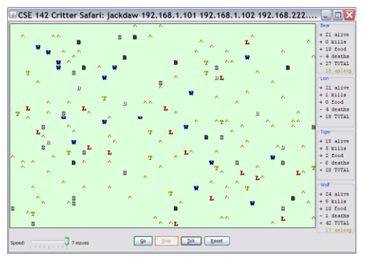
Review: Clients vs Objects
Client classes
Object Classes
A class that is executable, in Java this means it contains a Main method
public static void main(String[] args)
A coded structure that contains data and behavior
Start with the data you want to hold, organize the things you want to enable users to do with that data

Slide 19
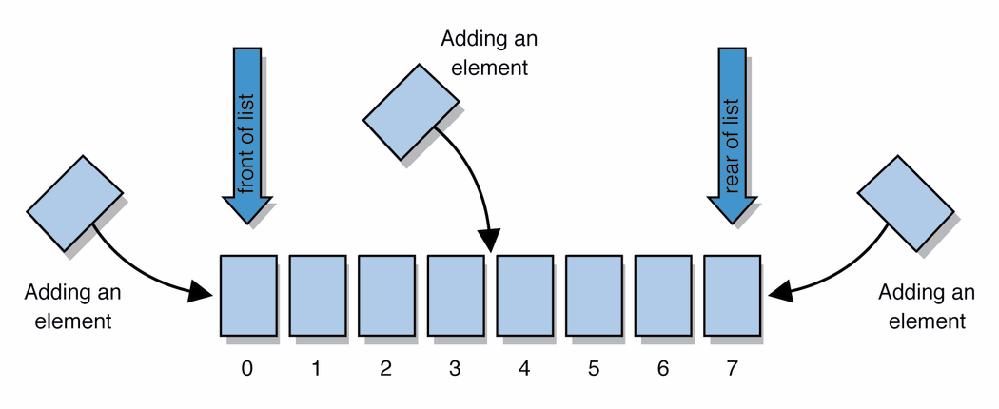
Abstract Data Types (ADT)
Abstract Data Types
An abstract definition for expected operations and behavior
Defines the input and outputs, not the implementations
Review: List - a collection storing an ordered sequence of elements
each element is accessible by a 0-based index
a list has a size (number of elements that have been added)
elements can be added to the front, back, or elsewhere
in Java, a list can be represented as an ArrayList object
Notes:
A way to communicate with other programmers, a standard that we all can agree on so we can discuss conceptual ways of organizing data

Slide 20
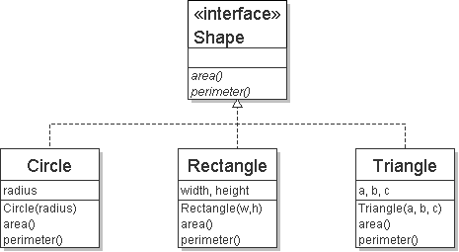
Review: Interfaces
Example
// Describes features common to all // shapes.
public interface Shape {
public double area();
public double perimeter();
}
interface: A construct in Java that defines a set of methods that a class promises to implement
Interfaces give you an is-a relationship without code sharing.
A Rectangle object can be treated as a Shape but inherits no code.
Analogous to non-programming idea of roles or certifications:
"I'm certified as a CPA accountant. This assures you I know how to do taxes, audits, and consulting."
"I'm 'certified' as a Shape, because I implement the Shape interface. This assures you I know how to compute my area and perimeter."
public interface name {
public type name(type name, ..., type name);
public type name(type name, ..., type name);
...
public type name(type name, ..., type name);
}

Slide 21
Review: Java Collections
Java provides some implementations of ADTs for you!
Lists List<Integer> a = new ArrayList<Integer>();
Stacks Stack<Character> c = new Stack<Character>();
Queues Queue<String> b = new LinkedList<String>();
Maps Map<String, String> d = new TreeMap<String, String>();
But some data structures you made from scratch… why?
Linked Lists - LinkedIntList was a collection of ListNode
Binary Search Trees – SearchTree was a collection of SearchTreeNodes
ADTs
Data Structures

Slide 22
Full Definitions
Abstract Data Type (ADT)
A definition for expected operations and behavior
A mathematical description of a collection with a set of supported operations and how they should behave when called upon
Describes what a collection does, not how it does it
Can be expressed as an interface
Examples: List, Map, Set
Data Structure
A way of organizing and storing related data points
An object that implements the functionality of a specified ADT
Describes exactly how the collection will perform the required operations
Examples: LinkedIntList, ArrayIntList

Slide 23
ADTs we’ll discuss this quarter
List
Set
Map
Stack
Queue
Priority Queue
Graph
Disjoint Set

Slide 24
Questions?
Clarification on anything we’ve talked about?
https://pollev.com/uwcse373

Slide 25
This is where we ended for lecture 1

Slide 26
Case Study: The List ADT
list: a collection storing an ordered sequence of elements.
Each item is accessible by an index.
A list has a variable size defined as the number of elements in the list
Elements can be added to or removed from any position in the list
Relation to code and our mental image of a list:
List<String> names = new ArrayList<>(); // []
names.size(); // evaluates to 0
names.add(”Amanda"); // [“Amanda”]
names.add(”Anish"); // [“Amanda, Anish”]
names.insert("Brian”, 0); // [“Brian”, “Amanda”, “Anish”]
names.size(); // evaluates to 3
Notes:
The main idea is that a list can store pieces of data and you can control the order when you add / remove / it.
Also a note on these slides before we talk about code: we know our code isn’t going to be perfect java programs since we want it to be readable / simple when possible, but if there’s something that’s bothering or confusing you about the code (like syntax or what something means) please ask. There will definitely be weird typos since Powerpoint is not the best way to write code.
Transition to next slide: Now that we have perspective of what the ADT representation is (when we think about this visual model and understanding the indices), let’s talk about this line of code that specifies ArrayList and what an ArrayList is.

Slide 27
Case Study: List Implementations
ArrayList
uses an Array as underlying storage
LinkedList
uses nodes as underlying storage
List ADT
ArrayList<E>
LinkedList<E>
state
Set of ordered items
Count of items
state
state
data[]
size
Node front
size
behavior
get(index) return item at index
set(item, index) replace item at index
add(item) add item to end of list
insert(item, index) add item at index
delete(index) delete item at index
size() count of items
behavior
behavior
get return data[index]
set data[index] = value
add data[size] = value, if out of space grow data
insert shift values to make hole at index, data[index] = value, if out of space grow data
delete shift following values forward
size return size
get loop until index, return node’s value
set loop until index, update node’s value
add create new node, update next of last node
insert create new node, loop until index, update next fields
delete loop until index, skip node
size return size
0 | 1 | 2 | 3 | 4
88.6 | 26.1 | 94.4 | 0 | 0
88.6
26.1
94.4
list
free space
Notes:
Mention on the relevant slide: There are plenty of more methods that the ADT defines and listed here as reference and for curiosity, but they’re not necessary for the rest of today’s lecture.

Slide 28
Case Study: The List ADT: ArrayList
How do Java / other programming languages implement ArrayList to achieve all the List behavior?
On the inside:
stores the elements inside an array (which has a fixed capacity) that typically has more space than currently used (For example when there is only 1 element in the actual list, the array might have 10 spaces for data),
stores all of these elements at the front of the array and keeps track of how many there are (the size) so that the implementation doesn’t get confused enough to look at the empty space. This means that sometimes we will have to do a lot of work to shift the elements around.
List view ArrayList view
[”Brian”, “Amanda”, “Anish”] [“Brian”, “Amanda”, “Anish”, null, null, null, null]
(this is the internal array with extra space)

Slide 29
Implementing ArrayList
ArrayList<E>
insert(element, index) with shifting
state
data[]
size
0 | 1 | 2 | 3
insert(“d”, 0)
a
b
c
d
behavior
a
b
c
get return data[index]
set data[index] = value
add data[size] = value, if out of space make data into a bigger array and copy everything over
insert shift values to make hole at index, data[index] = value, if out of space grow data
delete shift following values forward
size return numberOfItems
size =
4
3
delete(index) with shifting
0 | 1 | 2 | 3
a
b
c
delete(0)
d
a
b
c
size =
4
3
Take 1 Minute
Yes/No should we overwrite index 3 (the old c) with null? Everyone please vote with the yes/ no buttons and message in the chat your explanations why.
Notes:
2 minutes – how does insert work? Delete?
2 minutes – should we overwrite garbage values with null or leave them garbage?
Which should we do? The answer is: I don’t know! It depends on what we’re trying to achieve with this particular data structure – this is a major theme of this course (here are the pros, here are the cons, but there are multiple correct answers). Something probably new compared to CSE 142 / 143, but we’re going to do a lot of it in this class. Throughout this course we’re going to come up with reasons for one option to be good, and other reasons for another option to be good and debate them.

Slide 30
Implementing ArrayList
append(element) with growth
ArrayList<E>
0 | 1 | 2 | 3
state
append(2)
10
3
4
5
data[]
size
behavior
get return data[index]
set data[index] = value
add data[size] = value, if out of space grow data
insert shift values to make hole at index, data[index] = value, if out of space grow data
delete shift following values forward
size return size
numberOfItems =
4
5
0 | 1 | 2 | 3 | 4 | 5 | 6 | 7
2

Slide 31
Case Study: List Implementations
ArrayList
uses an Array as underlying storage
LinkedList
uses nodes as underlying storage
List ADT
ArrayList<E>
LinkedList<E>
state
Set of ordered items
Count of items
state
state
data[]
size
Node front
size
behavior
get(index) return item at index
set(item, index) replace item at index
add(item) add item to end of list
insert(item, index) add item at index
delete(index) delete item at index
size() count of items
behavior
behavior
get return data[index]
set data[index] = value
add data[size] = value, if out of space grow data
insert shift values to make hole at index, data[index] = value, if out of space grow data
delete shift following values forward
size return size
get loop until index, return node’s value
set loop until index, update node’s value
add create new node, update next of last node
insert create new node, loop until index, update next fields
delete loop until index, skip node
size return size
Take 1 Minute spam the chat
What method/situations will be much faster for LinkedList than for ArrayList?
0 | 1 | 2 | 3 | 4
88.6 | 26.1 | 94.4 | 0 | 0
88.6
26.1
94.4
list
free space
Notes:
Now let’s zoom out again.
Just talked about ArrayList, one possible data structure implementation for the List ADT. Let’s compare it to LinkedList, the other implementation!
With ArrayList you can specify the index and just notation like data[index], but for LL the only way to get to data further in the list is to follow the .next fields (the arrows in this picture here). So for get for example, for ArrayList we just said looks like data[index], one line of code and pretty simple. But for LL, we have to start at the front, then go to the next, and the next and the next, till we get to the specified index.
So it seems like that’s one case where ArrayList is preferred over LinkedList, but since we’re so focused on design stuff:
What about the other side? In what situations (what methods / parameters) is LinkedList preferred?

Slide 32
Design Decisions
For every ADT there are lots of different ways to implement them
Based on your situation you should consider:
Memory vs Speed
Generic/Reusability vs Specific/Specialized
One Function vs Another
Robustness vs Performance
This class is all about implementing ADTs based on making the right design tradeoffs!
> A common topic in interview questions

Slide 33
Design Decisions
Take 1 Minute spam the chat
Dub Street Burgers is implementing a new system for ticket (i.e. food order) management.
When a new ticket comes in, it is placed at the end of the set of tickets.
Food is prepared in approximately the same order it was requested, but sometimes tickets are fulfilled out of order.
Let’s represent tickets as a list. Which of our ADT implementations should we use?
Why?

Slide 34
Design Decisions
Let’s represent tickets as a list. Which of our ADT implementations should we use?
Why?
ArrayList
Creating a new ticket is very fast (as long as we don’t resize), and I want the cooks to be able to see all the orders right away.
LinkedList
We’ll mostly be removing from the front of the list, which is much faster for the linkedlist (no shifting), and I want finished orders to be removed fast so they aren’t distracting.

Slide 35
Design Decisions
Both ArrayList and LinkedList implementations have pros and cons.
Neither is strictly better than the other.
Some major objectives of this course:
Evaluating pros and cons
Deciding on a design
Defending that design decision
Especially when there’s more than one possible answer.

