Slide 1
Implementing Graphs
Data Structures and Algorithms
https://visualdatahub.wordpress.com/2013/04/02/a-web-of-thrones-character-relationships/

Slide 2
Introduction to Graphs

Slide 3
Inter-data Relationships
Arrays
Categorically associated
Sometimes ordered
Typically independent
Elements only store pure data, no connection info
Trees
Directional Relationships
Ordered for easy access
Limited connections
Elements store data and connection info
Graphs
Multiple relationship connections
Relationships dictate structure
Connection freedom!
Both elements and connections can store data
0 | 1 | 2
A | B | C
A
B
B
C
C
A

Slide 4
Graph: Formal Definition
G
A graph is defined by a pair of sets G = (V, E) where…
V is a set of vertices
A vertex or “node” is a data entity
E is a set of edges
An edge is a connection between two vertices
H
V = { A, B, C, D, E, F, G, H }
F
A
E = { (A, B), (A, C), (A, D), (A, H),
(C, B), (B, D), (D, E), (D, F),
(F, G), (G, H)}
D
C
B
E

Slide 5
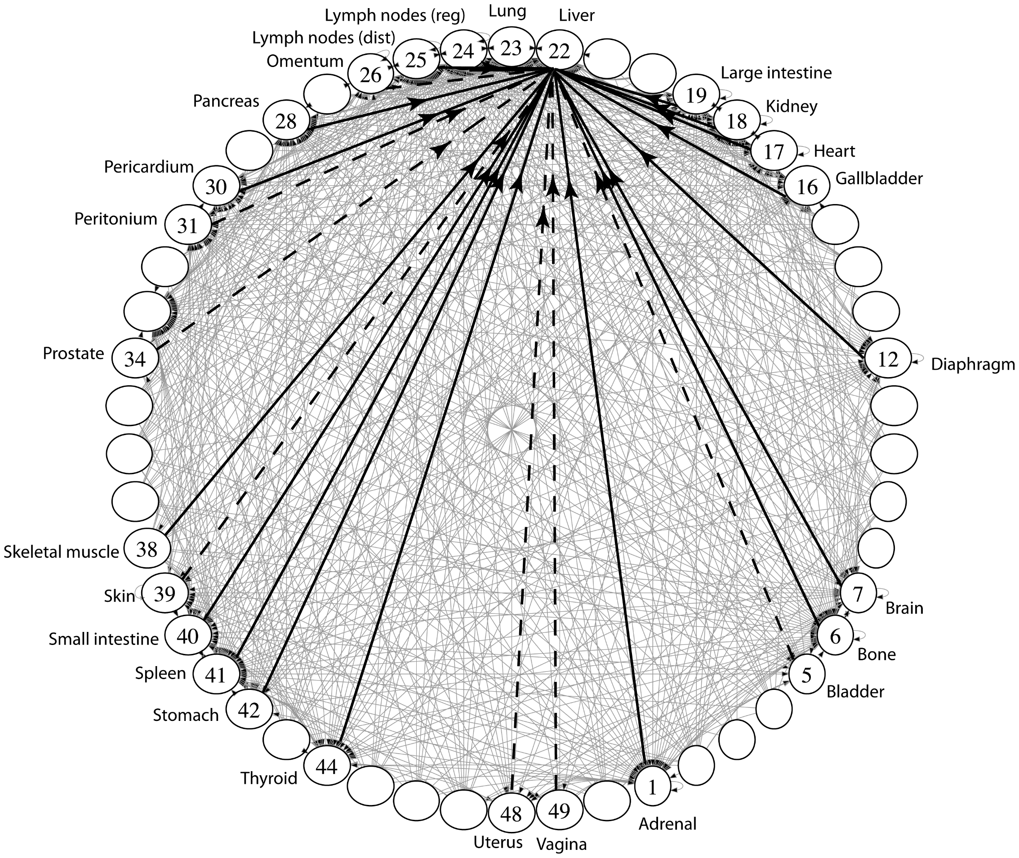
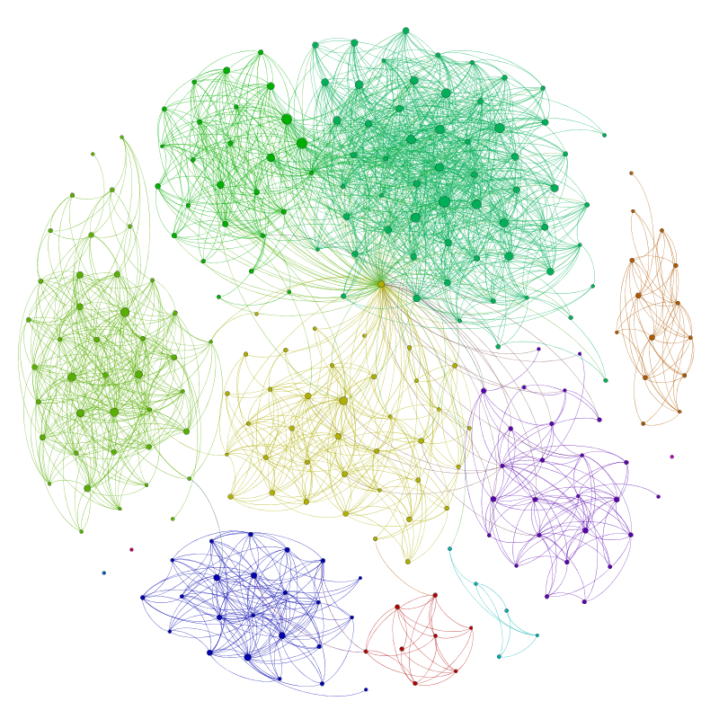
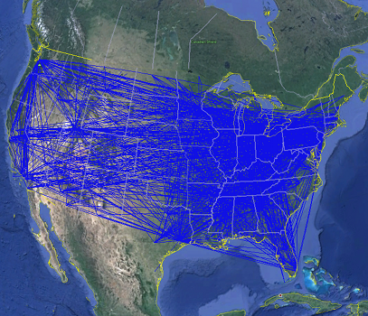
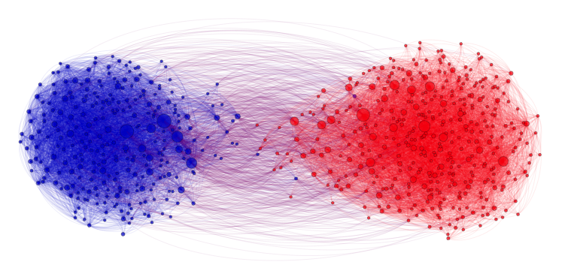
Applications
Physical Maps
Airline maps
Vertices are airports, edges are flight paths
Traffic
Vertices are addresses, edges are streets
Relationships
Social media graphs
Vertices are accounts, edges are follower relationships
Code bases
Vertices are classes, edges are usage
Influence
Biology
Vertices are cancer cell destinations, edges are migration paths
Related topics
Web Page Ranking
Vertices are web pages, edges are hyperlinks
Wikipedia
Vertices are articles, edges are links
SO MANY MORREEEE
www.allthingsgraphed.com

Slide 6
Warm Up
Sansa
Arya
Draw a graph that represents the following relationships:
Ned and Catelyn are married
Ned and Catelyn are the parents of Robb, Sansa, Arya, Bran and Rickon
Ned is the “father” of Jon
Ned and Robert are in allies
Robert and Cersei are married
Cersei and Jaime are in love
Tywin is the father of Cersei, Jamie and Tyrion
V = 13
E = 19
Bran
Robb
Rickon
Jon
Ned
Catelyn
Tyrion
Robert
Jaime
Tywin
Cersei

Slide 7
Graph Vocabulary
Undirected Graph:
Graph Direction
Undirected graph – edges have no direction and are two-way
Directed graphs – edges have direction and are thus one-way
Degree of a Vertex
Degree – the number of edges connected to that vertex
Drogo : 1, Danny : 1, Jon : 1
In-degree – the number of directed edges that point to a vertex
Petyr : 0, Catelyn : 2, Ned : 1
Out-degree – the number of directed edges that start at a vertex
Petyr : 1, Catelyn : 1, Ned : 1
Drogo
Dany
V = { Dany, Drogo, Jon }
E = { (Dany, Drogo), (Dany, Jon) } inferred (Drogo, Dany) and (Jon, Dany)
Directed Graph:
Jon
V = { Petyr, Catelyn, Ned }
E = { (Petyr, Catelyn), (Catelyn, Ned), (Ned, Catelyn) }
Catelyn
Petyr
Ned

Slide 8
Graph Vocabulary
Self loop – an edge that starts and ends at the same vertex
Parallel edges – two edges with the same start and end vertices
Simple graph – a graph with no self-loops and no parallel edges
Petyr
Dany
Drogo
Loras
Brienne
Margaery
Renly

Slide 9
Food for thought
Is a graph valid if there exists a vertex with a degree of 0?
Yes
Catelyn
Lyanna
Jaime
Petyr
Robert
Cersei
Ned
Rheagar
Robert
Petyr has an “in degree” of 0
Lyanna has an “out degree” of 0
Robert has both an “in degree” and an “out degree” of 0
Are these valid?
Is this a valid graph?
Yup
Stark
Lannister
Robert
Joffrey
Tommen
Cersei
Jon
Yes!
Sure
Targaryens
Tyrells

Slide 10
Implementing a Graph
Implement with nodes…
Implementation gets super messy
What if you wanted a vertex without an edge?
How can we implement without requiring edges to access nodes?
Implement using some of our existing data structures!

Slide 11
Adjacency Matrix
 | A | B | C | D
A |  | T | T
B
C |  | T |  | T
D | T
Assign each vertex a number from 0 to V – 1
Create a V x V array of Booleans
If (x,y) $∈$ E then arr[x][y] = true
Runtime (in terms of V and E)
get out - edges for a vertex O(v)
get in – edges for a vertex O(v)
decide if an edge exists O(1)
insert an edge O(1)
delete an edge O(1)
delete a vertex (subject to implementation)
add a vertex (subject to implementation)
How much space is used?
V²
B
A
C
D

Slide 12
Graph Vocabulary
Stark
Lannister
Dense Graph – a graph with a lot of edges
E $∈$ Θ(V²)
Sparse Graph – a graph with “few” edges
E $∈$ Θ(V)
An Adjacency Matrix seems a waste for a sparse graph…
Targaryens
Tyrells
Jon
Sam
Yoren
Pyp
Eddison

Slide 13
Adjacency List
B
A
Create a Dictionary of size V from type V to Collection of E
If (x,y) $∈$ E then add y to the set associated with the key x
Runtime (in terms of V and E)
get out - edges for a vertex O(1)
get in - edges for a vertex O(V + E)
decide if an edge exists O(1)
insert an edge O(1)
delete an edge O(1)
delete a vertex (subject to implementation)
add a vertex (subject to implementation)
How much space is used?
V + E
C
D
0
1
2
3
A
B
C
B
C
B
D
D
A

Slide 14
Walks and Paths
Walk – continuous set of edges leading from vertex to vertex
A list of vertices where if I is some int where 0 < 1 < Vn every pair (Vi, Vi+1) in E is true
Path – a walk that never visits the same vertex twice
Castle
Black
Castle
Black
Winterfell
Winterfell
Casterly
Rock
Casterly
Rock
King’s
Landing
King’s
Landing

Slide 15
Connected Graphs
Connected graph – a graph where every vertex is connected to every other vertex via some path. It is not required for every vertex to have an edge to every other vertex
There exists some way to get from each vertex to every other vertex
Connected Component – a subgraph in which any two vertices are connected via some path, but is connected to no additional vertices in the supergraph
There exists some way to get from each vertex within the connected component to every other vertex in the connected component
A vertex with no edges is itself a connected component
Robb
Sansa
Rickon
Dany
Viserys
Arya
Jon
Bran

Slide 16
Graph Algorithms

Slide 17
Traversing a Graph
In all previous data structures:
Start at first element
Move to next element
Repeat until end of elements
For graphs – Where do we start? How do we decide where to go next? When do we end?
Pick any vertex to start, mark it “visited”
Put all neighbors of first vertex in a “to be visited” collection
Move onto next vertex in “to be visited” collection
Mark vertex “visited”
Put all unvisited neighbors in “to be visited”
Move onto next vertex in “to be visited” collection
Repeat…

Slide 18
Breadth First Search
search(graph)
toVisit.enqueue(first vertex)
while(toVisit is not empty)
current = toVisit.dequeue()
for (v : current.neighbors())
if (v is not in visited)
toVisit.enqueue(v)
visited.add(current)
F
G
D
A
I
H
E
B
H
Current node:
Queue:
Visited:
I
A
E
D
B
G
F
C
G
C
B
D
E
C
F
G
H
I
A
B
D
E
C
F
G
H
I

Slide 19
Breadth First Search Analysis
search(graph)
toVisit.enqueue(first vertex)
while(toVisit is not empty)
current = toVisit.dequeue()
for (v : current.neighbors())
if (v is not in visited)
toVisit.enqueue(v)
visited.add(current)
F
G
D
A
I
H
E
B
A
B
D
E
C
F
G
H
I
Visited:
C
How many times do you visit each node?
How many times do you traverse each edge?
1 time each
Max 2 times each
Putting them into toVisit
Checking if they’re in toVisit
Runtime?
O(V + 2E) = O(V + E)
“graph linear”

Slide 20
Depth First Search (DFS)
BFS uses a queue to order which vertex we move to next
Gives us a growing “frontier” movement across graph
Can you move in a different pattern? Can you use a different data structure?
What if you used a stack instead?
bfs(graph)
toVisit.enqueue(first vertex)
while(toVisit is not empty)
current = toVisit.dequeue()
for (V : current.neighbors())
if (V is not in visited)
toVisit.enqueue(v)
visited.add(current)
dfs(graph)
toVisit.push(first vertex)
while(toVisit is not empty)
current = toVisit.pop()
for (V : current.neighbors())
if (V is not in visited)
toVisit.push(v)
visited.add(current)

Slide 21
Depth First Search
dfs(graph)
toVisit.push(first vertex)
while(toVisit is not empty)
current = toVisit.pop()
for (V : current.neighbors())
if (V is not in stack)
toVisit.push(v)
visited.add(current)
F
G
D
A
I
H
E
Current node:
Stack:
Visited:
G
B
A
B
H
F
E
D
C
I
D
C
C
B
E
I
H
G
F
A
B
E
H
G
F
I
C
D
How many times do you visit each node?
How many times do you traverse each edge?
1 time each
Max 2 times each
Putting them into toVisit
Checking if they’re in toVisit
Runtime?
O(V + 2E) = O(V + E)
“graph linear”

