Slide 1
Lecture 13: Computer Memory
CSE 373 Data Structures and Algorithms

Slide 2
Administrivia
Sorry no office hours this afternoon :/
Midterm review session Monday 6-8pm Sieg 134 (hopefully)
Written HW posted later today – individual assignment

Slide 3
Thought experiment
public int sum1(int n, int m, int[][] table) {
int output = 0;
for (int i = 0; i < n; i++) {
for (int j = 0; j < m; j++) {
output += table[i][j];
}
}
return output;
}
public int sum2(int n, int m, int[][] table) {
int output = 0;
for (int i = 0; i < n; i++) {
for (int j = 0; j < m; j++) {
output += table[j][i];
}
}
return output;
}
What do these two methods do?
What is the big-Θ
Θ(n*m)

Slide 4
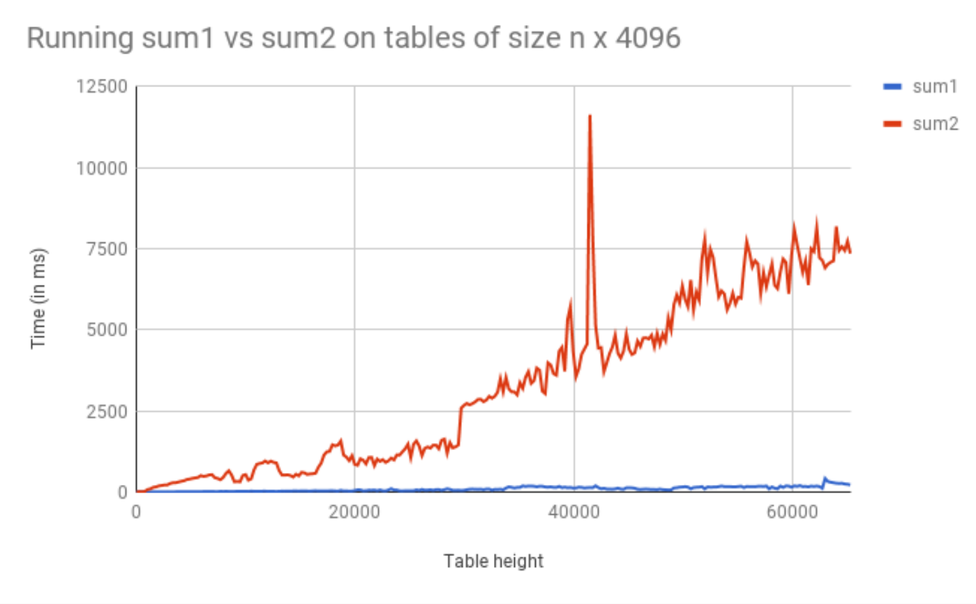
Warm Up

Slide 5
Incorrect Assumptions
Lies!
Accessing memory is a quick and constant-time operation
Sometimes accessing memory is cheaper and easier than at other times
Sometimes accessing memory is very slow

Slide 6
Memory Architecture
What is it? | Typical Size | Time
The brain of the computer! | 32 bits | ≈free
Extra memory to make accessing it faster | 128KB | 0.5 ns
Extra memory to make accessing it faster | 2MB | 7 ns
Working memory, what your programs need | 8GB | 100 ns
Large, longtime storage | 1 TB | 8,000,000 ns
CPU Register
L1 Cache
L2 Cache
RAM
Disk
Notes:
1 ns vs 8,000,000 is like 1 sec vs 3 months
It’s faster to do:
5 million arithmetic ops than 1 disk access
2500 L2 cache accesses than 1 disk access
400 RAM accesses than 1 disk access

Slide 7
Review: Binary, Bits and Bytes
byte
The most commonly referred to unit of memory, a grouping of 8 bits
Can represent 265 different numbers (28)
1 Kilobyte = 1 thousand bytes (kb)
1 Megabyte = 1 million bytes (mb)
1 Gigabyte = 1 billion bytes (gb)
binary
A base-2 system of representing numbers using only 1s and 0s
- vs decimal, base 10, which has 9 symbols
bit
The smallest unit of computer memory represented as a single binary value either 0 or 1
Decimal | Decimal Break Down | Binary | Binary Break Down
0 | $$(0 ∗{10}^{0})$$ | 0 | $$(0 ∗2^{0})$$
1 | $$(1 ∗{10}^{0})$$ | 1 | $$(1∗2^{0})$$
10 | $$(1 ∗{10}^{1})+(0∗{10}^{0})$$ | 1010 | $$(1∗2^{3})+(0∗2^{2})+(1∗2^{1})+(0∗2^{0})$$
12 | $$(1 ∗{10}^{1})+(2∗{10}^{0})$$ | 1100 | $$(1∗2^{3})+(1∗2^{2})+(0∗2^{1})+(0∗2^{0})$$
127 | $$\left(1∗{10}^{2}\right)+(1 ∗{10}^{1})+(2∗{10}^{0})$$ | 01111111 | $$(0∗2^{7})+(1∗2^{6})+(1∗2^{5})+(1∗2^{4})(1∗2^{3})+(1∗2^{2})+(1∗2^{1})+(1∗2^{0})$$

Slide 8
Memory Architecture
Takeaways:
- the more memory a layer can store, the slower it is (generally)
- accessing the disk is very slow
Computer Design Decisions
Physics
Speed of light
Physical closeness to CPU
Cost
“good enough” to achieve speed
Balance between speed and space

Slide 9
Locality
How does the OS minimize disk accesses?
Spatial Locality
Computers try to partition memory you are likely to use close by
- Arrays
- Fields
Temporal Locality
Computers assume the memory you have just accessed you will likely access again in the near future

Slide 10
Leveraging Spatial Locality
When looking up address in “slow layer”
- bring in more than you need based on what’s near by
- cost of bringing 1 byte vs several bytes is the same
- Data Carpool!

Slide 11
Leveraging Temporal Locality
When looking up address in “slow layer”
Once we load something into RAM or cache, keep it around or a while
- But these layers are smaller
When do we “evict” memory to make room?

Slide 12
Moving Memory
Amount of memory moved from disk to RAM
- Called a “block” or “page”
≈4kb
Smallest unit of data on disk
Amount of memory moved from RAM to Cache
- called a “cache line”
≈64 bytes
Operating System is the Memory Boss
- controls page and cache line size
- decides when to move data to cache or evict

Slide 13
Warm Up
public int sum1(int n, int m, int[][] table) {
int output = 0;
for (int i = 0; i < n; i++) {
for (int j = 0; j < m; j++) {
output += table[i][j];
}
}
return output;
}
public int sum2(int n, int m, int[][] table) {
int output = 0;
for (int i = 0; i < n; i++) {
for (int j = 0; j < m; j++) {
output += table[j][i];
}
}
return output;
}
Why does sum1 run so much faster than sum2?
sum1 takes advantage of spatial and temporal locality
0 | 1 | 2 | 3 | 4
0 | 1 | 2
‘a’ | ‘b’ | ‘c’
0 | 1 | 2
‘d’ | ‘e’ | ‘f’
0 | 1 | 2
‘g’ | ‘h’ | ‘i’
0 | 1 | 2
‘j’ | ‘k’ | ‘l’
0 | 1 | 2
‘m’ | ‘n’ | ‘o’

Slide 14
Java and Memory
What happens when you use the “new” keyword in Java?
- Your program asks the Java Virtual Machine for more memory from the “heap”
Pile of recently used memory
- If necessary the JVM asks Operating System for more memory
Hardware can only allocate in units of page
If you want 100 bytes you get 4kb
Each page is contiguous
What happens when you create a new array?
Program asks JVM for one long, contiguous chunk of memory
What happens when you create a new object?
Program asks the JVM for any random place in memory
What happens when you read an array index?
Program asks JVM for the address, JVM hands off to OS
OS checks the L1 caches, the L2 caches then RAM then disk to find it
If data is found, OS loads it into caches to speed up future lookups
What happens when we open and read data from a file?
Files are always stored on disk, must make a disk access

Slide 15
Array v Linked List
Is iterating over an ArrayList faster than iterating over a LinkedList?
Answer:
LinkedList nodes can be stored in memory, which means the don’t have spatial locality. The ArrayList is more likely to be stored in contiguous regions of memory, so it should be quicker to access based on how the OS will load the data into our different memory layers.

Slide 16
Thought Experiment
Suppose we have an AVL tree of height 50. What is the best case scenario for number of disk accesses? What is the worst case?
RAM
Disk
Notes:
Draw a tree entirely in RAM
Draw a tree who’s top node is on RAM and everything else is in disk

Slide 17
Maximizing Disk Access Effort
Instead of each node having 2 children, let it have M children.
Each node contains a sorted array of children
Pick a size M so that fills an entire page of disk data
Assuming the M-ary search tree is balanced, what is its height?
What is the worst case runtime of get() for this tree?
log_{m}(n)
log₂(m) to pick a child
log_{m}(n) * log₂(m) to find node

Slide 18
Maximizing Disk Access Effort
If each child is at a different location in disk memory – expensive!
What if we construct a tree that stores keys together in branch nodes, all the values in leaf nodes
 | K |  | K |  | K |  | K |  | K
<- internal nodes
K | V
K | V
K | V
K | V
K | V
K | V
K | V
K | V
K | V
K | V
K | V
K | V
K | V
K | V
K | V
K | V
K | V
K | V
K | V
K | V
K | V
K | V
K | V
K | V
leaf nodes ->

Slide 19
B Trees
Has 3 invariants that define it
1. B-trees must have two different types of nodes: internal nodes and leaf nodes
2. B-trees must have an organized set of keys and pointers at each internal node
3. B-trees must start with a leaf node, then as more nodes are added they must stay at least half full

Slide 20
Node Invariant
Internal nodes contain M pointers to children and M-1 sorted keys
A leaf node contains L key-value pairs, sorted by key
 | K |  | K |  | K |  | K |  | K
M = 6
L = 3
K | V
K | V
K | V
K | V

Slide 21
Order Invariant
For any given key k, all subtrees to the left may only contain keys x that satisfy x < k. All subtrees to the right may only contain keys x that satisfy k >= x
 | 3 |  | 7 |  | 12 |  | 21
X < 3
3 <= X < 7
7 <= X < 12
12 <= X < 21
21 <= x

Slide 22
Structure Invariant
If n <= L, the root node is a leaf
When n > L the root node must be an internal node containing 2 to M children
All other internal nodes must have M/2 to M children
All leaf nodes must have L/2 to L children
All nodes must be at least half-full The root is the only exception, which can have as few as 2 children
Helps maintain balance
Requiring more than 2 children prevents degenerate Linked List trees
K | V
K | V
K | V
K | V

Slide 23
B-Trees
Has 3 invariants that define it
1. B-trees must have two different types of nodes: internal nodes and leaf nodes
An internal node contains M pointers to children and M – 1 sorted keys.
M must be greater than 2
Leaf Node contains L key-value pairs, sorted by key.
2. B-trees order invariant
For any given key k, all subtrees to the left may only contain keys that satisfy x < k
All subtrees to the right may only contain keys x that satisfy k >= x
3. B-trees structure invariant
If n<= L, the root is a leaf
If n >= L, root node must be an internal node containing 2 to M children
All nodes must be at least half-full

Slide 24
get() in B Trees
 | 12 |  | 44
get(6)
get(39)
 | 6
 | 20 |  | 27 |  | 34
 | 50
1 | 1
2 | 2
3 | 3
6 | 4
8 | 5
9 | 6
10 | 7
12 | 8
14 | 9
16 | 10
17 | 11
20 | 12
22 | 13
24 | 14
27 | 15
28 | 16
32 | 17
34 | 18
38 | 19
39 | 20
41 | 21
Worst case run time = log_{m}(n)log₂(m)
Disk accesses = log_{m}(n) = height of tree

Slide 25
put() in B Trees
Suppose we have an empty B-tree where M = 3 and L = 3. Try inserting 3, 18, 14, 30, 32, 36
3 | 1
3 | 1
18
2
14
3
 | 18
14
3
32
18
2
3 | 1
18 | 2
32 | 5
14
3
30
4
36
6
32
5

Slide 26
Warm Up
What operations would occur in what order if a call of get(24) was called on this b-tree?
What is the M for this tree? What is the L?
If Binary Search is used to find which child to follow from an internal node, what is the runtime for this get operation?
 | 12
 | 6
 | 20 |  | 27 |  | 34
1 | 1
2 | 2
3 | 3
6 | 4
8 | 5
9 | 6
10 | 7
12 | 8
14 | 9
16 | 10
17 | 11
20 | 12
22 | 13
24 | 14
27 | 15
28 | 16
32 | 17
34 | 18
38 | 19
39 | 20
41 | 21

Slide 27
Review: B-Trees
Has 3 invariants that define it
1. B-trees must have two different types of nodes: internal nodes and leaf nodes
An internal node contains M pointers to children and M – 1 sorted keys.
M must be greater than 2
Leaf Node contains L key-value pairs, sorted by key.
2. B-trees order invariant
For any given key k, all subtrees to the left may only contain keys that satisfy x < k
All subtrees to the right may only contain keys x that satisfy k >= x
3. B-trees structure invariant
If n<= L, the root is a leaf
If n >= L, root node must be an internal node containing 2 to M children
All nodes must be at least half-full

Slide 28
Put() for B-Trees
Build a new b-tree where M = 3 and L = 3.
Insert (3,1), (18,2), (14,3), (30,4) where (k,v)
When n <= L b-tree root is a leaf node
No space for (30,4) ->split the node
Create two new leafs that each hold ½ the values and create a new internal node
3 | 1
18
2
wrong ->
14
3
 | 18
<- use smallest value in larger subset as sign post
2. B-trees order invariant
For any given key k, all subtrees to the left may only contain keys that satisfy x < k
All subtrees to the right may only contain keys x that satisfy k >= x
3 | 1
14 | 3
18 | 2
30 | 4

Slide 29
You try!
Try inserting (32, 5) and (36, 6) into the following tree
 | 18
32
3 | 1
14 | 3
18 | 2
30 | 4
32 | 5
36 | 6
32
5

Slide 30
Splitting internal nodes
Try inserting (15, 7) and (16, 8) into our existing tree
 | 18
32
Make a new internal node!
3 | 1
14 | 3
15 | 7
16 | 8
18 | 2
30 | 4
32 | 5
36 | 6
15
7
32
5
18
Make a new internal node!
 | 15
 | 32
3 | 1
14 | 3
15 | 7
16 | 8
18 | 2
30 | 4
32 | 5
36 | 6

Slide 31
B-tree Run Time
Time to find correct leaf
Time to insert into leaf
Time to split leaf
Time to split leaf’s parent internal node
Number of internal nodes we might have to split
All up worst case runtime:
Height = log_{m}(n)log₂(m) = tree traversal time
Θ(L)
Θ(L)
Θ(M)
Θ(log_{m}(n))
Θ(L + Mlog_{m}(n))

