Slide 1
Lecture 7: Solving Recurrences
CSE 373: Data Structures and Algorithms

Slide 2
Warm Up – Writing Recurrences

Slide 3
Administriva
HW 2 Part 1 due Friday
- git runners will get overloaded on Friday, plan accordingly
No Kasey office hours Friday

Slide 4
Solving Recurrences

Slide 5
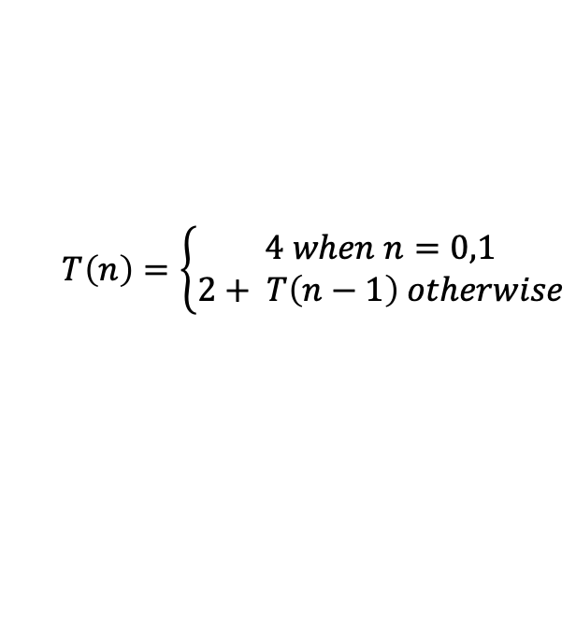
Review: Modeling Recursion
Write a mathematical model of the following code
public int factorial(int n) {
if (n == 0 || n == 1) {
return 1;
} else {
return n * factorial(n-1);
}
}
+3
+1
+2
$$T\left(n\right)=\left\{\begin{aligned}4 when n=0,1 \\ 2+ T\left(n−1\right) otherwise\end{aligned}\right.$$
What is the Big O?

Slide 6
Solving Recurrences
How do we go from code model to Big O?
Explore the recursive pattern by tracing through the a few levels of recursion
Write a new model of the runtime or “work done” for the pattern in terms of the level of recursion “i”
Use algebra (and likely a summation) to simplify the T recursive call out of your new model
Use algebra to simplify down to the “closed form” so you can easily identify the Big O

Slide 7


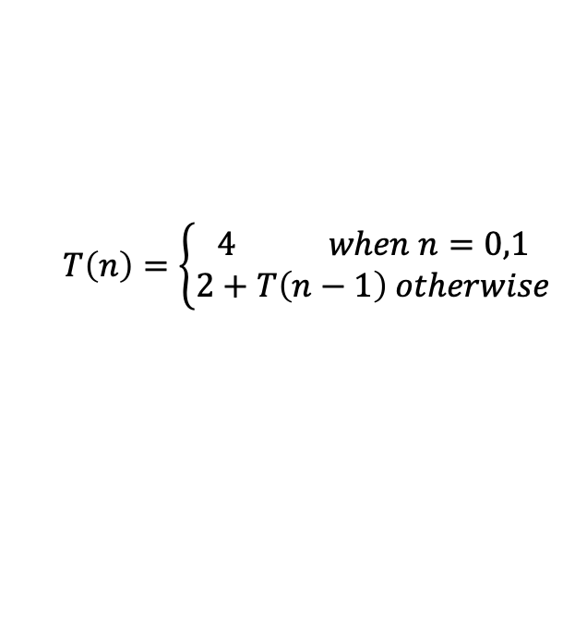



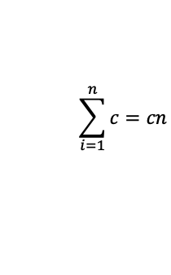
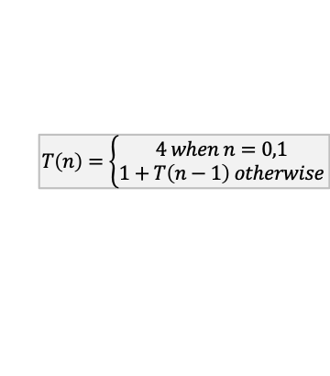

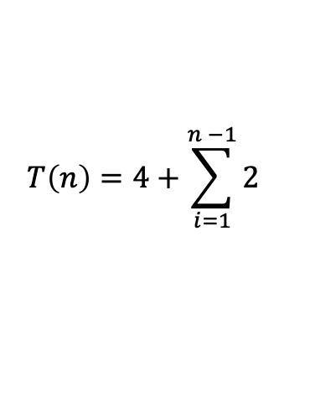




Unrolling Method
Walk through function definition until you see a pattern
$$T\left(n\right)=\left\{\begin{aligned}4 when n=0,1 \\ 2+T\left(n−1\right) otherwise\end{aligned}\right.$$
$$2+T(n−1)$$
$$T\left(n\right)=$$
$$T\left(n\right)=\left\{\begin{aligned}4 when n=0,1 \\ 2+T\left(n−1\right) otherwise\end{aligned}\right.$$
$$T\left(n\right)=2+2+T(n−1 −1)$$
i = 1
$$T\left(n\right)=2+2+T(n−2)$$
$$T\left(n\right)=\left\{\begin{aligned}4 when n=0,1 \\ 1+T\left(n−1\right) otherwise\end{aligned}\right.$$
$$T\left(n\right)=2+2+2+T(n−2−1)$$
i = 2
$$T\left(n\right)=2+2+2+T(n−3)$$
$$T\left(n\right)=\left\{\begin{aligned}4 when n=0,1 \\ 1+T\left(n−1\right) otherwise\end{aligned}\right.$$
$$T\left(n\right)=2+2+2+2+ T(n−3−1)$$
i = 3
i = ?
$$T\left(n\right)=2+2+2+2+…+ T\left(1\right)=2+2+2+2+ … +4$$
T(n-i) = T(1) when i= n-1
n-1 recursive cases
1 base case
$$T\left(n\right)=4+\sum_{i=1}^{n −1}{2}$$
Summation of a constant
$$\sum_{i=1}^{n}{c=cn}$$
$$T\left(n\right)=4+2(n−1)$$
$T\left(4\right)=2+T\left(4−1\right)=2+2+T\left(3−1\right)=2+2+2+T\left(2−1\right)=2+2+2+4=3∗2+4$

Slide 8


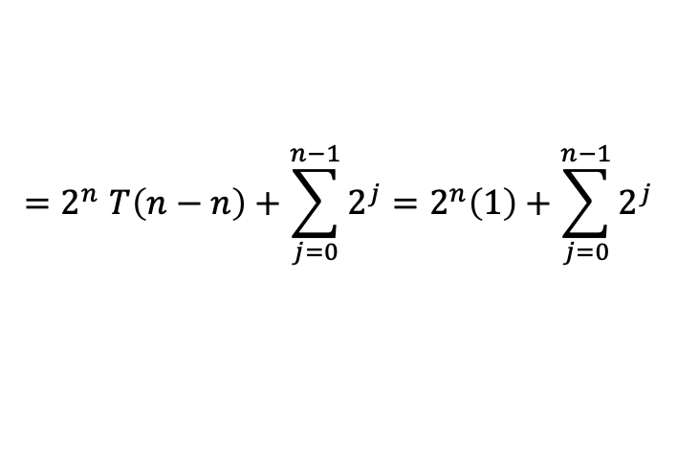
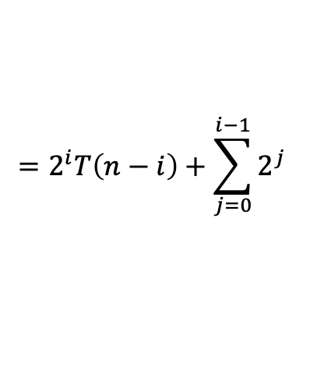

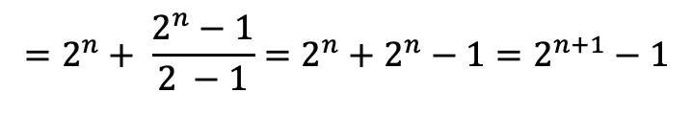


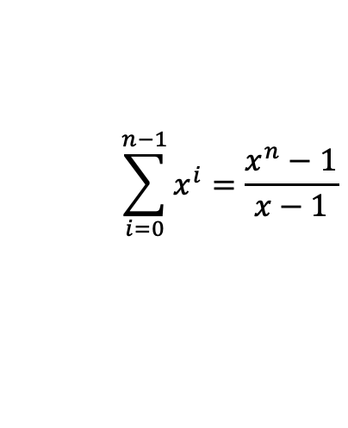

Unrolling Method
5 Minutes
Walk through function definition until you see a pattern
$$1 when n=0$$
$$T\left(n\right)=$$
$$2T\left(n−1\right)+1 otherwise$$
i = 1
$$=2T\left(n−1\right)+1$$
i = 2
$$=2\left(2T\left(n −2\right)+1\right)+1$$
$$=2^{2}T\left(n−2\right)+2+1$$
i = 3
$$=2^{2}\left(2T\left(n−3\right)+1\right)+2+1$$
$$=2^{3}T\left(n−3\right)+2^{2}+2^{1}+2^{0}$$
i = 4
$$=2^{3}\left(2T\left(n−4\right)+1\right)+2^{2}+2^{1}+2^{0}$$
$$=2^{4}T\left(n−4\right)+2^{3}+2^{2}+2^{1}+2^{0}$$
$$=2^{i}T\left(n−i\right)+\sum_{j=0}^{i−1}{2^{j}}$$
$${=2}^{n}T\left(n−n\right)+\sum_{j=0}^{n−1}{2^{j}}=2^{n}\left(1\right)+\sum_{j=0}^{n−1}{2^{j}}$$
i = n-i
$$=2^{i}T\left(n−i\right)+2^{i−1}+2^{i−2}+2^{i−3}+…+2^{0}$$
Finite Geometric Series
$$\sum_{i=0}^{n−1}{x^{i}=\frac{x^{n}−1}{x−1}}$$
$$=2^{n}+ \frac{2^{n}−1}{2 −1}=2^{n}+2^{n}−1=2^{n+1}−1$$

Slide 9
Solving Recurrences
How do we go from code model to Big O?
Explore the recursive pattern
Write a new model in terms of “i”
Use algebra simplify the T away
Use algebra to find the “closed form”
  Using unrolling method
  Plug definition into itself to write out first few levels of recursion
  Simplify away parenthesis but leave separate terms to help identify pattern in terms of i
  Plug in a value of i to solve for base case, write summation representing recursive work
  Using summation identities as appropriate reduced to “closed form”

Slide 10

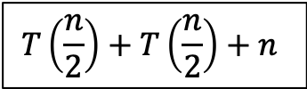













Tree Method
Draw out call stack, how much work does each call do?
$$T\left(n\right)=\left\{\begin{aligned}1 when n≤1 \\ 2T\left(\frac{n}{2}\right)+n otherwise\end{aligned}\right.$$
$$T\left(\frac{n}{2}\right)+T\left(\frac{n}{2}\right)+n$$
$$T\left(n\right)$$
$$n$$
Draw an overall root representing the start of your family of recursive calls
How much work is done by the top recursive level?
How much of that work is delegated to downstream recursive calls?
How much work is done by each of those child recursive calls?
How much of that work is delegated to downstream recursive calls?
…
What does the last row of the tree look like?
Sum up all the work!
$$\frac{n}{2}$$
$$\frac{n}{2}$$
$$T\left(\frac{n}{4}\right)+T\left(\frac{n}{4}\right)+\frac{n}{2}$$
$$T\left(\frac{n}{4}\right)+T\left(\frac{n}{4}\right)+\frac{n}{2}$$
$$T\left(\frac{n}{2}\right)$$
$$T\left(\frac{n}{2}\right)$$
$$\frac{n}{4}$$
$$T\left(\frac{n}{4}\right)$$
$$T\left(\frac{n}{4}\right)$$
$$T\left(\frac{n}{4}\right)$$
$$T\left(\frac{n}{4}\right)$$
$$\frac{n}{4}$$
$$\frac{n}{4}$$
$$\frac{n}{4}$$
…
…
…
…
…
…
…
…
$$1$$
$$1$$
$$1$$
$$1$$
$$1$$
$$1$$
$$1$$
$$1$$
$$1$$
$$1$$
$$1$$
$$1$$
$$1$$
$$1$$
$$1$$
$$1$$

Slide 11




Tree Method
$$1 when n≤1$$
$$T\left(n\right)=$$
$$2T\left(\frac{n}{2}\right)+n otherwise$$
How many pieces of work at each level?
How much work done by each piece?
How much work across each level?
$$n$$
1
n
n
$$\frac{n}{2}$$
$$\frac{n}{2}$$
2
$\frac{n}{2}$
n
$$\frac{n}{4}$$
$$\frac{n}{4}$$
$$\frac{n}{4}$$
$$\frac{n}{4}$$
4
$\frac{n}{2^{2}}$
n
$$\frac{n}{8}$$
$$\frac{n}{8}$$
$$\frac{n}{8}$$
$$\frac{n}{8}$$
$$\frac{n}{8}$$
$$\frac{n}{8}$$
$$\frac{n}{8}$$
$$\frac{n}{8}$$
8
$\frac{n}{2^{3}}$
n
…
…
…
…
…
…
…
…
…
…
…
…
…
…
…
…
$$1$$
$$1$$
$$1$$
$$1$$
$$1$$
$$1$$
$$1$$
$$1$$
$$1$$
$$1$$
$$1$$
$$1$$
$$1$$
$$1$$
$$1$$
$$1$$
n
$1$
n

Slide 12

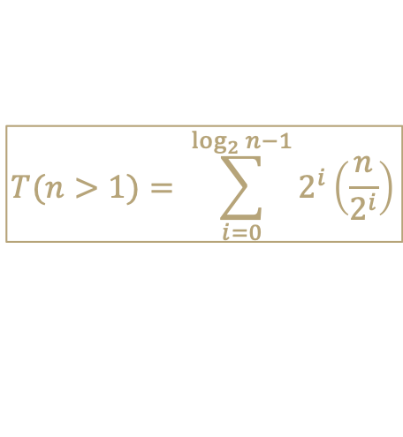
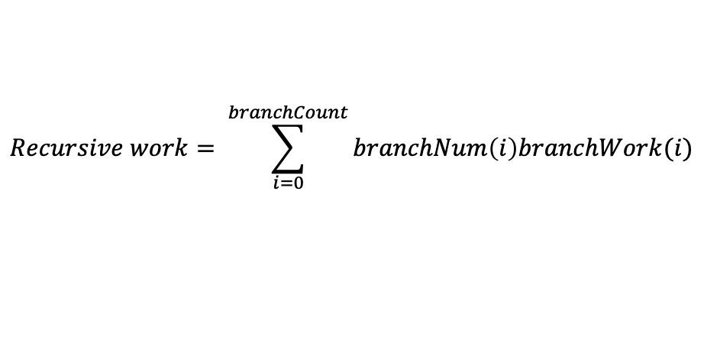
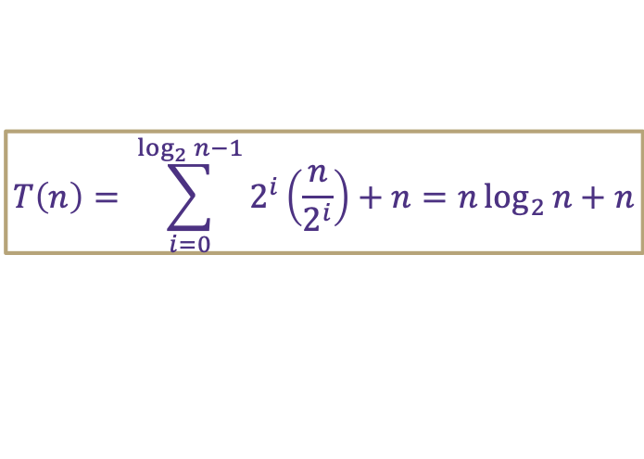
Tree Method Formulas
$$1 when n≤1$$
$$T\left(n\right)=$$
$$2T\left(\frac{n}{2}\right)+n otherwise$$
How much work is done by recursive levels (branch nodes)?
  1. How many recursive calls are on the i-th level of the tree?
    i = 0 is overall root level
  2. At each level i, how many inputs does a single node process?
  3. How many recursive levels are there?
    Based on the pattern of how we get down to base case
How much work is done by the base case level (leaf nodes)?
  1. How much work is done by a single leaf node?
  2. How many leaf nodes are there?
numberNodesPerLevel(i) = 2^{i}
inputsPerRecursiveCall(i) = (n/ 2^{i})
branchCount = log₂n - 1
$$Recursive work= \sum_{i=0}^{branchCount}{branchNum\left(i\right)branchWork(i)}$$
$$T(n>1)= \sum_{i=0}^{\log_{2}{n}−1}{2^{i}\left(\frac{n}{2^{i}}\right)}$$
leafWork = 1
leafCount = 2^{log}₂^{n} = n
$$NonRecursive work=leafWork×leafCount=leafWork×branchNum^{numLevels}$$
$$T\left(n≤1\right)=1\left(2^{log2n}\right)= n$$
$$T\left(n\right)= \sum_{i=0}^{\log_{2}{n}−1}{2^{i}\left(\frac{n}{2^{i}}\right)}+n=n\log_{2}{n}+n$$
$$total work=recursive work+nonrecursive work=$$

Slide 13
Tree Method Practice
$$4 when n≤1$$
$$T\left(n\right)=$$
$$3T\left(\frac{n}{4}\right)+cn^{2} otherwise$$
$$T\left(\frac{n}{4}\right)+T\left(\frac{n}{4}\right)+T\left(\frac{n}{4}\right)+cn^{2}$$
$$cn^{2}$$
Answer the following questions:
How many nodes on each branch level?
How much work for each branch node?
How much work per branch level?
How many branch levels?
How much work for each leaf node?
How many leaf nodes?
$$c{\left(\frac{n}{4}\right)}^{2}$$
$$T\left(\frac{n}{4}\right)$$
$$T\left(\frac{n}{4}\right)$$
$$c{\left(\frac{n}{4}\right)}^{2}$$
$$c{\left(\frac{n}{4}\right)}^{2}$$
$$T\left(\frac{n}{4}\right)$$
$$c{\left(\frac{n}{16}\right)}^{2}$$
$$c{\left(\frac{n}{16}\right)}^{2}$$
$$c{\left(\frac{n}{16}\right)}^{2}$$
$$c{\left(\frac{n}{16}\right)}^{2}$$
$$c{\left(\frac{n}{16}\right)}^{2}$$
$$c{\left(\frac{n}{16}\right)}^{2}$$
$$c{\left(\frac{n}{16}\right)}^{2}$$
$$c{\left(\frac{n}{16}\right)}^{2}$$
$$c{\left(\frac{n}{16}\right)}^{2}$$
…
…
…
…
…
…
…
…
…
…
…
…
…
…
…
…
…
…
…
…
…
…
…
…
…
…
…
4
4
4
4
4
4
4
4
4
4
4
4
4
4
4
4
4
4
4
4
4
4
4
4
4
4
4

Slide 14

Tree Method Practice
5 Minutes
$$4 when n≤1$$
$$T\left(n\right)=$$
$$3T\left(\frac{n}{4}\right)+cn^{2} otherwise$$
Level (i) | Number of Nodes | Work per Node | Work per Level
0 | 1 | $$cn2$$ | $$cn2$$
1 | 3 | $$c{\left(\frac{n}{4}\right)}^{2}$$ | $$\frac{3}{16}cn^{2}$$
2 | 9 | $$c{\left(\frac{n}{16}\right)}^{2}$$ | $$\frac{9}{256}cn^{2}$$
base | $$3^{log4n}$$ | 4 | $${12}^{log4n}$$
$$3^{i}$$
How many nodes on each branch level?
How much work for each branch node?
How much work per branch level?
How many branch levels?
How much work for each leaf node?
How many leaf nodes?
$$c{\left(\frac{n}{4^{i}}\right)}^{2}$$
$$3^{i}c{\left(\frac{n}{4^{i}}\right)}^{2}$$
$${=\left(\frac{3}{16}\right)}^{i}{cn}^{2}$$
Combining it all together…
$$\log_{4}{n −1}$$
$$T\left(n\right)= \sum_{i=0}^{\log_{4}{n −1}}{{\left(\frac{3}{16}\right)}^{i}cn^{2}+ } 4n^{log43}$$
$$4$$
$$3^{\log_{4}{n}}$$
power of a log
$$n^{\log_{4}{3}}$$
$$x^{\log_{b}{y}}=y^{\log_{b}{x}}$$

Slide 15
Tree Method Practice
factoring out a constant
$$T\left(n\right)= \sum_{i=0}^{\log_{4}{n −1}}{{\left(\frac{3}{16}\right)}^{i}cn^{2}+ } 4n^{log43}$$
$$T\left(n\right)=cn^{2}\sum_{i=0}^{\log_{4}{n −1}}{{\left(\frac{3}{16}\right)}^{i}+ } 4n^{log43}$$
$$\sum_{i=a}^{b}{cf(i)=}c\sum_{i=a}^{b}{f(i)}$$
Closed form:
finite geometric series
$$T\left(n\right)=cn^{2}\left(\frac{{\frac{3}{16}}^{\log_{4}{n}}−1}{\frac{3}{16} −1}\right)+4n^{log43}$$
$$\sum_{i=0}^{n−1}{x^{i}=\frac{x^{n}−1}{x−1}}$$
If we’re trying to prove upper bound…
infinite geometric series
$$T\left(n\right)=cn^{2}\left(\frac{1}{1 −\frac{3}{16}}\right)+4n^{log43}$$
$$T\left(n\right)=cn^{2}\sum_{i=0}^{∞}{{\left(\frac{3}{16}\right)}^{i}+ } 4n^{log43}$$
$$\sum_{i=0}^{∞}{x^{i}=\frac{1}{1−x} }$$
$$T\left(n\right)∈O(n^{2})$$
when -1 < x < 1

Slide 16
Solving Recurrences
How do we go from code model to Big O?
Explore the recursive pattern
Write a new model in terms of “i”
Use algebra simplify the T away
Use algebra to find the “closed form”
  Using unrolling method
  Plug definition into itself to write out first few levels of recursion
  Simplify away parenthesis but leave separate terms to help identify pattern in terms of i
  Plug in a value of i to solve for base case, write summation representing recursive work
  Using summation identities as appropriate reduced to “closed form”
  Using tree method
  Plug definition into itself to draw out first few levels of tree
  Answer questions about nature of tree to identify work done by recursive levels and base case in terms of i
  Combine answers to questions to complete model in terms of i
  Using summation identities as appropriate reduced to “closed form”

Slide 17
Is there an easier way?
What if you do want an exact closed form?
Sorry, no
If we want to find a big Θ
Sometimes, yes!

Slide 18
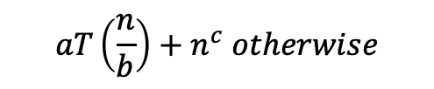
Master Theorem
Given a recurrence of the following form:
$$d when n=1$$
$$T\left(n\right)=$$
$$aT\left(\frac{n}{b}\right)+n^{c} otherwise$$
Then thanks to magical math brilliance we can know the following:
If
$$\log_{b}{a}<c$$
then
$$T\left(n\right)∈Θ\left(n^{c}\right)$$
If
$$\log_{b}{a}=c$$
then
$$T\left(n\right)∈Θ\left(n^{c}\log_{2}{n}\right)$$
If
$$\log_{b}{a}>c$$
then
$$T\left(n\right)∈Θ\left(n^{\log_{b}{a}}\right)$$

Slide 19
Apply Master Theorem
Given a recurrence of the form:
$$d when n=1$$
$$T\left(n\right)=$$
a = 2
b = 2
c = 1
d = 1
$$aT\left(\frac{n}{b}\right)+n^{c} otherwise$$
$$1 when n≤1$$
$$T\left(n\right)=$$
$$2T\left(\frac{n}{2}\right)+n otherwise$$
If
$$\log_{b}{a}<c$$
then
$$T\left(n\right)∈Θ\left(n^{c}\right)$$
If
$$\log_{b}{a}=c$$
then
$$T\left(n\right)∈Θ\left(n^{c}\log_{2}{n}\right)$$
If
$$\log_{b}{a}>c$$
then
$$T\left(n\right)∈Θ\left(n^{\log_{b}{a}}\right)$$
$\log_{b}{a}=c$ ${⇒ log}_{2}{2}=1$
$$T\left(n\right)∈Θ\left(n^{c}\log_{2}{n}\right)⇒Θ\left(n^{1}\log_{2}{n}\right)$$

Slide 20
Reflecting on Master Theorem
The case
  Recursive case conquers work more quickly than it divides work
  Most work happens near “top” of tree
  Non recursive work in recursive case dominates growth, n^{c} term
  The case
  Work is equally distributed across call stack (throughout the “tree”)
  Overall work is approximately work at top level x height
The case
  Recursive case divides work faster than it conquers work
  Most work happens near “bottom” of tree
  Leaf work dominates branch work
Given a recurrence of the form:
$$\log_{b}{a}<c$$
$$d when n=1$$
$$T\left(n\right)=$$
$$aT\left(\frac{n}{b}\right)+n^{c} otherwise$$
If
$$\log_{b}{a}<c$$
then
$$T\left(n\right)∈Θ\left(n^{c}\right)$$
If
$$\log_{b}{a}=c$$
then
$$T\left(n\right)∈Θ\left(n^{c}\log_{2}{n}\right)$$
$$\log_{b}{a}=c$$
If
$$\log_{b}{a}>c$$
then
$$T\left(n\right)∈Θ\left(n^{\log_{b}{a}}\right)$$
$$height ≈\log_{b}{a}$$
$$\log_{b}{a}>c$$
$$branchWork ≈n^{c}\log_{b}{a}$$
$$leafWork ≈d\left(n^{\log_{b}{a}}\right)$$

