Slide 1
Lecture 6: More Definitions, Modeling Complex Algorithms
CSE 373: Data Structures and Algorithms

Slide 2
Administrivia
Homework 1 due tonight
Homework 2 goes live tonight
Email list active!
turn off discussion board notifications
please do use discussion board
IDE Setup Office Hours today CSE Floor 2 breakout 3:30-7:30
Please fill out student background survey

Slide 3
Edge Cases
True or False: $10n^{2}+15n$ is $O(n^{3})$
It’s true – it fits the definition
$$10n2≤c・n3 when c=10 for n≥1$$
$$15n≤c・n3 when c=15 for n≥1$$
$$10n2+15n≤10n3+15n3≤25n3 for n≥1$$
$10n^{2}+15n$ is $O(n^{3})$ because $10n^{2}+15n≤25n3 for n≥1$
Big-O is just an upper bound. It doesn’t have to be a good upper bound
If we want the best upper bound, we’ll ask you for a tight big-O bound.
$O\left(n^{2}\right)$ is the tight bound for this example.
It is (almost always) technically correct to say your code runs in time $O(n!)$.
DO NOT TRY TO PULL THIS TRICK ON AN EXAM. Or in an interview.

Slide 4
Why Are We Doing This?
You already intuitively understand what big-O means.
Who needs a formal definition anyway?
We will.
Your intuitive definition and my intuitive definition might be different.
We’re going to be making more subtle big-O statements in this class.
We need a mathematical definition to be sure we’re on the same page.
Once we have a mathematical definition, we can go back to intuitive thinking.
But when a weird edge case, or subtle statement appears, we can figure out what’s correct.

Slide 5
Function comparison: exercise
3 Minutes
True – all linear functions are treated as equivalent
f(n) = n ≤ g(n) = 5n + 3?
f(n) = 5n + 3 ≤ g(n) = n?
f(n) = 5n + 3 ≤ g(n) = 1?
f(n) = 5n + 3 ≤ g(n) = n²?
f(n) = n² + 3n + 2 ≤ g(n) = n³?
f(n) = n³ ≤ g(n) = n² + 3n + 2 ?
True
False
True – quadratic will always dominate linear
True
False

Slide 6
O, Omega, Theta [oh my?]
Big-O is an upper bound
My code takes at most this long to run
Big-Omega is a lower bound
Big Theta is “equal to”
$Ω\left(f\left(n\right)\right)≤f\left(n\right)== θ\left(f\left(n\right)\right)≤O(f\left(n\right))$
f(n)
O(1)
O(log n)
O(n)
O(n²)
O(n³)
Is dominated by
f(n) ∈ O(g(n))
Dominates
f(n) ∈ Ω(g(n))
$f(n)$ is $Ω(g\left(n\right))$ if there exist positive constants $c, n_{0}$ such that for all $n≥n_{0}$,
$$f\left(n\right)≥c⋅g\left(n\right)$$
Big-Omega
$f(n)$ is $Θ(g\left(n\right))$ if
$f\left(n\right)$ is $O(g\left(n\right))$ and $f\left(n\right)$ is $Ω(g\left(n\right))$.
Big-Theta

Slide 7
Viewing O as a class
Sometimes you’ll see big-O defined as a family or set of functions.
$O(g\left(n\right))$ is the set of all functions $f\left(n\right)$ such that there exist positive constants $c, n_{0}$ such that for all $n≥n_{0}$, $f\left(n\right)≤c⋅g\left(n\right)$
Big-O (alternative definition)
For that reason, some people write $f\left(n\right)∈O\left(g\left(n\right)\right)$ where we wrote “$f\left(n\right)$ is $O(g\left(n\right))$”.
Other people write “$f\left(n\right)=O\left(g\left(n\right)\right)$” to mean the same thing.
The set of all functions that run in linear time (i.e. $O(n)$) is a “complexity class.”
We never write $O(5n)$ instead of $O(n)$ – they’re the same thing!
It’s like writing $\frac{6}{2}$ instead of $3$. It just looks weird.

Slide 8
Examples
$f(n)$ $∈$ $O(g\left(n\right))$ if there exist positive constants $c, n_{0}$ such that for all $n≥n_{0}$,
$$f\left(n\right)≤c⋅g\left(n\right)$$
Big-O
4n² ∈ Ω(1)
true
4n² ∈ Ω(n)
true
4n² ∈ Ω(n²)
true
4n² ∈ Ω(n³)
false
4n² ∈ Ω(n⁴)
false
4n² ∈ O(1)
false
4n² ∈ O(n)
false
4n² ∈ O(n²)
true
4n² ∈ O(n³)
true
4n² ∈ O(n⁴)
true
$f(n)$ $∈ Ω(g\left(n\right))$ if there exist positive constants $c, n_{0}$ such that for all $n≥n_{0}$,
$$f\left(n\right)≥c⋅g\left(n\right)$$
Big-Omega
$f(n)$ $∈$ $Θ(g\left(n\right))$ if
$f\left(n\right)$ is $O(g\left(n\right))$ and $f\left(n\right)$ is $Ω(g\left(n\right))$.
Big-Theta

Slide 9
Practice
3 Minutes
$f(n)$ $∈$ $O(g\left(n\right))$ if there exist positive constants $c, n_{0}$ such that for all $n≥n_{0}$,
$$f\left(n\right)≤c⋅g\left(n\right)$$
Big-O
5n + 3 ∈ O(n)
n ∈ O(5n + 3)
5n + 3 = O(n)
O(5n + 3) = O(n)
O(n²) = O(n)
n² ∈ O(1)
n² ∈ O(n)
n² ∈ O(n²)
n² ∈ O(n³)
n² ∈ O(n¹⁰⁰)
True
True
True
$f(n)$ $∈ Ω(g\left(n\right))$ if there exist positive constants $c, n_{0}$ such that for all $n≥n_{0}$,
$$f\left(n\right)≥c⋅g\left(n\right)$$
Big-Omega
True
False
False
False
$f(n)$ $∈$ $Θ(g\left(n\right))$ if
$f\left(n\right)$ is $O(g\left(n\right))$ and $f\left(n\right)$ is $Ω(g\left(n\right))$.
Big-Theta
True
True
True

Slide 10
Warm Up
Construct a mathematical function modeling the worst-case runtime of the following method. Your function should be written in terms of n, the provided input.
Assume each println takes some constant time c to run.
public void mystery(int n) {
for (int i = 0; i < n; i++) {
for (int j = 0; j < n * n; j++) {
System.out.println(“Hello”);
}
for (int j = 0; j < 10; j++) {
System.out.println(“world”);
}
}
}
Remember: work outside in
Solution: T(n) = n(n² + 10) = n³ + 10n
+1
n²
n
+1
10
Socrative:
www.socrative.com
Room Name: CSE373
Please enter your name as: Last, First

Slide 11
Modeling Complex Code

Slide 12
Modeling Complex Loops
2 Minutes
Write a mathematical model of the following code
for (int i = 0; i < n; i++) {
for (int j = 0; j < i; j++) {
System.out.println(“Hello!”);
}
}
+1
n
n
f(n) = n²
Keep an eye on loop bounds!

Slide 13
Modeling Complex Loops
for (int i = 0; i < n; i++) {
for (int j = 0; j < i; j++) {
System.out.println(“Hello!”);
}
}
+1
0 + 1 + 2 + 3 +…+ i-1
n
T(n) = n (0 + 1 + 2 + 3 +…+ i-1)
Definition: Summation
How do we model this part?
Summations!
1 + 2 + 3 + 4 +… + n =
$$\sum_{i=1}^{n}{i}$$
$$\sum_{i=a}^{b}{f(i)}$$
= f(a) + f(a + 1) + f(a + 2) + … + f(b-2) + f(b-1) + f(b)
$$\sum_{i=0}^{n−1}{\sum_{j=0}^{i−1}{1}}$$
T(n) =
What is the Big O?

Slide 14
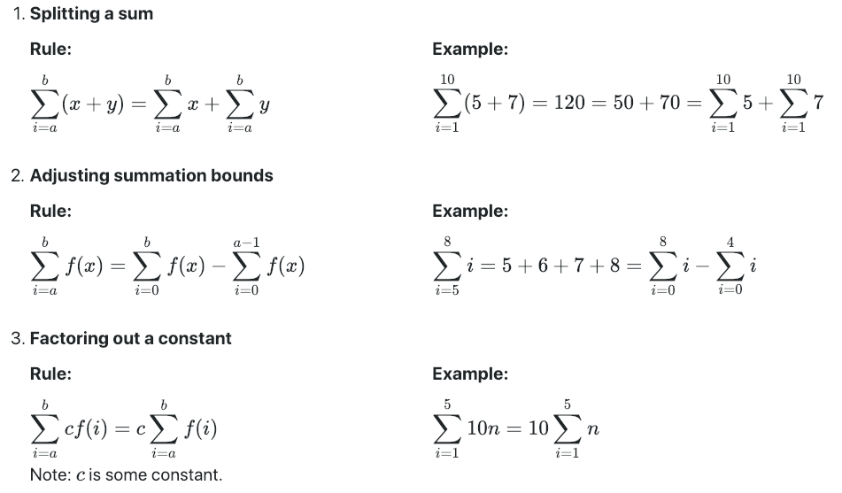
Summation Identities
https://courses.cs.washington.edu/courses/cse373/19wi/resources/math/
Provided on the exams!
And more!

Slide 15
Simplifying Summations
for (int i = 0; i < n; i++) {
for (int j = 0; j < i; j++) {
System.out.println(“Hello!”);
}
}
$$T\left(n\right)=\sum_{i=0}^{n−1}{\sum_{j=0}^{i−1}{1}}$$
Summation of a constant
$$\sum_{i=0}^{n−1}{1・i}$$
$$\sum_{i=0}^{n−1}{c=cn}$$
=
Factoring out a constant
$$1\sum_{i=0}^{n−1}{i}$$
=
$$\sum_{i=a}^{b}{cf\left(i\right)=c\sum_{i=a}^{b}{f(i)}}$$
Gauss’s Identity
$$c\frac{n\left(n−1\right)}{2}$$
$$\sum_{i=0}^{n−1}{i=\frac{n\left(n−1\right)}{2}}$$
=
$$\frac{c}{2}n^{2}−\frac{c}{2}n$$
=
O(n²)
=

Slide 16
Modeling Recursion
1 Minute
Write a mathematical model of the following code
public int factorial(int n) {
if (n == 0 || n == 1) {
return 1;
} else {
return n * factorial(n-1);
}
}
+3
+1
+1
+??????
recurrence!
$$T\left(n\right)=\left\{\begin{aligned}4 when n=0,1 \\ T\left(n−1\right) otherwise\end{aligned}\right.$$

Slide 17
Writing a Recurrence
If the function runs recursively, our formula for the running time should probably be recursive as well.
Such a formula is called a recurrence.
$T\left(n\right)= \left\{\begin{aligned}T\left(n−1\right)+2 if n>1 \\ 1 otherwise\end{aligned}\right.$
What does this say?
The input to $T$is the size of the input to the Length.
If the input to T() is large, the running time depends on the recusive call.
If not we can just use the base case.

Slide 18
Another example
public int Mystery(int n){
if(n == 1) {
return 1;
} else {
for(int i = 0; i < n; i++){
for(int j = 0; j < n; j++){
System.out.println(“hi!”);
}
}
return Mystery(n/2)
}
}
+1
+1
+1
1 * n
1 * n * n
$$T\left(n\right)= \left\{\begin{aligned}1 when n=1 \\ T\left(n/2\right)+n^{2} if n>1\end{aligned}\right.$$

