Slide 1
Lecture 4: Introduction to Asymptotic Analysis
CSE 373: Data Structures and Algorithms

Slide 2
Warm Up
5 Minutes
Read through the code on the worksheet given
Come up with a test case for each of the described test categories
Expected Behavior
Forbidden Input
Empty/Null
Boundary/Edge
Scale
add(1)
add(null)
Add into empty list
Add enough values to trigger internal array double and copy
Add 1000 times in a row
Socrative:
www.socrative.com
Room Name: CSE373
Please enter your name as: Last, First

Slide 3
Administrivia
Fill out class survey
Find a partner by Thursday!
143 Review TONIGHT - SIEG 134 6:00pm

Slide 4
Algorithm Analysis

Slide 5
Code Analysis
How do we compare two pieces of code?
Time needed to run
Memory used
Number of network calls
Amount of data saved to disk
Specialized vs generalized
Code reusability
Security

Slide 6
Comparing Algorithms with Mathematical Models
Consider overall trends as inputs increase
Computers are fast, small inputs don’t differentiate
Must consider what happens with large inputs
Estimate final result independent of incidental factors
CPU speed, programming language, available computer memory
Model performance across multiple possible scenarios
Worst case - what is the most expensive or least performant an operation can be
Average case – what functions are most likely to come up?
Best case – if we understand the ideal conditions can increase the likelihood of those conditions?
Identify trends without investing in testing

Slide 7
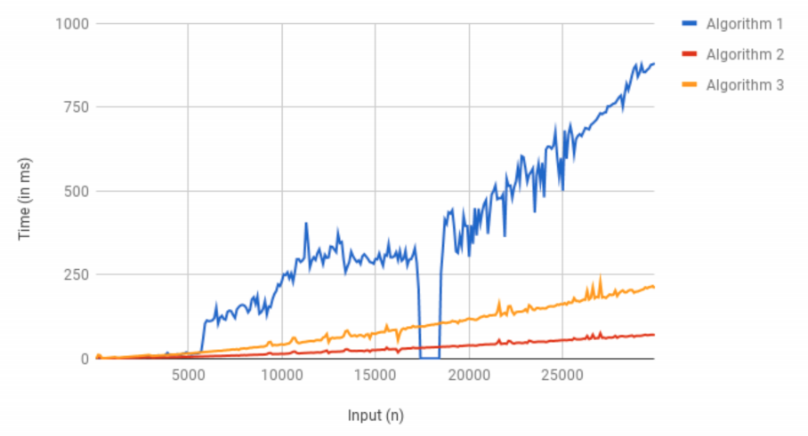
Which is the best algorithm?
Algorithm | Runtime (in ms)
Algorithm 1 | 1
Algorithm 2 | 30
Algorithm 3 | 100
Does this apply to the same number of inputs?
Are we going to pass in the same number of inputs on each run?

Slide 8
Review: Sequential Search
1 Minute
sequential search: Locates a target value in an array / list by examining each element from start to finish.
Example: Searching the array below for the value 42:
index | 0 | 1 | 2 | 3 | 4 | 5 | 6 | 7 | 8 | 9 | 10 | 11 | 12 | 13 | 14 | 15 | 16
value | -4 | 2 | 7 | 10 | 15 | 20 | 22 | 25 | 30 | 36 | 42 | 50 | 56 | 68 | 85 | 92 | 103
i
How many elements will be examined?
What is the best case?
What is the worst case?
What is the complexity class?
First element examined, index 0
Last element examined, index 16
Or item not in array
O(n)

Slide 9
Review: Binary Search
2 Minutes
binary search: Locates a target value in a sorted array or list by successively eliminating half of the array from consideration.
Example: Searching the array below for the value 42:
index | 0 | 1 | 2 | 3 | 4 | 5 | 6 | 7 | 8 | 9 | 10 | 11 | 12 | 13 | 14 | 15 | 16
value | -4 | 2 | 7 | 10 | 15 | 20 | 22 | 25 | 30 | 36 | 42 | 50 | 56 | 68 | 85 | 92 | 103
min
mid
max
How many elements will be examined?
What is the best case?
What is the worst case?
What is the complexity class?
First element examined, index 8
Last element examined, index 9
Or item not array
Log₂(n)

Slide 10
Analyzing Binary Search
What is the pattern?
At each iteration, we eliminate half of the remaining elements
How long does it take to finish?
1st iteration – N/2 elements remain
2nd iteration – N/4 elements remain
Kth iteration - N/2^{k} elements remain
$$\frac{n}{2^{k}}=1$$
Finishes when
-> multiply right side by 2^{K}
N = 2^{K}
-> isolate K exponent with logarithm
log₂N = k
$$\frac{n}{2^{k}}=1$$
index | 0 | 1 | 2 | 3 | 4 | 5 | 6 | 7 | 8 | 9 | 10 | 11 | 12 | 13 | 14 | 15 | 16
value | -4 | 2 | 7 | 10 | 15 | 20 | 22 | 25 | 30 | 36 | 42 | 50 | 56 | 68 | 85 | 92 | 103

Slide 11
Asymptotic Analysis
asymptotic analysis – the process of mathematically representing runtime of a algorithm in relation to the number of inputs and how that relationship changes as the number of inputs grow
Two step process
Model – reduce code run time to a mathematical relationship with number of inputs
Analyze – compare runtime/input relationship across multiple algorithms

Slide 12
Code Modeling

Slide 13
Code Modeling
code modeling – the process of mathematically representing how many operations a piece of code will run in relation to the number of inputs n
Examples:
Sequential search
Binary search
$$f\left(n\right)=n$$
$$f\left(n\right)=log2n$$
What counts as an “operation”?
Basic operations
Adding ints or doubles
Variable assignment
Variable update
Return statement
Accessing array index or object field
Consecutive statements
Sum time of each statement
Assume all operations run in equivalent time
Function calls
Count runtime of function body
Conditionals
Time of test + worst case scenario branch
Loops
Number of iterations of loop body x runtime of loop body

Slide 14
Modeling Case Study
Goal: return ‘true’ if a sorted array of ints contains duplicates
Solution 1: compare each pair of elements
public boolean hasDuplicate1(int[] array) {
for (int i = 0; i < array.length; i++) {
for (int j = 0; j < array.length; j++) {
if (i != j && array[i] == array[j]) {
return true;
}
}
}
return false;
}
Solution 2: compare each consecutive pair of elements
public boolean hasDuplicate2(int[] array) {
for (int i = 0; i < array.length - 1; i++) {
if (array[i] == array[i + 1]) {
return true;
}
}
return false;
}

Slide 15
Modeling Case Study: Solution 2
$$f\left(n\right)$$
Goal: produce mathematical function representing runtime where n = array.length
Solution 2: compare each consecutive pair of elements
public boolean hasDuplicate2(int[] array) {
for (int i = 0; i < array.length - 1; i++) {
if (array[i] == array[i + 1]) {
return true;
}
}
return false;
}
linear -> O(n)
loop = (n – 1)(body)
+4
+1
If statement = 5
+1
Approach
-> start with basic operations, work inside out for control structures
Each basic operation = +1
Conditionals = worst case test operations + branch
Loop = iterations (loop body)
$$f\left(n\right)=5\left(n−1\right)+1$$

Slide 16
Modeling Case Study: Solution 1
Solution 1: compare each consecutive pair of elements
public boolean hasDuplicate1(int[] array) {
for (int i = 0; i < array.length; i++) {
for (int j = 0; j < array.length; j++) {
if (i != j && array[i] == array[j]) {
return true;
}
}
}
return false;
}
quadratic -> O(n²)
x n
x n
+5
6n²
+1
6n
6
+1
Approach
-> start with basic operations, work inside out for control structures
Each basic operation = +1
Conditionals = worst case test operations + branch
Loop = iterations (loop body)
$$f\left(n\right)=5\left(n−1\right)+1$$

Slide 17
Your turn!
5 Minutes
Write the specific mathematical code model for the following code and indicate the big o runtime.
public void foobar (int k) {
int j = 0;
while (j < k) {
for (int i = 0; i < k; i++) {
System.out.println(“Hello world”);
}
j = j + 5;
}
}
+1
+k/5 (body)
$$f\left(k\right)=\frac{\left(k+2\right)}{5}$$
+k(body)
+1
linear -> O(n)
+2
Approach
-> start with basic operations, work inside out for control structures
Each basic operation = +1
Conditionals = worst case test operations + branch
Loop = iterations (loop body)

