Slide 1
Lecture 1: Welcome!
CSE 373: Data Structures and Algorithms

Slide 2
Agenda
Introductions
Syllabus
Dust off data structure cob webs
Meet the ADT
What is “complexity”?

Slide 3
Waitlist/ Overloads
There are no overloads
I have no control over these things :/
Email cse373@cs.washington.edu for all registration questions
Many students move around, likely a spot will open
Keep coming to lecture!

Slide 4
Hello!
I am Kasey Champion
Software Engineer @ Karat
High School Teacher @ Franklin High
champk@cs.washington.edu
Office in CSE 218
Office Hours: Wednesdays 9:30-11:30, Fridays 2:30-4:30
@techie4good

Slide 5
Class Style
Kasey has to go to her “real job” after this
The internets
Your TAs
Each other
Please come to lecture (yes, there will be panoptos)
Warm Ups -> Extra Credit
Collaboration
Demos
Ask questions! Point out mistakes!
Sections
TAs = heroes
Exam Practice problems
Sections start this week

Slide 6
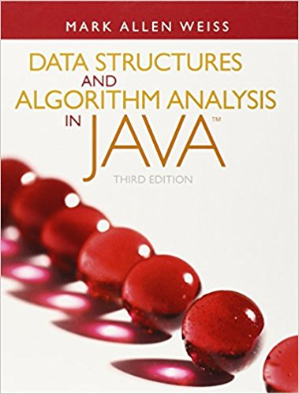
Course Administration
Course Page
All course content/announcements posted here
Pay attention for updates!
Canvas
Grades will be posted here
Office Hours
Will be posted on Course Page
Will start next week
Google Discussion Board
Great place to discuss questions with other students
Will be monitored by course staff
No posting of project code!
Textbook
Optional
Data Structures and Algorithm Analysis in Java by Mark Allen Weiss

Slide 7
Grade Break Down
Homework (55%)
4 Partner Projects (40%)
Partners encouraged
Graded automatically
3 Individual Assignments (15%)
Must be individual
Graded by TAs
Exams (35%)
Midterm Exam – Friday February 15th in class (20%)
Final Exam – Tuesday March 19th 8:30-10:30 here! (25%)

Slide 8
Syllabus
Homework Policies
3 late days
Both partners must use one
When you run out you will forfeit 20% each 24 hour period an assignment is late
No assignment will be accepted more than 2 days late
Project Regrades
Get back half your missed points for part 1 when you turn in part 2
Email Kasey if you believe grades are incorrect
Exams
Allowed 8.5”x11” note page
NO MAKE UPS!
Let Kasey know ASAP if you cannot attend an exam
Academic Integrity
No posting code on discussion board or ANYWHERE online
We do run MOSS
No directly sharing code with one another (except for partners)
Extra Credit
Available on some homework assignments
Available for attending lecture
Worth up to 0.05 GPA bump

Slide 9
Questions?
Clarification on syllabus, General complaining/moaning

Slide 10
What is this class about?
CSE 143 – Object Oriented Programming
CSE 373 – Data Structures and Algorithms
Classes and Interfaces
Methods, variables and conditionals
Loops and recursion
Linked lists and binary trees
Sorting and Searching
O(n) analysis
Generics
Design decisions
Design analysis
Implementations of data structures
Debugging and testing
Abstract Data Types
Code Modeling
Complexity Analysis
Software Engineering Practices

Slide 11
Data Structures and Algorithms
What are they anyway?

Slide 12
Basic Definitions
Data Structure
A way of organizing and storing related data points
Examples from CSE 14X: arrays, linked lists, stacks, queues, trees
Algorithm
A series of precise instructions used to perform a task
Examples from CSE 14X: binary search, merge sort, recursive backtracking

Slide 13
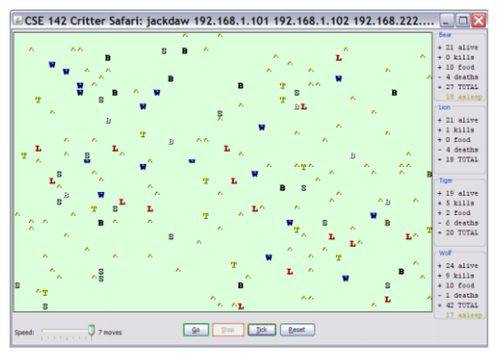
Review: Clients vs Objects
Client classes
Object Classes
A class that is executable, in Java this means it contains a Main method
public static void main(String[] args)
A coded structure that contains data and behavior
Start with the data you want to hold, organize the things you want to enable users to do with that data

Slide 14
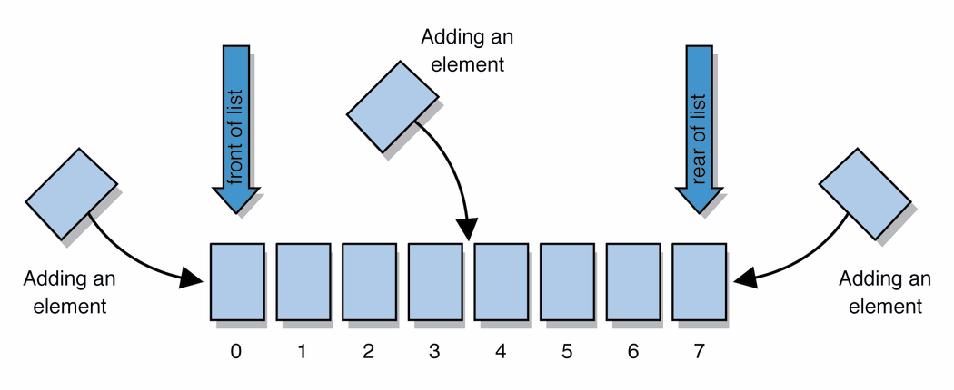
Abstract Data Types (ADT)
Abstract Data types
A definition for expected operations and behavior
Start with the operations you want to do then define how those operations will play out on whatever data is being stored
Review: List - a collection storing an ordered sequence of elements
each element is accessible by a 0-based index
a list has a size (number of elements that have been added)
elements can be added to the front, back, or elsewhere
in Java, a list can be represented as an ArrayList object
Notes:
A way to communicate with other programmers, a standard that we all can agree on so we can discuss conceptual ways of organizing data

Slide 15
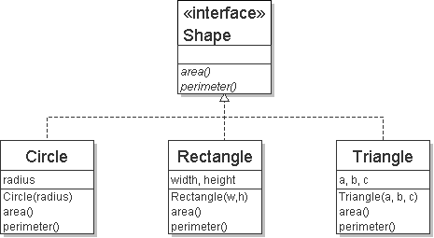
Review: Interfaces
Example
// Describes features common to all // shapes.
public interface Shape {
public double area();
public double perimeter();
}
interface: A list of methods that a class promises to implement.
Interfaces give you an is-a relationship without code sharing.
A Rectangle object can be treated as a Shape but inherits no code.
Analogous to non-programming idea of roles or certifications:
"I'm certified as a CPA accountant. This assures you I know how to do taxes, audits, and consulting."
"I'm 'certified' as a Shape, because I implement the Shape interface. This assures you I know how to compute my area and perimeter."
public interface name {
public type name(type name, ..., type name);
public type name(type name, ..., type name);
...
public type name(type name, ..., type name);
}

Slide 16
Review: Java Collections
Java provides some implementations of ADTs for you!
You used:
Lists List<Integer> a = new ArrayList<Integer>();
Stacks Stack<Character> c = new Stack<Character>();
Queues Queue<String> b = new LinkedList<String>();
Maps Map<String, String> d = new TreeMap<String, String>();
But some data structures you made from scratch… why?
Linked Lists - LinkedIntList was a collection of ListNode
Binary Search Trees – SearchTree was a collection of SearchTreeNodes

Slide 17
Full Definitions
Abstract Data Type (ADT)
A definition for expected operations and behavior
A mathematical description of a collection with a set of supported operations and how they should behave when called upon
Describes what a collection does, not how it does it
Can be expressed as an interface
Examples: List, Map, Set
Data Structure
A way of organizing and storing related data points
An object that implements the functionality of a specified ADT
Describes exactly how the collection will perform the required operations
Examples: LinkedIntList, ArrayIntList

Slide 18
ADTs we’ll discuss this qarter
List
Set
Map
Stack
Queue
Priority Queue
Graph

Slide 19
Case Study: The List ADT
list: stores an ordered sequence of information.
Each item is accessible by an index.
Lists have a variable size as items can be added and remove
List ADT
supported operations:
get(index): returns the item at the given index
set(value, index): sets the item at the given index to the given value
append(value): adds the given item to the end of the list
insert(value, index): insert the given item at the given index maintaining order
delete(index): removes the item at the given index maintaining order
size(): returns the number of elements in the list
state
Set of ordered items
Count of items
behavior
get(index) return item at index
set(item, index) replace item at index
append(item) add item to end of list
insert(item, index) add item at index
delete(index) delete item at index
size() count of items

Slide 20
Case Study: List Implementations
ArrayList
uses an Array as underlying storage
LinkedList
uses nodes as underlying storage
List ADT
ArrayList<E>
LinkedList<E>
state
Set of ordered items
Count of items
state
state
data[]
size
Node front
size
behavior
get(index) return item at index
set(item, index) replace item at index
append(item) add item to end of list
insert(item, index) add item at index
delete(index) delete item at index
size() count of items
behavior
behavior
get return data[index]
set data[index] = value
append data[size] = value, if out of space grow data
insert shift values to make hole at index, data[index] = value, if out of space grow data
delete shift following values forward
size return size
get loop until index, return node’s value
set loop until index, update node’s value
append create new node, update next of last node
insert create new node, loop until index, update next fields
delete loop until index, skip node
size return size
0 | 1 | 2 | 3 | 4
88.6 | 26.1 | 94.4 | 0 | 0
88.6
26.1
94.4
list
free space
Notes:
Code up an implementation of List

Slide 21
Implementing ArrayList
insert(element, index) with shifting
ArrayList<E>
0 | 1 | 2 | 3
state
insert(10, 0)
5
3
4
5
10
3
4
data[]
size
4
behavior
numberOfItems =
3
get return data[index]
set data[index] = value
append data[size] = value, if out of space grow data
insert shift values to make hole at index, data[index] = value, if out of space grow data
delete shift following values forward
size return size
delete(index) with shifting
0 | 1 | 2 | 3
10
3
4
5
delete(0)
3
4
5
numberOfItems =
4
3

Slide 22
Implementing ArrayList
append(element) with growth
ArrayList<E>
0 | 1 | 2 | 3
state
append(2)
10
3
4
5
data[]
size
behavior
get return data[index]
set data[index] = value
append data[size] = value, if out of space grow data
insert shift values to make hole at index, data[index] = value, if out of space grow data
delete shift following values forward
size return size
numberOfItems =
4
5
0 | 1 | 2 | 3 | 4 | 5 | 6 | 7
2

Slide 23
Design Decisions
For every ADT there are lots of different ways to implement them
Based on your situation you should consider:
Memory vs Speed
Generic/Reusability vs Specific/Specialized
One Function vs Another
Robustness vs Performance
This class is all about implementing ADTs based on making the right design tradeoffs!
> A common topic in interview questions

Slide 24
Review: “Big Oh”
efficiency: measure of computing resources used by code.
can be relative to speed (time), memory (space), etc.
most commonly refers to run time
Assume the following:
Any single Java statement takes same amount of time to run.
A method call's runtime is measured by the total of the statements inside the method's body.
A loop's runtime, if the loop repeats N times, is N times the runtime of the statements in its body.
We measure runtime in proportion to the input data size, N.
growth rate: Change in runtime as N gets bigger. How does this algorithm perform with larger and larger sets of data?
b = c + 10;
for (int i = 0; i < N; i++) {
for (int j = 0; j < N; j++) {
dataTwo[j][i] = dataOne[i][j];
dataOne[i][j] = 0;
}
}
for (int i = 0; i < N; i++) {
dataThree[i] = b;
}
This algorithm runs 2N² + N + 1 statements.
We ignore constants like 2 because they are tiny next to N.
The highest-order term (N²) “dominates” the overall runtime.
We say that this algorithm runs "on the order of" N².
or O(N²) for short ("Big-Oh of N squared")

Slide 25
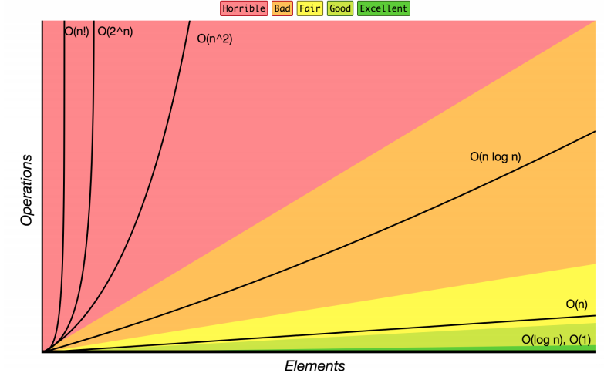
Review: Complexity Class
complexity class: A category of algorithm efficiency based on the algorithm's relationship to the input size N.
Complexity Class | Big-O | Runtime if you double N | Example Algorithm
constant | O(1) | unchanged | Accessing an index of an array
logarithmic | O(log₂ N) | increases slightly | Binary search
linear | O(N) | doubles | Looping over an array
log-linear | O(N log₂ N) | slightly more than doubles | Merge sort algorithm
quadratic | O(N²) | quadruples | Nested loops!
... | ... | ... | ...
exponential | O(2^{N}) | multiplies drastically | Fibonacci with recursion

Slide 26
List ADT tradeoffs
Time needed to access i-th element:
Array: O(1) constant time
LinkedList: O(n) linear time
Time needed to insert at i-th element
Array: O(n) linear time
LinkedList: O(n) linear time
Amount of space used overall
Array: sometimes wasted space
LinkedList: compact
Amount of space used per element
Array: minimal
LinkedList: tiny extra
char[] myArr = new char[5]
0 | 1 | 2 | 3 | 4
‘h’ | ‘e’ | ‘l’ | ‘l’ | ‘o’
LinkedList<Character> myLl = new LinkedList<Character>();
front
‘h’
‘e’
‘l’
‘l’
‘o’ | /

Slide 27
TODO list
Skim through full Syllabus on class web page
Sign up for Google Discussion
Review 142/143 materials. Materials provided on class webpage.
Sign Up for Practice-It http://practiceit.cs.washington.edu

