Slide 1
Lecture 17: Shortest Paths
CSE 373: Data Structures and Algorithms

Slide 2
Administrivia
Project 4 partner form due tonight.
Project 3 due Wednesday
Exercise 4 is out.

Slide 3
Warm Up
Run Breadth First Search on this graph starting from s.
What order are vertices placed on the queue?
When processing a vertex insert neighbors in alphabetical order.
In a directed graph, BFS only follows an edge in the direction it points.
x
bfs(graph)
toVisit.enqueue(first vertex)
mark first vertex as seen
while(toVisit is not empty)
current = toVisit.dequeue()
for (V : current.outneighbors())
if (v is not seen)
mark v as visited
toVisit.enqueue(v)
u
s
t
v
y
pollEV.com/cse373su19
What order are vertices placed on the queue?
w
Notes:
9:22

Slide 4
Warm Up
Run Breadth First Search on this graph starting from s.
What order are vertices placed on the queue?
When processing a vertex insert neighbors in alphabetical order.
In a directed graph, BFS only follows an edge in the direction it points.
x
bfs(graph)
toVisit.enqueue(first vertex)
mark first vertex as seen
while(toVisit is not empty)
current = toVisit.dequeue()
for (V : current.outneighbors())
if (v is not seen)
mark v as visited
toVisit.enqueue(v)
u
s
t
v
y
Correct order: s,u,v,y,x,w,t
w
Notes:
9:22

Slide 5
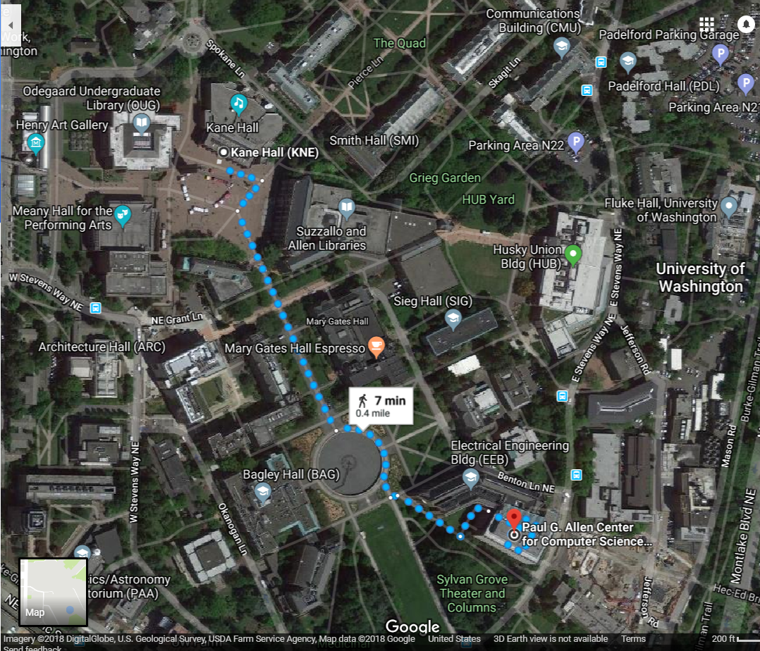
Shortest Paths
How does Google Maps figure out this is the fastest way to get to office hours?

Slide 6
Representing Maps as Graphs
How do we represent a map as a graph? What are the vertices and edges?

Slide 7
Representing Maps as Graphs
K
2
1
R
2
S
H
4
4
5
D
3
P

Slide 8
Shortest Paths
The length of a path is the sum of the edge weights on that path.
Shortest Path Problem
Given: a directed graph G and vertices s and t
Find: the shortest path from s to t
1
y
4
3
s
w
t
5
6
4
5
2
u
v
x
1

Slide 9
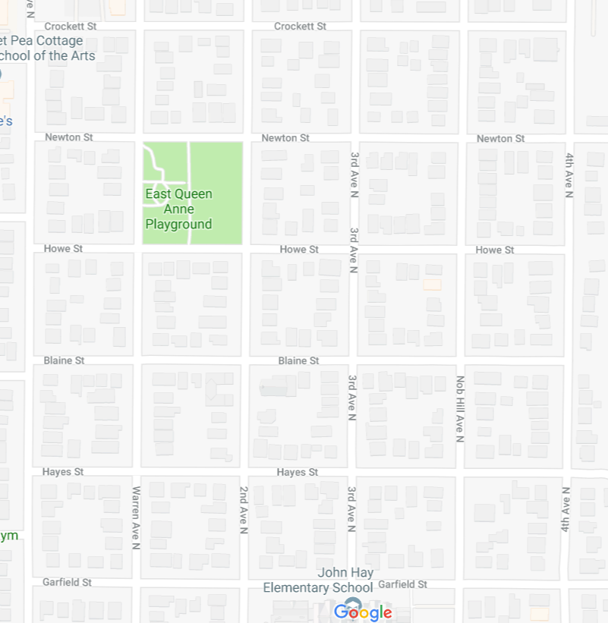
Unweighted graphs
Let’s start with a simpler version: the edges are all the same weight (unweighted)
If the graph is unweighted, how do we find a shortest paths?
Notes:
9:38:30

Slide 10
Unweighted Graphs
If the graph is unweighted, how do we find a shortest paths?
What’s the shortest path from s to s?
Well….we’re already there.
What’s the shortest path from s to u or v?
Just go on the edge from s
From s to w,x, or y?
Can’t get there directly from s, if we want a length 2 path, have to go through u or v.
u
w
s
y
t
v
x

Slide 11
Unweighted Graphs: Key Idea
To find the set of vertices at distance k, just find the set of vertices at distance k-1, and see if any of them have an outgoing edge to an undiscovered vertex.
Do we already know an algorithm that does something like that?
Yes! BFS!
bfsShortestPaths(graph G, vertex source)
toVisit.enqueue(source)
mark source as seen
source.dist = 0
while(toVisit is not empty){
current = toVisit.dequeue()
for (v : current.outNeighbors())
{
if (v is not seen){
v.distance = current.distance + 1
v.predecessor = current
toVisit.enqueue(v)
mark v as seen
}
}
}

Slide 12
Unweighted Graphs
Use BFS to find shortest paths in this graph.
bfsShortestPaths(graph G, vertex source)
toVisit.enqueue(source)
mark source as seen
source.dist = 0
while(toVisit is not empty){
current = toVisit.dequeue()
for (v : current.outNeighbors())
{
if (v is not seen){
v.distance = current.distance + 1
v.predecessor = current
toVisit.enqueue(v)
mark v as seen
}
}
}
u
w
s
y
t
v
x

Slide 13
Unweighted Graphs
Use BFS to find shortest paths in this graph.
1
2
bfsShortestPaths(graph G, vertex source)
toVisit.enqueue(source)
mark source as seen
source.dist = 0
while(toVisit is not empty){
current = toVisit.dequeue()
for (v : current.outNeighbors())
{
if (v is not seen){
v.distance = current.distance + 1
v.predecessor = current
toVisit.enqueue(v)
mark v as seen
}
}
}
u
w
2
s
y
t
3
v
x
1
2

Slide 14
What about the target vertex?
Given: a directed graph G and vertices s,t
Find: the shortest path from s to t.
Shortest Path Problem
BFS didn’t mention a target vertex…
It actually finds the distance from s to every other vertex.
All our shortest path algorithms have this property.
If you only care about one target, you can sometimes stop early (in bfsShortestPaths, when the target pops off the queue)
Notes:
9:48

Slide 15
Weighted Graphs
Each edge should represent the “time” or “distance” from one vertex to another.
Sometimes those aren’t uniform, so we put a weight on each edge to record that number.
The length of a path in a weighted graph is the sum of the weights along that path.
We’ll assume all of the weights are positive
For GoogleMaps that definitely makes sense.
Sometimes negative weights make sense. Today’s algorithm doesn’t work for those graphs
There are other algorithms that do work.
Notes:
9:50

Slide 16
Weighted Graphs: Take 1
BFS works if the graph is unweighted.
Maybe it just works for weighted graphs too?
1
1
w
x
1
s
u
v
t
20
1
1

Slide 17
Weighted Graphs: Take 1
BFS works if the graph is unweighted. Maybe it just works for weighted graphs too?
$$∞$$
$$1$$
$$∞$$
1
$$2$$
1
w
x
1
s
u
v
t
0
20
$$∞$$
1
$$∞$$
1
$$∞$$
$$20$$
$$22$$
$$3$$
$$21$$
What went wrong? When we found a shorter path from s to u, we needed to update the distance to v (and anything whose shortest path went through u) but BFS doesn’t do that.

Slide 18
Weighted Graphs: Take 2
Using an algorithm for Problem B to solve Problem A.
Reduction (informally)
You already do this all the time.
In Project 2, you reduced implementing a hashset to implementing a hashmap.
Any time you use a library, you’re reducing your problem to the one the library solves.
Can we reduce finding shortest paths on weighted graphs to finding them on unweighted graphs?
Notes:
9:55

Slide 19
Weighted Graphs: Take 2
Given a weighted graph, how do we turn it into an unweighted one without messing up the path lengths?

Slide 20
Weighted Graphs: A Reduction
Transform Input
u
2
u
1
2
s
t
s
t
1
v
v
Unweighted Shortest Paths
2
u
s
t
2
v
Transform Output
2
u
1
2
s
t
2
1
v
2

Slide 21
Weighted Graphs: A Reduction
What is the running time of our reduction on this graph?
O(|V|+|E|) of the modified graph, which is…slow.
Does our reduction even work on this graph?
Ummm….
5000
u
150
$$0.5$$
u
$$3$$
200
$$π$$
s
t
s
t
1
v
5000
1
v
5000
tl;dr: If your graph’s weights are all small positive integers, this reduction might work great.
Otherwise we probably need a new idea.

Slide 22
Weighted Graphs: Take 3
So we can’t just do a reduction.
Instead figure out why BFS worked in the unweighted case, try to make the same thing happen in the weighted case.
How did we avoid this problem:
$$1$$
1
$$2$$
1
w
x
1
s
u
v
t
0
20
$$3$$
1
$$21$$
1
$$22$$
Notes:
10:01

Slide 23
Weighted Graphs: Take 3
In BFS When we used a vertex u to update shortest paths we already knew the exact shortest path to u.
So we never ran into the update problem
If we process the vertices in order of distance from s, we have a chance.

Slide 24
Weighted Graphs: Take 3
Goal: Process the vertices in order of distance from s
Idea:
Have a set of vertices that are “known”
(we know at least one path from s to them).
Record an estimated distance
(the best way we know to get to each vertex).
If we process only the vertex closest in estimated distance, we won’t ever find a shorter path to a processed vertex.
This statement is the key to proving correctness.
It’s nice if you want to practice induction/understand the algorithm better.

Slide 25
Dijkstra’s Algorithm
Vertex | Distance | Predecessor | Processed
s
w
x
u
v
t
Dijkstra(Graph G, Vertex source)
initialize distances to $∞$
mark source as distance 0
mark all vertices unprocessed
while(there are unprocessed vertices){
let u be the closest unprocessed vertex
foreach(edge (u,v) leaving u){
if(u.dist+weight(u,v) < v.dist){
v.dist = u.dist+weight(u,v)
v.predecessor = u
}
}
mark u as processed
}
1
1
w
x
1
s
u
v
t
20
1
1

Slide 26
Dijkstra’s Algorithm
Vertex | Distance | Predecessor | Processed
s | 0 | -- | Yes
w | 1 | s | Yes
x | 2 | w | Yes
u | 20 3 | s x | Yes
v | 4 | u | Yes
t | 5 | v | Yes
Dijkstra(Graph G, Vertex source)
initialize distances to $∞$
mark source as distance 0
mark all vertices unprocessed
while(there are unprocessed vertices){
let u be the closest unprocessed vertex
foreach(edge (u,v) leaving u){
if(u.dist+weight(u,v) < v.dist){
v.dist = u.dist+weight(u,v)
v.predecessor = u
}
}
mark u as processed
}
1
1
w
x
1
s
u
v
t
20
1
1

Slide 27
Dijkstra’s Run Through
Vertex | Distance | Predecessor | Processed
S
C
B
T
E
Pseudocode
Dijkstra(Graph G, Vertex source)
initialize distances to $∞$
mark all vertices unprocessed
mark source as distance 0
while(there are unprocessed vertices){
let u be the closest unprocessed vertex
for each(edge (u,v) leaving u){
if(u.dist+weight(u,v) < v.dist){
v.dist = u.dist+weight(u,v)
v.predecessor = u
}
}
mark u as processed
}

Slide 28
Dijkstra’s Run Through
Vertex | Distance | Predecessor | Processed
S | 0 |  | No
C | ∞ |  | No
B | ∞ |  | No
T | ∞ |  | No
E | ∞ |  | No
Pseudocode
Dijkstra(Graph G, Vertex source)
initialize distances to $∞$
mark all vertices unprocessed
mark source as distance 0
while(there are unprocessed vertices){
let u be the closest unprocessed vertex
for each(edge (u,v) leaving u){
if(u.dist+weight(u,v) < v.dist){
v.dist = u.dist+weight(u,v)
v.predecessor = u
}
}
mark u as processed
}

Slide 29
Dijkstra’s Run Through
Vertex | Distance | Predecessor | Processed
S | 0 | -- | No
C | 6 | S | No
B | 1 | S | No
T | ∞ |  | No
E | ∞ |  | No
Pseudocode
Dijkstra(Graph G, Vertex source)
initialize distances to $∞$
mark all vertices unprocessed
mark source as distance 0
while(there are unprocessed vertices){
let u be the closest unprocessed vertex
for each(edge (u,v) leaving u){
if(u.dist+weight(u,v) < v.dist){
v.dist = u.dist+weight(u,v)
v.predecessor = u
}
}
mark u as processed
}

Slide 30
Dijkstra’s Run Through
Vertex | Distance | Predecessor | Processed
S | 0 | -- | Yes
C | 6 | S | No
B | 1 | S | No
T | ∞ |  | No
E | ∞ |  | No
Pseudocode
Dijkstra(Graph G, Vertex source)
initialize distances to $∞$
mark all vertices unprocessed
mark source as distance 0
while(there are unprocessed vertices){
let u be the closest unprocessed vertex
for each(edge (u,v) leaving u){
if(u.dist+weight(u,v) < v.dist){
v.dist = u.dist+weight(u,v)
v.predecessor = u
}
}
mark u as processed
}

Slide 31
Dijkstra’s Run Through
Vertex | Distance | Predecessor | Processed
S | 0 | -- | Yes
C | 6 | S | No
B | 1 | S | Yes
T | 6 | B | No
E | 2 | B | No
Pseudocode
Dijkstra(Graph G, Vertex source)
initialize distances to $∞$
mark all vertices unprocessed
mark source as distance 0
while(there are unprocessed vertices){
let u be the closest unprocessed vertex
for each(edge (u,v) leaving u){
if(u.dist+weight(u,v) < v.dist){
v.dist = u.dist+weight(u,v)
v.predecessor = u
}
}
mark u as processed
}

Slide 32
Dijkstra’s Run Through
Vertex | Distance | Predecessor | Processed
S | 0 | -- | Yes
C | 6 | S | No
B | 1 | S | Yes
T | 6 3 | E | No
E | 2 | B | Yes
Pseudocode
Dijkstra(Graph G, Vertex source)
initialize distances to $∞$
mark all vertices unprocessed
mark source as distance 0
while(there are unprocessed vertices){
let u be the closest unprocessed vertex
for each(edge (u,v) leaving u){
if(u.dist+weight(u,v) < v.dist){
v.dist = u.dist+weight(u,v)
v.predecessor = u
}
}
mark u as processed
}

Slide 33
Dijkstra’s Run Through
Vertex | Distance | Predecessor | Processed
S | 0 | -- | Yes
C | 6 | S | No
B | 1 | S | Yes
T | 6 3 | E | Yes
E | 2 | B | Yes
Pseudocode
Dijkstra(Graph G, Vertex source)
initialize distances to $∞$
mark all vertices unprocessed
mark source as distance 0
while(there are unprocessed vertices){
let u be the closest unprocessed vertex
for each(edge (u,v) leaving u){
if(u.dist+weight(u,v) < v.dist){
v.dist = u.dist+weight(u,v)
v.predecessor = u
}
}
mark u as processed
}

Slide 34
Dijkstra’s Pseuodocode
Dijkstra(Graph G, Vertex source)
initialize distances to $∞$
mark source as distance 0
mark all vertices unprocessed
while(there are unprocessed vertices){
let u be the closest unprocessed vertex
foreach(edge (u,v) leaving u){
if(u.dist+weight(u,v) < v.dist){
v.dist = u.dist+weight(u,v)
v.predecessor = u
}
}
mark u as processed
}
Min Priority Queue ADT
state
Set of comparable values - Ordered by “priority”
Huh?
behavior
peek() – find the element with the smallest priority
insert(value) – add new element to collection
removeMin() – returns and removes element with the smallest priority

Slide 35
Dijkstra’s Pseuodocode
Dijkstra(Graph G, Vertex source)
initialize distances to $∞$
mark source as distance 0
mark all vertices unprocessed
initialize MPQ as a Min Priority Queue, add source
while(there are unprocessed vertices){
u = MPQ.removeMin();
foreach(edge (u,v) leaving u){
if(u.dist+weight(u,v) < v.dist){
v.dist = u.dist+weight(u,v)
v.predecessor = u
}
}
mark u as processed
}
Min Priority Queue ADT
state
Set of comparable values - Ordered by “priority”
How?
behavior
peek() – find the element with the smallest priority
insert(value) – add new element to collection
removeMin() – returns and removes element with the smallest priority

Slide 36
Dijkstra(Graph G, Vertex source)
initialize distances to $∞$
mark source as distance 0
mark all vertices unprocessed
initialize MPQ as a Min Priority Queue
add source
while(there are unprocessed vertices){
u = MPQ.removeMin();
foreach(edge (u,v) leaving u){
if(u.dist+weight(u,v) < v.dist){
v.dist = u.dist+weight(u,v)
v.predecessor = u
}
}
mark u as processed
}
Dijkstra(Graph G, Vertex source)
for (Vertex v : G.getVertices())
{ v.dist = INFINITY; }
G.getVertex(source).dist = 0;
initialize MPQ as a Min Priority Queue
add source
while(MPQ is not empty){
u = MPQ.removeMin();
for (Edge e : u.getEdges(u)){
oldDist = v.dist;
newDist = u.dist+weight(u,v)
if(newDist < oldDist){
v.dist = newDist
v.predecessor = u
if(oldDist == INFINITY) { MPQ.insert(v) }
else { MPQ.updatePriority(v, newDist) }
}
}
}

Slide 37
Dijkstra’s Runtime
Just like when we analyzed BFS, don’t just work inside out; try to figure out how many times each line will be executed.
Dijkstra(Graph G, Vertex source)
for (Vertex v : G.getVertices()) { v.dist = INFINITY; }
G.getVertex(source).dist = 0;
initialize MPQ as a Min Priority Queue, add source
while(MPQ is not empty){
u = MPQ.removeMin();
for (Edge e : u.getEdges(u)){
oldDist = v.dist; newDist = u.dist+weight(u,v)
if(newDist < oldDist){
v.dist = newDist
v.predecessor = u
if(oldDist == INFINITY) { MPQ.insert(v) }
else { MPQ.updatePriority(v, newDist) }
}
}
}
+logV
This actually doesn’t run $m$ times for every iteration of the outer loop. It actually will run $m$ times in total; if every vertex is only removed from the priority queue (processed) once, then we examine each edge once. Each line inside this foreach gets multiplied by a single E instead of E * V.
Tight O Bound = O(n log n + m log n)
+logV

Slide 38
More Dijkstra’s Implementation
The details of the implementation depend on what data structures you have available.
Your implementation in the programming project will be different in a few spots.
Our running time is $Θ(E\log{V}+V\log{V)}$ i.e. $Θ(m\log{n}+n\log{n)}.$
If you go to Wikipedia right now, they say it’s $O(E+V\log{V)}$
They’re using a Fibonacci heap instead of a binary heap.
$Θ(E\log{V+V\log{V)}}$is the right running time for this class.

Slide 39
Optional Content More Graph Applications

Slide 40
Another Application of Shortest Paths
Shortest path algorithms are obviously useful for GoogleMaps.
The wonderful thing about graphs is they can encode arbitrary relationships among objects.
We won’t test you on this application of Dijkstra’s
I just want you to see that these algorithms have non-obvious applications.
Notes:
Need 7 minutes.

Slide 41
Another Application of Shortest Paths
I have a message I need to get from point s to point t.
But the connections are unreliable.
What path should I send the message along so it has the best chance of arriving?
u
0.8
0.7
s
t
0.6
0.2
0.97
v
Given: a directed graph G, where each edge weight is the probability of successfully transmitting a message across that edge
Find: the path from s to t with maximum probability of message transmission
Maximum Probability Path

Slide 42
Another Application of Shortest Paths
Let each edge’s weight be the probability a message is sent successfully across the edge.
What’s the probability we get our message all the way across a path?
It’s the product of the edge weights.
We only know how to handle sums of edge weights.
Is there a way to turn products into sums?
$\log\left(ab\right)=\log{a+\log{b}}$
u
0.8
0.7
s
t
0.6
0.2
0.97
v

Slide 43
Another Application of Shortest Paths
u
-0.32
-0.51
s
t
-0.74
-2.32
-0.04
We’ve still got two problems.
1. When we take logs, our edge weights become negative.
2. We want the maximum probability of success, but that’s the longest path not the shortest one.
Multiplying all edge weights by negative one fixes both problems at once!
We reduced the maximum probability path problem to a shortest path problem by taking $−\log{()}$ of each edge weight.
v

Slide 44
Maximum Probability Path Reduction
Transform Input
u
u
0.8
0.7
0.32
0.51
s
t
s
0.74
t
0.6
0.2
0.97
2.32
0.04
v
v
Weighted Shortest Paths
u
0.32
0.51
s
0.74
t
2.32
0.04
Transform Output
u
v
0.8
0.7
s
0.6
t
0.2
0.97
v

