Slide 1
Lecture 24: Disjoint Sets
CSE 373: Data Structures and Algorithms

Slide 2
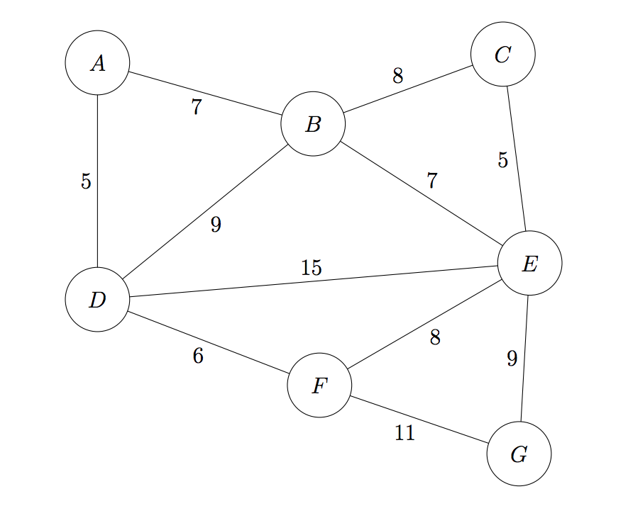
Warmup
Run Kruskal’s algorithm on the following graph to find the MST (minimum spanning tree) of the graph below.
Recall the definition of a minimum spanning tree: a minimum-weight set of edges such that you can get from
any vertex of the graph to any other on only those edges. The set of these edges form a valid tree in the graph.
Below is the provided pseudocode for Kruksal’s algorithm to choose all the edges.
PollEv.com/373lecture
KruskalMST(Graph G)
initialize each vertex to be an independent component
sort the edges by weight
foreach(edge (u, v) in sorted order){
if(u and v are in different components){
add (u,v) to the MST
update u and v to be in the same component
}
}

Slide 3
Announcements
Kasey out today (no Kasey 2:30 office hours)
Hw6 released, due next Wednesday
Hw7 partner form out now, due Monday 11:59pm.
If you do not fill out the partner form out on time, Brian will be sad because he has to do more work unnecessarily to fix it
No office hours Monday (Memorial Day)

Slide 4
What are we doing today?
- Disjoint Set ADT
- Implementing Disjoint Set
Disjoint Set is honestly a very specific ADT/Data structure that has pretty limited realistic uses … but it’s exciting because:
- is a cool recap of topics / touches on a bunch of different things we’ve seen in this course (trees, arrays, graphs, optimizing runtime, etc.)
- it has a lot of details and is fairly complex – it doesn’t seem like a plus at first, but after you learn this / while you’re learning this…you’ve come along way since lists and being able to learn new complex data structures is a great skill to have built)

Slide 5
The Disjoint Set ADT

Slide 6
Disjoint Sets in mathematics
- “In mathematics, two sets are said to be disjoint sets if they have no element in common.” - Wikipedia
- disjoint = not overlapping
Kevin
Meredith
Velocity
Blarry
Matt
Matt
Brian
Vivian
Sherdil
Set #1
Set #2
Set #3
Set #4
These two sets are disjoint sets
These two sets are not disjoint sets

Slide 7
Disjoint Sets in computer science
new ADT!
In computer science, a disjoint set keeps track of multiple “mini” disjoint sets (confusing naming, I know)
This overall grey blob thing is the actual
disjoint set, and it’s keeping track of any
number of mini-sets, which are all disjoint
(the mini sets have no overlapping
values).
Kevin
Velocity
Note: this might feel really different than ADTs we’ve
run into before. The ADTs we’ve seen before
(dictionaries, lists, sets, etc.) just store values directly.
But the Disjoint Set ADT is particularly interested in
letting you group your values into sets and
keep track of which particular set your values are in.
Blarry
Vivian
Sherdil
Set #1
Set #2
Notes:
Can think of the disjoint set we’re talking about today as a set of sets!
DW gonna be a little bit clearer as we go through some more examples and see some different disjoint sets.

Slide 8
What methods does the DisjointSet ADT have?
Just 3 methods (and one of them is pretty simple!)
- findSet(value)
- union(valueA, valueB)
- makeSet(value)

Slide 9
findSet(value)
findSet(value) returns some indicator for which particular set the value is in. You can think of this as an ID. For Disjoint Sets, we often call this the representative.
Examples:
findSet(Brian)
findSet(Sherdil)
findSet(Velocity)
findSet(Kevin) == findSet(Blarry)
3
Sherdil
2
Kasey
2
Kevin
Velocity
Brian
Blarry
true
Vivian
Keanu
Set #2
Set #4
Set #1
Set #3
3

Slide 10
What methods does the Disjoint Set ADT have?
Just 3 methods (and one of them is pretty simple!)
- findSet(value)
- union(valueA, valueB)
- makeSet(value)

Slide 11
union(valueA, valueB)
union(valueA, valueB) merges the set that A is in with the set that B is in. (basically add the two sets together into one)
Example: union(Blarry,Brian)
Sherdil
Sherdil
Kasey
Kasey
Kevin
Velocity
Kevin
Velocity
Brian
Blarry
Keanu
Blarry
Keanu
Brian
Vivian
Set #2
Set #4
Vivian
Set #2
Set #4
Set #3
Set #1
Set #1

Slide 12
What methods does the DisjointSet ADT have?
Just 3 methods (and one of them is pretty simple!)
- findSet(value)
- union(valueA, valueB)
- makeSet(value)

Slide 13
makeSet(value)
makeSet(value) makes a new mini set that just has the value parameter in it.
Examples:
makeSet(Cherie)
makeSet(Anish)
Cherie
Anish
Set #5
Set #6
Sherdil
Kasey
Kevin
Velocity
Brian
Blarry
Vivian
Keanu
Set #2
Set #4
Set #1
Set #3

Slide 14
Disjoint Set ADT Summary
Disjoint-Set ADT
state
Set of Sets
Mini sets are disjoint: Elements must be unique across mini sets
No required order
Each set has id/representative
behavior
makeSet(value) – creates a new set within the disjoint set where the only member is the value. Picks id/representative for set
findSet(value) – looks up the set containing the value, returns id/representative/ of that set
union(x, y) – looks up set containing x and set containing y, combines two sets into one. All of the values of one set are added to the other, and the now empty set goes away.

Slide 15
Why are we doing this again?
Notes:
It’s not obvious because Disjoint Sets seem like such a specific data structure what we’d use it for… but Kasey hinted at it on Wednesday and the warmup hinted at it too. … it turns out that Kruskal’s algorithm uses disjoint set in a very important way to build the MST

Slide 16
Kruskal’s Algorithm Implementation
KruskalMST(Graph G)
initialize each vertex to be an independent component
sort the edges by weight
foreach(edge (u, v) in sorted order){
if(u and v are in different components){
update u and v to be in the same component
add (u,v) to the MST
}
}
KruskalMST(Graph G)
foreach (V : G.vertices) {
makeSet(v);
}
sort the edges by weight
foreach(edge (u, v) in sorted order){
if(findSet(v) is not the same as findSet(u)){
union(u, v)
add (u, v) to the MST
}
}
Notes:
see each thing get translated
the disjoint set helps us easily skip over things that would create cycles, and also efficiently union components going forward

Slide 17
Kruskal’s with disjoint sets on the side example
KruskalMST(Graph G)
foreach (V : G.vertices) {
makeSet(v);
}
sort the edges by weight
foreach(edge (u, v) in sorted order){
if(findSet(v) is not the same as findSet(u)){
union(u, v)
}
}
Notes:
figure out what to say here more
probably just go through a couple of circling with makeSet, and checking findSet a couple times till you reach the first cycle inducing edge .. should be the 8s

Slide 18
Why are we doing this again? (continued)
Disjoint Sets help us manage groups of distinct values.
This is a common idea in graphs, where we want to keep track of different connected components of a graph.
In Kruskal’s, if each connected-so-far-island of the graph is its own mini set in our disjoint set, we can easily check that we don’t introduce cycles. If we’re considering a new edge, we just check that the two vertices of that edge are in different mini sets by calling findSet.

Slide 19
1 min break
Take a second to review notes with your neighbors, ask questions, try to clear up any confusions you have… we’ll group back up and see if there are still any unanswered questions then!

Slide 20
Implementing Disjoint Set

Slide 21
Implementing Disjoint Set with Dictionaries
Approach 1: dictionary of value -> set ID/representative
Approach 2: dictionary of ID/representative of set
-> all the values in that set
Sherdil
1
1
Sarah, Sherdil
Robbie
2
2
Robbie
Sarah
1
Notes:
explain that the words are the values – for example sherdil is a value in this disjoint set and is in the set # 1. Sarah is in the same set.
Ask for questions here after this slide

Slide 22
Exercise (1.5 min)
Calculate the worst case Big O runtimes for each of the methods (makeSet, findSet, union) for both approaches.
Approach 2: dictionary of ID/representative of set
-> all the values in that set
Approach 1: dictionary of value -> set ID/representative
 | approach 1 | approach 2
makeSet(value) | O(1) | O(1)
findSet(value) | O(1) | O(n)
union(valueA, valueB) | O(n) | O(n)
Sherdil
1
1
Sarah, Sherdil
Robbie
2
2
Robbie
Sarah
1
Notes:
makeSet seems easy enough for both
findSet works in approach one because you can directly look up the set when you use the value as the key
union looks like the problem. What happens if we try to use a different implementation that would make union faster?

Slide 23
Implementing Disjoint Set with Trees (and dictionaries) (1)
Each mini-set is now represented as a separate tree. (Note: using letters/numbers from now on as the values because they’re easier to fit inside the nodes)
a
1
d
e
b
2
c
a
b
c
1
d
1
e
2
Notes:
the dictionary that before said value (a) is in set 1 … now will have everything that was in set 1 in a tree… everything that was in set 2 in a different tree (point out the values

Slide 24
Implementing Disjoint Set with Trees (and dictionaries) (1)
Each mini-set is now represented as a different tree. (Note: using letters/numbers from now on as the values because they’re easier to fit inside the nodes)
a
1
d
e
b
2
c
a
b
c
1
d
1
e
d
e
2
a
b
c
dictionary so you can jump to nodes in the tree
Notes:
note if we called findSet but all we had was the tree … how do we even get to our node? Have to store that information, we’ll use a dictionary here. (this is what the dictionary at the top is referring to)
Not going to draw it in the later slides but that’s how you access the nodes directly

Slide 25
Implementing Disjoint Set with Trees (and dictionaries) (2)
union(valueA, valueB) -- the method with the problem runtime from before -- should look a lot easier in terms of updating the data structure – all we have to do is change one link so they’re connected.
What should we change? If we change the root of one to point to the other tree, then all the lower things will be updated. It turns out it will be most efficient if we have the root point to the other tree’s root.
1
11
2
6
12
15
3
4
5
7
10
13
14
16
17
8
9
18

Slide 26
Implementing Disjoint Set with Trees (and dictionaries) (3)
findSet has to be different though …
They all have access to the root node because all the links point up – we can use the root node as our id / representative. For example:
findSet(5)
findSet(9)
they’re in the same set because they have the same representative!
1
2
6
3
4
5
7
10
8
9
Notes:
findSet(5) … is going to travel upwards following the pointers to the root – and once it hits the root it knows to return
same for findSet(9) – travels to the root and returns the root – they’re in the same set because they have the same root/representative
something about this seems suspicious … findSet has to do looping? What if you have to do a lot of looping? Is there a worst case tree that would have to do the most looping?

Slide 27
Seems great so far but let’s abuse some stuff
makeSet(a)
makeSet(b)
makeSet(c)
makeSet(d)
makeSet(e) union(a, b)
union(a, c)
union(a, d)
union(a, e)
findSet (a) – how long will this take? Could turn into a linked list where you might have to start at the bottom and loop all the way to the top.
Notes:
a b c d e
a points to b
a points to b points to c
a points to b points to c points to d…
findSet(a) – annoying we would love to never be in this type of situation because it’s going to make our methods slower

Slide 28
Improving union
Problem: Trees can be unbalanced (and look linked-list-like) so our findSet runtime becomes closer to N
Solution: Union-by-rank!
let rank(x) be a number representing the upper bound of the height of x so rank(x) >= height(x)
Keep track of rank of all trees
When unioning make the tree with larger rank the root
If it’s a tie, pick one randomly and increase rank by one
rank = 0
rank = 0
rank = 0
rank = 2
rank = 1
4
2
0
4
1
3
5
Notes:
note that if you merge the smaller one into the bigger one … how does the worst case change? it stays the same – which is good compared to that linked list that kept on getting bigger.

Slide 29
Practice
Given the following disjoint-set what would be the result of the following calls on union if we add the “union-by-rank” optimization. Draw the forest at each stage with corresponding ranks for each tree.
rank = 2
rank = 0
rank = 2
rank = 1
6
2
8
7
0
4
3
9
10
11
13
1
5
12
union(2, 13)
union(4, 12)
union(2, 8)

Slide 30
Practice
Given the following disjoint-set what would be the result of the following calls on union if we add the “union-by-rank” optimization. Draw the forest at each stage with corresponding ranks for each tree.
rank = 2
rank = 0
rank = 2
rank = 1
6
2
8
7
0
4
3
9
10
11
13
1
5
12
union(2, 13)

Slide 31
Practice
Given the following disjoint-set what would be the result of the following calls on union if we add the “union-by-rank” optimization. Draw the forest at each stage with corresponding ranks for each tree.
rank = 2
rank = 2
rank = 1
6
8
7
0
4
3
9
10
11
13
2
1
5
12
union(2, 13)
union(4, 12)

Slide 32
Practice
Given the following disjoint-set what would be the result of the following calls on union if we add the “union-by-rank” optimization. Draw the forest at each stage with corresponding ranks for each tree.
rank = 3
rank = 1
8
7
6
9
10
11
13
2
0
4
3
12
1
5
union(2, 13)
union(4, 12)
union(2, 8)

Slide 33
Practice
Given the following disjoint-set what would be the result of the following calls on union if we add the “union-by-rank” optimization. Draw the forest at each stage with corresponding ranks for each tree.
rank = 3
8
6
9
10
11
7
0
4
3
12
13
2
1
5
union(2, 13)
union(4, 12)
union(2, 8)
Does this improve the worst case runtimes?
findSet is more likely to be O(log(n)) than O(n)

Slide 34
Exercise (2 min)
Given the following disjoint-set what would be the result of the following calls on union if we add the “union-by-rank” optimization. Draw the forest at each stage with corresponding ranks for each tree.
rank = 2
rank = 0
rank = 2
rank = 1
6
2
8
7
0
4
3
9
10
11
13
1
5
12
union(5, 8)
union(1, 2)
union(7, 3)

Slide 35
Improving findSet()
Problem: Every time we call findSet() you must traverse all the levels of the tree to find representative. If there are a lot of levels (big height), this is more inefficient than need be.
Solution: Path Compression
Collapse tree into fewer levels by updating parent pointer of each node you visit
Whenever you call findSet() update each node you touch’s parent pointer to point directly to overallRoot
rank = 3
rank = 3
findSet(5)
findSet(4)
8
8
6
9
10
11
7
5
4
6
9
10
11
7
Does this improve the worst case runtimes?
findSet is more likely to be O(1) than O(log(n))
4
3
12
13
2
3
12
13
2
5
Notes:
One more optimization we can do – it turns out doing unionByRank helps lower the tree height but we can compress the height even more by doing unionByRank and pathCompression

Slide 36
Exercise if time?
Using the union-by-rank and path-compression optimized implementations of disjoint-sets draw the resulting forest caused by these calls:
makeSet(a)
makeSet(b)
makeSet(c)
makeSet(d)
makeSet(e)
makeSet(f)
makeSet(h)
union(c, e)
union(d, e)
union(a, c)
union(g, h)
union(b, f)
union(g, f)
union(b, c)

Slide 37
Optimized Disjoint Set Runtime
makeSet(x)
Without Optimizations
With Optimizations
findSet(x)
Without Optimizations
With Optimizations
union(x, y)
Without Optimizations
With Optimizations
O(1)
O(1)
O(n)
Best case: O(1) Worst case: O(logn)
O(n)
Best case: O(1) Worst case: O(logn)

Slide 38
Next time
- union should call findMin to get access to the root of the trees
- why rank is an approximation of height
- array representation instead of tree
- more practice!

