Slide 1

Lecture 23: Minimum Spanning Trees
CSE 373: Data Structures and Algorithms

Slide 2
Administriva

Slide 3

Minimum Spanning Trees
It’s the 1920’s. Your friend at the electric company needs to choose where to build wires to connect all these cities to the plant.
B
6
3
E
2
1
C
A
10
9
5
7
4
D
8
She knows how much it would cost to lay electric wires between any pair of locations, and wants the cheapest way to make sure electricity from the plant to every city.

Slide 4
Minimum Spanning Trees
What do we need? A set of edges such that:
  Every vertex touches at least one of the edges. (the edges span the graph)
  The graph on just those edges is connected.
  The minimum weight set of edges that meet those conditions.
Assume all edge weights are positive.
Claim: The set of edges we pick never has a cycle. Why?
MST is the exact number of edges to connect all vertices
  taking away 1 edge breaks connectiveness
  adding 1 edge makes a cycle
  contains exactly V – 1 edges
Notice we do not need a directed graph!
B
B
B
B
2
2
2
2
3
3
3
3
E
E
E
E
1
1
1
1
C
C
C
C
7
7
A
7
A
A
A
5
5
5
4
4
4
4
D
D
D
D

Slide 5
Aside: Trees
B
2
Our BSTs had:
  A root
  Left and/or right children
  Connected and no cycles
Our heaps had:
  A root
  Varying numbers of children
  Connected and no cycles
On graphs our tees:
  Don’t need a root (the vertices aren’t ordered, and we can start BFS from anywhere)
  Varying numbers of children
  Connected and no cycles
3
E
1
C
A
4
D
An undirected, connected acyclic graph.
Tree (when talking about graphs)

Slide 6
MST Problem
What do we need? A set of edges such that:
  Every vertex touches at least one of the edges. (the edges span the graph)
  The graph on just those edges is connected.
  The minimum weight set of edges that meet those conditions.
Our goal is a tree!
We’ll go through two different algorithms for this problem today.
Given: an undirected, weighted graph G
Find: A minimum-weight set of edges such that you can get from any vertex of G to any other on only those edges.
Minimum Spanning Tree Problem

Slide 7
Example
Try to find an MST of this graph:
Graph Algorithm Toolbox
B
B
BFS
Pick an arbitrary starting point
Queue up unprocessed neighbors
Process next neighbor in queue
Repeat until all vertices in queue have been processed
Dijkstra’s
Start at source
Update distance from current to unprocessed neighbors
Process optimal neighbor
Repeat until all vertices have been marked processed
E
E
C
C
A
A
F
D
F
D

Slide 8
Example
Try to find an MST of this graph:
Graph Algorithm Toolbox
B
B
B
B
B
B
6
6
6
6
6
BFS
Pick an arbitrary starting point
Queue up unprocessed neighbors
Process next neighbor in queue
Repeat until all vertices in queue have been processed
Dijkstra’s
Start at source
Update distance from current to unprocessed neighbors
Process optimal neighbor
Repeat until all vertices have been marked processed
6
3
3
3
3
3
3
E
E
E
E
E
E
2
2
2
2
2
2
1
1
1
1
1
1
C
C
C
C
C
C
10
10
10
10
10
A
10
A
A
A
A
A
9
9
9
9
9
9
5
5
5
5
5
5
7
7
7
7
7
7
4
4
4
4
4
4
F
F
F
F
F
D
F
D
D
D
D
D
8
8
8
8
8
8

Slide 9
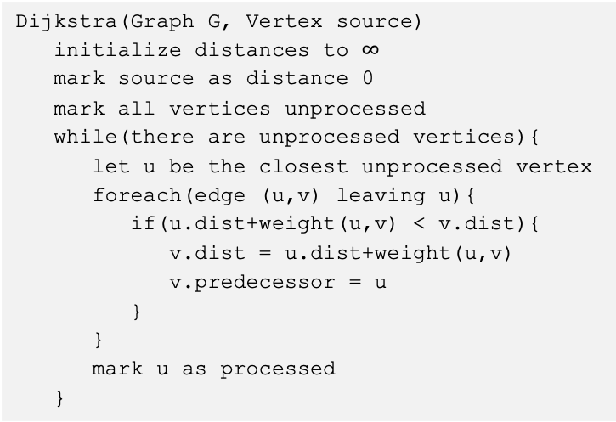
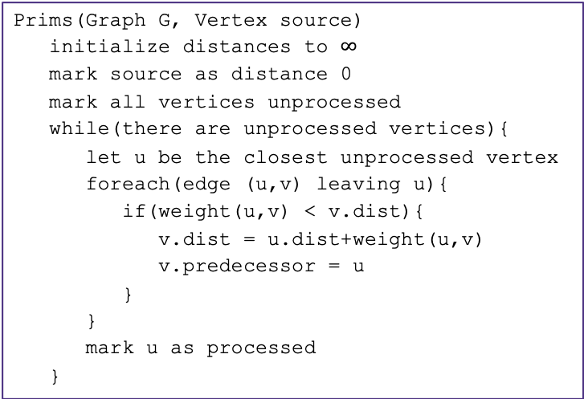
Prim’s Algorithm
Dijkstra’s
Start at source
Update distance from current to unprocessed neighbors
Process optimal neighbor
Repeat until all vertices have been marked processed
Algorithm idea:
  choose an arbitrary starting point
  Investigate edges that connect unprocessed vertices
  Add the lightest edge to solution (be greedy)
  Repeat until solution connects all vertices
Prims(Graph G, Vertex source)
initialize distances to $∞$
mark source as distance 0
mark all vertices unprocessed
while(there are unprocessed vertices){
let u be the closest unprocessed vertex
foreach(edge (u,v) leaving u){
if(weight(u,v) < v.dist){
v.dist = u.dist+weight(u,v)
v.predecessor = u
}
}
mark u as processed
}
Dijkstra(Graph G, Vertex source)
initialize distances to $∞$
mark source as distance 0
mark all vertices unprocessed
while(there are unprocessed vertices){
let u be the closest unprocessed vertex
foreach(edge (u,v) leaving u){
if(u.dist+weight(u,v) < v.dist){
v.dist = u.dist+weight(u,v)
v.predecessor = u
}
}
mark u as processed
}

Slide 10
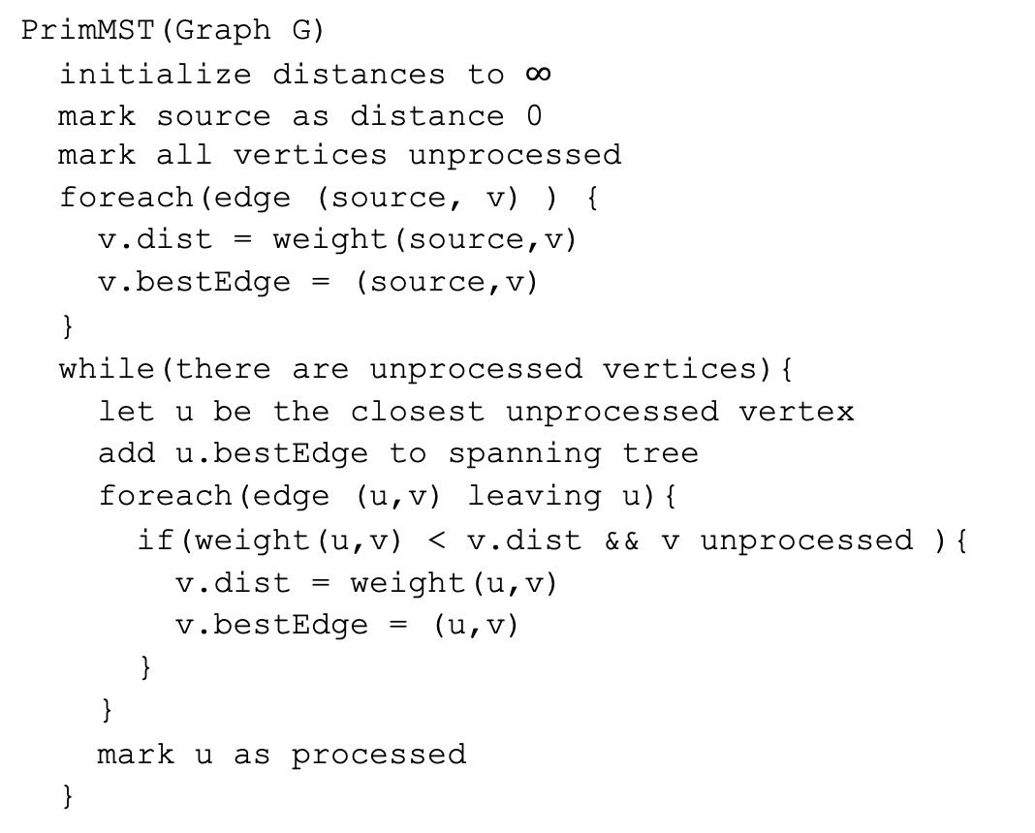
Try it Out
G
50
6
B
2
3
E
PrimMST(Graph G)
initialize distances to $∞$
mark source as distance 0
mark all vertices unprocessed
foreach(edge (source, v) ) {
v.dist = weight(source,v)
v.bestEdge = (source,v)
}
while(there are unprocessed vertices){
let u be the closest unprocessed vertex
add u.bestEdge to spanning tree
foreach(edge (u,v) leaving u){
if(weight(u,v) < v.dist && v unprocessed ){
v.dist = weight(u,v)
v.bestEdge = (u,v)
}
}
mark u as processed
}
4
C
5
A
9
2
7
7
F
D
8
Vertex | Distance | Best Edge | Processed
A
B
C
D
E
F
G

Slide 11
Try it Out
G
50
6
B
2
3
E
PrimMST(Graph G)
initialize distances to $∞$
mark source as distance 0
mark all vertices unprocessed
foreach(edge (source, v) ) {
v.dist = weight(source,v)
v.bestEdge = (source,v)
}
while(there are unprocessed vertices){
let u be the closest unprocessed vertex
add u.bestEdge to spanning tree
foreach(edge (u,v) leaving u){
if(weight(u,v) < v.dist && v unprocessed ){
v.dist = weight(u,v)
v.bestEdge = (u,v)
}
}
mark u as processed
}
4
C
5
A
9
2
7
7
F
D
8
Vertex | Distance | Best Edge | Processed
A
B
C
D
E
F
G
-
X
✓
2
(A, B)
✓
4
(A, C)
✓
--------(C, D)
---2
(A, D)
✓
7
(B, E)
6
--------(C, E)
✓
---5
3
(B, F)
✓
50
(B, G)
✓

Slide 12
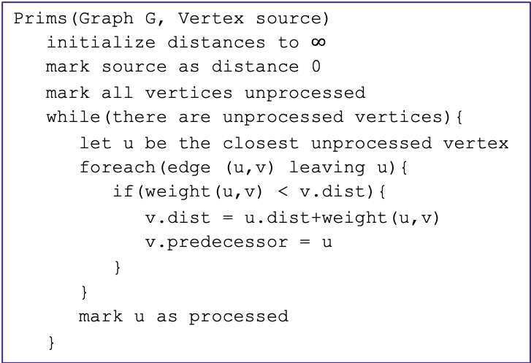
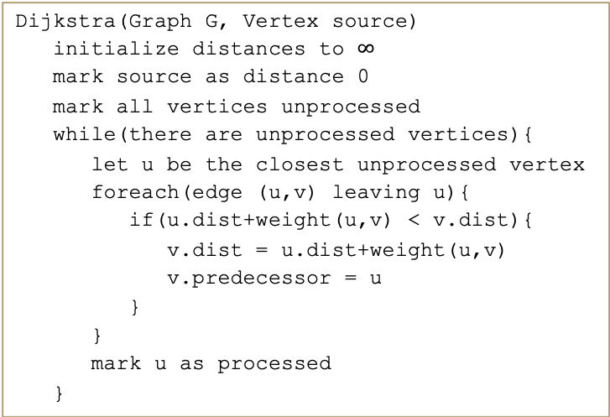
Prim’s Runtime
Runtime = VlogV + ElogV
Runtime = VlogV + ElogV
Prims(Graph G, Vertex source)
initialize distances to $∞$
mark source as distance 0
mark all vertices unprocessed
while(there are unprocessed vertices){
let u be the closest unprocessed vertex
foreach(edge (u,v) leaving u){
if(weight(u,v) < v.dist){
v.dist = u.dist+weight(u,v)
v.predecessor = u
}
}
mark u as processed
}
Dijkstra(Graph G, Vertex source)
initialize distances to $∞$
mark source as distance 0
mark all vertices unprocessed
while(there are unprocessed vertices){
let u be the closest unprocessed vertex
foreach(edge (u,v) leaving u){
if(u.dist+weight(u,v) < v.dist){
v.dist = u.dist+weight(u,v)
v.predecessor = u
}
}
mark u as processed
}

Slide 13
A different Approach
Prim’s Algorithm started from a single vertex and reached more and more other vertices.
Prim’s thinks vertex by vertex (add the closest vertex to the currently reachable set).
What if you think edge by edge instead?
Start from the lightest edge; add it if it connects new things to each other (don’t add it if it would create a cycle)
This is Kruskal’s Algorithm.

Slide 14
Example
Try to find an MST of this graph by adding edges in sorted order
G
G
G
G
G
G
G
50
50
50
50
50
50
50
6
6
6
6
6
6
6
B
B
B
B
B
B
B
2
2
2
2
2
2
2
3
3
3
3
3
3
3
E
E
E
E
E
E
E
4
4
4
4
4
4
4
5
5
5
5
5
5
C
5
C
C
C
C
C
C
A
A
A
A
A
A
A
9
9
9
9
9
9
9
2
2
2
2
2
2
2
7
7
7
7
7
7
7
7
7
7
7
7
7
7
F
F
F
F
F
F
F
D
D
D
D
D
D
D
8
8
8
8
8
8
8

Slide 15
Kruskal’s Algorithm
KruskalMST(Graph G)
initialize each vertex to be an independent component
sort the edges by weight
foreach(edge (u, v) in sorted order){
if(u and v are in different components){
add (u,v) to the MST
Update u and v to be in the same component
}
}

Slide 16
Try It Out
B
3
6
E
KruskalMST(Graph G)
initialize each vertex to be an independent component
sort the edges by weight
foreach(edge (u, v) in sorted order){
if(u and v are in different components){
add (u,v) to the MST
Update u and v to be in the same component
}
}
2
1
C
A
10
5
9
7
4
D
F
8
Edge | Include? | Reason
(A,C)
(C,E)
(A,B)
(A,D)
(C,D)
Edge (cont.) | Inc? | Reason
(B,F)
(D,E)
(D,F)
(E,F)
(C,F)

Slide 17
Try It Out
B
3
6
E
2
KruskalMST(Graph G)
initialize each vertex to be an independent component
sort the edges by weight
foreach(edge (u, v) in sorted order){
if(u and v are in different components){
add (u,v) to the MST
Update u and v to be in the same component
}
}
1
C
A
10
5
9
7
4
D
F
8
Edge | Include? | Reason
(A,C) | Yes
(C,E) | Yes
(A,B) | Yes
(A,D) | Yes
(C,D) | No | Cycle A,C,D,A
Edge (cont.) | Inc? | Reason
(B,F) | Yes
(D,E) | No | Cycle A,C,E,D,A
(D,F) | No | Cycle A,D,F,B,A
(E,F) | No | Cycle A,C,E,F,D,A
(C,F) | No | Cycle C,A,B,F,C

Slide 18
Kruskal’s Algorithm Implementation
KruskalMST(Graph G)
initialize each vertex to be an independent component
sort the edges by weight
foreach(edge (u, v) in sorted order){
if(u and v are in different components){
add (u,v) to the MST
update u and v to be in the same component
}
}
KruskalMST(Graph G)
foreach (V : vertices) {
makeMST(v);
}
sort edges in ascending order by weight
foreach(edge (u, v)){
if(findMST(v) is not in findMST(u)){
union(u, v)
}
}
+?
+V(makeMST)
+ElogE
How many times will we call union?
V – 1
-> +Vunion + EfindMST
+?
+E(2findMST + union)
+?

Slide 19
Appendix: MST Properties, Another MST Application

Slide 20
Why do all of these MST Algorithms Work?
MSTs satisfy two very useful properties:
Cycle Property: The heaviest edge along a cycle is NEVER part of an MST.
Cut Property: Split the vertices of the graph any way you want into two sets A and B. The lightest edge with one endpoint in A and the other in B is ALWAYS part of an MST.
Whenever you add an edge to a tree you create exactly one cycle, you can then remove any edge from that cycle and get another tree out.
This observation, combined with the cycle and cut properties form the basis of all of the greedy algorithms for MSTs.

Slide 21
One More MST application
Let’s say you’re building a new building.
There are very important building donors coming to visit TOMORROW,
  and the hallways are not finished.
You have n rooms you need to show them, connected by the unfinished hallways.
Thanks to your generous donors you have n-1 construction crews, so you can assign one to each of that many hallways.
  Sadly the hallways are narrow and you can’t have multiple crews working on the same hallway.
Can you finish enough hallways in time to give them a tour?
Given: an undirected, weighted graph G
Find: A spanning tree such that the weight of the maximum edge is minimized.
Minimum Bottleneck Spanning Tree Problem

Slide 22
MSTs and MBSTs
Given: an undirected, weighted graph G
Find: A minimum-weight set of edges such that you can get from any vertex of G to any other on only those edges.
Minimum Spanning Tree Problem
Given: an undirected, weighted graph G
Find: A spanning tree such that the weight of the maximum edge is minimized.
Minimum Bottleneck Spanning Tree Problem
B
B
2
2
3
3
C
C
A
A
1
1
2
2
4
4
D
D
Graph on the right is a minimum bottleneck spanning tree, but not a minimum spanning tree.

Slide 23
Finding MBSTs
Algorithm Idea: want to use smallest edges. Just start with the smallest edge and add it if it connects previously unrelated things (and don’t if it makes a cycle).
Hey wait…that’s Kruskal’s Algorithm!
Every MST is an MBST (because Kruskal’s can find any MST when looking for MBSTs)
but not vice versa (see the example on the last slide).
If you need an MBST, any MST algorithm will work.
There are also some specially designed MBST algorithms that are faster (see Wikipedia)
Takeaway: When you’re modeling a problem, be careful to really understand what you’re looking for. There may be a better algorithm out there.

