Slide 1
Lecture 17: Shortest Paths
CSE 373: Data Structures and Algorithms

Slide 2
Administrivia
How to Ace the Technical Interview Session today!
6-8pm
Sieg 134
No BS CS Career Talk Thursday
5:30-6:30
Bag 131

Slide 3
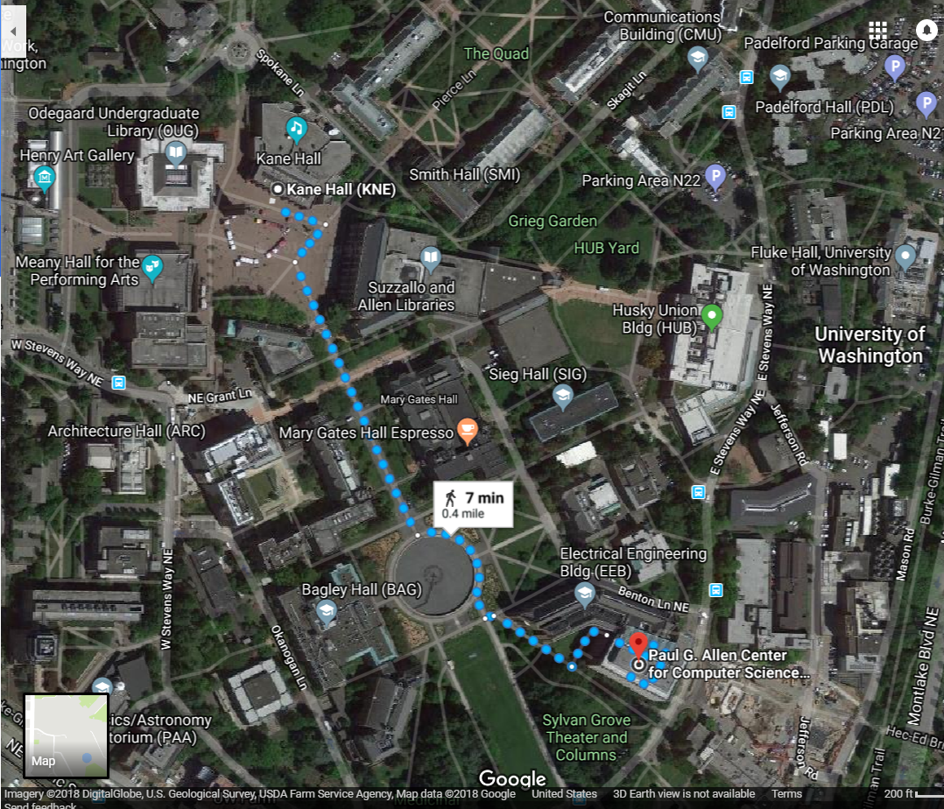
Shortest Paths
How does Google Maps figure out this is the fastest way to get to office hours?

Slide 4
Representing Maps as Graphs
How do we represent a map as a graph? What are the vertices and edges?

Slide 5
Representing Maps as Graphs
K
2
1
R
2
S
H
4
4
5
D
3
P

Slide 6
Shortest Paths
The length of a path is the sum of the edge weights on that path.
Shortest Path Problem
Given: a directed graph G and vertices s and t
Find: the shortest path from s to t
1
y
4
3
s
w
t
5
6
4
5
2
u
v
x
1

Slide 7
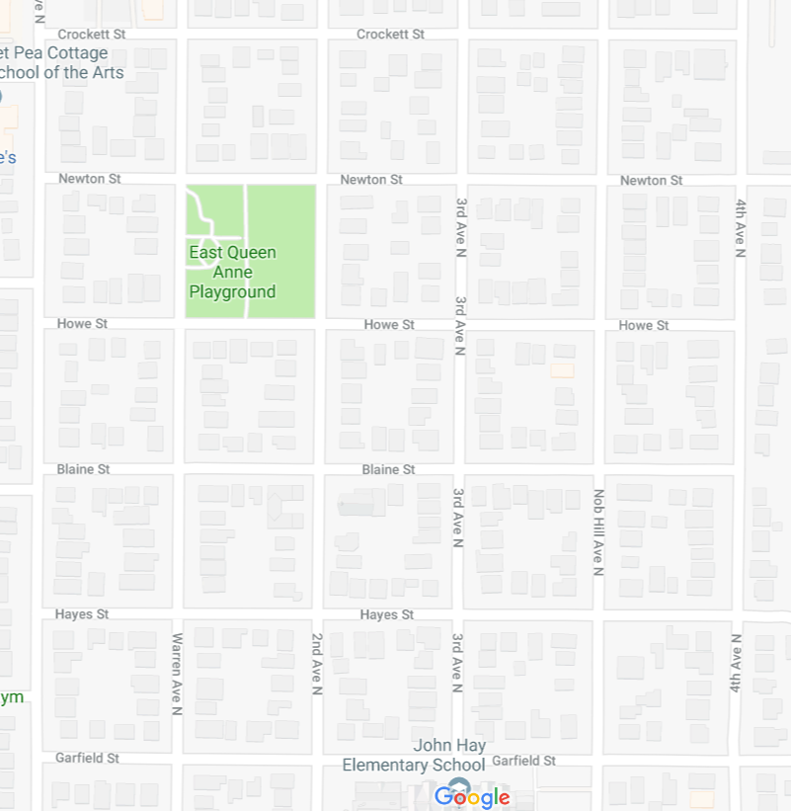
Unweighted graphs
Let’s start with a simpler version: the edges are all the same weight (unweighted)
If the graph is unweighted, how do we find a shortest paths?
Notes:
9:38:30

Slide 8
Unweighted Graphs
If the graph is unweighted, how do we find a shortest paths?
What’s the shortest path from s to s?
Well….we’re already there.
What’s the shortest path from s to u or v?
Just go on the edge from s
From s to w,x, or y?
Can’t get there directly from s, if we want a length 2 path, have to go through u or v.
u
w
s
y
t
v
x

Slide 9
Unweighted Graphs: Key Idea
To find the set of vertices at distance k, just find the set of vertices at distance k-1, and see if any of them have an outgoing edge to an undiscovered vertex.
Do we already know an algorithm that does something like that?
Yes! BFS!
bfsShortestPaths(graph G, vertex source)
toVisit.enqueue(source)
source.dist = 0
while(toVisit is not empty){
current = toVisit.dequeue()
for (v : current.outNeighbors())
{
if (v is unknown){
v.distance = current.distance + 1
v.predecessor = current
toVisit.enqueue(v)
mark v as known
}
}
}

Slide 10
Unweighted Graphs
Use BFS to find shortest paths in this graph.
u
w
bfsShortestPaths(graph G, vertex source)
toVisit.enqueue(source)
source.dist = 0
mark source as visited
while(toVisit is not empty){
current = toVisit.dequeue()
for (v : current.outNeighbors()){
if (v is not yet visited){
v.distance = current.distance + 1
v.predecessor = current
toVisit.enqueue(v)
mark v as visited
}
}
}
s
y
t
v
x

Slide 11
Unweighted Graphs
If the graph is unweighted, how do we find a shortest paths?
1
2
u
w
bfsShortestPaths(graph G, vertex source)
toVisit.enqueue(source)
source.dist = 0
while(toVisit is not empty){
current = toVisit.dequeue()
for (v : current.outNeighbors())
{
if (v is unknown){
v.distance = current.distance + 1
v.predecessor = current
toVisit.enqueue(v)
mark v as known
}
}
}
2
s
y
t
3
v
x
1
2

Slide 12
What about the target vertex?
Given: a directed graph G and vertices s,t
Find: the shortest path from s to t.
Shortest Path Problem
BFS didn’t mention a target vertex…
It actually finds the shortest path from s to every other vertex.
Notes:
9:48

Slide 13
Weighted Graphs
Each edge should represent the “time” or “distance” from one vertex to another.
Sometimes those aren’t uniform, so we put a weight on each edge to record that number.
The length of a path in a weighted graph is the sum of the weights along that path.
We’ll assume all of the weights are positive
For GoogleMaps that definitely makes sense.
Sometimes negative weights make sense. Today’s algorithm doesn’t work for those graphs
There are other algorithms that do work.
Notes:
9:50

Slide 14
Weighted Graphs: Take 1
BFS works if the graph is unweighted.
Maybe it just works for weighted graphs too?
1
1
w
x
1
s
u
v
t
20
1
1

Slide 15
Weighted Graphs: Take 1
BFS works if the graph is unweighted. Maybe it just works for weighted graphs too?
$$∞$$
$$1$$
$$∞$$
1
$$2$$
1
w
x
1
s
u
v
t
0
20
$$∞$$
1
$$∞$$
1
$$∞$$
$$20$$
$$22$$
$$3$$
$$21$$
What went wrong? When we found a shorter path from s to u, we needed to update the distance to v (and anything whose shortest path went through u) but BFS doesn’t do that.

Slide 16
Weighted Graphs: Take 2
Using an algorithm for Problem B to solve Problem A.
Reduction (informally)
You already do this all the time.
In Homework 3, you reduced implementing a hashset to implementing a hashmap.
Any time you use a library, you’re reducing your problem to the one the library solves.
Can we reduce finding shortest paths on weighted graphs to finding them on unweighted graphs?
Notes:
9:55

Slide 17
Weighted Graphs Take 2
Given a weighted graph, how do we turn it into an unweighted one without messing up the path lengths?

Slide 18
Weighted Graphs: A Reduction
Transform Input
u
2
u
1
2
s
t
s
t
1
v
v
Unweighted Shortest Paths
2
u
s
t
2
v
Transform Output
2
u
1
2
s
t
2
1
v
2

Slide 19
Weighted Graphs: A Reduction
What is the running time of our reduction on this graph?
O(|V|+|E|) of the modified graph, which is…slow.
Does our reduction even work on this graph?
Ummm….
5000
u
150
$$0.5$$
u
$$3$$
200
$$π$$
s
t
s
t
1
v
5000
1
v
5000
tl;dr: If your graph’s weights are all small positive integers, this reduction might work great.
Otherwise we probably need a new idea.

Slide 20
Weighted Graphs: Take 3
So we can’t just do a reduction.
Instead figure out why BFS worked in the unweighted case, try to make the same thing happen in the weighted case.
How did we avoid this problem:
$$1$$
1
$$2$$
1
w
x
1
s
u
v
t
0
20
$$3$$
1
$$21$$
1
$$22$$
Notes:
10:01

Slide 21
Weighted Graphs: Take 3
In BFS When we used a vertex u to update shortest paths we already knew the exact shortest path to u.
So we never ran into the update problem
If we process the vertices in order of distance from s, we have a chance.

Slide 22
Weighted Graphs: Take 3
Goal: Process the vertices in order of distance from s
Idea:
Have a set of vertices that are “known”
(we know at least one path from s to them).
Record an estimated distance
(the best way we know to get to each vertex).
If we process only the vertex closest in estimated distance, we won’t ever find a shorter path to a processed vertex.
This statement is the key to proving correctness.
It’s nice if you want to practice induction/understand the algorithm better.

Slide 23
Dijkstra’s Algorithm
Vertex | Distance | Predecessor | Processed
s
w
x
u
v
t
Dijkstra(Graph G, Vertex source)
initialize distances to $∞$
mark source as distance 0
mark all vertices unprocessed
while(there are unprocessed vertices){
let u be the closest unprocessed vertex
foreach(edge (u,v) leaving u){
if(u.dist+weight(u,v) < v.dist){
v.dist = u.dist+weight(u,v)
v.predecessor = u
}
}
mark u as processed
}
1
1
w
x
1
s
u
v
t
20
1
1

Slide 24
Dijkstra’s Algorithm
Vertex | Distance | Predecessor | Processed
s | 0 | -- | Yes
w | 1 | s | Yes
x | 2 | w | Yes
u | 20 3 | s x | Yes
v | 4 | u | Yes
t | 5 | v | Yes
Dijkstra(Graph G, Vertex source)
initialize distances to $∞$
mark source as distance 0
mark all vertices unprocessed
while(there are unprocessed vertices){
let u be the closest unprocessed vertex
foreach(edge (u,v) leaving u){
if(u.dist+weight(u,v) < v.dist){
v.dist = u.dist+weight(u,v)
v.predecessor = u
}
}
mark u as processed
}
1
1
w
x
1
s
u
v
t
20
1
1

