Slide 1
Lecture 12: Hash Open Indexing
Data Structures and Algorithms

Slide 2
Linear Probing
3 Minutes
Insert the following values into the Hash Table using a hashFunction of % table size and linear probing to resolve collisions
38, 19, 8, 109, 10
0 | 1 | 2 | 3 | 4 | 5 | 6 | 7 | 8 | 9
8
10
38
8
19
109
Problem:
Linear probing causes clustering
Clustering causes more looping when probing
Primary Clustering
When probing causes long chains of occupied slots within a hash table

Slide 3
Administrivia
HW 4 Partner Form due tonight 11:59pm
HW 3 code modeling got more details
Midterm Friday
Debugging
More office hours today
Review session on Wednesday 4pm – 5:50pm PAA A102

Slide 4
Runtime
2 Minutes
When is runtime good?
Empty table
When is runtime bad?
Table nearly full
When we hit a “cluster”
Maximum Load Factor?
λ at most 1.0
When do we resize the array?
λ ≈ ½

Slide 5
Can we do better?
Clusters are caused by picking new space near natural index
Solution 2: Open Addressing
Type 2: Quadratic Probing
If we collide instead try the next i² space
public int hashFunction(String s)
int naturalHash = this.getHash(s);
if(natural hash in use) {
int i = 1;
while (index in use) {
try (naturalHash + i);
i++;
i * i);

Slide 6
Quadratic Probing
Insert the following values into the Hash Table using a hashFunction of % table size and quadratic probing to resolve collisions
89, 18, 49, 58, 79
0 | 1 | 2 | 3 | 4 | 5 | 6 | 7 | 8 | 9
58
79
18
49
89
(49 % 10 + 0 * 0) % 10 = 9
(49 % 10 + 1 * 1) % 10 = 0
(58 % 10 + 0 * 0) % 10 = 8
(58 % 10 + 1 * 1) % 10 = 9
(58 % 10 + 2 * 2) % 10 = 2
Problems:
If λ≥ ½ we might never find an empty spot
Infinite loop!
Can still get clusters
(79 % 10 + 0 * 0) % 10 = 9
(79 % 10 + 1 * 1) % 10 = 0
(79 % 10 + 2 * 2) % 10 = 3

Slide 7
Secondary Clustering
3 Minutes
Insert the following values into the Hash Table using a hashFunction of % table size and quadratic probing to resolve collisions
19, 39, 29, 9
0 | 1 | 2 | 3 | 4 | 5 | 6 | 7 | 8 | 9
39
29
9
19
Secondary Clustering
When using quadratic probing sometimes need to probe the same sequence of table cells, not necessarily next to one another

Slide 8
Probing
h(k) = the natural hash
h’(k, i) = resulting hash after probing
i = iteration of the probe
T = table size
Linear Probing:
h’(k, i) = (h(k) + i) % T
Quadratic Probing
h’(k, i) = (h(k) + i²) % T
For both types there are only O(T) probes available
Can we do better?

Slide 9
Double Hashing
Probing causes us to check the same indices over and over- can we check different ones instead?
Use a second hash function!
h’(k, i) = (h(k) + i * g(k)) % T
public int hashFunction(String s)
int naturalHash = this.getHash(s);
if(natural hash in use) {
int i = 1;
while (index in use) {
try (naturalHash + i * jump_Hash(key));
i++;
<- Most effective if g(k) returns value prime to table size

Slide 10
Second Hash Function
Effective if g(k) returns a value that is relatively prime to table size
If T is a power of 2, make g(k) return an odd integer
If T is a prime, make g(k) return any smaller, non-zero integer
g(k) = 1 + (k % T(-1))
How many different probes are there?
T different starting positions
T – 1 jump intervals
O(T²) different probe sequences
Linear and quadratic only offer O(T) sequences

Slide 11
Resizing
How do we resize?
Remake the table
Evaluate the hash function over again.
Re-insert.
When to resize?
Depending on our load factor $λ$
Heuristic:
for separate chaining $λ$between $1$ and $3$ is a good time to resize.
For open addressing $λ$between $0.5$ and $1$ is a good time to resize.

Slide 12
Separate chaining: Running Times
What are the running times for:
insert
Best: $O(1)$
Worst: $O(n)$ (if insertions are always at the end of the linked list)
find
Best: $O(1)$
Worst: $O(n)$
delete
Best: $O(1)$
Worst: $O(n)$

Slide 13
Linear probing: Average-case insert
If $λ<1$ we’ll find a spot eventually.
What’s the average running time?
If find is unsuccessful: $\frac{1}{2}\left(1+\frac{1}{{\left(1−λ\right)}^{2}}\right)$
If find is successful: $\frac{1}{2}\left(1+\frac{1}{(1−λ)}\right)$
We won’t ask you to prove these
for any pair of elements x, y
the probability that h(x) = h(y) is $\frac{1}{TableSize}$
Uniform Hashing Assumption

Slide 14
Summary
1. Pick a hash function to:
Avoid collisions
Uniformly distribute data
Reduce hash computational costs
2. Pick a collision strategy
Chaining
LinkedList
AVL Tree
Probing
Linear
Quadratic
Double Hashing
No clustering
Potentially more “compact” (λ can be higher)
Managing clustering can be tricky
Less compact (keep λ < ½)
Array lookups tend to be a constant factor faster than traversing pointers

Slide 15
Summary
Separate Chaining
Easy to implement
Running times $O(1+λ)$
Open Addressing
Uses less memory.
Various schemes:
Linear Probing – easiest, but need to resize most frequently
Quadratic Probing – middle ground
Double Hashing – need a whole new hash function, but low chance of clustering.
Which you use depends on your application and what you’re worried about.

Slide 16
Other applications of hashing
- Cryptographic hash functions: Hash functions with some additional properties
Commonly used in practice: SHA-1, SHA-265
To verify file integrity. When you share a large file with someone, how do you know that the other person got the exact same file? Just compare hash of the file on both ends. Used by file sharing services (Google Drive, Dropbox)
For password verification: Storing passwords in plaintext is insecure. So your passwords are stored as a hash.
For Digital signature
Lots of other crypto applications
- Finding similar records: Records with similar but not identical keys
Spelling suggestion/corrector applications
Audio/video fingerprinting
Clustering
- Finding similar substrings in a large collection of strings
Genomic databases
Detecting plagiarism
- Geometric hashing: Widely used in computer graphics and computational geometry

Slide 17
Wrap Up
Hash Tables:
Efficient find, insert, delete on average, under some assumptions
Items not in sorted order
Tons of real world uses
…and really popular in tech interview questions.
Need to pick a good hash function.
Have someone else do this if possible.
Balance getting a good distribution and speed of calculation.
Resizing:
Always make the table size a prime number.
$λ$ determines when to resize, but depends on collision resolution strategy.

Slide 18
ADT Review

Slide 19
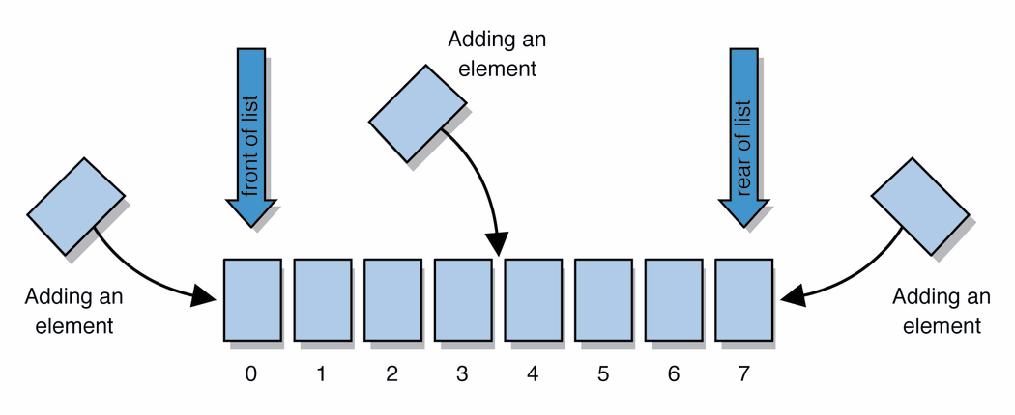
List ADT
ArrayList
uses an Array as underlying storage
LinkedList
uses nodes as underlying storage
List ADT
ArrayList<E>
LinkedList<E>
state
Set of ordered items
Count of items
state
state
data[]
size
Node front
size
behavior
get(index) return item at index
set(item, index) replace item at index
append(item) add item to end of list
insert(item, index) add item at index
delete(index) delete item at index
size() count of items
behavior
behavior
get return data[index]
set data[index] = value
append data[size] = value, if out of space grow data
insert shift values to make hole at index, data[index] = value, if out of space grow data
delete shift following values forward
size return size
get loop until index, return node’s value
set loop until index, update node’s value
append create new node, update next of last node
insert create new node, loop until index, update next fields
delete loop until index, skip node
size return size
0 | 1 | 2 | 3 | 4
88.6 | 26.1 | 94.4 | 0 | 0
88.6
26.1
94.4
list
free space
Notes:
Code up an implementation of List

Slide 20
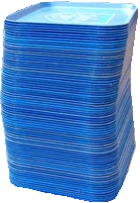
Stack ADT
push
pop, peek
top | 3
 | 2
bottom | 1
stack: A collection based on the principle of adding elements and retrieving them in the opposite order.
Last-In, First-Out ("LIFO")
Elements are stored in order of insertion.
We do not think of them as having indexes.
Client can only add/remove/examine the last element added (the "top").
Stack ADT
ArrayStack<E>
LinkedStack<E>
state
state
state
Set of ordered items
Number of items
data[]
size
Node top
size
behavior
behavior
behavior
push(item) add item to top
pop() return and remove item at top
peek() look at item at top
size() count of items
isEmpty() count of items is 0?
push data[size] = value, if out of room grow data
pop return data[size - 1], size-1
peek return data[size - 1]
size return size
isEmpty return size == 0
push add new node at top
pop return and remove node at top
peek return node at top
size return size
isEmpty return size == 0

Slide 21
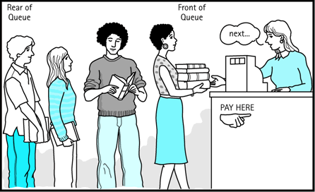
Queue ADT
front |  | back
1 | 2 | 3
remove, peek
add
queue: Retrieves elements in the order they were added.
First-In, First-Out ("FIFO")
Elements are stored in order of insertion but don't have indexes.
Client can only add to the end of the queue, and can only examine/remove the front of the queue.
ArrayQueue<E>
LinkedQueue<E>
Queue ADT
state
state
data[]
Size
front index
back index
Node front
Node back
size
state
Set of ordered items
Number of items
behavior
behavior
behavior
add – data[size] = value, if out of room grow data
remove – return data[size - 1], size-1
peek – return data[size - 1]
size – return size
isEmpty – return size == 0
add – add node to back
remove – return and remove node at front
peek – return node at front
size – return size
isEmpty – return size == 0
add(item) add item to back
remove() remove and return item at front
peek() return item at front
size() count of items
isEmpty() count of items is 0?

Slide 22
Map/Dictionary ADT
key | value
“at" | 43
key | value
“in" | 37
key | value
“you" | 22
dictionary: Holds a set of unique keys and a collection of values, where each key is associated with one value.
a.k.a. "dictionary", "associative array", "hash"
key | value
“the" | 56
ArrayDictionary<K, V>
map.get("the")
56
Dictionary ADT
LinkedDictionary<K, V>
state
Pair<K, V>[] data
state
state
Set of items & keys
Count of items
behavior
front
size
put create new pair, add to next available spot, grow array if necessary
get scan all pairs looking for given key, return associated item if found
containsKey scan all pairs, return if key is found
remove scan all pairs, replace pair to be removed with last pair in collection
size return count of items in dictionary
behavior
behavior
put(key, item) add item to collection indexed with key
get(key) return item associated with key
containsKey(key) return if key already in use
remove(key) remove item and associated key
size() return count of items
put if key is unused, create new with pair, add to front of list, else replace with new value
get scan all pairs looking for given key, return associated item if found
containsKey scan all pairs, return if key is found
remove scan all pairs, skip pair to be removed
size return count of items in dictionary

Slide 23
Binary Search Trees
TreeDictionary<K, V>
state
overallRoot
size
A binary search tree is a binary tree that contains comparable items such that for every node, all children to the left contain smaller data and all children to the right contain larger data.
behavior
put if key is unused, create new pair, place in BST order, rotate to maintain balance
get traverse through tree using BST property, return item if found
containsKey traverse through tree using BST property, return if key is found
remove traverse through tree using BST property, replace or nullify as appropriate
size return count of items in dictionary
Binary Search Trees allow us to:
quickly find what we’re looking for
add and remove values easily
Dictionary Operations:
Runtime in terms of height, “h”
get() – O(h)
put() – O(h)
remove() – O(h)
What do you replace the node with?
Largest in left sub tree or smallest in right sub tree
10
9
15
7
12
18

Slide 24
Meet AVL Trees
AVL Trees must satisfy the following properties:
binary trees: all nodes must have between 0 and 2 children
binary search tree: for all nodes, all keys in the left subtree must be smaller and all keys in the right subtree must be larger than the root node
balanced: for all nodes, there can be no more than a difference of 1 in the height of the left subtree from the right. Math.abs(height(left subtree) – height(right subtree)) ≤ 1
AVL stands for Adelson-Velsky and Landis (the inventors of the data structure)
Dictionary Operations:
get() – same as BST
containsKey() – same as BST
put() – same as BST + rebalance
remove() – same as BST + rebalance

Slide 25
How long does AVL insert take?
AVL insert time = BST insert time + time it takes to rebalance the tree
= O(log n) + time it takes to rebalance the tree
How long does rebalancing take?
Assume we store in each node the height of its subtree.
How long to find an unbalanced node:
Just go back up the tree from where we inserted.
How many rotations might we have to do?
Just a single or double rotation on the lowest unbalanced node.
AVL insert time = O(log n)+ O(log n) + O(1) = O(log n)
← O(log n)
← O(1)

Slide 26
Review: Dictionaries
Dictionary ADT
It’s all about data baby!
Why are we so obsessed with Dictionaries?
When dealing with data:
Adding data to your collection
Getting data out of your collection
Rearranging data in your collection
state
SUPER common in comp sci
- Databases
- Network router tables
- Compilers and Interpreters
Set of items & keys
Count of items
behavior
put(key, item) add item to collection indexed with key
get(key) return item associated with key
containsKey(key) return if key already in use
remove(key) remove item and associated key
size() return count of items
Operation |  | ArrayList | LinkedList | BST | AVLTree
put(key,value) | best | O(1) | O(1) | O(1) | O(1)
 | average | O(n) | O(n) | O(logn) | O(logn)
 | worst | O(n) | O(n) | O(n) | O(logn)
get(key) | best | O(1) | O(1) | O(1) | O(1)
 | average | O(n) | O(n) | O(logn) | O(logn)
 | worst | O(n) | O(n) | O(n) | O(logn)
remove(key) | best | O(1) | O(1) | O(logn) | O(logn)
 | average | O(n) | O(n) | O(logn) | O(logn)
 | worst | O(n) | O(n) | O(n) | O(logn)

Slide 27
Hashing
HashMap<Integer>
Operation |  | Separate Chaining | Probing
put(key,value) | best | O(1) | O(1)
 | average | O(1 + λ) | O(1 + λ)
 | worst | O(n) | O(n)
get(key) | best | O(1) | O(1)
 | average | O(1 + λ) | O(1 + λ)
 | worst | O(n) | O(n)
remove(key) | best | O(1) | O(1)
 | average | O(1 + λ) | O(1 + λ)
 | worst | O(n) | O(n)
state
Data[]
size
behavior
put mod key by table size, put item at result
get mod key by table size, get item at result
containsKey mod key by table size, return data[result] == null remove mod key by table size, nullify element at result
size return count of items in dictionary

