Slide 1
Lecture 10: BST and AVL Trees
CSE 373: Data Structures and Algorithms

Slide 2
Warm Up
6
Is valid BST?
No
Height?
2
8
2
8
1
4
7
12
6
11
Is valid BST?
Yes
10
13
7
15
Height?
3
9
9 > 8

Slide 3
Administrivia

Slide 4
Trees

Slide 5
Binary Search Trees
A binary search tree is a binary tree that contains comparable items such that for every node, all children to the left contain smaller data and all children to the right contain larger data.
10
9
15
7
12
18
8
17

Slide 6
Implement Dictionary
10
“foo”
Binary Search Trees allow us to:
  quickly find what we’re looking for
  add and remove values easily
  Dictionary Operations:
  Runtime in terms of height, “h”
  get() – O(h)
  put() – O(h)
  remove() – O(h)
    What do you replace the node with?
    Largest in left sub tree or smallest in right sub tree
7
12
“bar”
“baz”
5
9
15
“fo”
“sho”
“sup”
1
8
13
“burp”
“poo”
“boo”

Slide 7
Height in terms of Nodes
For “balanced” trees h ≈ log_{c}(n) where c is the maximum number of children
Balanced binary trees h ≈ log₂(n)
Balanced trinary tree h ≈ log₃(n)
Thus for balanced trees operations take Θ(log_{c}(n))

Slide 8
Unbalanced Trees
10
Is this a valid Binary Search Tree?
Yes, but…
We call this a degenerate tree
For trees, depending on how balanced they are,
Operations at worst can be O(n) and at best
can be O(logn)
How are degenerate trees formed?
  insert(10)
  insert(9)
  insert(7)
  insert(5)
9
7
5

Slide 9
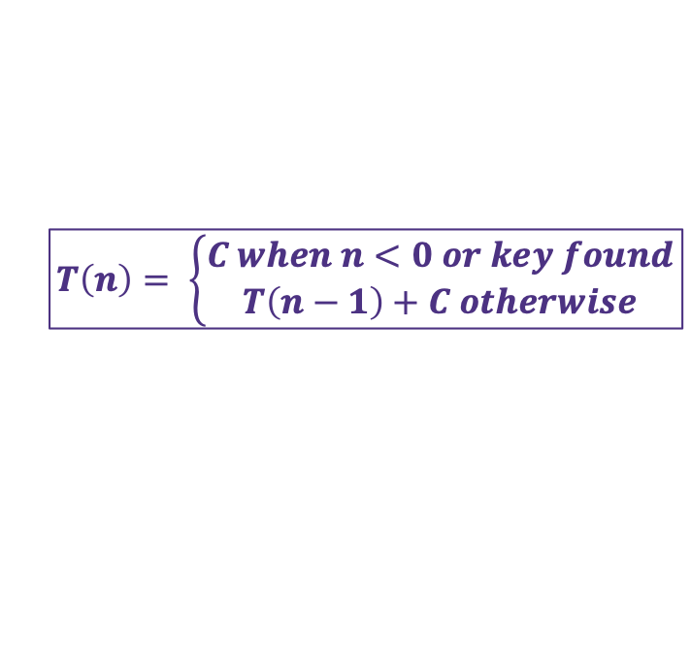
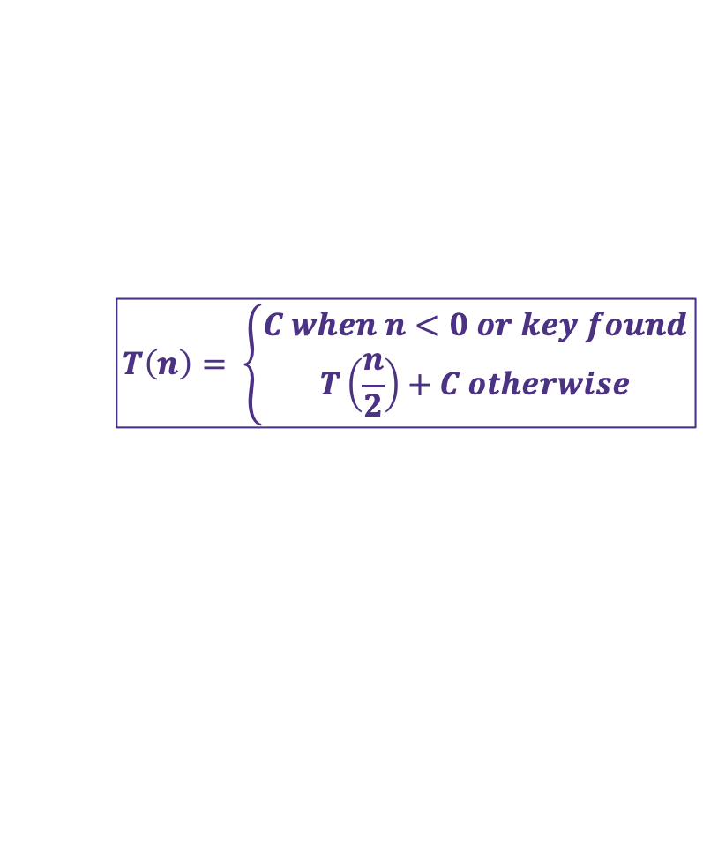
Implementing Dictionary with BST
2 Minutes
public boolean contains(K key, BSTNode node) {
if (node == null) {
return false;
}
int compareResult = compareTo(key, node.data);
if (compareResult < 0) {
returns contains(key, node.left);
} else if (compareResult > 0) {
returns contains(key, node.right);
} else {
returns true;
}
}
+C₁
+C₂
+T(n/2) best
+ T(n-1) worst
+T(n/2) best
+ T(n-1) worst
Best Case (assuming key is at the bottom)
$$T\left(n\right)= \left\{\begin{aligned}C when n<0 or key found \\ T\left(\frac{n}{2}\right)+C otherwise\end{aligned}\right.$$
+C₃
Worst Case (assuming key is at the bottom)
$$T\left(n\right)= \left\{\begin{aligned}C when n<0 or key found \\ T\left(n−1\right)+C otherwise\end{aligned}\right.$$

Slide 10
Measuring Balance
2 Minutes
Measuring balance:
For each node, compare the heights of its two sub trees
Balanced when the difference in height between sub trees is no greater than 1
8
10
8
7
7
9
15
Balanced
7
Balanced
Balanced
12
18
Unbalanced

Slide 11
Meet AVL Trees
AVL Trees must satisfy the following properties:
  binary trees: all nodes must have between 0 and 2 children
  binary search tree: for all nodes, all keys in the left subtree must be smaller and all keys in the right subtree must be larger than the root node
  balanced: for all nodes, there can be no more than a difference of 1 in the height of the left subtree from the right. Math.abs(height(left subtree) – height(right subtree)) ≤ 1
  AVL stands for Adelson-Velsky and Landis (the inventors of the data structure)

Slide 12
Is this a valid AVL tree?
7
Is it…
Binary
BST
Balanced?
yes
yes
4
10
yes
3
5
9
12
2
6
8
11
13
14

Slide 13
Is this a valid AVL tree?
2 Minutes
6
Is it…
Binary
BST
Balanced?
yes
yes
2
8
no
Height = 0
Height = 2
1
4
7
12
3
5
10
13
9
11

Slide 14
Is this a valid AVL tree?
2 Minutes
8
Is it…
Binary
BST
Balanced?
yes
no
6
11
yes
2
7
15
-1
5
9
9 > 8

Slide 15
Implementing an AVL tree dictionary
Dictionary Operations:
get() – same as BST
containsKey() – same as BST
put() - ???
remove() - ???
Add the node to keep BST, fix AVL property if necessary
Replace the node to keep BST, fix AVL property if necessary
Unbalanced!
1
2
2
1
3
3

Slide 16
Rotations!
Balanced!
Unbalanced!
a
b
a
Insert ‘c’
b
b
a
X
Z
X
Y
Z
c
Y
Z
X
Y
c

Slide 17
Rotate Left
parent’s right becomes child’s left, child’s left becomes its parent
Balanced!
Unbalanced!
a
b
a
Insert ‘c’
b
b
a
X
Z
X
Y
Z
c
Y
Z
X
Y
c

Slide 18
Rotate Right
parent’s left becomes child’s right, child’s right becomes its parent
3
4
15
height
put(16);
3
2
2
8
22
Unbalanced!
1
0
2
1
0
4
10
19
24
0
0
1
0
0
3
6
17
20
0
16

Slide 19
Rotate Right
parent’s left becomes child’s right, child’s right becomes its parent
3
15
height
put(16);
2
2
8
19
1
0
1
1
4
10
17
22
0
0
0
0
0
3
6
16
20
24

Slide 20
So much can go wrong
Unbalanced!
Unbalanced!
Unbalanced!
1
3
1
3
3
1
Rotate Left
Rotate Right
2
2
2
Parent’s right becomes child’s left
Child’s left becomes its parent
Parent’s left becomes child’s right
Child’s right becomes its parent

Slide 21
Two AVL Cases
Line Case
Solve with 1 rotation
Kink Case
Solve with 2 rotations
3
1
1
3
2
2
3
1
1
3
2
2
Rotate Right
Parent’s left becomes child’s right
Child’s right becomes its parent
Rotate Left
Parent’s right becomes child’s left
Child’s left becomes its parent
Right Kink Resolution
Rotate subtree left
Rotate root tree right
Left Kink Resolution
Rotate subtree right
Rotate root tree left

Slide 22
Double Rotations 1
Unbalanced!
a
a
a
Insert ‘c’
e
d
X
e
d
W
W
e
Z
d
Y
Z
Y
X
c
X
Z
Y
X
c

Slide 23
Double Rotations 2
Unbalanced!
d
a
a
e
d
W
e
W
Y
X
Z
Y
c
c
X
Z

Slide 24

Implementing Dictionary with AVL
2 Minutes
public boolean contains(K key, AVLNode node) {
if (node == null) {
return false;
}
int compareResult = compareTo(key, node.data);
if (compareResult < 0) {
returns contains(key, node.left);
} else if (compareResult > 0) {
returns contains(key, node.right);
} else {
returns true;
}
}
+C₁
+C₂
+T(n/2)
+T(n/2)
Worst Case Improvement Guaranteed with AVL
+C₃
$$T\left(n\right)= \left\{\begin{aligned}C when n<0 or key found \\ T\left(\frac{n}{2}\right)+C otherwise\end{aligned}\right.$$

Slide 25
How long does AVL insert take?
AVL insert time = BST insert time + time it takes to rebalance the tree
= O(log n) + time it takes to rebalance the tree
How long does rebalancing take?
  Assume we store in each node the height of its subtree.
  How long to find an unbalanced node:
    Just go back up the tree from where we inserted.
  How many rotations might we have to do?
    Just a single or double rotation on the lowest unbalanced node.
AVL insert time = O(log n)+ O(log n) + O(1) = O(log n)
    ← O(log n)
    ← O(1)

Slide 26
AVL wrap up
Pros:
- O(log n) worst case for find, insert, and delete operations.
- Reliable running times than regular BSTs (because trees are balanced)
Cons:
- Difficult to program & debug [but done once in a library!]
- (Slightly) more space than BSTs to store node heights.

Slide 27
Lots of cool Self-Balancing BSTs out there!
Popular self-balancing BSTs include:
AVL tree
Splay tree
2-3 tree
AA tree
Red-black tree
Scapegoat tree
Treap
(Not covered in this class, but several are in the textbook and all of them are online!)
(From https://en.wikipedia.org/wiki/Self-balancing_binary_search_tree#Implementations)

