Slide 1
Lecture 8: Tree Method
CSE 373: Data Structures and Algorithms

Slide 2
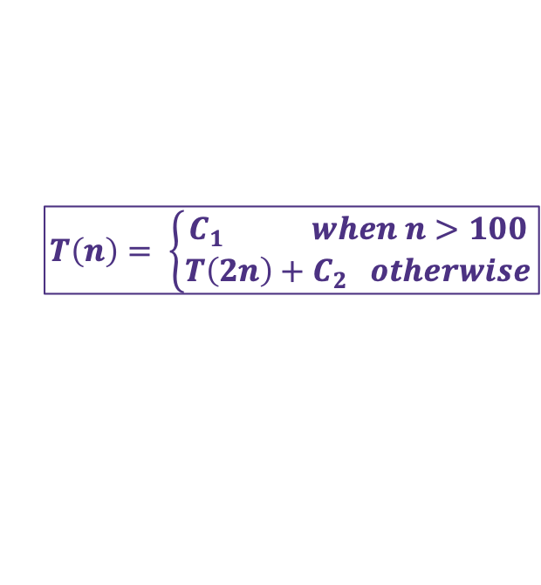
Warm Up – Writing Recurrence
Write a recurrence for the following piece of code:
public void mystery2(int n) {
if (n > 100) {
System.out.print(n);
} else {
mystery2(2 * n);
System.out.print(", " + n);
}
}
+1
+1
C when n >100
+1
C + T(2n) when n <100
  Extra Credit:
Go to PollEv.com/champk
Text CHAMPK to 22333 to join session, text “1” or “2” to select your answer
$$T\left(n\right)= \left\{\begin{aligned}C_{1} when n>100 \\ T\left(2n\right)+C_{2} otherwise\end{aligned}\right.$$

Slide 3
Solving Recurrences
How do we go from code model to Big O?
Explore the recursive pattern
Write a new model in terms of “i”
Use algebra simplify the T away
Use algebra to find the “closed form”
Three Methods:
Tree Method – draw out the branching nature of recursion to find pattern
Unrolling – plug function into itself to find pattern
Master Theorem – plug and chug!

Slide 4

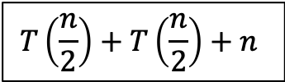













Tree Method
Draw out call stack, how much work does each call do?
$$T\left(n\right)=\left\{\begin{aligned}1 when n≤1 \\ 2T\left(\frac{n}{2}\right)+n otherwise\end{aligned}\right.$$
$$T\left(\frac{n}{2}\right)+T\left(\frac{n}{2}\right)+n$$
$$T\left(n\right)$$
$$n$$
Draw an overall root representing the start of your family of recursive calls
How many inputs are handled by the top recursive level?
How many of those inputs are passed downstream to the next recursive calls?
…
What does the last row of the tree look like?
Sum up all the work!
$$\frac{n}{2}$$
$$\frac{n}{2}$$
$$T\left(\frac{n}{4}\right)+T\left(\frac{n}{4}\right)+\frac{n}{2}$$
$$T\left(\frac{n}{4}\right)+T\left(\frac{n}{4}\right)+\frac{n}{2}$$
$$T\left(\frac{n}{2}\right)$$
$$T\left(\frac{n}{2}\right)$$
$$\frac{n}{4}$$
$$T\left(\frac{n}{4}\right)$$
$$T\left(\frac{n}{4}\right)$$
$$T\left(\frac{n}{4}\right)$$
$$T\left(\frac{n}{4}\right)$$
$$\frac{n}{4}$$
$$\frac{n}{4}$$
$$\frac{n}{4}$$
…
…
…
…
…
…
…
…
$$1$$
$$1$$
$$1$$
$$1$$
$$1$$
$$1$$
$$1$$
$$1$$
$$1$$
$$1$$
$$1$$
$$1$$
$$1$$
$$1$$
$$1$$
$$1$$

Slide 5




Tree Method
$$1 when n≤1$$
$$T\left(n\right)=$$
$$2T\left(\frac{n}{2}\right)+n otherwise$$
How many pieces of work at each level?
How many inputs are passed into each call?
How many inputs are processed across this level of recursion?
$$n$$
1
n
n
$$\frac{n}{2}$$
$$\frac{n}{2}$$
2
$\frac{n}{2}$
n
$$\frac{n}{4}$$
$$\frac{n}{4}$$
$$\frac{n}{4}$$
$$\frac{n}{4}$$
4
$\frac{n}{2^{2}}$
n
$$\frac{n}{8}$$
$$\frac{n}{8}$$
$$\frac{n}{8}$$
$$\frac{n}{8}$$
$$\frac{n}{8}$$
$$\frac{n}{8}$$
$$\frac{n}{8}$$
$$\frac{n}{8}$$
8
$\frac{n}{2^{3}}$
n
…
…
…
…
…
…
…
…
…
…
…
…
…
…
…
…
$$1$$
$$1$$
$$1$$
$$1$$
$$1$$
$$1$$
$$1$$
$$1$$
$$1$$
$$1$$
$$1$$
$$1$$
$$1$$
$$1$$
$$1$$
$$1$$
n
$1$
n

Slide 6

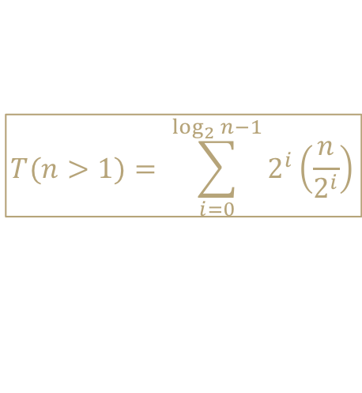
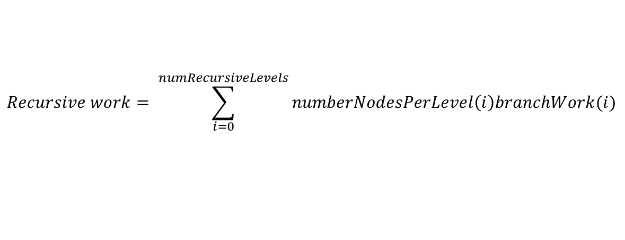
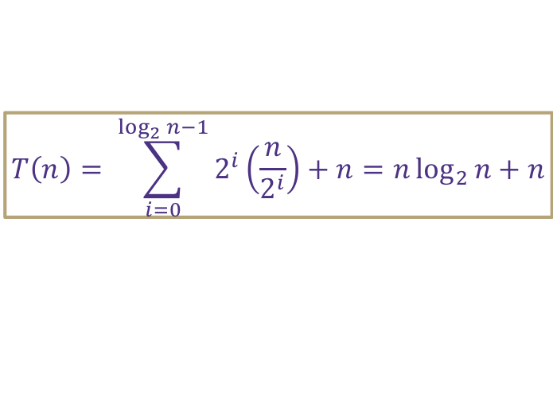
Tree Method Formulas
$$1 when n≤1$$
$$T\left(n\right)=$$
$$2T\left(\frac{n}{2}\right)+n otherwise$$
How much work is done by recursive levels (branch nodes)?
  1. How many recursive calls are on the i-th level of the tree?
    i = 0 is overall root level
  2. At each level i, how many inputs does a single node process?
  3. How many recursive levels are there?
    Based on the pattern of how we get down to base case
How much work is done by the base case level (leaf nodes)?
  1. How much work is done by a single leaf node?
  2. How many leaf nodes are there?
numberNodesPerLevel(i) = 2^{i}
inputsPerRecursiveCall(i) = (n/ 2^{i})
numRecursiveLevels = log₂n - 1
$$Recursive work= \sum_{i=0}^{numRecursiveLevels}{numberNodesPerLevel\left(i\right)branchWork(i)}$$
$$T(n>1)= \sum_{i=0}^{\log_{2}{n}−1}{2^{i}\left(\frac{n}{2^{i}}\right)}$$
leafWork = 1
leafCount = 2^{log}₂^{n} = n
$$T\left(n≤1\right)=1\left(2^{log2n}\right)= n$$
$$base case work=leafWork×leafCount=leafWork×numberNodesPerLevel^{numRecursiveLevels+1}$$
$$T\left(n\right)= \sum_{i=0}^{\log_{2}{n}−1}{2^{i}\left(\frac{n}{2^{i}}\right)}+n=n\log_{2}{n}+n$$
$$total work=recursive work+base case work=$$

Slide 7
Tree Method Practice
$$4 when n≤1$$
$$T\left(n\right)=$$
$$3T\left(\frac{n}{4}\right)+cn^{2} otherwise$$
$$T\left(\frac{n}{4}\right)+T\left(\frac{n}{4}\right)+T\left(\frac{n}{4}\right)+cn^{2}$$
$$cn^{2}$$
Answer the following questions:
How many nodes on each branch level?
How much work for each branch node?
How much work per branch level?
How many branch levels?
How much work for each leaf node?
How many leaf nodes?
$$c{\left(\frac{n}{4}\right)}^{2}$$
$$T\left(\frac{n}{4}\right)$$
$$T\left(\frac{n}{4}\right)$$
$$c{\left(\frac{n}{4}\right)}^{2}$$
$$c{\left(\frac{n}{4}\right)}^{2}$$
$$T\left(\frac{n}{4}\right)$$
$$c{\left(\frac{n}{16}\right)}^{2}$$
$$c{\left(\frac{n}{16}\right)}^{2}$$
$$c{\left(\frac{n}{16}\right)}^{2}$$
$$c{\left(\frac{n}{16}\right)}^{2}$$
$$c{\left(\frac{n}{16}\right)}^{2}$$
$$c{\left(\frac{n}{16}\right)}^{2}$$
$$c{\left(\frac{n}{16}\right)}^{2}$$
$$c{\left(\frac{n}{16}\right)}^{2}$$
$$c{\left(\frac{n}{16}\right)}^{2}$$
…
…
…
…
…
…
…
…
…
…
…
…
…
…
…
…
…
…
…
…
…
…
…
…
…
…
…
4
4
4
4
4
4
4
4
4
4
4
4
4
4
4
4
4
4
4
4
4
4
4
4
4
4
4

Slide 8

Tree Method Practice
5 Minutes
$$4 when n≤1$$
$$T\left(n\right)=$$
$$3T\left(\frac{n}{4}\right)+cn^{2} otherwise$$
Level (i) | Number of Nodes | Work per Node | Work per Level
0 | 1 | $$cn2$$ | $$cn2$$
1 | 3 | $$c{\left(\frac{n}{4}\right)}^{2}$$ | $$\frac{3}{16}cn^{2}$$
2 | 9 | $$c{\left(\frac{n}{16}\right)}^{2}$$ | $$\frac{9}{256}cn^{2}$$
base | $$3^{log4n}$$ | 4 | $${12}^{log4n}$$
$$3^{i}$$
How many nodes on each branch level?
How much work for each branch node?
How much work per branch level?
How many branch levels?
How much work for each leaf node?
How many leaf nodes?
$$c{\left(\frac{n}{4^{i}}\right)}^{2}$$
$$3^{i}c{\left(\frac{n}{4^{i}}\right)}^{2}$$
$${=\left(\frac{3}{16}\right)}^{i}{cn}^{2}$$
Combining it all together…
$$\log_{4}{n −1}$$
$$T\left(n\right)= \sum_{i=0}^{\log_{4}{n −1}}{{\left(\frac{3}{16}\right)}^{i}cn^{2}+ } 4n^{log43}$$
$$4$$
$$3^{\log_{4}{n}}$$
power of a log
$$n^{\log_{4}{3}}$$
$$x^{\log_{b}{y}}=y^{\log_{b}{x}}$$

Slide 9
Tree Method Practice
factoring out a constant
$$T\left(n\right)= \sum_{i=0}^{\log_{4}{n −1}}{{\left(\frac{3}{16}\right)}^{i}cn^{2}+ } 4n^{log43}$$
$$T\left(n\right)=cn^{2}\sum_{i=0}^{\log_{4}{n −1}}{{\left(\frac{3}{16}\right)}^{i}+ } 4n^{log43}$$
$$\sum_{i=a}^{b}{cf(i)=}c\sum_{i=a}^{b}{f(i)}$$
Closed form:
finite geometric series
$$T\left(n\right)=cn^{2}\left(\frac{{\frac{3}{16}}^{\log_{4}{n}}−1}{\frac{3}{16} −1}\right)+4n^{log43}$$
$$\sum_{i=0}^{n−1}{x^{i}=\frac{x^{n}−1}{x−1}}$$
If we’re trying to prove upper bound…
infinite geometric series
$$T\left(n\right)=cn^{2}\left(\frac{1}{1 −\frac{3}{16}}\right)+4n^{log43}$$
$$T\left(n\right)=cn^{2}\sum_{i=0}^{∞}{{\left(\frac{3}{16}\right)}^{i}+ } 4n^{log43}$$
$$\sum_{i=0}^{∞}{x^{i}=\frac{1}{1−x} }$$
$$T\left(n\right)∈O(n^{2})$$
when -1 < x < 1

Slide 10
Reflecting on Master Theorem
The case
  Recursive case conquers work more quickly than it divides work
  Most work happens near “top” of tree
  Non recursive work in recursive case dominates growth, n^{c} term
  The case
  Work is equally distributed across call stack (throughout the “tree”)
  Overall work is approximately work at top level x height
The case
  Recursive case divides work faster than it conquers work
  Most work happens near “bottom” of tree
  Leaf work dominates branch work
Given a recurrence of the form:
$$\log_{b}{a}<c$$
$$d when n=1$$
$$T\left(n\right)=$$
$$aT\left(\frac{n}{b}\right)+n^{c} otherwise$$
If
$$\log_{b}{a}<c$$
then
$$T\left(n\right)∈Θ\left(n^{c}\right)$$
If
$$\log_{b}{a}=c$$
then
$$T\left(n\right)∈Θ\left(n^{c}\log_{2}{n}\right)$$
$$\log_{b}{a}=c$$
If
$$\log_{b}{a}>c$$
then
$$T\left(n\right)∈Θ\left(n^{\log_{b}{a}}\right)$$
$$height ≈\log_{b}{a}$$
$$\log_{b}{a}>c$$
$$branchWork ≈n^{c}\log_{b}{a}$$
$$leafWork ≈d\left(n^{\log_{b}{a}}\right)$$

Slide 11
Solving Recurrences
How do we go from code model to Big O?
Explore the recursive pattern
Write a new model in terms of “i”
Use algebra simplify the T away
Use algebra to find the “closed form”
  Using unrolling method
  Plug definition into itself to write out first few levels of recursion
  Simplify away parenthesis but leave separate terms to help identify pattern in terms of i
  Plug in a value of i to solve for base case, write summation representing recursive work
  Using summation identities as appropriate reduced to “closed form”
  Using tree method
  Plug definition into itself to draw out first few levels of tree
  Answer questions about nature of tree to identify work done by recursive levels and base case in terms of i
  Combine answers to questions to complete model in terms of i
  Using summation identities as appropriate reduced to “closed form”

Slide 12
Is there an easier way?
What if you do want an exact closed form?
Sorry, no
If we want to find a big Θ
Sometimes, yes!

Slide 13
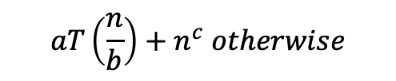
Master Theorem
Given a recurrence of the following form:
$$d when n=1$$
$$T\left(n\right)=$$
$$aT\left(\frac{n}{b}\right)+n^{c} otherwise$$
Then thanks to magical math brilliance we can know the following:
If
$$\log_{b}{a}<c$$
then
$$T\left(n\right)∈Θ\left(n^{c}\right)$$
If
$$\log_{b}{a}=c$$
then
$$T\left(n\right)∈Θ\left(n^{c}\log_{2}{n}\right)$$
If
$$\log_{b}{a}>c$$
then
$$T\left(n\right)∈Θ\left(n^{\log_{b}{a}}\right)$$

Slide 14
Apply Master Theorem
Given a recurrence of the form:
$$d when n=1$$
$$T\left(n\right)=$$
a = 2
b = 2
c = 1
d = 1
$$aT\left(\frac{n}{b}\right)+n^{c} otherwise$$
$$1 when n≤1$$
$$T\left(n\right)=$$
$$2T\left(\frac{n}{2}\right)+n otherwise$$
If
$$\log_{b}{a}<c$$
then
$$T\left(n\right)∈Θ\left(n^{c}\right)$$
If
$$\log_{b}{a}=c$$
then
$$T\left(n\right)∈Θ\left(n^{c}\log_{2}{n}\right)$$
If
$$\log_{b}{a}>c$$
then
$$T\left(n\right)∈Θ\left(n^{\log_{b}{a}}\right)$$
$\log_{b}{a}=c$ ${⇒ log}_{2}{2}=1$
$$T\left(n\right)∈Θ\left(n^{c}\log_{2}{n}\right)⇒Θ\left(n^{1}\log_{2}{n}\right)$$

Slide 15
Trees

Slide 16
Storing Sorted Items in an Array
get() – O(logn)
put() – O(n)
remove() – O(n)
Can we do better with insertions and removals?

Slide 17
Review: Trees!
A tree is a collection of nodes
  Each node has at most 1 parent and 0 or more children
Root node: the single node with no parent, “top” of the tree
Branch node: a node with one or more children
Leaf node: a node with no children
Edge: a pointer from one node to another
Subtree: a node and all it descendants
Height: the number of edges contained in the longest path from root node to some leaf node
1
2
5
3
6
7
4
8

Slide 18
Tree Height
2 Minutes
What is the height of the following trees?
overallRoot
overallRoot
overallRoot
1
7
null
2
5
7
Height = 2
Height = 0
Height = -1 or NA

Slide 19
Traversals
traversal: An examination of the elements of a tree.
  A pattern used in many tree algorithms and methods
Common orderings for traversals:
  pre-order: process root node, then its left/right subtrees
    17 41 29 6 9 81 40
  in-order: process left subtree, then root node, then right
    29 41 6 17 81 9 40
  post-order: process left/right subtrees, then root node
    29 6 41 81 40 9 17
Traversal Trick: Sailboat method
  Trace a path around the tree.
  As you pass a node on the
  proper side, process it.
    pre-order: left side
    in-order: bottom
    post-order: right side
overallRoot
17
41
9
29
6
81
40

Slide 20
Binary Search Trees
A binary search tree is a binary tree that contains comparable items such that for every node, all children to the left contain smaller data and all children to the right contain larger data.
10
9
15
7
12
18
8
17

Slide 21
Implement Dictionary
10
“foo”
Binary Search Trees allow us to:
  quickly find what we’re looking for
  add and remove values easily
  Dictionary Operations:
  Runtime in terms of height, “h”
  get() – O(h)
  put() – O(h)
  remove() – O(h)
    What do you replace the node with?
    Largest in left sub tree or smallest in right sub tree
7
12
“bar”
“baz”
5
9
15
“fo”
“sho”
“sup”
1
8
13
“burp”
“poo”
“boo”

Slide 22
Height in terms of Nodes
For “balanced” trees h ≈ log_{c}(n) where c is the maximum number of children
Balanced binary trees h ≈ log₂(n)
Balanced trinary tree h ≈ log₃(n)
Thus for balanced trees operations take Θ(log_{c}(n))

Slide 23
Unbalanced Trees
10
Is this a valid Binary Search Tree?
Yes, but…
We call this a degenerate tree
For trees, depending on how balanced they are,
Operations at worst can be O(n) and at best
can be O(logn)
How are degenerate trees formed?
  insert(10)
  insert(9)
  insert(7)
  insert(5)
9
7
5

Slide 24
Measuring Balance
2 Minutes
Measuring balance:
For each node, compare the heights of its two sub trees
Balanced when the difference in height between sub trees is no greater than 1
8
10
8
7
7
9
15
Balanced
7
Balanced
Balanced
12
18
Unbalanced

Slide 25
Meet AVL Trees
AVL Trees must satisfy the following properties:
  binary trees: all nodes must have between 0 and 2 children
  binary search tree: for all nodes, all keys in the left subtree must be smaller and all keys in the right subtree must be larger than the root node
  balanced: for all nodes, there can be no more than a difference of 1 in the height of the left subtree from the right. Math.abs(height(left subtree) – height(right subtree)) ≤ 1
  AVL stands for Adelson-Velsky and Landis (the inventors of the data structure)

Slide 26
Is this a valid AVL tree?
7
Is it…
Binary
BST
Balanced?
yes
yes
4
10
yes
3
5
9
12
2
6
8
11
13
14

Slide 27
Is this a valid AVL tree?
2 Minutes
6
Is it…
Binary
BST
Balanced?
yes
yes
2
8
no
Height = 0
Height = 2
1
4
7
12
3
5
10
13
9
11

Slide 28
Is this a valid AVL tree?
2 Minutes
8
Is it…
Binary
BST
Balanced?
yes
no
6
11
yes
2
7
15
-1
5
9
9 > 8

Slide 29
Implementing an AVL tree dictionary
Dictionary Operations:
get() – same as BST
containsKey() – same as BST
put() - ???
remove() - ???
Add the node to keep BST, fix AVL property if necessary
Replace the node to keep BST, fix AVL property if necessary
Unbalanced!
1
2
2
1
3
3

