Slide 1
Lecture 5: Algorithm Analysis and Modeling
CSE 373: Data Structures and Algorithms

Slide 2
Warm Up
5 Minutes
Approach
-> start with basic operations, work inside out for control structures
Each basic operation = +1
Conditionals = worst case test operations + branch
Loop = iterations (loop body)
Construct a mathematical function modeling the worst case runtime for the following functions
public void mystery1(ArrayList<String> list) {
for (int i = 0; i < 3000; i++) {
for (int j = 0; j < 1000; j++) {
int index = (i + j) % list.size();
System.out.println(list.get(index));
}
for (int j = 0; j < list.size(); j++) {
System.out.println(“:)”);
}
}
}
public void mystery2(ArrayList<String> list) {
for (int i = 0; i < list.size(); i++) {
for (int j = 0; j < list.size(); j++) {
System.out.println(list.get(0));
}
}
}
+4
+1
n(n(1))
n(1)
1000(6)
+2
3000(1000(6) + n(1))
Possible answer
T(n) = n²
+1
n(1)
Socrative:
www.socrative.com
Room Name: CSE373
Please enter your name as: Last, First
Possible answer
T(n) = 3000 (6000 + n)

Slide 3
Adminstrivia
HW 1 Due Tonight at 11:59pm
HW 2 goes live Today
Please fill out class survey
Read Pair Programming Doc if you haven’t!

Slide 4
Why don’t we care about exact constants?
Not enough information to compute precise constants
Depends on too many factors (underlying hardware, background processes, temperature etc…)
We really care about the growth of the function
Big O…

Slide 5
Comparing Functions

Slide 6
Asymptotic Analysis
asymptotic analysis – the process of mathematically representing runtime of a algorithm in relation to the number of inputs and how that relationship changes as the number of inputs grow
Two step process
Model – the process of mathematically representing how many operations a piece of code will run in relation to the number of inputs n
Analyze – compare runtime/input relationship across multiple algorithms
Graph the model of your code where x = number of inputs and y = runtime
For which inputs will one perform better than the other?

Slide 7
Function growth
Imagine you have three possible algorithms to choose between.
Each has already been reduced to its mathematical model
$$f\left(n\right)=n$$
$$g\left(n\right)=4n$$
$$h\left(n\right)=n^{2}$$
$$T\left(n\right)$$
$$T\left(n\right)$$
$$T\left(n\right)$$
$$n$$
$$n$$
$$n$$
The growth rate for f(n) and g(n) looks very different for small numbers of input
…but since both are linear eventually look similar at large input sizes
But for very small input values h(n) actually has a slower growth rate than either f(n) or g(n)
whereas h(n) has a distinctly different growth rate

Slide 8
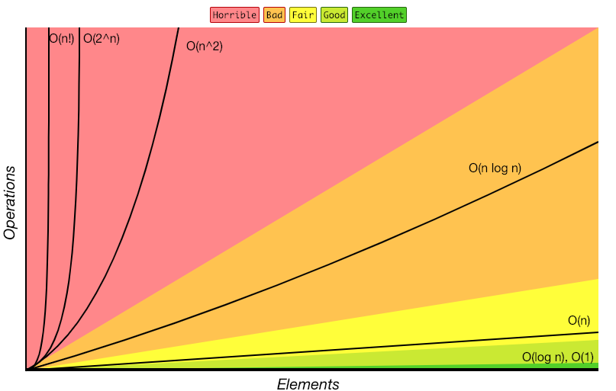
Review: Complexity Classes
complexity class – a category of algorithm efficiency based on the algorithm’s relationship to the input size N
Class | Big O | If you double N… | Example algorithm
constant | O(1) | unchanged | Add to front of linked list
logarithmic | O(log₂n) | Increases slightly | Binary search
linear | O(n) | doubles | Sequential search
log-linear | O(nlog₂n) | Slightly more than doubles | Merge sort
quadratic | O(n²) | quadruples | Nested loops traversing a 2D array
cubic | O(n³) | Multiplies by 8 | Triple nested loop
polynomial | O(n^{c})
exponential | O(c^{n}) | Multiplies drastically
http://bigocheatsheet.com/

Slide 9
Moving from Model to Complexity Class
Say an algorithm runs 0.4N³ + 25N² + 8N + 17 statements
17 is quickly dwarfed in the context of thousands of inputs
We ignore constants like 25 because they are tiny next to N
N³ is so powerful it dominates the overall runtime
O(N³)
$10n\log{n}+3n$
$5n^{2}\log{n}+13n^{3}$
$20n\log{\log{n}+2 n\log{n}}$
$2^{3n}$
Consider the runtime when N is extremely large
Lower order terms don’t matter – delete them.
Multiplying by constant factors has little effect on growth rate
Highest order term dominates the overall rate of change
Gives us a “simplified big-O”
$$O(n\log{n)}$$
$$O\left(n^{3}\right)$$
$$O(n\log{n})$$
$$O(8^{n})$$

Slide 10
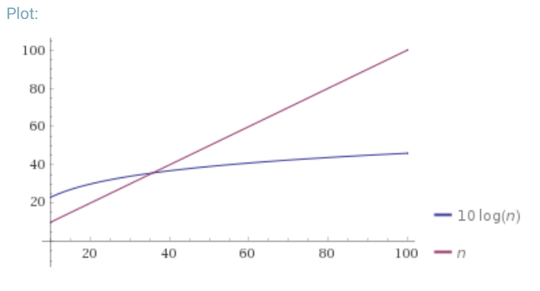
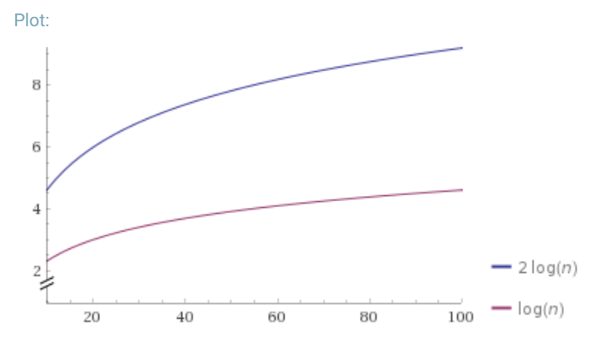
Definition: Big-O
Why $n_{0}$?
We wanted to find an upper bound on our algorithm’s running time, but
We don’t want to care about constant factors.
We only care about what happens as $n$ gets large.
$f(n)$ is $O(g\left(n\right))$ if there exist positive constants $c, n_{0}$ such that for all $n≥n_{0}$,
$$f\left(n\right)≤c⋅g\left(n\right)$$
Big-O
Why $c$?
We also say that $g\left(n\right)$ “dominates” $f(n)$
O(g(n)) is the “family” or “set” of all functions that are dominated by g(n)

Slide 11
Applying Big O Definition
$f(n)$ is $O(g\left(n\right))$ if there exist positive constants $c, n_{0}$ such that for all $n≥n_{0}$,
$$f\left(n\right)≤c⋅g\left(n\right)$$
Big-O
Show that
$$f\left(n\right)=10n+15$$
is
$$O\left(n\right)$$
Apply definition term by term
$$10n≤c・n when c=10 for all values of n$$
$$15≤c・n when c=15 for n≥1$$
Add up all your truths
$$10n+15≤10n+15n≤25n for n≥1$$
Select values for c and n0 and prove they validate the definition
Take $c=25$ and $n_{0}=1$
$$10n≤25n for all values of n$$
$$15≤25n for n≥1$$
Thus because a c and n0 exist, f(n) is O(n)

Slide 12
Exercise: Proving Big O
3 Minutes
Demonstrate that 5n² + 3n + 6 is dominated by n³ by finding a c and n₀ that satisfy the definition of domination
5n² + 3n + 6 ≤ 5n² + 3n² + 6n² when n ≥ 1
5n² + 3n² + 6n² = 14n²
5n² + 3n + 6 ≤ 14n² for n ≥ 1
14n² ≤ c*n³ for c = ? n >= ?
$\frac{14}{n}$ -> c = 14 & n >= 1
$f(n)$ is $O(g\left(n\right))$ if there exist positive constants $c, n_{0}$ such that for all $n≥n_{0}$,
$$f\left(n\right)≤c⋅g\left(n\right)$$
Big-O

Slide 13
Edge Cases
True or False: $10n^{2}+15n$ is $O(n^{3})$
It’s true – it fits the definition
$$10n2≤c・n3 when c=10 for n≥1$$
$$15n≤c・n3 when c=15 for n≥1$$
$$10n2+15n≤10n3+15n3≤25n3 for n≥1$$
$10n^{2}+15n$ is $O(n^{3})$ because $10n^{2}+15n≤25n3 for n≥1$
Big-O is just an upper bound. It doesn’t have to be a good upper bound
If we want the best upper bound, we’ll ask you for a tight big-O bound.
$O\left(n^{2}\right)$ is the tight bound for this example.
It is (almost always) technically correct to say your code runs in time $O(n!)$.
DO NOT TRY TO PULL THIS TRICK ON AN EXAM. Or in an interview.

Slide 14
Why Are We Doing This?
You already intuitively understand what big-O means.
Who needs a formal definition anyway?
We will.
Your intuitive definition and my intuitive definition might be different.
We’re going to be making more subtle big-O statements in this class.
We need a mathematical definition to be sure we’re on the same page.
Once we have a mathematical definition, we can go back to intuitive thinking.
But when a weird edge case, or subtle statement appears, we can figure out what’s correct.

Slide 15
Function comparison: exercise
3 Minutes
True – all linear functions are treated as equivalent
f(n) = n ≤ g(n) = 5n + 3?
f(n) = 5n + 3 ≤ g(n) = n?
f(n) = 5n + 3 ≤ g(n) = 1?
f(n) = 5n + 3 ≤ g(n) = n²?
f(n) = n² + 3n + 2 ≤ g(n) = n³?
f(n) = n³ ≤ g(n) = n² + 3n + 2 ?
True
False
True – quadratic will always dominate linear
True
False

Slide 16
O, Omega, Theta [oh my?]
Big-O is an upper bound
My code takes at most this long to run
Big-Omega is a lower bound
Big Theta is “equal to”
$Ω\left(f\left(n\right)\right)≤f\left(n\right)== θ\left(f\left(n\right)\right)≤O(f\left(n\right))$
f(n)
O(1)
O(log n)
O(n)
O(n²)
O(n³)
Is dominated by
f(n) ∈ O(g(n))
Dominates
f(n) ∈ Ω(g(n))
$f(n)$ is $Ω(g\left(n\right))$ if there exist positive constants $c, n_{0}$ such that for all $n≥n_{0}$,
$$f\left(n\right)≥c⋅g\left(n\right)$$
Big-Omega
$f(n)$ is $Θ(g\left(n\right))$ if
$f\left(n\right)$ is $O(g\left(n\right))$ and $f\left(n\right)$ is $Ω(g\left(n\right))$.
Big-Theta

Slide 17
Viewing O as a class
Sometimes you’ll see big-O defined as a family or set of functions.
$O(g\left(n\right))$ is the set of all functions $f\left(n\right)$ such that there exist positive constants $c, n_{0}$ such that for all $n≥n_{0}$, $f\left(n\right)≤c⋅g\left(n\right)$
Big-O (alternative definition)
For that reason, some people write $f\left(n\right)∈O\left(g\left(n\right)\right)$ where we wrote “$f\left(n\right)$ is $O(g\left(n\right))$”.
Other people write “$f\left(n\right)=O\left(g\left(n\right)\right)$” to mean the same thing.
The set of all functions that run in linear time (i.e. $O(n)$) is a “complexity class.”
We never write $O(5n)$ instead of $O(n)$ – they’re the same thing!
It’s like writing $\frac{6}{2}$ instead of $3$. It just looks weird.

Slide 18
Examples
$f(n)$ $∈$ $O(g\left(n\right))$ if there exist positive constants $c, n_{0}$ such that for all $n≥n_{0}$,
$$f\left(n\right)≤c⋅g\left(n\right)$$
Big-O
4n² ∈ Ω(1)
true
4n² ∈ Ω(n)
true
4n² ∈ Ω(n²)
true
4n² ∈ Ω(n³)
false
4n² ∈ Ω(n⁴)
false
4n² ∈ O(1)
false
4n² ∈ O(n)
false
4n² ∈ O(n²)
true
4n² ∈ O(n³)
true
4n² ∈ O(n⁴)
true
$f(n)$ $∈ Ω(g\left(n\right))$ if there exist positive constants $c, n_{0}$ such that for all $n≥n_{0}$,
$$f\left(n\right)≥c⋅g\left(n\right)$$
Big-Omega
$f(n)$ $∈$ $Θ(g\left(n\right))$ if
$f\left(n\right)$ is $O(g\left(n\right))$ and $f\left(n\right)$ is $Ω(g\left(n\right))$.
Big-Theta

Slide 19
Practice
3 Minutes
$f(n)$ $∈$ $O(g\left(n\right))$ if there exist positive constants $c, n_{0}$ such that for all $n≥n_{0}$,
$$f\left(n\right)≤c⋅g\left(n\right)$$
Big-O
5n + 3 ∈ O(n)
n ∈ O(5n + 3)
5n + 3 = O(n)
O(5n + 3) = O(n)
O(n²) = O(n)
n² ∈ O(1)
n² ∈ O(n)
n² ∈ O(n²)
n² ∈ O(n³)
n² ∈ O(n¹⁰⁰)
True
True
True
$f(n)$ $∈ Ω(g\left(n\right))$ if there exist positive constants $c, n_{0}$ such that for all $n≥n_{0}$,
$$f\left(n\right)≥c⋅g\left(n\right)$$
Big-Omega
True
False
False
False
$f(n)$ $∈$ $Θ(g\left(n\right))$ if
$f\left(n\right)$ is $O(g\left(n\right))$ and $f\left(n\right)$ is $Ω(g\left(n\right))$.
Big-Theta
True
True
True

