Slide 1
Lecture 3: Maps and Iterators
CSE 373: Data Structures and Algorithms

Slide 2
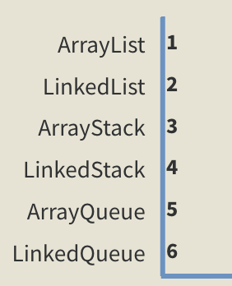
Warm Up
Take 3 Minutes
Q: Which ADT and data structure implementation would you choose if asked to implement a collection of comments for an Instagram post?
List ADT
Stack ADT
Queue ADT
state
state
state
Set of ordered items
Count of items
Set of ordered items
Number of items
Set of ordered items
Number of items
behavior
behavior
behavior
get(index) return item at index
set(item, index) replace item at index
append(item) add item to end of list
insert(item, index) add item at index
delete(index) delete item at index
size() count of items
push(item) add item to top
pop() return and remove item at top
peek() look at item at top
size() count of items
isEmpty() count of items is 0?
add(item) add item to back
remove() remove and return item at front
peek() return item at front
size() count of items
isEmpty() count of items is 0?
ArrayList – optimize for addition in order, the ability to remove regardless of position and update number of likes
Extra Credit:
Go to PollEv.com/champk
Text CHAMPK to 22333 to join session, text “1” or “2” to select your answer
LinkedList<E>
LinkedQueue<E>
ArrayStack<E>
state
state
LinkedStack<E>
Node front
size
Node front
Node back
size
state
behavior
state
data[]
size
get loop until index, return node’s value
set loop until index, update node’s value
append create new node, update next of last node
insert create new node, loop until index, update next fields
delete loop until index, skip node
size return size
ArrayList<E>
Node top
size
behavior
behavior
behavior
state
push data[size] = value, if out of room grow data
pop return data[size - 1], size-1
peek return data[size - 1]
size return size
isEmpty return size == 0
add – add node to back
remove – return and remove node at front
peek – return node at front
size – return size
isEmpty – return size == 0
data[]
size
ArrayQueue<E>
push add new node at top
pop return and remove node at top
peek return node at top
size return size
isEmpty return size == 0
behavior
get return data[index]
set data[index] = value
append data[size] = value, if out of space grow data
insert shift values to make hole at index, data[index] = value, if out of space grow data
delete shift following values forward
size return size
state
data[]
Size
front index
back index
behavior
add – data[size] = value, if out of room grow data
remove – return data[size - 1], size-1
peek – return data[size - 1]
size – return size
isEmpty – return size == 0

Slide 3
Administrivia

Slide 4
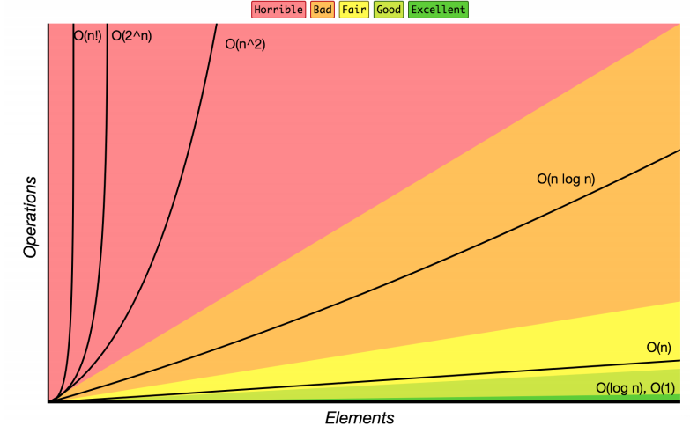
Review: Complexity Class
complexity class: A category of algorithm efficiency based on the algorithm's relationship to the input size N.
Complexity Class | Big-O | Runtime if you double N | Example Algorithm
constant | O(1) | unchanged | Accessing an index of an array
logarithmic | O(log₂ N) | increases slightly | Binary search
linear | O(N) | doubles | Looping over an array
log-linear | O(N log₂ N) | slightly more than doubles | Merge sort algorithm
quadratic | O(N²) | quadruples | Nested loops!
... | ... | ... | ...
exponential | O(2^{N}) | multiplies drastically | Fibonacci with recursion

Slide 5
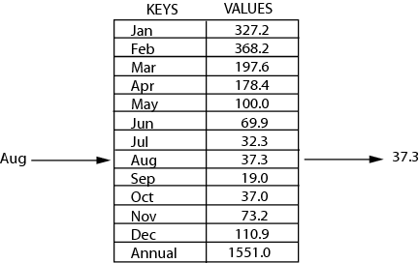
Review: Maps
key | value
“at" | 43
key | value
“in" | 37
key | value
“you" | 22
map: Holds a set of unique keys and a collection of values, where each key is associated with one value.
a.k.a. "dictionary", "associative array", "hash"
key | value
“the" | 56
map.get("the")
56
Dictionary ADT
supported operations:
put(key, value): Adds a given item into collection with associated key, if the map previously had a mapping for the given key, old value is replaced
get(key): Retrieves the value mapped to the key
containsKey(key): returns true if key is already associated with value in map, false otherwise
remove(key): Removes the given key and its mapped value
state
Set of items & keys
Count of items
behavior
put(key, item) add item to collection indexed with key
get(key) return item associated with key
containsKey(key) return if key already in use
remove(key) remove item and associated key
size() return count of items

Slide 6
Implementing a Dictionary with an Array
2 Minutes
Dictionary ADT
ArrayDictionary<K, V>
Big O Analysis
put()
get()
containsKey()
remove()
size()
state
state
O(n) linear
Set of items & keys
Count of items
Pair<K, V>[] data
O(n) linear
behavior
behavior
put(key, item) add item to collection indexed with key
get(key) return item associated with key
containsKey(key) return if key already in use
remove(key) remove item and associated key
size() return count of items
put create new pair, add to next available spot, grow array if necessary
get scan all pairs looking for given key, return associated item if found
containsKey scan all pairs, return if key is found
remove scan all pairs, replace pair to be removed with last pair in collection
size return count of items in dictionary
O(n) linear
O(n) linear
O(1) constant
put(‘a’, 1)
put(‘b’, 2)
put(‘c’, 3)
put(‘d’, 4)
remove(‘b’)
put(‘a’, 97)
0 | 1 | 2 | 3
97)
(‘a’, 1)
(‘b’, 2)
(‘c’, 3)
(‘d’, 4)

Slide 7
Implementing a Dictionary with Nodes
2 Minutes
Dictionary ADT
LinkedDictionary<K, V>
Big O Analysis
put()
get()
containsKey()
remove()
size()
state
state
O(n) linear
Set of items & keys
Count of items
front
size
O(n) linear
behavior
behavior
put(key, item) add item to collection indexed with key
get(key) return item associated with key
containsKey(key) return if key already in use
remove(key) remove item and associated key
size() return count of items
put if key is unused, create new with pair, add to front of list, else replace with new value
get scan all pairs looking for given key, return associated item if found
containsKey scan all pairs, return if key is found
remove scan all pairs, skip pair to be removed
size return count of items in dictionary
O(n) linear
O(n) linear
O(1) constant
put(‘a’, 1)
put(‘b’, 2)
put(‘c’, 3)
put(‘d’, 4)
remove(‘b’)
put(‘a’, 97)
front
‘d’
4
‘c’
3
‘b’
2
‘a’
1
97

Slide 8
Design Decisions
Take 5 Minutes
Discuss with your neighbors: Which implementation of the Dictionary ADT would you choose if asked to implement each of the following situations? For each consider the most important functions to optimize.
Situation #1: You are writing a program to store incidents in a software service you maintain. The keys will be time stamps, so you know they will be unique. You will be adding incidents as they occur and removing them as they are resolved. You are more likely to need to access and remove incidents that have recently been added to the collection.
LinkedDictionary – optimize for addition and removal of incidents without need of examining entire data set reguarly
Situation #2: You are writing a program to store a rather small dictionary that maps exam questions to the average score for that question across all students. The questions are numbered sequentially starting at 0. Often you will want to read the entire set of scores in the order of the test.
ArrayDictionary – optimize for accessing all entries in set in specific order or individually

Slide 9
Traversing Data
Array
for (int i = 0; i < arr.length; i++) {
System.out.println(arr[i]);
}
List
for (int i = 0; i < myList.size(); i++) {
System.out.println(myList.get(i));
}
for (T item : list) {
System.out.println(item);
}
Iterator!

Slide 10
Review: Iterators
iterator: a Java interface that dictates how a collection of data should be traversed. Can only move in the forward direction and in a single pass.
Iterator Interface
supported operations:
hasNext() – returns true if the iteration has more elements yet to be examined
next() – returns the next element in the iteration and moves the iterator forward to next item
behavior
hasNext() – true if elements remain
next() – returns next element
ArrayList<Integer> list = new ArrayList<Integer>();
//fill up list
Iterator itr = list.iterator();
while (itr.hasNext()) {
int item = itr.next();
}
ArrayList<Integer> list = new ArrayList<Integer>();
//fill up list
for (int i : list) {
int item = i;
}

Slide 11
Implementing an Iterator
hasNext()
itr
front
4
3
2
1
true
itr
front
4
3
2
1
false
next()
itr
front
4
3
2
1
4
itr
front
4
3
2
1
2
Notes:
Implement over the map we just made

Slide 12
Testing Your Code

Slide 13
Testing
Computers don’t make mistakes- people do!
“I’m almost done, I just need to make sure it works”
– Naive 14Xers
Software Test: a separate piece of code that exercises the code you are assessing by providing input to your code and finishes with an assertion of what the result should be.
Isolate - break your code into small modules
Build in increments - Make a plan from simplest to most complex cases
Test as you go - As your code grows, so should your tests

Slide 14
Types of Tests
Black Box
Behavior only – ADT requirements
From an outside point of view
Does your code uphold its contracts with its users?
Performance/efficiency
White Box
Includes an understanding of the implementation
Written by the author as they develop their code
Break apart requirements into smaller steps
“unit tests” break implementation into single assertions

Slide 15
What to test?
Expected behavior
The main use case scenario
Does your code do what it should given friendly conditions?
Forbidden Input
What are all the ways the user can mess up?
Empty/Null
Protect yourself!
How do things get started?
0, -1, null, empty collections
Boundary/Edge Cases
First items
Last item
Full collections
Scale
Is there a difference between 10, 100, 1000, 10000 items?

Slide 16
Testing Strategies
You can’t test everything
Break inputs into categories
What are the most important pieces of code?
Test behavior in combination
Call multiple methods one after the other
Call the same method multiple times
Trust no one!
How can the user mess up?
If you messed up, someone else might
Test the complex logic

Slide 17
Thought Experiment
5 Minutes
Discuss with your neighbors: Imagine you are writing an implementation of the List interface that stores integers in an Array. What are some ways you can assess your program’s correctness in the following cases:
Expected Behavior
Create a new list
Add some amount of items to it
Remove a couple of them
Forbidden Input
Add a negative number
Add duplicates
Add extra large numbers
Empty/Null
Call remove on an empty list
Add to a null list
Call size on an null list
Boundary/Edge Cases
Add 1 item to an empty list
Set an item at the front of the list
Set an item at the back of the list
Scale
Add 1000 items to the list
Remove 100 items in a row
Set the value of the same item 50 times

Slide 18
JUnit
JUnit: a testing framework that works with IDEs to give you a special GUI experience when testing your code
@Test
public void myTest() {
Map<String, Integer> basicMap = new LinkedListDict<String, Integer>();
basicMap.put(“Kasey”, 42);
assertEquals(42, basicMap.get(“Kasey”));
}
Assertions:
assertEquals(item1, item2)
assertTrue(Boolean expression)
assertFalse(bollean expression)
assertNotNull(item)
More: https://junit.org/junit5/docs/5.0.1/api/org/junit/jupiter/api/Assertions.html

