Slide 1
Lecture 2: Stacks and Queues
CSE 373: Data Structures and Algorithms

Slide 2
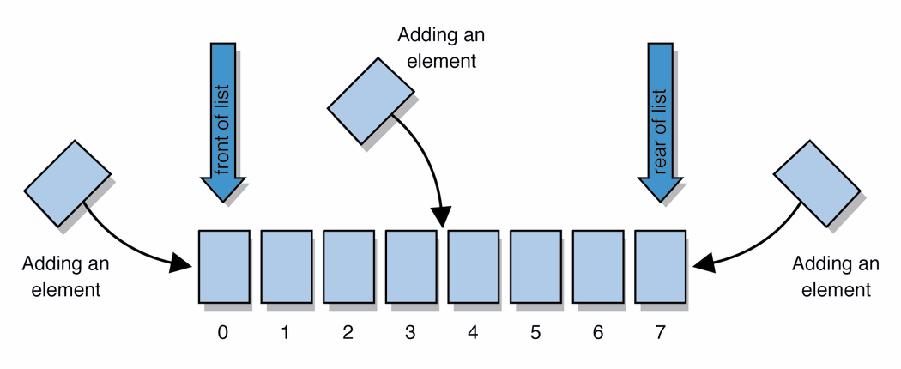
Warm Up
Q: Which data structure implementation of the List ADT would you choose to optimize for the “delete” function?
Instructions
ArrayList
uses an Array as underlying storage
LinkedList
uses nodes as underlying storage
Take 3 Minutes
ArrayList<E>
LinkedList<E>
Introduce yourself to your neighbors ☺
Discuss your answers
Log onto Poll Everywhere
Go to PollEv.com/champk
Text CHAMPK to 22333 to join session, text “1” or “2” to select your answer
Get extra credit!
state
state
data[]
size
Node front
size
List ADT
behavior
get return data[index]
set data[index] = value
append data[size] = value, if out of space grow data
insert shift values to make hole at index, data[index] = value, if out of space grow data
delete shift following values forward
size return size
behavior
get loop until index, return node’s value
set loop until index, update node’s value
append create new node, update next of last node
insert create new node, loop until index, update next fields
delete loop until index, skip node
size return size
state
Set of ordered items
Count of items
behavior
get(index) return item at index
set(item, index) replace item at index
append(item) add item to end of list
insert(item, index) add item at index
delete(index) delete item at index
size() count of items
0 | 1 | 2 | 3 | 4
88.6 | 26.1 | 94.4 | 0 | 0
88.6
26.1
94.4
list
free space

Slide 3
Administrivia
Course Stuff
Class webpage: cs.washington.edu/373
Piazza: piazza.com/washington/spring2019/cse373
Homework 1 Live!
Individual assignment
14x content review
GitLab/IntelliJ setup
You will be created a git lab repo (TODAY)
Important Dates
Midterm – Friday May 4th in class
Final – Tuesday June 11th 8:30-10:20am
Homework 2 out next week, partner project
You are responsible for finding your own partner
Lecture, section, piazza, office hours
Fill out partner form so we can generate repos

Slide 4
Review: “Big Oh”
efficiency: measure of computing resources used by code.
can be relative to speed (time), memory (space), etc.
most commonly refers to run time
Assume the following:
Any single Java statement takes same amount of time to run.
A method call's runtime is measured by the total of the statements inside the method's body.
A loop's runtime, if the loop repeats N times, is N times the runtime of the statements in its body.
We measure runtime in proportion to the input data size, N.
growth rate: Change in runtime as N gets bigger. How does this algorithm perform with larger and larger sets of data?
b = c + 10;
for (int i = 0; i < N; i++) {
for (int j = 0; j < N; j++) {
dataTwo[j][i] = dataOne[i][j];
dataOne[i][j] = 0;
}
}
for (int i = 0; i < N; i++) {
dataThree[i] = b;
}
This algorithm runs 2N² + N + 1 statements.
We ignore constants like 2 because they are tiny next to N.
The highest-order term (N²) “dominates” the overall runtime.
We say that this algorithm runs "on the order of" N².
or O(N²) for short ("Big-Oh of N squared")

Slide 5
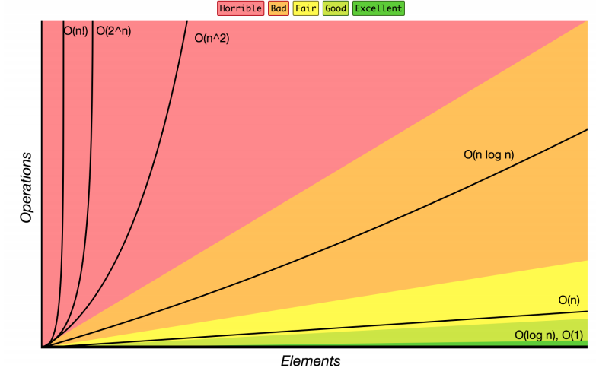
Review: Complexity Class
complexity class: A category of algorithm efficiency based on the algorithm's relationship to the input size N.
Complexity Class | Big-O | Runtime if you double N | Example Algorithm
constant | O(1) | unchanged | Accessing an index of an array
logarithmic | O(log₂ N) | increases slightly | Binary search
linear | O(N) | doubles | Looping over an array
log-linear | O(N log₂ N) | slightly more than doubles | Merge sort algorithm
quadratic | O(N²) | quadruples | Nested loops!
... | ... | ... | ...
exponential | O(2^{N}) | multiplies drastically | Fibonacci with recursion

Slide 6
List ADT tradeoffs
Time needed to access i-th element:
Array: O(1) constant time
LinkedList: O(n) linear time
Time needed to insert at i-th element
Array: O(n) linear time
LinkedList: O(n) linear time
Amount of space used overall
Array: sometimes wasted space
LinkedList: compact
Amount of space used per element
Array: minimal
LinkedList: tiny extra
char[] myArr = new char[5]
0 | 1 | 2 | 3 | 4
‘h’ | ‘e’ | ‘l’ | ‘l’ | ‘o’
LinkedList<Character> myLl = new LinkedList<Character>();
front
‘h’
‘e’
‘l’
‘l’
‘o’ | /

Slide 7
Design Decisions
Take 3 Minutes
Discuss with your neighbors: How would you implement the List ADT for each of the following situations? For each consider the most important functions to optimize.
Situation #1: Write a data structure that implements the List ADT that will be used to store a list of songs in a playlist.
LinkedList – optimize for growth of list and movement of songs
Situation #2: Write a data structure that implements the List ADT that will be used to store the history of a bank customer’s transactions.
ArrayList – optimize for addition to back and accessing of elements
Situation #3: Write a data structure that implements the List ADT that will be used to store the order of students waiting to speak to a TA at a tutoring center
LinkedList - optimize for removal from front
ArrayList – optimize for addition to back

Slide 8
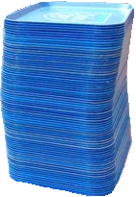
Review: What is a Stack?
stack: A collection based on the principle of adding elements and retrieving them in the opposite order.
Last-In, First-Out ("LIFO")
Elements are stored in order of insertion.
We do not think of them as having indexes.
Client can only add/remove/examine the last element added (the "top").
push
pop, peek
top | 3
 | 2
bottom | 1
Stack ADT
state
Set of ordered items
Number of items
supported operations:
push(item): Add an element to the top of stack
pop(): Remove the top element and returns it
peek(): Examine the top element without removing it
size(): how many items are in the stack?
isEmpty(): true if there are 1 or more items in stack, false otherwise
behavior
push(item) add item to top
pop() return and remove item at top
peek() look at item at top
size() count of items
isEmpty() count of items is 0?

Slide 9
Implementing a Stack with an Array
Stack ADT
ArrayStack<E>
Big O Analysis
pop()
peek()
size()
isEmpty()
push()
state
state
O(1) Constant
Set of ordered items
Number of items
data[]
size
O(1) Constant
behavior
behavior
push(item) add item to top
pop() return and remove item at top
peek() look at item at top
size() count of items
isEmpty() count of items is 0?
push data[size] = value, if out of room grow data
pop return data[size - 1], size-1
peek return data[size - 1]
size return size
isEmpty return size == 0
O(1) Constant
O(1) Constant
O(1) Constant or
worst case O(N) linear
push(3)
push(4)
pop()
push(5)
0 | 1 | 2 | 3
3
4
5
2
0
numberOfItems =
1

Slide 10
Implementing a Stack with Nodes
Stack ADT
LinkedStack<E>
Big O Analysis
pop()
peek()
size()
isEmpty()
push()
state
state
O(1) Constant
Set of ordered items
Number of items
Node top
size
O(1) Constant
behavior
behavior
push(item) add item to top
pop() return and remove item at top
peek() look at item at top
size() count of items
isEmpty() count of items is 0?
push add new node at top
pop return and remove node at top
peek return node at top
size return size
isEmpty return size == 0
O(1) Constant
O(1) Constant
O(1) Constant
4
push(3)
push(4)
pop()
front
3
numberOfItems =
1
0
2

Slide 11
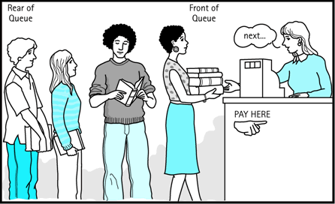
Review: What is a Queue?
queue: Retrieves elements in the order they were added.
First-In, First-Out ("FIFO")
Elements are stored in order of insertion but don't have indexes.
Client can only add to the end of the queue, and can only examine/remove the front of the queue.
front |  | back
1 | 2 | 3
remove, peek
add
Queue ADT
state
supported operations:
add(item): aka “enqueue” add an element to the back.
remove(): aka “dequeue” Remove the front element and return.
peek(): Examine the front element without removing it.
size(): how many items are stored in the queue?
isEmpty(): if 1 or more items in the queue returns true, false otherwise
Set of ordered items
Number of items
behavior
add(item) add item to back
remove() remove and return item at front
peek() return item at front
size() count of items
isEmpty() count of items is 0?

Slide 12
Implementing a Queue with an Array
Queue ADT
ArrayQueue<E>
Big O Analysis
remove()
peek()
size()
isEmpty()
add()
state
state
O(1) Constant
Set of ordered items
Number of items
data[]
Size
front index
back index
O(1) Constant
behavior
add(item) add item to back
remove() remove and return item at front
peek() return item at front
size() count of items
isEmpty() count of items is 0?
O(1) Constant
behavior
add – data[size] = value, if out of room grow data
remove – return data[size - 1], size-1
peek – return data[size - 1]
size – return size
isEmpty – return size == 0
O(1) Constant
O(1) Constant or
worst case O(N) linear
0 | 1 | 2 | 3 | 4
add(5)
add(8)
add(9)
remove()
5
8
9
1
2
numberOfItems =
3
0
1
front = 0
back = 0
2
1
Notes:
Spend rest of class implementing queue – do we need to address circular queues?

Slide 13
Implementing a Queue with an Array
> Wrapping Around
add(7)
add(4)
add(1)
front
back
0 | 1 | 2 | 3 | 4
4
5
9
2
7
front
5
3
back
numberOfItems =
4
0 | 1 | 2 | 3 | 4 | 5 | 6 | 7 | 8 | 9
5 | 9 | 2 | 7 | 4
1

Slide 14
Implementing a Queue with Nodes
Queue ADT
LinkedQueue<E>
Big O Analysis
remove()
peek()
size()
isEmpty()
add()
state
state
O(1) Constant
Set of ordered items
Number of items
Node front
Node back
size
O(1) Constant
behavior
add(item) add item to back
remove() remove and return item at front
peek() return item at front
size() count of items
isEmpty() count of items is 0?
O(1) Constant
behavior
add – add node to back
remove – return and remove node at front
peek – return node at front
size – return size
isEmpty – return size == 0
O(1) Constant
O(1) Constant
numberOfItems =
0
2
1
add(5)
add(8)
remove()
front
5
8
back
Notes:
Spend rest of class implementing queue – do we need to address circular queues?

Slide 15
Design Decisions
Take 3 Minutes
Discuss with your neighbors: For each scenario select the appropriate ADT and implementation to best optimize for the given scenario.
Situation #1: You are writing a program to manage a todo list with a very specific approach to tasks. This program will order tasks for someone to tackle so that the most recent task is addressed first. How would you store the transactions in appropriate order?
Stack – First in Last out
Nodes – make addition and removal of tasks very easy
Situation #2: You are writing a program to schedule jobs sent to a laser printer. The laser printer should process these jobs in the order in which the requests were received. How would you store the jobs in appropriate order?
Queue – First in First out
Array – want easy access to all items in queue in case you need to cancel a job

Slide 16
Review: Generics
public class Box {
private Object object;
public void set(Object object) {
this.object = object;
}
public Object get() {
return object;
}
}
// a parameterized (generic) class
public class name<TypeParameter> {
...
}
Forces any client that constructs your object to supply a type
Don't write an actual type such as String; the client does that
Instead, write a type variable name such as E (for "element") or T (for "type")
You can require multiple type parameters separated by commas
The rest of your class's code can refer to that type by name
public class Box<T> {
private T t;
public void set(T t) {
this.t = t;
}
public T get() {
return t;
}
}
More details: https://docs.oracle.com/javase/tutorial/java/generics/types.html

