Slide 1
Minimum Spanning Trees
Data Structures and Algorithms

Slide 2
Announcements
- Project 3 Due Tonight
- Project 4 Assigned Today
  Same partners as project 3
  We will re-run project 3 grading on project 4, just like the checkpoint from project 1 (this is why you are keeping your partners)
  If you are curious about the missing part2 of this project, look at last quarter’s website (change 18su to 18sp in the web address)
  Goal for today: Learn the algorithm you will be implementing in project 4.

Slide 3
Review: Minimum Spanning Trees
Spanning Tree – A subtree of a graph that spans (includes) all of the vertices
- connected
- acyclic
2
1
B
C
D
3
6
A
6
1
3
3
E
5
1
2
F
G
H
2
4

Slide 4
Review: Minimum Spanning Trees
Spanning Tree – A subtree of a graph that spans (includes) all of the vertices
- connected
- acyclic
2
1
B
C
D
3
6
A
6
1
3
3
E
5
1
2
F
G
H
2
4

Slide 5
Review: Minimum Spanning Trees
Spanning Tree – A subtree of a graph that spans (includes) all of the vertices
- connected
- acyclic
2
1
B
C
D
3
6
A
6
1
3
3
E
5
1
2
F
G
H
2
4

Slide 6
Review: Minimum Spanning Trees
Spanning Tree – A subtree of a graph that spans (includes) all of the vertices
- connected
- acyclic
2
1
B
C
D
3
6
A
6
1
3
3
E
5
1
2
F
G
H
2
4

Slide 7
Review: Minimum Spanning Trees
Minimum Spanning Tree – The lowest weight subtree of a graph that spans (includes) all of the vertices.
2
1
B
C
D
3
6
A
6
1
3
3
E
5
1
2
F
G
H
2
4

Slide 8
Review: Minimum Spanning Trees
Minimum Spanning Tree – The lowest weight subtree of a graph that spans (includes) all of the vertices.
- A graph can have more than one
2
1
B
C
D
3
6
A
6
1
3
3
E
5
1
2
F
G
H
2
4

Slide 9
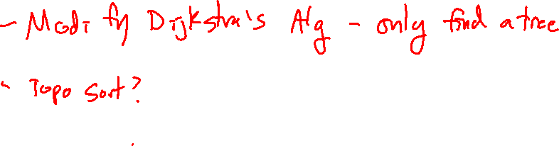
How Do We Find One?
Discuss with your neighbors – how could we try to find the minimum spanning tree?

Slide 10
Greedy Algorithms
Strategy: Take the best we can get right now, ignoring long-term optimality.
  Usually fast to implement
  Does not always get the “best” result
    But often is “good enough”
Does a greedy approach work for MST?

Slide 11
A Greedy Approach to MST
Strategy: Pick the smallest edge until we’re done.
2
1
B
C
D
3
6
A
2
1
3
3
E
5
1
2
F
G
H
2
4

Slide 12
A Greedy Approach to MST
Strategy: Pick the smallest edge until we’re done.
2
1
B
C
D
3
6
A
2
1
3
3
E
5
1
2
F
G
H
2
4

Slide 13
A Greedy Approach to MST
Strategy: Pick the smallest edge until we’re done.
2
1
B
C
D
3
6
A
2
1
3
3
E
5
1
2
F
G
H
2
4

Slide 14
A Greedy Approach to MST
Strategy: Pick the smallest edge until we’re done.
2
1
B
C
D
3
6
A
2
1
3
3
E
5
1
2
F
G
H
2
4

Slide 15
A Greedy Approach to MST
Strategy: Pick the smallest edge until we’re done.
2
1
B
C
D
3
6
A
2
1
3
3
E
5
1
2
F
G
H
2
4

Slide 16
A Greedy Approach to MST
Strategy: Pick the smallest edge until we’re done.
2
1
B
C
D
3
6
A
2
1
3
3
E
5
1
2
F
G
H
2
4

Slide 17
A Greedy Approach to MST
Strategy: Pick the smallest edge until we’re done.
2
1
B
C
D
3
6
A
2
1
3
3
E
5
1
2
F
G
H
2
4

Slide 18
A Greedy Approach to MST
Strategy: Pick the smallest edge that doesn’t create a cycle until we’re done.
2
1
B
C
D
3
6
A
2
1
3
3
E
5
1
2
F
G
H
2
4

Slide 19
A Greedy Approach to MST
Strategy: Pick the smallest edge that doesn’t create a cycle until we’re done.
2
1
B
C
D
3
6
A
2
1
3
3
E
5
1
2
F
G
H
2
4

Slide 20
A Greedy Approach to MST
Strategy: Pick the smallest edge that doesn’t create a cycle until we’re done.
2
1
B
C
D
3
6
A
2
1
3
3
E
5
1
2
F
G
H
2
4

Slide 21
A Greedy Approach to MST
Strategy: Pick the smallest edge that doesn’t create a cycle until we’re done.
2
1
B
C
D
3
6
A
2
1
3
3
E
5
1
2
F
G
H
2
4

Slide 22
A Greedy Approach to MST
Strategy: Pick the smallest edge that doesn’t create a cycle until we’re done.
2
1
B
C
D
3
6
A
2
1
3
3
E
5
1
2
F
G
H
2
4

Slide 23
A Greedy Approach to MST
Strategy: Pick the smallest edge that doesn’t create a cycle until we’re done.
2
1
B
C
D
3
6
A
2
1
3
3
E
5
1
2
F
G
H
2
4

Slide 24
A Greedy Approach to MST
Strategy: Pick the smallest edge that doesn’t create a cycle until we’re done.
2
1
B
C
D
3
6
A
2
1
3
3
E
5
1
2
F
G
H
2
4

Slide 25
A Greedy Approach to MST
Strategy: Pick the smallest edge that doesn’t create a cycle until we’re done.
2
1
B
C
D
3
6
A
2
1
3
3
E
5
1
2
F
G
H
2
4

Slide 26
A Greedy Approach to MST
Strategy: Pick the smallest edge that doesn’t create a cycle until we’re done.
2
1
B
C
D
3
6
A
2
1
3
3
E
5
1
2
F
G
H
2
4
Notes:
I think we’re done now.
We have a connected, acyclic, spanning subgraph.
What’s a quick criteria we could check?

Slide 27
A Greedy Approach to MST
Strategy: Pick the smallest edge that doesn’t create a cycle until we have n – 1 edges.
2
1
B
C
D
3
6
A
2
1
3
3
E
5
1
2
F
G
H
2
4

Slide 28
Does this always work?
Proof Sketch: (you don’t need to remember this – just remember greedy algorithms don’t always find the optimum solution, but this one does).
At every step we have a forest (never add edges that make a cycle).
At the end, we have a spanning tree (an acyclic graph with n-1 edges can only be a tree with |V| = n).
Suppose we found T, and T* is a minimum spanning tree. If we repeatedly swap in the smallest edge we didn’t pick from T*, we will eventually transform our tree into T*. No swap will ever increase the weight of our tree, since we picked edges in order from smallest to largest.
So T is at least as small as T*.
To really prove this, use induction! (See CSE 417/421)

Slide 29

Kruskal’s Algorithm
Kruskal(G = (V, E)):
queue = priorityQueue(E)
mst = empty list
while (size(mst) < |V| - 1):
e = queue.deleteMin()
if adding e would not create a cycle:
mst.add(e)
return mst
O(|E|) – Floyd’s Build-Heap
O(1)
At most |E| iterations
O(log |E|)
???
O(|V|+|E|) – DFS from section
O(1)
$$O({\left|E\right|}^{2})$$
Can we do better?
Notes:
By now you should know that the answer is usually yes.

Slide 30
A Criteria for Cycle Checking
Observation: An edge will create a cycle if and only if both endpoints are in the same connected component.
2
1
B
C
D
3
6
A
2
1
3
3
E
5
1
2
F
G
H
2
4
Strategy: Build a data structure that can quickly answer sameCC(A, B).

Slide 31
Properties of sameCC(A, B)
Recall: A is in the same connected component as B if and only if there is a path from A to B
- sameCC(A, A) = True
  There is always a (trivial) path from a vertex to itself
- sameCC(A, B) = sameCC(B, A)
  Reversing a path from A to B makes a path from B to A
- If sameCC(A,B) and sameCC(B, C), then sameCC(A, C)
  Can join a path from A to B to a path from B to C, yielding a path from A to C
In mathematics, we call anything with these properties and equivalence relation.
REFLEXIVITY
SYMMETRY
TRANSITIVITY

Slide 32
Equivalence Relations
Equivalence Relation: A binary relation (boolean valued function with two arguments of the same type) that is reflexive, symmetric, and transitive.
Namesake: Equals (==)
- A == A (reflexive)
- A == B ⬄ B == A (symmetric)
- A == B and B == C ➔ A == C (transitive)
The collection of all objects that are equivalent under an equivalence relation is called an equivalence class.
Connected components are equivalence classes under “sameCC” (i.e. pathExists(A,B))
Notes:
So if we can efficiently track connected components, we can efficiently check if edges will create a cycle!

Slide 33
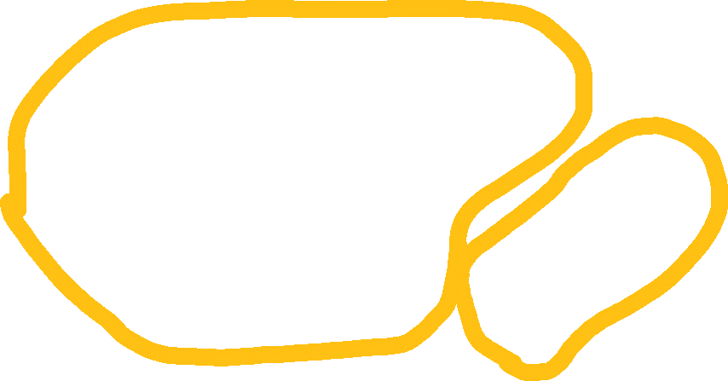
A Datastructure for Equivalence Classes
Main Idea: Link together elements in an equivalence class, pointing towards a representative element.
G
B
C
D
A
E
F
G
H
H
Notes:
Each connected component is “named” by its representative element.
To find which connected component an element is in, follow the arrows!

Slide 34
A Datastructure for Equivalence Classes
Notice: Equivalence classes are disjoint – they don’t share elements. They also cover the entire set of objects – each object is contained in an equivalence class.
G
This makes them an example of disjoint sets.
B
C
D
A
E
F
G
H
H
Notes:
Each connected component is “named” by its representative element.
To find which connected component an element is in, follow the arrows!

Slide 35
ADT: Disjoint Sets
Requirements:
- Keeps track of which set each element is in
- Dynamic: can combine sets (union)
- Online: can find the set an element is in on-the-fly (and then continue modifying)
ADT: Disjoint Sets
- union(A, B) – Joins together the sets which A and B belong to
- find(A) - finds a representative element for the set that A is in
- [constructor – all elements start in their own separate disjoint set]
Notes:
Each connected component is “named” by its representative element.
To find which connected component an element is in, follow the arrows!

Slide 36
Find
Find: Return the representative element of an element’s set. Example: find(D)
G
B
C
D
A
E
F
G
H
H
Notes:
Each connected component is “named” by its representative element.
To find which connected component an element is in, follow the arrows!

Slide 37
Find
Find: Return the representative element of an element’s set. Example: find(D)
G
B
C
D
A
E
F
G
H
H
Notes:
Each connected component is “named” by its representative element.
To find which connected component an element is in, follow the arrows!

Slide 38
Find
Find: Return the representative element of an element’s set. Example: find(D)
G
B
C
D
A
E
F
G
H
H
Notes:
Each connected component is “named” by its representative element.
To find which connected component an element is in, follow the arrows!

Slide 39
Find
Find: Return the representative element of an element’s set. Example: find(D)
G
B
C
D
A
E
F
G
H
H
Notes:
Each connected component is “named” by its representative element.
To find which connected component an element is in, follow the arrows!

Slide 40
A Datastructure for Equivalence Classes
Find: Return the representative element of an element’s set. Example: find(D)
G
B
C
D
A
E
F
G
H
H
Notes:
Each connected component is “named” by its representative element.
To find which connected component an element is in, follow the arrows!

Slide 41
Find
Find: Return the representative element of an element’s set. Example: find(D) = G
G
B
C
D
A
E
F
G
H
H
Notes:
Each connected component is “named” by its representative element.
To find which connected component an element is in, follow the arrows!

Slide 42
Union
Union: Combine two disjoint sets. Example: Union(D, E)
G
B
C
D
A
E
F
G
H
H
Notes:
Each connected component is “named” by its representative element.
To find which connected component an element is in, follow the arrows!

Slide 43
Uinion
Union: Combine two disjoint sets. Example: Union(D, E)
G
find(D) = G
B
C
D
A
E
F
G
H
H
Notes:
Each connected component is “named” by its representative element.
To find which connected component an element is in, follow the arrows!

Slide 44
Union
Union: Combine two disjoint sets. Example: Union(D, E)
G
B
C
D
find(E) = H
A
E
F
G
H
H
Notes:
Each connected component is “named” by its representative element.
To find which connected component an element is in, follow the arrows!

Slide 45
Union
Union: Combine two disjoint sets. Example: Union(D, E)
G
Make one of the representative elements the parent of the other
B
C
D
A
E
F
G
H
H
Notes:
Each connected component is “named” by its representative element.
To find which connected component an element is in, follow the arrows!

Slide 46

Union
Union: Combine two disjoint sets. Example: Union(D, E)
G
B
C
D
A
E
F
G
H
Notes:
Each connected component is “named” by its representative element.
To find which connected component an element is in, follow the arrows!

Slide 47
Representation
Observe: This is a forest. How can we represent these trees?
G
B
C
D
A
E
F
G
H
H
Notes:
Each connected component is “named” by its representative element.
To find which connected component an element is in, follow the arrows!

Slide 48
Disjoint Set Trees (aka Union-Find Trees)
Observe: Each element has at most 1 parent (the links point up towards the root).
G
H
F
C
E
A
B
Only 1 piece of data is needed for each element, so we can use an array.
D
A
B
C
D
E
F
G
H
F
C
G
C
H
G
G
H
Notes:
Each connected component is “named” by its representative element.
To find which connected component an element is in, follow the arrows!

Slide 49
Disjoint Set Trees (aka Union-Find Trees)
Observe: Each element has at most 1 parent (the links point up towards the root).
6
7
5
2
4
0
1
Only 1 piece of data is needed for each element, so we can use an array.
3
0
1
2
3
4
5
6
7
-1 is used as a sentinel value representing a root.
5
2
6
2
7
6
-1
-1
Notes:
Each connected component is “named” by its representative element.
To find which connected component an element is in, follow the arrows!

Slide 50
Disjoint Set (Simple Version)
constructor:
s = [-1, -1, -1, …, -1]
find(a):
if (s[a] < 0): return a
return find(s[a])
union(rootA, rootB): ← assumes you already ran “find”, so these are representative elements
s[rootA] = rootB

Slide 51
Is it fast?
Run union(0,1), union(0,2), … union(0, n):
n
We might form degenerate trees.
2
1
Remember balanced trees? Can we try and make this more balanced?
0

Slide 52
Union by Size
Strategy: Point the smaller tree at the larger to avoid deep chains.
union(rootA, rootB):
if size(rootB) > size(rootA):
s[rootA] = rootB
updateSize(rootB)
else:
s[rootB] = rootA
updateSize(rootA)
Problem: How to keep track of size?
Solution: Use the sentinel values! Instead of -1, store the negative of the size. -1 will still initializes!

Slide 53
Union by Size (in one array)
Strategy: Point the smaller tree at the larger to avoid deep chains.
union(rootA, rootB):
if s[rootB] < s[rootA]: // Note the flipped sign, since we are using the negative of the size!!!
s[rootB] = s[rootB] + s[rootA]
s[rootA] = rootB
else:
s[rootA] = s[rootA] + s[rootB]
s[rootB] = rootA
Problem: How to keep track of size?
Solution: Use the sentinel values! Instead of -1, store the negative of the size. -1 will still initializes!

Slide 54
Analysis of Union by Size
How deep can the trees get?
If the depth of a node increases after a union, it must have been in a smaller subtree.
Therefore, the size of its subtree has at least doubled.
We can double the size of a subtree at most log n times before everything is in one set.
Therefore the depth of any node can only increase at most log n times.
This means that the maximum depth of a union-by-size tree is O(log n)!
Corollary: A sequence of M operations on a disjoint sets collection with N elements takes at most O(M log N) time.
Notes:
M and N should be suggestive here – in our application for Kruskal’s algorithm, we have one element for each Vertex (so N total), and we do at max 3 operations for each of the M edges (find equivalence classes of each endpoint, then possibly union them).

Slide 55
Union by Height (in one array)
Strategy: Point the shallower tree at the larger to avoid deep chains.
union(rootA, rootB):
if s[rootB] < s[rootA]: // Note the flipped sign, since we are using the negative of the height!!!
s[rootA] = rootB
else:
if ( s[rootA] == s[rootB] ): // Total height only increases when both trees are equally deep!
s[rootA]-- // Subtracting increases the height
s[rootB] = rootA
Note that we are actually storing -(height + 1) so that height 0 trees are still negative (still start at -1)
Notes:
This tracks what we care about a bit more directly (height vs. size). The analysis for union by size still works since this algorithm will never produce deeper trees than union-by-size.

Slide 56
More Optimization!
It’s not hard to hit the worst case, but there’s not much more left to do!
We haven’t changed find yet – what could we do here?
Idea: Whenever we run find, “flatten” the tree for the path we explore (i.e. set the parent of all intermediate nodes to the root:
0
0
2
1
2
6
7
1
6
3
8
3
4
5
4
5
7
8
Notes:
Note that if we do this in a union-by-height tree, we might change the height without updating it. This is okay because we maintain the worst-case bounds. When we combine these two, we call this upper-bound on height the “rank” and call the algorithm union-by-rank with path compression.

Slide 57
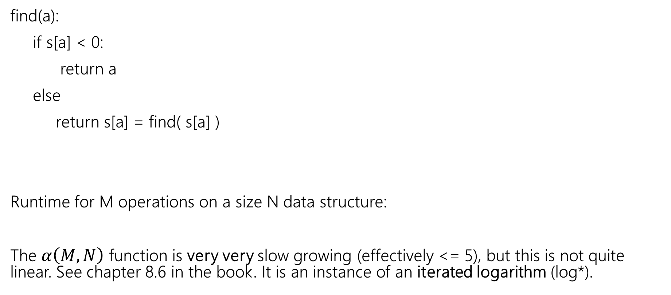

Find with Path Compression
find(a):
if s[a] < 0:
return a
else
return s[a] = find( s[a] )
Runtime for M operations on a size N data structure:
The $α\left(M, N\right)$ function is very very slow growing (effectively <= 5), but this is not quite linear. See chapter 8.6 in the book. It is an instance of an iterated logarithm (log*).
$$Θ(M α\left(M, N\right))$$

Slide 58
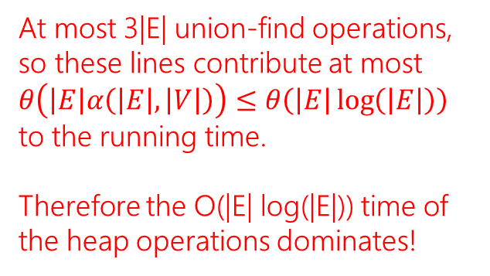
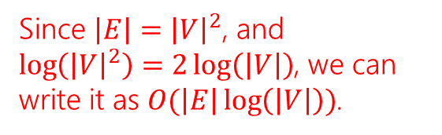
Bringing it back to MSTs: Kruskal’s Alg.
Kruskal(G = (V, E)):
queue = priorityQueue(E)
ds = new DisjointSets( |V| )
mst = empty list
while (size(mst) < |V| - 1):
e = (u,v) = queue.deleteMin()
repU = ds.find(u)
repV = ds.find(v)
if repU != repV:
mst.add(e)
ds.union(repU, repV)
return mst
At most 3|E| union-find operations,
so these lines contribute at most $θ\left(\left|E\right|α\left(\left|E\right|,\left|V\right|\right)\right)≤θ\left(\left|E\right|\log\left(\left|E\right|\right)\right)$ to the running time.
Therefore the O(|E| log(|E|)) time of the heap operations dominates!
Since $\left|E\right|={\left|V\right|}^{2}$, and $\log\left({\left|V\right|}^{2}\right)=2\log\left(\left|V\right|\right)$, we can write it as $O(\left|E\right|\log\left(\left|V\right|\right))$.
In practice we don’t usually need to iterate over all of the edges, so it’s even faster.

Slide 59
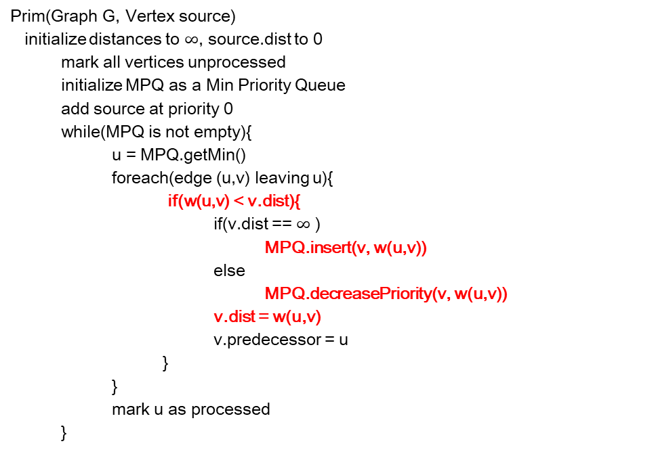
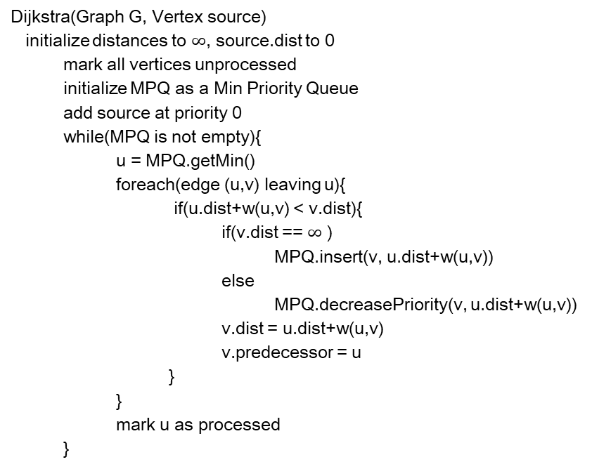
Another Approach to MSTs: Prim’s Alg.
Strategy – Grow an MST from a starting node, just like Dijkstra’s algorithm.
Dijkstra(Graph G, Vertex source)
initialize distances to $∞$, source.dist to 0
mark all vertices unprocessed
initialize MPQ as a Min Priority Queue
add source at priority 0
while(MPQ is not empty){
u = MPQ.getMin()
foreach(edge (u,v) leaving u){
if(u.dist+w(u,v) < v.dist){
if(v.dist == $∞$ )
MPQ.insert(v, u.dist+w(u,v))
else
MPQ.decreasePriority(v, u.dist+w(u,v))
v.dist = u.dist+w(u,v)
v.predecessor = u
}
}
mark u as processed
}
Prim(Graph G, Vertex source)
initialize distances to $∞$, source.dist to 0
mark all vertices unprocessed
initialize MPQ as a Min Priority Queue
add source at priority 0
while(MPQ is not empty){
u = MPQ.getMin()
foreach(edge (u,v) leaving u){
if(w(u,v) < v.dist){
if(v.dist == $∞$ )
MPQ.insert(v, w(u,v))
else
MPQ.decreasePriority(v, w(u,v))
v.dist = w(u,v)
v.predecessor = u
}
}
mark u as processed
}

