Slide 1
Graphs
Data Structures and Algorithms

Slide 2
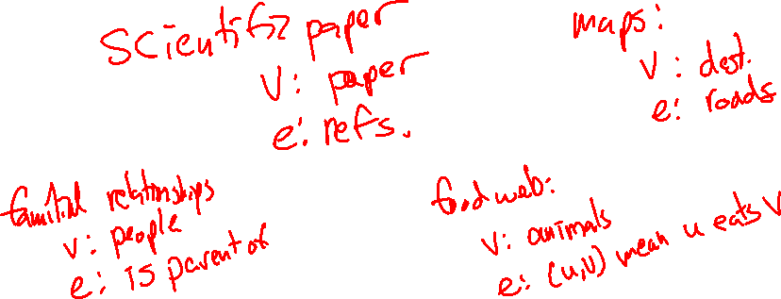
Warmup
Discuss with your neighbors:
Come up with as many kinds of relational data as you can (data that can be represented with a graph).

Slide 3
Announcements
Project 2 Due on Friday
Next individual HW assignment assigned tonight, due next Wednesday
  Two problems – merge sort and graph practice
  Sign up for Project 3 partners by Thursday night!
  I am gone tonight through Tuesday. Robbie will be lecturing again. No instructor office hours tomorrow or Tuesday next week.

Slide 4
Graph: Formal Definition
G
A graph is defined by a pair of sets G = (V, E) where…
  V is a set of vertices
    A vertex or “node” is a data entity
  E is a set of edges
    An edge is a connection between two vertices
H
V = { A, B, C, D, E, F, G, H }
F
A
E = { (A, B), (A, C), (A, D), (A, H),
(C, B), (B, D), (D, E), (D, F),
(F, G), (G, H)}
D
C
B
E

Slide 5
Graph Vocabulary
Undirected Graph:
Graph Direction
  Undirected graph – edges have no direction and are two-way
  Directed graphs – edges have direction and are thus one-way
Degree of a Vertex
  Degree – the number of edges containing that vertex
  A : 1, B : 1, C : 1
  In-degree – the number of directed edges that point to a vertex
  A : 0, B : 2, C : 1
  Out-degree – the number of directed edges that start at a vertex
  A : 1, B : 1, C : 1
A
B
V = { A, B, C }
E = { (A, B), (B, C) } inferred (B, A) and (C,B)
Undirected Graph:
C
V = { A, B, C }
B
E = { (A, B), (B, C), (C, B) }
A
C

Slide 6
Food for thought
Is a graph valid if there exists a vertex with a degree of 0?
Yes
B
B
B
A
A
A
C
C
C
A has an “in degree” of 0
B has an “out degree” of 0
C has both an “in degree” and an “out degree” of 0
Are these valid?
Is this a valid graph?
Yup
A
B
A
B
C
A
Yes!
Sure
D
C

Slide 7
Graph Vocabulary
Self loop – an edge that starts and ends at the same vertex
Parallel edges – two edges with the same start and end vertices
Simple graph – a graph with no self-loops and no parallel edges
Complete graph – a graph with edges between every pair of vertices
A
A
B
Notes:
When we say “graph” with no other specifications, we almost always mean a simple graph (and often an unweighted one at that)

Slide 8

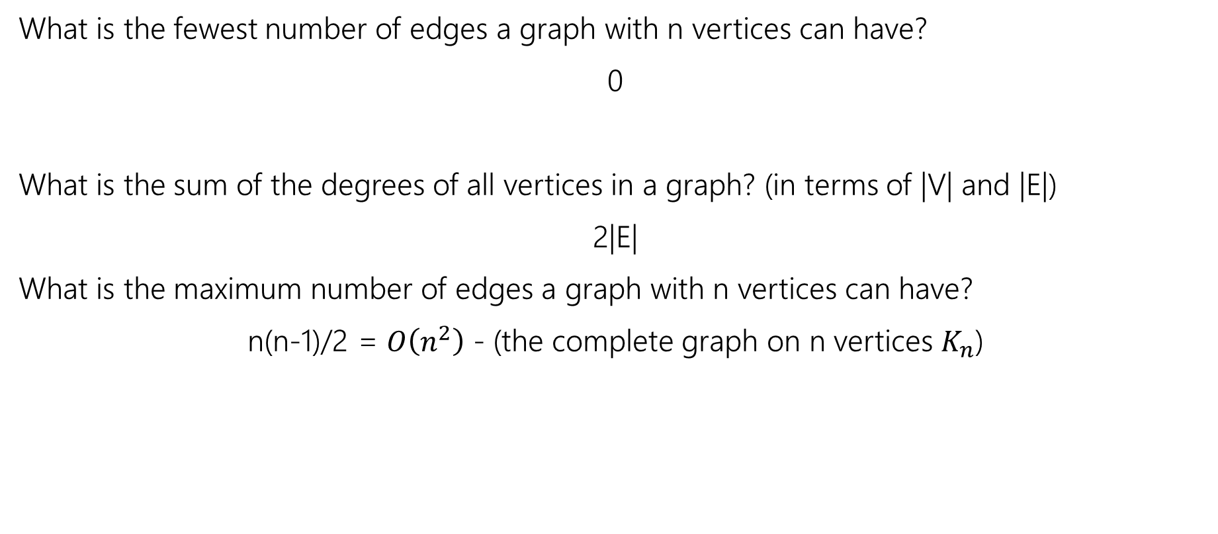



For simple, undirected graphs…
What is the fewest number of edges a graph with n vertices can have?
0
What is the sum of the degrees of all vertices in a graph? (in terms of |V| and |E|)
2|E|
What is the maximum number of edges a graph with n vertices can have?
n(n-1)/2 = $O\left(n^{2}\right)$ - (the complete graph on n vertices $K_{n}$)

Slide 9

Representing Graphs
Discuss with your neighbor: How would you implement a non-weighted, undirected graph?
Assume there are n vertices, and those vertices are numbered 0, 1, 2, …, n-1.
As an example:
G = (V, E)
V = {0,1,2,3,4,5,6}, E = { (0,1), (0,2), (1,3), (3,5), (4,5) }
4
0
1
5
6
2
3

Slide 10
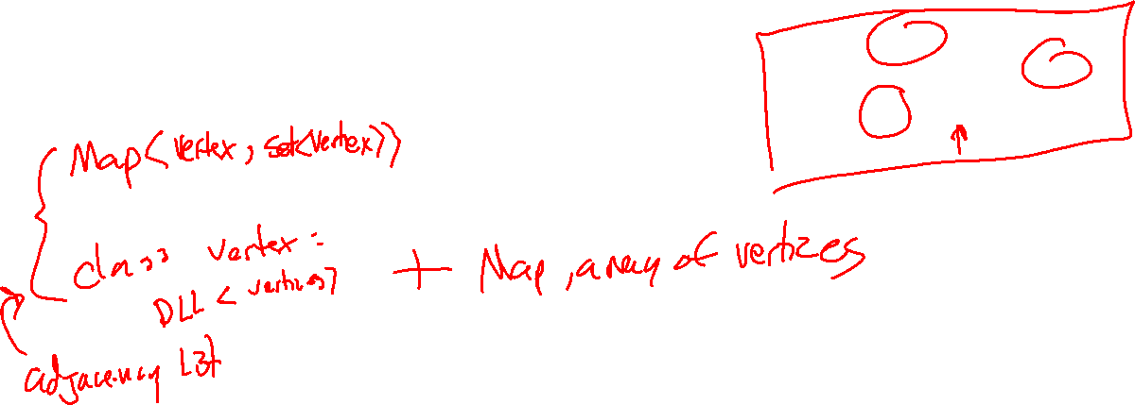
Representing Graphs
0
1
4
5
6
2
3

Slide 11

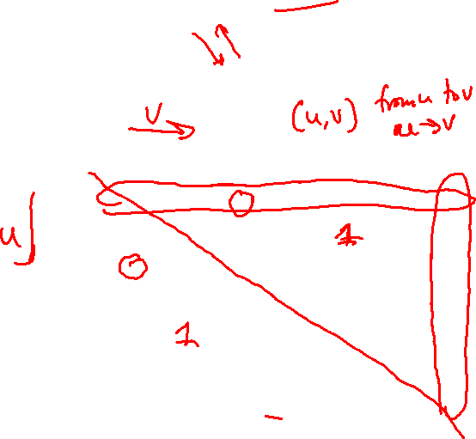
Adjacency Matrix
0
1
4
5
6
2
3
A matrix is a table of numbers, a[u][v].
In an adjacency matrix a[u][v] is 1 if there is an edge (u,v), and 0 otherwise.
Can represent both undirected and directed graphs
Can represent self-loops and parallel edges (interpret as the # of edges between two vertices
Time Complexity (|V| = n, |E| = m):
  Add Edge:
  Remove Edge:
  Check edge exists from (u,v):
  Get neighbors of u (out):
  Get neighbors of u (in):
Space Complexity:
 | 0 | 1 | 2 | 3 | 4 | 5 | 6
0 | 0 | 1 | 1 | 0 | 0 | 0 | 0
1 | 1 | 0 | 0 | 1 | 0 | 0 | 0
2 | 1 | 0 | 0 | 1 | 0 | 0 | 0
3 | 0 | 1 | 1 | 0 | 0 | 1 | 0
4 | 0 | 0 | 0 | 0 | 0 | 1 | 0
5 | 0 | 0 | 0 | 1 | 1 | 0 | 0
6 | 0 | 0 | 0 | 0 | 0 | 0 | 0
  O(1)
  O(1)
  O(1)
  O(n)
  O(n)
$$O(n^{2})$$
Notes:
It is usual to write |V| = n and |E| = m, though sometimes we’ll abuse notation and just use V and E.

Slide 12

Sparsity
A Dense Graph is a graph with many edges $\left|E\right|≈{\left|V\right|}^{2}$
A Sparse Graph is a graph with few edges $\left|E\right|≈|V|$
Adjacency Matrices are very wasteful of space for spare graphs – they are almost all 0s!
How could we save space?

Slide 13
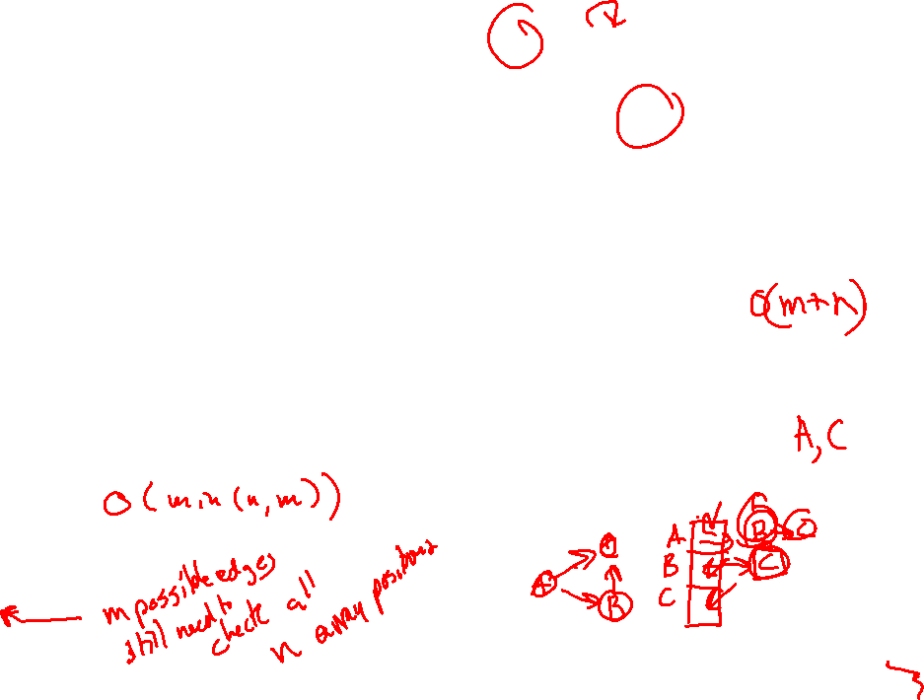
Adjacency List
0
1
4
5
6
2
3
An array where the u’th element contains a list of neighbors of u.
Can represent both undirected and directed graphs
In the directed case, put the out neighbors (a[u] has v for all (u,v) in E)
Can represent self-loops and parallel edges (repeat neighbor)
Time Complexity (|V| = n, |E| = m):
  Add Edge:
  Remove Edge:
  Check edge exists from (u,v):
  Get neighbors of u (out):
  Get neighbors of u (in):
Space Complexity:
0
1
2
3
4
5
6
1 → 2
0 → 3
0 → 3
1 → 2 → 5
  O(1)
5
  O( min(n, m) )
3 → 4
  O( min(n, m) )
  O(n)
  O(n + m)
O(n + m)

Slide 14
Graph Vocabulary
Weighted Graph – a graph with numeric weights associated with each edge
- can be directed or undirected
- weights can be negative, positive or 0
- common to specify “only non-negative edge weights”, or “only positive edge weights”
- denoted e = (u, v, w) or sometimes e = ((u,v), w)
- Weights often carry meaning such as “distance”, (e.g. driving time between cities)
3
A
B
0
C
D
-5

Slide 15
Representing Weighted Graphs
Adjacency Matrix – You can make the value of at each element the weight of the edge
- In an int array (int[]) you can’t distinguish between 0 weight edge and no edge
- Solution 1 – You know ahead of time that 0 weight (or negative weight) edges
do not exist and use that to represent no edge
- Solution 2 (Java) – Use an Integer array (Integer[]) – have null represent no edge
Adjacency list – Store pairs (neighbor, edge weight)

Slide 16
Storing Data In Graphs
We often have data associated with vertices and edges
Vertex Data Examples:
  Facebook: Name, Age, Birthday, Hometown, Likes
  Google Maps: City name, elevation, hours of operation
  Internet: Page title, page contents, date last modified
Edge Data Examples:
  Facebook: Date friendship was made, friend vs. acquaintance, etc.
  Google Maps: Length of road, speed limit

Slide 17
Storing Data in Graphs
We could have a Graph<V, E> where V is a data type for Vertices and E is one for Edges
Adjacency Matrix: E[][] – now each entry has a pointer to edge data, or null if that edge is not in the graph
Adjacency List: E[] – the neighbor lists are now a list of edges
Both: Maintain a list V[] of vertices
Alternative Adjacency List: V[] just a list of vertices, where each vertex contains within it a list of (outgoing) edges.

Slide 18
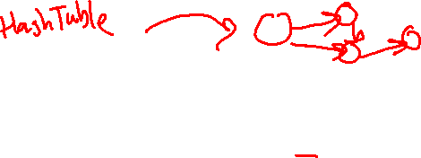
Arrays → HashTables
When we analyze and describe graph algorithms, for simplicity we assume that each vertex has a unique identity 0, 1, 2, … n-1.
Accesses in Adjacency Matrices and getting an adjacency list are both worst case O(1) for arrays.
In reality, we often don’t have unique sequential integers for each vertex. In a real graph implementation, we often use HashMaps or HashSets.
This would get us average case O(1), but worst case O(n). This is bad in analysis, but fine in practice. An adjacency list that stores references to the actual vertex objects can avoid repeated table lookups.
We could always use a hash table to give unique integer IDs to every element, incurring an O(n) worst case, but O(1) average case overhead before each call (which can save our worst case analysis for any O(n) or slower algorithm), but we don’t usually bother to.

Slide 19
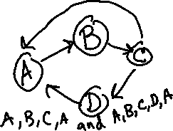
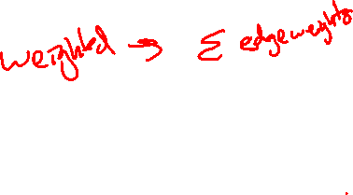
Graph Vocabulary
Path – A sequence of connected vertices
(Directed) Path – A path in a directed graph must follow the direction of the edges
Path Length (unweighted) – The number of edges in a path
- (A,B,C,D) has length 3.
Simple Path – A path that doesn’t repeat vertices (except maybe first=last)
Cycle – A path that starts and ends at the same vertex (of length at least 1)
A
B
C
D
A
B
C
D

Slide 20
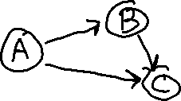



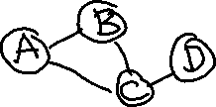

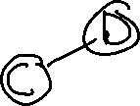
Graph Vocabulary
Connected Graph – A graph that has a path from every vertex to every other vertex (i.e. every vertex is reachable from every other vertex.
Strongly Connected Graph – A directed graph that is connected (note the direction of the edges!)
Weakly Connected Graph – A directed graph that is connected when interpreted as undirected. (Note all strongly connected graphs are also weakly connected)

Slide 21
Paths and Reachability
Very common questions:
- Is there a path between two vertices? (Can I drive from Seattle to LA?)
- What is the length of the shortest path between two vertices? (How long will it take?)
Less common, but still important:
What is the longest path in a graph?
  In general a “hard”™ problem
  7 degrees of Kevin Bacon
  Length of this path is called the “diameter” of a graph
Notes:
You will be implementing Shortest Path in a future project

Slide 22
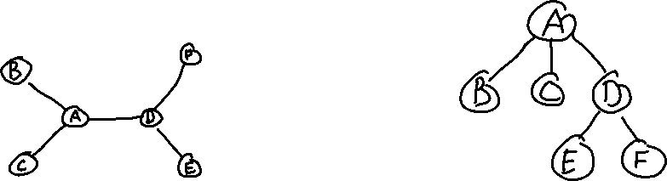
Trees
A tree is a connected, acyclic graph.
An a tree there exist exactly one path between every pair of vertices.
A graph consisting of several disconnected trees is called a forest.
The trees we have seen so far have been rooted trees – interpret one vertex as the root, and its neighbors are now children, and the root of their own subtrees.
How many edges does a tree with n vertices have?
n - 1

Slide 23
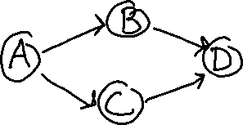
DAGs
DAG stands for Directed, Acyclic, Graph
This is the directed graph analog of a forest.
The trees we have made so far in this class have been implemented as weakly connected DAGs.
Can be used to represent dependencies: i.e. A must be completed before either B or C, and both B and C must be completed before D. Scheduling these tasks is called topological sort.

Slide 24

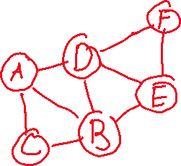
Subgraphs
Take a graph, and delete vertices and edges so you still have a graph.
The remaining red vertices and edges form a subgraph.
Formally: $G^{′}=\left(V^{′}, E^{′}\right)⊆G=\left(V,E\right)⇔V^{′}⊆V and E^{′}⊆E and G^{′} is a graph$
Notes:
This is like subtrees (and other “sub”stuffs).

Slide 25
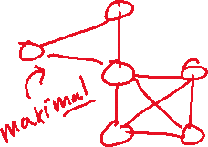
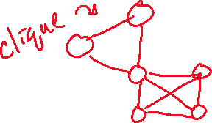
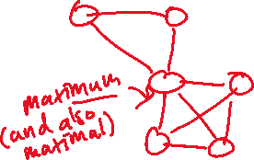
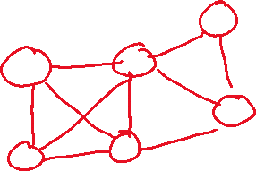
Interesting Subgraphs
Cliques
  A clique is a complete subgraph
  A maximal clique is a clique that you could not add any more vertices to and still have a clique. This is distinct from the maximum clique, which is the largest clique in a graph.
Notes:
Maximal, maximum, minimal and minimum are generic terms that are useful across a variety of subjects.

Slide 26
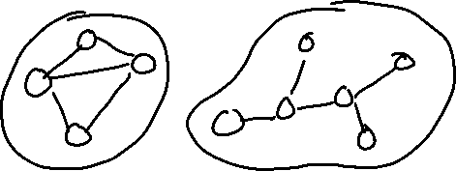
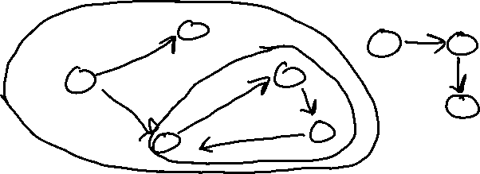
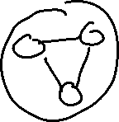
Interesting Subgraphs
Connected Components
  A connected component is a maximal, connected subgraph
  In directed graphs, you have two kinds: strongly connected, and weakly connected:

Slide 27
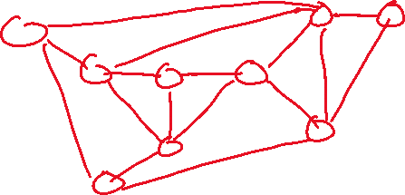
Interesting Subgraphs
A Spanning Tree is a subgraph that is both a tree and includes every vertex (it spans the graph).
Every connected graph has at least one spanning tree. They are like skeletons of the graph.
An important problem is finding the minimum spanning tree. We will learn 2 algorithms for this. It is useful for optimization tasks (e.g. minimum cost to build a road network).

Slide 28
Other interesting Graph Problems
- Circuits – paths or cycles that touch every vertex
- Reductions – Everything we’ve seen so far in this class can be represented as a graph – a lot of other problems can too! Graphs can solve many problems.

