Slide 1
Lecture 3: How to measure efficiency
Data Structures and Algorithms

Slide 2
Announcements
- Course background survey due by Friday
- HW 1 is Due Friday
- Alex has Office Hours after class (2:30-4:30) CSE 006, will help with setup
- If you have any questions about your setup please come to office hours so we can iron out all the wrinkles before the partnered projects begin next week.
- HW 2 Assigned on Friday – Partner selection forms due by 11:59pm Thursday
https://goo.gl/forms/rVrVUkFDdsqI8pkD2

Slide 3
Review: Sequential Search
sequential search: Locates a target value in an array / list by examining each element from start to finish.
How many elements will it need to examine?
Example: Searching the array below for the value 42:
What is the best case?
What is the worst case?
What is the complexity class?
index | 0 | 1 | 2 | 3 | 4 | 5 | 6 | 7 | 8 | 9 | 10 | 11 | 12 | 13 | 14 | 15 | 16
value | -4 | 2 | 7 | 10 | 15 | 20 | 22 | 25 | 30 | 36 | 42 | 50 | 56 | 68 | 85 | 92 | 103
i

Slide 4
Review: Binary Search
binary search: Locates a target value in a sorted array or list by successively eliminating half of the array from consideration.
How many elements will it need to examine?
Example: Searching the array below for the value 42:
What is the best case?
What is the worst case?
What is the complexity class?
index | 0 | 1 | 2 | 3 | 4 | 5 | 6 | 7 | 8 | 9 | 10 | 11 | 12 | 13 | 14 | 15 | 16
value | -4 | 2 | 7 | 10 | 15 | 20 | 22 | 25 | 30 | 36 | 42 | 50 | 56 | 68 | 85 | 92 | 103
min
mid
max

Slide 5
Analyzing Binary Search
What is the pattern?
At each iteration, we eliminate half of the remaining elements
How long does it take to finish?
1st iteration – N/2 elements remain
2nd iteration – N/4 elements remain
Kth iteration - N/2^k elements remain
Done when N/2^k = 1
index | 0 | 1 | 2 | 3 | 4 | 5 | 6 | 7 | 8 | 9 | 10 | 11 | 12 | 13 | 14 | 15 | 16
value | -4 | 2 | 7 | 10 | 15 | 20 | 22 | 25 | 30 | 36 | 42 | 50 | 56 | 68 | 85 | 92 | 103

Slide 6
Analyzing Binary Search

Slide 7
Analyzing Binary Search
Finishes when N / 2^{K} = 1
N / 2^{K} = 1
-> multiply right side by 2^{K}
N = 2^{K}
-> isolate K exponent with logarithm
Log₂N = k
Is this exact?
N can be things other than powers of 2
If N is odd we can’t technically use Log₂
When we have an odd number of elements we select the larger half
Within a fair rounding error

Slide 8
Asymptotic Analysis
asymptotic analysis: how the runtime of an algorithm grows as the data set grows
Approximations / Rules
Basic operations take “constant” time
Assigning a variable
Accessing a field or array index
Consecutive statements
Sum of time for each statement
Function calls
Time of function’s body
Conditionals
Time of condition + maximum time of branch code
Loops
Number of iterations x time for loop body

Slide 9
Modeling Case Study
Goal: return ‘true’ if a sorted array of ints contains duplicates
Solution 1: compare each pair of elements
public boolean hasDuplicate1(int[] array) {
for (int i = 0; i < array.length; i++) {
for (int j = 0; j < array.length; j++) {
if (i != j && array[i] == array[j]) {
return true;
}
}
}
return false;
}
Solution 2: compare each consecutive pair of elements
public boolean hasDuplicate2(int[] array) {
for (int i = 0; i < array.length - 1; i++) {
if (array[i] == array[i + 1]) {
return true;
}
}
return false;
}

Slide 10
Modeling Case Study: Solution 2
T(n) where n = array.length
-> work inside out
Solution 2: compare each consecutive pair of elements
public boolean hasDuplicate2(int[] array) {
for (int i = 0; i < array.length - 1; i++) {
if (array[i] == array[i + 1]) {
return true;
}
}
return false;
}
T(n) = 5 (n-1) + 1
linear time complexity class O(n)
+4
+1
x n - 1
If statement = 5
+1

Slide 11
Modeling Case Study: Solution 1
Solution 1: compare each consecutive pair of elements
public boolean hasDuplicate1(int[] array) {
for (int i = 0; i < array.length; i++) {
for (int j = 0; j < array.length; j++) {
if (i != j && array[i] == array[j]) {
return true;
}
}
}
return false;
}
T(n) = 6 n² + 1
quadratic time complexity class O(n²)
x n
x n
+5
6n²
+1
6n
6
+1

Slide 12
Comparing Functions

Slide 13
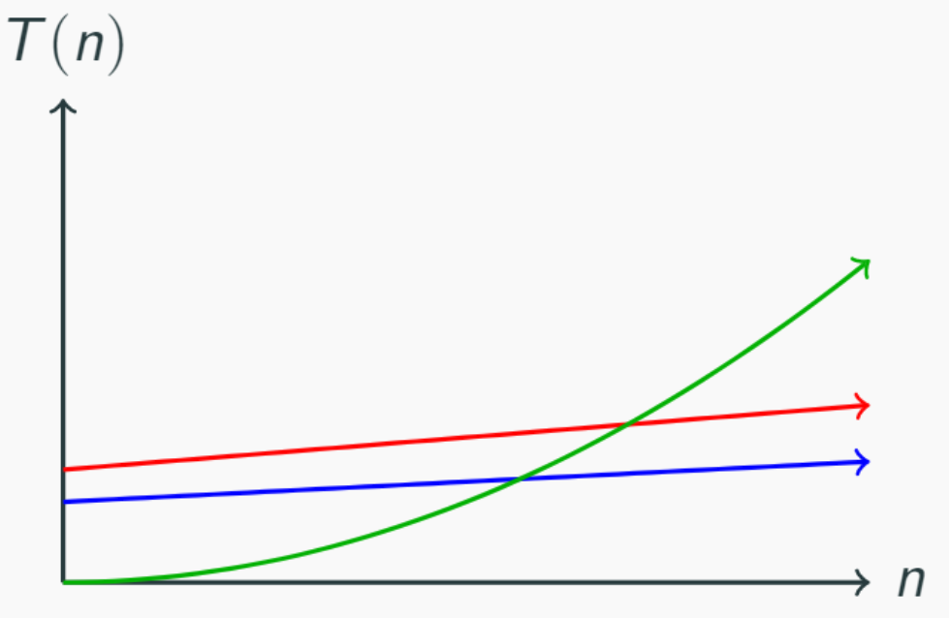
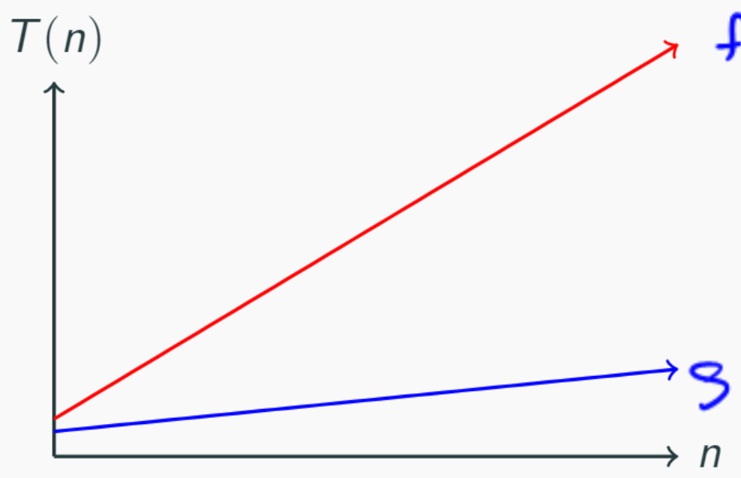
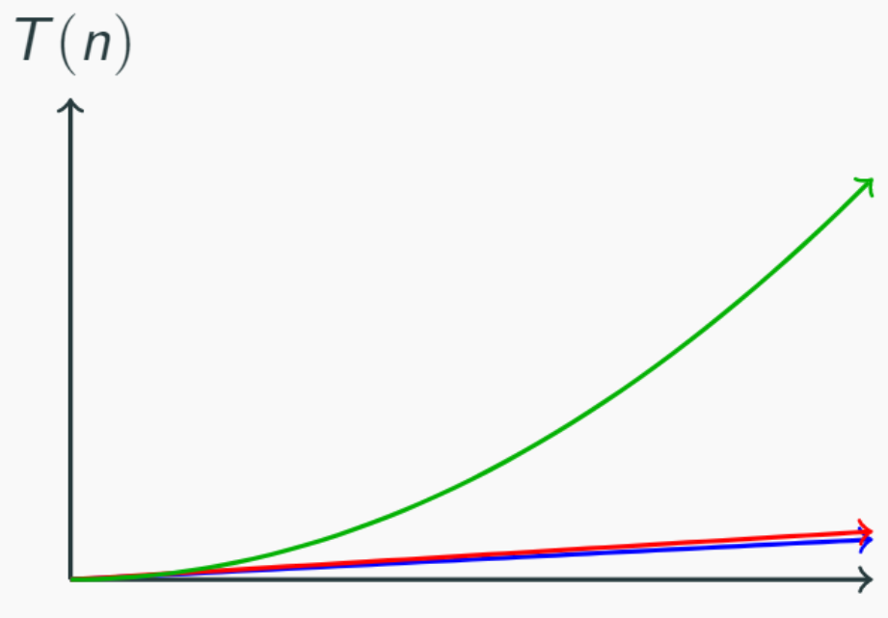
Function growth
n
n
n and 4n look very different up close
n and 4n look the same over time
n² doesn’t start off dominating the linear functions
It eventually takes over…
n² eventually dominates n

Slide 14
Function comparison: exercise
True – all linear functions are treated as equivalent
f(n) = n ≤ g(n) = 5n + 3?
f(n) = 5n + 3 ≤ g(n) = n?
f(n) = 5n + 3 ≤ g(n) = 1?
f(n) = 5n + 3 ≤ g(n) = n²?
f(n) = n² + 3n + 2 ≤ g(n) = n³?
f(n) = n³ ≤ g(n) = n² + 3n + 2 ?
True
False
True – quadratic will always dominate linear
True
False

Slide 15
Definition: function domination
A function f(n) is dominated by g(n) when…
There exists two constants c > 0 and n₀ > 0
Such that for all values of n ≥ n₀
f(n) ≤ c * g(n)
Example:
Is f(n) = n dominated by g(n) = 5n + 3 ?
c = 1
n₀ = 1
Yes!
Definition: Domination

Slide 16
Exercise: Function Domination
Demonstrate that 5n² + 3n + 6 is dominated by n³ by finding a c and n₀ that satisfy the definition of domination
5n² + 3n + 6 ≤ 5n² + 3n² + 6n² when n ≥ 1
5n² + 3n² + 6n² = 14n²
5n² + 3n + 6 ≤ 14n² for n ≥ 1
14n² ≤ c*n³ for c = ? n >= ?
$\frac{14}{n}$ -> c = 14 & n >= 1

Slide 17
Definition: Big O
If f(n) = n ≤ g(n) = 5n + 3 ≤ h(n) = 100n and
h(n) = 100n ≤ g(n) = 5n + 3 ≤ f(n) n
Really they are all the “same”
O(f(n)) is the “family” or “set” of all functions that are dominated by f(n)
Question: are O(n), O(5n + 3) and O(100n) all the same?
True! By convention we pick simplest of the above -> O(n) ie “linear”
Definition: Big O

Slide 18
Definitions: Big Ω
“f(n) is greater than or equal to g(n)”
F(n) dominates g(n) when:
There exists two constants such that c > 0 and n0 > 0
Such that for all values n >= n0
F(n) >= c * g(n) is true
Ω(f(n)) is the family of all functions that dominates f(n)
Definition: Big Ω

Slide 19
∈ Element Of
f(n) is dominated by g(n)
Is that the same as
“f(n) is contained inside O(g(n))”
Yes!
f(n) ∈ g(n)

Slide 20
Examples
Definition: Big O
O(f(n)) is the “family” or “set” of all functions that are dominated by f(n)
4n² ∈ Ω(1)
true
4n² ∈ Ω(n)
true
4n² ∈ Ω(n²)
true
4n² ∈ Ω(n³)
false
4n² ∈ Ω(n⁴)
false
4n² ∈ O(1)
false
4n² ∈ O(n)
false
4n² ∈ O(n²)
true
4n² ∈ O(n³)
true
4n² ∈ O(n⁴)
true
Definition: Big Ω
Ω(f(n)) is the family of all functions that dominates f(n)

Slide 21
Definitions: Big Θ
We say f(n) ∈ Θ(g(n)) when both
f(n) ∈ O(g(n)) and f(n) ∈ Ω (g(n)) are true
Which is only when f(n) = g(n)
Θ(f(n)) is the family of functions that are equivalent to f(n)
Industry uses “Big Θ” and “Big O” interchangeably
Definition: Big Θ

Slide 22
Summary
O(f(n)) $≤$ f(n) == Θ(f(n)) $≤$ Ω(f(n))
f(n)
O(1)
O(log n)
O(n)
O(n²)
O(n³)
Dominated by
f(n) ∈ O(g(n))
Dominates
f(n) ∈ Ω(g(n))

Slide 23
Justifying the “Rules”
Approximations / Rules
Basic operations take “constant” time
Assigning a variable
Accessing a field or array index
Consecutive statements
Sum of time for each statement
Function calls
Time of function’s body
Conditionals
Time of condition + maximum time of branch code
Loops
Number of iterations x time for loop body

Slide 24
A Slightly Harder example
public void mystery(int n) {
for (int i = 0; i < n; i++) {
for (int j = 0; j < n * n; j++) {
System.out.println(“Hello”);
}
for (int j = 0; j < 10; j++) {
System.out.println(“world”);
}
}
}
Remember: work outside in
Solution: T(n) = n(n² + 10) = n³ + 10n
+1
n²
n
+1
10

Slide 25
Modeling Complex Loops
for (int i = 0; i < n; i++) {
for (int j = 0; j < i; j++) {
System.out.println(“Hello!”);
}
}
+1
n
n
f(n) = n²
Keep an eye on loop bounds!

Slide 26
Modeling Complex Loops
for (int i = 0; i < n; i++) {
for (int j = 0; j < i; j++) {
System.out.println(“Hello!”);
}
}
+c
+1
0 + 1 + 2 + 3 +…+ n-1
n
$$\sum_{i=1}^{n}{i}$$
Summation
1 + 2 + 3 + 4 +… + n =
Definition: Summation
= f(a) + f(a + 1) + f(a + 2) + … + f(b-2) + f(b-1) + f(b)
$$\sum_{i=a}^{b}{f(i)}$$
$$\sum_{i=0}^{n−1}{\sum_{j=0}^{i−1}{c}}$$
T(n) =

Slide 27
Simplifying Summations
for (int i = 0; i < n; i++) {
for (int j = 0; j < i; j++) {
System.out.println(“Hello!”);
}
}
(0c + 1c + 2c + 3c + … + i-1c)
+ (0c + 1c + 2c + 3c + … + i-1c)
+ (0c + 1c + 2c + 3c + … + i-1c)
+ repeat n times
+c
0 + 1 + 2 + 3 +…+ n-1
n
$$\sum_{i=0}^{n−1}{\sum_{j=0}^{i−1}{c}}$$
$$\sum_{i=0}^{n−1}{ci}$$
T(n) =
=
Summation of a constant
$$c\sum_{i=0}^{n−1}{i}$$
=
Factoring out a constant
$$c\frac{n\left(n−1\right)}{2}$$
=
Gauss’s Identity
=
$$\frac{c}{2}n^{2}−\frac{c}{2}n$$
O(n²)

Slide 28
Function Modeling: Recursion
public int factorial(int n) {
if (n == 0 || n == 1) {
return 1;
} else {
return n * factorial(n – 1);
}
+3
+c
+1
+????

Slide 29
Function Modeling: Recursion
public int factorial(int n) {
if (n == 0 || n == 1) {
return 1;
} else {
return n * factorial(n – 1);
}
+c₁
+T(n-1)
+c₂
C₁
C₂ + T(n-1)
when n = 0 or 1
otherwise
T(n) =
Definition: Recurrence
Mathematical equivalent of an if/else statement
f(n) =

Slide 30
Unfolding Method
C₁
C₂ + T(n-1)
when n = 0 or 1
otherwise
T(n) =
= 2C₂ + C₁
T(3) =
T(n) = C₁ +
Summation of a constant
T(n) = C₁ + (n-1)C₂
C₂ + T(3 – 1)
= C₂ + (C₂ + T(2 – 1))
= C₂ + (C₂ + (C₁))
$$\sum_{i=0}^{n−1}{C2}$$

