Slide 1
Lecture 1: Welcome to CSE 373
Data Structures and Algorithms

Slide 2
Agenda
Introductions
First day rigamarole
Remember 143?
Meet the ADT

Slide 3
Hello!
I am Ben Jones
4th Year PhD Student in CSE – AI and HCI
Former Software Engineer at Quantcast
benjones@cs.washington.edu
CSE 264
Office Hours: TBD and Open Door

Slide 4
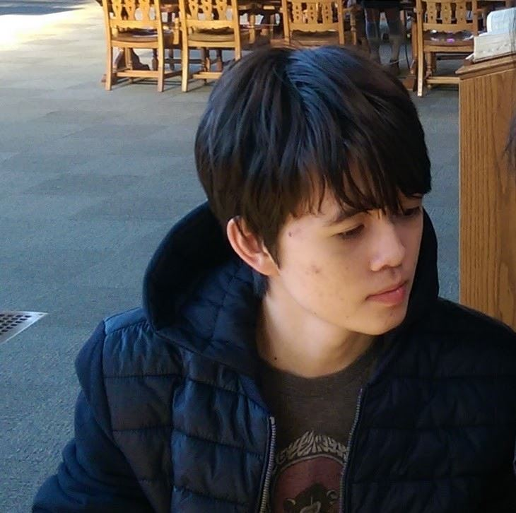
Meet Your TAs
Alex “Homework Wrangler” Okeson
Travis McGaha
Riley Germundson
Siva “The Moderator” Ramamoorthy
Wesley Wu

Slide 5
Course Goals
At the end of this class, you should be able to…
Implement your own data structures
Figure out which data structure AND implementation is best to solve a problem
Write tests to be confident that your implementation are correct
Work collaboratively with others on code
Use with professional software engineering tools
Ace software interviews
Notes:
In some ways, this course is the transition from learning the basic building blocks and theoretical tools, to using real world tools in real-world contexts
143 was about using, we are about building (move from client to object / implementor)
This is the most important part of the course to take-away – how to figure out the right tool for the job
In the real world, it’s not enough to think your code works – you need to convince yourself and others. Also a guide for others working on the same code
Code does not exist in a vacuum – on any real world project you will be working with others. You will learn to pair-program, as well as using modern collaborative workflows.
Modern collaborative tools, and tools for working with code (I will introduce IDEs this lecture).

Slide 6
Class Style
Please come to lecture and participate!
Collaboration
Demos
A “wrong” answer is a good answer
Ask questions! Point out mistakes!
Sections
Practice problems
Another chance to participate
Sections start this week
Notes:
Collab – both with me and with classmates
Demos – hands on coding, etc.
If you aren’t 100% sure – still answer. I know it is scary to talk in front of this large of a class
But if you have a misconception, there is a very good chance a lot of your peers do as well
A wrong answer is great because it points out where things are tricky, and allows us to dive
Deeply into those areas
If too nervous, we have a Piazza you can post on.

Slide 7
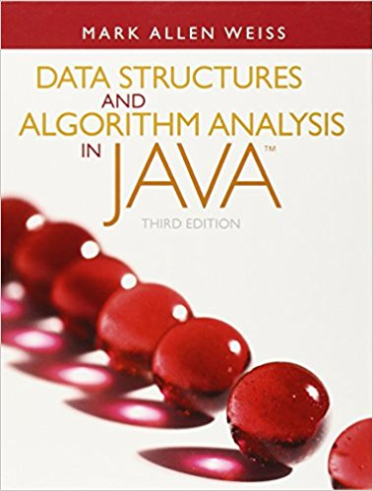
Course Administration
Course Page
All course content/announcements posted here
Pay attention for updates!
Canvas
Grades will be posted here
Office Hours
Will be posted on Course Page and announced in class
Will start next week
Piazza
Great place to discuss questions with other students
Will be monitored by course staff
No posting of project code!
Textbook
Optional!
Data Structures and Algorithm Analysis in Java by Mark Allen Weiss
Notes:
I am trying to reserve us a lab space for pair programming in – stay tuned for an announcement about that.
I have an “open door policy” – if my door is open, feel free to come talk to me.

Slide 8
Grade Break Down
Homework (65%)
Projects (50%)
Partners required
Written Assignments (15%)
Individual
Exams (35%)
Midterm Exam – (15%)
Final Exam – (20%)

Slide 9
Syllabus Highlights
Work on larger projects in pairs
Find yourself a partner, or be randomly assigned
Collaboration, the Internet and Cheating
Don’t work without your partner
“Gilligan’s Island Rule”
3 Late Days
Both partners need a late day
Max 1 used at a time
Getting Help
Use Piazza!
Come to office hours!

Slide 10
Questions?
Clarification on syllabus, General complaining/moaning

Slide 11
What is this class about?
CSE 143 – Object Oriented Programming
CSE 373 – Data Structures and Algorithms
Classes and Interfaces
Methods, variables and conditionals
Loops and recursion
Linked lists and binary trees
Sorting and Searching
O(n) analysis
Generics
Design decisions
Design analysis
Implementations of data structures
Debugging and testing
Abstract Data Types
Code-base development

Slide 12
Data Structures and Algorithms
What are they anyway?
Notes:
Ask class for what how they would describe these

Slide 13
Basic Definitions
Data Structure
A way of organizing and storing related data points
Examples from CSE 14X: arrays, linked lists, stacks, queues, trees
Algorithm
A series of precise instructions used to perform a task
Examples from CSE 14X: binary search, merge sort, recursive backtracking
Notes:
Storing, retrieving and manipulating

Slide 14
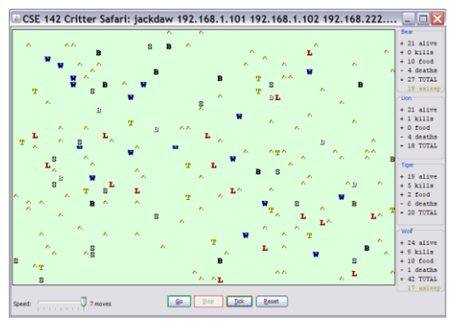
Review: Clients vs Objects
Client classes
Object Classes
A class that is executable, in Java this means it contains a Main method
public static void main(String[] args)
A coded structure that contains data and behavior
Start with the data you want to hold, organize the things you want to enable users to do with that data

Slide 15
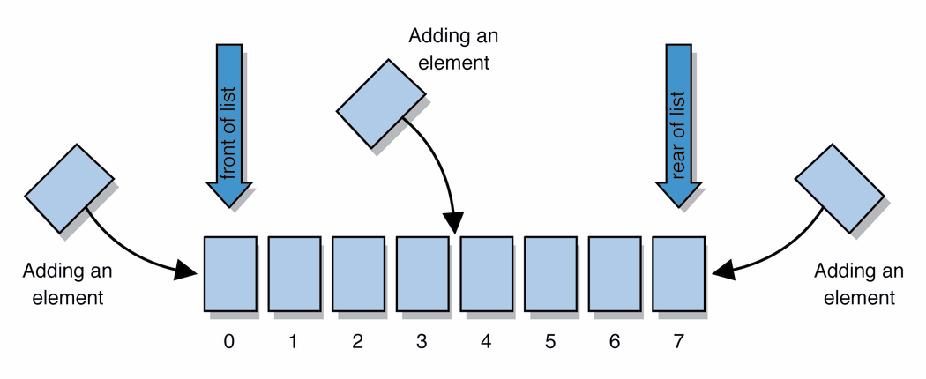
Abstract Data Types (ADT)
Abstract Data types
A definition for expected operations and behavior
Start with the operations you want to do then define how those operations will play out on whatever data is being stored
Review: List - a collection storing an ordered sequence of elements
each element is accessible by a 0-based index
a list has a size (number of elements that have been added)
elements can be added to the front, back, or elsewhere
in Java, a list can be represented as an ArrayList object
Notes:
A way to communicate with other programmers, a standard that we all can agree on so we can discuss conceptual ways of organizing data

Slide 16
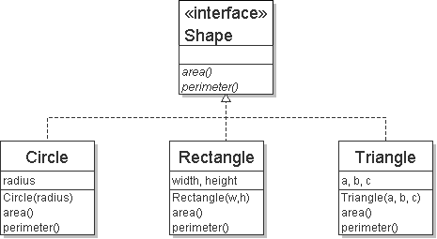
Review: Interfaces
Example
// Describes features common to all // shapes.
public interface Shape {
public double area();
public double perimeter();
}
interface: A list of methods that a class promises to implement.
Interfaces give you an is-a relationship without code sharing.
A Rectangle object can be treated as a Shape but inherits no code.
Analogous to non-programming idea of roles or certifications:
"I'm certified as a CPA accountant. This assures you I know how to do taxes, audits, and consulting."
"I'm 'certified' as a Shape, because I implement the Shape interface. This assures you I know how to compute my area and perimeter."
public interface name {
public type name(type name, ..., type name);
public type name(type name, ..., type name);
...
public type name(type name, ..., type name);
}

Slide 17
Review: Java Collections
Java provides some implementations of ADTs for you!
You used:
Lists List<Integer> a = new ArrayList<Integer>();
Stacks Stack<Character> c = new Stack<Character>();
Queues Queue<String> b = new LinkedList<String>();
Maps Map<String, String> d = new TreeMap<String, String>();
But some data structures you made from scratch… why?
Linked Lists - LinkedIntList was a collection of ListNode
Binary Search Trees – SearchTree was a collection of SearchTreeNodes

Slide 18
Full Definitions
Abstract Data Type (ADT)
A definition for expected operations and behavior
A mathematical description of a collection with a set of supported operations and how they should behave when called upon
Describes what a collection does, not how it does it
Can be expressed as an interface
Examples: List, Map, Set
Data Structure
A way of organizing and storing related data points
An object that implements the functionality of a specified ADT
Describes exactly how the collection will perform the required operations
Examples: LinkedIntList, ArrayIntList

Slide 19
List of ADTs
List
Set
Map
Stack
Queue
Priority Queue
Graph

Slide 20
Case Study: The List ADT
list: stores an ordered sequence of information.
Each item is accessible by an index.
Lists have a variable size as items can be added and removed
Notes:
First, let’s think of what lists are, and what they can do. Then let’s formalize this notion.
Get, set, append, insert, delete, size

Slide 21
Case Study: The List ADT
list: stores an ordered sequence of information.
Each item is accessible by an index.
Lists have a variable size as items can be added and removed
Supported Operations:
get(index): returns the item at the given index
set(value, index): sets the item at the given index to the given value
append(value): adds the given item to the end of the list
insert(value, index): insert the given item at the given index maintaining order
delete(index): removes the item at the given index maintaining order
size(): returns the number of elements in the list
Notes:
First, let’s think of what lists are, and what they can do. Then let’s formalize this notion.

Slide 22
Case Study: List Implementations
Notes:
Code up an implementation of List
Show eclipse, talk about it a bit and show some idiosyncrasies (like default project path)
Build the interface first, then build a class that implements it (help from students)

Slide 23
TODO list
Skim through full Syllabus on class web page
Sign up for Piazza
Review 142/143 materials. Materials provided on class webpage.
The first homework assignment will be a set of 14X review questions.

