Slide 1
Shortest Paths
Data Structures and Algorithms

Slide 2
Announcements
Hey, you’re not Kasey.
I’m Robbie
Kasey’s in Europe. She’ll be back Monday.
Kasey will be triaging email (but don’t expect immediate responses)
Office hours will shift a little (check the calendar on the webpage later in the week.)

Slide 3
Warm Up
Run Breadth First Search on this graph starting from s.
What order are vertices placed on the queue?
When processing a vertex insert neighbors in alphabetical order.
search(graph)
mark all vertices as unknown
toVisit.enqueue(first vertex)
while(toVisit is not empty)
current = toVisit.dequeue()
for (v : current.outNeighbors())
if (v is unknown){
toVisit.enqueue(v)
mark v as known
visited.add(current)
u
x
s
t
v
y
w
Notes:
9:22

Slide 4
This Week
Last week: Kasey showed you a new object – graphs
This week:
How do we actually use graphs to solve problems?

Slide 5
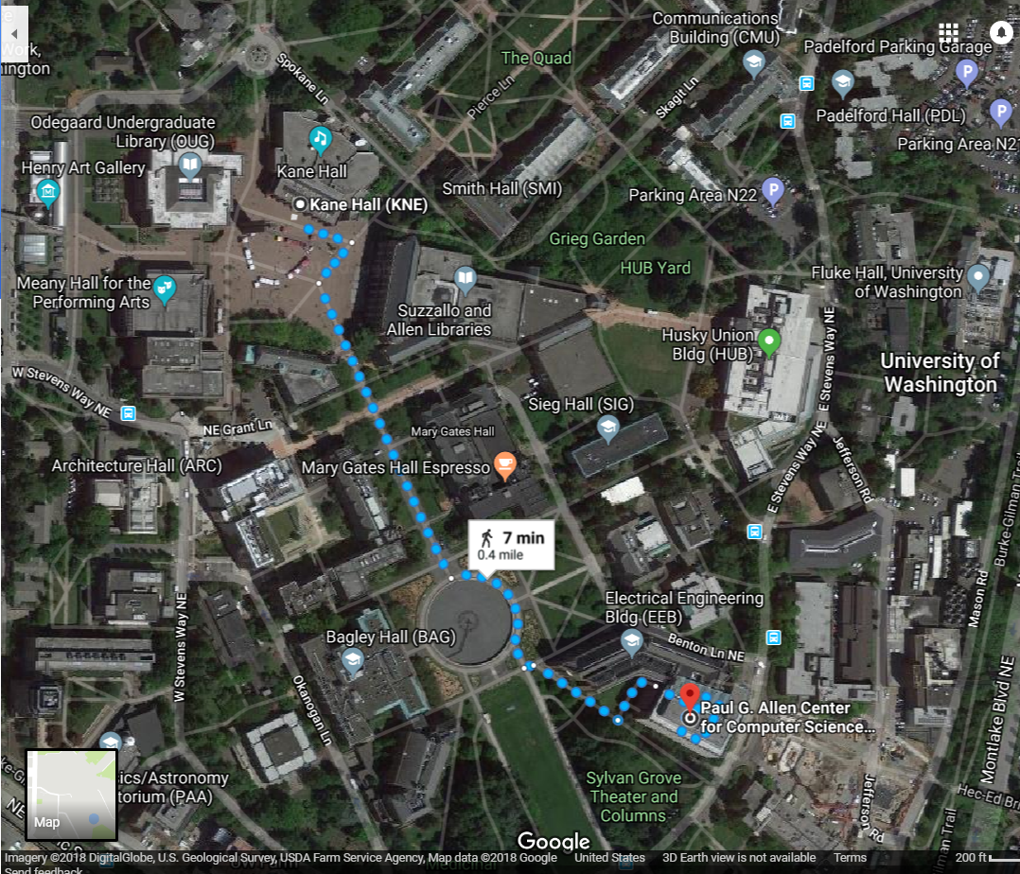
Shortest Paths
How does Google Maps figure out this is the fastest way to get to office hours?

Slide 6
Representing Maps as Graphs
How do we represent a map as a graph? What are the vertices and edges?

Slide 7
Representing Maps as Graphs
K
2
1
R
2
S
H
4
4
5
D
3
P

Slide 8
Shortest Paths
The length of a path is the sum of the edge weights on that path.
Shortest Path Problem
Given: a directed graph G and vertices s and t
Find: the shortest path from s to t
1
y
4
3
s
w
t
5
6
4
5
2
u
v
x
1

Slide 9
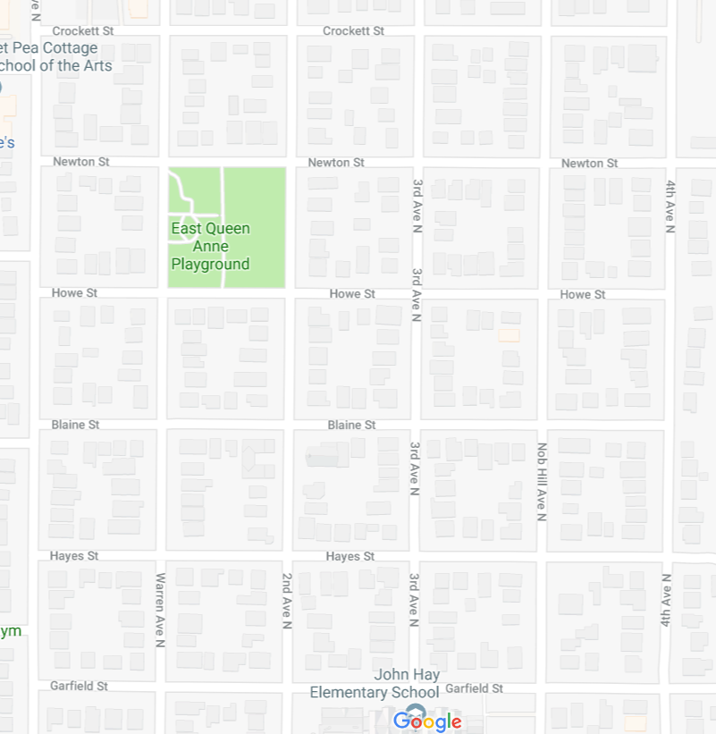
Unweighted graphs
Let’s start with a simpler version: the edges are all the same weight (unweighted)
If the graph is unweighted, how do we find a shortest paths?
Notes:
9:38:30

Slide 10
Unweighted Graphs
If the graph is unweighted, how do we find a shortest paths?
What’s the shortest path from s to s?
Well….we’re already there.
What’s the shortest path from s to u or v?
Just go on the edge from s
From s to w,x, or y?
Can’t get there directly from s, if we want a length 2 path, have to go through u or v.
u
w
s
y
t
v
x

Slide 11
Unweighted Graphs: Key Idea
To find the set of vertices at distance k, just find the set of vertices at distance k-1, and see if any of them have an outgoing edge to an undiscovered vertex.
Do we already know an algorithm that does something like that?
Yes! BFS!
bfsShortestPaths(graph G, vertex source)
toVisit.enqueue(source)
source.dist = 0
while(toVisit is not empty){
current = toVisit.dequeue()
for (v : current.outNeighbors())
{
if (v is unknown){
v.distance = current.distance + 1
v.predecessor = current
toVisit.enqueue(v)
mark v as known
}
}
}

Slide 12
Unweighted Graphs
If the graph is unweighted, how do we find a shortest paths?
1
2
u
w
bfsShortestPaths(graph G, vertex source)
toVisit.enqueue(source)
source.dist = 0
while(toVisit is not empty){
current = toVisit.dequeue()
for (v : current.outNeighbors())
{
if (v is unknown){
v.distance = current.distance + 1
v.predecessor = current
toVisit.enqueue(v)
mark v as known
}
}
}
2
s
y
t
3
v
x
1
2

Slide 13
What about the target vertex?
Given: a directed graph G and vertices s,t
Find: the shortest path from s to t.
Shortest Path Problem
BFS didn’t mention a target vertex…
It actually finds the shortest path from s to every other vertex.
Notes:
9:48

Slide 14
Weighted Graphs
Each edge should represent the “time” or “distance” from one vertex to another.
Sometimes those aren’t uniform, so we put a weight on each edge to record that number.
The length of a path in a weighted graph is the sum of the weights along that path.
We’ll assume all of the weights are positive
For GoogleMaps that definitely makes sense.
Sometimes negative weights make sense. Today’s algorithm doesn’t work for those graphs
There are other algorithms that do work.
Notes:
9:50

Slide 15
Weighted Graphs: Take 1
BFS works if the graph is unweighted. Maybe it just works for weighted graphs too?
$$∞$$
$$1$$
$$∞$$
1
$$2$$
1
w
x
1
s
u
v
t
0
20
$$∞$$
1
$$∞$$
1
$$∞$$
$$20$$
$$22$$
$$3$$
$$21$$
What went wrong? When we found a shorter path from s to u, we needed to update the distance to v (and anything whose shortest path went through u) but BFS doesn’t do that.

Slide 16
Weighted Graphs: Take 2
Using an algorithm for Problem B to solve Problem A.
Reduction (informally)
You already do this all the time.
In project 2, you reduced implementing a hashset to implementing a hashmap.
Any time you use a library, you’re reducing your problem to the one the library solves.
Can we reduce finding shortest paths on weighted graphs to finding them on unweighted graphs?
Notes:
9:55

Slide 17
Weighted Graphs: A Reduction
Given a weighted graph, how do we turn it into an unweighted one without messing up the edge lengths?
Transform Input
2
u
1
u
2
s
t
s
t
1
v
2
v
Unweighted Shortest Paths
u
s
t
2
v
2
Transform Output
u
1
2
2
s
t
1
v
2

Slide 18
Weighted Graphs: A Reduction
What is the running time of our reduction on this graph?
O(|V|+|E|) of the modified graph, which is…slow.
Does our reduction even work on this graph?
Ummm….
5000
$$0.5$$
u
$$3$$
u
150
200
$$π$$
s
t
s
t
v
1
v
5000
1
5000
Tl;dr: If your graph’s weights are all small positive integers, this reduction might work great.
Otherwise we probably need a new idea.

Slide 19
Weighted Graphs: Take 3
So we can’t just do a reduction.
Instead let’s try to figure out why BFS worked in the unweighted case, and try to make the same thing happen in the weighted case.
Why did BFS work on unweighted graphs? How did we avoid this problem:
When we used a vertex u to update shortest paths we already knew the exact shortest path to u. So we never ran into the update problem
So if we process the vertices in order of distance from s, we have a chance.
$$1$$
1
$$2$$
1
w
x
1
s
u
v
t
0
20
$$3$$
1
$$21$$
1
$$22$$
Notes:
10:01

Slide 20
Weighted Graphs: Take 3
Goal: Process the vertices in order of distance from s
Idea:
Have a set of vertices that are “known”
(we know at least one path from s to them).
Record an estimated distance
(the best way we know to get to each vertex).
If we process only the vertex closest in estimated distance, we won’t ever find a shorter path to a processed vertex.

Slide 21
Dijkstra’s Algorithm
Vertex | Distance | Predecessor | Processed
s
w
x
u
v
t
Dijkstra(Graph G, Vertex source)
initialize distances to $∞$
mark all vertices unprocesed
while(there are unprocessed vertices){
let u be the closest unprocessed vertex
foreach(edge (u,v) leaving u){
if(u.dist+w(u,v) < v.dist){
v.dist = u.dist+w(u,v)
v.predecessor = u
}
}
mark u as processed
}
1
1
w
x
1
s
u
v
t
20
1
1

Slide 22
Dijkstra’s Algorithm
Vertex | Distance | Predecessor | Processed
s | 0 | -- | Yes
w | 1 | s | Yes
x | 2 | w | Yes
u | 3 | x | Yes
v | 4 | u | Yes
t | 5 | v | Yes
Dijkstra(Graph G, Vertex source)
initialize distances to $∞$
mark source as distance 0
mark all vertices unprocessed
while(there are unprocessed vertices){
let u be the closest unprocessed vertex
foreach(edge (u,v) leaving u){
if(u.dist+w(u,v) < v.dist){
v.dist = u.dist+w(u,v)
v.predecessor = u
}
}
mark u as processed
}
1
1
w
x
1
s
u
v
t
20
1
1

Slide 23
Implementation Details
One of those lines of pseudocode was a little sketchy
> let u be the closest unprocessed vertex
What ADT have we talked about that might work here?
Minimum Priority Queues!
Min Priority Queue ADT
state
Set of comparable values
- Ordered based on “priority”
behavior
removeMin() – returns the element with the smallest priority, removes it from the collection
peekMin() – find, but do not remove the element with the smallest priority
insert(value) – add a new element to the collection
Notes:
10:06

Slide 24
Making Minimum Priority Queues Work
They won’t quite work “out of the box”.
We don’t have an update priority method. Can we add one?
Percolate up!
To percolate u’s entry in the heap up we’ll have to get to it.
Each vertex need pointer to where it appears in the priority queue
I’m going to ignore this point for the rest of the lecture.
Min Priority Queue ADT
state
Set of comparable values
- Ordered based on “priority”
behavior
removeMin() – returns the element with the smallest priority, removes it from the collection
peekMin() – find, but do not remove the element with the smallest priority
insert(value) – add a new element to the collection
DecreasePriority(e, p) – decreases the priority of element e down to p.

Slide 25
Running Time Analysis
Dijkstra(Graph G, Vertex source)
initialize distances to $∞$, source.dist to 0
mark all vertices unprocessed
initialize MPQ as a Min Priority Queue
add source at priority 0
while(MPQ is not empty){
u = MPQ.getMin()
foreach(edge (u,v) leaving u){
if(u.dist+w(u,v) < v.dist){
if(v.dist == $∞$ )
MPQ.insert(v, u.dist+w(u,v))
else
MPQ.decreasePriority(v, u.dist+w(u,v))
v.dist = u.dist+w(u,v)
v.predecessor = u
}
}
mark u as processed
}

Slide 26
Another Application of Shortest Paths
Shortest path algorithms are obviously useful for GoogleMaps.
The wonderful thing about graphs is they can encode arbitrary relationships among objects.
I don’t care if you remember this problem
I don’t care if you remember how we apply shortest paths.
I just want you to see that these algorithms have non-obvious applications.
Notes:
Need 7 minutes.

Slide 27
Another Application of Shortest Paths
I have a message I need to get from point s to point t.
But the connections are unreliable.
What path should I send the message along so it has the best chance of arriving?
u
0.8
0.7
s
t
0.6
0.2
0.97
v
Given: a directed graph G, where each edge weight is the probability of successfully transmitting a message across that edge
Find: the path from s to t with maximum probability of message transmission
Maximum Probability Path

Slide 28
Another Application of Shortest Paths
Let each edge’s weight be the probability a message is sent successfully across the edge.
What’s the probability we get our message all the way across a path?
It’s the product of the edge weights.
We only know how to handle sums of edge weights.
Is there a way to turn products into sums?
$\log\left(ab\right)=\log{a+\log{b}}$
u
0.8
0.7
s
t
0.6
0.2
0.97
v

Slide 29
Another Application of Shortest Paths
u
-0.32
-0.51
s
t
-0.74
-2.32
-0.04
We’ve still got two problems.
1. When we take logs, our edge weights become negative.
2. We want the maximum probability of success, but that’s the longest path not the shortest one.
Multiplying all edge weights by negative one fixes both problems at once!
We reduced the maximum probability path problem to a shortest path problem by taking $−\log{()}$ of each edge weight.
v

Slide 30
Maximum Probability Path Reduction
Transform Input
u
u
0.8
0.7
0.32
0.51
s
t
s
0.74
t
0.6
0.2
0.97
2.32
0.04
v
v
Weighted Shortest Paths
u
0.32
0.51
s
0.74
t
2.32
0.04
Transform Output
u
v
0.8
0.7
s
0.6
t
0.2
0.97
v

