Slide 1
Introduction to Graphs
Data Structures and Algorithms

Slide 2
Warm Up
0 | 1 | 2 | 3 | 4
8 | 2 | 57 | 91 | 22
0 | 1
8 | 2
0 | 1 | 2
57 | 91 | 22
The Merge Sort algorithm has the same runtime for its worst, best and average case. Create a recurrence that represents this runtime:
0
8
0
2
0
57
0 | 1
91 | 22
0
91
0
22
T(n) =
1 if n<= 1
2T(n/2) + n otherwise
0 | 1
22 | 91
0 | 1
2 | 8
0 | 1 | 2
22 | 57 | 91
mergeSort(input) {
if (input.length == 1)
return
else
smallerHalf = mergeSort(new [0, ..., mid])
largerHalf = mergeSort(new [mid + 1, ...])
return merge(smallerHalf, largerHalf)
}
0 | 1 | 2 | 3 | 4
2 | 8 | 22 | 57 | 91

Slide 3
Review: Unfolding Technique
$$1 when n=0$$
$$T\left(n\right)=$$
$$2T\left(n−1\right)+1 otherwise$$
$$T\left(5\right)=2T\left(5−1\right)+1$$
$$=2(2T\left(4 −1\right)+1)+1$$
The pattern by which we move towards the base case is n – 1
We would call this a “linear recurrence”
$$=2(2\left(2T\left(3 −1\right)+1\right)+1)+1$$
$$=2(2\left(2(2T\left(2 −1\right)+1)+1\right)+1)+1$$
$$=2(2\left(2(2(2T\left(1 −1\right)+1)+1)+1\right)+1)+1$$
$$=2(2\left(2(2(2(1)+1)+1)+1\right)+1)+1$$
$$=2^{5}+5$$
$$=2^{n}+n$$

Slide 4
Unfolding Technique
$$1 when n≤1$$
$$T\left(n\right)=$$
$$2T\left(\frac{n}{2}\right)+n otherwise$$
$$T\left(16\right)=2T\left(\frac{16}{2}\right)+16$$
The pattern by which we move towards the base case is not linear
Multiple recursive calls cause branching
Is there an easier way to find the closed form?
$$=2(2T\left(\frac{8}{2}\right)+8)+16$$
$$=2(2(2T\left(\frac{4}{2}\right)+4)+8)+16$$
$$=2(2(2(2T\left(\frac{2}{2}\right)+2)+4)+8)+16$$
$$=2(2(2(2(1)+2)+4)+8)+16$$
$$=2^{4}+ \sum_{1}^{4}{16}$$
$$=2^{\sqrt{n}}+ \sum_{1}^{\sqrt{n}}{n}$$
$$=16+16+16+16+16$$
$$T\left(n\right)=2T\left(\frac{n}{2}\right)+n$$
$$=2\left(2T\left(\frac{n}{4}\right)+\frac{n}{2}\right)+n$$
$$=2\left(2\left(2T\left(\frac{n}{8}\right)+\frac{n}{4}\right)+\frac{n}{2}\right)+n$$
$$=2\left(2\left(2\left(2T\left(\frac{n}{16}\right)+\frac{n}{8}\right)+\frac{n}{4}\right)+\frac{n}{2}\right)+n$$
$$=2\left(2\left(2\left(2\left(1\right)+\frac{n}{8}\right)+\frac{n}{4}\right)+\frac{n}{2}\right)+n$$
$$=2\left(2\left(4+\frac{2n}{8}+\frac{n}{4}\right)+\frac{n}{2}\right)+n$$
$$=2\left(8+\frac{4n}{8}+\frac{2n}{4}+\frac{n}{2}\right)+n$$
$$=16+\frac{8n}{8}+\frac{4n}{4}+\frac{2n}{2}+n$$

Slide 5
Tree Method
What work to do?
Replace with definition
Break apart non recursive and recursive pieces
Replace with definition
Break apart non recursive and recursive pieces
…
$$1 when n≤1$$
$$T\left(n\right)=$$
$$T\left(\frac{n}{2}\right)+T\left(\frac{n}{2}\right)+n otherwise$$
$$2T\left(\frac{n}{2}\right)+n otherwise$$
$$T\left(\frac{n}{2}\right)+T\left(\frac{n}{2}\right)+n$$
$$T\left(n\right)$$
$$n$$
$$\frac{n}{2}$$
$$\frac{n}{2}$$
$$T\left(\frac{n}{4}\right)+T\left(\frac{n}{4}\right)+\frac{n}{2}$$
$$T\left(\frac{n}{4}\right)+T\left(\frac{n}{4}\right)+\frac{n}{2}$$
$$T\left(\frac{n}{2}\right)$$
$$T\left(\frac{n}{2}\right)$$
$$\frac{n}{4}$$
$$T\left(\frac{n}{4}\right)$$
$$T\left(\frac{n}{4}\right)$$
$$T\left(\frac{n}{4}\right)$$
$$T\left(\frac{n}{4}\right)$$
$$\frac{n}{4}$$
$$\frac{n}{4}$$
$$\frac{n}{4}$$
…
…
…
…
…
…
…
…

Slide 6
Tree Method
$$1 when n≤1$$
$$T\left(n\right)=$$
$$2T\left(\frac{n}{2}\right)+n otherwise$$
How many pieces of work at each level?
How much work at each level?
$$n$$
1
n
How much work per level?
$$\frac{n}{2}$$
$$\frac{n}{2}$$
2
n
n
How many levels?
log(n)
$$\frac{n}{4}$$
$$\frac{n}{4}$$
$$\frac{n}{4}$$
$$\frac{n}{4}$$
4
n
Runtime
$$T(n)= \sum_{i=0}^{\log_{2}{n}}{n}$$
$$\frac{n}{8}$$
$$\frac{n}{8}$$
$$\frac{n}{8}$$
$$\frac{n}{8}$$
$$\frac{n}{8}$$
$$\frac{n}{8}$$
$$\frac{n}{8}$$
$$\frac{n}{8}$$
8
n
…
…
…
…
…
…
…
…
…
…
…
…
…
…
…
…
$$1$$
$$1$$
$$1$$
$$1$$
$$1$$
$$1$$
$$1$$
$$1$$
$$1$$
$$1$$
$$1$$
$$1$$
$$1$$
$$1$$
$$1$$
$$1$$
n
n

Slide 7
Tree Method Formulas
$$1 when n≤1$$
$$T\left(n\right)=$$
$$2T\left(\frac{n}{2}\right)+n otherwise$$
How much work is done by recursive levels (branch nodes)?
1. How many nodes are on each branch level i? branchNum(i)
i = 0 is overall root level
How many recursive calls are in each recursive branch to the power of which branch
2. At each level i, how much work does a single node do? branchWork(i)
3. How many recursive levels are there? branchCount
Based on the pattern of how we get down to base case
How much work is done by the base case level (leaf nodes)?
1. How much work does a single leaf node do? leafWork
2. How many leaf nodes are there? leafCount
How many branch nodes are in the second to last level x recursive calls per node
branchNum(i) = 2^{i}
branchWork(i) = (n/ 2^{i})
branchCount = log₂n - 1
$$Recursive work= \sum_{i=0}^{branchCount}{branchNum\left(i\right)branchWork(i)}$$
$$T(n>1)= \sum_{i=0}^{\log_{2}{n}−1}{2^{i}\left(\frac{n}{2^{i}}\right)}$$
leafWork = 1
leafCount = 2^{log2n} = n
$$NonRecursive work=leafWork×leafCount=leafWork×branchNum^{numLevels}$$
$$T\left(n≤1\right)=n$$
$$T\left(n\right)= \sum_{i=0}^{\log_{2}{n}−1}{2^{i}\left(\frac{n}{2^{i}}\right)}+n=n\log_{2}{n}+n$$

Slide 8
Tree Method Practice
$$4 when n≤1$$
$$T\left(n\right)=$$
$$3T\left(\frac{n}{4}\right)+cn^{2} otherwise$$
$$T\left(\frac{n}{4}\right)+T\left(\frac{n}{4}\right)+T\left(\frac{n}{4}\right)+cn^{2}$$
$$cn^{2}$$
Answer the following questions:
How many nodes on each branch level?
How much work for each branch node?
How much work per branch level?
How many branch levels?
How much work for each leaf node?
How many leaf nodes?
$$c{\left(\frac{n}{4}\right)}^{2}$$
$$T\left(\frac{n}{4}\right)$$
$$T\left(\frac{n}{4}\right)$$
$$c{\left(\frac{n}{4}\right)}^{2}$$
$$c{\left(\frac{n}{4}\right)}^{2}$$
$$T\left(\frac{n}{4}\right)$$
$$c{\left(\frac{n}{16}\right)}^{2}$$
$$c{\left(\frac{n}{16}\right)}^{2}$$
$$c{\left(\frac{n}{16}\right)}^{2}$$
$$c{\left(\frac{n}{16}\right)}^{2}$$
$$c{\left(\frac{n}{16}\right)}^{2}$$
$$c{\left(\frac{n}{16}\right)}^{2}$$
$$c{\left(\frac{n}{16}\right)}^{2}$$
$$c{\left(\frac{n}{16}\right)}^{2}$$
$$c{\left(\frac{n}{16}\right)}^{2}$$
…
…
…
…
…
…
…
…
…
…
…
…
…
…
…
…
…
…
…
…
…
…
…
…
…
…
…
4
4
4
4
4
4
4
4
4
4
4
4
4
4
4
4
4
4
4
4
4
4
4
4
4
4
4

Slide 9
Tree Method Practice
$$4 when n≤1$$
$$T\left(n\right)=$$
$$3T\left(\frac{n}{4}\right)+cn^{2} otherwise$$
Level (i) | Number of Nodes | Work per Node | Work per Level
0 | 1 | $$cn2$$ | $$cn2$$
1 | 3 | $$c{\left(\frac{n}{4}\right)}^{2}$$ | $$\frac{3}{16}cn^{2}$$
2 | 9 | $$c{\left(\frac{n}{16}\right)}^{2}$$ | $$\frac{9}{256}cn^{2}$$
base | $$3^{log4n}$$ | 4 | $${12}^{log4n}$$
$$3^{i}$$
How many nodes on each branch level?
How much work for each branch node?
How much work per branch level?
How many branch levels?
How much work for each leaf node?
How many leaf nodes?
$$c{\left(\frac{n}{4^{i}}\right)}^{2}$$
$$3^{i}c{\left(\frac{n}{4^{i}}\right)}^{2}$$
$${=\left(\frac{3}{16}\right)}^{i}{cn}^{2}$$
Combining it all together…
$$\log_{4}{n −1}$$
$$T\left(n\right)= \sum_{i=0}^{\log_{4}{n −1}}{{\left(\frac{3}{16}\right)}^{i}cn^{2}+ } 4n^{log43}$$
$$4$$
$$3^{\log_{4}{n}}$$
power of a log
$$n^{\log_{4}{3}}$$
$$x^{\log_{b}{y}}=y^{\log_{b}{x}}$$

Slide 10
Tree Method Practice
factoring out a constant
$$T\left(n\right)= \sum_{i=0}^{\log_{4}{n −1}}{{\left(\frac{3}{16}\right)}^{i}cn^{2}+ } 4n^{log43}$$
$$T\left(n\right)=cn^{2}\sum_{i=0}^{\log_{4}{n −1}}{{\left(\frac{3}{16}\right)}^{i}+ } 4n^{log43}$$
$$\sum_{i=a}^{b}{cf(i)=}c\sum_{i=a}^{b}{f(i)}$$
Closed form:
finite geometric series
$$T\left(n\right)=cn^{2}\left(\frac{{\frac{3}{16}}^{\log_{4}{n}}−1}{\frac{3}{16} −1}\right)+4n^{log43}$$
$$\sum_{i=0}^{n−1}{x^{i}=\frac{x^{n}−1}{x−1}}$$
If we’re trying to prove upper bound…
infinite geometric series
$$T\left(n\right)=cn^{2}\left(\frac{1}{1 −\frac{3}{16}}\right)+4n^{log43}$$
$$T\left(n\right)=cn^{2}\sum_{i=0}^{∞}{{\left(\frac{3}{16}\right)}^{i}+ } 4n^{log43}$$
$$\sum_{i=0}^{∞}{x^{i}=\frac{1}{1−x} }$$
$$T\left(n\right)∈O(n^{2})$$
when -1 < x < 1

Slide 11
Is there an easier way?
What if you don’t want an exact closed form?
Sorry, no
If we want to find a big Θ
Yes!

Slide 12
Master Theorem
Given a recurrence of the following form:
$$d when n=1$$
$$T\left(n\right)=$$
$$aT\left(\frac{n}{b}\right)+n^{c} otherwise$$
Then thanks to magical math brilliance we can assume the following:
If
$$\log_{b}{a}<c$$
then
$$T\left(n\right)∈Θ\left(n^{c}\right)$$
If
$$\log_{b}{a}=c$$
then
$$T\left(n\right)∈Θ\left(n^{c}\log_{2}{n}\right)$$
If
$$\log_{b}{a}>c$$
then
$$T\left(n\right)∈Θ\left(n^{\log_{b}{a}}\right)$$

Slide 13
Apply Master Theorem
Given a recurrence of the form:
$$d when n=1$$
$$T\left(n\right)=$$
a = 2
b = 2
c = 1
d = 1
$$aT\left(\frac{n}{b}\right)+n^{c} otherwise$$
$$1 when n≤1$$
$$T\left(n\right)=$$
$$2T\left(\frac{n}{2}\right)+n otherwise$$
If
$$\log_{b}{a}<c$$
then
$$T\left(n\right)∈Θ\left(n^{c}\right)$$
If
$$\log_{b}{a}=c$$
then
$$T\left(n\right)∈Θ\left(n^{c}\log_{2}{n}\right)$$
If
$$\log_{b}{a}>c$$
then
$$T\left(n\right)∈Θ\left(n^{\log_{b}{a}}\right)$$
$\log_{b}{a}=c$ ${⇒ log}_{2}{2}=1$
$$T\left(n\right)∈Θ\left(n^{c}\log_{2}{n}\right)⇒Θ\left(n^{1}\log_{2}{n}\right)$$

Slide 14
Reflecting on Master Theorem
The case
Recursive case conquers work more quickly than it divides work
Most work happens near “top” of tree
Non recursive work in recursive case dominates growth, n^{c} term
The case
Work is equally distributed across call stack (throughout the “tree”)
Overall work is approximately work at top level x height
The case
Recursive case divides work faster than it conquers work
Most work happens near “bottom” of tree
Leaf work dominates branch work
Given a recurrence of the form:
$$\log_{b}{a}<c$$
$$d when n=1$$
$$T\left(n\right)=$$
$$aT\left(\frac{n}{b}\right)+n^{c} otherwise$$
If
$$\log_{b}{a}<c$$
then
$$T\left(n\right)∈Θ\left(n^{c}\right)$$
If
$$\log_{b}{a}=c$$
then
$$T\left(n\right)∈Θ\left(n^{c}\log_{2}{n}\right)$$
$$\log_{b}{a}=c$$
If
$$\log_{b}{a}>c$$
then
$$T\left(n\right)∈Θ\left(n^{\log_{b}{a}}\right)$$
$$height ≈\log_{b}{a}$$
$$\log_{b}{a}>c$$
$$branchWork ≈n^{c}\log_{b}{a}$$
$$leafWork ≈d\left(n^{\log_{b}{a}}\right)$$

Slide 15
Introduction to Graphs

Slide 16
Inter-data Relationships
Arrays
Categorically associated
Sometimes ordered
Typically independent
Elements only store pure data, no connection info
Trees
Directional Relationships
Ordered for easy access
Limited connections
Elements store data and connection info
Graphs
Multiple relationship connections
Relationships dictate structure
Connection freedom!
Both elements and connections can store data
0 | 1 | 2
A | B | C
A
B
B
C
C
A

Slide 17
Graph: Formal Definition
G
A graph is defined by a pair of sets G = (V, E) where…
V is a set of vertices
A vertex or “node” is a data entity
E is a set of edges
An edge is a connection between two vertices
H
V = { A, B, C, D, E, F, G, H }
F
A
E = { (A, B), (A, C), (A, D), (A, H),
(C, B), (B, D), (D, E), (D, F),
(F, G), (G, H)}
D
C
B
E

Slide 18
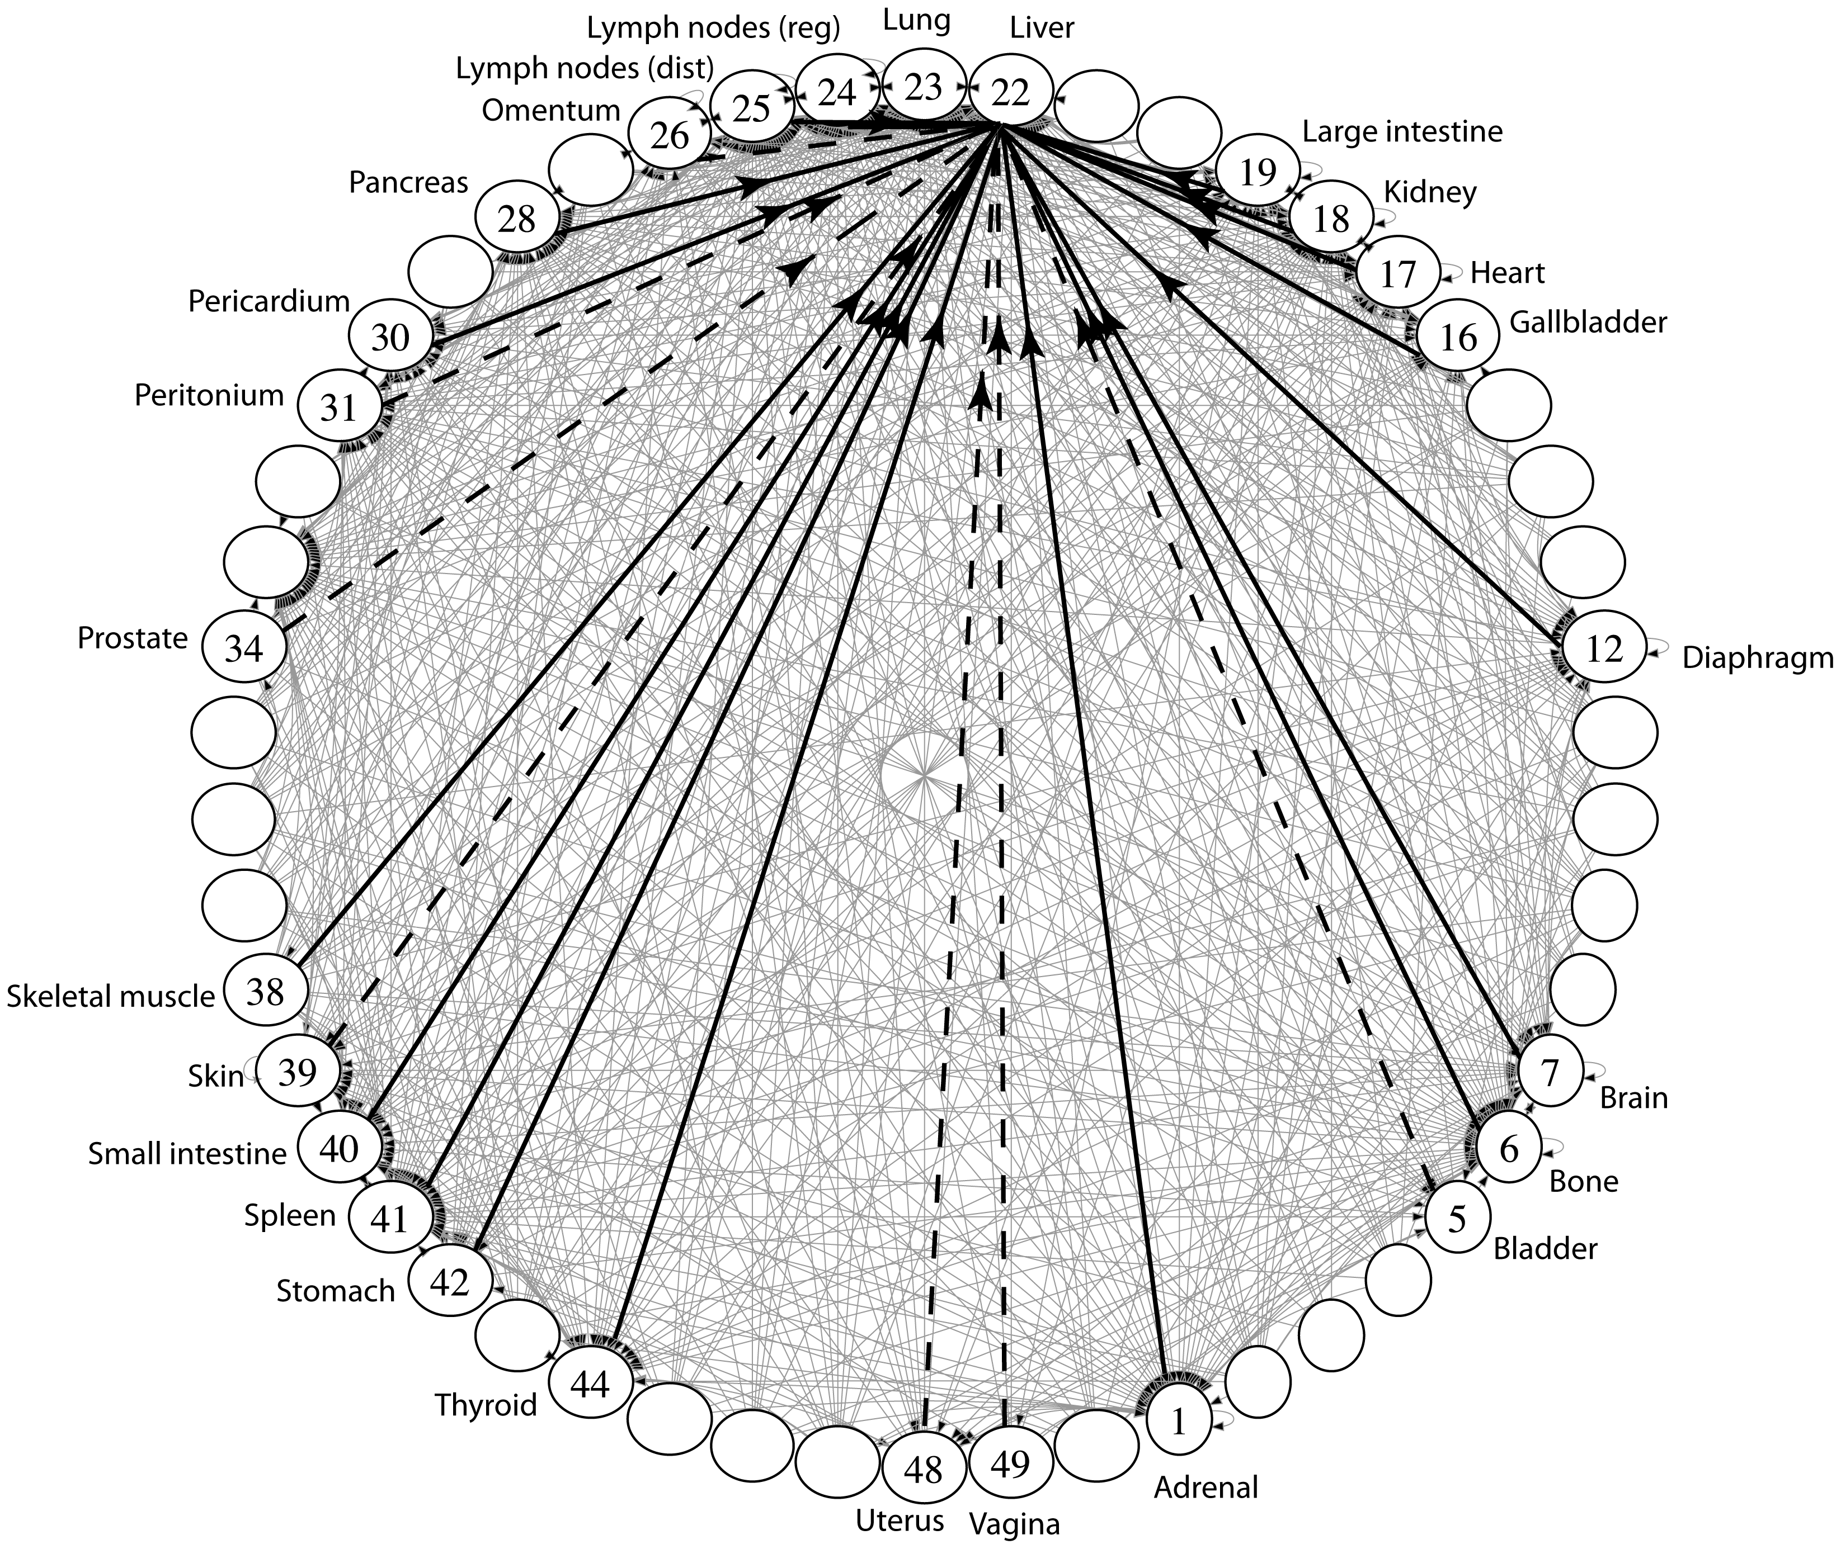
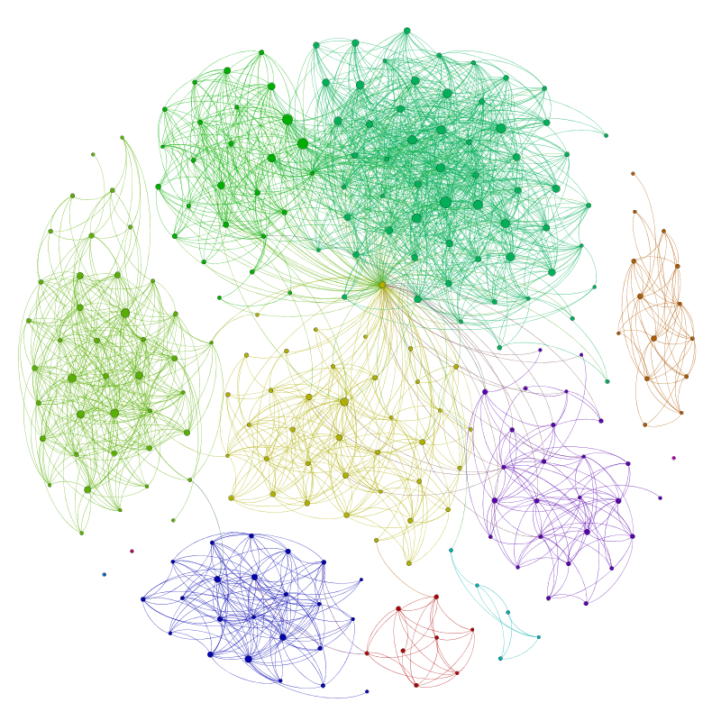
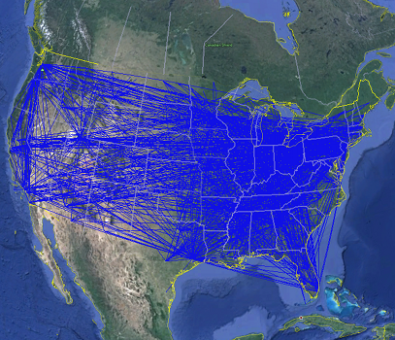
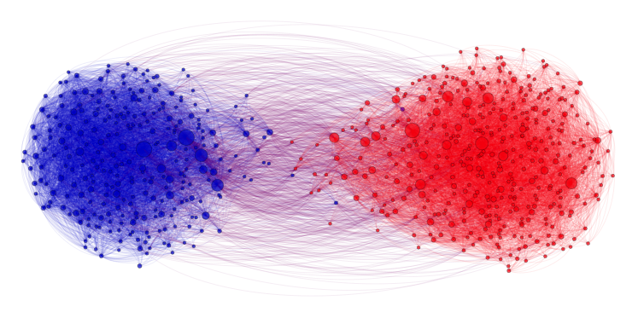
Applications
Physical Maps
Airline maps
Vertices are airports, edges are flight paths
Traffic
Vertices are addresses, edges are streets
Relationships
Social media graphs
Vertices are accounts, edges are follower relationships
Code bases
Vertices are classes, edges are usage
Influence
Biology
Vertices are cancer cell destinations, edges are migration paths
Related topics
Web Page Ranking
Vertices are web pages, edges are hyperlinks
Wikipedia
Vertices are articles, edges are links
SO MANY MORREEEE
www.allthingsgraphed.com

Slide 19
Graph Vocabulary
Undirected Graph:
Graph Direction
Undirected graph – edges have no direction and are two-way
Directed graphs – edges have direction and are thus one-way
Degree of a Vertex
Degree – the number of edges containing that vertex
A : 1, B : 1, C : 1
In-degree – the number of directed edges that point to a vertex
A : 0, B : 2, C : 1
Out-degree – the number of directed edges that start at a vertex
A : 1, B : 1, C : 1
A
B
V = { A, B, C }
E = { (A, B), (B, C) } inferred (B, A) and (C,B)
Undirected Graph:
C
V = { A, B, C }
B
E = { (A, B), (B, C), (C, B) }
A
C

Slide 20
Food for thought
Is a graph valid if there exists a vertex with a degree of 0?
Yes
B
B
B
A
A
A
C
C
C
A has an “in degree” of 0
B has an “out degree” of 0
C has both an “in degree” and an “out degree” of 0
Are these valid?
Is this a valid graph?
Yup
A
B
A
B
C
A
Yes!
Sure
D
C

Slide 21
Graph Vocabulary
Self loop – an edge that starts and ends at the same vertex
Parallel edges – two edges with the same start and end vertices
Simple graph – a graph with no self-loops and no parallel edges
A
A
B

