Slide 1
Midterm Review
Data Structures and Algorithms

Slide 2
Warm Up
Imagine you are asked to test a method in a class that implements a Binary Search Tree. This method should be able to take in any node and then return back the height of the given tree.
public int treeHeight(TreeNode node)
What are some unit tests you would write to validate this method works like it should?
What would you name those unit tests?
What are some examples of trees you would pass into the method to test if it can handle all appropriate cases?

Slide 3
Logistics
50 minutes
8.5 x 11 in note page, front and back
Review tonight
4:30-6:30 in MLR 301
Extra TA office hours
No office hours on Friday

Slide 4
ADTs vs Data Structures
Data Structure
A way of organizing and storing related data points
An object that implements the functionality of a specified ADT
Describes exactly how the collection will perform the required operations
Examples: LinkedIntList, ArrayIntList
Algorithm
A series of precise instructions used to perform a task
Examples from CSE 14X: binary search, merge sort, recursive backtracking
Abstract Data Type (ADT)
A definition for expected operations and behavior
A mathematical description of a collection with a set of supported operations and how they should behave when called upon
Describes what a collection does, not how it does it
Can be expressed as an interface
Examples: List, Map, Set

Slide 5
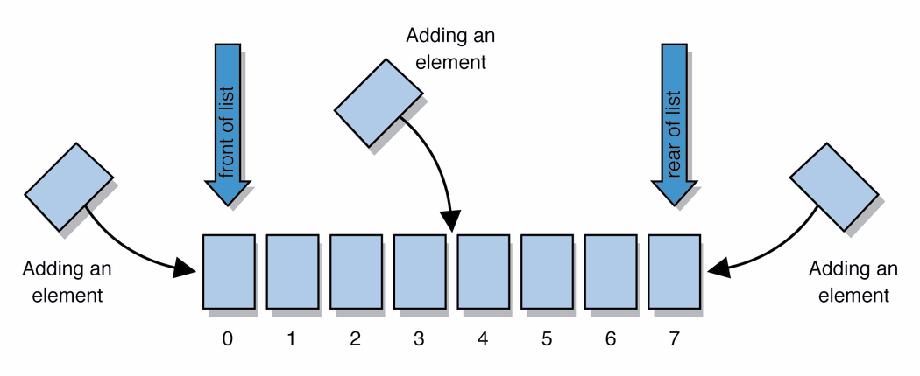
List ADT
list: stores an ordered sequence of information.
Each item is accessible by an index.
Lists have a variable size as items can be added and removed
Supported Operations:
get(index): returns the item at the given index
set(value, index): sets the item at the given index to the given value
append(value): adds the given item to the end of the list
insert(value, index): insert the given item at the given index maintaining order
delete(index): removes the item at the given index maintaining order
size(): returns the number of elements in the list

Slide 6
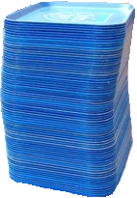
Stack ADT
stack: A collection based on the principle of adding elements and retrieving them in the opposite order.
Last-In, First-Out ("LIFO")
Elements are stored in order of insertion.
We do not think of them as having indexes.
Client can only add/remove/examine the last element added (the "top").
basic stack operations:
push(item): Add an element to the top of stack
pop(): Remove the top element and returns it
peek(): Examine the top element without removing it
size(): how many items are in the stack?
isEmpty(): true if there are 1 or more items in stack, false otherwise
push
pop, peek
top | 3
 | 2
bottom | 1
stack

Slide 7
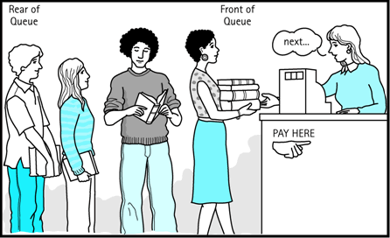
Queue ADT
queue: Retrieves elements in the order they were added.
First-In, First-Out ("FIFO")
Elements are stored in order of insertion but don't have indexes.
Client can only add to the end of the queue, and can only examine/remove the front of the queue.
basic queue operations:
add(item): aka “enqueue” add an element to the back.
remove(): aka “dequeue” Remove the front element and return.
peek(): Examine the front element without removing it.
size(): how many items are stored in the queue?
isEmpty(): if 1 or more items in the queue returns true, false otherwise
front |  | back
1 | 2 | 3
remove, peek
add
queue

Slide 8
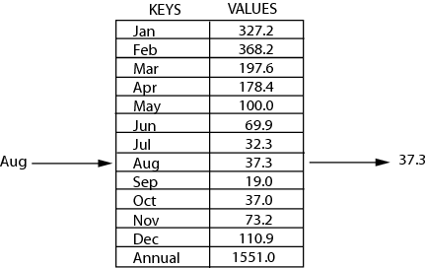
Map ADT
map: Holds a set of unique keys and a collection of values, where each key is associated with one value.
a.k.a. "dictionary", "associative array", "hash"
operations:
put(key, value ): Adds a mapping from a key to a value.
get(key ): Retrieves the value mapped to the key.
remove(key ): Removes the given key and its mapped value.
key | value
“at" | 43
key | value
“in" | 37
key | value
“you" | 22
key | value
“the" | 56
map.get("the")
56

Slide 9
Iterators
iterator: a Java interface that dictates how a collection of data should be traversed.
Behaviors:
hasNext() – returns true if the iteration has more elements
next() – returns the next element in the iteration
while (iterator.hasNext()) {
T item = iterator.next();
}

Slide 10
Testing and Debugging
Black Box
Behavior only – ADT requirements
From an outside point of view
Does your code uphold its contracts with its users?
Performance/efficiency
White Box
Includes an understanding of the implementation
Written by the author as they develop their code
Break apart requirements into smaller steps
“unit tests” break implementation into single assertions
Expected behavior
The main use case scenario
Does your code do what it should given friendly conditions?
Forbidden Input
What are all the ways the user can mess up?
Empty/Null
Protect yourself!
How do things get started?
Boundary/Edge Cases
First
last
Scale
Is there a difference between 10, 100, 1000, 10000 items?

Slide 11
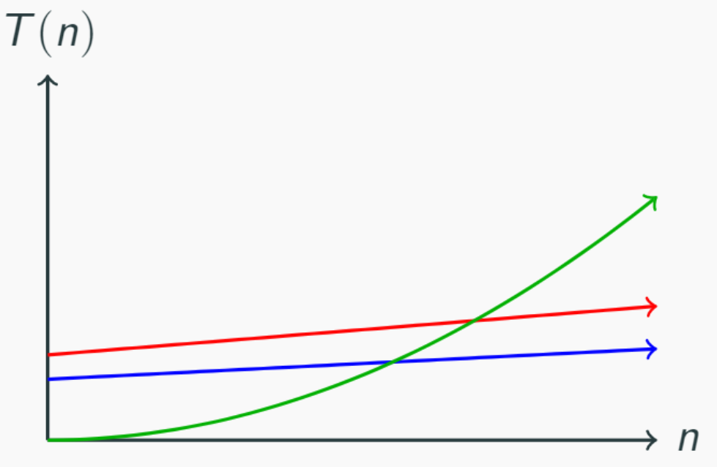
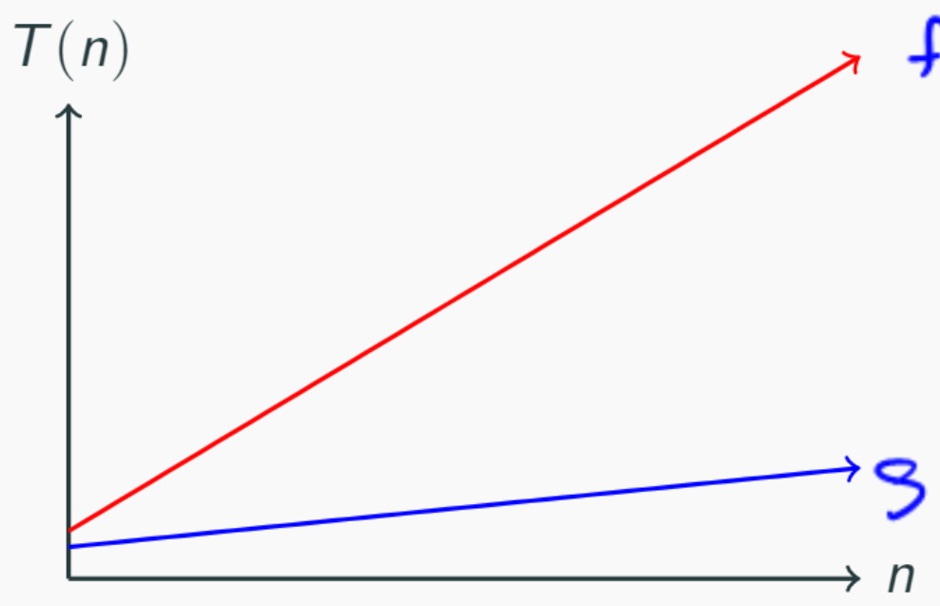
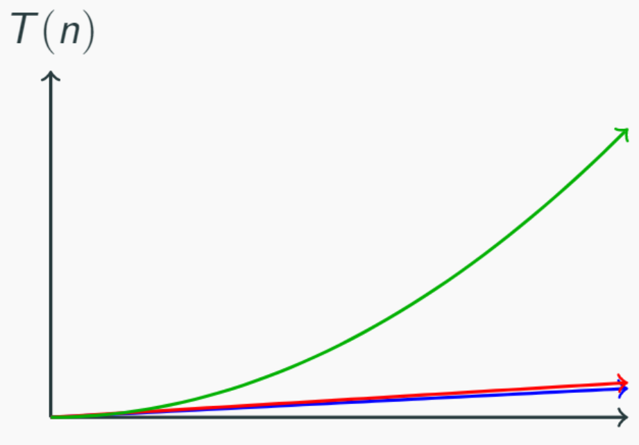
Asymptotic Analysis
asymptotic analysis: how the runtime of an algorithm grows as the data set grows
n and 4n look very different up close
n and 4n look the same over time
n² doesn’t start off dominating the linear functions
It eventually takes over…
n² eventually dominates n
A function f(n) is dominated by g(n) when there exists two constants c > 0 and n₀ > 0 such that for all values of n ≥ n₀ f(n) ≤ c * g(n)

Slide 12
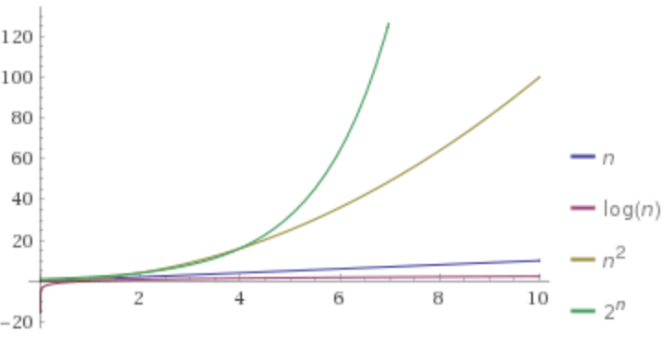
Domination in Graphs
Dominates
f(n) ∈ Ω(g(n))
Dominated by
f(n) ∈ O(g(n))

Slide 13
O, Ω, Θ Definitions
O(f(n)) is the “family” or “set” of all functions that are dominated by f(n)
f(n) ∈ O(g(n)) when f(n) <= g(n)
Ω(f(n)) is the family of all functions that dominate f(n)
f(n) ∈ Ω(g(n)) when f(n) >= g(n)
Θ(f(n)) is the family of functions that are equivalent to f(n)
We say f(n) ∈ Θ(g(n)) when both
f(n) ∈ O(g(n)) and f(n) ∈ Ω (g(n)) are true
For in-depth explanation see https://piazza.com/class/jfbjq4r4em21sn?cid=188

Slide 14
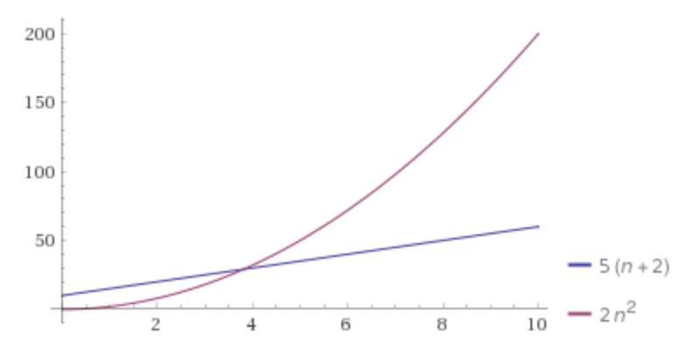
Proving Domination
f(n) = 5(n + 2)
g(n) = 2n²
Find a c and n₀ that show that f(n) ∈ O(g(n)).
f(n) = 5n + 10
5n + 10 <= 5n² + 10n²
5n + 10 <= 15n2 for n>= 1
15n² <= c * 2n²
c = 15/2 = 7.5
n₀ = 1

Slide 15
O, Ω, Θ Examples
For the following functions give the simplest tight O bound
a(n) = 10logn + 5
b(n) = 3^{n} – 4n
c(n) = $\frac{n}{2}$
For the above functions indicate whether the following are true or false
a(n) ∈ O(b(n))
a(n) ∈ O(c(n))
a(n) ∈ Ω(b(n))
a(n) ∈ Ω(c(n))
a(n) ∈ Θ(b(n))
a(n) ∈ Θ(c(n))
a(n) ∈ Θ(a(n))
O(logn)
O(3^{n})
O(n)
TRUE
TRUE
FALSE
FALSE
FALSE
FALSE
TRUE
b(n) ∈ O(a(n))
b(n) ∈ O(c(n))
b(n) ∈ Ω(a(n))
b(n) ∈ Ω(c(n))
b(n) ∈ Θ(a(n))
b(n) ∈ Θ(c(n))
b(n) ∈ Θ(b(n))
FALSE
FALSE
TRUE
TRUE
FALSE
FALSE
TRUE
c(n) ∈ O(b(n))
c(n) ∈ O(a(n))
c(n) ∈ Ω(b(n))
c(n) ∈ Ω(a(n))
c(n) ∈ Θ(b(n))
c(n) ∈ Θ(a(n))
c(n) ∈ Θ(c(n))
TRUE
FALSE
FALSE
TRUE
FALSE
FALSE
TRUE

Slide 16
Function Modeling
Create a mathematical model of a piece of code’s runtime in relation to the given input.
You can assume basic operations all take the same constant time.
You can ignore the runtime of the operations in a for loop’s header and just include how many times the for loop iterates.
public int mystery(int n) {
int result = 0;
for (int i = 0; i < n/2; i++) {
result++;
}
for (int i = 0; i < n/2; i+=2) {
result++;
}
result * 10;
return result;
}
$$f\left(n\right)=3+\frac{3}{4}n$$

Slide 17
Modeling Complex Loops
for (int i = 0; i < n; i++) {
for (int j = 0; j < i; j++) {
System.out.println(“Hello!”);
}
}
+c
+1
0 + 1 + 2 + 3 +…+ n-1
n
$$\sum_{i=1}^{n}{i}$$
Summation
1 + 2 + 3 + 4 +… + n =
Definition: Summation
= f(a) + f(a + 1) + f(a + 2) + … + f(b-2) + f(b-1) + f(b)
$$\sum_{i=a}^{b}{f(i)}$$
$$\sum_{i=0}^{n−1}{\sum_{j=0}^{i−1}{c}}$$
T(n) =

Slide 18
Function Modeling: Recursion
public int factorial(int n) {
if (n == 0 || n == 1) {
return 1;
} else {
return n * factorial(n – 1);
}
+c₁
+T(n-1)
+c₂
C₁
C₂ + T(n-1)
when n = 0 or 1
otherwise
T(n) =
Definition: Recurrence
Mathematical equivalent of an if/else statement
f(n) =
$$\left\{\begin{aligned}&runtime of base case when conditional \\ &runtime of recursive case otherwise\end{aligned}\right.$$

