Slide 1
Computer Memory
Data Structures and Algorithms

Slide 2
Warm Up
public int sum1(int n, int m, int[][] table) {
int output = 0;
for (int i = 0; i < n; i++) {
for (int j = 0; j < m; j++) {
output += table[i][j];
}
}
return output;
}
public int sum2(int n, int m, int[][] table) {
int output = 0;
for (int i = 0; i < m; i++) {
for (int j = 0; j < n; j++) {
output += table[j][i];
}
}
return output;
}
What do these two methods do?
What is the big-Θ
Θ(n*m)

Slide 3
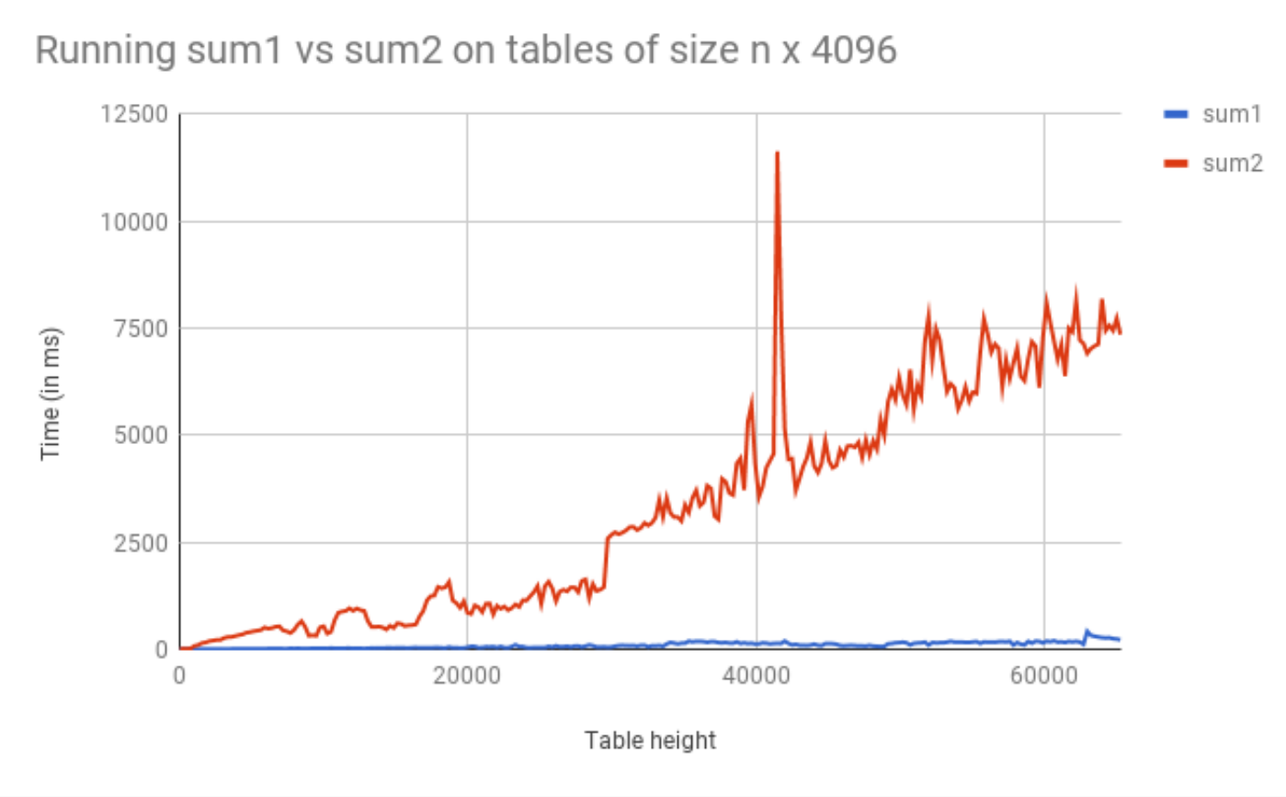
Warm Up

Slide 4
Incorrect Assumptions
Lies!
Accessing memory is a quick and constant-time operation
Sometimes accessing memory is cheaper and easier than at other times
Sometimes accessing memory is very slow

Slide 5
Memory Architecture
What is it? | Typical Size | Time
The brain of the computer! | 32 bits | ≈free
Extra memory to make accessing it faster | 128KB | 0.5 ns
Extra memory to make accessing it faster | 2MB | 7 ns
Working memory, what your programs need | 8GB | 100 ns
Large, longtime storage | 1 TB | 8,000,000 ns
CPU Register
L1 Cache
L2 Cache
RAM
Disk
Notes:
1 ns vs 8,000,000 is like 1 sec vs 3 months
It’s faster to do:
5 million arithmetic ops than 1 disk access
2500 L2 cache accesses than 1 disk access
400 RAM accesses than 1 disk access

Slide 6
Review: Binary, Bits and Bytes
byte
The most commonly referred to unit of memory, a grouping of 8 bits
Can represent 265 different numbers (28)
1 Kilobyte = 1 thousand bytes (kb)
1 Megabyte = 1 million bytes (mb)
1 Gigabyte = 1 billion bytes (gb)
binary
A base-2 system of representing numbers using only 1s and 0s
- vs decimal, base 10, which has 9 symbols
bit
The smallest unit of computer memory represented as a single binary value either 0 or 1
Decimal | Decimal Break Down | Binary | Binary Break Down
0 | $$(0 ∗{10}^{0})$$ | 0 | $$(0 ∗2^{0})$$
1 | $$(1 ∗{10}^{0})$$ | 1 | $$(1∗2^{0})$$
10 | $$(1 ∗{10}^{1})+(0∗{10}^{0})$$ | 1010 | $$(1∗2^{3})+(0∗2^{2})+(1∗2^{1})+(0∗2^{0})$$
12 | $$(1 ∗{10}^{1})+(2∗{10}^{0})$$ | 1100 | $$(1∗2^{3})+(1∗2^{2})+(0∗2^{1})+(0∗2^{0})$$
127 | $$\left(1∗{10}^{2}\right)+(1 ∗{10}^{1})+(2∗{10}^{0})$$ | 01111111 | $$(0∗2^{7})+(1∗2^{6})+(1∗2^{5})+(1∗2^{4})(1∗2^{3})+(1∗2^{2})+(1∗2^{1})+(1∗2^{0})$$

Slide 7
Memory Architecture
Takeaways:
- the more memory a layer can store, the slower it is (generally)
- accessing the disk is very slow
Computer Design Decisions
Physics
Speed of light
Physical closeness to CPU
Cost
“good enough” to achieve speed
Balance between speed and space

Slide 8
Locality
How does the OS minimize disk accesses?
Spatial Locality
Computers try to partition memory you are likely to use close by
- Arrays
- Fields
Temporal Locality
Computers assume the memory you have just accessed you will likely access again in the near future

Slide 9
Leveraging Spatial Locality
When looking up address in “slow layer”
- bring in more than you need based on what’s near by
- cost of bringing 1 byte vs several bytes is the same
- Data Carpool!

Slide 10
Leveraging Temporal Locality
When looking up address in “slow layer”
Once we load something into RAM or cache, keep it around or a while
- But these layers are smaller
When do we “evict” memory to make room?

Slide 11
Moving Memory
Amount of memory moved from disk to RAM
- Called a “block” or “page”
≈4kb
Smallest unit of data on disk
Amount of memory moved from RAM to Cache
- called a “cache line”
≈64 bytes
Operating System is the Memory Boss
- controls page and cache line size
- decides when to move data to cache or evict

Slide 12
Warm Up
public int sum1(int n, int m, int[][] table) {
int output = 0;
for (int i = 0; i < n; i++) {
for (int j = 0; j < m; j++) {
output += table[i][j];
}
}
return output;
}
public int sum2(int n, int m, int[][] table) {
int output = 0;
for (int i = 0; i < m; i++) {
for (int j = 0; j < n; j++) {
output += table[j][i];
}
}
return output;
}
Why does sum1 run so much faster than sum2?
sum1 takes advantage of spatial and temporal locality
0 | 1 | 2 | 3 | 4
0 | 1 | 2
‘a’ | ‘b’ | ‘c’
0 | 1 | 2
‘d’ | ‘e’ | ‘f’
0 | 1 | 2
‘g’ | ‘h’ | ‘i’
0 | 1 | 2
‘j’ | ‘k’ | ‘l’
0 | 1 | 2
‘m’ | ‘n’ | ‘o’

Slide 13
Java and Memory
What happens when you use the “new” keyword in Java?
- Your program asks the Java Virtual Machine for more memory from the “heap”
Pile of recently used memory
- If necessary the JVM asks Operating System for more memory
Hardware can only allocate in units of page
If you want 100 bytes you get 4kb
Each page is contiguous
What happens when you create a new array?
Program asks JVM for one long, contiguous chunk of memory
What happens when you create a new object?
Program asks the JVM for any random place in memory
What happens when you read an array index?
Program asks JVM for the address, JVM hands off to OS
OS checks the L1 caches, the L2 caches then RAM then disk to find it
If data is found, OS loads it into caches to speed up future lookups
What happens when we open and read data from a file?
Files are always stored on disk, must make a disk access

Slide 14
Array v Linked List
Is iterating over an ArrayList faster than iterating over a LinkedList?
Answer:
LinkedList nodes can be stored in memory, which means the don’t have spatial locality. The ArrayList is more likely to be stored in contiguous regions of memory, so it should be quicker to access based on how the OS will load the data into our different memory layers.

