Slide 1
Algorithm Analysis and Modeling
Data Structures and Algorithms

Slide 2
Warm Up
From Last Lecture:
Imagine you have implemented a Map with the following functions:
- put(key,value)
- get(key)
- size()
What are some test cases you would use to check it works?
Socrative:
www.socrative.com
Room Name: CSE373
Please enter your name as: Last, First

Slide 3
Administrivia
Due dates:
- Partner form Thursday April 5th at 1:59pm
- Homework #1 Friday April 6th at 11:59pm
- Class Survey Friday April 6th at 11:59pm
Notes:
- Sign up for piazza!
- Set up your development environment
- Project 1 to go out Friday

Slide 4
Asymptotic Analysis
asymptotic analysis: how the runtime of an algorithm grows as the data set grows
Approximations
Basic operations take “constant” time
Assigning a variable
Accessing a field or array index
Consecutive statements
Some of time for each statement
Function calls
Time of function’s body
Conditionals
Time of condition + maximum time of branch code
Loops
Number of iterations x time for loop body

Slide 5
Modeling Case Study
Goal: return ‘true’ if a sorted array of ints contains duplicates
Solution 1: compare each pair of elements
public boolean hasDuplicate1(int[] array) {
for (int i = 0; i < array.length; i++) {
for (int j = 0; j < array.length; j++) {
if (i != j && array[i] == array[j]) {
return true;
}
}
}
return false;
}
Solution 2: compare each consecutive pair of elements
public boolean hasDuplicate2(int[] array) {
for (int i = 0; i < array.length - 1; i++) {
if (array[i] == array[i + 1]) {
return true;
}
}
return false;
}

Slide 6
Modeling Case Study: Solution 2
T(n) where n = array.length
-> work inside out
Solution 2: compare each consecutive pair of elements
public boolean hasDuplicate2(int[] array) {
for (int i = 0; i < array.length - 1; i++) {
if (array[i] == array[i + 1]) {
return true;
}
}
return false;
}
T(n) = 5 (n-1) + 1
linear time complexity class O(n)
+4
+1
x n - 1
If statement = 5
+1

Slide 7
Modeling Case Study: Solution 1
Solution 1: compare each consecutive pair of elements
public boolean hasDuplicate1(int[] array) {
for (int i = 0; i < array.length; i++) {
for (int j = 0; j < array.length; j++) {
if (i != j && array[i] == array[j]) {
return true;
}
}
}
return false;
}
T(n) = 6 n² + 1
quadratic time complexity class O(n²)
x n
x n
+5
6n²
+1
6n
6
+1

Slide 8
Comparing Functions

Slide 9
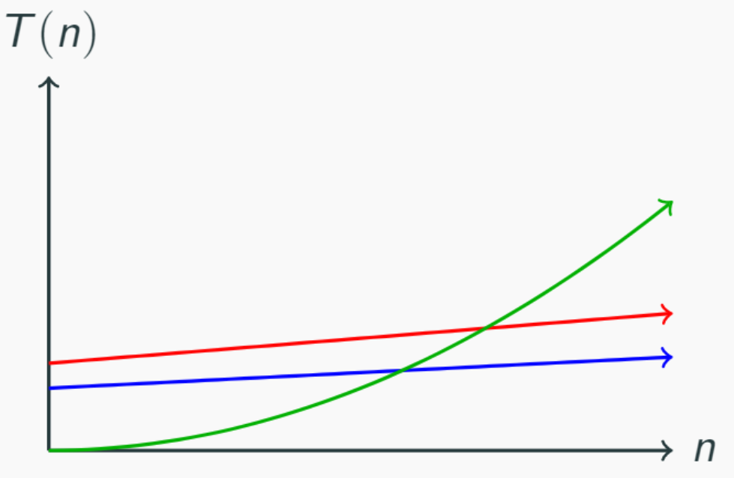
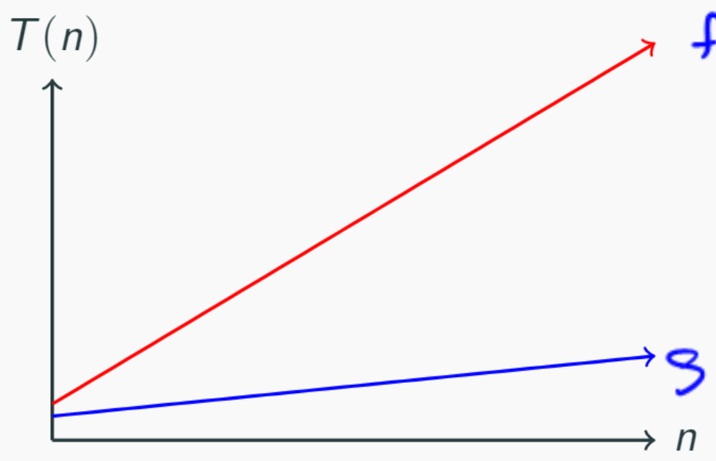
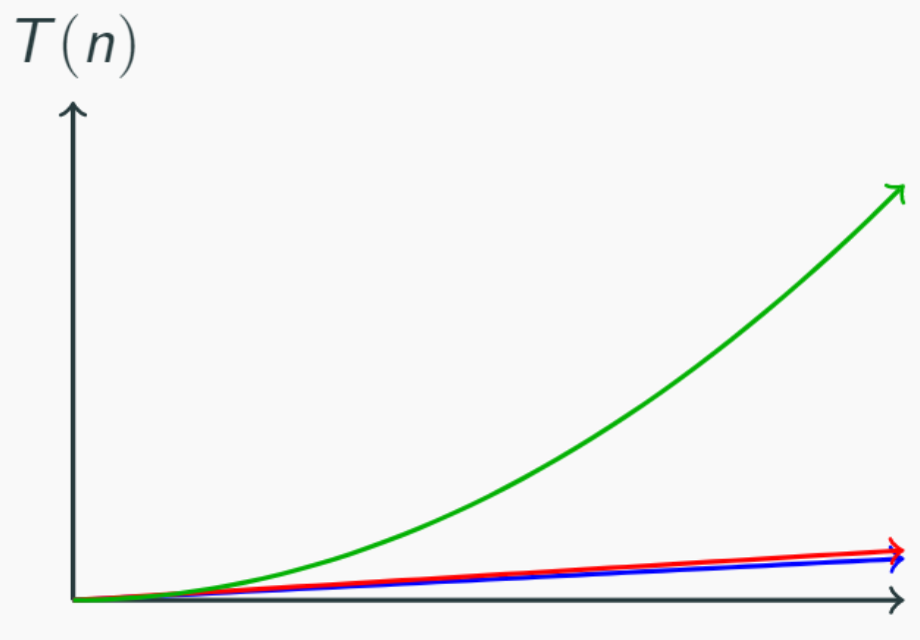
Function growth
n
n
n and 4n look very different up close
n and 4n look the same over time
n² doesn’t start off dominating the linear functions
It eventually takes over…
n² eventually dominates n

Slide 10
Function comparison: exercise
True – all linear functions are treated as equivalent
f(n) = n ≤ g(n) = 5n + 3?
f(n) = 5n + 3 ≤ g(n) = n?
f(n) = 5n + 3 ≤ g(n) = 1?
f(n) = 5n + 3 ≤ g(n) = n²?
f(n) = n² + 3n + 2 ≤ g(n) = n³?
f(n) = n³ ≤ g(n) = n² + 3n + 2 ?
True
False
True – quadratic will always dominate linear
True
False

Slide 11
Definition: function domination
A function f(n) is dominated by g(n) when…
There exists two constants c > 0 and n₀ > 0
Such that for all values of n ≥ n₀
f(n) ≤ c * g(n)
Example:
Is f(n) = n dominated by g(n) = 5n + 3 ?
c = 1
n₀ = 1
Yes!
Definition: Domination

Slide 12
Exercise: Function Domination
Demonstrate that 5n² + 3n + 6 is dominated by n³ by finding a c and n₀ that satisfy the definition of domination
5n² + 3n + 6 ≤ 5n² + 3n² + 6n² when n ≥ 1
5n² + 3n² + 6n² = 14n²
5n² + 3n + 6 ≤ 14n² for n ≥ 1
14n² ≤ c*n³ for c = ? n >= ?
$\frac{14}{n}$ -> c = 14 & n >= 1

Slide 13
Definition: Big O
If f(n) = n ≤ g(n) = 5n + 3 ≤ h(n) = 100n and
h(n) = 100n ≤ g(n) = 5n + 3 ≤ f(n) n
Really they are all the “same”
O(f(n)) is the “family” or “set” of all functions that are dominated by f(n)
Question: are O(n), O(5n + 3) and O(100n) all the same?
True! By convention we pick simplest of the above -> O(n) ie “linear”
Definition: Big O

Slide 14
Definitions: Big Ω
“f(n) is greater than or equal to g(n)”
F(n) dominates g(n) when:
There exists two constants such that c > 0 and n0 > 0
Such that for all values n >= n0
F(n) >= c * g(n) is true
Ω(f(n)) is the family of all functions that dominates f(n)
Definition: Big Ω

Slide 15
∈ Element Of
f(n) is dominated by g(n)
Is that the same as
“f(n) is contained inside O(g(n))”
Yes!
f(n) ∈ g(n)

Slide 16
Examples
Definition: Big O
O(f(n)) is the “family” or “set” of all functions that are dominated by f(n)
4n² ∈ Ω(1)
true
4n² ∈ Ω(n)
true
4n² ∈ Ω(n²)
true
4n² ∈ Ω(n³)
false
4n² ∈ Ω(n⁴)
false
4n² ∈ O(1)
false
4n² ∈ O(n)
false
4n² ∈ O(n²)
true
4n² ∈ O(n³)
true
4n² ∈ O(n⁴)
true
Definition: Big Ω
Ω(f(n)) is the family of all functions that dominates f(n)

Slide 17
Definitions: Big Θ
We say f(n) ∈ Θ(g(n)) when both
f(n) ∈ O(g(n)) and f(n) ∈ Ω (g(n)) are true
Which is only when f(n) = g(n)
Θ(f(n)) is the family of functions that are equivalent to f(n)
Industry uses “Big Θ” and “Big O” interchangeably
Definition: Big Θ

