Slide 1
Final Review
CSE 373: Data Structures and Algorithms
Autumn 2018
Shrirang (Shri) Mare
shri@cs.washington.edu
Thanks to Kasey Champion, Ben Jones, Adam Blank, Michael Lee, Evan McCarty, Robbie Weber, Whitaker Brand, Zora Fung, Stuart Reges, Justin Hsia, Ruth Anderson, and many others for sample slides and materials ...

Slide 2
Today
Practice exam posted
Use it as reference for exam question formats, not as a study material.
TA-led review session
Sunday 2-5pm in Smith Hall (SMI) 120
Office hours on Monday
Check the course calendar tomorrow
HW5 Part 2

Slide 3
Exam format: Type of questions
Type of questions
1. Multiple choice questions (MCQ)
Select one correct choice
Select multiple correct choices
2. Short-answer question (SAQ)
Answer in one word or one sentence
3. Medium-answer question (MAQ)
Expected in 4-5 sentences
E.g., explain how you would solve so and so problem

Slide 4
Exam format
- Somewhat different than previous term exams that you may have seen.
- Ordered roughly in the order of difficultly
Three (or maybe four) sections
1. Warmup – mostly MCQs and SAQs
2. Basic – mostly MCQs and SAQs
3. Applied – mostly MAQs
4. … ?

Slide 5
Exam Tips
Manage your time well
Don’t dwell on MCQs for too long
(Rough guideline) 1 point worth MCQ means you should not spend more than 1 minute on it.
What type of questions you won’t get on the exam:
Execute Primm’s algorithm on this graph and fill the Primm’s algorithm table
Insert given list of values in a hash table that uses quadratic probing
Insert elements in heap or AVL tree
Questions asking you to write java code
Find c and n0, or solve summations

Slide 6
Exam Tips: Medium-answer questions
1. No need to explain how the algorithms we covered in the class. You can use them as black box tools in your solution, unless you are modifying the algorithm, in which case you need to describe your modification.
2. Don’t worry about constant factors unless the question explicitly asks otherwise.
3. Expectation: Answer in 4-5 sentences.
(For partial credit)
4. A brute force solution that works will get more partial credit than an efficient but incomplete answer. So, if you are stuck at finding and efficient, but know a brute force solution give that first.
5. Solving a problem may involve multiple steps. If you know how to solve one step, but not the other, write down solution to step 1 for partial credit.

Slide 7
Review

Slide 8
ADTs vs Data Structures
Data Structure
A way of organizing and storing related data points
An object that implements the functionality of a specified ADT
Describes exactly how the collection will perform the required operations
Examples: LinkedIntList, ArrayIntList
Algorithm
A series of precise instructions used to perform a task
Examples from CSE 14X: binary search, merge sort, recursive backtracking
Abstract Data Type (ADT)
A definition for expected operations and behavior
A mathematical description of a collection with a set of supported operations and how they should behave when called upon
Describes what a collection does, not how it does it
Can be expressed as an interface
Examples: List, Map, Set

Slide 9
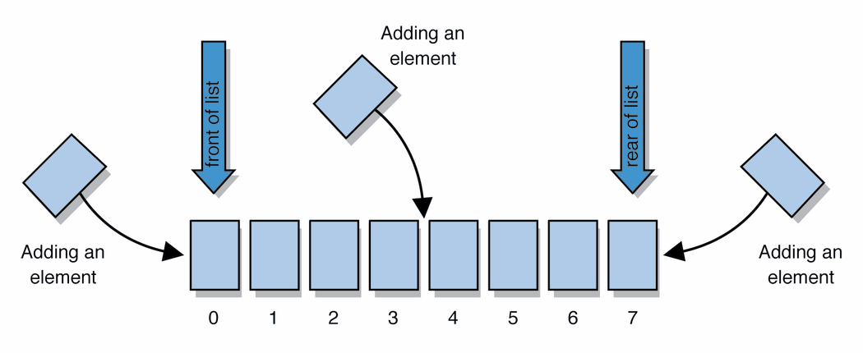
List ADT
list: stores an ordered sequence of information.
Each item is accessible by an index.
Lists have a variable size as items can be added and removed
Supported Operations:
get(index): returns the item at the given index
set(value, index): sets the item at the given index to the given value
append(value): adds the given item to the end of the list
insert(value, index): insert the given item at the given index maintaining order
delete(index): removes the item at the given index maintaining order
size(): returns the number of elements in the list

Slide 10
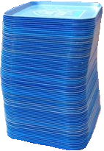
Stack ADT
stack: A collection based on the principle of adding elements and retrieving them in the opposite order.
Last-In, First-Out ("LIFO")
Elements are stored in order of insertion.
We do not think of them as having indexes.
Client can only add/remove/examine the last element added (the "top").
basic stack operations:
push(item): Add an element to the top of stack
pop(): Remove the top element and returns it
peek(): Examine the top element without removing it
size(): how many items are in the stack?
isEmpty(): true if there are 1 or more items in stack, false otherwise
push
pop, peek
top | 3
 | 2
bottom | 1
stack

Slide 11
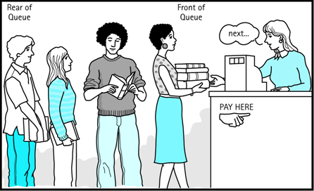
Queue ADT
queue: Retrieves elements in the order they were added.
First-In, First-Out ("FIFO")
Elements are stored in order of insertion but don't have indexes.
Client can only add to the end of the queue, and can only examine/remove the front of the queue.
basic queue operations:
add(item): aka “enqueue” add an element to the back.
remove(): aka “dequeue” Remove the front element and return.
peek(): Examine the front element without removing it.
size(): how many items are stored in the queue?
isEmpty(): if 1 or more items in the queue returns true, false otherwise
front |  | back
1 | 2 | 3
remove, peek
add
queue

Slide 12
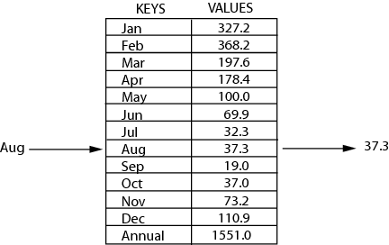
Map ADT (Dictionary)
map: Holds a set of unique keys and a collection of values, where each key is associated with one value.
a.k.a. "dictionary", "associative array", "hash"
operations:
put(key, value ): Adds a mapping from a key to a value.
get(key ): Retrieves the value mapped to the key.
remove(key ): Removes the given key and its mapped value.
key | value
“at" | 43
key | value
“in" | 37
key | value
“you" | 22
key | value
“the" | 56
map.get("the")
56

Slide 13
Tree Height
What is the height of the following trees?
overallRoot
overallRoot
overallRoot
1
7
null
2
5
7
Height = 2
Height = 0
Height = -1 or NA

Slide 14
Traversals
traversal: An examination of the elements of a tree.
A pattern used in many tree algorithms and methods
Common orderings for traversals:
pre-order: process root node, then its left/right subtrees
17 41 29 6 9 81 40
in-order: process left subtree, then root node, then right
29 41 6 17 81 9 40
post-order: process left/right subtrees, then root node
29 6 41 81 40 9 17
overallRoot
17
41
9
29
6
81
40
Notes:
When to use Pre-Order, In-order or Post-Order?
The traversal strategy the programmer selects depends on the specific needs of the algorithm being designed. The goal is speed, so pick the strategy that brings you the nodes you require the fastest.
- If you know you need to explore the roots before inspecting any leaves, you pick pre-orderbecause you will encounter all the roots before all of the leaves.
- If you know you need to explore all the leaves before any nodes, you select post-orderbecause you don't waste any time inspecting roots in search for leaves.
- If you know that the tree has an inherent sequence in the nodes, and you want to flatten the tree back into its original sequence, than an in-order traversal should be used. The tree would be flattened in the same way it was created. A pre-order or post-order traversal might not unwind the tree back into the sequence which was used to create it.

Slide 15
Binary Search Trees
A binary search tree is a binary tree that contains comparable items such that for every node, all children to the left contain smaller data and all children to the right contain larger data.
10
9
15
7
12
18
8
17

Slide 16
AVL trees: Balanced BSTs
AVL Trees must satisfy the following properties:
binary trees: every node must have between 0 and 2 children
binary search tree (BST property): for every node, all keys in the left subtree must be smaller and all keys in the right subtree must be larger than the root node
Balanced (AVL property): for every node, there can be no more than a difference of 1 in the height of the left subtree from the right. Math.abs(height(left subtree) – height(right subtree)) ≤ 1
AVL stands for Adelson-Velsky and Landis (the inventors of the data structure)
The AVL property:
1. ensures depth is always O(log n) – Yes!
2. is easy to maintain – Yes! (using single and double rotations)

Slide 17
Four cases to consider
Insert location | Solution
Left subtree of left child of y | Single right rotation
Right subtree of left child of y | Double (left-right) rotation
Left subtree of right child of y | Double (right-left) rotation
Right subtree of right child of y | Single left rotation
y
x
z
A
B
C
D

Slide 18
How Long Does Rebalancing Take?
Assume we store in each node the height of its subtree.
How do we find an unbalanced node?
Just go back up the tree from where we inserted.
How many rotations might we have to do?
Just a single or double rotation on the lowest unbalanced node.
A rotation will cause the subtree rooted where the rotation happens to have the same height it had before insertion.

Slide 19
Hash tables: Motivation
- data = (key, value)
- operations: put(key, value); get(key); remove(key)
- O(n) with Arrays and Linked List
- O(log n) with BST and AVL trees.
- Can we do better? Can we do this in O(1) ?

Slide 20
Strategies to handle hash collision
There are multiple strategies. In this class, we’ll cover the following three:
1. Separate chaining
2. Open addressing
Linear probing
Quadratic probing
3. Double hashing

Slide 21
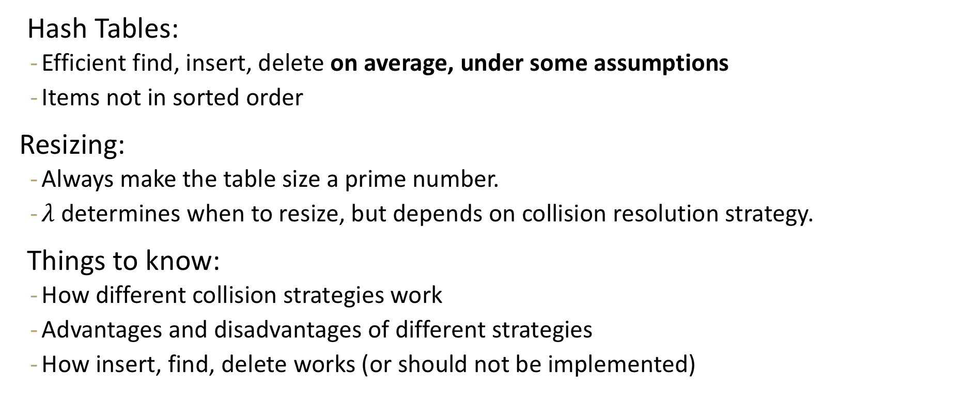
Hash tables review
Hash Tables:
Efficient find, insert, delete on average, under some assumptions
Items not in sorted order
Resizing:
Always make the table size a prime number.
$λ$ determines when to resize, but depends on collision resolution strategy.
Things to know:
How different collision strategies work
Advantages and disadvantages of different strategies
How insert, find, delete works (or should not be implemented)

Slide 22
Heap review
Heap is a tree-based data structure that satisfies
- (a) structure property: it’s a complete tree
- (b) heap property, which states:
for min-heap: $parent≤children$
for max-heap: $parent≥children$
Operations of interest:
removeMin()
peekMin()
insert()
Applications: priority queue, sorting, ..

Slide 23
Desired properties in a sorting algorithm
Stable
In the output, equal elements (i.e., elements with equal keys) appear in their original order
In-place
Algorithm uses a constant additional space, $O(1)$ extra space
Adaptive
Performs better when input is almost sorted or nearly sorted
(Likely different big-O for best-case and worst-case)
Fast. $O (n\log{n)}$
No algorithm has all of these properties. So choice of algorithm depends on the situation.

Slide 24
Sorting algorithms – High-level view
- $O\left(n^{2}\right)$
Insertion sort
Selection sort
Quick sort (worst)
- $O(n\log{n)}$
Merge sort
Heap sort
Quick sort (avg)
- $Ω(n\log{n)}$ -- lower bound on comparison sorts
- $O(n)$ – non-comparison sorts
Bucket sort (avg)

Slide 25
Tree method
Level | Number of Nodes at level | Work per Node | Work per Level
0
1
2
$$i$$
base
Last recursive level:

Slide 26
Design technique: Divide-and-conquer
Very important technique in algorithm to attack problems
Three steps:
1. Divide: Split the original problem into smaller parts
2. Conquer: Solve individual parts independently (think recursion)
3. Combine: Put together individual solved parts to produce an overall solution
Merge sort and Quick sort are classic examples of sorting algorithms that use this technique

Slide 27
Graph Review
Graph Definitions/Vocabulary
Vertices, Edges
Directed/undirected
Weighted
Etc…
Graph Traversals
Breadth First Search
Depth First Search
Finding Shortest Path
Dijkstra’s
Topological Sort, Strongly connected components
Minimum Spanning Trees
Primm’s
Kruskal’s
Disjoint Sets
Implementing Kruskal’s

Slide 28
Strongly Connected Components
Notes:
12:30

Slide 29
Connected [Undirected] Graphs
Connected graph – a graph where every vertex is connected to every other vertex via some path. It is not required for every vertex to have an edge to every other vertex
There exists some way to get from each vertex to every other vertex
Connected Component – a subgraph in which any two vertices are connected via some path, but is connected to no additional vertices in the supergraph
There exists some way to get from each vertex within the connected component to every other vertex in the connected component
A vertex with no edges is itself a connected component
Robb
Sansa
Rickon
Dany
Viserys
Arya
Jon
Bran

Slide 30
Strongly Connected Components
A subgraph C such that every pair of vertices in C is connected via some path in both directions, and there is no other vertex which is connected to every vertex of C in both directions.
Strongly Connected Component
A
D
E
B
C
Note: the direction of the edges matters!

Slide 31
Strongly Connected Components Problem
A
B
D
E
K
C
F
J
{A}, {B}, {C,D,E,F}, {J,K}
Given: A directed graph G
Find: The strongly connected components of G
Strongly Connected Components Problem

Slide 32
SCC Algorithm
Ok. How do we make a computer do this?
You could:
run a [B/D]FS from every vertex,
For each vertex record what other vertices it can get to
and figure it out from there.
But you can do better. There’s actually an O(|V|+|E|) algorithm!
I only want you to remember two things about the algorithm:
It is an application of depth first search.
It runs in linear time
The problem with running a [B/D]FS from every vertex is you recompute a lot of information.
The time you are popped off the stack in DFS contains a “smart” ordering to do a second DFS where you don’t need to recompute that information.

Slide 33
Why Find SCCs?
Graphs are useful because they encode relationships between arbitrary objects.
We’ve found the strongly connected components of G.
Let’s build a new graph out of them! Call it H
Have a vertex for each of the strongly connected components
Add an edge from component 1 to component 2 if there is an edge from a vertex inside 1 to one inside 2.
A
B
D
E
K
1
2
C
F
J
3
4

Slide 34
Why Find SCCs?
That’s awful meta. Why?
This new graph summarizes reachability information of the original graph.
I can get from A (of G) in 1 to F (of G) in 3 if and only if I can get from 1 to 3 in H.
A
B
D
E
K
1
2
C
F
J
3
4

Slide 35
Why Must H Be a DAG?
H is always a DAG (do you see why?).

Slide 36
Takeaways
Finding SCCs lets you collapse your graph to the meta-structure. If (and only if) your graph is a DAG, you can find a topological sort of your graph.
Both of these algorithms run in linear time.
Just about everything you could want to do with your graph will take at least as long.
You should think of these as “almost free” preprocessing of your graph.
Your other graph algorithms only need to work on
topologically sorted graphs and
strongly connected graphs.

Slide 38
Practice exam Q5
Recall that in insertion sort, the algorithm does a linear search to find the position in the sorted subarray where the current element should be inserted. Suppose you use a binary search instead of the linear search to find that position, what would be the worst-case tight big-O time complexity of the sort? Briefly justify your answer.

Slide 39
Practice exam Q5
Recall that in insertion sort, the algorithm does a linear search to find the position in the sorted subarray where the current element should be inserted. Suppose you use a binary search instead of the linear search to find that position, what would be the worst-case tight big-O time complexity of the sort? Briefly justify your answer.
Solution: O(n$^2$)Because even if we find the insertion index quickly (in O (log n) time), we still need to shift all the elements, which takes O (n) time, so the time complexity still remains as O(n^2).

Slide 40
Practice exam Q6
Suppose you are given a source code and you need to figure out the order in which to compile the files. Explain how you would solve this problem? State the runtime of your solution.

Slide 41
Practice exam Q6
Suppose you are given a source code and you need to figure out the order in which to compile the files. Explain how you would solve this problem? State the runtime of your solution.
Solution: Represent the source code files as a directed unweighted graph, where each vertex is a file and an edge represents dependency, i.e., if file A imports file B, there is an edge from B to A.
Run topological sort, and use one of the topological orderings to compile files.

Slide 42
Practice exam Q7
Frodo and Sam are on their way to Mordor to destroy the ring, and along their path they have to pass through several human villages on their way, some of which are now deserted and likely Orc territory. They learn that there are some paths that are being heavily guarded by Orcs, and they want to avoid those paths at all costs. Friendly spies tell Frodo and Sam that they should avoid the road between two deserted villages, as it is more likely be monitored by Orcs.

Slide 43
Practice exam Q7
Frodo and Sam are on their way to Mordor to destroy the ring, and along their path they have to pass through several human villages on their way, some of which are now deserted and likely Orc territory. They learn that there are some paths that are being heavily guarded by Orcs, and they want to avoid those paths at all costs. Friendly spies tell Frodo and Sam that they should avoid the road between two deserted villages, as it is more likely be monitored by Orcs.
Solution:
Run BFS, identify all unsafe edges, and then remove them.
Run Dijkstra’s to find the shortest path.

Slide 44
P vs. NP review slides

Slide 45
Decision Problems
Let’s go back to dividing problems into solvable/not solvable. For today, we’re going to talk about decision problems.
Problems that have a “yes” or “no” answer.
Why?
Theory reasons (ask me later).
But it’s not too bad
most problems can be rephrased as very similar decision problems.
E.g. instead of “find the shortest path from s to t” ask Is there a path from s to t of length at most $k$?

Slide 46
P
The set of all decision problems that have an algorithm that runs in time $O\left(n^{k}\right)$ for some constant $k$.
P (stands for “Polynomial”)
The decision version of all problems we’ve solved in this class are in P.
P is an example of a “complexity class”
A set of problems that can be solved under some limitations (e.g. with some amount of memory or in some amount of time).

Slide 47
P vs. NP
The set of all decision problems that have an algorithm that runs in time $O\left(n^{k}\right)$ for some constant $k$.
P (stands for “Polynomial”)
The set of all decision problems such that if the answer is YES, there is a proof of that which can be verified in polynomial time.
NP (stands for “nondeterministic polynomial”)
Claim: P is a subset of NP, i.e. every problem in P is also in NP
(do you see why?)

Slide 48
NP-Complete
Let’s say we want to prove that some problem in NP needs exponential time (i.e. that P is not equal to NP).
Ideally we’d start with a really hard problem in NP.
What is the hardest problem in NP?
What does it mean to be a hard problem?
NP-complete
We say that a problem B is “NP-complete” if B is in NP and for all problems A in NP, A reduces to B.

