Slide 1
P vs. NP
Data Structures and Algorithms

Slide 2
Goals for today
Define “P, NP, and NP-complete”
Explain the P vs. NP problem
why it’s the biggest open problem in CS.
And what to do when a problem you want to solve is “NP-complete”

Slide 3
Problem For Today
You just started a job at Amazon.
They give you the following problem: You have a weighted, directed graph, where each vertex is a place to deliver a package.
One vertex is marked as the amazon warehouse.
How do you direct the truck to deliver all the packages, and return to the warehouse, using the least amount of gas?
This is NOT just finding a minimum spanning tree.
Keep this problem in mind, today we’ll discuss why you shouldn’t hope to solve it, and what you should do instead.

Slide 4
Taking a Big Step Back
What has this quarter been about?
We’ve taken problems you probably knew how to solve slowly,
And we figured out how to solve them faster.
In some sense, that’s the job of a computer scientist.
Figure out how to take our problems
And make the computer do the hard work for us.

Slide 5
Taking a Big Step Back
Let’s take a big step back, and try to break problems into two types:
Those for which a computer might be able to help.
And those which would take so long to solve even on a computer we wouldn’t expect to solve them.
There are problems we could solve in finite time…but we’ll all be long dead before our computer tells us the answer.

Slide 6
Efficient
We’ll consider a problem “efficiently solvable” if it has a polynomial time algorithm.
I.e. an algorithm that runs in time $O(n^{k})$ where $k$ is a constant.
Are these algorithms always actually efficient?
Well………no
Your $n^{10000}$ algorithm or even your $2^{2^{2^{2^{2}}}}⋅ n^{3}$ algorithm probably aren’t going to finish anytime soon.
But these edge cases are rare, and polynomial time is good as a low bar
If we can’t even find an $n^{10000}$ algorithm, we should probably rethink our strategy

Slide 7
Decision Problems
Let’s go back to dividing problems into solvable/not solvable. For today, we’re going to talk about decision problems.
Problems that have a “yes” or “no” answer.
Why?
Theory reasons (ask me later).
But it’s not too bad
most problems can be rephrased as very similar decision problems.
E.g. instead of “find the shortest path from s to t” ask Is there a path from s to t of length at most $k$?

Slide 8
P
The set of all decision problems that have an algorithm that runs in time $O\left(n^{k}\right)$ for some constant $k$.
P (stands for “Polynomial”)
The decision version of all problems we’ve solved in this class are in P.
P is an example of a “complexity class”
A set of problems that can be solved under some limitations (e.g. with some amount of memory or in some amount of time).

Slide 9
I’ll know it when I see it.
Another class of problems we want to talk about.
“I’ll know it when I see it” Problems.
Decision Problems such that:
If the answer is YES, you can prove the answer is yes by
Being given a “proof” or a “certificate”
Verifying that certificate in polynomial time.
What certificate would be convenient for short paths?
The path itself. Easy to check the path is really in the graph and really short.

Slide 10
I’ll know it when I see it.
More formally,
It’s a common misconception that NP stands for “not polynomial” Please never ever ever ever say that.
Please.
Every time you do a theoretical computer scientist sheds a single tear.
(That theoretical computer scientist is me)
The set of all decision problems such that if the answer is YES, there is a proof of that which can be verified in polynomial time.
NP (stands for “nondeterministic polynomial”)

Slide 11
NP
We can verify YES instances of NP problems efficiently, but can we decide whether the answer is YES or NO efficiently?
I.e. can you bootstrap the ability to check a certificate into the ability to find a certificate?
We don’t know.
This is the P vs. NP problem.

Slide 12
P vs. NP
The set of all decision problems that have an algorithm that runs in time $O\left(n^{k}\right)$ for some constant $k$.
P (stands for “Polynomial”)
The set of all decision problems such that if the answer is YES, there is a proof of that which can be verified in polynomial time.
NP (stands for “nondeterministic polynomial”)
Claim: P is a subset of NP, i.e. every problem in P is also in NP
(do you see why?)

Slide 13
P vs. NP
Are P and NP the same complexity class?
That is, can every problem that can be verified in polynomial time also be solved in polynomial time.
P vs. NP
No one knows the answer to this problem.
In fact, it’s the biggest open problem in Computer Science.

Slide 14
Hard Problems
Let’s say we want to prove that some problem in NP needs exponential time (i.e. that P is not equal to NP).
Ideally we’d start with a really hard problem in NP.
What is the hardest problem in NP?
What does it mean to be a hard problem?

Slide 15
Using an algorithm for Problem B to solve Problem A.
Reduction (informally)
Transform Input
u
2
u
1
2
s
t
s
t
1
v
v
Unweighted Shortest Paths
2
u
s
t
2
v
Transform Output
2
u
1
2
s
t
2
1
v
2

Slide 16
NP-Complete
Let’s say we want to prove that some problem in NP needs exponential time (i.e. that P is not equal to NP).
Ideally we’d start with a really hard problem in NP.
What is the hardest problem in NP?
What does it mean to be a hard problem?
NP-complete
We say that a problem B is “NP-complete” if B is in NP and for all problems A in NP, A reduces to B.

Slide 17
NP-Completeness
An NP-complete problem is a universal language for encoding “I’ll know it when I see it” problems.
If you find an efficient algorithm for an NP-complete problem, you have an algorithm for every problem in NP
3-SAT is NP-complete
Cook-Levin Theorem (1971)

Slide 18
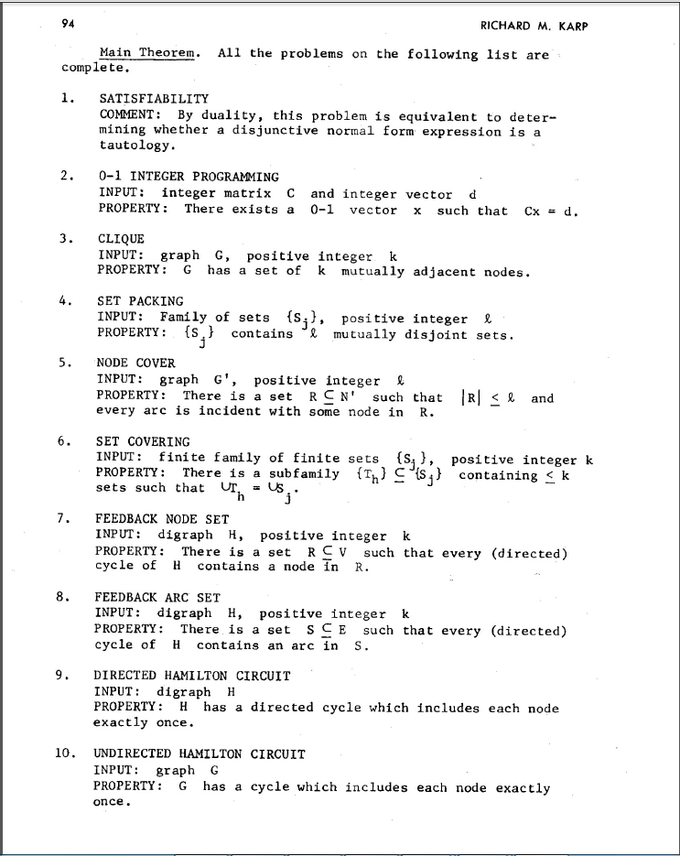
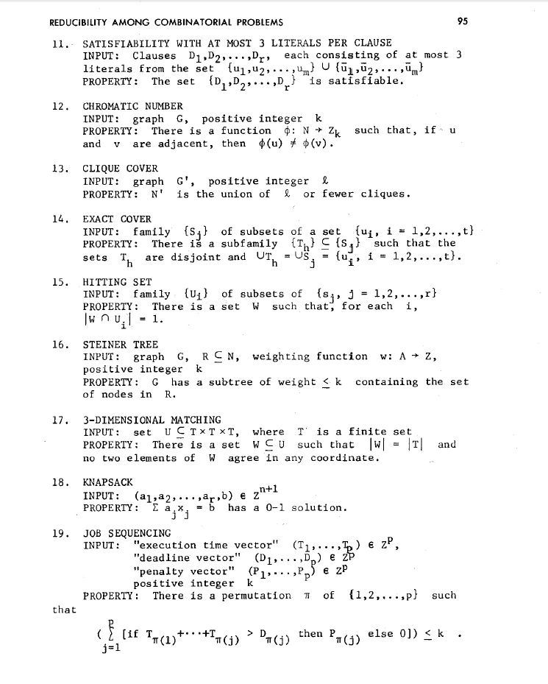
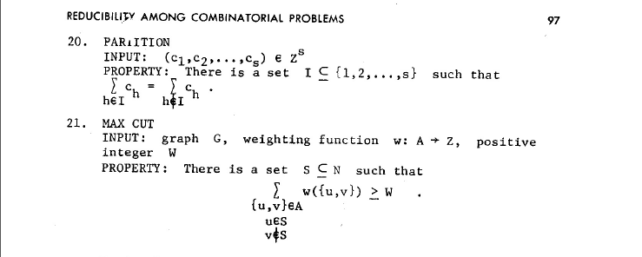
NP-Complete Problems
But Wait! There’s more!
A lot of problems are NP-complete
Karp’s Theorem (1972)

Slide 19
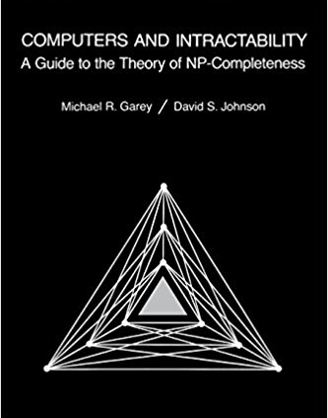
NP-Complete Problems
But Wait! There’s more!
By 1979, at least 300 problems had been proven NP-complete.
Garey and Johnson put a list of all the NP-complete problems they could find in this textbook.
Took them almost 100 pages to just list them all.
No one has made a comprehensive list since.

Slide 20
NP-Complete Problems
But Wait! There’s more!
In the last month, mathematicians and computer scientists have put papers on the arXiv claiming to show (at least) 11 more problems are NP-complete.
There are literally thousands of NP-complete problems known.
And some of them look weirdly similar to problems we’ve already studied.

Slide 21
Examples
There are literally thousands of NP-complete problems.
And some of them look weirdly similar to problems we do know efficient algorithms for.
In P
NP-Complete
Given a directed graph, report if there is a path from s to t of length at most $k$.
Short Path
Given a directed graph, report if there is a path from s to t of length at least$k$.
Long Path

Slide 22
Examples
In P
NP-Complete
Given a weighted graph, find a spanning tree (a set of edges that connect all vertices) of weight at most $k$.
Light Spanning Tree
Given a weighted graph, find a tour (a walk that visits every vertex and returns to its start) of weight at most $k$.
Traveling Salesperson
The electric company just needs a greedy algorithm to lay its wires.
Amazon doesn’t know a way to optimally route its delivery trucks.

Slide 23
Dealing with NP-Completeness
Option 1: Maybe it’s a special case we understand
Maybe you don’t need to solve the general problem, just a special case
Option 2: Maybe it’s a special case we don’t understand (yet)
There are algorithms that are known to run quickly on “nice” instances. Maybe your problem has one of those.
One approach: Turn your problem into a SAT instance, find a solver and cross your fingers.

Slide 24
Dealing with NP-Completeness
Option 3: Approximation Algorithms
You might not be able to get an exact answer, but you might be able to get close.
Given a weighted graph, find a tour (a walk that visits every vertex and returns to its start) of minimum weight.
Optimization version of Traveling Salesperson
Algorithm:
Find a minimum spanning tree.
Have the tour follow the visitation order of a DFS of the spanning tree.
Theorem: This tour is at most twice as long as the best one.

Slide 25
Why should you care about P vs. NP
Most computer scientists are convinced that P$≠$NP.
Why should you care about this problem?
It’s your chance for:
$1,000,000. The Clay Mathematics Institute will give $1,000,000 to whoever solves P vs. NP (or any of the 5 remaining problems they listed)
To get a Turing Award

Slide 26
Why should you care about P vs. NP
Most computer scientists are convinced that P$≠$NP.
Why should you care about this problem?
It’s your chance for:
$1,000,000. The Clay Mathematics Institute will give $1,000,000 to whoever solves P vs. NP (or any of the 5 remaining problems they listed)
To get a Turing Award the Turing Award renamed after you.

Slide 27
Why Should You Care if P=NP?
Suppose P=NP.
Specifically that we found a genuinely in-practice efficient algorithm for an NP-complete problem. What would you do?
$1,000,000 from the Clay Math Institute obviously, but what’s next?

Slide 28
Why Should You Care if P=NP?
We found a genuinely in-practice efficient algorithm for an NP-complete problem. What would you do?
Another $5,000,000 from the Clay Math Institute
Put mathematicians out of work.
Decrypt (essentially) all current internet communication.
No more secure online shopping or online banking or online messaging…or online anything.
A world where P=NP is a very very different place from the world we live in now.

Slide 29
Why Should You Care if P$≠$NP?
We already expect P$≠$NP. Why should you care when we finally prove it?
P$≠$NP says something fundamental about the universe.
For some questions there is not a clever way to find the right answer
Even though you’ll know it when you see it.
There is actually a way to obscure information, so it cannot be found quickly no matter how clever you are.

Slide 30
Why Should You Care if P$≠$NP?
To prove P$≠$NP we need to better understand the differences between problems.
Why do some problems allow easy solutions and others don’t?
What is the structure of these problems?
We don’t care about P vs NP just because it has a huge effect about what the world looks like.
We will learn a lot about computation along the way.

