Slide 1
More on disjoint sets
CSE 373: Data Structures and Algorithms
Autumn 2018
Shrirang (Shri) Mare
shri@cs.washington.edu
Thanks to Kasey Champion, Ben Jones, Adam Blank, Michael Lee, Evan McCarty, Robbie Weber, Whitaker Brand, Zora Fung, Stuart Reges, Justin Hsia, Ruth Anderson, and many others for sample slides and materials ...

Slide 2
Today
Revisiting Kruskal’s algorithm (with union/find operations)
Array representation of a disjoint set
Review: Answering algorithm design questions

Slide 3
Set and union
Set:
Collection of elements.
We want to identify all elements in a set with one value, so that findSet(x) == findSet(y) if x and y in one set.
In tree structure, every node has one root.
So use a tree structure for our set, and identified the set as the root element
Union of two elements is union of sets of those elements:
Combine the two trees
2
1
3
5
4
5

Slide 4
Improving union
Problem: Trees can be unbalanced
Solution: Union-by-rank!
let rank(x) be a number representing the upper bound of the height of x so rank(x) $≥$height(x)
Keep track of rank of all trees
When unioning make the tree with larger rank the root
If it’s a tie, pick one randomly and increase rank by one
rank = 0
rank = 0
rank = 1
rank = 2
rank = 0
4
2
0
4
5
1
3
5

Slide 5
Improving findSet()
Problem: Every time we call findSet() you must traverse all the levels of the tree to find representative
Solution: Path Compression
Collapse tree into fewer levels by updating parent pointer of each node you visit
Whenever you call findSet() update each node you touch to point directly to overallRoot
rank = 3
rank = 3
findSet(5)
8
8
6
9
10
11
7
5
4
6
9
10
11
7
12
4
3
13
2
3
12
13
2
5

Slide 6
Optimized disjoint set runtime
makeSet(x)
Without Optimizations
With Optimizations
findSet(x)
Without Optimizations
With Optimizations
union(x, y)
Without Optimizations
With Optimizations
O(1)
O(1)
O(n)
Worst case: O(logn)
O(n)
Worst case: O(logn)

Slide 7
Worksheet question 1

Slide 8
Worksheet question 1

Slide 9
Implementation
Use Nodes?
In modern Java (assuming 64-bit JDK) each object takes about 32 bytes
int field takes 4 bytes
Pointer takes 8 bytes
Overhead ~ 16 bytes
Adds up to 28, but we must partition in multiples of 8 => 32 bytes
Use arrays instead!
Make index of the array be the vertex number
Either directly to store ints or representationally
We implement makeSet(x) so that we choose the representative
Make element in the array the index of the parent

Slide 10
Array implementation
rank = 0
rank = 3
rank = 3
0
1
11
2
6
12
15
3
4
5
7
10
13
14
16
17
8
9
18
0 | 1 | 2 | 3 | 4 | 5 | 6 | 7 | 8 | 9 | 10 | 11 | 12 | 13 | 14 | 15 | 16 | 17 | 18

Slide 11
Array implementation
rank = 0
rank = 3
rank = 3
0
1
11
2
6
12
15
3
4
5
7
10
13
14
16
17
8
9
18
0 | 1 | 2 | 3 | 4 | 5 | 6 | 7 | 8 | 9 | 10 | 11 | 12 | 13 | 14 | 15 | 16 | 17 | 18
0 | 1 | 2 | 3 | 4 | 5 | 6 | 7 | 8 | 9 | 10 | 11 | 12 | 13 | 14 | 15 | 16 | 17 | 18
-1 | -1 | 1 | 2 | 2 | 2 | 1 | 6 | 7 | 7 | 7 | -1 | 11 | 12 | 12 | 11 | 15 | 15 | 17
0 | 1 | 2 | 3 | 4 | 5 | 6 | 7 | 8 | 9 | 10 | 11 | 12 | 13 | 14 | 15 | 16 | 17 | 18
-1 | -4 | 1 | 2 | 2 | 2 | 1 | 6 | 7 | 7 | 6 | -4 | 11 | 12 | 12 | 11 | 15 | 15 | 17
Store (rank * -1) - 1

Slide 12
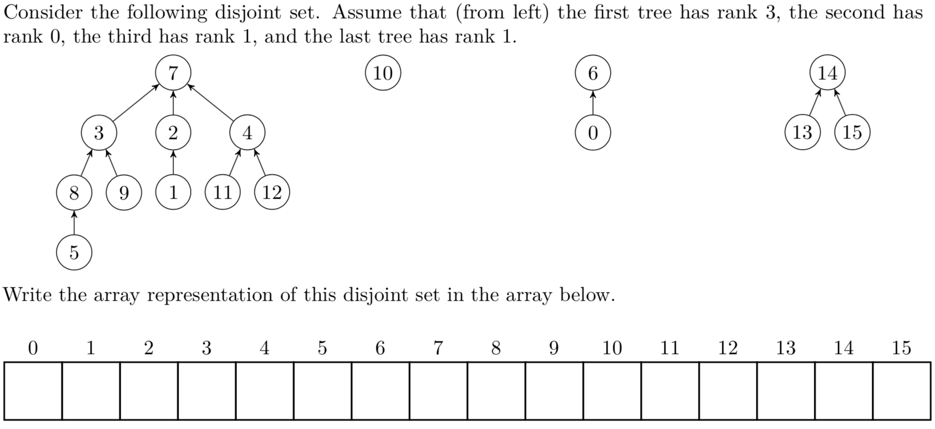
Worksheet question 2

Slide 13
Array method implementation
makeSet(x)
add new value to array with a rank of -1
findSet(x)
Jump into array at index/value you’re looking for, jump to parent based on element at that index, continue until you hit negative number
union(x, y)
findSet(x) and findSet(y) to decide who has larger rank, update element to represent new parent as appropriate

Slide 14
Graph Review
Graph Definitions/Vocabulary
Vertices, Edges
Directed/undirected
Weighted
Etc…
Graph Traversals
Breadth First Search
Depth First Search
Finding Shortest Path
Dijkstra’s
Topological Sort, Strongly connected components
Minimum Spanning Trees
Primm’s
Kruskal’s
Disjoint Sets
Implementing Kruskal’s

Slide 15
Next week
Monday: Guest lecture on Technical Interviews
Wednesday: P vs. NP
Thursday (Section): Final review session
Friday: Final review session
Sunday (tentative): TA lead extra review session

Slide 16
Topics covered in final
- Everything we learned in the class
- Final is cumulative with more focus on topics we covered after midterm.
So there will be questions on the topics we covered before midterm as well.
- Topics not covered in final
B-Trees
Java generics and Java interfaces
Java Syntax
Advice:
- Make use of exams from previous terms. A practice exam will be posted on Monday.
- Review section handouts for how to write good answers (particularly algorithm design questions)
- Finish HW7 early so you can focus on Final.

Slide 17
Worksheet question 3
Suppose you are given a connected graph G. Describe how you would figure out if the graph has a cycle. (Answer in at most 3-4 sentences.)

Slide 18
Worksheet question 3
Suppose you are given a connected graph G. Describe how you would figure out if the graph has a cycle. (Answer in at most 3-4 sentences.)
Run DFS but keep track of vertices in the stack.
If we hit a vertex that is already in the stack, then there is a cycle in the graph.
(Another solution is using topological sort, which is a similar idea, but it works only for directed graphs.)

