Slide 1
Topological Sort
CSE 373: Data Structures and Algorithms
Autumn 2018
Shrirang (Shri) Mare
shri@cs.washington.edu
Thanks to Kasey Champion, Ben Jones, Adam Blank, Michael Lee, Evan McCarty, Robbie Weber, Whitaker Brand, Zora Fung, Stuart Reges, Justin Hsia, Ruth Anderson, and many others for sample slides and materials ...

Slide 2
Dijkstra’s algorithm
Vertex | Distance | Predecessor | Processed

Slide 3
Dijkstra’s algorithm
Vertex | Distance | Predecessor | Processed
S | 0 | -- | Yes
B | 1 | S | Yes
C | 6 | S | Yes
E | 2 | B | Yes
T | 3 | E | Yes

Slide 4
Running time analysis
Notes:
\begin{algorithmic}[1]
\Function{Dijkstra}{Graph G, Vertex source} \Comment{with MPQ}
\State initialize distances to $\infty$, source.dist = 0
\State mark all vertices unprocessed
\State initialize MPQ as a min priority queue; add source with priority 0
\While {MPQ is not empty}
\State u = MPQ.getMin()
\For {each edge (u,v) leaving u}
\If {u.dist + w(u,v) $<$ v.dist}
\If {v.dist == $\infty$}
\State MPQ.insert(v, u.dist + w(u, v))
\Else
\State MPQ.decreasePriority(v, u.dist + w(u,v))
\EndIf
\State v.dist = u.dist + w(u,v)
\State v.predecessor = u
\EndIf
\EndFor
\State mark u as processed
\EndWhile
\EndFunction
\end{algorithmic}

Slide 5
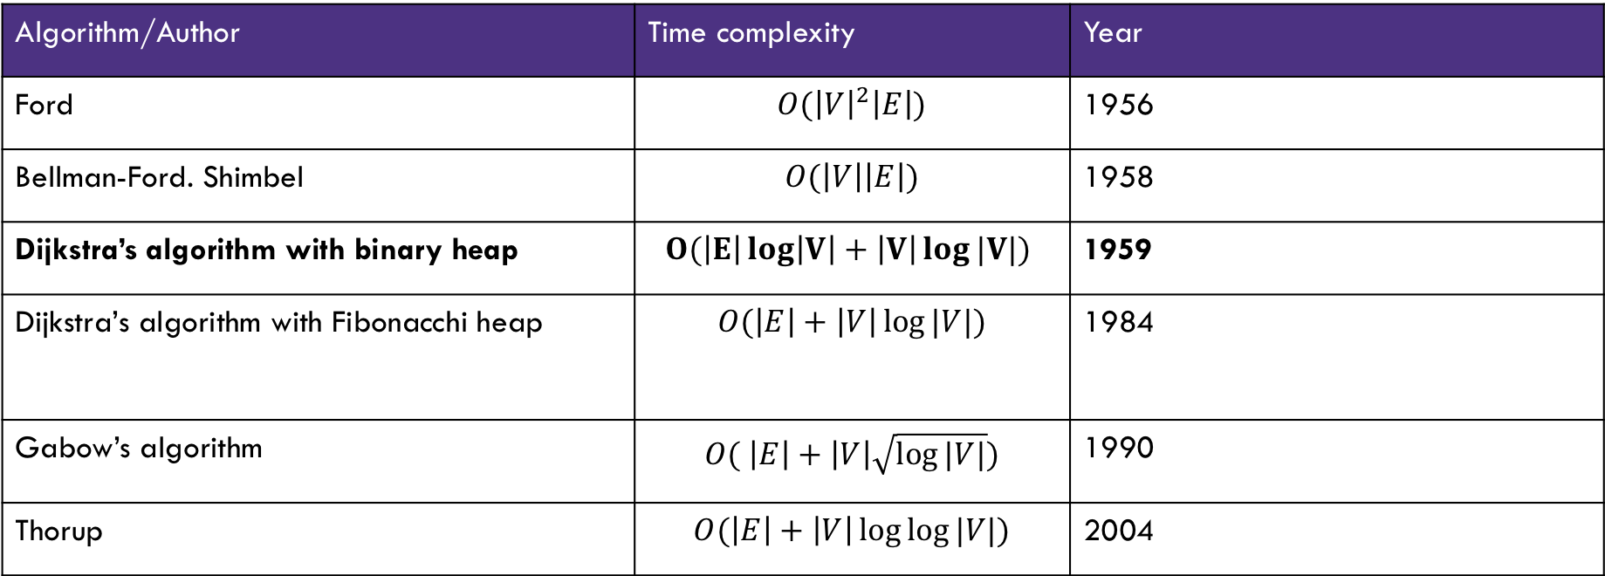
History of shortest path algorithms
Algorithm/Author | Time complexity | Year
Ford | $$O({\left|V\right|}^{2}\left|E\right|)$$ | 1956
Bellman-Ford. Shimbel | $$O(\left|V\right|\left|E\right|)$$ | 1958
Dijkstra’s algorithm with binary heap | $$O(\left|E\right|\log\left|V\right|+\left|V\right|\log{|V|})$$ | 1959
Dijkstra’s algorithm with Fibonacchi heap | $$O(\left|E\right|+\left|V\right|\log{|V|)}$$ | 1984
Gabow’s algorithm | $$O( \left|E\right|+\left|V\right|\sqrt{\log{|V|}})$$ | 1990
Thorup | $$O(\left|E\right|+\left|V\right|\log{\log{|V|)}}$$ | 2004
History of shortest path algorithms. In this class, from this table, you are expected to know only Dijkstra’s algorithm with binary heap and its time complexity. You are not expected to know the other algorithms or their time complexities.

Slide 6

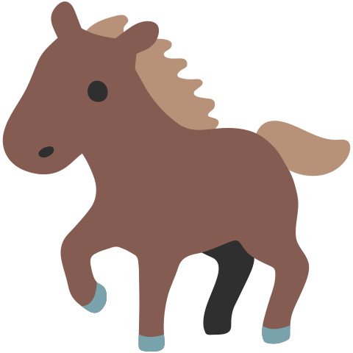



Other applications of shortest paths
Shortest path algorithms are obviously useful for GoogleMaps.
The wonderful thing about graphs is they can encode arbitrary relationships among objects.
u
I have a message I need to get from point s to point t.
But the connections are unreliable.
What path should I send the message along so it has the best chance of arriving?
0.8
0.7
s
t
0.6
0.2
0.97
v
Given: a directed graph G, where each edge weight is the probability of successfully transmitting a message across that edge
Find: the path from s to t with maximum probability of message transmission
Maximum Probability Path Problem
Notes:
Need 7 minutes.

Slide 7
Other applications of shortest paths
Robot navigation
Urban traffic planning
Tramp steamer problem
Optimal pipelining of VLSI chips
Operator scheduling
Subroutine in higher level algorithms
Exploiting arbitrage opportunities in currency exchanges
Open shortest path first routing protocol for IP
Optimal truck routing through given traffic congestion

Slide 8
Topological Sort

Slide 9
Problem 1: Ordering Dependencies
Given a bunch of courses with prerequisites, find an order to take the courses in.
Math 126
CSE 374
CSE 143
CSE 142
CSE 373
CSE 417
Math 126
CSE 142
CSE 143
CSE 373
CSE 374
CSE 417

Slide 10
Problem 1: Ordering Dependencies
Given a directed graph G, where we have an edge from u to v if u must happen before v.
We can only do things one at a time, can we find an order that respects dependencies?
Given: a directed graph G
Find: an ordering of the vertices so all edges go from left to right.
Topological Sort (aka Topological Ordering)
Uses:
Compiling multiple files
Graduating
Manufacturing workflows (assembly lines)

Slide 11
Topological Ordering
A course prerequisite chart and a possible topological ordering.
Math 126
CSE 374
CSE 143
CSE 142
CSE 373
CSE 417
Math 126
CSE 142
CSE 143
CSE 373
CSE 374
CSE 417

Slide 12
Can we always order a graph?
Can you topologically order this graph?
A
B
C
A directed graph without any cycles.
Directed Acyclic Graph (DAG)
A graph has a topological ordering if and only if it is a DAG.
Notes:
3:00

Slide 13
Ordering a DAG
Does this graph have a topological ordering? If so find one.
A
C
D
B
E
If a vertex doesn’t have any edges going into it, we can add it to the ordering.
More generally, if the only incoming edges are from vertices already in the ordering, it’s safe to add.

Slide 14
How Do We Find a Topological Ordering?
Notes:
\begin{algorithmic}[1]
\Function{TopologicalSort}{Graph G, Vertex source}
\State count how many incoming edges each vertex has
\State Collection toProcess = new Collection()
\For {each Vertex v in G}
\If{v.edgesRemaining == 0}
\State toProcess.insert(v)
\EndIf
\EndFor
\State topOrder = new List()
\While{toProcess is not empty}
\State u = toProcess.remove()
\State topOrder.insert(u)
\For{each edge (u,v) leaving u}
\State v.edgesRemaining = v.edgesRemaining - 1
\If{v.edgesRemaining == 0}
\State toProcess.insert(v)
\EndIf
\EndFor
\EndWhile
\EndFunction
\end{algorithmic}

Slide 15
What’s the running time?

Slide 16
Strongly Connected Components
Notes:
12:30

Slide 17
Connected [Undirected] Graphs
Connected graph – a graph where every vertex is connected to every other vertex via some path. It is not required for every vertex to have an edge to every other vertex
There exists some way to get from each vertex to every other vertex
Connected Component – a subgraph in which any two vertices are connected via some path, but is connected to no additional vertices in the supergraph
  There exists some way to get from each vertex within the connected component to every other vertex in the connected component
  A vertex with no edges is itself a connected component
Robb
Sansa
Rickon
Dany
Viserys
Arya
Jon
Bran

Slide 18
Strongly Connected Components
A subgraph C such that every pair of vertices in C is connected via some path in both directions, and there is no other vertex which is connected to every vertex of C in both directions.
Strongly Connected Component
A
D
E
B
C
Note: the direction of the edges matters!

Slide 19
Strongly Connected Components Problem
A
B
D
E
K
C
F
J
{A}, {B}, {C,D,E,F}, {J,K}
Given: A directed graph G
Find: The strongly connected components of G
Strongly Connected Components Problem

Slide 20
SCC Algorithm
Ok. How do we make a computer do this?
You could:
  run a [B/D]FS from every vertex,
  For each vertex record what other vertices it can get to
  and figure it out from there.
But you can do better. There’s actually an O(|V|+|E|) algorithm!
I only want you to remember two things about the algorithm:
  It is an application of depth first search.
  It runs in linear time
The problem with running a [B/D]FS from every vertex is you recompute a lot of information.
The time you are popped off the stack in DFS contains a “smart” ordering to do a second DFS where you don’t need to recompute that information.

Slide 21
Why Find SCCs?
Graphs are useful because they encode relationships between arbitrary objects.
We’ve found the strongly connected components of G.
Let’s build a new graph out of them! Call it H
  Have a vertex for each of the strongly connected components
  Add an edge from component 1 to component 2 if there is an edge from a vertex inside 1 to one inside 2.
A
B
D
E
K
1
2
C
F
J
3
4

Slide 22
Why Find SCCs?
That’s awful meta. Why?
This new graph summarizes reachability information of the original graph.
  I can get from A (of G) in 1 to F (of G) in 3 if and only if I can get from 1 to 3 in H.
A
B
D
E
K
1
2
C
F
J
3
4

Slide 23
Why Must H Be a DAG?
H is always a DAG (do you see why?).

Slide 24
Takeaways
Finding SCCs lets you collapse your graph to the meta-structure.
If (and only if) your graph is a DAG, you can find a topological sort of your graph.
Both of these algorithms run in linear time.
Just about everything you could want to do with your graph will take at least as long.
You should think of these as “almost free” preprocessing of your graph.
  Your other graph algorithms only need to work on
    topologically sorted graphs and
    strongly connected graphs.

Slide 25
Appendix: Strongly Connected Components Algorithm

Slide 26
Efficient SCC
We’d like to find all the vertices in our strongly connected component in time corresponding to the size of the component, not for the whole graph.
We can do that with a DFS (or BFS) as long as we don’t leave our connected component.
If we’re a “sink” component, that’s guaranteed. I.e. a component whose vertex in the meta-graph has no outgoing edges.
How do we find a sink component? We don’t have a meta-graph yet (we need to find the components first)
DFS can find a vertex in a source component, i.e. a component whose vertex in the meta-graph has no incoming edges.
  That vertex is the last one to be popped off the stack.
So if we run DFS in the reversed graph (where each edge points the opposite direction) we can find a sink component.

Slide 27
Efficient SCC
So from a DFS in the reversed graph, we can use the order vertices are popped off the stack to find a sink component (in the original graph).
Run a DFS from that vertex to find the vertices in that component in size of that component time.
Now we can delete the edges coming into that component.
The last remaining vertex popped off the stack is a sink of the remaining graph, and now a DFS from them won’t leave the component.
Iterate this process (grab a sink, start DFS, delete edges entering the component).
In total we’ve run two DFSs. (since we never leave our component in the second DFS).
More information, and pseudocode:
https://en.wikipedia.org/wiki/Kosaraju%27s_algorithm
http://jeffe.cs.illinois.edu/teaching/algorithms/notes/19-dfs.pdf (mathier)

