Slide 1
Shortest Paths
CSE 373: Data Structures and Algorithms
Autumn 2018
Shrirang (Shri) Mare
shri@cs.washington.edu
Thanks to Kasey Champion, Ben Jones, Adam Blank, Michael Lee, Evan McCarty, Robbie Weber, Whitaker Brand, Zora Fung, Stuart Reges, Justin Hsia, Ruth Anderson, and many others for sample slides and materials ...

Slide 2
Four classes of graph problem
.. that can be solved efficiently (in polynomial time)
Shortest path – find a shortest path between two vertices in a graph
Minimum spanning tree – find subset of edges with minimum total weights
Matching – find set of edges without common vertices
Maximum flow – find the maximum flow from a source vertex to a sink vertex
A wide array of graph problems that can be solved in polynomial time are variants of these above problems.
In this class, we’ll cover the first two problems – shortest path and minimum spanning tree

Slide 3
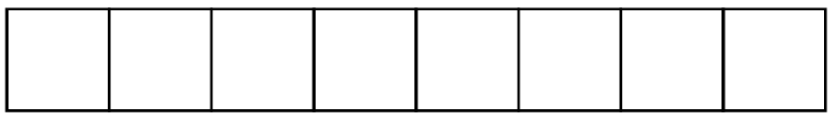
BFS on a directed graph
Run Breadth First Search on this graph starting from s.
What order are vertices placed on the queue?
When processing a vertex insert neighbors in alphabetical order.
u
x
s
t
v
y
Queue
w
Notes:
\begin{algorithmic}[1]
\Function{search}{Graph G}
\State mark all vertices as unknown
\State toVisit.enqueue(first vertex)
\State mark first vertex as known
\While {toVisit is not empty}
\State current = toVisit.dequeue()
\For {v : current.outNeighbors()}
\If {v is unknown}
\State toVisit.enqueue(v)
\State mark v as known
\EndIf
\EndFor
\State visited.add(current)
\EndWhile
\EndFunction
\end{algorithmic}

Slide 4
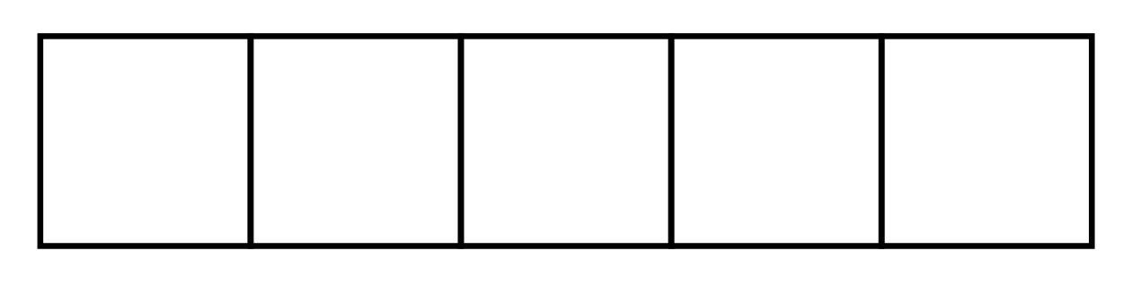
Q1: Do a BFS no this graph, starting at node A
Add nodes to queue in alphabetical order
Add nodes to queue in reverse alphabetical order
Queue
Queue

Slide 5
Q2: Do a DFS no this graph, starting at node A
Add nodes to stack in alphabetical order
Add nodes to stack in reverse alphabetical order
Stack
Stack

Slide 6
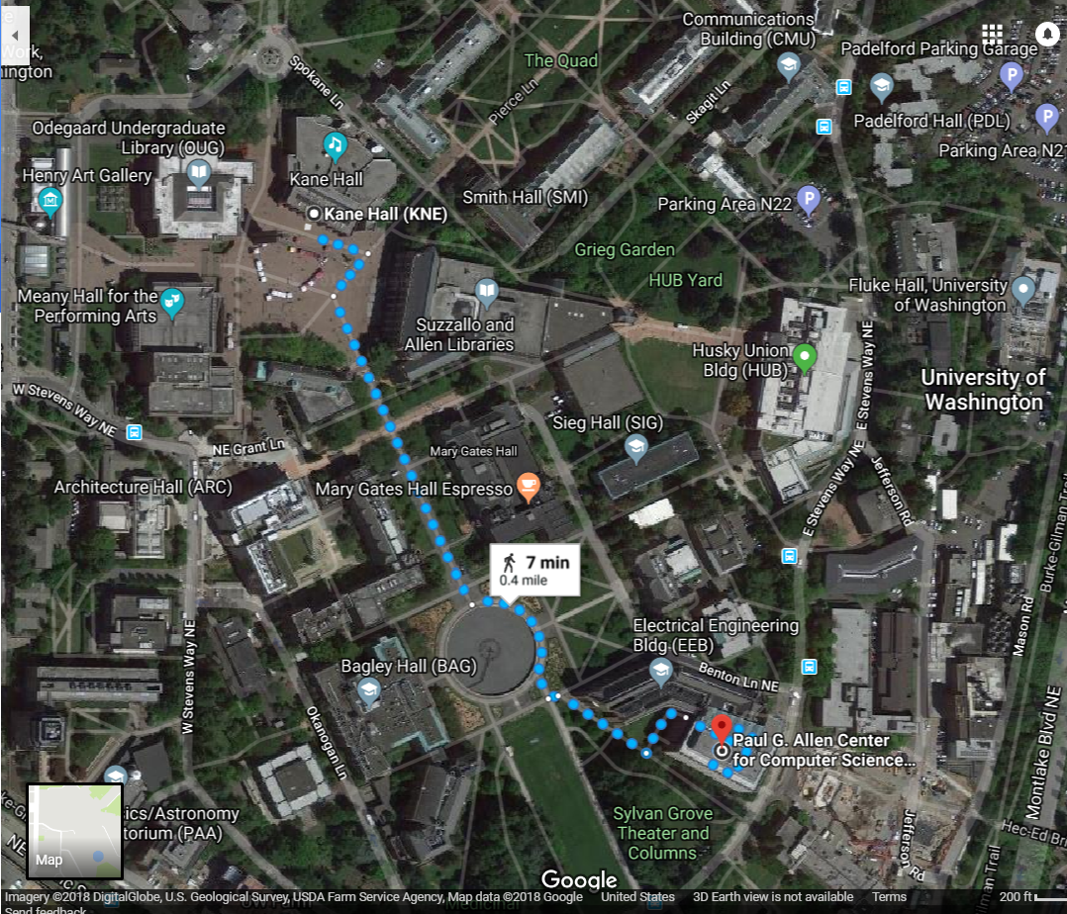
Shortest paths
How does Google Maps figure out this is the fastest way to get to office hours?

Slide 7
Representing maps as graphs
How do we represent a map as a graph? What are the vertices and edges?

Slide 8

Representing maps as graphs
Question:
Does this graph correctly model
all the shown paths?
K
R
S
H
D
P

Slide 9
Representing maps as graphs
Question:
Does this graph correctly model
all the shown paths?
Not quite.
Some paths are longer than others.
So we use “weights” to capture that additional information.
K
2
1
R
2
S
H
4
4
5
D
3
P

Slide 10
Shortest paths
The length of a path is the sum of the edge weights on that path.
Shortest Path Problem
Given: a directed graph G and vertices s and t
Find: the shortest path from s to t
1
y
4
3
s
w
t
5
6
4
5
2
u
v
x
1

Slide 11
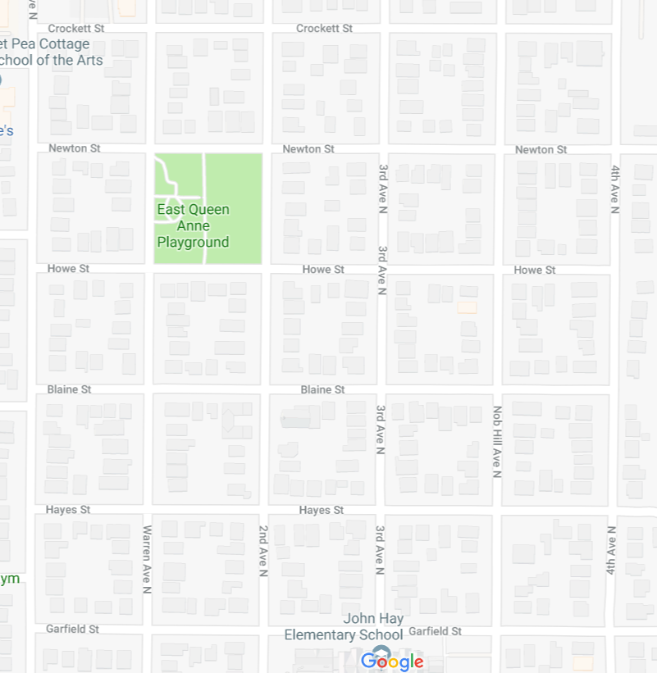
Unweighted graphs
Let’s start with a simpler version: the edges are all the same weight (unweighted)
If the graph is unweighted, how do we find a shortest paths?
Notes:
9:38:30

Slide 12
Unweighted graphs
If the graph is unweighted, how do we find a shortest paths?
What’s the shortest path from s to s?
  Well….we’re already there.
What’s the shortest path from s to u or s to v?
  Just go on the edge from s
From s to w, x, or y?
  Can’t get there directly from s, if we want a length 2 path, have to go through u or v.
u
w
s
y
t
v
x

Slide 13
Unweighted graphs: Key Idea
To find the set of vertices at distance k, just find the set of vertices at distance k-1, and see if any of them have an outgoing edge to an undiscovered vertex.
Do we already know an algorithm that does something like that?
Yes! BFS!
Notes:
\begin{algorithmic}[1]
\Function{bfsShortestPaths}{Graph G, \underline{Vertex source}}
\State toVisit.enqueue(source)
\State mark source as known
\State source.dist = 0
\While {toVisit is not empty}
\State current = toVisit.dequeue()
\For {v : current.outNeighbors()}
\If {v is unknown}
\State \underline{v.distance = current.distance + 1}
\State \underline{v.predecessor = current}
\State toVisit.enqueue(v)
\State mark v as known
\EndIf
\EndFor
\EndWhile
\EndFunction
\end{algorithmic}

Slide 14
Unweighted graphs
If the graph is unweighted, how do we find a shortest paths?
1
2
u
w
2
s
y
t
3
v
x
1
2

Slide 15
What about the target vertex?
Given: a directed graph G and vertices s,t
Find: the shortest path from s to t.
Shortest Path Problem
BFS didn’t mention a target vertex…
It actually finds the shortest path from s to every other vertex.
Notes:
9:48

Slide 16
Weighted graphs
Each edge should represent the “time” or “distance” from one vertex to another.
Sometimes those aren’t uniform, so we put a weight on each edge to record that number.
The length of a path in a weighted graph is the sum of the weights along that path.
We’ll assume all of the weights are positive
  For GoogleMaps that definitely makes sense.
  Sometimes negative weights make sense. Today’s algorithm doesn’t work for those graphs
  There are other algorithms that do work.
Notes:
9:50

Slide 17











Weighted graphs: Take 1
BFS works if the graph is unweighted. Maybe it just works for weighted graphs too?
$$∞$$
$$1$$
$$∞$$
1
$$2$$
1
w
x
1
s
u
v
t
0
20
$$∞$$
1
$$∞$$
1
$$∞$$
$$20$$
$$22$$
$$3$$
$$21$$
What went wrong? When we found a shorter path from s to u, we needed to update the distance to v (and anything whose shortest path went through u) but BFS doesn’t do that.

Slide 18
Weighted graphs: Take 2
Using an algorithm for Problem B to solve Problem A.
Reduction (informally)
You already do this all the time.
In project 2, you reduced implementing a hashset to implementing a hashmap.
Any time you use a library, you’re reducing your problem to the one the library solves.
Can we reduce finding shortest paths on weighted graphs to finding them on unweighted graphs?
Notes:
9:55

Slide 19
Weighted graphs: A Reduction
Given a weighted graph, how do we turn it into an unweighted one without messing up the edge lengths?
Transform Input
2
u
1
u
2
s
t
s
t
1
v
2
v
Unweighted Shortest Paths
u
s
t
2
v
2
Transform Output
u
1
2
2
s
t
1
v
2

Slide 20



Weighted graphs: A Reduction
What is the running time of our reduction on this graph?
O(|V|+|E|) of the modified graph, which is…slow.
Does our reduction even work on this graph?
Ummm….
5000
$$0.5$$
u
$$3$$
u
150
200
$$π$$
s
t
s
t
v
1
v
5000
1
5000
Tl;dr: If your graph’s weights are all small positive integers, this reduction might work great.
Otherwise we probably need a new idea.

Slide 21





Weighted graphs: Take 3
So we can’t just do a reduction.
Instead let’s try to figure out why BFS worked in the unweighted case, and try to make the same thing happen in the weighted case.
Why did BFS work on unweighted graphs? How did we avoid this problem:
When we used a vertex u to update shortest paths we already knew the exact shortest path to u. So we never ran into the update problem
So if we process the vertices in order of distance from s, we have a chance.
$$1$$
1
$$2$$
1
w
x
1
s
u
v
t
0
20
$$3$$
1
$$21$$
1
$$22$$
Notes:
10:01

Slide 22
Weighted graphs: Take 3
Goal: Process the vertices in order of distance from s
Idea:
Have a set of vertices that are “known”
  (we know at least one path from s to them).
Record an estimated distance
  (the best way we know to get to each vertex).
If we process only the vertex closest in estimated distance, we won’t ever find a shorter path to a processed vertex.

Slide 23
Dijkstra’s algorithm
Vertex | Distance | Predecessor | Processed
s
w
x
u
v
t
1
1
w
x
1
s
u
v
t
20
1
1
Notes:
\begin{algorithmic}[1]
\Function{Dijkstra}{Graph G, Vertex source}
\State initialize distances to $\infty$
\State mark source as distance 0
\State mark all vertices unprocessed
\While {there are unprocessed vertices}
\State let u be the closest unprocessed vertex
\For {each edge (u, v) leaving u}
\If {u.dist + w(u, v) < v.dist}
\State v.dist = u.dist + w(u, v)
\State v.predecessor = u
\EndIf
\EndFor
\State mark u as processed
\EndWhile
\EndFunction
\end{algorithmic}

Slide 24
Dijkstra’s algorithm
Vertex | Distance | Predecessor | Processed
s | 0 | -- | Yes
w | 1 | s | Yes
x | 2 | w | Yes
u | 3 | x | Yes
v | 4 | u | Yes
t | 5 | v | Yes
1
1
w
x
1
s
u
v
t
20
1
1

Slide 25
Implementation details
One of those lines of pseudocode was a little sketchy
> let u be the closest unprocessed vertex
What ADT have we talked about that might work here?
Minimum Priority Queues!
Min Priority Queue ADT
state
Set of comparable values
- Ordered based on “priority”
behavior
removeMin() – returns the element with the smallest priority, removes it from the collection
peekMin() – find, but do not remove the element with the smallest priority
insert(value) – add a new element to the collection
Notes:
10:06

Slide 26
Making minimum priority queues (MPQ) work
They won’t quite work “out of the box”.
Min Priority Queue ADT
state
Set of comparable values
- Ordered based on “priority”
behavior
removeMin() – returns the element with the smallest priority, removes it from the collection
peekMin() – find, but do not remove the element with the smallest priority
insert(value) – add a new element to the collection

Slide 27
Dijkstra’s algorithm
Vertex | Distance | Predecessor | Processed
s | 0 | -- | Yes
w | 1 | s | Yes
x | 2 | w | Yes
u | 3 | x | Yes
v | 4 | u | Yes
t | 5 | v | Yes
1
1
w
x
1
s
u
v
t
20
1
1

Slide 28
Making minimum priority queues (MPQ) work
They won’t quite work “out of the box”.
We don’t have an update priority method. Can we add one?
  Percolate up!
To percolate u’s entry in the heap up we’ll have to get to it.
  Each vertex need pointer to where it appears in the priority queue
  I’m going to ignore this point for the rest of the lecture.
Min Priority Queue ADT
state
Set of comparable values
- Ordered based on “priority”
behavior
removeMin() – returns the element with the smallest priority, removes it from the collection
peekMin() – find, but do not remove the element with the smallest priority
insert(value) – add a new element to the collection
DecreasePriority(e, p) – decreases the priority of element e down to p.

Slide 29
Running time analysis
Notes:
\begin{algorithmic}[1]
\Function{Dijkstra}{Graph G, Vertex source} \Comment{with MPQ}
\State initialize distances to $\infty$, source.dist = 0
\State mark all vertices unprocessed
\State initialize MPQ as a min priority queue; add source with priority 0
\While {MPQ is not empty}
\State u = MPQ.getMin()
\For {each edge (u,v) leaving u}
\If {u.dist + w(u,v) $<$ v.dist}
\If {v.dist == $\infty$}
\State MPQ.insert(v, u.dist + w(u, v))
\Else
\State MPQ.decreasePriority(v, u.dist + w(u,v))
\EndIf
\State v.dist = u.dist + w(u,v)
\State v.predecessor = u
\EndIf
\EndFor
\State mark u as processed
\EndWhile
\EndFunction
\end{algorithmic}

Slide 30
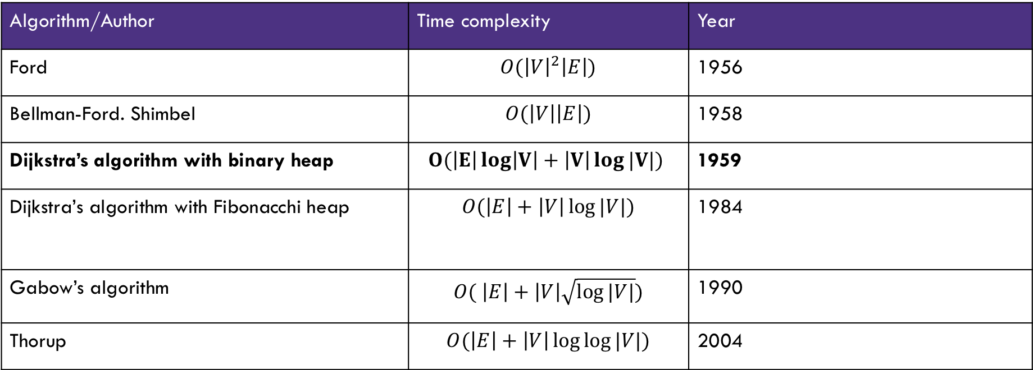
History of shortest path algorithms
Algorithm/Author | Time complexity | Year
Ford | $$O({\left|V\right|}^{2}\left|E\right|)$$ | 1956
Bellman-Ford. Shimbel | $$O(\left|V\right|\left|E\right|)$$ | 1958
Dijkstra’s algorithm with binary heap | $$O(\left|E\right|\log\left|V\right|+\left|V\right|\log{|V|})$$ | 1959
Dijkstra’s algorithm with Fibonacchi heap | $$O(\left|E\right|+\left|V\right|\log{|V|)}$$ | 1984
Gabow’s algorithm | $$O( \left|E\right|+\left|V\right|\sqrt{\log{|V|}})$$ | 1990
Thorup | $$O(\left|E\right|+\left|V\right|\log{\log{|V|)}}$$ | 2004
History of shortest path algorithms. In this class, from this table, you are expected to know only Dijkstra’s algorithm with binary heap and its time complexity. You are not expected to know the other algorithms or their time complexities.

Slide 31
Other applications of shortest paths
Shortest path algorithms are obviously useful for GoogleMaps.
The wonderful thing about graphs is they can encode arbitrary relationships among objects.
I don’t care if you remember this problem
I don’t care if you remember how we apply shortest paths.
I just want you to see that these algorithms have non-obvious applications.
Notes:
Need 7 minutes.

Slide 32





Other applications: Maximum probability path
I have a message I need to get from point s to point t.
But the connections are unreliable.
What path should I send the message along so it has the best chance of arriving?
u
0.8
0.7
s
t
0.6
0.2
0.97
v
Given: a directed graph G, where each edge weight is the probability of successfully transmitting a message across that edge
Find: the path from s to t with maximum probability of message transmission
Maximum Probability Path

Slide 33
Other applications of shortest paths
Robot navigation
Urban traffic planning
Tramp steamer problem
Optimal pipelining of VLSI chips
Operator scheduling
Subroutine in higher level algorithms
Exploiting arbitrage opportunities in currency exchanges
Open shortest path first routing protocol for IP
Optimal truck routing through given traffic congestion

