Slide 1
Graph Traversals
CSE 373: Data Structures and Algorithms
Autumn 2018
Shrirang (Shri) Mare
shri@cs.washington.edu
Thanks to Kasey Champion, Ben Jones, Adam Blank, Michael Lee, Evan McCarty, Robbie Weber, Whitaker Brand, Zora Fung, Stuart Reges, Justin Hsia, Ruth Anderson, and many others for sample slides and materials ...

Slide 2
Graph Vocabulary
Undirected Graph:
Graph Direction
  Undirected graph – edges have no direction and are two-way
  Directed graphs – edges have direction and are thus one-way
Degree of a Vertex
  Degree – the number of edges containing that vertex
  A : 1, B : 2, C : 1
  In-degree – the number of directed edges that point to a vertex
  A : 0, B : 2, C : 1
  Out-degree – the number of directed edges that start at a vertex
  A : 1, B : 1, C : 1
A
B
V = { A, B, C }
E = { (A, B), (B, C) } inferred (B, A) and (C,B)
Directed Graph:
C
V = { A, B, C }
B
E = { (A, B), (B, C), (C, B) }
A
C

Slide 3

Graph Vocabulary
A
B
Dense Graph – a graph with a lot of edges
E $∈$ Θ(V²)
Sparse Graph – a graph with “few” edges
E $∈$ Θ(V)
C
D
E
F
G
I
H

Slide 4
Graph Vocabulary
Self loop – an edge that starts and ends at the same vertex
Parallel edges – two edges with the same start and end vertices
Simple graph – a graph with no self-loops and no parallel edges
A
A
B

Slide 5
Graph Vocabulary
Walk – A sequence of adjacent vertices. Each connected to next by an edge.
(Directed) Walk–must follow the direction of the edges
Length – The number of edges in a walk
- (A,B,C,D) has length 3.
A,B,C,D is a walk.
So is A,B,A
A
B
C
D
A,B,C,D,A is a directed walk.
A,B,A is not.
A
B
C
D
Notes:
Terminology here varies by source. This is what the textbook uses – some people use walk instead of path’ and reserve path for what we called a simple path.

Slide 6
Graph Vocabulary
Path – A walk that doesn’t repeat a vertex. A,B,C,D is a path. A,B,A is not.
Cycle – path with an extra edge from last vertex back to first.
Be careful looking at other sources.
Some people call our “walks” “paths” and our “paths” “simple paths”
Use the definitions on these slides.
A
B
C
D
A
B
C
D
Notes:
Terminology here varies by source. This is what the textbook uses – some people use walk instead of path’ and reserve path for what we called a simple path.

Slide 7
Paths and Reachability
Common questions:
- Is there a path between two vertices? (Can I drive from Seattle to LA?)
- What is the length of the shortest path between two vertices? (How long will it take?)
- List vertices that can reach the maximum number of nodes with a path of length 2.
- Can every vertex reach every other on a short path?
      Length of the longest shortest path is the “diameter” of a graph
Notes:
You will be implementing Shortest Path in a future project

Slide 8
Implementing a Graph
Two main ways to implement a graph:
1. Adjacency Matrix
2. Adjacency List

Slide 9

Adjacency Matrix
 | A | B | C | D
A |  | T | T
B
C |  | T |  | T
D | T
Assign each vertex a number from 0 to V – 1
Create a V x V array of Booleans (or Int, as 0 and 1)
If (x,y) $∈$ E then arr[x][y] = true
Time complexity (in terms of V and E)
  Get in-edges:
  Get out–edges:
  Decide if an edge (u, w) exists:
  Insert an edge:
  Delete an edge:
  Space complexity:
B
A
C
D

Slide 10

Adjacency Matrix
 | A | B | C | D
A |  | T | T
B
C |  | T |  | T
D | T
Assign each vertex a number from 0 to V – 1
Create a V x V array of Booleans (or Int, as 0 and 1)
If (x,y) $∈$ E then arr[x][y] = true
Time complexity (in terms of V and E)
  Get in-edges:$O(\left|V\right|)$
  Get out–edges: $O(\left|V\right|)$
  Decide if an edge (u, w) exists:$O(1)$
  Insert an edge: $O(1)$
  Delete an edge: $O(1)$
  Space complexity: $O({\left|V\right|}^{2})$
B
A
C
D

Slide 11

Adjacency List
B
A
Create a Dictionary of size V from type V to Collection of E
If (x,y) $∈$ E then add y to the set associated with the key x
Time complexity
  Get in-edges:
  Get out–edges:
  Decide if an edge (u, w) exists:
  Insert an edge:
  Delete an edge:
  Space complexity:
C
D
0
1
2
3
A
B
C
B
C
B
D
D
A

Slide 12

Adjacency List
B
A
Create a Dictionary of size V from type V to Collection of E
If (x,y) $∈$ E then add y to the set associated with the key x
Time complexity
  Get in-edges: $O(\left|V\right|+|E|)$
  Get out–edges: $O(1)$
  Decide if an edge (u, w) exists: $O(1)$
  Insert an edge: $O(1)$
  Delete an edge: $O(1)$
  Space complexity: $O($|V| + |E|)
C
D
0
1
2
3
A
B
C
B
C
B
D
D
A

Slide 13
Traversing a graph
Four collections: ‘unvisited’, ‘visited’, ‘to be visited’, and ‘current’.
The vertex you are currently processing is your ‘current’ vertex.
Pick any vertex to start
Put all neighbors of the current vertex in a “to be visited” collection
Mark the current vertex “visited”
Move onto next vertex in “to be visited” collection
Put all unvisited neighbors in “to be visited”
Move onto next vertex in “to be visited” collection
Repeat…

Slide 14
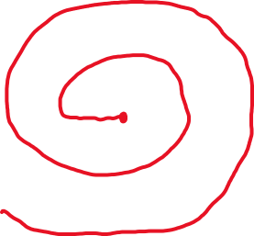
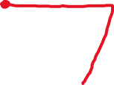
Traversing a graph
Breadth first search
Depth first search

Slide 15
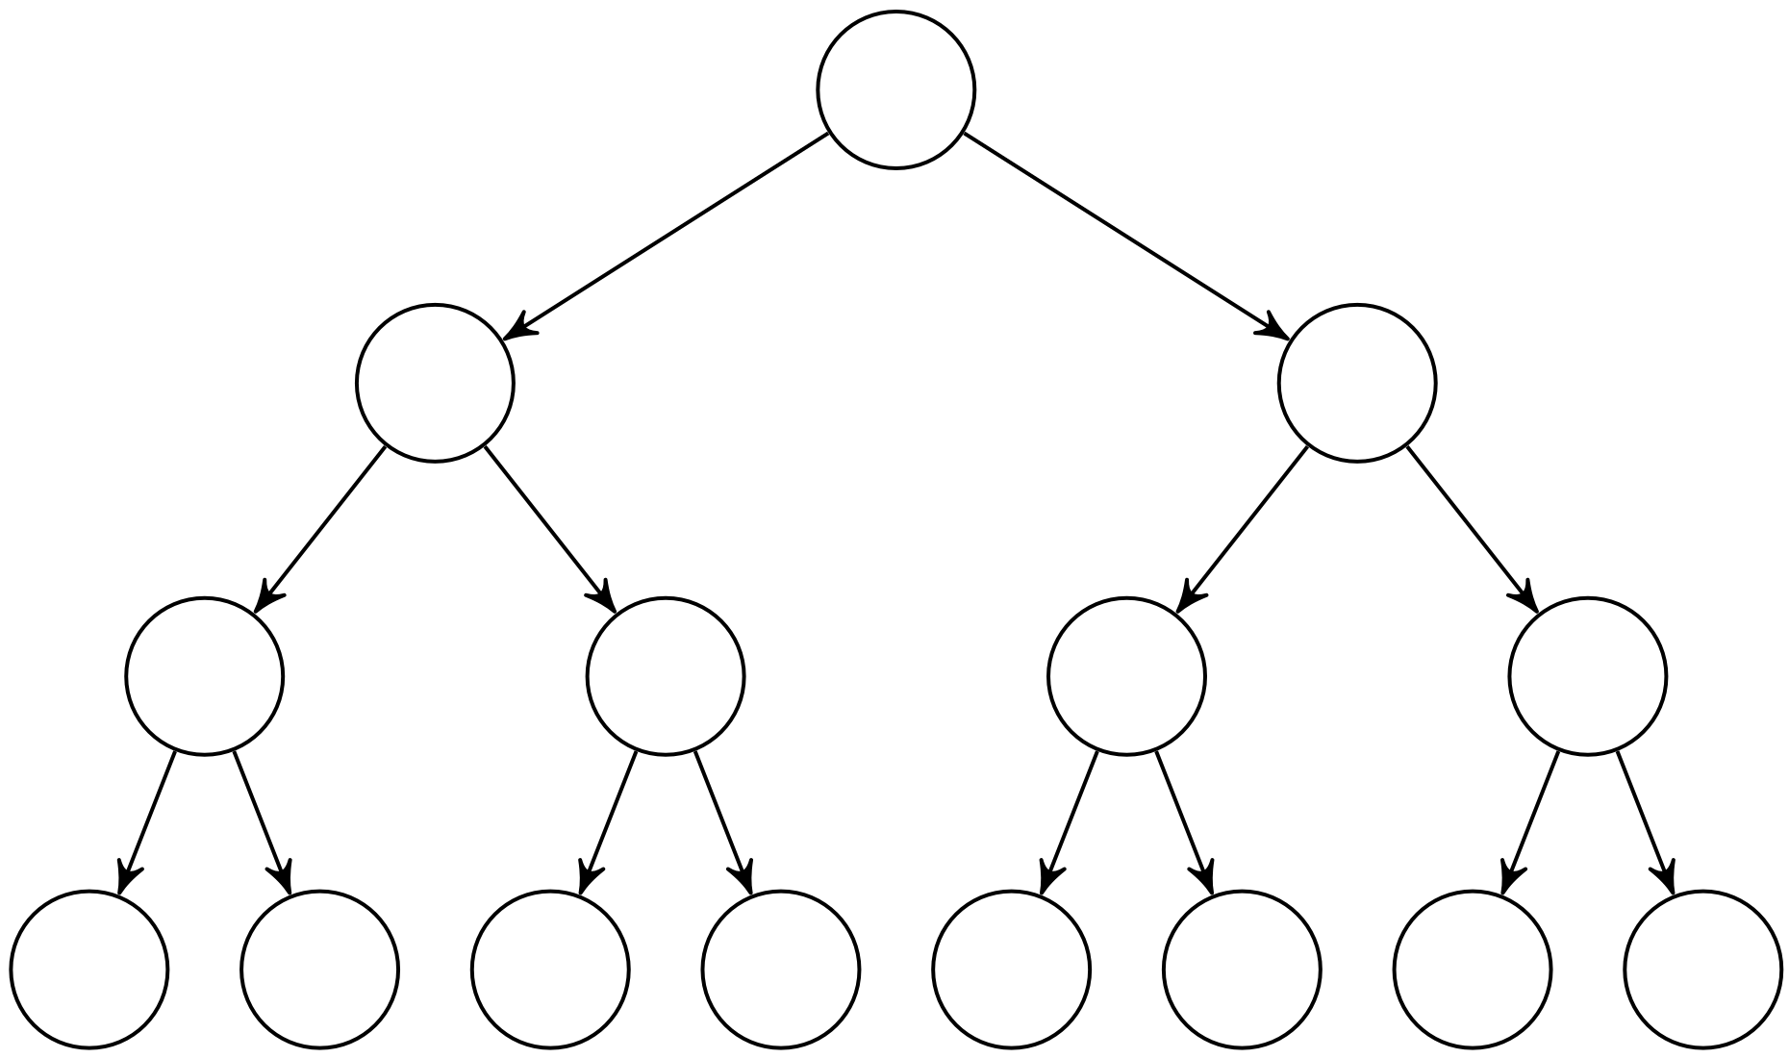
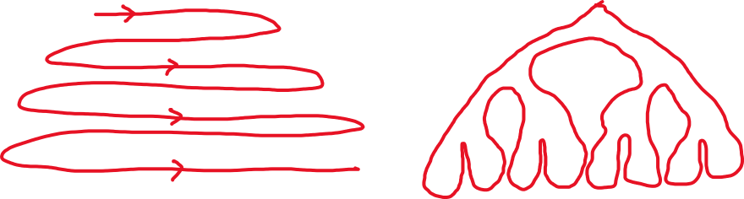
BFS and DFS on Trees
Breadth first search
(Level order traversal)
Depth first search
(pre-order, in-order, post-order traversals)

Slide 16
Breadth First Search
search(graph)
toVisit.enqueue(first vertex)
mark first vertex as visited
while(toVisit is not empty)
current = toVisit.dequeue()
for (V : current.neighbors())
if (v is not visited)
toVisit.enqueue(v)
mark v as visited
finished.add(current)
F
J
G
D
A
I
H
E
B
H
Current node:
Queue:
Finished:
I
A
E
D
B
G
F
C
G
C
B
D
E
C
F
G
H
I
A
B
D
E
C
F
G
H
I

Slide 17
Breadth First Search Analysis
search(graph)
toVisit.enqueue(first vertex)
mark first vertex as visited
while(toVisit is not empty)
current = toVisit.dequeue()
for (V : current.neighbors())
if (v is not visited)
toVisit.enqueue(v)
mark v as visited
finished.add(current)
F
J
G
D
A
I
H
E
B
A
B
D
E
C
F
G
H
I
Visited:
C
How many times do you visit each node?
How many times do you traverse each edge?
1 time each
Max 2 times each
Putting them into toVisit
Checking if they’re visited
Runtime?
O(V + 2E) = O(V + E)
“graph linear”

Slide 18
Depth First Search (DFS)
BFS uses a queue to order which vertex we move to next
Gives us a growing “frontier” movement across graph
Can you move in a different pattern? Can you use a different data structure?
What if you used a stack instead?
bfs(graph)
toVisit.enqueue(first vertex)
mark first vertex as visited
while(toVisit is not empty)
current = toVisit.dequeue()
for (V : current.neighbors())
if (v is not visited)
toVisit.enqueue(v)
mark v as visited
finished.add(current)
dfs(graph)
toVisit.push(first vertex)
mark first vertex as visited
while(toVisit is not empty)
current = toVisit.pop()
for (V : current.neighbors())
if (V is not visited)
toVisit.push(v)
mark v as visited
finished.add(current)

Slide 19
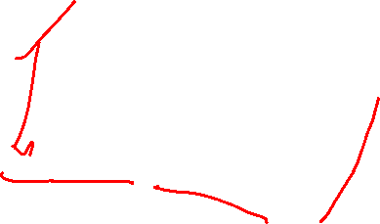
Depth First Search
dfs(graph)
toVisit.push(first vertex)
mark first vertex as visited
while(toVisit is not empty)
current = toVisit.pop()
for (V : current.neighbors())
if (V is not visited)
toVisit.push(v)
mark v as visited
finished.add(current)
F
J
G
D
A
I
H
E
Current node:
Stack:
Finished:
G
B
A
B
H
F
E
D
C
I
D
C
C
B
E
I
H
G
F
A
B
E
H
G
F
I
C
D
How many times do you visit each node?
How many times do you traverse each edge?
1 time each
Max 2 times each
Putting them into toVisit
Checking if they’re visited
Runtime?
O(V + 2E) = O(V + E)
“graph linear”

