Slide 1
Graphs
CSE 373: Data Structures and Algorithms
Autumn 2018
Shrirang (Shri) Mare
shri@cs.washington.edu
Thanks to Kasey Champion, Ben Jones, Adam Blank, Michael Lee, Evan McCarty, Robbie Weber, Whitaker Brand, Zora Fung, Stuart Reges, Justin Hsia, Ruth Anderson, and many others for sample slides and materials ...

Slide 2
Technique 3: Master Theorem
Given a recurrence of the following form:
$$d when n=1$$
$$T\left(n\right)=$$
$$aT\left(\frac{n}{b}\right)+n^{c} otherwise$$
Where $a$, $b$, and $c$ are constants, then $T(n)$ has the following asymptotic bounds
If
$$\log_{b}{a}<c$$
then
$$T\left(n\right)∈Θ\left(n^{c}\right)$$
If
$$\log_{b}{a}=c$$
then
$$T\left(n\right)∈Θ\left(n^{c}\log_{2}{n}\right)$$
If
$$\log_{b}{a}>c$$
then
$$T\left(n\right)∈Θ\left(n^{\log_{b}{a}}\right)$$

Slide 3
Recurrence analysis techniques
1. Unfolding method
more of a brute force method
Tedious but works
2. Tree methods
more scratch work but less error prone
3. Master theorem
quick, but applicable only to certain type of recurrences
does not give a closed form (gives big-Theta)

Slide 4
Desired properties in a sorting algorithm
Stable
In the output, equal elements (i.e., elements with equal keys) appear in their original order
In-place
Algorithm uses a constant additional space, $O(1)$ extra space
Adaptive
Performs better when input is almost sorted or nearly sorted
(Likely different big-O for best-case and worst-case)
Fast. $O (n\log{n)}$
No algorithm has all of these properties. So choice of algorithm depends on the situation.

Slide 5
Merge sort
0 | 1 | 2 | 3 | 4
8 | 2 | 57 | 91 | 22
0 | 1
8 | 2
0 | 1 | 2
57 | 91 | 22
Split array in the middle
Sort the two halves
Merge them together
0
8
0
2
0
57
0 | 1
91 | 22
0
91
0
22
0 | 1
22 | 91
$$T\left(n\right)=\left\{\begin{aligned}c_{1} if n≤1 \\ 2T\left(\frac{n}{2}\right)+c_{2}n otherwise\end{aligned}\right.$$
0 | 1
2 | 8
0 | 1 | 2
22 | 57 | 91
0 | 1 | 2 | 3 | 4
2 | 8 | 22 | 57 | 91

Slide 6
Quick Sort
0 | 1 | 2 | 3 | 4 | 5 | 6
20 | 50 | 70 | 10 | 60 | 40 | 30
0
10
0 | 1 | 2 | 3 | 4
50 | 70 | 60 | 40 | 30
quickSort(input) {
if (input.length == 1)
return
else
pivot = getPivot(input)
smallerHalf = quickSort(getSmaller(pivot, input))
largerHalf = quickSort(getBigger(pivot, input))
return smallerHalf + pivot + largerHalf
}
0 | 1
40 | 30
0 | 1
70 | 60
0
30
0
60
0 | 1
30 | 40
0 | 1
60 | 70
Worst case runtime?
Best case runtime?
Average runtime?
Stable?
In-place?
T(n) =
1 if n<= 1
n + T(n - 1) otherwise
0 | 1 | 2 | 3 | 4
30 | 40 | 50 | 60 | 70
T(n) =
1 if n<= 1
n + 2T(n/2) otherwise
0 | 1 | 2 | 3 | 4 | 5 | 6
10 | 20 | 30 | 40 | 50 | 60 | 70
No
Can be

Slide 7
Choosing a Pivot
Average case behavior depends on a good pivot.
Pivot ideas:
Just take the first element
Simple. But an already sorted (or reversed) list will give you a bad time.
Pick an element uniformly at random.
Regardless of input!
Probably too slow in practice :(
Median of Three
Take the median of the first, last, and midpoint as the pivot.
Fast!
Unlikely to get bad behavior (but definitely still possible)
Reasonable default choice.

Slide 8
Worksheet Questions 1-3

Slide 9
Parting thoughts on sorts
- Hybrid sorts
- Internal vs. external sorting

Slide 10
Graphs

Slide 11
Inter-data Relationships
Arrays
Categorically associated
Sometimes ordered
Typically independent
Elements only store pure data, no connection info
Trees
Directional Relationships
Ordered for easy access
Limited connections
Elements store data and connection info
Graphs
Multiple relationship connections
Relationships dictate structure
Connection freedom!
Both elements and connections can store data
0 | 1 | 2
A | B | C
A
B
B
C
C
A

Slide 12
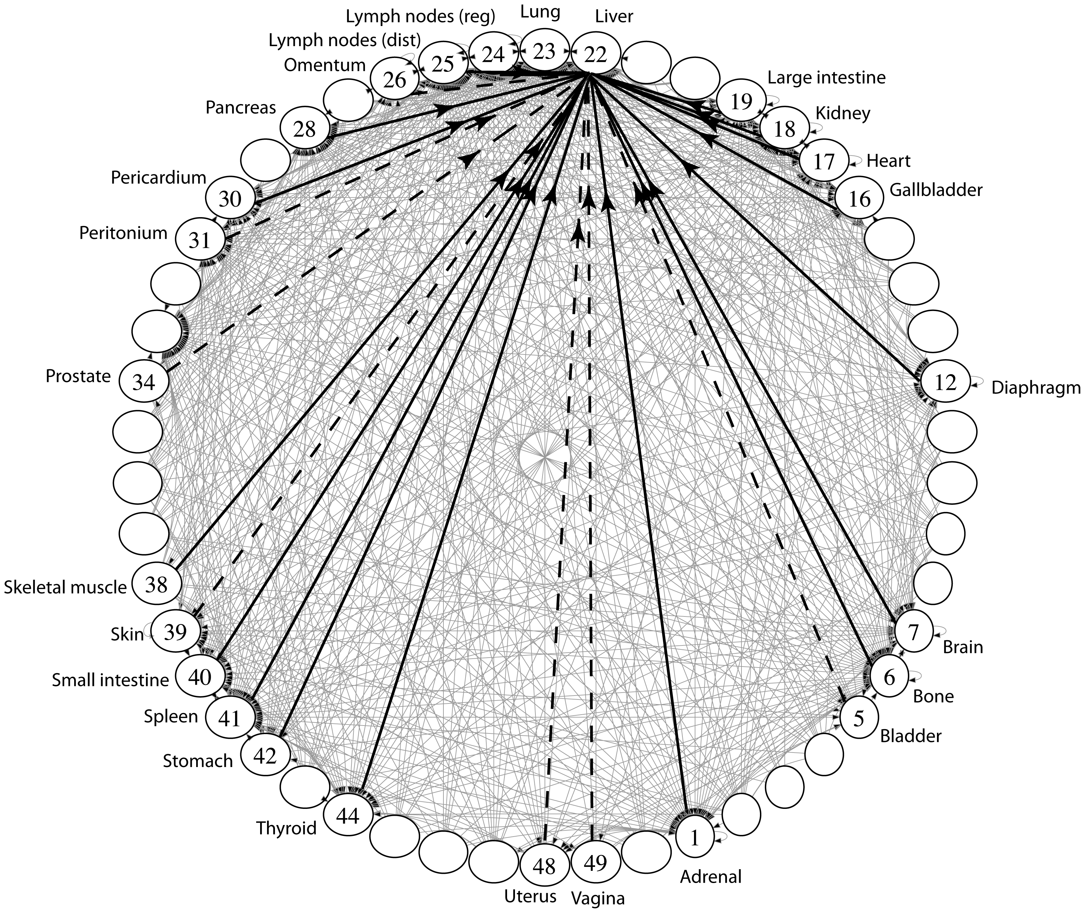
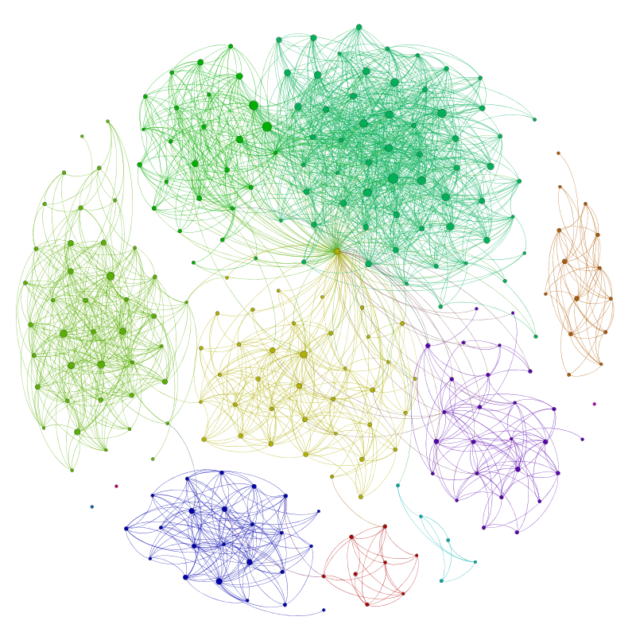
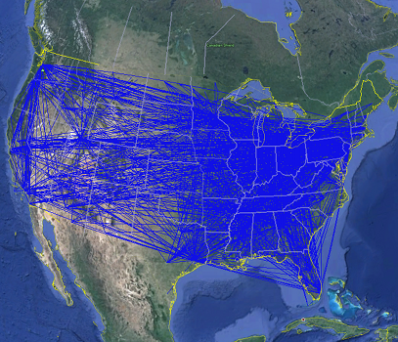
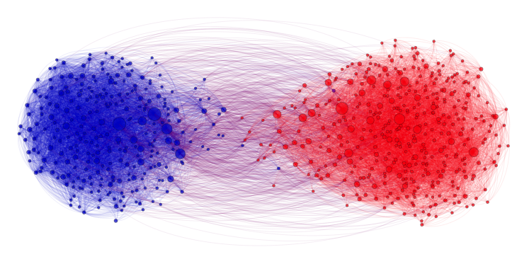
Applications
Physical Maps
Airline maps
Vertices are airports, edges are flight paths
Traffic
Vertices are addresses, edges are streets
Relationships
Social media graphs
Vertices are accounts, edges are follower relationships
Code bases
Vertices are classes, edges are usage
Influence
Biology
Vertices are cancer cell destinations, edges are migration paths
Related topics
Web Page Ranking
Vertices are web pages, edges are hyperlinks
Wikipedia
Vertices are articles, edges are links
SO MANY MORREEEE
www.allthingsgraphed.com

Slide 13
Graph Vocabulary
Undirected Graph:
Graph Direction
Undirected graph – edges have no direction and are two-way
Directed graphs – edges have direction and are thus one-way
Degree of a Vertex
Degree – the number of edges containing that vertex
A : 1, B : 1, C : 1
In-degree – the number of directed edges that point to a vertex
A : 0, B : 2, C : 1
Out-degree – the number of directed edges that start at a vertex
A : 1, B : 1, C : 1
A
B
V = { A, B, C }
E = { (A, B), (B, C) } inferred (B, A) and (C,B)
Undirected Graph:
C
V = { A, B, C }
B
E = { (A, B), (B, C), (C, B) }
A
C

Slide 14
Food for thought
Is a graph valid if there exists a vertex with a degree of 0?
Yes
B
B
B
A
A
A
C
C
C
A has an “in degree” of 0
B has an “out degree” of 0
C has both an “in degree” and an “out degree” of 0
Are these valid?
Is this a valid graph?
Yup
A
B
A
B
C
A
Yes!
Sure
D
C

Slide 15
Graph Vocabulary
Self loop – an edge that starts and ends at the same vertex
Parallel edges – two edges with the same start and end vertices
Simple graph – a graph with no self-loops and no parallel edges
A
A
B

Slide 16
Graph Vocabulary
Walk – A sequence of adjacent vertices. Each connected to next by an edge.
(Directed) Walk–must follow the direction of the edges
Length – The number of edges in a walk
- (A,B,C,D) has length 3.
A,B,C,D is a walk.
So is A,B,A
A
B
C
D
A
B
C
D
A,B,C,D,B is a directed walk.
A,B,A is not.
Notes:
Terminology here varies by source. This is what the textbook uses – some people use walk instead of path’ and reserve path for what we called a simple path.

Slide 17
Graph Vocabulary
Path – A walk that doesn’t repeat a vertex. A,B,C,D is a path. A,B,A is not.
Cycle – path with an extra edge from last vertex back to first.
Be careful looking at other sources.
Some people call our “walks” “paths” and our “paths” “simple paths”
Use the definitions on these slides.
A
B
C
D
A
B
C
D
Notes:
Terminology here varies by source. This is what the textbook uses – some people use walk instead of path’ and reserve path for what we called a simple path.

Slide 18
Worksheet Question 4

Slide 19
Implementing a Graph
Implement with nodes…
Implementation gets super messy
What if you wanted a vertex without an edge?
How can we implement without requiring edges to access nodes?
Implement using some of our existing data structures!

Slide 20
Adjacency Matrix
 | A | B | C | D
A |  | T | T
B
C |  | T |  | T
D | T
Assign each vertex a number from 0 to V – 1
Create a V x V array of Booleans
If (x,y) $∈$ E then arr[x][y] = true
Runtime (in terms of V and E)
get out - edges for a vertex O(v)
get in – edges for a vertex O(v)
decide if an edge exists O(1)
insert an edge O(1)
delete an edge O(1)
delete a vertex
add a vertex
How much space is used?
V²
B
A
C
D

Slide 21
Graph Vocabulary
A
B
Dense Graph – a graph with a lot of edges
E $∈$ Θ(V²)
Sparse Graph – a graph with “few” edges
E $∈$ Θ(V)
An Adjacency Matrix seems a waste for a sparse graph…
C
D
E
F
G
I
H

Slide 22
Adjacency List
B
A
Create a Dictionary of size V from type V to Collection of E
If (x,y) $∈$ E then add y to the set associated with the key x
Runtime (in terms of V and E)
get out - edges for a vertex O(1)
get in - edges for a vertex O(V + E)
decide if an edge exists O(1)
insert an edge O(1)
delete an edge O(1)
delete a vertex
add a vertex
How much space is used?
V + E
C
D
0
1
2
3
A
B
C
B
C
B
D
D
A

Slide 23
Graph Vocabulary -- Connected Graphs
Connected graph – a graph where every vertex is connected to every other vertex via some path. It is not required for every vertex to have an edge to every other vertex
There exists some way to get from each vertex to every other vertex
Connected Component – a subgraph in which any two vertices are connected via some path, but is connected to no additional vertices in the supergraph
There exists some way to get from each vertex within the connected component to every other vertex in the connected component
A vertex with no edges is itself a connected component
B
C
A
G
H
D
F
E

