Slide 1
Sorting and recurrence analysis techniques
CSE 373: Data Structures and Algorithms
Autumn 2018
Shrirang (Shri) Mare
shri@cs.washington.edu
Thanks to Kasey Champion, Ben Jones, Adam Blank, Michael Lee, Evan McCarty, Robbie Weber, Whitaker Brand, Zora Fung, Stuart Reges, Justin Hsia, Ruth Anderson, and many others for sample slides and materials ...

Slide 2
Sorting problem statement
Given n comparable elements, rearrange them in an increasing order.
Input
An array $A$ that contains n elements
Each element has a key $k$ and an associated data
Keys support a comparison function (e.g., keys implement a Comparable interface)
Expected output
An output array $A$ such that for any $i$ and $j$,
$A[i] ≤ A[j]$ if $i < j$ (increasing order)
Array $A$ can also have elements in reverse order (decreasing order)

Slide 3
Desired properties in a sorting algorithm
Stable
In the output, equal elements (i.e., elements with equal keys) appear in their original order
In-place
Algorithm uses a constant additional space, $O(1)$ extra space
Adaptive
Performs better when input is almost sorted or nearly sorted
(Likely different big-O for best-case and worst-case)
Fast. $O (n\log{n)}$
No algorithm has all of these properties. So choice of algorithm depends on the situation.

Slide 4
Sorting algorithms – High-level view
- $O\left(n^{2}\right)$
Insertion sort
Selection sort
Quick sort (worst)
- $O(n\log{n)}$
Merge sort
Heap sort
Quick sort (avg)
- $Ω(n\log{n)}$ -- lower bound on comparison sorts
- $O(n)$ – non-comparison sorts
Bucket sort (avg)

Slide 5
A framework to think about sorting algos
Some questions to consider when analyzing a sorting algorithm.
What is the state of the data during each step while sorting
Yes/No/Can-be
Yes/No/Can-be
Yes/No
> or < or approx. equal
Which data structure is better suited for this algo

Slide 6
Insertion sort
Visualization: https://visualgo.net/en/sorting
Idea: At step $i$, insert the $i^{th}$ element in the correct position among the first $i$ elements.

Slide 7
Selection sort
Visualization: https://visualgo.net/en/sorting
Idea: At step $i$, find the smallest element among the not-yet-sorted elements ($i … n$) and swap it with the element at $i$.

Slide 8
Heap sort
Idea:

Slide 9
In-place heap sort
Idea:
1. Treat initial array as a heap
2. When you call removeMin(), that frees up a slot towards the end in the array. Put the extract min element there.
3. More specifically, when you remove the $i^{th}$ element, put it at $A\left[n−i\right]$
4. This gives you a reverse sorted array. But easy to fix in-place.

Slide 10
Design technique: Divide-and-conquer
Very important technique in algorithm to attack problems
Three steps:
1. Divide: Split the original problem into smaller parts
2. Conquer: Solve individual parts independently (think recursion)
3. Combine: Put together individual solved parts to produce an overall solution
Merge sort and Quick sort are classic examples of sorting algorithms that use this technique

Slide 11
Merge sort
Visualization: https://visualgo.net/en/sorting
To sort a given array,
Divide: Split the input array into two halves
Conquer: Sort each half independently
Combine: Merge the two sorted halves into one sorted whole (HW3 Problem 6!)

Slide 12
Merge sort
0 | 1 | 2 | 3 | 4
8 | 2 | 57 | 91 | 22
0 | 1
8 | 2
0 | 1 | 2
57 | 91 | 22
Split array in the middle
Sort the two halves
Merge them together
0
8
0
2
0
57
0 | 1
91 | 22
0
91
0
22
0 | 1
22 | 91
$$T\left(n\right)=\left\{\begin{aligned}c_{1} if n≤1 \\ 2T\left(\frac{n}{2}\right)+c_{2}n otherwise\end{aligned}\right.$$
0 | 1
2 | 8
0 | 1 | 2
22 | 57 | 91
0 | 1 | 2 | 3 | 4
2 | 8 | 22 | 57 | 91

Slide 13
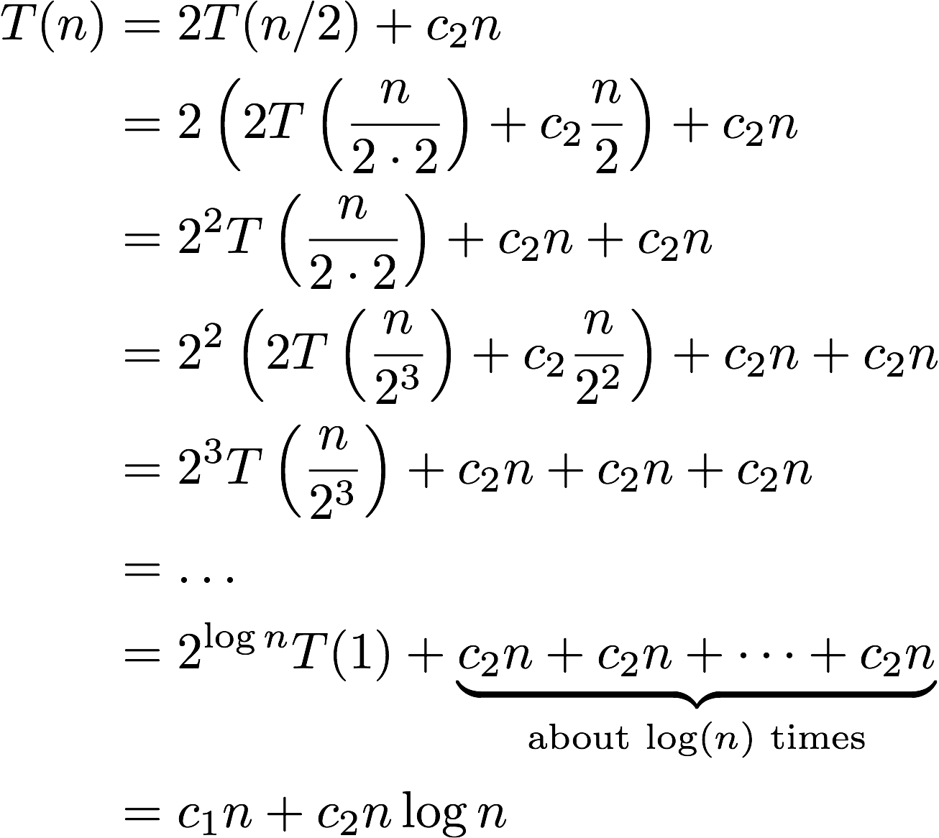
Review: Unfolding (technique 1)
$$T\left(n\right)=\left\{\begin{aligned}c_{1} if n≤1 \\ 2T\left(\frac{n}{2}\right)+c_{2}n otherwise\end{aligned}\right.$$

Slide 14
Technique 2: Tree method
Level | Number of Nodes at level | Work per Node | Work per Level
0
1
2
$$i$$
base
Last recursive level:

Slide 15
Technique 2: Tree method
Level | Number of Nodes at level | Work per Node | Work per Level
0
1
2
$$i$$
base
Last recursive level:

Slide 16
Technique 2: Tree method
Level | Number of Nodes at level | Work per Node | Work per Level
0
1
2
$$i$$
base
Last recursive level:

Slide 17
Technique 2: Tree method
Level | Number of Nodes at level | Work per Node | Work per Level
0
1
2
$$i$$
base
Last recursive level:

Slide 18
Technique 2: Tree method
Level | Number of Nodes at level | Work per Node | Work per Level
0
1
2
$$i$$
base
Last recursive level:

Slide 19
Technique 2: Tree method
Level | Number of Nodes at level | Work per Node | Work per Level
0 | 1 | $$n$$ | $$n$$
1 | 2 | $$\frac{n}{2}$$ | $$n$$
2 | 4 | $$\frac{n}{4}$$ | $$n$$
$$i$$ | $$2^{i}$$ | $$\frac{n}{2^{i}}$$ | $$n$$
base | $$2^{log2n}$$ | 1 | $$n$$
Last recursive level: $\log{n} −1$
Combining it all together…
$$T\left(n\right)=n+\sum_{i=0}^{\log_{2}{n −1}}{n =n+n\log{n}}$$

Slide 20
Tree Method Practice
Level (i) | Number of Nodes | Work per Node | Work per Level
0 | 1
1
2
$$i$$
base
$$4 when n≤1$$
$$T\left(n\right)=$$
$$3T\left(\frac{n}{4}\right)+cn^{2} otherwise$$
$$T\left(\frac{n}{4}\right)+T\left(\frac{n}{4}\right)+T\left(\frac{n}{4}\right)+cn^{2}$$
$$cn^{2}$$
$$c{\left(\frac{n}{4}\right)}^{2}$$
$$T\left(\frac{n}{4}\right)$$
$$T\left(\frac{n}{4}\right)$$
$$c{\left(\frac{n}{4}\right)}^{2}$$
$$c{\left(\frac{n}{4}\right)}^{2}$$
$$T\left(\frac{n}{4}\right)$$
$$c{\left(\frac{n}{16}\right)}^{2}$$
$$c{\left(\frac{n}{16}\right)}^{2}$$
$$c{\left(\frac{n}{16}\right)}^{2}$$
$$c{\left(\frac{n}{16}\right)}^{2}$$
$$c{\left(\frac{n}{16}\right)}^{2}$$
$$c{\left(\frac{n}{16}\right)}^{2}$$
$$c{\left(\frac{n}{16}\right)}^{2}$$
$$c{\left(\frac{n}{16}\right)}^{2}$$
$$c{\left(\frac{n}{16}\right)}^{2}$$
…
…
…
…
…
…
…
…
…
…
…
…
…
…
…
…
…
…
…
…
…
…
…
…
…
…
…
4
4
4
4
4
4
4
4
4
4
4
4
4
4
4
4
4
4
4
4
4
4
4
4
4
4
4

Slide 21
Tree Method Practice
Level (i) | Number of Nodes | Work per Node | Work per Level
0 | 1 | $$cn2$$ | $$cn2$$
1 | 3 | $$c{\left(\frac{n}{4}\right)}^{2}$$ | $$\frac{3}{16}cn^{2}$$
2 | 9 | $$c{\left(\frac{n}{16}\right)}^{2}$$ | $$\frac{9}{256}cn^{2}$$
$$i$$ | $$3^{i}$$ | $$c{\left(\frac{n}{4^{i}}\right)}^{2}$$ | $${\left(\frac{3}{16}\right)}^{i}cn^{2}$$
base | $$3^{log4n}$$ | 4 | $${4∙3}^{log4n}$$
$$4 when n≤1$$
$$T\left(n\right)=$$
$$3T\left(\frac{n}{4}\right)+cn^{2} otherwise$$
$$T\left(\frac{n}{4}\right)+T\left(\frac{n}{4}\right)+T\left(\frac{n}{4}\right)+cn^{2}$$
$$cn^{2}$$
$$c{\left(\frac{n}{4}\right)}^{2}$$
$$T\left(\frac{n}{4}\right)$$
$$T\left(\frac{n}{4}\right)$$
$$c{\left(\frac{n}{4}\right)}^{2}$$
$$c{\left(\frac{n}{4}\right)}^{2}$$
$$T\left(\frac{n}{4}\right)$$
Last recursive level: $\log_{4}{n −1}$
$$c{\left(\frac{n}{16}\right)}^{2}$$
$$c{\left(\frac{n}{16}\right)}^{2}$$
Combining it all together…
$$c{\left(\frac{n}{16}\right)}^{2}$$
$$c{\left(\frac{n}{16}\right)}^{2}$$
$$c{\left(\frac{n}{16}\right)}^{2}$$
$$c{\left(\frac{n}{16}\right)}^{2}$$
$$c{\left(\frac{n}{16}\right)}^{2}$$
$$c{\left(\frac{n}{16}\right)}^{2}$$
$$c{\left(\frac{n}{16}\right)}^{2}$$
$$T\left(n\right)={4 n}^{log43}+\sum_{i=0}^{\log_{4}{n −1}}{{\left(\frac{3}{16}\right)}^{i}cn^{2} }$$
…
…
…
…
…
…
…
…
…
…
…
…
…
…
…
…
…
…
…
…
…
…
…
…
…
…
…
4
4
4
4
4
4
4
4
4
4
4
4
4
4
4
4
4
4
4
4
4
4
4
4
4
4
4

Slide 22
Technique 3: Master Theorem
Given a recurrence of the following form:
$$d when n=1$$
$$T\left(n\right)=$$
$$aT\left(\frac{n}{b}\right)+n^{c} otherwise$$
Where $a$, $b$, and $c$ are constants, then $T(n)$ has the following asymptotic bounds
If
$$\log_{b}{a}<c$$
then
$$T\left(n\right)∈Θ\left(n^{c}\right)$$
If
$$\log_{b}{a}=c$$
then
$$T\left(n\right)∈Θ\left(n^{c}\log_{2}{n}\right)$$
If
$$\log_{b}{a}>c$$
then
$$T\left(n\right)∈Θ\left(n^{\log_{b}{a}}\right)$$

Slide 23
Apply Master Theorem
Given a recurrence of the form:
$$d when n=1$$
$$T\left(n\right)=$$
a = 2
b = 2
c = 1
d = 1
$$aT\left(\frac{n}{b}\right)+n^{c} otherwise$$
$$1 when n≤1$$
$$T\left(n\right)=$$
$$2T\left(\frac{n}{2}\right)+n otherwise$$
If
$$\log_{b}{a}<c$$
then
$$T\left(n\right)∈Θ\left(n^{c}\right)$$
If
$$\log_{b}{a}=c$$
then
$$T\left(n\right)∈Θ\left(n^{c}\log_{2}{n}\right)$$
If
$$\log_{b}{a}>c$$
then
$$T\left(n\right)∈Θ\left(n^{\log_{b}{a}}\right)$$
$\log_{b}{a}=c$ ${⇒ log}_{2}{2}=1$
$$T\left(n\right)∈Θ\left(n^{c}\log_{2}{n}\right)⇒Θ\left(n^{1}\log_{2}{n}\right)$$

Slide 24
Reflecting on Master Theorem
The case
Recursive case conquers work more quickly than it divides work
Most work happens near “top” of tree
Non recursive work in recursive case dominates growth, n^{c} term
The case
Work is equally distributed across call stack (throughout the “tree”)
Overall work is approximately work at top level x height
The case
Recursive case divides work faster than it conquers work
Most work happens near “bottom” of tree
Leaf work dominates branch work
Given a recurrence of the form:
$$\log_{b}{a}<c$$
$$d when n=1$$
$$T\left(n\right)=$$
$$aT\left(\frac{n}{b}\right)+n^{c} otherwise$$
If
$$\log_{b}{a}<c$$
then
$$T\left(n\right)∈Θ\left(n^{c}\right)$$
If
$$\log_{b}{a}=c$$
then
$$T\left(n\right)∈Θ\left(n^{c}\log_{2}{n}\right)$$
$$\log_{b}{a}=c$$
If
$$\log_{b}{a}>c$$
then
$$T\left(n\right)∈Θ\left(n^{\log_{b}{a}}\right)$$
$$height ≈\log_{b}{a}$$
$$\log_{b}{a}>c$$
$$branchWork ≈n^{c}\log_{b}{a}$$
$$leafWork ≈d\left(n^{\log_{b}{a}}\right)$$

Slide 25
Recurrence analysis techniques
1. Unfolding method
more of a brute force method
Tedious but works
2. Tree methods
more scratch work but less error prone
3. Master theorem
quick, but applicable only to certain type of recurrences
does not give a closed form (gives big-Theta)

