Slide 1
Hash Tables: Handling Collisions
CSE 373: Data Structures and Algorithms
Autumn 2018
Shrirang (Shri) Mare
shri@cs.washington.edu
Thanks to Kasey Champion, Ben Jones, Adam Blank, Michael Lee, Evan McCarty, Robbie Weber, Whitaker Brand, Zora Fung, Stuart Reges, Justin Hsia, Ruth Anderson, and many others for sample slides and materials ...

Slide 2
Announcements
- HW3 due Friday Noon
- Office hours for next week have changed. Please see the calendar for the correct info
- We made a mistake in a comment in HW4. We’ll push a commit to your repo to correct that. (So expect one more git commit from us.)

Slide 3
Today
- Review Hashing
- Separate Chaining
- Open addressing with linear probing
- Open addressing with quadratic probing

Slide 4
Problem (Motivation for hashing)
How can we implement a dictionary such that dictionary operations are efficient?
Idea 1: Create a giant array and use keys as indices.
(This approach is called direct-access table or direct-access map)
Two main problems:
1. Can only work with integer keys?
2. Too much wasted space
Idea 2: What if we
(a) convert any type of key into a non-negative integer key
(b) map the entire key space into a small set of keys (so we can use just the right size array)

Slide 5
Solution to problem 1: Can only work with integer keys?
Idea: Use functions that convert a non-integer key into a non-negative integer key

Slide 6
Solution to problem 1: Can only work with integer keys?
Idea: Use functions that convert a non-integer key into a non-negative integer key
Everything is stored as bits in memory and can be represented as an integer.
But the representation can be much simpler (nothing to do with memory).
For example (just for illustration; this is not how strings, images, and videos are hashed in practice):
  Strings can be represented with number of characters in the string, ascii value of the first char, last char
  Image can be represented with resolution, size of image, value of the 5th pixel in the image, 100th pixel
  Similarly, video can be represented resolution, size, frame rate, size of the 10th frame

Slide 7
Solution to problem 1: Can only work with integer keys?
Idea: Use functions that convert a non-integer key into a non-negative integer key
Everything is stored as bits in memory and can be represented as an integer.
But the representation can be much simpler (nothing to do with memory).
For example (just for illustration; this is not how strings, images, and videos are hashed in practice):
  Strings can be represented with number of characters in the string, ascii value of the first char, last char
  Image can be represented with resolution, size of image, value of the 5th pixel in the image, 100th pixel
  Similarly, video can be represented resolution, size, frame rate, size of the 10th frame
  Question: What are some good strategies to pick a hash function? (This is important)
  Quick: Computing hash should be quick (constant time).
  Deterministic: Hash value of a key should be the same hash table.
  Random: A good hash function should distribute the keys uniformly into the slots in the table.

Slide 8
Solution to problem 2: Too much wasted space
Idea: Map the entire key space into a small set of keys (so we can use just the right sized array)

Slide 9
Solution to problem 2: Too much wasted space
Idea: Map the entire key space into a small set of keys (so we can use just the right sized array)

Slide 10
Review: The “modulus” (mod) operation
Examples:
1 % 10 = 1
11 % 10 = 1
10 % 10 = 0
5746 % 10 = 6
71 % 7 = 1
The “modulus” (mod) operation
The modulus (or mod) operation gives the remainder of a division of one number by another. Written as x mod n or x % n.
For more review/practice, check out https://www.khanacademy.org/computing/computer-science/cryptography/modarithmetic/a/what-is-modular-arithmetic

Slide 11
Review: The “modulus” (mod) operation
Examples:
1 % 10 = 1
11 % 10 = 1
10 % 10 = 0
5746 % 10 = 6
71 % 7 = 1
The “modulus” (mod) operation
The modulus (or mod) operation gives the remainder of a division of one number by another. Written as x mod n or x % n.
Common applications of the mod operation:
- finding last digit ( % 10)
- whether a number is odd/even (% 2)
- wrap around behavior (% wrap limit)
The application we are interested in is the wrap around behavior.
It lets us map any large integer into an index in our array of size m (using % m)
For more review/practice, check out https://www.khanacademy.org/computing/computer-science/cryptography/modarithmetic/a/what-is-modular-arithmetic

Slide 12
Implementing a simple hash table (assume no collisions)
public V get(int key) {
return this.array[key].value;
}
public void put(int key, V value) {
this.array[key] = value;
}
public void remove(int key) {
this.array[key] = null;
}

Slide 13
Implementing a simple hash table (assume no collisions)
public V get(int key) {
key = getHash(key)
return this.array[key].value;
}
public void put(int key, V value) {
key = getHash(key)
this.array[key] = value;
}
public void remove(int key) {
key = getHash(key)
this.array[key] = null;
}
public int getHash(int a) {
return a % this.array.length;
}

Slide 14
Our simple hash table: insert (1000)

Slide 15
Our simple hash table: insert (1000)
Hash collision
Some other value
exists in slot at index 0

Slide 16
Hash collision
What is a hash collision?
It’s a case when two different keys have the same hash value.
Mathematically, h(k1) = h(k2) when k1 ≠ k2

Slide 17
Hash collision
What is a hash collision?
It’s a case when two different keys have the same hash value.
Mathematically, h(k1) = h(k2) when k1 ≠ k2
Why is this a problem?
- We put keys in slots determined by the hash function. That is, we put k1 at index h(k1),
- A collision means the natural choice slot is taken
- We cannot replace k1 with k2 (because the keys are different)
- So the problem is where do we put k2?

Slide 18
Strategies to handle hash collision

Slide 19
Strategies to handle hash collision
There are multiple strategies. In this class, we’ll cover the following three:
1. Separate chaining
2. Open addressing
  Linear probing
  Quadratic probing
3. Double hashing

Slide 20
Separate chaining
- Separate chaining is a collision resolution strategy where collisions are resolved by storing all colliding keys in the same slot (using linked list or some other data structure)
- Each slot stores a pointer to another data structure (usually a linked list or an AVL tree)
put(21, value21)
put(44, value44)
Note: For simplicity, the table shows only keys, but in each slot/node both, key and value, are stored.

Slide 21
Separate chaining
- Separate chaining is a collision resolution strategy where collisions are resolved by storing all colliding keys in the same slot (using linked list or some other data structure)
- Each slot stores a pointer to another data structure (usually a linked list or an AVL tree)
put(21, value21)
put(44, value44)
Note: For simplicity, the table shows only keys, but in each slot/node both, key and value, are stored.

Slide 22
Separate chaining: Running Times
What are the running times for:
insert
Best:
Worst:
find
Best:
Worst:
delete
Best:
  Worst:

Slide 23

Separate chaining: Running Times
What are the running times for:
insert
Best: $O(1)$
Worst: $O(n)$ (if insertions are always at the end of the linked list)
find
Best: $O(1)$
Worst: $O(n)$
delete
Best: $O(1)$
  Worst: $O(n)$

Slide 24
Load Factor
Load Factor (λ)
Ratio of number of entries in the table to table size.
If n is the total number of (key, value) pairs stored in the table and c is capacity of the table (i.e., array),
Load factor

Slide 25
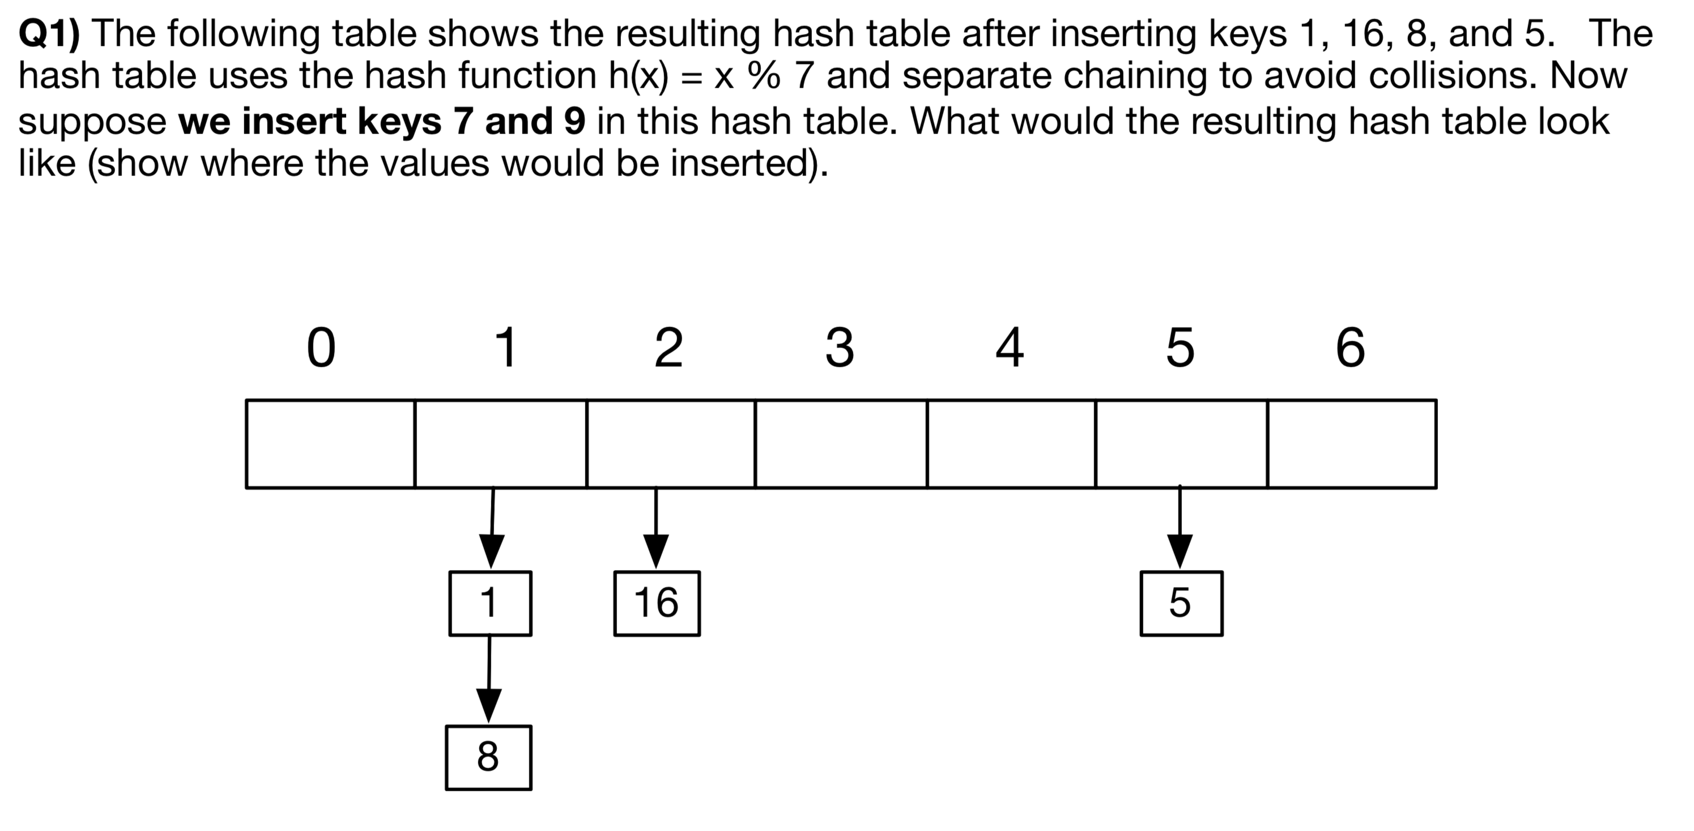
Worksheet Q1-Q3

Slide 26
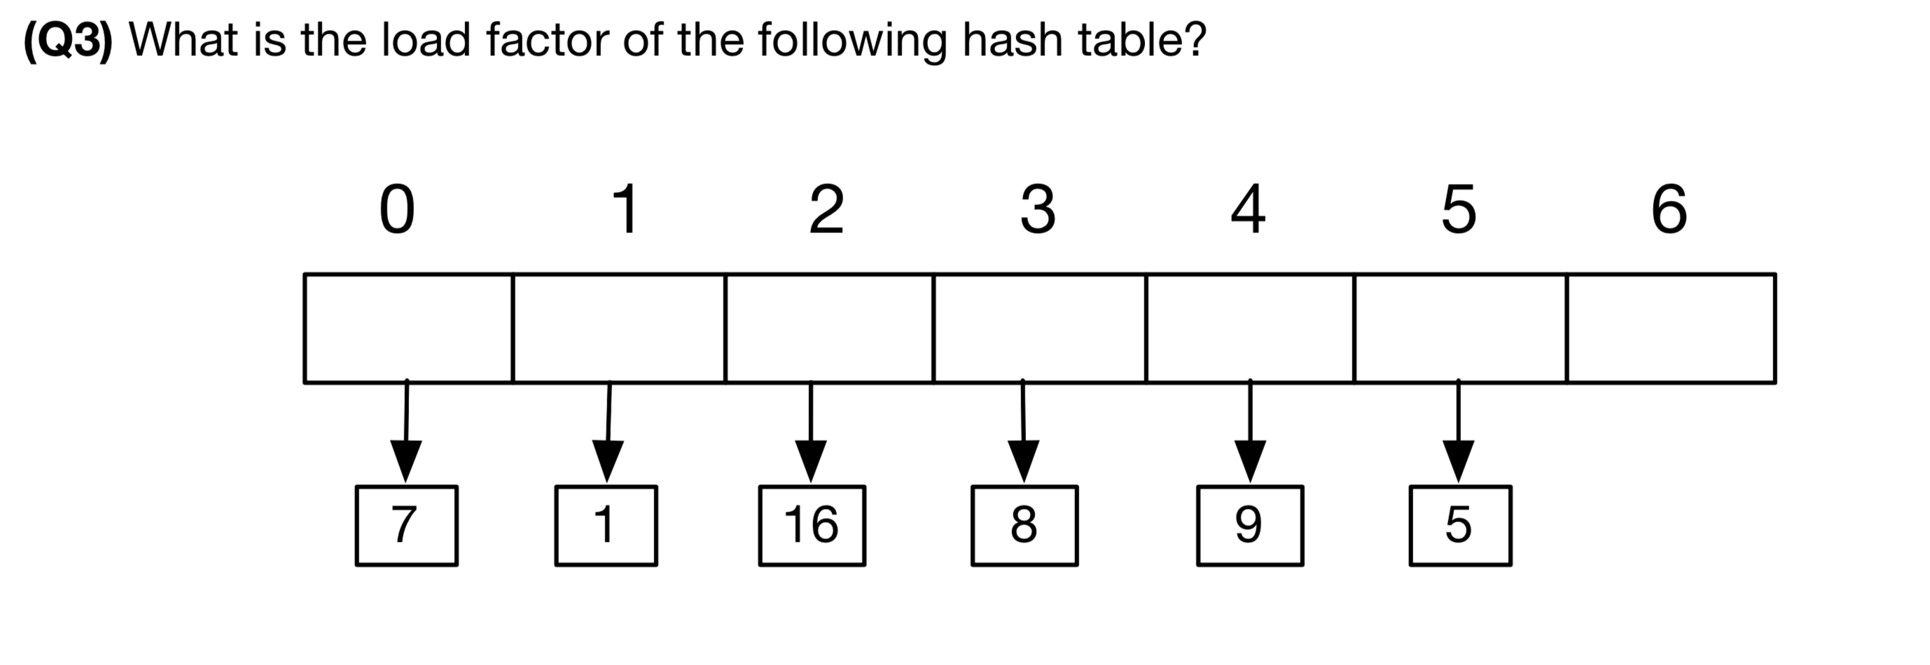
Worksheet Q3

Slide 27
Open Addressing
- Open addressing is a collision resolution strategy where collisions are resolved by storing the colliding key in a different location when the natural choice is full.

Slide 28
Open Addressing
- Open addressing is a collision resolution strategy where collisions are resolved by storing the colliding key in a different location when the natural choice is full.
put(21, value21)
Note: For simplicity, the table shows only keys, but in each slot both, key and value, are stored.

Slide 29
Open Addressing: Linear probing
- Open addressing is a collision resolution strategy where collisions are resolved by storing the colliding key in a different location when the natural choice is full.
Linear probing
Index = hash(k) + 0 (if occupied, try next i)
= hash(k) + 1 (if occupied, try next i)
= hash(k) + 2 (if occupied, try next i)
= ..
= ..
= ..
put(21, value21)
Note: For simplicity, the table shows only keys, but in each slot both, key and value, are stored.

Slide 30
Open Addressing: Quadratic probing
- Open addressing is a collision resolution strategy where collisions are resolved by storing the colliding key in a different location when the natural choice is full.
Quadratic probing
Index = hash(k) + 0 (if occupied, try next i^2)
= hash(k) + 1^2 (if occupied, try next i^2)
= hash(k) + 2^2 (if occupied, try next i^2)
= hash(k) + 3^2 (if occupied, try next i^2)
= ..
= ..
put(21, value21)
Note: For simplicity, the table shows only keys, but in each slot both, key and value, are stored.

Slide 31
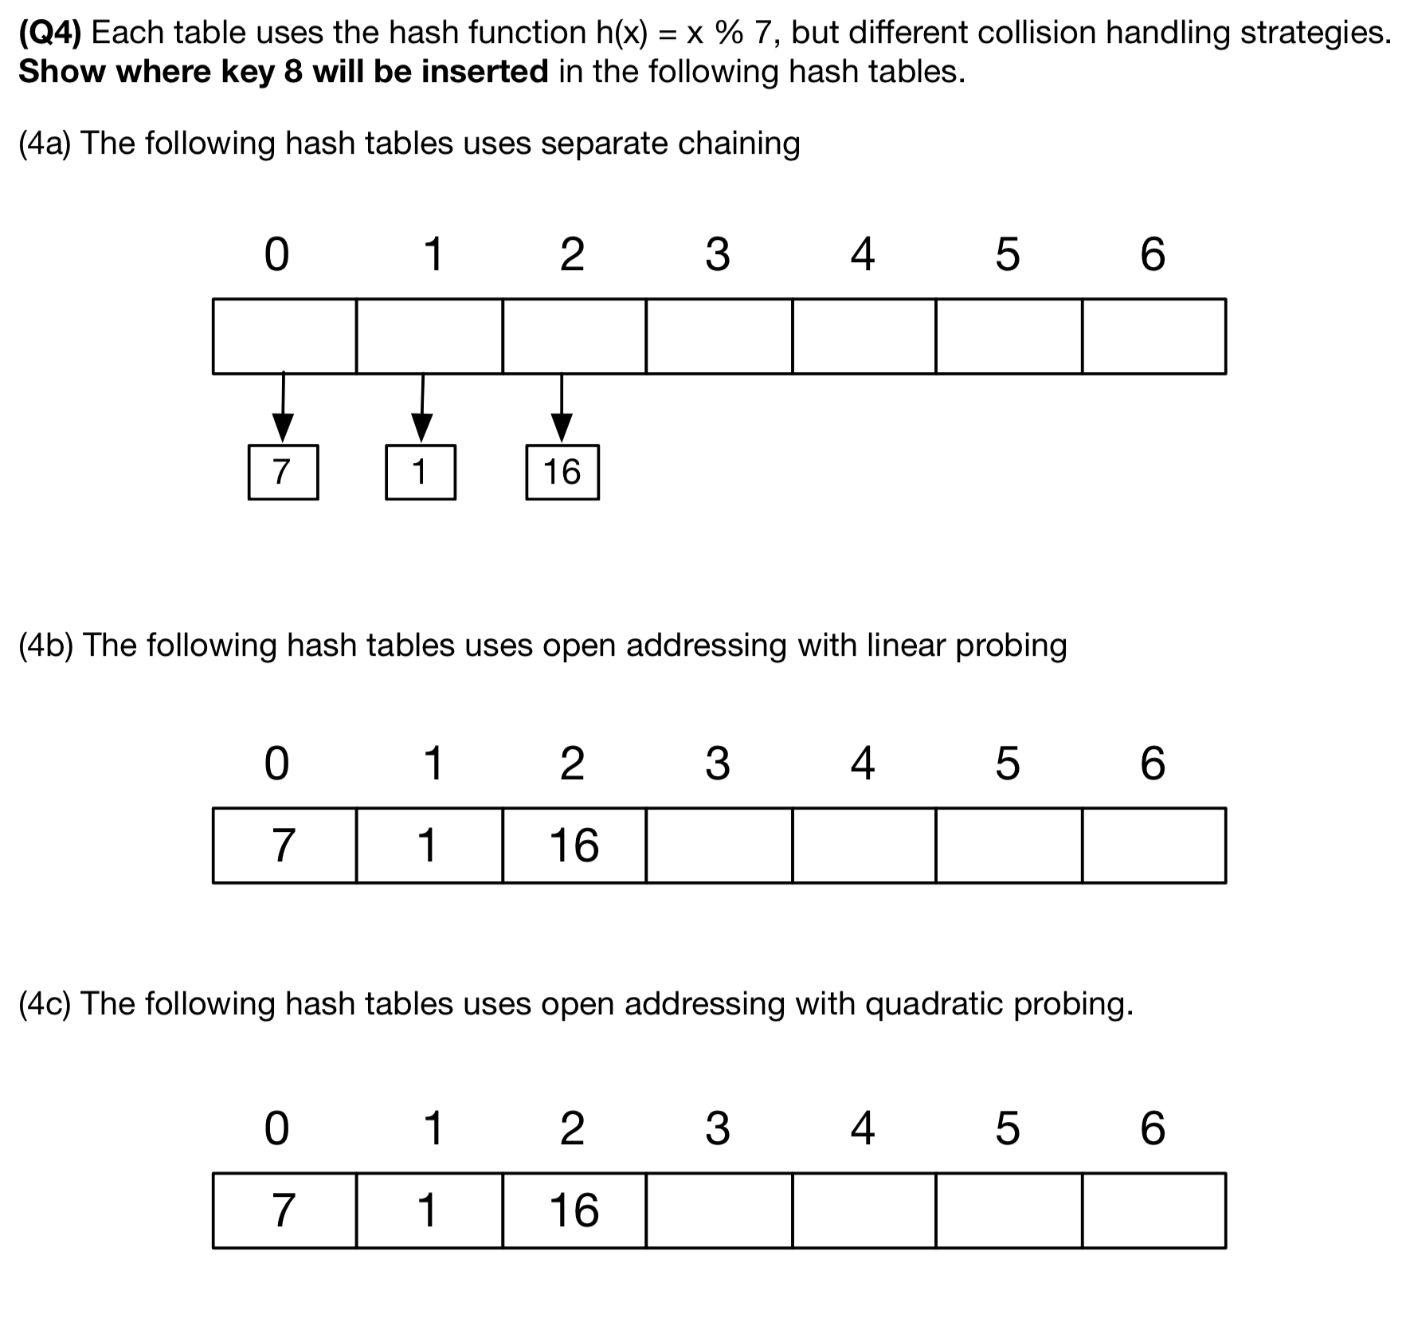
Worksheet Q4

Slide 32
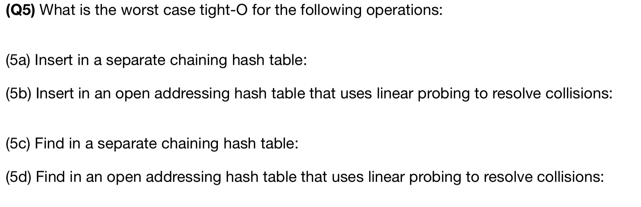
Worksheet Q5

