Slide 1
More on AVL Trees
CSE 373: Data Structures and Algorithms
Autumn 2018
Shrirang (Shri) Mare
shri@cs.washington.edu
Thanks to Kasey Champion, Ben Jones, Adam Blank, Michael Lee, Evan McCarty, Robbie Weber, Whitaker Brand, Zora Fung, Stuart Reges, Justin Hsia, Ruth Anderson, and many others for sample slides and materials ...

Slide 2
Quick (Anonymous) Feedback
Go to this URL https://tinyurl.com/373-feedback
1. In general, pace of class:
1 too fast
2 kind of fast
3 just right
4 kind of slow
5 Too slow
2. Please Keep doing this
3. Please Quit doing this
4. Please Start doing this

Slide 3
Outline
So far
BSTs are efficient for insert and remove operations, but in worst case they take linear time – O(n).
If we keep BSTs ‘balanced’, we can avoid the worst case.
We can easily maintain a balanced BSTs using the AVL balance condition
Today
Maintaining AVL balance condition
(Maybe) Intro to Hash tables

Slide 4
AVL trees: Balanced BSTs
AVL Trees must satisfy the following properties:
binary trees: every node must have between 0 and 2 children
binary search tree (BST property): for every node, all keys in the left subtree must be smaller and all keys in the right subtree must be larger than the root node
Balanced (AVL property): for every node, there can be no more than a difference of 1 in the height of the left subtree from the right. Math.abs(height(left subtree) – height(right subtree)) ≤ 1
AVL stands for Adelson-Velsky and Landis (the inventors of the data structure)
The AVL property:
1. ensures depth is always O(log n) – Yes!
2. is easy to maintain – Yes! (using single and double rotations)

Slide 5
Insertion
What happens if when we do an insert(3), we break the AVL condition?
1
2
2
1
3
3

Slide 6
AVL Example: 8,9,10
8
9
10
Notes:
This is the line case.

Slide 7
AVL Example: 8,9,10
8
9
10
Notes:
Do a left rotation to correct

Slide 8
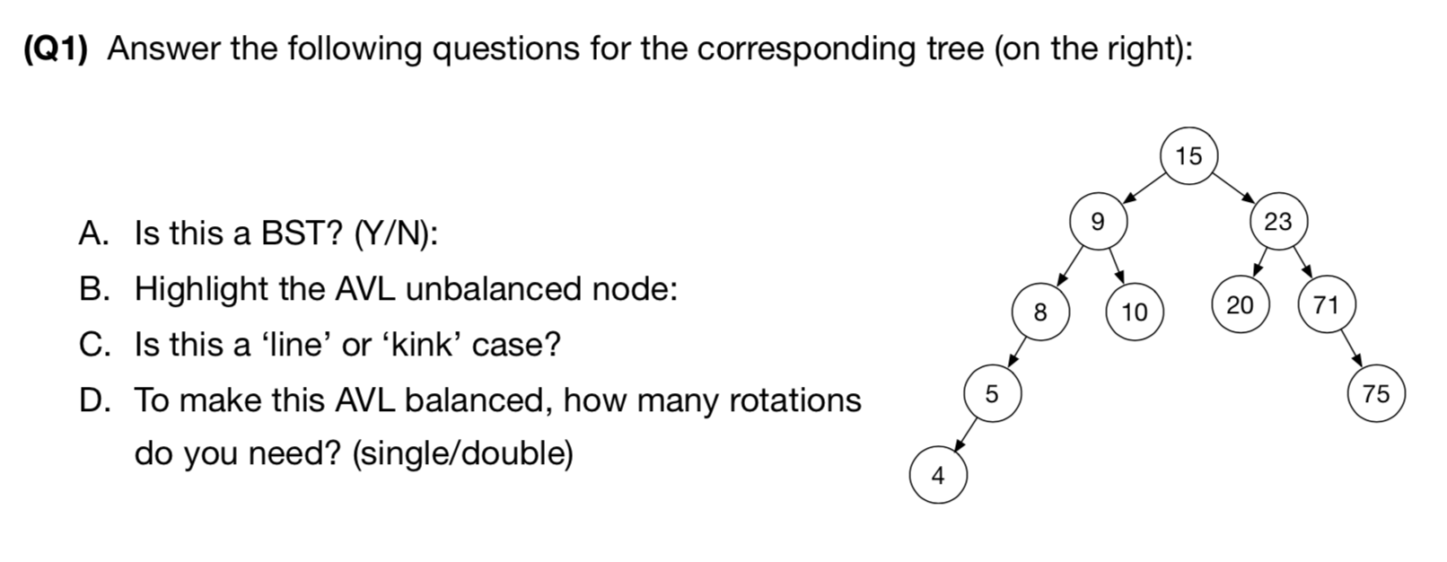
Worksheet (Q1)

Slide 9
Left Rotation
Rest of the tree
Rest of the tree
BALANCED
Right subtree is 1 longer
UNBALANCED
Right subtree is 2 longer
y
x
x
y
z
A
A
B
z
B
C
D
C
D

Slide 10
It Gets More Complicated
There’s a “kink” in the tree where the insertion happened.
1
1
2
3
2
1
3
2
3
Now do a left rotation.
Can’t do a left rotation
Do a “right” rotation around 3 first.

Slide 11
Four cases to consider
Insert location | Solution
Left subtree of left child of y | Single right rotation
Right subtree of left child of y | Double (left-right) rotation
Left subtree of right child of y | Double (right-left) rotation
Right subtree of right child of y | Single left rotation
y
x
z
A
B
C
D

Slide 12
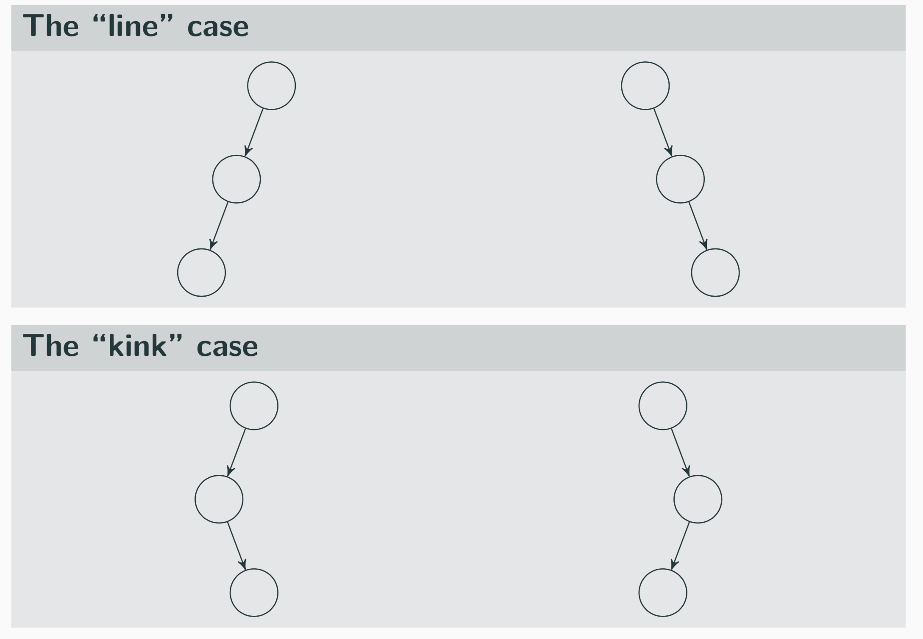
Four cases to consider
y
x
z
A
B
C
D

Slide 13
Right Left Rotation
Rest of the tree
Rest of the tree
BALANCED
Right subtree is 1 longer
UNBALANCED
Right subtree is 2 longer
y
x
Left subtree is
1 longer
x
z
z
A
A
B
y
D
C
D
B
C

Slide 14
AVL Example: 8,9,10,12,11
9
8
10
12
11
Notes:
This is the kink case

Slide 15
AVL Example: 8,9,10,12,11
9
8
10
12
11
Notes:
Do a right rotation to get into a line case

Slide 16
AVL Example: 8,9,10,12,11
9
8
10
11
12
Notes:
Now do a left rotation to re-balance the line!

Slide 17
Worksheet (Q10A)

Slide 18
Worksheet (Q10B)

Slide 19
How Long Does Rebalancing Take?
Assume we store in each node the height of its subtree.
How do we find an unbalanced node?
How many rotations might we have to do?

Slide 20
How Long Does Rebalancing Take?
Assume we store in each node the height of its subtree.
How do we find an unbalanced node?
Just go back up the tree from where we inserted.
How many rotations might we have to do?
Just a single or double rotation on the lowest unbalanced node.
A rotation will cause the subtree rooted where the rotation happens to have the same height it had before insertion.

Slide 21
Lots of cool Self-Balancing BSTs out there!
Popular self-balancing BSTs include:
AVL tree
Splay tree
2-3 tree
AA tree
Red-black tree
Scapegoat tree
Treap
(Not covered in this class, but several are in the textbook and all of them are online!)
(From https://en.wikipedia.org/wiki/Self-balancing_binary_search_tree#Implementations)

