Slide 1
AVL Trees
CSE 373: Data Structures and Algorithms
Autumn 2018
Shrirang (Shri) Mare
shri@cs.washington.edu
Thanks to Kasey Champion, Ben Jones, Adam Blank, Michael Lee, Evan McCarty, Robbie Weber, Whitaker Brand, Zora Fung, Stuart Reges, Justin Hsia, Ruth Anderson, and many others for sample slides and materials ...

Slide 2
Outline
So far
  List
  Dictionaries
  Add and remove operations on dictionaries implemented with arrays or lists are O(n)
  Trees, BSTs in particular, offer speed up because of their branching factors
  BSTs are in the average case, but not in the worse case
Today
  Can we do better? Can we adapt our BST so we never get the worst case
 | Insert() | Find() | Remove()
Average case | O(log n) | O(log n) | O(log n)
Worst case | O(n) | O(n) | O(n)

Slide 3
Review: Worksheets

Slide 4
Balanced BST observation
BST: the shallower the better!
For a BST with n nodes inserted in arbitrary order
– Average height is O(log n)
– Worst case height is O(n)
Solution: Require a Balance Condition that
Simple cases such as inserting in key order lead to the worst-case scenario
1. ensures depth is always O(log n) – strong enough!
2. is easy to maintain – not strong enough!

Slide 5
AVL trees: Balanced BSTs
AVL Trees must satisfy the following properties:
  binary trees: every node must have between 0 and 2 children
  binary search tree (BST property): for every node, all keys in the left subtree must be smaller and all keys in the right subtree must be larger than the root node
  Balanced (AVL property): for every node, there can be no more than a difference of 1 in the height of the left subtree from the right. Math.abs(height(left subtree) – height(right subtree)) ≤ 1
  AVL stands for Adelson-Velsky and Landis (the inventors of the data structure)
  The AVL property:
1. ensures depth is always O(log n) – Yes!
2. is easy to maintain – Yes! (using single and double rotations)

Slide 6
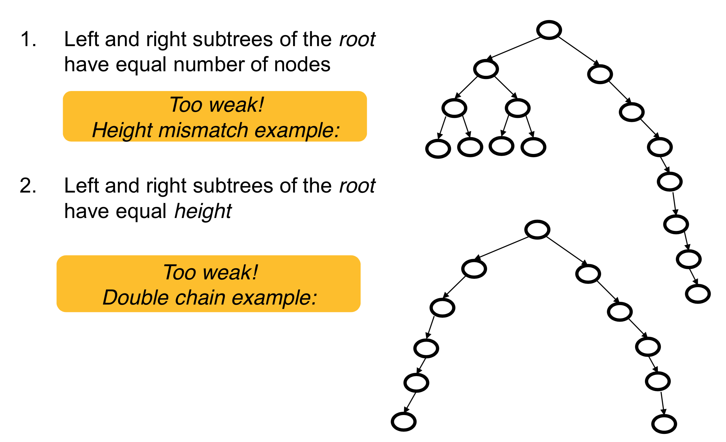
Potential balance conditions (1)

Slide 7
Potential balance conditions (1)

Slide 8
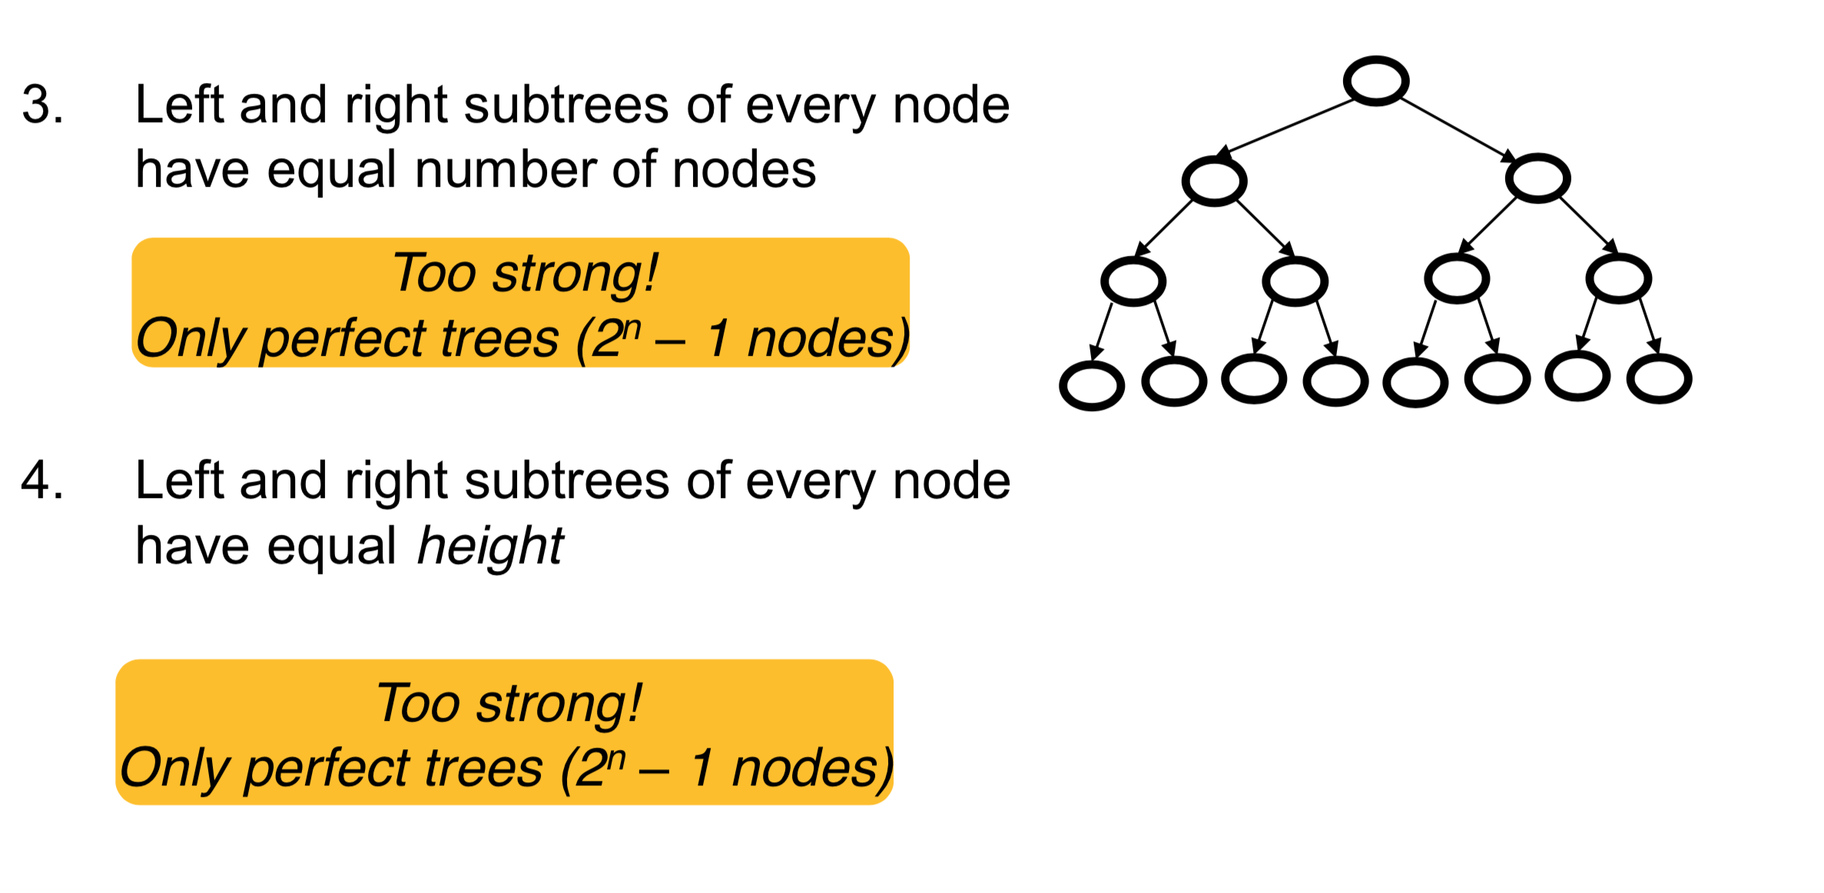
Potential balance conditions (2)

Slide 9
Potential balance conditions (2)

Slide 10
AVL balance condition
AVL condition: For every node, the height of its left subtree and right subtree differ by at most 1.
balance(node) = Math.abs( height(node.left) – height(node.right) )
AVL condition: for every node, balance(node) ≤ 1

Slide 11
Worksheet (Q9)

Slide 12
Insertion
What happens if when we do an insert(3), we break the AVL condition?
1
2
2
1
3
3

Slide 13
Left Rotation
Rest of the tree
Rest of the tree
BALANCED
Right subtree is 1 longer
UNBALANCED
Right subtree is 2 longer
y
x
x
y
z
A
A
B
z
B
C
D
C
D

Slide 14
Tree Rotations: Right rotation
B
A
C
W
X
Y
Z

Slide 15
It Gets More Complicated
There’s a “kink” in the tree where the insertion happened.
1
1
2
3
2
1
3
2
3
Now do a left rotation.
Can’t do a left rotation
Do a “right” rotation around 3 first.

Slide 16
Right Left Rotation
Rest of the tree
Rest of the tree
BALANCED
Right subtree is 1 longer
UNBALANCED
Right subtree is 2 longer
y
x
Left subtree is
1 longer
x
z
z
A
A
B
y
D
C
D
B
C

Slide 17
Four cases to consider
Insert location | Solution
Left subtree of left child of y | Single right rotation
Right subtree of left child of y | Double (left-right) rotation
Left subtree of right child of y | Double (right-left) rotation
Right subtree of right child of y | Single left rotation
y
x
z
A
B
C
D

Slide 18
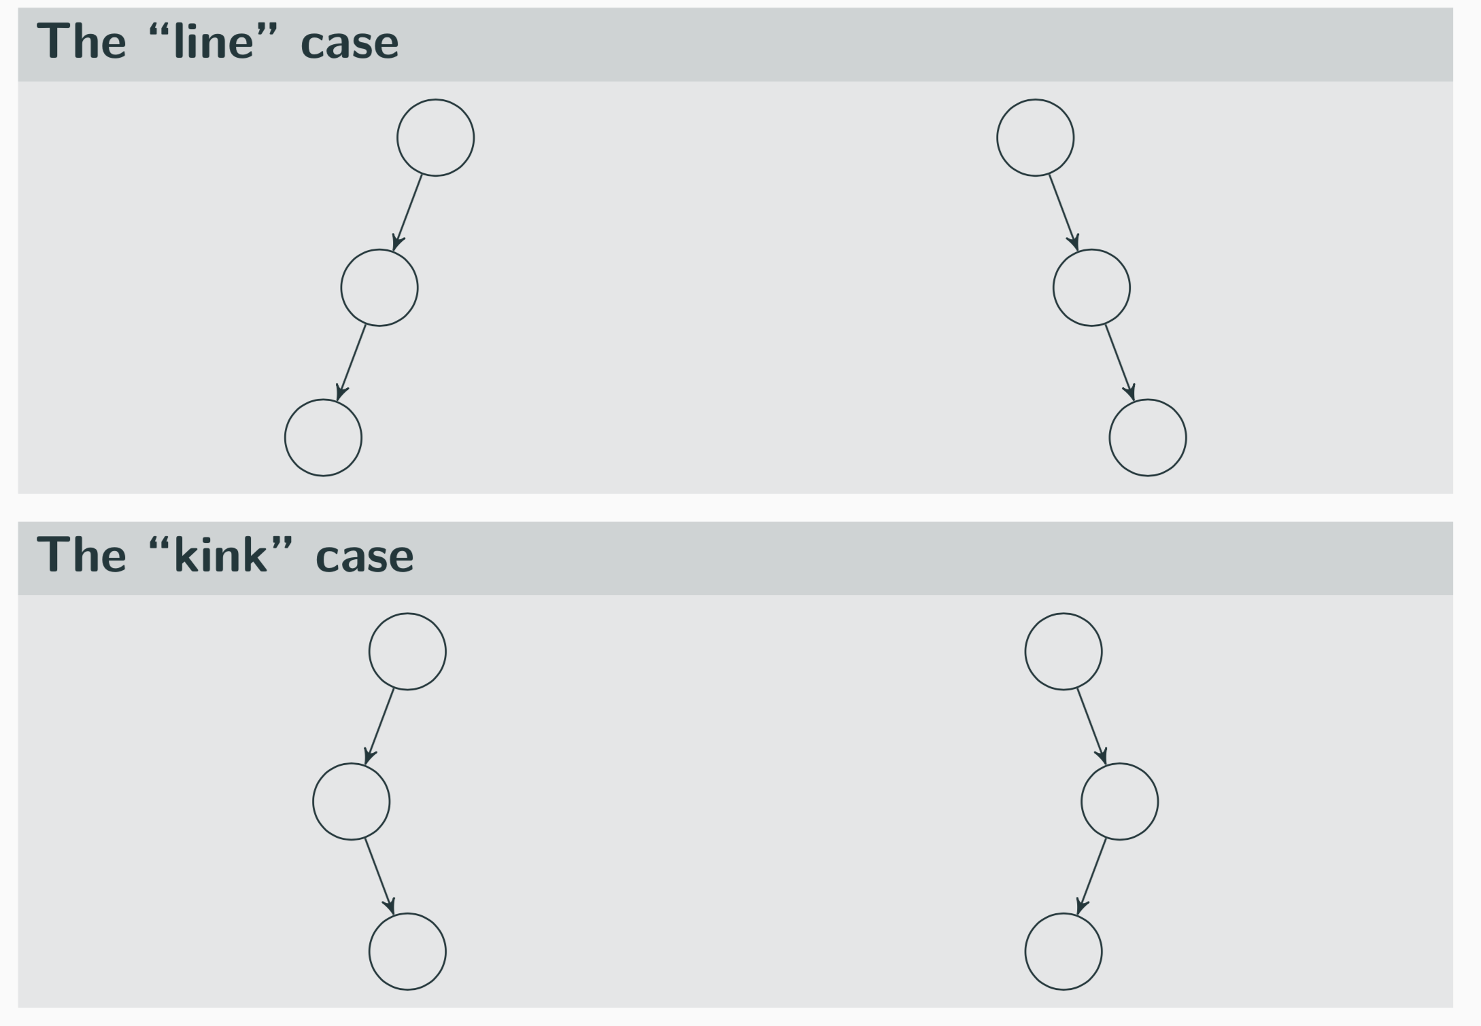
Four cases to consider
y
x
z
A
B
C
D

Slide 19
AVL Example: 8,9,10,12,11
8
9
10
Notes:
This is the line case.

Slide 20
AVL Example: 8,9,10,12,11
8
9
10
Notes:
Do a left rotation to correct

Slide 21
AVL Example: 8,9,10,12,11
9
8
10
12
11
Notes:
This is the kink case

Slide 22
AVL Example: 8,9,10,12,11
9
8
10
12
11
Notes:
Do a right rotation to get into a line case

Slide 23
AVL Example: 8,9,10,12,11
9
8
10
11
12
Notes:
Now do a left rotation to re-balance the line!

Slide 24
Worksheet (Q10A)

Slide 25
Worksheet (Q10B)

Slide 26
How Long Does Rebalancing Take?
Assume we store in each node the height of its subtree.
How do we find an unbalanced node?
How many rotations might we have to do?

Slide 27
How Long Does Rebalancing Take?
Assume we store in each node the height of its subtree.
How do we find an unbalanced node?
  Just go back up the tree from where we inserted.
How many rotations might we have to do?
  Just a single or double rotation on the lowest unbalanced node.
  A rotation will cause the subtree rooted where the rotation happens to have the same height it had before insertion.

Slide 28
Lots of cool Self-Balancing BSTs out there!
Popular self-balancing BSTs include:
AVL tree
Splay tree
2-3 tree
AA tree
Red-black tree
Scapegoat tree
Treap
(Not covered in this class, but several are in the textbook and all of them are online!)
(From https://en.wikipedia.org/wiki/Self-balancing_binary_search_tree#Implementations)

