Slide 1
CSE 373: Data Structures & Algorithms Finish Sorting; Induction; Recurrence Relations
Riley Porter
Winter 2017

Slide 2
Course Logistics
HW5 due today! Check your submission please (download and expand the zip)
HW6 out already → sorting (and to a lesser degree reading specs/other files/tests)

Slide 3
Review: Sorting: The Big Picture
O(n²)
O(n)
Simple
algorithms:
O(n²)
Fancier
algorithms:
O(n log n)
Comparison
lower bound:
Ω(n log n)
Specialized
algorithms:
O(n)
Handling
huge data
sets
Insertion sort
Selection sort
Bubble sort
Shell sort
…
Heap sort
Merge sort
Quick sort (avg)
…
Bucket sort
Radix sort
External
sorting

Slide 4
Non-Comparison Sorts
Bucket Sort:
every possible element in our domain is known
the domain is relatively small (ex: numbers 1-100, all sections AA-AF)
Radix Sort:
we have a base we can use to bucket sort our domain in a series of passes (ex: 0-9 for decimal numbers, ascii values for chars)

Slide 5
Example: Bucket Sort
Quiz scores (0-5 possible):
CJ Cregg – 5
Donna Moss – 5
Jed Bartlet – 4
Josh Lyman – 4
Leo McGarry – 5
Sam Seaborn – 2
Toby Ziegler – 3
count array
0 | 0
1 | 0
2 | 0
3 | 0
4 | 0
5 | 0

Slide 6
Example: Bucket Sort
Quiz scores (0-5 possible):
CJ Cregg – 5
Donna Moss – 5
Jed Bartlet – 4
Josh Lyman – 4
Leo McGarry – 5
Sam Seaborn – 2
Toby Ziegler – 3
count array
0 | 0
1 | 0
2 | 0
3 | 0
4 | 0
5 | 1

Slide 7
Example: Bucket Sort
Quiz scores (0-5 possible):
CJ Cregg – 5
Donna Moss – 5
Jed Bartlet – 4
Josh Lyman – 4
Leo McGarry – 5
Sam Seaborn – 2
Toby Ziegler – 3
count array
0 | 0
1 | 0
2 | 0
3 | 0
4 | 0
5 | 2

Slide 8
Example: Bucket Sort
Quiz scores (0-5 possible):
CJ Cregg – 5
Donna Moss – 5
Jed Bartlet – 4
Josh Lyman – 4
Leo McGarry – 5
Sam Seaborn – 2
Toby Ziegler – 3
count array
0 | 0
1 | 0
2 | 0
3 | 0
4 | 1
5 | 2

Slide 9
Example: Bucket Sort
Quiz scores (0-5 possible):
CJ Cregg – 5
Donna Moss – 5
Jed Bartlet – 4
Josh Lyman – 4
Leo McGarry – 5
Sam Seaborn – 2
Toby Ziegler – 3
count array
0 | 0
1 | 0
2 | 0
3 | 0
4 | 2
5 | 2

Slide 10
Example: Bucket Sort
Quiz scores (0-5 possible):
CJ Cregg – 5
Donna Moss – 5
Jed Bartlet – 4
Josh Lyman – 4
Leo McGarry – 5
Sam Seaborn – 2
Toby Ziegler – 3
count array
0 | 0
1 | 0
2 | 0
3 | 0
4 | 2
5 | 3

Slide 11
Example: Bucket Sort
Quiz scores (0-5 possible):
CJ Cregg – 5
Donna Moss – 5
Jed Bartlet – 4
Josh Lyman – 4
Leo McGarry – 5
Sam Seaborn – 2
Toby Ziegler – 3
count array
0 | 0
1 | 0
2 | 1
3 | 0
4 | 2
5 | 3

Slide 12
Example: Bucket Sort
Quiz scores (0-5 possible):
CJ Cregg – 5
Donna Moss – 5
Jed Bartlet – 4
Josh Lyman – 4
Leo McGarry – 5
Sam Seaborn – 2
Toby Ziegler – 3
count array
0 | 0
1 | 0
2 | 1
3 | 1
4 | 2
5 | 3

Slide 13
Example: Bucket Sort
count array
0 | 0
1 | 0
2 | 1
3 | 1
4 | 2
5 | 3
Output, sorted scores: 2, 3, 4, 4, 5, 5, 5

Slide 14
Example: Bucket Sort
What if we wanted to keep track of who got which score?
Quiz scores (0-5 possible):
CJ Cregg – 5
Donna Moss – 5
Jed Bartlet – 4
Josh Lyman – 4
Leo McGarry – 5
Sam Seaborn – 2
Toby Ziegler – 3
count array
0 | /
1 | /
2 | /
3 | /
4 | /
5 | /

Slide 15
Example: Bucket Sort
What if we wanted to keep track of who got which score?
Quiz scores (0-5 possible):
CJ Cregg – 5
Donna Moss – 5
Jed Bartlet – 4
Josh Lyman – 4
Leo McGarry – 5
Sam Seaborn – 2
Toby Ziegler – 3
count array
0 | /
1 | /
2 | /
3 | /
4 | /
5
CJ Cregg

Slide 16
Example: Bucket Sort
What if we wanted to keep track of who got which score?
Quiz scores (0-5 possible):
CJ Cregg – 5
Donna Moss – 5
Jed Bartlet – 4
Josh Lyman – 4
Leo McGarry – 5
Sam Seaborn – 2
Toby Ziegler – 3
count array
0 | /
1 | /
2 | /
3 | /
4 | /
5
CJ Cregg
Donna Moss

Slide 17
Example: Bucket Sort
What if we wanted to keep track of who got which score?
Quiz scores (0-5 possible):
CJ Cregg – 5
Donna Moss – 5
Jed Bartlet – 4
Josh Lyman – 4
Leo McGarry – 5
Sam Seaborn – 2
Toby Ziegler – 3
count array
0 | /
1 | /
2 | /
3 | /
4
5
Jed Bartlet
Josh Lyman
CJ Cregg
Donna Moss
Leo McGarry

Slide 18
Example: Bucket Sort
What if we wanted to keep track of who got which score?
Quiz scores (0-5 possible):
CJ Cregg – 5
Donna Moss – 5
Jed Bartlet – 4
Josh Lyman – 4
Leo McGarry – 5
Sam Seaborn – 2
Toby Ziegler – 3
count array
0 | /
1 | /
2
3 | /
4
5
Sam Seaborn
Jed Bartlet
Josh Lyman
CJ Cregg
Donna Moss
Leo McGarry

Slide 19
Example: Bucket Sort
What if we wanted to keep track of who got which score?
Quiz scores (0-5 possible):
CJ Cregg – 5
Donna Moss – 5
Jed Bartlet – 4
Josh Lyman – 4
Leo McGarry – 5
Sam Seaborn – 2
Toby Ziegler – 3
count array
0 | /
1 | /
2
3
4
5
Sam Seaborn
Toby Ziegler
Jed Bartlet
Josh Lyman
CJ Cregg
Donna Moss
Leo McGarry

Slide 20
Example: Bucket Sort
Final output:
(Sam Seaborn, 2), (Toby Ziegler, 3), (Jed Bartlet, 4), (Josh Lyman, 4), (CJ Cregg, 5), (Donna Moss, 5), (Leo McGarry, 5)
count array
0 | /
1 | /
2
3
4
5
Sam Seaborn
Toby Ziegler
Jed Bartlet
Josh Lyman
CJ Cregg
Donna Moss
Leo McGarry

Slide 21
Example: Radix Sort
What if these scores were in the range (0-300)?
CJ Cregg – 51
Donna Moss – 125
Jed Bartlet – 243
Josh Lyman – 34
Leo McGarry – 299
Sam Seaborn – 103
Toby Ziegler – 9
The count array we were using before would be a lot larger and the complexity for the final pass would be O(K + N) where K = 301 and N =7

Slide 22
Radix Sort: Example
Radix = 10
(digits are 0-9)
Input:
CJ Cregg – 051
Donna Moss – 125
Jed Bartlet – 243
Josh Lyman – 034
Leo McGarry – 299
Sam Seaborn – 103
Toby Ziegler – 009
0
1
2
3
4
5
6
7
8
9
First pass:
bucket sort input in given order by ones digit

Slide 23
Radix Sort: Example
Radix = 10
(digits are 0-9)
Input:
CJ Cregg – 051
Donna Moss – 125
Jed Bartlet – 243
Josh Lyman – 034
Leo McGarry – 299
Sam Seaborn – 103
Toby Ziegler – 009
0
1
2
3
4
5
6
7
8
9
051 - CJ Cregg
First pass:
bucket sort input in given order by ones digit

Slide 24
Radix Sort: Example
Radix = 10
(digits are 0-9)
Input:
CJ Cregg – 051
Donna Moss – 125
Jed Bartlet – 243
Josh Lyman – 034
Leo McGarry – 299
Sam Seaborn – 103
Toby Ziegler – 009
0
1
2
3
4
5
6
7
8
9
051 - CJ Cregg
125 – Donna Moss
First pass:
bucket sort input in given order by ones digit

Slide 25
Radix Sort: Example
Radix = 10
(digits are 0-9)
Input:
CJ Cregg – 051
Donna Moss – 125
Jed Bartlet – 243
Josh Lyman – 034
Leo McGarry – 299
Sam Seaborn – 103
Toby Ziegler – 009
0
1
2
3
4
5
6
7
8
9
051 - CJ Cregg
243 – Jed Bartlet
125 – Donna Moss
First pass:
bucket sort input in given order by ones digit

Slide 26
Radix Sort: Example
Radix = 10
(digits are 0-9)
Input:
CJ Cregg – 051
Donna Moss – 125
Jed Bartlet – 243
Josh Lyman – 034
Leo McGarry – 299
Sam Seaborn – 103
Toby Ziegler – 009
0
1
2
3
4
5
6
7
8
9
051 - CJ Cregg
243 – Jed Bartlet
125 – Donna Moss
034 – Josh Lyman
First pass:
bucket sort input in given order by ones digit

Slide 27
Radix Sort: Example
Radix = 10
(digits are 0-9)
Input:
CJ Cregg – 051
Donna Moss – 125
Jed Bartlet – 243
Josh Lyman – 034
Leo McGarry – 299
Sam Seaborn – 103
Toby Ziegler – 009
0
1
2
3
4
5
6
7
8
9
125 – Donna Moss
299 – Leo McGarry
051 - CJ Cregg
243 – Jed Bartlet
034 – Josh Lyman
First pass:
bucket sort input in given order by ones digit

Slide 28
Radix Sort: Example
Radix = 10
(digits are 0-9)
Input:
CJ Cregg – 051
Donna Moss – 125
Jed Bartlet – 243
Josh Lyman – 034
Leo McGarry – 299
Sam Seaborn – 103
Toby Ziegler – 009
0
1
2
3
4
5
6
7
8
9
125 – Donna Moss
299 – Leo McGarry
051 - CJ Cregg
243 – Jed Bartlet
034 – Josh Lyman
103 – Sam Seaborn
First pass:
bucket sort input in given order by ones digit

Slide 29
Radix Sort: Example
Radix = 10
(digits are 0-9)
Input:
CJ Cregg – 051
Donna Moss – 125
Jed Bartlet – 243
Josh Lyman – 034
Leo McGarry – 299
Sam Seaborn – 103
Toby Ziegler – 009
0
1
2
3
4
5
6
7
8
9
125 – Donna Moss
299 – Leo McGarry
051 - CJ Cregg
243 – Jed Bartlet
034 – Josh Lyman
103 – Sam Seaborn
009 – Toby Ziegler
First pass:
bucket sort input in given order by ones digit

Slide 30
Radix Sort: Example
Radix = 10
(digits are 0-9)
New Input Order:
CJ Cregg – 051
Jed Bartlet – 243
Sam Seaborn – 103
Josh Lyman – 034
Donna Moss – 125
Leo McGarry – 299
Toby Ziegler – 009
0
1
2
3
4
5
6
7
8
9
Ready for second pass:
bucket sort input in given order by tens digit

Slide 31
Radix Sort: Example
Radix = 10
(digits are 0-9)
New Input Order:
CJ Cregg – 051
Jed Bartlet – 243
Sam Seaborn – 103
Josh Lyman – 034
Donna Moss – 125
Leo McGarry – 299
Toby Ziegler – 009
0
1
2
3
4
5
6
7
8
9
051 - CJ Cregg
Ready for second pass:
bucket sort input in given order by tens digit

Slide 32
Radix Sort: Example
Radix = 10
(digits are 0-9)
New Input Order:
CJ Cregg – 051
Jed Bartlet – 243
Sam Seaborn – 103
Josh Lyman – 034
Donna Moss – 125
Leo McGarry – 299
Toby Ziegler – 009
0
1
2
3
4
5
6
7
8
9
243 – Jed Bartlet
051 - CJ Cregg
Ready for second pass:
bucket sort input in given order by tens digit

Slide 33
Radix Sort: Example
Radix = 10
(digits are 0-9)
New Input Order:
CJ Cregg – 051
Jed Bartlet – 243
Sam Seaborn – 103
Josh Lyman – 034
Donna Moss – 125
Leo McGarry – 299
Toby Ziegler – 009
0
1
2
3
4
5
6
7
8
9
103 – Sam Seaborn
243 – Jed Bartlet
051 - CJ Cregg
Ready for second pass:
bucket sort input in given order by tens digit

Slide 34
Radix Sort: Example
Radix = 10
(digits are 0-9)
New Input Order:
CJ Cregg – 051
Jed Bartlet – 243
Sam Seaborn – 103
Josh Lyman – 034
Donna Moss – 125
Leo McGarry – 299
Toby Ziegler – 009
0
1
2
3
4
5
6
7
8
9
103 – Sam Seaborn
243 – Jed Bartlet
051 - CJ Cregg
034 – Josh Lyman
Ready for second pass:
bucket sort input in given order by tens digit

Slide 35
Radix Sort: Example
Radix = 10
(digits are 0-9)
New Input Order:
CJ Cregg – 051
Jed Bartlet – 243
Sam Seaborn – 103
Josh Lyman – 034
Donna Moss – 125
Leo McGarry – 299
Toby Ziegler – 009
0
1
2
3
4
5
6
7
8
9
103 – Sam Seaborn
125 – Donna Moss
243 – Jed Bartlet
051 - CJ Cregg
034 – Josh Lyman
Ready for second pass:
bucket sort input in given order by tens digit

Slide 36
Radix Sort: Example
Radix = 10
(digits are 0-9)
New Input Order:
CJ Cregg – 051
Jed Bartlet – 243
Sam Seaborn – 103
Josh Lyman – 034
Donna Moss – 125
Leo McGarry – 299
Toby Ziegler – 009
0
1
2
3
4
5
6
7
8
9
125 – Donna Moss
243 – Jed Bartlet
299 – Leo McGarry
103 – Sam Seaborn
051 - CJ Cregg
034 – Josh Lyman
Ready for second pass:
bucket sort input in given order by tens digit

Slide 37
Radix Sort: Example
Radix = 10
(digits are 0-9)
New Input Order:
CJ Cregg – 051
Jed Bartlet – 243
Sam Seaborn – 103
Josh Lyman – 034
Donna Moss – 125
Leo McGarry – 299
Toby Ziegler – 009
0
1
2
3
4
5
6
7
8
9
125 – Donna Moss
243 – Jed Bartlet
299 – Leo McGarry
103 – Sam Seaborn
051 - CJ Cregg
034 – Josh Lyman
009 – Toby Ziegler
Ready for second pass:
bucket sort input in given order by tens digit

Slide 38
Radix Sort: Example
Radix = 10
(digits are 0-9)
New Input Order:
Sam Seaborn – 103
Toby Ziegler – 009
Donna Moss – 125
Josh Lyman – 034
Jed Bartlet – 243
CJ Cregg – 051
Leo McGarry – 299
0
1
2
3
4
5
6
7
8
9
Ready for third pass:
bucket sort input in given order by hundreds digit

Slide 39
Radix Sort: Example
Radix = 10
(digits are 0-9)
New Input Order:
Sam Seaborn – 103
Toby Ziegler – 009
Donna Moss – 125
Josh Lyman – 034
Jed Bartlet – 243
CJ Cregg – 051
Leo McGarry – 299
0
1
2
3
4
5
6
7
8
9
103 – Sam Seaborn
Ready for third pass:
bucket sort input in given order by hundreds digit

Slide 40
Radix Sort: Example
Radix = 10
(digits are 0-9)
New Input Order:
Sam Seaborn – 103
Toby Ziegler – 009
Donna Moss – 125
Josh Lyman – 034
Jed Bartlet – 243
CJ Cregg – 051
Leo McGarry – 299
0
1
2
3
4
5
6
7
8
9
103 – Sam Seaborn
009 – Toby Ziegler
Ready for third pass:
bucket sort input in given order by hundreds digit

Slide 41
Radix Sort: Example
Radix = 10
(digits are 0-9)
New Input Order:
Sam Seaborn – 103
Toby Ziegler – 009
Donna Moss – 125
Josh Lyman – 034
Jed Bartlet – 243
CJ Cregg – 051
Leo McGarry – 299
0
1
2
3
4
5
6
7
8
9
103 – Sam Seaborn
009 – Toby Ziegler
125 – Donna Moss
Ready for third pass:
bucket sort input in given order by hundreds digit

Slide 42
Radix Sort: Example
Radix = 10
(digits are 0-9)
New Input Order:
Sam Seaborn – 103
Toby Ziegler – 009
Donna Moss – 125
Josh Lyman – 034
Jed Bartlet – 243
CJ Cregg – 051
Leo McGarry – 299
0
1
2
3
4
5
6
7
8
9
103 – Sam Seaborn
009 – Toby Ziegler
125 – Donna Moss
034 – Josh Lyman
Ready for third pass:
bucket sort input in given order by hundreds digit

Slide 43
Radix Sort: Example
Radix = 10
(digits are 0-9)
New Input Order:
Sam Seaborn – 103
Toby Ziegler – 009
Donna Moss – 125
Josh Lyman – 034
Jed Bartlet – 243
CJ Cregg – 051
Leo McGarry – 299
0
1
2
3
4
5
6
7
8
9
103 – Sam Seaborn
243 – Jed Bartlet
009 – Toby Ziegler
125 – Donna Moss
034 – Josh Lyman
Ready for third pass:
bucket sort input in given order by hundreds digit

Slide 44
Radix Sort: Example
Radix = 10
(digits are 0-9)
New Input Order:
Sam Seaborn – 103
Toby Ziegler – 009
Donna Moss – 125
Josh Lyman – 034
Jed Bartlet – 243
CJ Cregg – 051
Leo McGarry – 299
0
1
2
3
4
5
6
7
8
9
103 – Sam Seaborn
243 – Jed Bartlet
009 – Toby Ziegler
125 – Donna Moss
034 – Josh Lyman
051 - CJ Cregg
Ready for third pass:
bucket sort input in given order by hundreds digit

Slide 45
Radix Sort: Example
Radix = 10
(digits are 0-9)
New Input Order:
Sam Seaborn – 103
Toby Ziegler – 009
Donna Moss – 125
Josh Lyman – 034
Jed Bartlet – 243
CJ Cregg – 051
Leo McGarry – 299
0
1
2
3
4
5
6
7
8
9
103 – Sam Seaborn
243 – Jed Bartlet
299 – Leo McGarry
009 – Toby Ziegler
125 – Donna Moss
034 – Josh Lyman
051 - CJ Cregg
Ready for third pass:
bucket sort input in given order by hundreds digit

Slide 46
Radix Sort: Example
Radix = 10
(digits are 0-9)
Final Order:
Toby Ziegler – 009
Josh Lyman – 034
CJ Cregg – 051
Sam Seaborn – 103
Donna Moss – 125
Jed Bartlet – 243
Leo McGarry – 299
0
1
2
3
4
5
6
7
8
9
103 – Sam Seaborn
243 – Jed Bartlet
299 – Leo McGarry
009 – Toby Ziegler
125 – Donna Moss
034 – Josh Lyman
051 - CJ Cregg

Slide 47
Sorting Takeaways
Simple O(n²) sorts can be fastest for small n
Selection sort, Insertion sort (latter linear for mostly-sorted)
Good for “below a cut-off” to help divide-and-conquer sorts
O(n log n) sorts
Heap sort, in-place but not stable nor parallelizable
Merge sort, not in place but stable and works as external sort
Quick sort, in place but not stable and O(n²) in worst-case
Often fastest, but depends on costs of comparisons/copies
Ω (n log n) is worst-case and average lower-bound for sorting by comparisons
Non-comparison sorts
Bucket sort good for small number of possible key values
Radix sort uses fewer buckets and more phases
Best way to sort? It depends!

Slide 48
Switching Topics: Induction and Recurrences
recursive cat is recursive

Slide 49
Background on Induction
Type of mathematical proof
Typically used to establish a given statement for all natural numbers (integers > 0)
Proof is a sequence of deductive steps
Show the statement is true for the first number.
Show that the statement is true for any one arbitrary number and then, this implies the statement is true for the next arbitrary number.
If so, we can infer that the statement is true for all numbers.

Slide 50
Motivation
Induction turns out to be a useful technique
proof of AVL trees log(n) worst case height
Heaps
proof of Graph algorithms
Can also prove things like 3^{n} > n³ for n ≥ 4
Exposure to rigorous thinking and proofs. Helps with recursion and recursive reasoning.

Slide 51
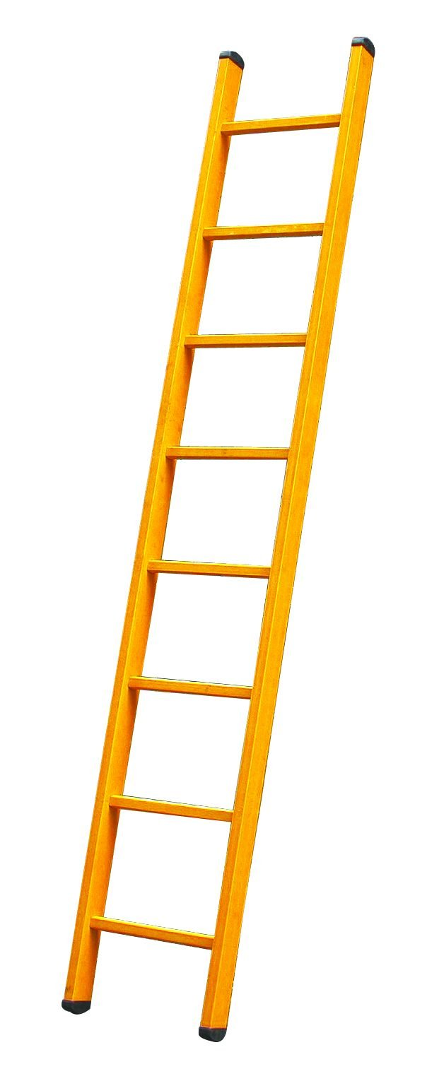
Think about climbing a ladder
1. Show you can get to the first rung (base case)
2. Show you can get between rungs (inductive step)
3. Now you can climb forever on an infinity ladder
Notes:
dominos? if you can knock down the first one, and prove that each domino will knock down another domino

Slide 52
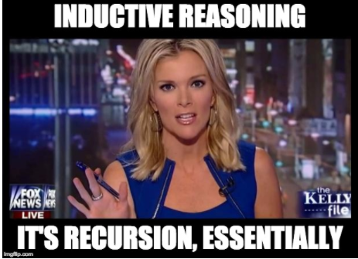
Notes:
dominos? if you can knock down the first one, and prove that each domino will knock down another domino

Slide 53
5 steps to inductive proofs
State what you’re trying to prove.
Suppose that P(n) is some predicate (mention n)
Ex:
“Let P(n) be …
Will prove that P(n) is true for every n >= x”
Prove the “base case”
Show that P(x) is true
Inductive Hypothesis (IH)
Assume that P(k) is true for some arbitrary integer k in the set of integers you’re looking at
Inductive Step
Show that P(k + 1) is true.
Be sure to use the Inductive Hypothesis, and point out where you use it!
Conclusion. Conclude that you did it.

Slide 54
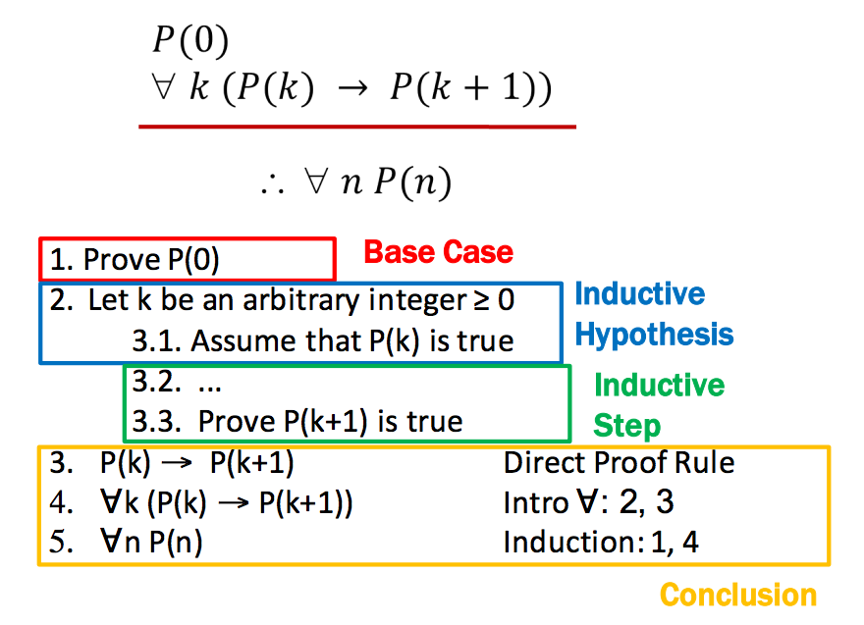
More specifically

Slide 55
Example
Prove: 1 + 2 + 4 + 8 + … + 2^{n} = 2^{n+1}-1 for all n >= 0
(see handwritten notes)

Slide 56
Example
Prove: 1 + 2 + 4 + 8 + … + 2^{n} = 2^{n+1}-1 for all n >= 0

Slide 57
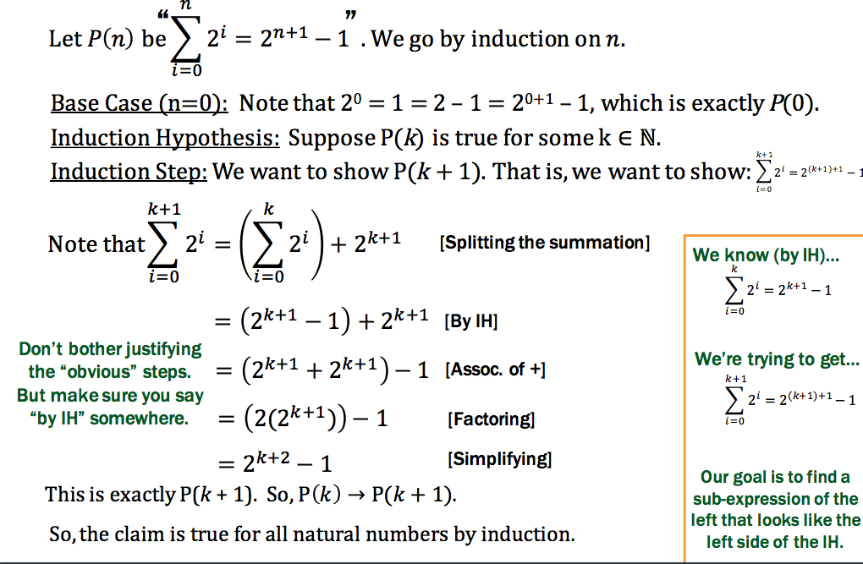

Slide 58
Asymptotic Runtime of Recursion
Recurrence Definition:
A recurrence is a recursive definition of a function in terms of smaller values.
Example: Fibonacci numbers.
To analyze the runtime of recursive code, we use a recurrence by splitting the work into two pieces:
Non-Recursive Work
Recursive Work

Slide 59
Recursive version of sum:
int sum(int[] arr){
return help(arr,0,arr.length);
}
int help(int[] arr, int lo, int hi) {
if(lo==hi) return 0;
if(lo==hi-1) return arr[lo];
int mid = (hi+lo)/2;
return help(arr,lo,mid) + help(arr,mid,hi);
}
What’s the recurrence T(n)?
Non-Recursive Work: O(1)
Recursive Work: T(n/2) * 2 halves
T(n) = O(1) + 2*T(n/2)

Slide 60
Solving That Recurrence Relation
Determine the recurrence relation. What is the base case?
If T(1) = 1, then T(n) = 1 + 2*T(n/2)
“Expand” the original relation to find an equivalent general expression in terms of the number of expansions.
T(n) = 1 + 2 * T(n / 2)
= 1 + 2 + 2 * T(n / 4)
= 1 + 2 + 4 + ... for log(n) times
= …
= 2^{(log n)} – 1
Find a closed-form expression by setting the number of expansions to a value which reduces the problem to a base case
So T(n) is O(n)
Explanation: it adds each number once while doing little else

Slide 61
Solving Recurrence Relations Example 2
Determine the recurrence relation. What is the base case?
If T(n) = 10 + T(n/2) and T(1) = 10
“Expand” the original relation to find an equivalent general expression in terms of the number of expansions.
T(n) = 10 + 10 + T(n/4)
= 10 + 10 + 10 + T(n/8)
= …
= 10k + T(n/(2^{k}))
Find a closed-form expression by setting the number of expansions to a value which reduces the problem to a base case
n/(2^{k}) = 1 means n = 2^{k} means k = log₂ n
So T(n) = 10 log₂ n + 8 (get to base case and do it)
So T(n) is O(log n)

Slide 62
Really common recurrences
You can recognize some really common recurrences:
T(n) = O(1) + T(n-1) linear
T(n) = O(1) + 2T(n/2) linear
T(n) = O(1) + T(n/2) logarithmic O(log n)
T(n) = O(1) + 2T(n-1) exponential
T(n) = O(n) + T(n-1) quadratic
T(n) = O(n) + T(n/2) linear
T(n) = O(n) + 2T(n/2) O(n log n) (divide and conquer sort)
Note big-Oh can also use more than one variable
Example: can sum all elements of an n-by-m matrix in O(nm)

Slide 63
Parallelism teaser
But suppose we could do two recursive calls at the same time
Like having a friend do half the work for you!
int sum(int[]arr){
return help(arr,0,arr.length);
}
int help(int[]arr, int lo, int hi) {
if(lo==hi) return 0;
if(lo==hi-1) return arr[lo];
int mid = (hi+lo)/2;
return help(arr,lo,mid) + help(arr,mid,hi);
}
If you have as many “friends of friends” as needed the recurrence is now T(n) = O(1) + 1T(n/2)
O(log n) : same recurrence as for find

