Slide 1
CSE 373: Data Structures & Algorithms Balancing BSTs; Lazy Deletion; Amortized Analysis
Riley Porter
Winter 2017

Slide 2
Course Logistics
HW1 due last night, HW2 (Asymptotic Runtime Analysis (Big-O) and Implementing Heaps) released tomorrow and due a week from Friday.
Canvas does weird name things with resubmission, don’t worry about it. We’ll make future HW submissions a zip to avoid it.
If you have weird technical issues with submitting HW, you can email your TA an attachment of your files. This shouldn’t be the norm, but we can accept an email with that timestamp as a submission.
Course message board will be better monitored, we have a schedule now.
We’ll be posting weekly summaries / self checks. Expect the first two week’s posted tomorrow. They’re just extra material for you to gauge how you’re doing, feel free to ask questions about them in office hours or on the discussion board. This is hopefully to supplement not recording lectures in case you are nervous about what you need to have learned each week.
Section materials will be posted online, the day before section, but solutions only available in section. If you have to miss a day, talk to your TA.

Slide 3
Topics from Last Lecture
Floyd’s algorithm for building a heap
proof of O(N) for buildHeap, which is faster than N inserts which would be O(NlogN)
Review from 143 Dictionaries/Maps/Sets: understand how to be a client of them and the ADT, think about tradeoffs for implementations.
implementations all assuming non-hash structure
Review from 143 Binary Search Trees: structure, insert, evaluate the runtime of operations. New thing: deleting from a BST. (findMin and findMax for node replacement)

Slide 4
Review: Dictionary Implementation
We store the keys with their values so all we really care about is how the keys are stored.
want fast operations for iterating over the keys
You could think about this in a couple ways:
Key A
Value
Key A
Value
Key B
Value
Key B
Value
Key C
Value
Key C
Value

Slide 5
Review: Simple Dictionary Implementations; Operation Analysis
For dictionary with n key/value pairs
insert find delete
Unsorted linked-list
Unsorted array
Sorted linked list
Sorted array
* Unless we need to check for duplicates
O(1)*
O(N)
O(N)
O(1)*
O(N)
O(N)
O(N)
O(N)
O(N)
O(N)
O(logN)
O(N)
We’ll see a Binary Search Tree (BST) probably does better, but not in the worst case unless we keep it balanced

Slide 6
Sorted Array: Lazy Deletion
10 | 12 | 24 | 30 | 41 | 42 | 44 | 45 | 50
✓ | ✗ | ✓ | ✓ | ✓ | ✓ | ✗ | ✓ | ✓
A general technique for making delete as fast as find:
Instead of actually removing the item just mark it deleted
Plusses:
Simpler to delete (no shifting). If element is re-added soon afterwards, simple to insert it again (no shifting)
Can control removals and do them later in batches (amortized cost, we’ll talk about this later today)
Minuses:
Extra space for the “is-it-deleted” flag
Data structure full of deleted nodes wastes space
Now we can’t use N in runtime: find O(log m) time where m is data-structure size (okay)

Slide 7
Review: Binary Search Tree
Structure property (“binary”)
Each node has ≤ 2 children
Order property
All keys in left subtree smaller than node’s key
All keys in right subtree larger than node’s key
Result: easy to find any given key
8
5
11
2
6
10
12
4
7
9
14
13

Slide 8
BuildTree for BST
Let’s consider buildTree (Insert all, starting from an empty tree)
Insert data 1, 2, 3, 4, 5, 6, 7, 8, 9 into an empty BST
If inserted in given order, what is the tree?
What big-O runtime for this kind of sorted input?
Is inserting in the reverse order
any better?
1
Θ(n²)
O(n²)
Not a happy place
2
3
Nope, the BST would just be the opposite
Θ(n²)

Slide 9
Intuition: Balanced BSTs are good
What if we re-arrange the data when inserting
median first, then left median, right median, etc.
5, 3, 7, 2, 1, 4, 8, 6, 9
What tree does that give us?
What big-O runtime?
5
3
7
2
4
6
8
O(N logN), definitely better
1
9
5, 3, 7, 2, 1, 6, 8, 9 better: n log n

Slide 10
Intuition: Unbalanced BSTs are bad
Even if we balance a BST during buildTree, a series of sorted data insertions can mess up our structure badly
With a bad structure,
all operations are O(N):
find
insert
delete
1
2
3

Slide 11
BST Operations Analysis
For BST with n nodes
insert find delete
Worst Case
(unbalanced)
Average Case
(balanced)
O(N)
O(N)
O(N)
O(logN)
O(logN)
O(logN)
Hard to keep a BST balanced, so BSTs are only “probably” better as implementations than a sorted array. We’ll see how to keep them balanced on Friday

Slide 12
Lazy Deletion for BSTs:
Plusses:
Simpler: delete with findMin and findMax are difficult operations, this minimizes those traversals
Can do “real deletions” later as a batch
Some inserts can just “undelete” a tree node
Minuses:
Can waste space and slow down find operations
Makes some operations more complicated with extra nodes in the tree

Slide 13
Keeping BSTs Balanced
For a BST with N nodes inserted in arbitrary order
Average height is O(log N) – intuition on Friday’s slides, proof in text
Worst case height is O(N)
Simple, commonly occurring cases, such as inserting in key order, lead to the worst-case scenario
Solution: Require a Balance Condition that maintains a nice structure:
Ensures depth is always O(log N) – strong enough!
Is efficient to maintain – not too strong!

Slide 14
Potential Balance Conditions
Left and right subtrees of every node have equal number of nodes
Left and right subtrees of every node have equal height
Too strong!
Only perfect trees (2^{n} – 1 nodes)
Too strong!
Only perfect trees (2^{n} – 1 nodes)

Slide 15
Potential Balance Conditions
Left and right subtrees of the root have equal number of nodes
4. Left and right subtrees of the root have equal height
Too weak!
Height mismatch example:
Too weak!
Double chain example:

Slide 16
The AVL Balance Condition
Adelson-Velskii and Landis
Left and right subtrees of every node
have heights differing by at most 1
Definition: balance(node) = height(node.left) – height(node.right)
AVL property: for every node x, –1 ≤ balance(x) ≤ 1
Ensures small depth
Will prove this by showing that an AVL tree of height h must have a number of nodes exponential in h
Efficient to maintain
Using single and double rotations

Slide 17
Any questions on Dictionaries or BSTs?
We’ll explore the AVL balance condition and AVL trees more on Friday.
For now let’s consider something we skipped when talking about asymptotic runtime analysis

Slide 18
Amortized Runtime Complexity
Recall our plain-old stack implemented as an array that doubles its size if it runs out of room
How can we claim push is O(1) time if resizing is O(n) time?
We can’t, but we can claim it’s an O(1) amortized operation
What does amortized mean?
When are amortized bounds good enough?
How can we prove an amortized bound?
Will just do two simple examples
Text has more sophisticated examples and proof techniques
Idea of how amortized describes average cost is essential

Slide 19
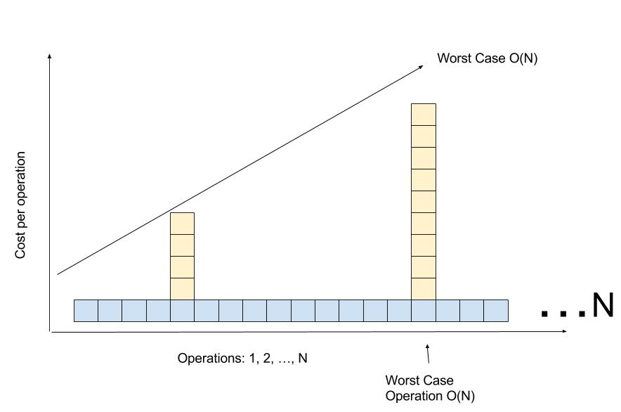
Amortized Runtime Intuition
Consider implementing a Stack with an Array. What if we had initially 5 empty slots, and every time it gets full, we add an additional size * 2 slots and have to copy over all the old data? What is the worst case runtime for the add(element) operation?

Slide 20
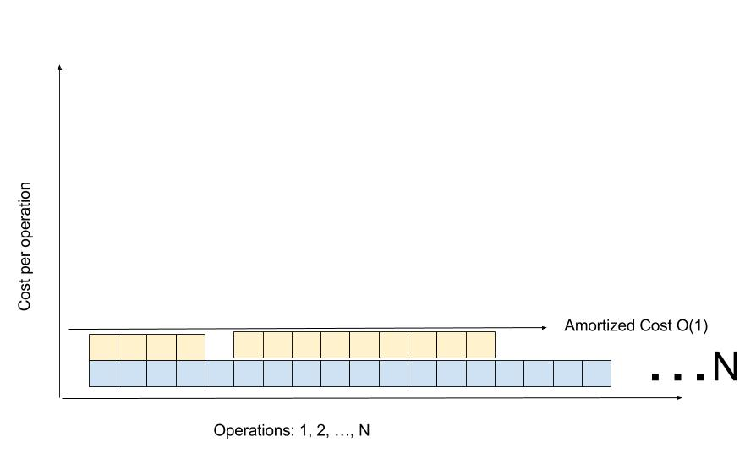
Amortized Runtime Intuition
Consider implementing a Stack with an Array. What if we had initially 5 empty slots, and every time it gets full, we add an additional size * 2 slots and have to copy over all the old data? What is the amortized runtime for the add(element) operation?

Slide 21
“Building Up Credit” Intuition
Can think of preceding “cheap” operations as building up “credit” that can be used to “pay for” later “expensive” operations
Because any sequence of operations must be under the bound, enough “cheap” operations must come first
Else a prefix of the sequence, which is also a sequence, would violate the bound

Slide 22
Amortized Runtime Complexity
If a sequence of M operations takes O(M f(n)) time,
we say the amortized runtime is O(f(n))
Amortized bound: worst-case guarantee over sequences of operations
Example: If any n operations take O(n), then amortized O(1)
Example: If any n operations take O(n³), then amortized O(n²)
The worst case time per operation can be larger than f(n)
As long as the worst case is always “rare enough” in any sequence of operations
Amortized guarantee ensures the average time per operation for any sequence is O(f(n))

Slide 23
Example #1: Resizing stack
A stack implemented with an array where we double the size of the array if it becomes full
Claim: Any sequence of push/pop/isEmpty is amortized O(1)
Need to show any sequence of M operations takes time O(M)
Recall the non-resizing work is O(M) (i.e., M*O(1))
The resizing work is proportional to the total number of element copies we do for the resizing
So it suffices to show that:
After M operations, we have done < 2M total element copies
(So average number of copies per operation is bounded by a constant)

Slide 24
Amount of copying
After M operations, we have done < 2M total element copies
Let n be the size of the array after M operations
Then we have done a total of:
n/2 + n/4 + n/8 + … INITIAL_SIZE < n
element copies
Because we must have done at least enough push operations to cause resizing up to size n:
M ≥ n/2
So
2M ≥ n > number of element copies

Slide 25
Other approaches
If array grows by a constant amount (say 1000),
operations are not amortized O(1)
After O(M) operations, you may have done Θ(M²) copies
If array doubles when full and shrinks when 1/2 empty,
operations are not amortized O(1)
Terrible case: pop once and shrink, push once and grow, pop once and shrink, …
If array doubles when full and shrinks when 3/4 empty,
it is amortized O(1)
Proof is more complicated, but basic idea remains: by the time an expensive operation occurs, many cheap ones occurred

Slide 26
Example #2: Queue with two stacks
A clever and simple queue implementation using only stacks
class Queue<E> {
Stack<E> in = new Stack<E>();
Stack<E> out = new Stack<E>();
void enqueue(E x){ in.push(x); }
E dequeue(){
if(out.isEmpty()) {
while(!in.isEmpty()) {
out.push(in.pop());
}
}
return out.pop();
}
}
enqueue: A, B, C
C
B
A
in
out

Slide 27
Example #2: Queue with two stacks
A clever and simple queue implementation using only stacks
class Queue<E> {
Stack<E> in = new Stack<E>();
Stack<E> out = new Stack<E>();
void enqueue(E x){ in.push(x); }
E dequeue(){
if(out.isEmpty()) {
while(!in.isEmpty()) {
out.push(in.pop());
}
}
return out.pop();
}
}
dequeue
A
B
C
in
out

Slide 28
Example #2: Queue with two stacks
A clever and simple queue implementation using only stacks
class Queue<E> {
Stack<E> in = new Stack<E>();
Stack<E> out = new Stack<E>();
void enqueue(E x){ in.push(x); }
E dequeue(){
if(out.isEmpty()) {
while(!in.isEmpty()) {
out.push(in.pop());
}
}
return out.pop();
}
}
enqueue D, E
A
E
D
B
C
in
out

Slide 29
Example #2: Queue with two stacks
A clever and simple queue implementation using only stacks
class Queue<E> {
Stack<E> in = new Stack<E>();
Stack<E> out = new Stack<E>();
void enqueue(E x){ in.push(x); }
E dequeue(){
if(out.isEmpty()) {
while(!in.isEmpty()) {
out.push(in.pop());
}
}
return out.pop();
}
}
dequeue twice
C B A
E
D
in
out

Slide 30
Example #2: Queue with two stacks
A clever and simple queue implementation using only stacks
class Queue<E> {
Stack<E> in = new Stack<E>();
Stack<E> out = new Stack<E>();
void enqueue(E x){ in.push(x); }
E dequeue(){
if(out.isEmpty()) {
while(!in.isEmpty()) {
out.push(in.pop());
}
}
return out.pop();
}
}
dequeue again
D C B A
E
in
out

Slide 31
Correctness and usefulness
If x is enqueued before y, then x will be popped from in later than y and therefore popped from out sooner than y
So it is a queue
Example:
Wouldn’t it be nice to have a queue of t-shirts to wear instead of a stack (like in your dresser)?
So have two stacks
in: stack of t-shirts go after you wash them
out: stack of t-shirts to wear
if out is empty, reverse in into out

Slide 32
Analysis
dequeue is not O(1) worst-case because out might be empty and in may have lots of items
But if the stack operations are (amortized) O(1), then any sequence of queue operations is amortized O(1)
The total amount of work done per element is 1 push onto in, 1 pop off of in, 1 push onto out, 1 pop off of out
When you reverse n elements, there were n earlier O(1) enqueue operations to average with

Slide 33
Amortized useful?
When the average per operation is all we care about (i.e., sum over all operations), amortized is perfectly fine
This is the usual situation
If we need every operation to finish quickly (e.g., in a web server), amortized bounds may be too weak
While amortized analysis is about averages, we are averaging cost-per-operation on worst-case input
Contrast: Average-case analysis is about averages across possible inputs. Example: if all initial permutations of an array are equally likely, then quicksort is O(n log n) on average even though on some inputs it is O(n²))

Slide 34
Not always so simple
Proofs for amortized bounds can be much more complicated
Example: Splay trees are dictionaries with amortized O(log n) operations
See Chapter 4.5 if curious
For more complicated examples, the proofs need much more sophisticated invariants and “potential functions” to describe how earlier cheap operations build up “energy” or “money” to “pay for” later expensive operations
See Chapter 11 if curious

