Slide 1
Instructor: Lilian de Greef Quarter: Summer 2017
CSE 373: Data Structures and Algorithms
Lecture 21: Finish Sorting, P vs NP

Slide 2
Today
Announcements
Finish up sorting
Radix Sort
Final comments on sorting
Complexity Theory: P =? NP

Slide 3
Announcements
Final Exam:
Next week
During usual lecture time (10:50am - 11:50am)
Cumulative (so all material we’ve covered in class is fair game)
... but with emphasis on material covered after the midterm
Date?

Slide 4
The Big Picture
Surprising amount of juicy computer science: 2-3 lectures…
Simple
algorithms:
O(n²)
Fancier
algorithms:
O(n log n)
Comparison
lower bound:
Ω(n log n)
Specialized
algorithms:
O(n)
Handling
huge data
sets
Insertion sort
Selection sort
Shell sort
…
Heap sort
Merge sort
Quick sort (avg)
…
Bucket sort
Radix sort
External
sorting
How???
Change the model – assume
more than “compare(a,b)”

Slide 5
Radix sort
Radix = “the base of a number system”
Examples will use 10 because we are used to that
In implementations use larger numbers
For example, for ASCII strings, might use 128
Idea:
Bucket sort on one digit at a time
Number of buckets = radix
Starting with least significant digit
Keeping sort stable
Do one pass per digit
Invariant: After k passes (digits), the last k digits are sorted
Aside: Origins go back to the 1890 U.S. census

Slide 6
Radix Sort: Example
First pass: bucket sort by one’s digit
0 | 1 | 2 | 3 | 4 | 5 | 6 | 7 | 8 | 9
Input:
478
537
9
721
3
38
143
67
Output:
Second pass: stable bucket sort by ten’s digit
0 | 1 | 2 | 3 | 4 | 5 | 6 | 7 | 8 | 9
Third pass: stable bucket sort by hundred’s digit
0 | 1 | 2 | 3 | 4 | 5 | 6 | 7 | 8 | 9

Slide 7
(extra space for scratch work / notes)

Slide 8
Analysis
Input size: n
Number of buckets = Radix: B
Number of passes = “Digits”: P
Work per pass is 1 bucket sort:
Total work is
Compared to comparison sorts, sometimes a win, but often not
Example: Strings of English letters up to length 15
Run-time proportional to: 15*(52 + n)
This is less than n log n only if n > 33,000
Of course, cross-over point depends on constant factors of the implementations
And radix sort can have poor locality properties

Slide 9
Comments on Sorting Algorithms

Slide 10
Sorting massive data
Need sorting algorithms that minimize disk/tape access time:
Quicksort and Heapsort both jump all over the array, leading to random disk accesses
Merge sort scans linearly through arrays, leading to (relatively) sequential disk access
Merge sort is the basis of massive sorting
Merge sort can leverage multiple disks
Notes:
Don’t have to spend a lot of time gettign into details. Point out mergesort has seq reading of a data which is good for spatial locality.

Slide 11
External Merge Sort
Sort 900 MB using 100 MB RAM
Read 100 MB of data into memory
Sort using conventional method (e.g. quicksort)
Write sorted 100MB to temp file
Repeat until all data in sorted chunks (900/100 = 9 total)
Read first 10 MB of each sorted chuck, merge into remaining 10 MB
writing and reading as necessary
Single merge pass instead of log n
Additional pass helpful if data much larger than memory
Parallelism and better hardware can improve performance
Distribution sorts (similar to bucket sort) are also used

Slide 12
Wrap-up on Sorting
Simple O(n²) sorts can be fastest for small n
Insertion sort (latter linear for mostly-sorted)
Good “below a cut-off” for divide-and-conquer sorts
O(n log n) sorts
Heap sort, in-place, not stable, not parallelizable
Merge sort, not in place but stable and works as external sort
Quick sort, in place, not stable and O(n²) in worst-case
Often fastest, but depends on costs of comparisons/copies
Ω (n log n) is worst-case and average lower-bound for sorting by comparisons
Non-comparison sorts
Bucket sort good for small number of possible key values
Radix sort uses fewer buckets and more phases
Best way to sort?

Slide 13
Source: https://xkcd.com/1185/

Slide 14
Complexity Theory: P vs NP
Just a small taste of Complexity Theory

Slide 15
“Easy” Problems for the Computer
Sorting a list of n numbers
Multiplying two n x n matrices
3 5 2 7
1 6 8 9
2 4 6 10
9 3 2 12
1 5 5 4
5 12 8 6
7 6 1 5
9 23 5 8
=
n
n
n
n
n

Slide 16
“Easy” Problems for the Computer
Shortest Path Algorithm
Minimum Spanning Tree Algorithms
2
2
2
A
B
F
3
H
B
A
1
1
5
10
2
1
1
4
9
3
2
5
E
G
1
2
C
D
D
11
1
1
5
3
E
C
7
2
6
G
10
F
Edsgar Dijkstra

Slide 17
“Hard” Problems for the Computer
The Knapsack Problem
I want to carry as much money’s worth as I can that still fits in my bag! What do I pack?

Slide 18
“Hard” Problems for the Computer
I’ll leave Seattle to sell goods, visiting each city only once, and return to Seattle. What’s the shortest route?
The Traveling Salesperson Problem
Seattle
5058
5217
Berlin
5411
4583
6775
1004
6685
Beijing
3608
Moscow
6356
7325
1533
10 933
2185
3488
São Paulo
7577
Tehran

Slide 19
“Hard” Problems for the Computer
Find a Hamiltonian path (a path that visits each vertex exactly once)
(never mind weights
or even returning to
our starting point!)

Slide 20
Comparing n² vs 2^{n}
The alien’s computer performs 10⁹ operations/sec
 | n = 10 | n = 30 | n = 50 | n = 70
n² | 100 < 1 sec | 900 < 1 sec | 2500 < 1 sec | 4900 < sec
2^{n} | 1024 < 1 sec
n! | 3628800 < 1 sec
10⁹
1 sec
10¹⁵
11.6 days
10²¹
31,688 years
10¹⁶ years
10⁴⁸ years
10⁸³ years
(10⁵ x age of the universe!)

Slide 21
“Easy” vs “Hard” Problems for the Computer
“Polynomial Time” = “Efficient”
Is an algorithm “efficient” with…
O(n)?
O(n²)?
O(n¹⁰)?
O(n log n)?
O(n^{log n})?
O(2^{n})?
O(n!)?

Slide 22
Polynomial Time?
So we know there are polynomial time algorithms to
Sort numbers
Multiply n x n matrices
Find the shortest path in a graph
Find the minimum spanning tree
… and more
But the million dollar question is… are there polynomial time algorithms to solve
The Knapsack Problem?
The Traveling Salesperson Problem?
Finding Hamiltonian Paths?
… and thousands more!

Slide 23
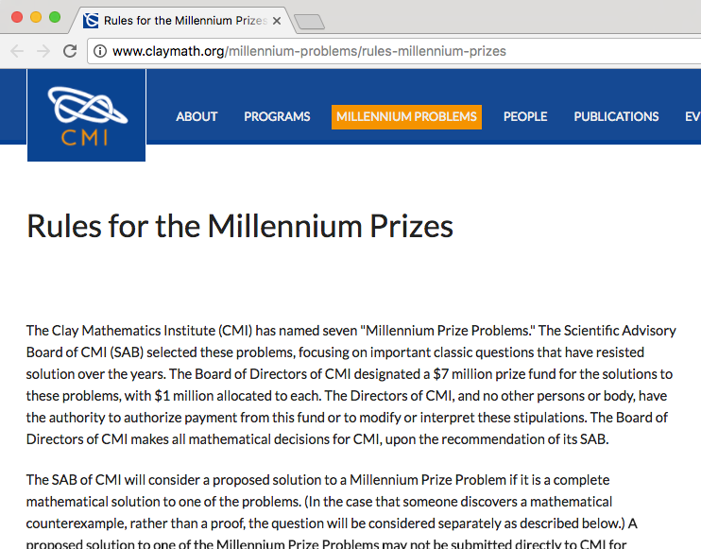
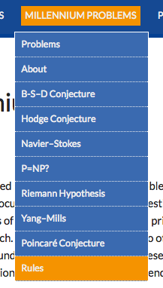

Slide 24
P = NP?
NP (Nondeterministic Polynomial Time)
SAT
Traveling Salesperson
Hamiltonian Path
n x n x n Sudoku
P (Polynomial Time)
Knapsack
Dijkstra’s
sort
search
Prim’s
Kruskal’s
And there are problems even harder than NP!

Slide 25
Relevance of P = NP
NP contains lots of problems we don’t know to be in P
Classroom Scheduling
Packing objects into bins
Scheduling jobs on machines
Finding cheap tours visiting a subset of cities
Finding good packet routings in networks
Decryption ...

Slide 26
With this knowledge, we can avoid saying…
“I can’t find an efficient algorithm. I guess I’m too dumb.”
Cartoon courtesy of “Computers and Intractability: A Guide to the Theory of NP-Completeness” by M. Garey and D. Johnson

Slide 27
But know it isn’t wise to say…
“I can’t find an efficient algorithm because no such algorithm is possible!”
Cartoon courtesy of “Computers and Intractability: A Guide to the Theory of NP-Completeness” by M. Garey and D. Johnson

Slide 28
And, instead, prove it’s in NP to then say…
“I can’t find an efficient algorithm, but neither can all these famous people.”
Cartoon courtesy of “Computers and Intractability: A Guide to the Theory of NP-Completeness” by M. Garey and D. Johnson

Slide 29
Source: https://xkcd.com/287/

Slide 30
Preparing for Final Exam

Slide 31
Final Exam Study Strategies

Slide 32
Practice Problem
Given a value ‘x’ and an array of integers, determine whether two of the numbers add up to ‘x’
Notes:
Questions you should have asked me:
Is the array in any particular order?
Should I consider the case where adding two large numbers could cause an overflow?
Is space a factor, in other words, can I use an additional structure(s)?
Is this method going to be called frequently with different/the same value of ‘x’?
About how many values should I expect to see in the array, or is that unspecified?
Will ‘x’ always be a positive value?
Can I assume the array won’t always be empty, what if its null?

